Slide 1
Define.xml Content Validation – CRF Page Check
Shenglin Zhang, PAREXEL
PharmaSUG China 2016 Paper #77

Slide 2
Contents
Introduction
Define.Xml Content Extraction
Annotated CRF Comments Extraction
Parsing imported Comments With Perl Regular Expression
Macro Invoke
Validation Result
References
@pharmasug

Slide 3
INTRODUCTION

Slide 4
SDTM Submission Package
Content
SAS xpt files(all expected datasets/variables)
define.xml (define.xsl and define.css)
blankcrf.pdf (SDTM annotated CRF)
Supporting documents, e.g., study-data-reviewers-guide.pdf

Slide 5
Importance of Define.xml
A critical component of data submission is the define file. A properly functioning define.xml file is an important part of the submission of standardized electronic datasets and should not be considered optional
An insufficiently documented define file is a common deficiency that reviewers have noted

Slide 6
Origin Field in Define.xml
Indicator of the origin of the variable.
CRF
Derived
eDT
Assigned
Protocol
Hyperlink is provided to display the specific CRF Pages
If the reviewer clicks the hyperlink of a CRF Page, then there should be a annotation in corresponding CRF Page

Slide 7
Validity of Origin Field
All the CRF Page with the same annotation should be listed in the Origin field for that variable in the define.xml
To do this validation manually can be cumbersome and time consuming

Slide 8
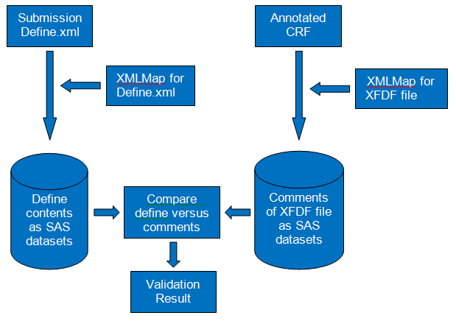
A Programming Way to Check
Notes:
Step 1: Read define.xml into SAS dataset
Step 2: Read annotation of blankcrf.pdf into SAS dataset
CRF page checks between the datasets created in Step 1 and Step 2 and the discrepancies are outputted in a Excel file

Slide 9
XML Mapper
Download SAS XML mapper
http://support.sas.com/downloads/browse.htm?cat=12

Slide 10
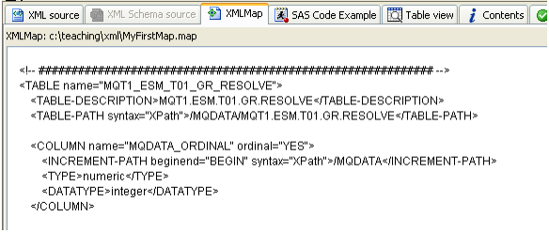
How to Customize a XML Mapper
Wendi L. Wright. 2010. How to Create an XML Map with the XML Mapper. NESUG 2010.

Slide 11
Define.Xml Content Extraction

Slide 12
Syntax for Reading define.xml into SAS Dataset
filename define "./define.xml";
filename defmap "./define2sas.map";
libname define xmlv2 xmlmap=defmap automap=replace access=readonly;
proc copy in=define out=work;
run;

Slide 13
Annotated CRF Comments Extraction

Slide 14
Read Comments in PDF to SAS Dataset
Export Annotation in blankcrf to Data file (XFDF, a xml version of form data in PDF)
Version: Acrobat version 7.0

Slide 15
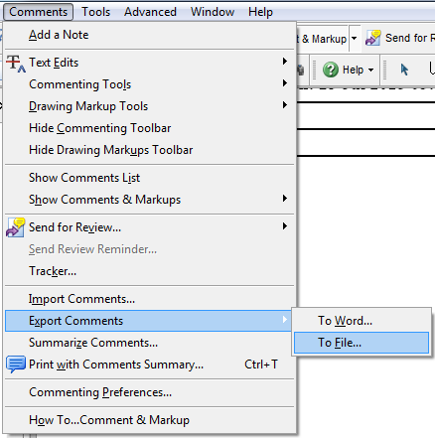
Read Comments in PDF to SAS Dataset
Select “Comments → Export Comments → To File” from the main menu

Slide 16
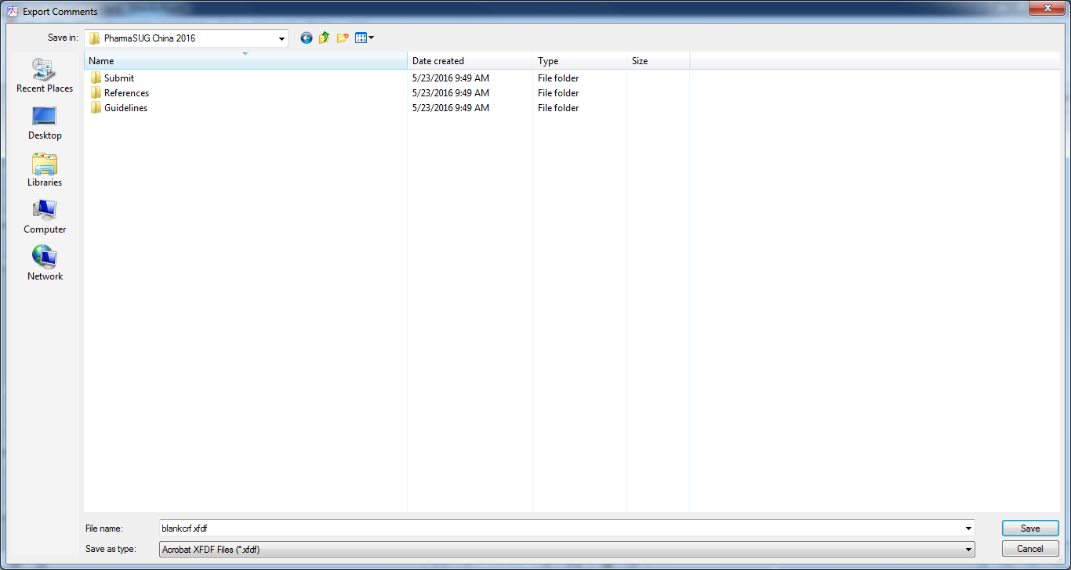
Read Comments in PDF to SAS Dataset
A new box with the title “Export Comments” appears. Save this resulting PDF as XFDF file at your location. Select save as type to be “Acrobat XFDF Files (*.xfdf)”

Slide 17
Syntax for Reading XFDF file into SAS Dataset
Same methodology used to extract define.xml
filename blankcrf "./blankcrf.xfdf";
filename acrfmap "./acrf2sas.map";
libname blankcrf xmlv2 xmlmap=acrfmap automap=replace access=readonly;
proc copy in=blankcrf out=work;
run;

Slide 18
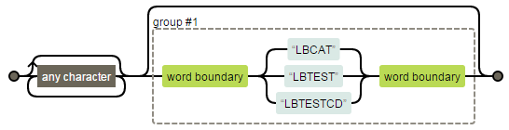
Parsing Imported Comments With Perl Regular Expression
PRXCHANGE Function:
prxchange("s/.*?(\b(?:LBCAT|LBTEST|LBTESTCD)\b)?/\1 /o", -1, cats(COMMENTS));
Regular expression visualization:
Notes:
The “.” matches any single character except newline. The “*?” is lazy repetition factor, matches 0 or more occurrences of the preceding character as few times as possible. The first “(“and “)” characters matches a pattern and creates a capture buffer for the match. The last “?” is greedy repetition factor, matches the first capturing group zero or one time as many times as possible. The “\b” matches a word boundary. Since we want to mention “\b” only once, so the second “(“and “)”characters are needed. The “(?:…)” means non-capturing group, the “?:” is not necessary in this example. Since there is no memory required for the second catch (?:), it may work faster. The “\1” matches capture buffer 1.

Slide 19
Macro Invoke
Parameter | Description
DEFCRFPATH | Path where define.xml to be validated and annotated CRF are located
XMLMAPPATH | Path where XMLMap is located
OUTPATH | Path where check result is located
Using example:
%ChkDefCrfPage(defcrfpath = &demo_path
, xmlmappath = &demo_path
, outpath = &demo_path
);

Slide 20
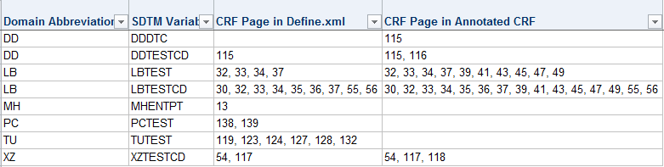
Validation Result
Notes:
The first row indicates that a variable DDDTC is annotated on page 115 of blankcrf.pdf, however, the CRF page number of variable in define.xml is missing, therefore the origin of variable in define.xml does not indicate that this variable came from page 115. The fifth row shows that define.xml defines the variable MHENTPT is annotated on page 13 of blankcrf.pdf, however, page 13 of the blankcrf.pdf is missing the annotation.

Slide 21
Reference
Jeff Xia, Sangeetha Mahalingam. “Cross Check between Define.xml and blankcrf.pdf”. NJ CDISC User Group Meeting 2014.
FDA CDER, 2011. “Common Data Standards Issue Document.”
Prafulla Girase, Robert Agostinelli. “Automating Validation of Define.xml using SAS”. PharmaSUG 2013.
Wendi L. Wright. 2010. “How to Create an XML Map with the XML Mapper”. NESUG 2010.
Joel Campbell, Ryan Wilkins. “Importing and Parsing Comments From a PDF Document With Help From Perl Regular Expressions”. PharmaSUG 2011.

Slide 22
Name: Shenglin Zhang
Organization: PAREXEL International
Address: 20F, Taiping Finance Tower, No. 488, Middle YinCheng Road, Pudong
City, State ZIP: Shanghai, 200120
Work Phone: +86 21-51118092
Fax: +86 21 61609196
E-mail: Shenglin.Zhang@PAREXLE.com
Web: http://www.parexel.com/

Slide 23
Thanks!
Any questions?

