Slide 1
No LEAD Function? Let's Create It!
Xianhua Zeng, Elixir Clinical Research, Shanghai, China
In data analysis and statistical modeling, there are situations where the ability to access next observations (look-ahead) for specific variables is essential for making comparisons and calculations. Unfortunately, SAS does not provide a built-in LEAD function for this purpose. This paper presents a custom macro-based methodology to create a LEAD function using the PROC FCMP procedure. To access LEAD values in various scenarios, a versatile macro called "GetLeadValue" is also introduced. It supports obtaining lead values based on a specific by-group in dataset.

Slide 2
No LEAD Function? Let's Create It!
Xianhua Zeng, Elixir Clinical Research, Shanghai, China
Data analysis frequently involves the need to access future observations for specific variables, a task typically accomplished using a LEAD function. However, SAS lacks a built-in LEAD function, which can be a significant limitation for SAS users. This paper addresses this gap by presenting a custom macrobased approach to create a LEAD function using the PROC FCMP procedure. We also introduce a versatile macro ‘GetLeadValue’, which can be used to access LEAD values in various scenarios.

Slide 3
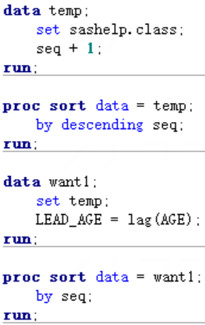
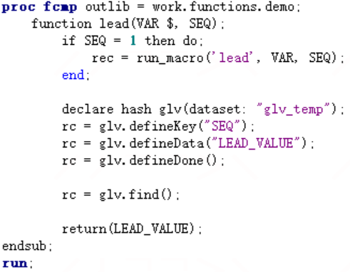
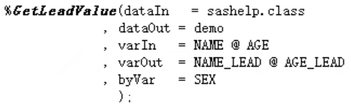
No LEAD Function? Let's Create It!
Xianhua Zeng, Elixir Clinical Research, Shanghai, China
Method 1
Method 2
Method 3

Slide 4
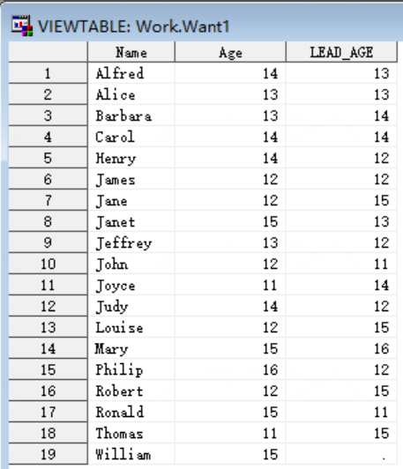
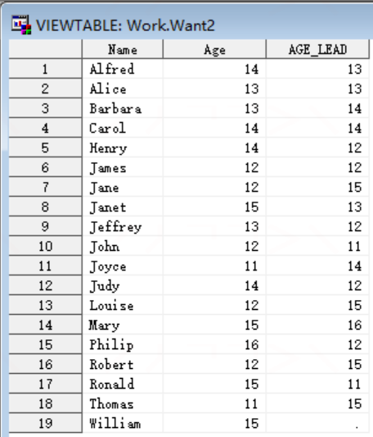
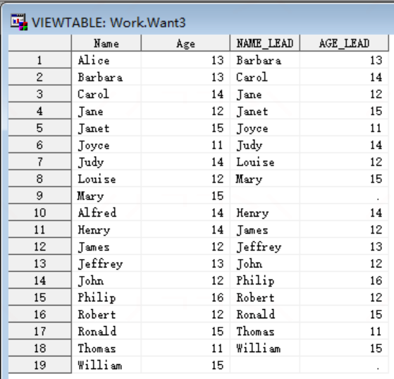
No LEAD Function? Let's Create It!
Xianhua Zeng, Elixir Clinical Research, Shanghai, China
Result 1
Result 2
Result 3

Slide 5
No LEAD Function? Let's Create It!
Xianhua Zeng, Elixir Clinical Research, Shanghai, China
Creating a custom LEAD function in SAS using PROC FCMP fills a critical gap in situations where the built-in LEAD function is not available. Additionally, the "GetLeadValue" macro supports obtaining LEAD values based on specific groups or by-group variables, expanding the utility of the custom LEAD function.
The FCMP Procedure. Available at https://support.sas.com/documentation/onlinedoc/base/91/fcmp.pdf

