Slide 1
Order system based on Android
user
administrator
User management
consumer
merchant
Authority management
Sign in/sign up
Order management
Look over
System maintenance
Browse recipes
Recipes management
Add ,delete ,change, check
Sites settings
Search
advertisement management
Data backup
collect
Advertisement management
review
Operation log

Slide 2
recipes
Food specification
contains
Description
Price
Item name
Used by
describes
restaurant
stocks
item
Address
name
Consumer
user
merchant
contains
contains
check
administrator
check

Slide 3
order
Sign in
Check order
Human services
consumer
Sign up
Personal information
collect
Browse recipes
review

Slide 4
Add recipes
Recipe management
Change recipes
Make order
Order process
Order confirm
merchant
Order management
Order check
Review users assessment
Store management
Check report
Restaurant information

Slide 5
Operation log
Data backup
Platform management
platform basic information settings
advertisement
Consumer management
administrator
User management
Check merchant information
Merchant management
Merchant operation
Check push information
Push management
Push information

Slide 6
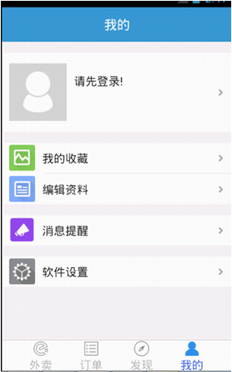
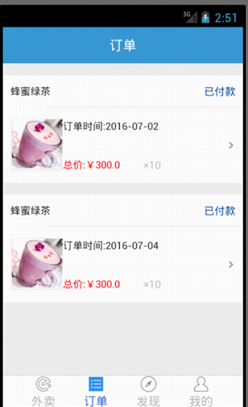
User Interface Design

Slide 7
