Slide 1
Probe simulation: principles and setup
Xiantao Cheng

Slide 2
Index
Introduction: problem of simulating probes in PIC
Basics of probe simulation:
logic of simulation
equations of simulation
benefits of simulation
Details of Finite-Difference Time-Domain(FDTD):
Examples of FDTD
Future works

Slide 3
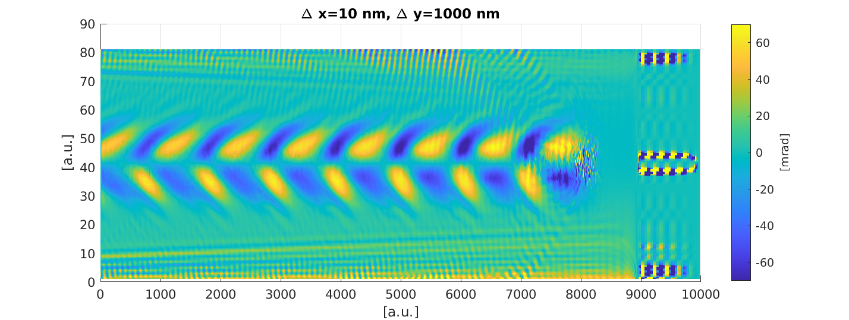
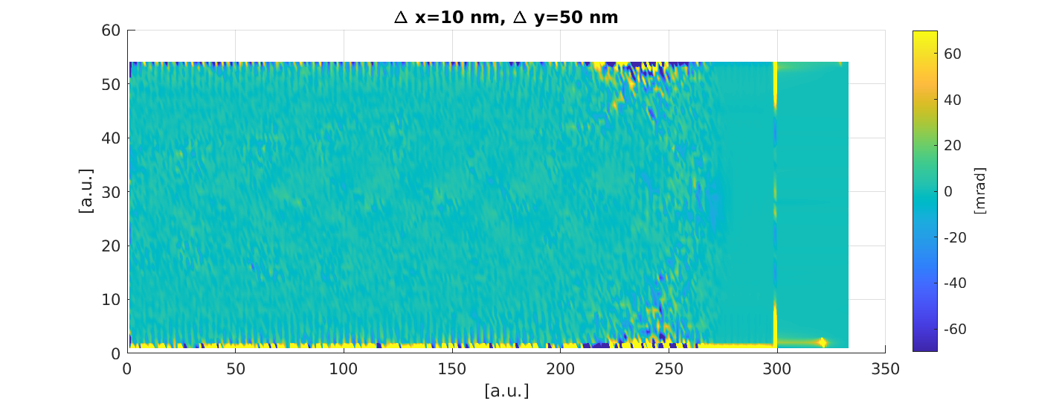
Problem of simulating probes in PIC
Accurate simulations of optical probes in PIC simulations require high density grids, which will raise the computation cost rapidly and can make simulation become impossible to run.

Slide 4
Probe simulation: logic
Fields
Fields
Pusher
FDTD
FDTD
Flow equations
Particles
Current
Currents
Projector

Slide 5

Probe simulation: equation
Flow equations:
Perturbation flow equations:
Traditional plasma fluid simulation breaks in bubble regime. Because flow equations are nonlinear equations. You can't describe multiple fluids crossing a same spot by single-fluid equations. But perturbation flow equations are linear.

Slide 6
Probe simulation: benefits
Loose PIC grid and dense probe grid
Moving PIC grid and static probe grid
3D PIC grid and 2D probe grid

Slide 7
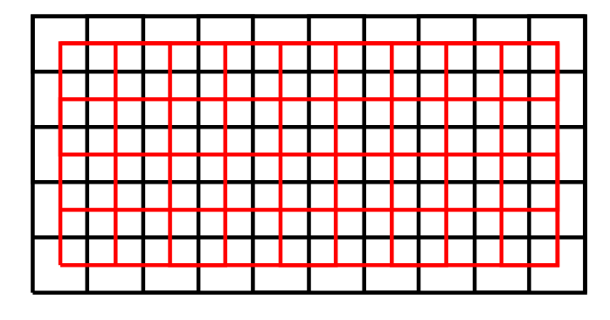

FDTD: basics
E-fields and B-fields are using different grids
Only 2nd and 4th equations of Maxwell’s equations are used

Slide 8
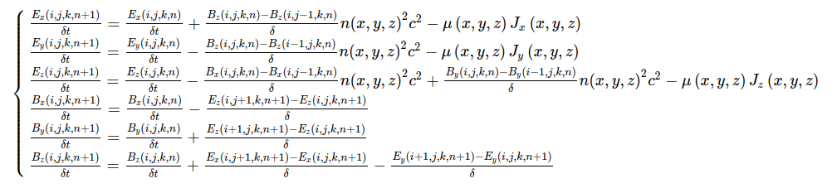
FDTD: Yee's solver
2D grid:

Slide 9
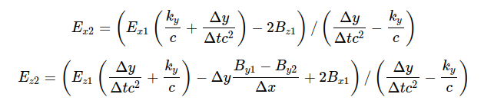
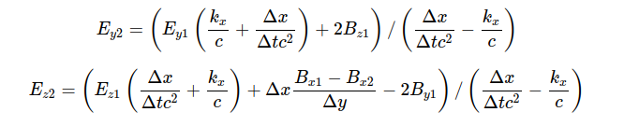
FDTD: Silver-Muller boundary condition
2D grids:
x_min and x_max
y_min and y_max

Slide 10


FDTD: laser injection and moving window
Laser injection:
Moving window:
The implementation of moving window might be very difficult, if you need to deal with openMP or MPI or particle injections. For example, it takes 553 lines in Smilei to accomplish this function.

Slide 11
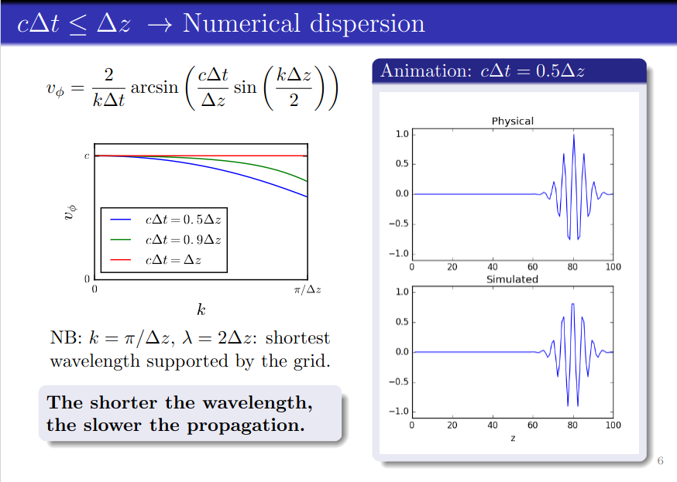
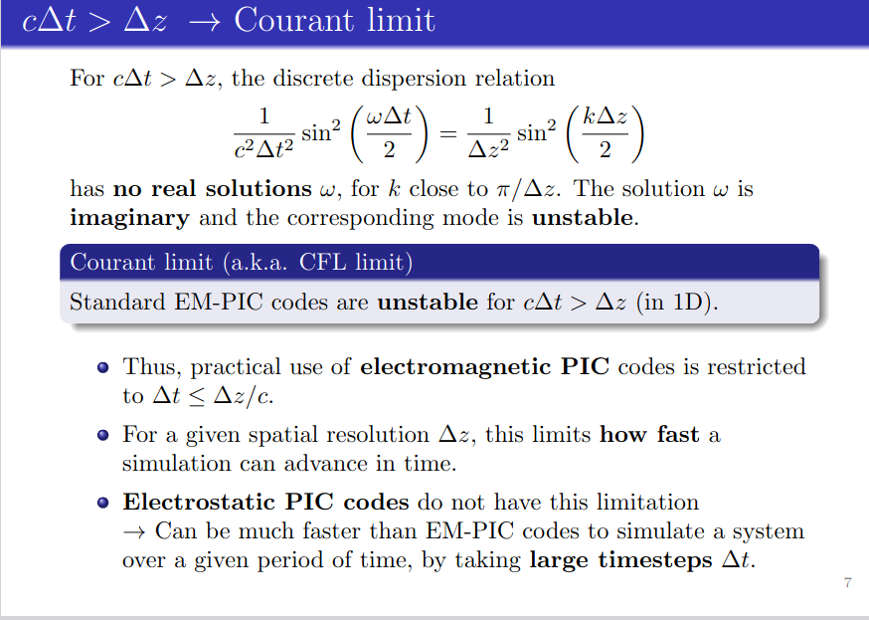
FDTD: errors

Slide 12
Examples

Slide 13
Future works
Test Faraday rotation and Cotton-Mouton effects
Test inverse Faraday rotation effects
Compare longitudinal and transverse probes with equivalent PIC simulations
Error analysis

