Slide 1
Introduction to Optical Thomson Scattering Diagnostics
程先涛

Slide 2
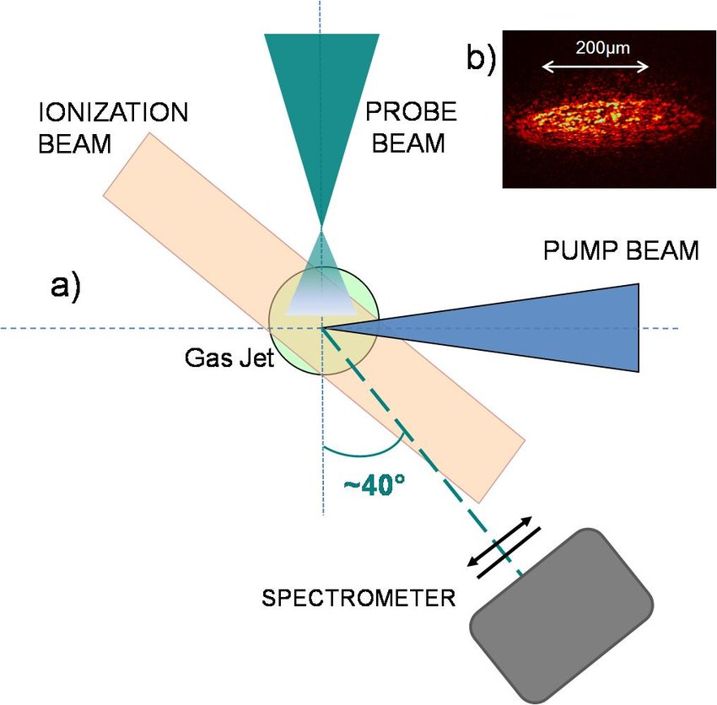
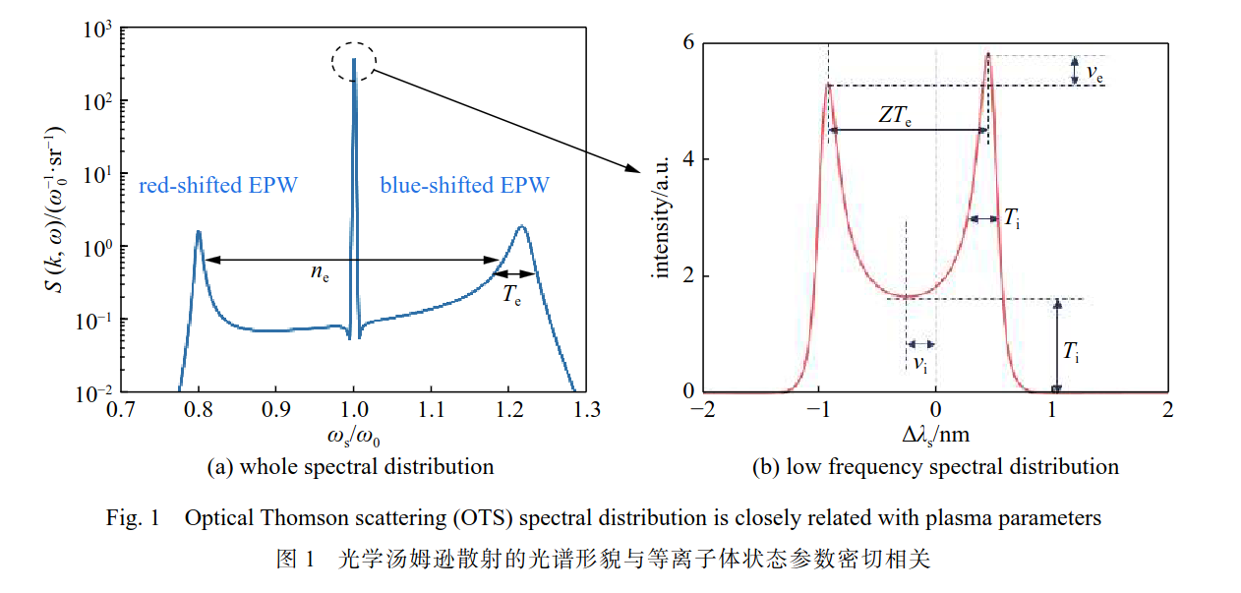
Setup and ideal spectrum
1

Slide 3
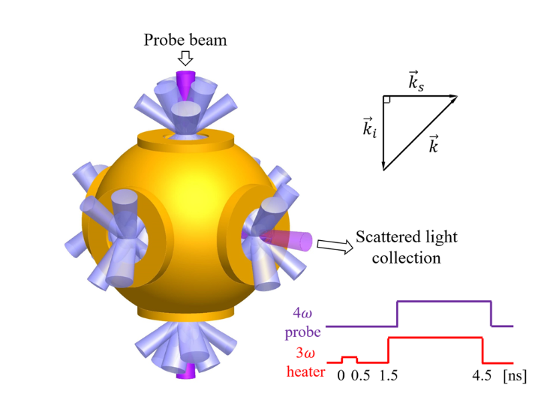
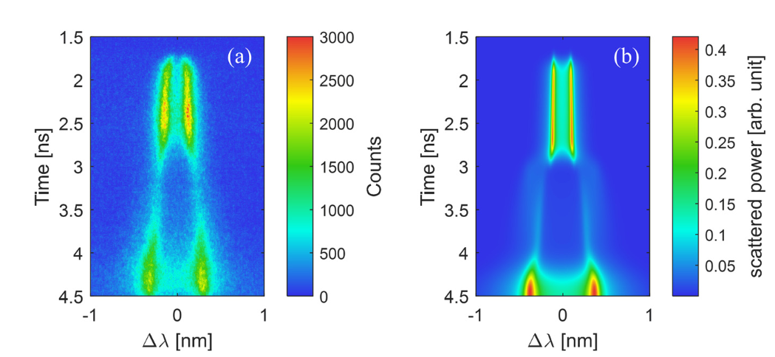
OTS experiments on Shenguang-III
2

Slide 4







Method of calculating OTS spectrum
OTS spectrum of collisionless plasmas:
Electric susceptibility:
Maxwell distributions:
3

Slide 5







OTS theory: spectrum
4

Slide 6
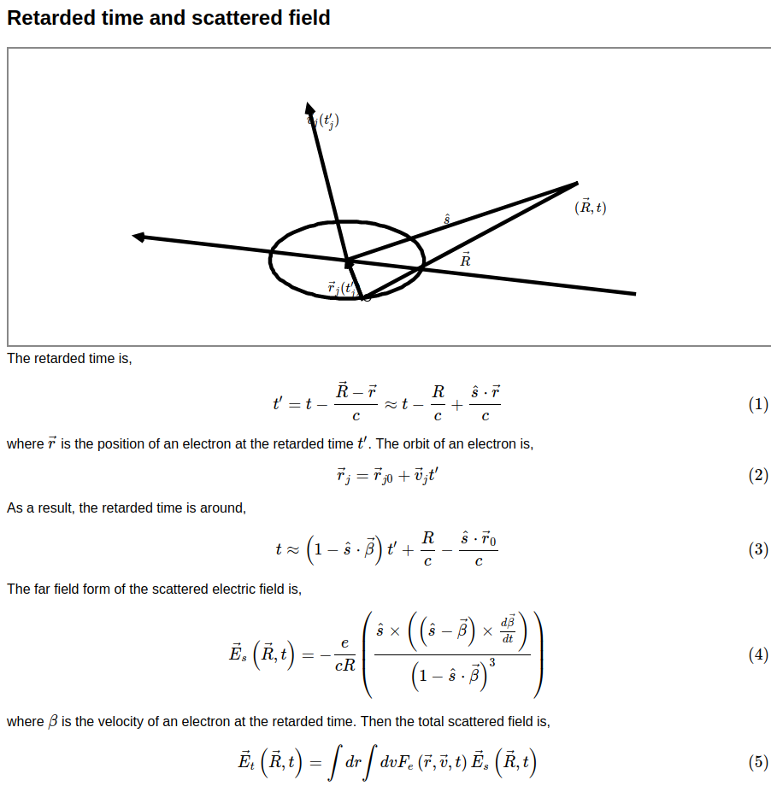
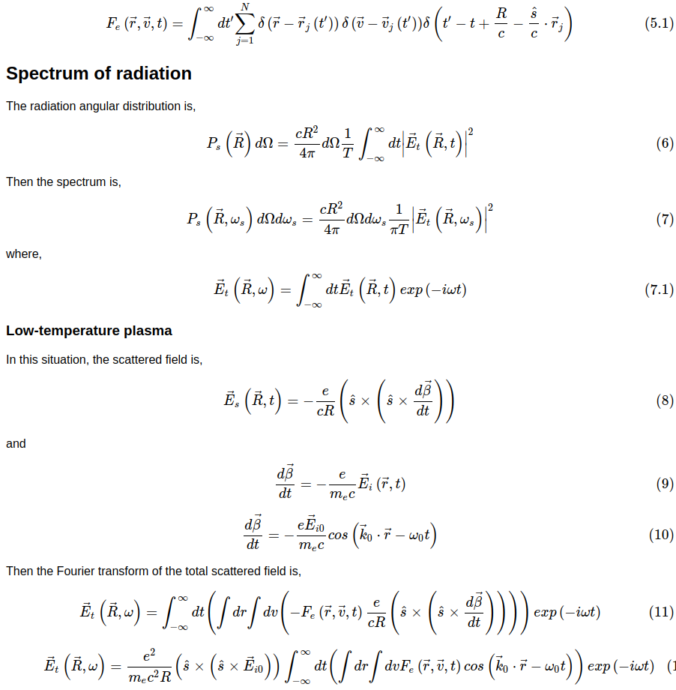
OTS theory: spectrum

Slide 7
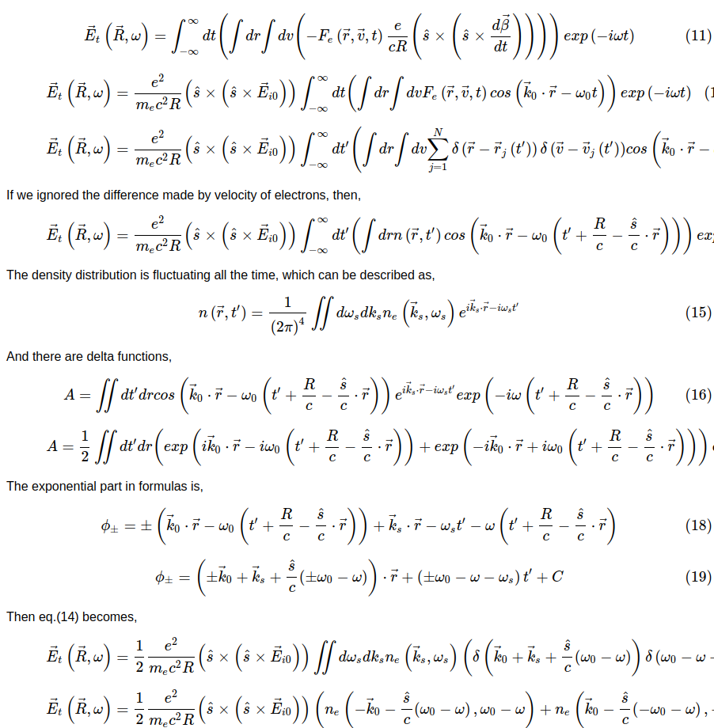
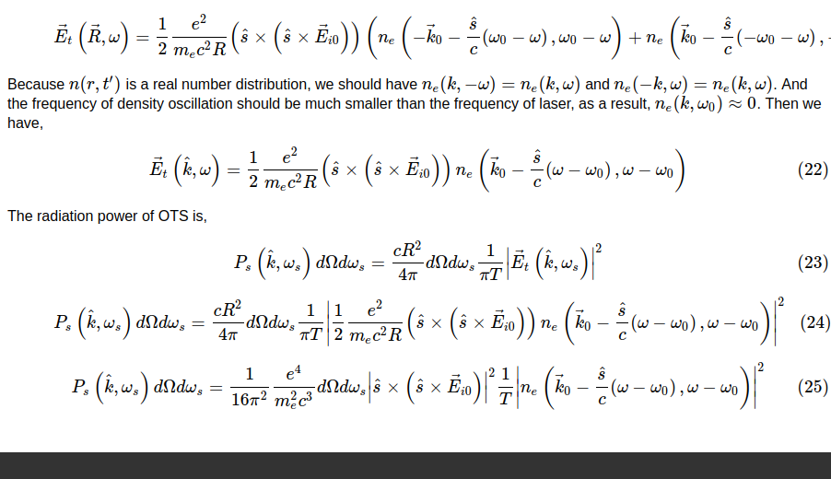
OTS theory: spectrum

Slide 8



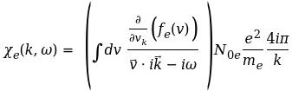
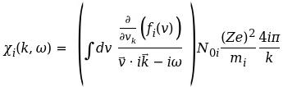

OTS theory: ne(k,w)
-
-
-
-
+
+
+
5

Slide 9
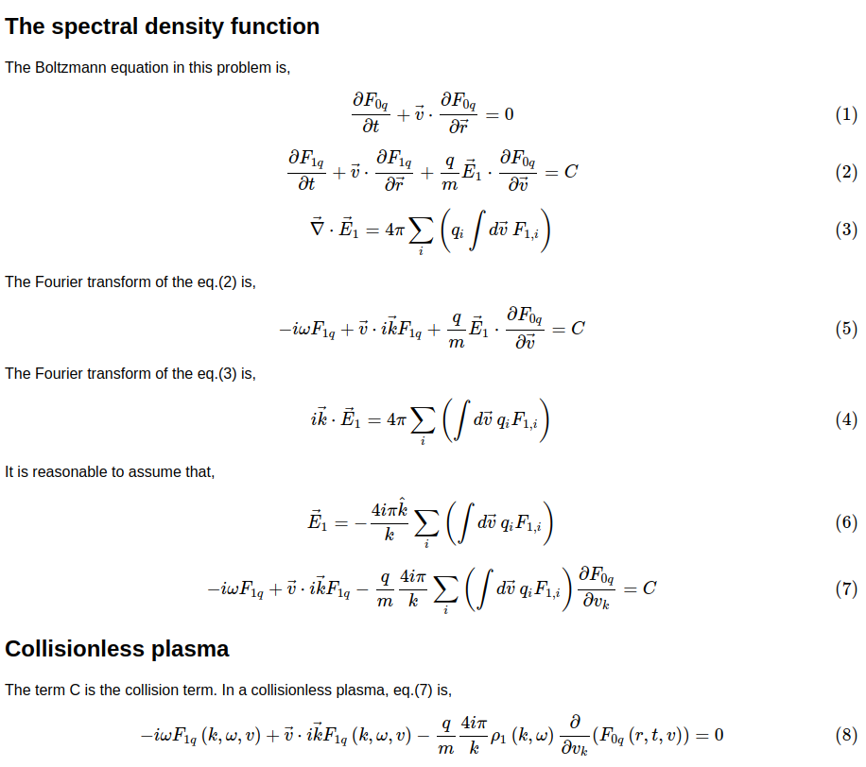
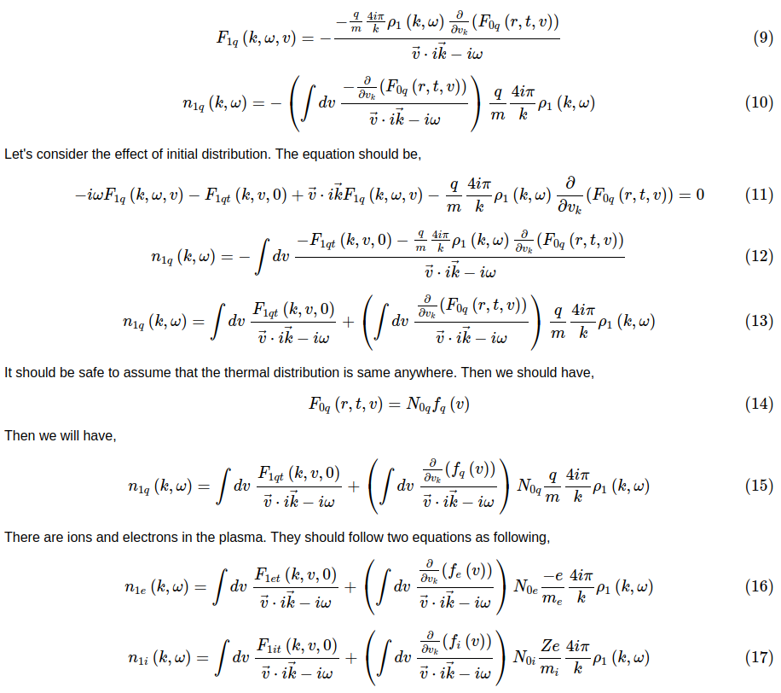
OTS theory: ne(k,w)
5

Slide 10
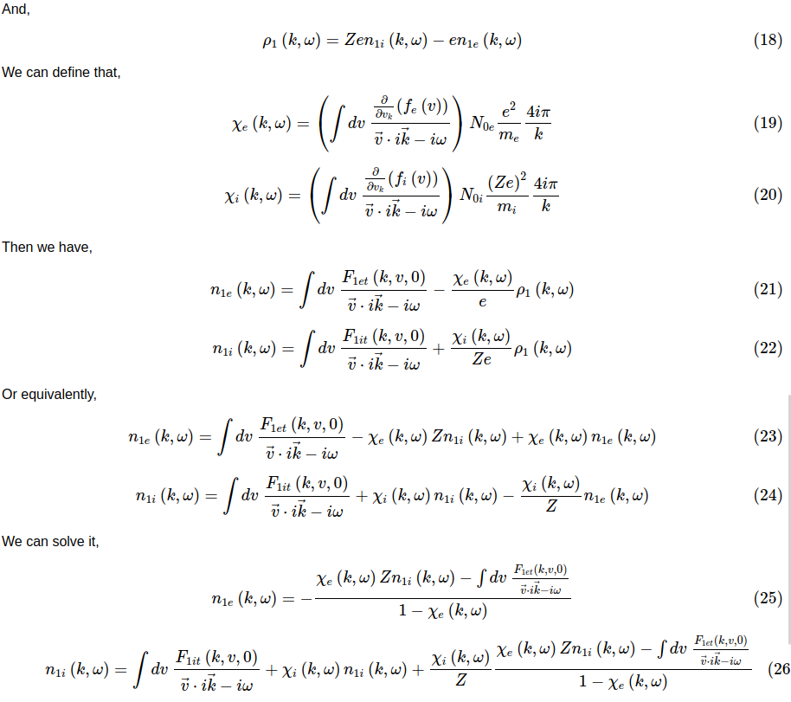
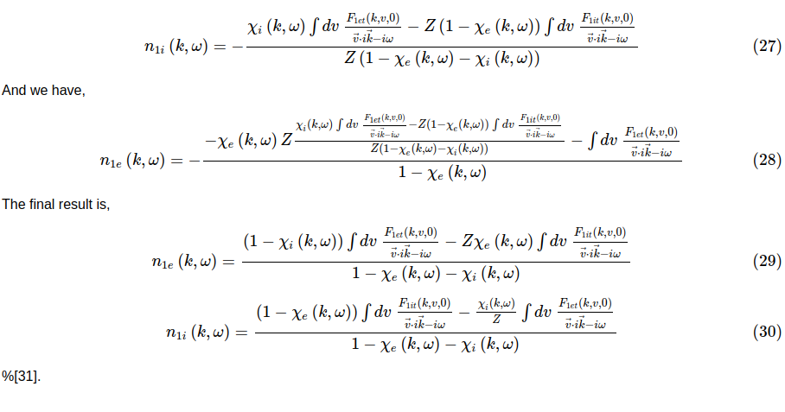
OTS theory: ne(k,w)
5

Slide 11
Method of calculating OTS spectrum
OTS spectrum of collisionless plasmas:
Electric susceptibility:
Maxwell distributions:
3

Slide 12
OTS spectrum of arbitrary distributions
Electric susceptibility:
Electric susceptibility:
Maxwell distributions:
3

Slide 13
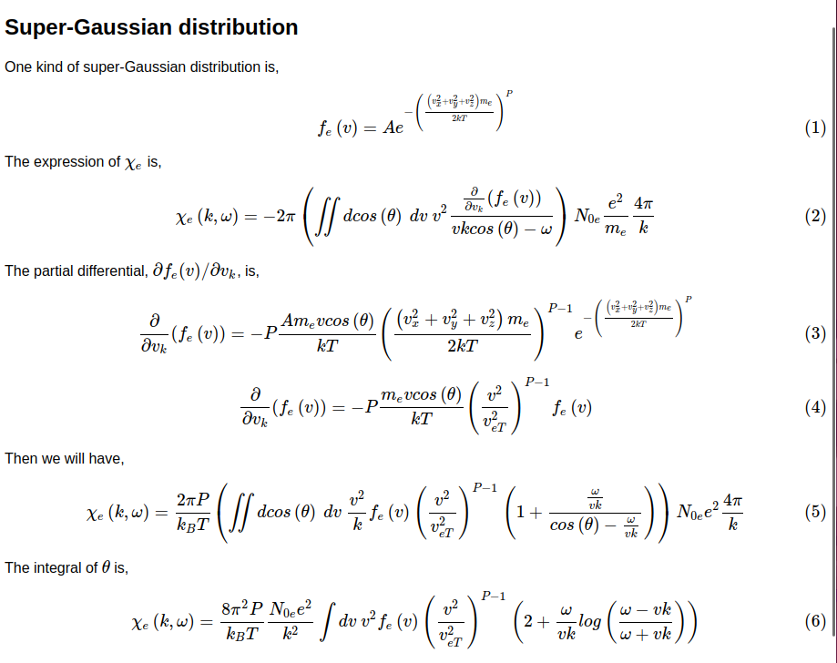
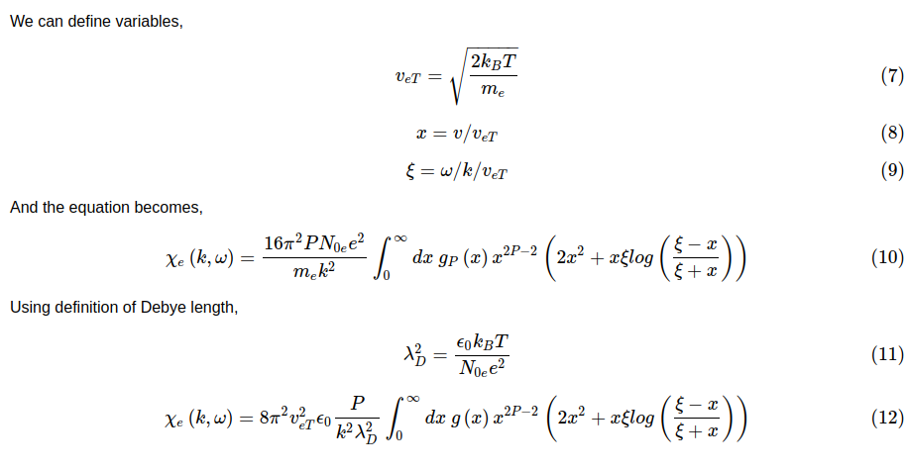
Example: super-Gaussian distribution
3

Slide 14


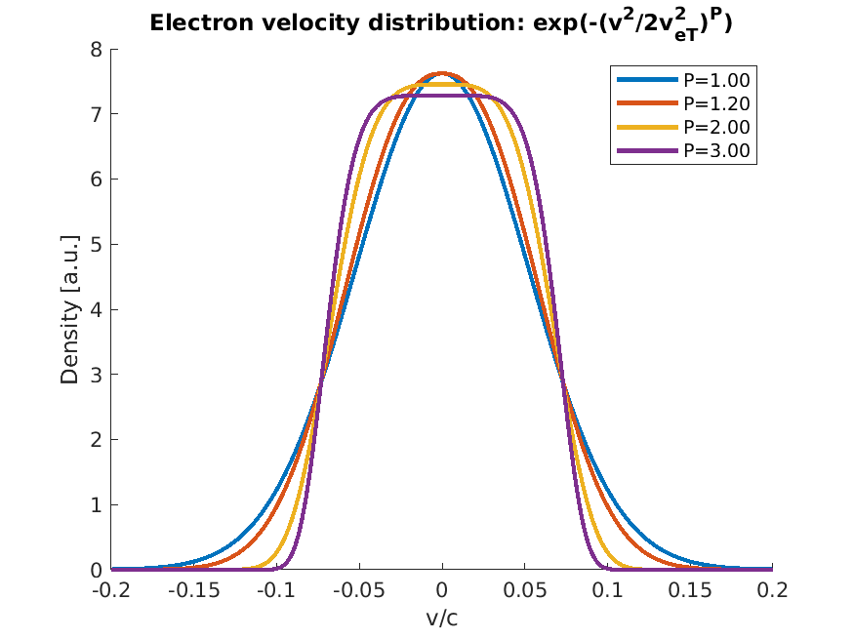
Example: super-Gaussian distribution
Electric susceptibility:
super-Gaussian distributions:
3

Slide 15
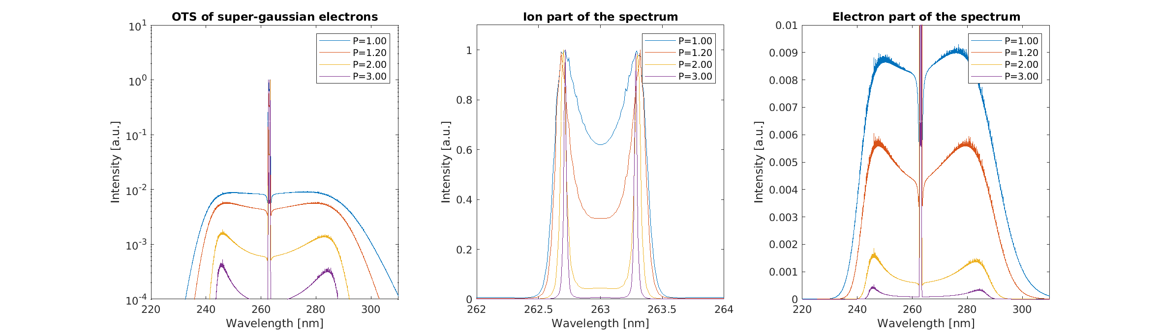
Example: super-Gaussian distribution
Electric susceptibility:
super-Gaussian distributions:
3

Slide 16

Example: Maxwell distribution
Electric susceptibility:
Electric susceptibility:
Maxwell distributions:
Maxwell distributions:
3

Slide 17
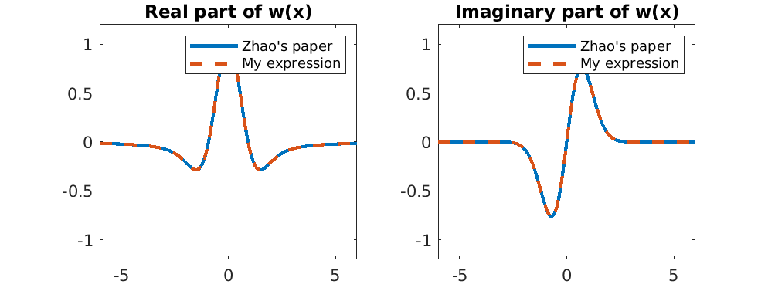
Example: Maxwell distribution
7

