Slide 1

Surface magnetic field
程先涛

Slide 2

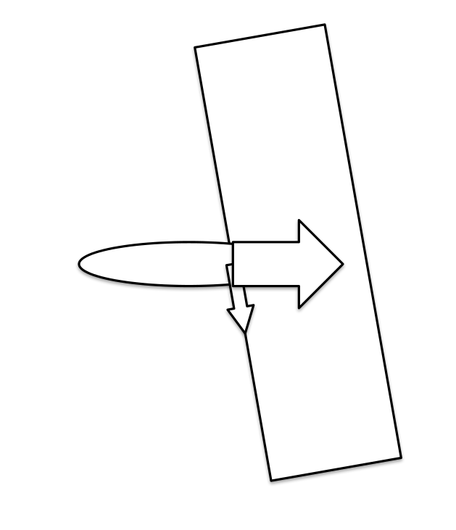
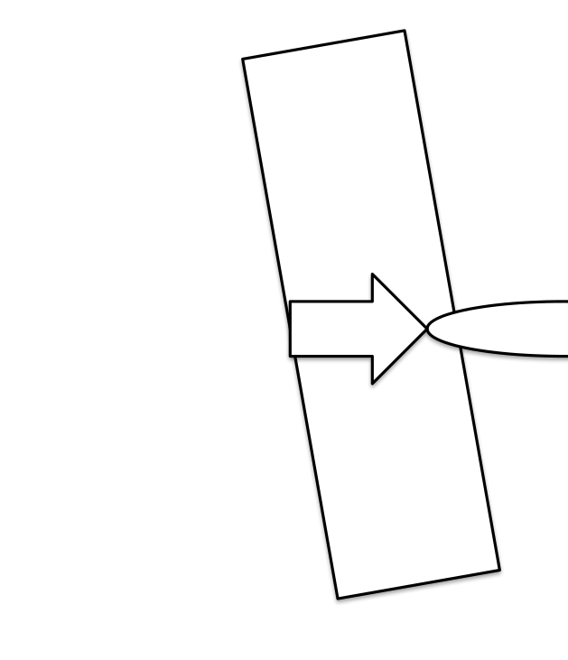
Currents and magneta
1

Slide 3
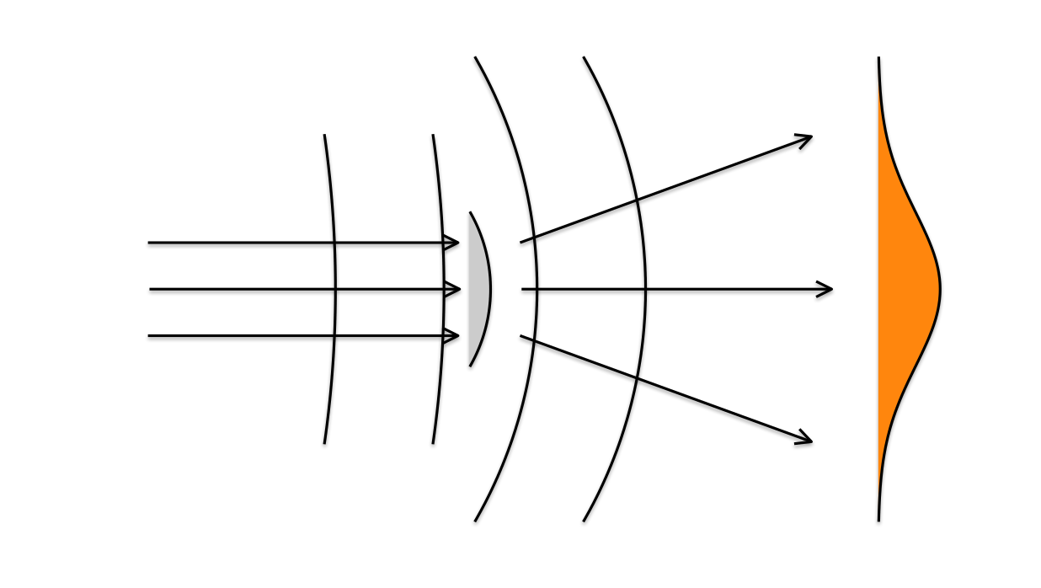
Fourier optics
2

Slide 4
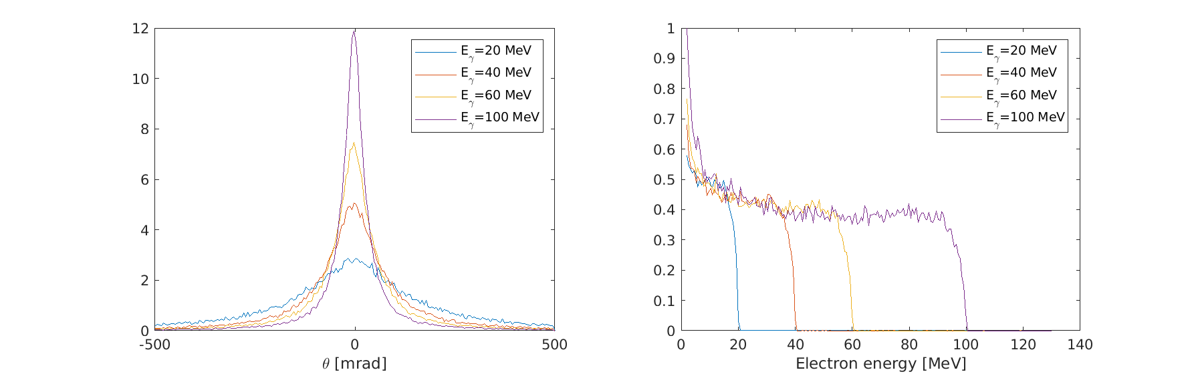
Xray stimulated electrons
3

Slide 5


