Slide 1




Observation Pre-processor for WRFDA
Hui-Chuan Lin Yong-Run Guo
NCAR/NESL/MMM
WRFDA tutorial
July 2013

Slide 2
What types of observations?
Where to download observations?
What does WRFDA’s OBSPROC (OBServation PROCessor) do?
How to run OBSPROC?
Formats!

Slide 3
WRFDA-3DVar Cost Function
J(x): Scalar cost function
x: The analysis
x_{b}: Background field
B: Background error covariance matrix
y: Observations
H: Observation operator
R: Observation error covariance matrix
y and R are discussed in this presentation

Slide 4
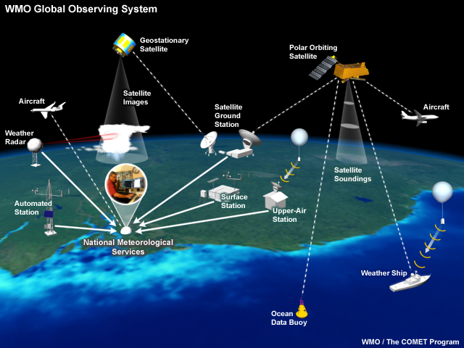

Slide 5
WRFDA can assimilate …
In-Situ conventional observations:
Surface (SYNOP, METAR, SHIP, BUOY)
Upper air (TEMP, PIBAL, AIREP, ACARS, AMDAR, TAMDAR)
Remotely sensed observations:
Atmospheric Motion Vectors (geo/polar) (SATOB)
SATEM thickness
Ground-based GPS Total Precipitable Water/Zenith Total Delay (GPSPW/GPSZD)
SSM/I oceanic surface wind speed and TPW
Scatterometer oceanic surface winds (QSCAT)
Wind profiler (PROFL)
Radar radial velocities and reflectivity
Satellite temperature/humidity/thickness profiles (AIRSR)
GPS refractivity (GPSRF/GPSEP)
Stage IV precipitation data/rain rate (only in 4DVAR mode)
Radiances (using RTTOV or CRTM):
HIRS NOAA-16, NOAA-17, NOAA-18, NOAA-19, METOP-A
AMSU-A NOAA-15, NOAA-16, NOAA-18, NOAA-19, EOS-Aqua, METOP-A
AMSU-B NOAA-15, NOAA-16, NOAA-17
MHS NOAA-18, NOAA-19, METOP-A
AIRS EOS-Aqua
SSMIS DMSP-16, DMSP-17, DMSP-18
IASI METOP-A
ATMS Suomi-NPP
MWTS FY-3
MWHS FY-3
Bogus data
TC bogus
Global bogus
QuikSCAT/SeaWinds – ended on November 23, 2009
ASCAT (METOP-A)
ASCAT (METOP-B)
ASCAT (EARS)
OSCAT (Oceansat-2)
WindSAT

Slide 6
WRFDA can read in …
Observations in little_r format
OBSPROC
stage IV precipitation
radiance
ob.bufr
gpsro.bufr
ob.ascii
amsua.bufr
amsub.bufr
mhs.bufr
airs.bufr
atms.bufr
iasi.bufr
hirs4.bufr
ob.radar
ob01.rain
ob02.rain
(see 4DVAR talk)
ob_format=1
ob_format=2
WRFDA

Slide 7
ob.radar
In simple ASCII format
Header record for Radar site information (site, lat0, lon0, elv etc)
Header record for observation location (FM-128 RADAR, date, lat, lon, elv, levs)
Data-level record (height<m>, Radial_V<m/s>, qc, err, Reflectivity<dbz>, qc, err)
Preprocessing Doppler radar data is an important procedure before assimilation
Quality control
de-aliasing (folded velocity)
removal of clutters, second-trip echo, anomalously propagated clutter, and other noises
Mapping
Interpolation, smoothing, super-obing, data filling
Error statistics
Variance and covariance
However, there is no standard software included in WRFDA
Contact Juanzhen (Jenny) Sun (sunj@ucar.edu) for collaboration
Check out the last radar presentation in August 2010
http://www.mmm.ucar.edu/wrf/users/wrfda/Tutorials/2010_Aug/docs/WRFDA_radar.pdf

Slide 8
ob.bufr
gpsro.bufr
radiance
bufr files
NCEP real-time data
ftp://ftp.ncep.noaa.gov/pub/data/nccf/com/gfs/prod
NOAA National Operational Model Archive and Distribution System (NOMADS) archive
http://nomads.ncep.noaa.gov/pub/data/nccf/com/gfs/prod/
http://nomads.ncdc.noaa.gov/data/gdas
NCAR CISL archive
http://rda.ucar.edu/datasets/ds337.0 – for conventional data
http://rda.ucar.edu/datasets/ds735.0 – for radiance data
NCAR HPSS personal archive
/LIUZ/GDAS/yyyymm/yyyymmddhh

Slide 9
Files to look for
gdas1.thhz.1bamua.tm00.bufr_d
gdas1.thhz.1bamub.tm00.bufr_d
gdas1.thhz.1bhrs3.tm00.bufr_d
gdas1.thhz.1bhrs4.tm00.bufr_d
gdas1.thhz.1bmhs.tm00.bufr_d
gdas1.thhz.airsev.tm00.bufr_d
gdas1.thhz.atms.tm00.bufr_d
gdas1.thhz.gpsro.tm00.bufr_d
gdas1.thhz.mtiasi.tm00.bufr_d
gdas1.thhz.prepbufr.nr
gdas1.thhz.prepbufr.unblok.nr (unblocked version of gdas1.thhz.prepbufr.nr)
hh is the analysis time 00/06/12/18
ob.bufr
gpsro.bufr
amsua.bufr
amsub.bufr
mhs.bufr
airs.bufr
atms.bufr
iasi.bufr
hirs4.bufr
About NCEP BUFR format
http://www.nco.ncep.noaa.gov/sib/decoders/BUFRLIB
http://www.nco.ncep.noaa.gov/sib/decoders/BUFRLIB/toc/prepbufr
Notes on using BUFR in WRFDA
http://www.mmm.ucar.edu/wrf/users/wrfda/Docs/readBufr.htm
Notes on using PREPBUFR in WRFDA
https://wiki.ucar.edu/display/~hclin/prepbufr2wrfvar

Slide 10
Observations in little_r format
NCAR archived observations in little_r format on HPSS:
/BRESCH/RT/DATA/yyyymm/obs.yyyymmddhh.gz
Radiosondes: TTAA, TTBB, PPBB, etc.
Surface obs: SYNOPS, METARS, AWS, ships, buoys, CMAN
Profiler
Sat winds: GOES, METSAT, MODIS, AVHRR
Satem
Aircraft: PIREPS, AIREPS, AMDAR, ACARS
Dropsondes and "hurricane hunter" obs
Quikscat
Ground-based GPS PW
COSMIC GPS refractivity
OBSPROC
ob.ascii
WRFDA
Check out the notes about the data
http://www.mmm.ucar.edu/individual/bresch/data

Slide 11
Other data sources that require additional converters
GPS refractivity
http://cdaac-www.cosmic.ucar.edu/cdaac/products.html
AIRS Retrieval
ftp://airspar1u.ecs.nasa.gov/ftp/data/s4pa/Aqua_AIRS_Level2/AIRX2RET.006
Scatterometer surface winds
http://www.knmi.nl/scatterometer
Stage IV precipitation
http://data.eol.ucar.edu/codiac/dss/id=21.093

Slide 12
What is little_r format?
A format used by MM5/Little_r objective analysis program, a successor of RAWINS
Little_r format is also used by WRF/OBSGRID objective analysis program
What does OBSPROC do?
Ingest multiple types of observations that are converted to little_r format and concatenated to one file, process the observation data and output the ASCII file(s) suitable for WRFDA needs − 3DVAR, FGAT (First Guess at Appropriate Time), 4DVAR
What is in ob.ascii (output of OBSPROC/input to WRFDA)?

Slide 13
obs_gts_yyyy-mm-dd_hh:00:00.3DVAR (ob.ascii)
TOTAL = 29596, MISS. =-888888.,
SYNOP = 463, METAR = 156, SHIP = 25, BUOY = 54, BOGUS = 0, TEMP = 31,
AMDAR = 501, AIREP = 78, TAMDAR= 0, PILOT = 31, SATEM = 0, SATOB = 9318,
GPSPW = 0, GPSZD = 0, GPSRF = 49, GPSEP = 0, SSMT1 = 0, SSMT2 = 0,
TOVS = 0, QSCAT = 18890, PROFL = 0, AIRSR = 0, OTHER = 0,
PHIC = -87.40, XLONC = 180.00, TRUE1 = -71.00, TRUE2 = -91.00, XIM11 = 1.00, XJM11 = 1.00,
base_temp= 268.00, base_lapse= 50.00, PTOP = 1000., base_pres=100000., base_tropo_pres= 20000., base_strat_temp= 215.,
IXC = 217, JXC = 165, IPROJ = 2, IDD = 1, MAXNES= 1,
NESTIX= 217,
NESTJX= 165,
NUMC = 1,
DIS = 60.00,
NESTI = 1,
NESTJ = 1,
INFO = PLATFORM, DATE, NAME, LEVELS, LATITUDE, LONGITUDE, ELEVATION, ID.
SRFC = SLP, PW (DATA,QC,ERROR).
EACH = PRES, SPEED, DIR, HEIGHT, TEMP, DEW PT, HUMID (DATA,QC,ERROR)*LEVELS.
INFO_FMT = (A12,1X,A19,1X,A40,1X,I6,3(F12.3,11X),6X,A40)
SRFC_FMT = (F12.3,I4,F7.2,F12.3,I4,F7.3)
EACH_FMT = (3(F12.3,I4,F7.2),11X,3(F12.3,I4,F7.2),11X,3(F12.3,I4,F7.2))
#------------------------------------------------------------------------------#
FM-18 BUOY 2008-10-31_21:00:00 Platform Id >>> 55956 1 -41.973 -166.164 0.000 55956
101090.000 0 200.00 -888888.000 -88 0.200
101090.000 0 100.00 -888888.000 -88 1.40 -888888.000 -88 5.00 0.000 0 6.00 -888888.000 -88 2.00 -888888.000 -88 2.00 -888888.000 -88 10.00
FM-35 TEMP 2008-10-31_21:00:00 CHATHAM ISLAND / NEW ZEALAND 19 -43.950 -176.560 48.000 93986
-888888.000 -88 200.00 -888888.000 -88 0.200
100400.000 0 100.00 7.202 0 1.40 330.000 0 5.00 48.000 0 7.00 284.348 1 1.80 279.848 1 1.80 73.609 1 10.00
100000.000 0 100.00 -888888.000 -88 1.40 -888888.000 -88 5.00 83.000 0 7.00 284.024 -10 1.80 279.024 -10 1.80 71.046 -10 10.00
99800.000 0 99.82 -888888.000 -88 1.41 -888888.000 -88 5.00 100.000 3 7.01 283.861 1 1.80 277.861 1 1.80 66.222 1 10.00
92700.000 0 93.36 -888888.000 -88 1.64 -888888.000 -88 5.00 707.000 3 7.21 277.935 1 1.69 275.935 1 1.69 86.823 1 10.00
92500.000 0 93.18 -888888.000 -88 1.65 -888888.000 -88 5.00 724.000 0 7.22 277.763 1 1.69 275.563 1 1.69 85.579 1 10.00
91400.000 0 92.17 -888888.000 -88 1.69 -888888.000 -88 5.00 822.000 3 7.25 277.150 0 1.67 272.250 0 1.67 70.338 0 10.00
90300.000 0 91.17 -888888.000 -88 1.72 -888888.000 -88 5.00 920.000 3 7.29 277.750 0 1.66 258.750 0 1.66 23.873 0 10.00
85000.000 0 86.35 -888888.000 -88 1.90 -888888.000 -88 5.00 1410.000 0 7.46 275.750 0 1.57 263.750 0 1.57 40.903 0 10.00
84600.000 0 85.99 -888888.000 -88 1.91 -888888.000 -88 5.00 1449.000 3 7.47 275.350 0 1.57 263.350 0 1.57 40.794 0 10.00
78300.000 0 80.25 -888888.000 -88 2.12 -888888.000 -88 5.00 2072.000 3 7.69 273.550 0 1.46 249.550 0 1.46 14.884 0 10.00
70000.000 0 72.70 -888888.000 -88 2.40 -888888.000 -88 5.00 2964.000 0 8.00 270.050 0 1.30 256.050 0 1.30 33.387 0 10.00
69000.000 0 71.79 -888888.000 -88 2.42 -888888.000 -88 5.00 3078.000 3 8.03 269.450 0 1.30 256.450 0 1.30 36.084 0 10.00
65700.000 0 68.79 -888888.000 -88 2.49 -888888.000 -88 5.00 3463.000 3 8.11 267.250 0 1.30 247.250 0 1.30 19.399 0 10.00
64000.000 0 67.24 -888888.000 -88 2.52 -888888.000 -88 5.00 3669.000 3 8.16 267.450 0 1.30 228.450 0 1.30 3.148 0 10.00
57700.000 0 61.51 -888888.000 -88 2.65 -888888.000 -88 5.00 4471.000 3 8.34 261.850 0 1.30 247.850 0 1.30 31.074 0 10.00
56400.000 0 60.32 -888888.000 -88 2.67 -888888.000 -88 5.00 4646.000 3 8.39 262.050 0 1.30 239.050 0 1.30 13.679 0 10.00
50100.000 0 54.59 -888888.000 -88 2.80 -888888.000 -88 5.00 5545.000 3 8.60 256.650 0 1.30 241.650 0 1.30 26.971 0 10.00
50000.000 0 54.50 -888888.000 -88 2.80 -888888.000 -88 5.00 5560.000 0 8.60 256.650 0 1.30 -888888.000 -11 1.30 -888888.000 -11 10.00
49700.000 0 54.23 -888888.000 -88 2.81 -888888.000 -88 5.00 5606.000 3 8.72 256.650 0 1.31 -888888.000 -11 1.31 -888888.000 -11 10.00
ob numbers
Header
domain information
skipped in WRFDA reading code
Data format

Slide 14
Platform ID for each observation type
Name | WMO code | WMO code name
SYNOP | 12, 14 | SYNOP, SYNOP MOBIL
SHIP | 13, 17 | SHIP
METAR | 15, 16 | METAR, SPECI
PILOT | 32, 33, 34 | PILOT, PILOT SHIP, PILOT MOBIL
TEMP | 35, 36, 37, 38 | TEMP, TEMP SHIP, TEMP DROP, TEMP MOBIL
AMDAR | 42 | AMDAR
SATEM | 86 | SATEM
SATOB | 88 | SATOB
AIREP | 96, 97 | AIREP
TAMDAR | 101 | TAMDAR
GPSPW | 111 | GPSPW (Ground-based GPS precipitable water)
GPSZD | 114 | GPSZD (Ground-based GPS Zenith Total Delay)
GPSRF | 116 | GPSRF (Space-based GPS Refractivity)
PROFL | 132 | WIND PROFILER
AIRSR | 133 | AIRSRET
BOGUS | 135 | TCBOU (Typhoon bogus), BOGUS (other bogus)
QSCAT | 281 | Quik SCAT level-2B SeaWind
WRFDA combines AMDAR and AIREP as AIREP
WRFDA seperates SATOB as geoamv and polaramv
made-up code
In WRFDA, each observation type is identified by its platform ID

Slide 15
Quality flags assigned by obsproc
missing_data = -88, ! Data is missing with the value of missing_r outside_of_domain = -77, ! Data outside horizontal domain or time window, data
! set to missing_r wrong_direction = -15, ! Wind vector direction <0 or> 360 => direction set to ! missing_r negative_spd = -14, ! Wind vector norm is negative => norm set to missing_r zero_spd = -13, ! Wind vector norm is zero => norm set to missing_r wrong_wind_data = -12, ! Spike in wind profile =>direction and norm set to
! missing_r zero_t_td = -11, ! t or td = 0 => t or td, rh and qv are set to missing_r
t_fail_supa_inver = -10, ! super-adiabatic temperature wrong_t_sign = - 9, ! Spike in Temperature profile above_model_lid = - 8, ! heigh above model lid => no action far_below_model_surface = - 7, ! heigh far below model surface => no action below_model_surface = - 6, ! height below model surface => no action standard_atmosphere = - 5, ! Missing h, p or t =>Datum interpolated from standard
! atmosphere from_background = - 4, ! Missing h, p or t =>Datum interpolated from model fails_error_max = - 3, ! Datum Fails error max check => no action fails_buddy_check = - 2, ! Datum Fails buddy check => no action no_buddies = - 1, ! Datum has no buddies => no action good_quality = 0, ! OBS datum has good quality convective_adjustment = 1, ! convective adjustment check =>apply correction on t,
! td, rh and qv surface_correction = 2, ! Surface datum => apply correction on datum Hydrostatic_recover = 3, ! Height from hydrostatic assumption with the OBS data
! calibration Reference_OBS_recover = 4, ! Height from reference state with OBS data calibration Other_check = 88 ! passed other quality check
data with quality flags >= 0 will be used in WRFDA

Slide 16
INFO = PLATFORM, DATE, NAME, LEVELS, LATITUDE, LONGITUDE, ELEVATION, ID.
SRFC = SLP, PW (DATA,QC,ERROR).
EACH = PRES, SPEED, DIR, HEIGHT, TEMP, DEW PT, HUMID (DATA,QC,ERROR)*LEVELS.
variables in ob.ascii
wind speed
wind direction
sea level pressure
pressure
height
temperature
dew point temperature
relative humidity
total precipitable water
GPS refractivity
SATEM thickness
state variables in WRFDA
x-component wind u (relative to model grid)
y-component wind v (relative to model grid)
temperature
specific humidity
surface pressure
pressure

Slide 17
What does OBSPROC do?
domain and time checks
sort and merge duplicate reports
assign observation errors
gross check
vertical consistency check and adiabatic check
data completeness check
assign quality flags
thinning for SATOB and QSCAT
model meteorological fields are not used in OBSPROC

Slide 18
What does OBSPROC do?
time window check
Observations within the specified time window (time_window_min and time_window_max) will be kept.
domain check
For regional application (domain_check_h = .TRUE.), with IPROJ = 1 (Lambert conformal), 2 (Polar Stereographic), or 3 (Mercator), there is geographic-filtered dump performed based on the model domain settings.
For the global application of WRFDA, set IPROJ = 0 and no geographic-filtering is performed.
Time and domain checks are also done in WRFDA

Slide 19
What does OBSPROC do?
gross check
Check for unreasonable and non-logical mistakes in the raw observation reports
ignore the report with invalid/unknown platform ID
any reported values in header record > 888887 or < -888887 or pressure%data <= 0.0, etc., will be regarded as missing (-888888)
elevations for SHIP and BUOY data outside the Great Lakes are always set to zero. If the pressure < 850 hPa for SHIP and BUOY, the reports are tossed
gross pressure/height consistency check based on the reference atmosphere defined by namelist variables: base_pres, base_temp, base_lapse
if both pressure and height are missing, the whole report is discarded
other check…

Slide 20
What does OBSPROC do?
sort and merge duplicate reports
retrieve the pressure or height based on the observed information with the hydrostatic assumption.
re-order (from bottom to top) and merge the reports with the same platform, time, and location based on the pressure
remove duplicate reports of observations:
for 3DVAR and FGAT, observations (at the same locations) nearest to the analysis time are kept
for 4DVAR, the observations nearest to the central time of each of the time slots are kept.

Slide 21
What does OBSPROC do?
assign observation errors
according to observation types and observed variables
Sources of the observations errors:
Directly from the observation reports (GPS PW/ZTD, QSCAT, etc.)
US Air Force Weather Agency (AFWA) OBS error table: obserr.txt
The AFWA OBS errors for each type of observations are written out in different formats after running obsproc:
WIND.txt, TEMP.txt, RH.txt, PRES.txt, HEIGHT.txt

Slide 22
obserr.txt
0.5 0.5 0.5 0.5 0.5 BOGUS TEMP SENSOR ERRORS
0.5 0.5 0.5 0.5 0.5 :
0.5 0.5 0.5 0.5 0.5 :
0.0 0.0 0.0 0.0 0.0 NU
0.0 0.0 0.0 0.0 0.0 :
0.0 0.0 0.0 0.0 0.0 :
0.0 0.0 0.0 0.0 0.0 NU
0.0 0.0 0.0 0.0 0.0 :
0.0 0.0 0.0 0.0 0.0 :
0.0 0.0 0.0 0.0 0.0 NU
0.0 0.0 0.0 0.0 0.0 :
0.0 0.0 0.0 0.0 0.0 :
1.0 1.0 1.0 1.0 1.0 RAOBS
1.0 1.0 1.0 1.0 1.0 :
1.0 1.0 1.0 1.0 1.0 :
1.0 1.0 1.0 1.0 1.0 PIBALS
1.0 1.0 1.0 1.0 1.0 :
1.0 1.0 1.0 1.0 1.0 :
0.0 0.0 0.0 0.0 0.0 NU
0.0 0.0 0.0 0.0 0.0 :
0.0 0.0 0.0 0.0 0.0 :
0.0 0.0 0.0 0.0 0.0 NU
0.0 0.0 0.0 0.0 0.0 :
0.0 0.0 0.0 0.0 0.0 :
1.0 1.0 1.0 1.0 1.0 AIREPS
1.0 1.0 1.0 1.0 1.0 :
1.0 1.0 1.0 1.0 1.0 :
a snippet of obserr.txt
*. *********************************************************************
*.
*. INSTRUMENT ERROR FILE
*.
*. PURPOSE: PROVIDES SENSOR ERROR DATA USED IN OI ANALYSIS AT PRESSURE LEVELS
*. -------
*.
*. 1) FOR HEIGHT, TEMPERATURE, PRESSURE AND RELATIVE HUMIDITY (IN hPa):
*.
*. 1000, 850, 700, 500, 400,
*. 300, 250, 200, 150, 100,
*. 70, 50, 30, 20, 10
*.
*. 2) FOR WIND:
*.
*. 10, 20, 30, 40, 50, 100, 150,
*. 200, 250, 300, 350, 400, 450, 500,
*. 550, 600, 650, 700, 750, 800, 850,
*. 900, 950, 1000, 1050, 1100, xxxx, yyyy
*. (last two values are place holders).
*.
*. Beware the additional levels and the reverse order for wind.
description of the file can be found near the end of obserr.txt

Slide 23
What does OBSPROC do?
perform quality control check for soundings
Vertical consistency check: super adiabatic check and wind shear check (qc_test_vert_consistency=.true.)
Dry convective adjustment (qc_test_convecctive_adj =.true.)
Discard the data above the model top (p<p_{top}) in the upper air observations (remove_above_lid = .true.)
thinning for SATOB and QSCAT
data nearest to the model grid will be kept
write out in ASCII format file as the WRFDA input
GTS data (obs_gts_yyyy-mm-dd_hh:00:00.3DVAR): pressure, wind, height, temperature, dew-point, RH, thickness, etc.

Slide 24
Compiling and Running OBSPROC
To compile
./configure wrfda
./compile all_wrfvar
WRFDA/var/obsproc/src/obsproc.exe is generated after a successful WRFDA build
To run
edit namelist.obsproc
input files ready in the working directory:
obs.2012020100 little_r observation file (user provided)
obserr.txt observation error file
obsproc.exe obsproc executable file
namelist.obsproc obsproc namelist file
execute
./obsproc.exe >&! obsproc.log
Files to look for
obs_gts_yyyy-mm-dd_hh:00:00.3DVAR one ASCII file for 3DVAR
or obs_gts_yyyy-mm-dd_hh:00:00.FGAT multiple ASCII files for FGAT
or obs_gts_yyyy-mm-dd_hh:00:00.4DVAR multiple ASCII files for 4DVAR
obsproc.log: execution log file
A list of diagnostic files: *.diag files

Slide 25
namelist.obsproc
WRFDA/var/obsproc/README.namelist
examples:
WRFDA/var/obsproc/namelist.obsproc.3dvar.wrfvar-tut
WRFDA/var/obsproc/namelist.obsproc.4dvar.wrfvar-tut
&record1 Defines the input file names
obs_gts_filename = 'obs.2008020512', Little_r file name
obs_err_filename = 'obserr.txt', Observation error file name
fg_format = ‘WRF’ Mapping in WRF convention
/
&record2 Defines the analysis time and time window
time_window_min = '2008-02-05_11:00:00',
time_analysis = '2008-02-05_12:00:00',
time_window_max = '2008-02-05_13:00:00',
/

Slide 26
namelist.obsproc
&record3 Defines the maximum number of observations allowed
max_number_of_obs = 400000, Maximum number of observations to be loaded
fatal_if_exceed_max_obs = .TRUE.,
/
&record4 Defines the quality control switches
qc_test_vert_consistency = .ture. Perform a vertical consistency check on sounding
domain_check_h = .true., Discard the observations outside the domain
remove_above_lid = .true. (.false. is recommended) remove the observation above model lid
thining_satob = .true.
thining_qscat = .true.
…
/
&record5 Print a serial of diagnostic file
print_gts_read = .TRUE., Write the diagnostic little_r obs into file obs_gts_read.diag
…
/

Slide 27
namelist.obsproc
&record6 Defines the reference state
ptop = 1000.0, reference pressure at model top
base_temp = 300.0, mean sea level temperature
base_lapse = 50.0, temperature lapse rate
base_pres = 100000.0, reference sea level pressure
base_strat_temp = 215.0, isothermal temperature above tropopause
base_tropo_pres = 20000.0, tropopause pressure
/
&record7 Defines geographic parameters
IPROJ = 1, 0 = Cylindrical Equidistance, 1 = Lambert Conformal, 2 = Polar stereographic, 3 = Mercator)
PHIC = 40.0, central latitude of the domain
XLONC = -95.0, central longitude of the domain
TRUELAT1= 30.0,
TRUELAT2= 60.0,
MOAD_CEN_LAT = 40.0, central latitude for the Mother Of All Domains
STANDARD_LON = -95.0, standard longitude
/
ncdump –h wrfinput_d01 for domain information

Slide 28
namelist.obsproc
&record8 Defines the domain setting
IDD = 1, when XLONC /= STANDARD_LON, set IDD=2, otherwise set to 1
MAXNES = 1, set to 1
NESTIX = 60, I(y) direction dimension of the domain
NESTJX = 90, J(x)-direction dimension of the domain
DIS = 60, grid size of the domain
NUMC = 1, set to 1
NESTI = 1, set to 1
NESTJ = 1, set to 1
/
&record9 Defines the output
use_for = '3DVAR', FGAT; 4DVAR
num_slots_past = 3, number of time slots before time_analysis
num_slots_ahead = 3, number of time slots after time_analysis
/
OBSPROC was developed in the MM5 era when I referred to Y direction and J referred to X direction

Slide 29
Binning of observations
3DVAR
all observations within the time window are considered valid at the analysis time
when multiple reports from a fixed station are available within the time window, only one report that is closest to the analysis time will be kept
FGAT (First Guess at Appropriate Time)
multiple time slots (model first guesses) within the time window
observations are binned in different time slots
when multiple reports from a fixed station are available within the time window, only one report that is closest to the analysis time will be kept
4DVAR
multiple time slots (model first guesses) within the time window
observations are binned in different time slots
time duplicate observations not allowed within each time slot
Time window
fg01
fg02
fg03
analysis time
fg05
fg06
fg07
fg04
slot1
slot2
slot3
slot4
slot5
slot6
slot7

Slide 30
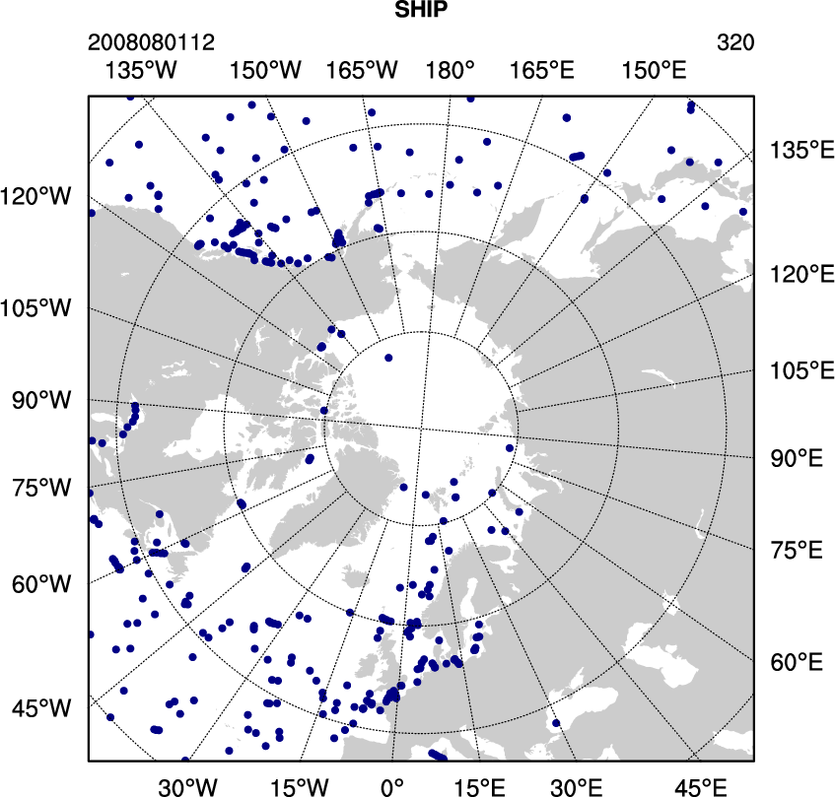
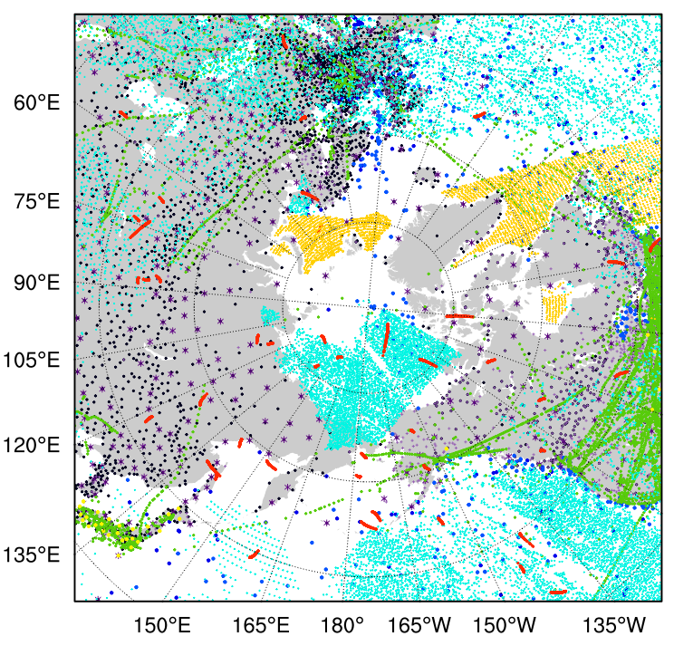
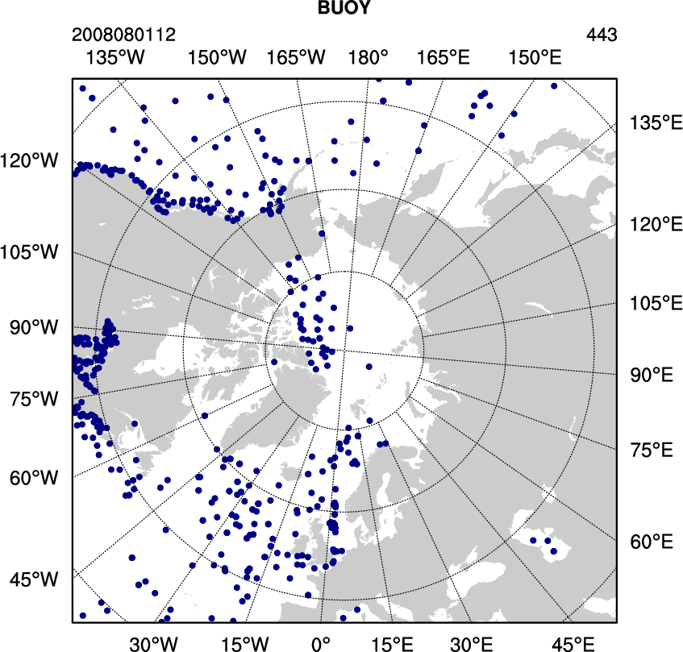
Plotting observation locations
http://www.mmm.ucar.edu/wrf/users/wrfda/download/tools.html
var/graphics/ncl/plot_ob_ascii_loc.ncl – a sample NCL script to plot observation locations
Refer to http://www.ncl.ucar.edu/Applications/station.shtml for more station plotting examples

Slide 31
little_r format
little_r file is the report-based ASCII file
different observation files can be concatenated (cat) together to one file
Little_r file…
Report 1
.
.
Report 10
.
.
Report n
Header record
Data record
Ending record
3 tail integers
field1, … field60
field1, … field20
field1, … field20
-888888 -888888 -888888
Reports can be from different observation types: metar, ship, sound, amdar, profl, airep, etc.
WRF User’s Guide Chapter 7

Slide 32
little_r format
A little_r format observation file is composed of Reports
Report is composed of Records (header, data,…, and ending) and 3 tail integers (3i7):
Record is composed of fields
fields in the header record
fields in the data record
fields in the ending record
Example: one sounding report in a little_r file
13.48000 2.1600061052 NIAMEY-AERO / NIGER FM-35 TEMP GTS (ROHK) USNR20 DRRN 242300
227.00000 1 -888888 -888888 55 -888888 T F F -888888 -888888 20100824230000-888888.00000 0-888888.00000 0-888888.00000 0-888888.00000
0-888888.00000 0-888888.00000 0-888888.00000 0-888888.00000 0-888888.00000 0-888888.00000 0-888888.00000 0-888888.00000 0-888888.00000 0
98600.00000 0 227.00000 0 300.75000 0 293.75000 0 4.11556 0 240.00000 0-888888.00000 0-888888.00000 0-888888.00000 0-888888.00000 0
100000.00000 0 97.00000 0 -888888.00000 0-888888.00000 0-888888.00000 0-888888.00000 0-888888.00000 0-888888.00000 0-888888.00000 0-888888.00000 0
92500.00000 0 788.00000 0 299.94998 0 290.94998 0 6.68778 0 255.00000 0-888888.00000 0-888888.00000 0-888888.00000 0-888888.00000 0
85000.00000 0 1530.00000 0 295.94998 0 284.94998 0 1.54333 0 225.00000 0-888888.00000 0-888888.00000 0-888888.00000 0-888888.00000 0
70000.00000 0 3187.00000 0 283.35001 0 278.75000 0 7.71667 0 75.00000 0-888888.00000 0-888888.00000 0-888888.00000 0-888888.00000 0
50000.00000 0 5900.00000 0 267.04999 0 256.04999 0 12.86111 0 85.00000 0-888888.00000 0-888888.00000 0-888888.00000 0-888888.00000 0
40000.00000 0 7610.00000 0 256.64999 0 240.64999 0 6.68778 0 75.00000 0-888888.00000 0-888888.00000 0-888888.00000 0-888888.00000 0
30000.00000 0 9720.00000 0 242.64999 0 239.04999 0 6.68778 0 165.00000 0-888888.00000 0-888888.00000 0-888888.00000 0-888888.00000 0
25000.00000 0 10990.00000 0 232.64999 0-888888.00000 0 6.17333 0 145.00000 0-888888.00000 0-888888.00000 0-888888.00000 0-888888.00000 0
20000.00000 0 12470.00000 0 220.25000 0-888888.00000 0 3.60111 0 135.00000 0-888888.00000 0-888888.00000 0-888888.00000 0-888888.00000 0
15000.00000 0 14260.00000 0 205.84999 0-888888.00000 0 18.00556 0 100.00000 0-888888.00000 0-888888.00000 0-888888.00000 0-888888.00000 0
10000.00000 0 16640.00000 0 194.04999 0-888888.00000 0 9.77444 0 70.00000 0-888888.00000 0-888888.00000 0-888888.00000 0-888888.00000 0
-888888.00000 0-888888.00000 0-888888.00000 0-888888.00000 0-888888.00000 0-888888.00000 0-888888.00000 0-888888.00000 0-888888.00000 0-888888.00000 0
-777777.00000 0-777777.00000 0 13.00000 0-888888.00000 0-888888.00000 0-888888.00000 0-888888.00000 0-888888.00000 0-888888.00000 0-888888.00000 0
58 0 0
Header record
Data record
Ending record
3 tail integer

Slide 33
little_r format
The fields in the header record (Fortran format in parenthesis)
No | Field | No | Filed | No | Field
1 | Latitude (f20.5) | 2 | Longitude (f20.5) | 3 | ID (a40)
4 | Name (a40) | 5 | Platform (a40) | 6 | Source (a40)
7 | Elevation (f20.5) | 8 | Num_vld_fld (i10) | 9 | Num_error (i10)
10 | Num_warning (i10) | 11 | Seq_num (i10) | 12 | Num_dupd (i10)
13 | Is_sound (L10) | 14 | Bogus (L10) | 15 | Discard (L10)
16 | Valid_time%sut (i10) | 17 | Valid_time%julian (i10) | 18 | Valid_time%date_char(a20)
19 | Slp%data (f13.5) | 20 | Slp%qc (i7) | 21 | Ref_pres%data (f13.5)
22 | Ref_pres%qc (i7) | 23 | Ground_t%data (f13.5) | 24 | Ground_t%qc (i7)
25 | SST%data (f13.5) | 26 | SST%qc (i7) | 27 | Psfc%data (f13.5)
28 | Psfc%qc (i7) | 29 | Precip%data (f13.5) | 30 | Precip%qc (i7)
31 | T_max%data (f13.5) | 32 | T_max%qc (i7) | 33 | T_min%data (f13.5)
34 | T_min%qc (i7) | 35 | T_min_night%data (f13.5) | 36 | T_min_night%qc (i7)
37 | P_tend03%data (f13.5) | 38 | P_tend03%qc (i7) | 39 | P_tend24%data (f13.5)
40 | P_tend24%qc (i7) | 41 | Cloud_cvr%data (f13.5) | 42 | Cloud_cvr%qc (i7)
43 | Celling%data (f13.5) | 44 | Celling%qc (i7) | 45 | Pw%data (f13.5)
46 | Pw%qc (i7) | 47 | Tb19v%data (f13.5) | 48 | Tb19v%qc (i7)
49 | Tb19h%data (f13.5) | 50 | Tb19h%qc (i7) | 51 | Tb22v%data (f13.5)
52 | Tb22v%qc (i7) | 53 | Tb37v%data (f13.5) | 54 | Tb37v%qc (i7)
55 | Tb37h%data (f13.5) | 56 | Tb37h%qc (i7) | 57 | Tb85v%data (f13.5)
58 | Tb85v%qc (i7) | 59 | Tb85h%data (f13.5) | 60 | Tb85h%qc
SSMI TB
can be omitted

Slide 34
little_r format
The fields in the data record (Fortran format in parenthesis)
No | Field | No | Field
1 | Pressure%data (f13.5) | 2 | Pressure%qc (i7)
3 | Height%data (f13.5) | 4 | Height%qc (i7)
5 | Temperature%data (f13.5) | 6 | Temperature%qc (i7)
7 | Dew_point%data (f13.5) | 8 | Dew_point%qc (i7)
9 | Speed%data (f13.5) | 10 | Speed%qc (i7)
11 | Direction%data (f13.5) | 12 | Direction%qc (i7)
13 | U%data (f13.5) | 14 | U%qc (i7)
15 | V%data (f13.5) | 16 | V%qc (i7)
17 | RH%data (f13.5) | 18 | RH%qc (i7)
19 | Thickness%data (f13.5) | 20 | Thickness%qc (i7)
85000.00000 0 1530.00000 0 295.94998 0 284.94998 0 1.54333 0 225.00000 0-888888.00000 0-888888.00000 0-888888.00000 0-888888.00000 0
The 0s after each piece of data are quality control identifiers to be defined in the little_r objective analysis program. They have no meanings for WRFDA.

Slide 35
little_r format
The fields in the ending record
No | field | No | field | No | field | No | field
1 | -777777.00000 | 2 | 0 | 3 | -777777.00000 | 4 | 0
5 | -888888.00000 | 6 | 0 | 7 | -888888.00000 | 8 | 0
9 | -888888.00000 | 10 | 0 | 11 | -888888.00000 | 12 | 0
13 | -888888.00000 | 14 | 0 | 15 | -888888.00000 | 16 | 0
17 | -888888.00000 | 18 | 0 | 19 | -888888.00000 | 20 | 0
-777777.00000 0-777777.00000 0 13.00000 0-888888.00000 0-888888.00000 0-888888.00000 0-888888.00000 0-888888.00000 0-888888.00000 0-888888.00000 0

Slide 36
little_r format
a snippet of Fortran code that writes data in little_r format
C header:
WRITE ( UNIT = iunit , ERR = 19 , FMT = rpt_format )
* xlat,xlon, string1 , string2 ,
* string3 , string4 , ter, kx*6, 0,0,iseq_num,0,
* logical1, logical2, logical3,
* -888888, -888888, date_char ,
* slp,0,-888888.,0, -888888.,0, -888888.,0, -888888.,0,
* -888888.,0,
* -888888.,0, -888888.,0, -888888.,0, -888888.,0,
* -888888.,0,
* -888888.,0, -888888.,0
C report:
do 100 k = 1 , kx
WRITE ( UNIT = iunit , ERR = 19 , FMT = meas_format )
* p(k), 0, z(k),0, t(k),0, td(k),0,
* spd(k),0, dir(k),0,
* -888888.,0, -888888.,0,-888888.,0, -888888.,0
100 continue
C end of report line:
WRITE ( UNIT = iunit , ERR = 19 , FMT = meas_format )
* -777777.,0, -777777.,0,float(kx),0,
* -888888.,0, -888888.,0, -888888.,0,
* -888888.,0, -888888.,0, -888888.,0,
* -888888.,0
C end of message line:
WRITE ( UNIT = iunit , ERR = 19 , FMT = end_format ) kx, 0, 0

Slide 37
little_r format
QSCAT: U and V fields are used to store observation errors of wind speed and wind direction
press | geo height | temp | dew-p | speed | dir | u | v | rh | thickness
 |  |  |  |  |  | obs error of wind speed | obs error of wind direction
1.0 m/s minimum obs error imposed by WRFDA
GPS Refractivity
press | geo height | temp | dew-p | speed | dir | u | v | rh | thickness
 | height (m) |  | Refractivity (N) | Impact parameter (x1.e-3) | azimuth angle (degree) | latitude | longitude | Bending angle (radx1.e7) | Opt. bending
little_r format and OBSPROC were developed before some observation types became available
OBSPROC was extended to handle some “non-conventional” observation types in a non-standard way

Slide 38
Questions?
wrfhelp@ucar.edu
The NESL Mission is:
To advance understanding of weather, climate, atmospheric composition and processes;
To provide facility support to the wider community; and,
To apply the results to benefit society.
NCAR is sponsored by the National Science Foundation

