Slide 1
WRF Data Assimilation System
Michael Kavulich
Special thanks to:
Xin Zhang, Xiang-Yu Huang
WRFDA Tutorial, July 2013, NCAR
Many slides are borrowed from WRF software lectures

Slide 2
WRFDA System – Outline
Introduction
WRFDA Software Overview
Computing Overview
Notes:
Introduction: intended audience, available resources, WRF framework, supported platforms
Computing Overview: application – system – hardware
patches processes processors
tiles threads nodes
comms messages networks
need for parallelism
distributed memory
communication
WRF Software Overview: architecture
directory structure
WRF model layers
interfaces between layers
data structure
IO
the Registry file

Slide 3
Introduction – What is WRFDA?
A data assimilation system for the WRF Model (ARW core)
3D- and 4D-VAR, Ensemble, and Hybrid methods
Designed to be flexible, portable and easily installed and modified
Open-source and public domain
Can be compiled on a variety of platforms
Part of the WRF Software Framework
Designed to handle a wide variety of data
Conventional observations
Radar velocity and reflectivity
Satellite (radiance and derived data)
Accumulated precipitation
Notes:
WRF: Weather Research and Forecast model
ARW: Advanced Research WRF
WRFDA: WRF Data Assimilation
MMM: “M-cubed; Mesoscale and Microscale division of NCAR
Can actually work for both ARW and NMM cores, but this tutorial is specifically for the ARW WRFDA

Slide 4
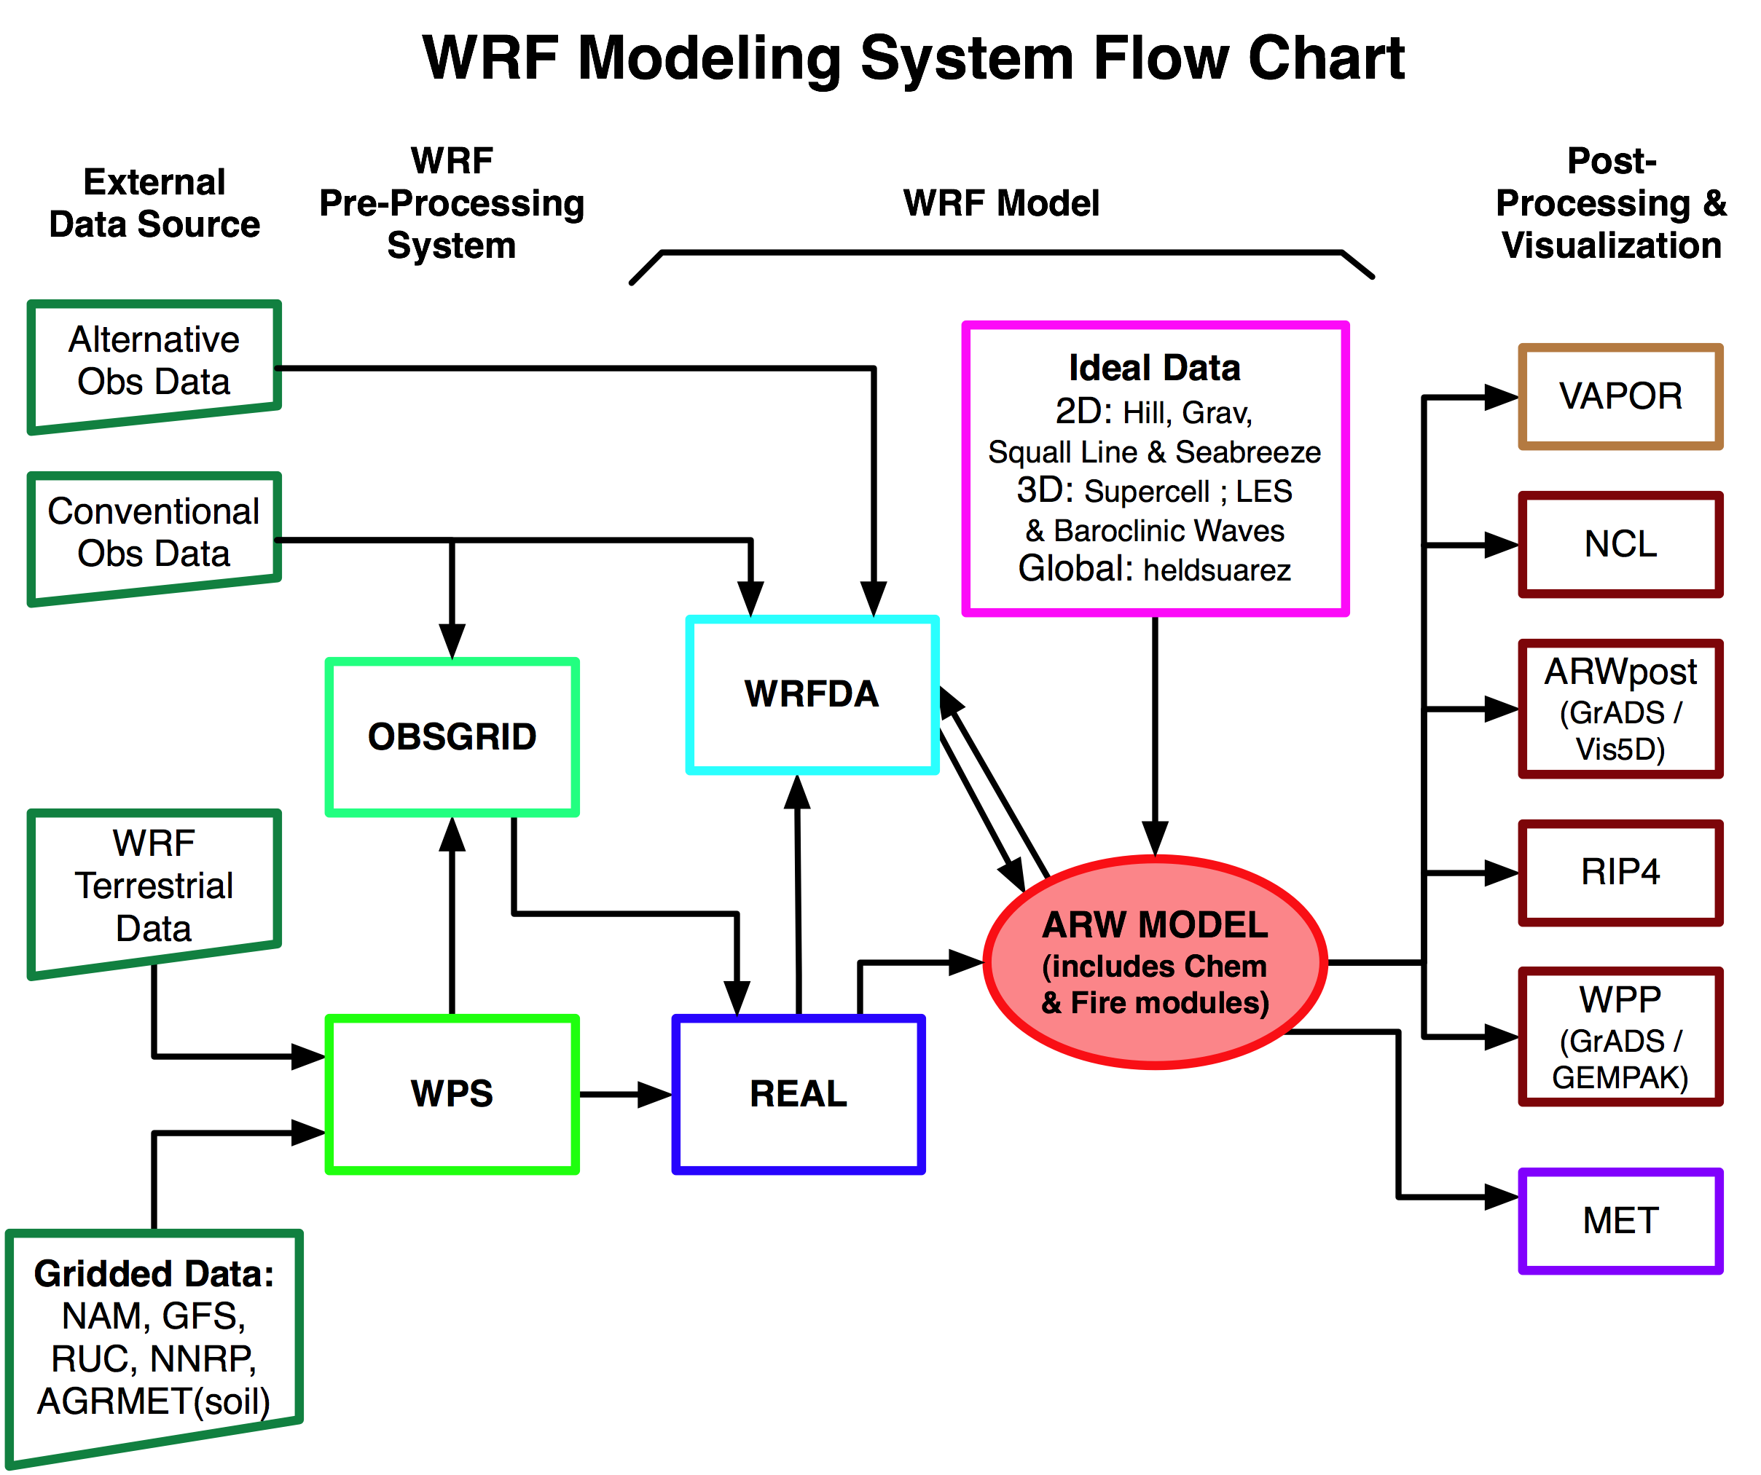

Slide 5
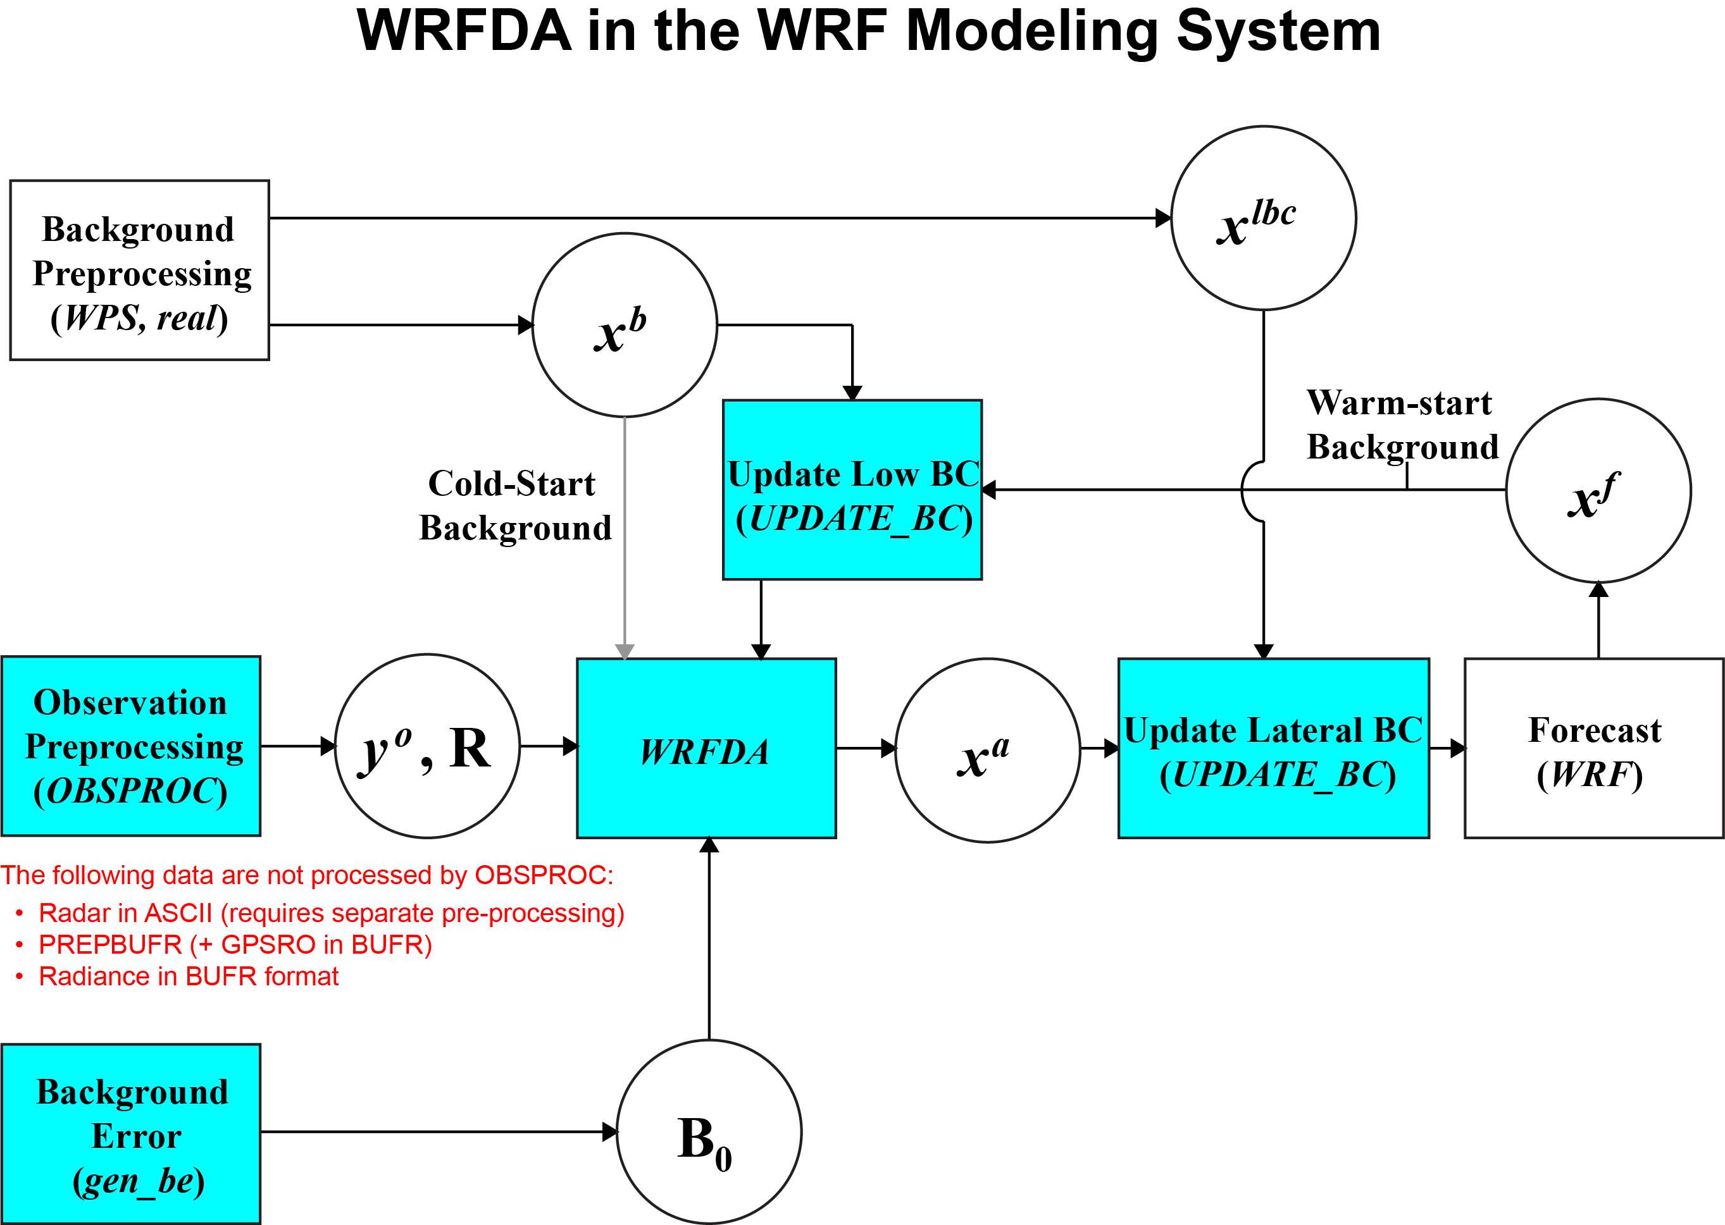
Blue: Supported by WRFDA team

Slide 6
WRFDA System – Outline
Introduction
WRFDA Software
Computing Overview
Notes:
Introduction: intended audience, available resources, WRF framework, supported platforms
Computing Overview: application – system – hardware
patches processes processors
tiles threads nodes
comms messages networks
need for parallelism
distributed memory
communication
WRF Software Overview: architecture
directory structure
WRF model layers
interfaces between layers
data structure
IO
the Registry file

Slide 7
program da_wrfvar_main !----------------------------------------------------------------------- ! Purpose: Main program of WRF-Var. Responsible for starting up, reading ! in (and broadcasting for distributed memory) configuration data, defining ! and initializing the top-level domain, either from initial or restart ! data, setting up time-keeping, and then calling the da_solve ! routine assimilation. After the assimilation is completed, ! the model is properly shut down. !----------------------------------------------------------------------- use module_symbols_util, only : wrfu_finalize use da_control, only : trace_use, var4d use da_tracing, only : da_trace_init, da_trace_report, da_trace_entry, & da_trace_exit use da_wrf_interfaces, only : wrf_shutdown, wrf_message, disable_quilting use da_wrfvar_top, only : da_wrfvar_init1,da_wrfvar_init2,da_wrfvar_run, & da_wrfvar_finalize #ifdef VAR4D use da_4dvar, only : clean_4dvar, da_finalize_model #endif implicit none ! Split initialisation into 2 parts so we can start and stop trace here call disable_quilting call da_wrfvar_init1 if (trace_use) call da_trace_init if (trace_use) call da_trace_entry("da_wrfvar_main") call da_wrfvar_init2 call da_wrfvar_run call da_wrfvar_finalize #ifdef VAR4D if (var4d) then call clean_4dvar call da_finalize_model end if #endif call wrf_message("*** WRF-Var completed successfully ***") if (trace_use) call da_trace_exit("da_wrfvar_main") if (trace_use) call da_trace_report call wrfu_finalize call wrf_shutdown end program da_wrfvar_main
Notes:
This is the source code for the main WRFDA executable. No, seriously, that’s it! WRFDA is designed to be as structured and intuitive as possible, so that each significant step is executed by a subroutine, which calls further subroutines, etc.

Slide 8
WRFDA Directory structure
arch
clean
compile
configure
dyn_em
dyn_exp
external
frame
inc
main
Makefile
phys
README.DA
Registry
run
share
test
tools
var
build scripts
README file with information about WRFDA
Contains registry.var
Legend:
Blue – directory
Green – script file
Gray – other text file
WRFDA source
code directory
Notes:
WRF has interfaces between each of the layers.
For the interface between the mediation layer (physics drivers) and the model layer (physics packages), there are explicit requirements to insure correctly handled driver and mediation support (I/O, parallelism, external packages).

Slide 9
WRFDA/var Directory structure
build
convertor
da
external
gen_be
graphics
Makefile
obsproc
README.basics
README.namelist
README.radiance
run
scripts
test
Executables built here
WRFDA source code contained here
Source code for external libraries (CRTM, BUFR, etc.)
GEN_BE source code
OBSPROC source code
More README files with useful information
Useful runtime files (mostly for radiance)
Data for tutorial cases
Legend:
Blue – directory
Green – script file
Gray – other text file
Notes:
WRF has interfaces between each of the layers.
For the interface between the mediation layer (physics drivers) and the model layer (physics packages), there are explicit requirements to insure correctly handled driver and mediation support (I/O, parallelism, external packages).

Slide 10
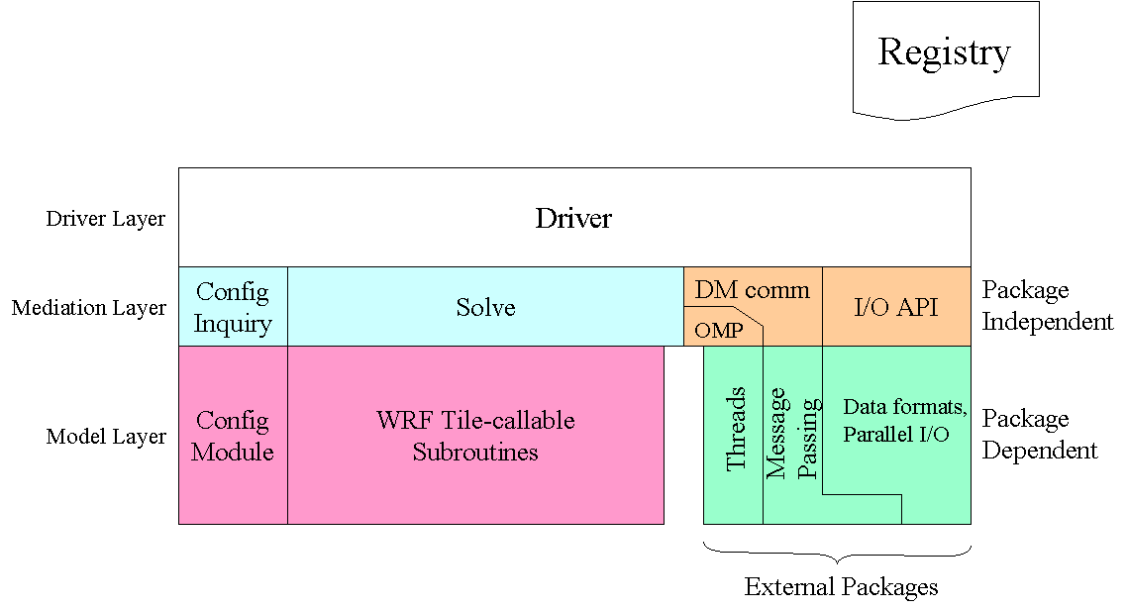
WRFDA Software – Architecture
registry.var
DA obs_type-callable
Subroutine
Hierarchical software architecture
Insulate scientists' code from parallelism and other architecture/implementation-specific details
Well-defined interfaces between layers, and external packages for communications, I/O.
Notes:
Major components: driver layer – does not care what model it is driving
model layer – should be drivable by any framework
mediation layer – has to know about the model and the driver
Registry file
Most physics packages are column oriented, so little work required to get new code to parallelize
Interfaces form contract with developers (though we change the contract every so often)

Slide 11
WRFDA Software – Architecture
registry.var
DA obs_type-callable
Subroutine
Registry: an “Active” data dictionary
Tabular listing of model state and attributes
Large sections of interface code generated automatically
Scientists manipulate model state simply by modifying Registry, without further knowledge of code mechanics
registry.var is the dictionary for WRFDA
Notes:
Dimensions, staggering, I/O and model coupling, communications, nesting, etc.
Interfaces between layers, communications
Approximately ¼ of wrf is autogen’d in this way
Packages of physics options with required fields
Adding a variable to state or namelist, 1 line change

Slide 12
WRFDA Software – Architecture
Registry
DA obs_type-callable
Subroutine
Driver Layer
Domains: Allocates, stores, decomposes, represents abstractly as single data objects
Notes:
Primarily in the frame directory, rarely do scientists spend any time there
Most changes that would be required are set up with automatically generated code

Slide 13
WRFDA Software – Architecture
Registry
DA obs_type-callable
Subroutine
Minimization/Solver Layer
Minimization/Solver routine, choose the function based on the namelist variable, 3DVAR, 4DVAR, FSO or Verification, and choose the minimization algorithm.
Notes:
Additions to the variable set that is required for a physics scheme, or the development of a new scheme, require coding changes in the various physics drivers

Slide 14
WRFDA Software – Architecture
Registry
DA obs_type-callable
Subroutine
Observation Layer
Observation interfaces: contains the gradient and cost function calculation subroutines for each type of observations.
Notes:
Grep print, write, stop in v 2.1.2 in the phys directory: 719 lines
Section of the code most users will visit: contains all physics packages
Each physics package is a Fortran module, each employs use association with that package’s driver

Slide 15
Call Structure Superimposed on Architecture
da_sound.f90(da_sound)
da_wrfvar_main (var/da/da_main/da_wrfvar_main.f90)
da_wrfvar_run (da_main)
da_wrfvar_interface -> da_solve (da_main)
da_minimise_cg (da_minimisation)
da_calculate_j (da_minimisation)
KFCPS (phys/module_ra_kf.F
KFCPS (phys/module_ra_kf.F
KFCPS (phys/module_ra_kf.F
KFCPS (phys/module_ra_kf.F
KFCPS (phys/module_ra_kf.F
synop (da_synop/da-synop.f90)
sound (da_sound/da_sound.f90)

Slide 16
WRFDA broken down by process
Namelist
x_{b}
y, R
B
Read namelist
Set up framework
Set up background
Set up observations and error
Set up background error
Compute analysis
Minimize cost function
Calculate y − H (x)
Outer loop
Calculate diagnostics
Formulate analysis
Clean up
Diagnostics
x_{a}

Slide 17
WRFDA broken down by process
Input files
Namelist
x_{b}
y, R
B
Read namelist
Set up framework
Set up background
Set up observations and error
Set up background error
Compute analysis
Minimize cost function
Calculate y − H (x)
Outer loop
Calculate diagnostics
Formulate analysis
Clean up
Diagnostics
x_{a}

Slide 18
Input files: Namelist
File name: namelist.input
Specifies Input/Output options, domain details, types of observations to assimilate and how to assimilate them
Allows user great flexibility to change the usage of WRFDA without having to recompile
A large number (>1000) of namelist options govern the running of WRFDA; however, users will typically only be concerned with setting a few dozen of these
More details can be found in the User’s Guide

Slide 19
Input files: x_{b} (background)
File name: fg
Can be either a WRF input file created by WPS and real.exe, or a WRF output file from a forecast.

Slide 20
Input files: y (observations) and R (observation errors)
File name: ob.ascii, amsua.bufr, ob01.rain, etc.
WRFDA accepts a wide variety of observations in several different formats
OBSPROC ASCII format (surface, sounding, GPS, etc.)
PREPBUFR format (surface, sounding, etc.)
BUFR format (radiance)
Other ASCII format (radar, precipitation)
Observation errors are either provided in the observation file, or standard errors (file name: obserr.txt) are used.

Slide 21
Input files: B (background error)
File name: be.dat
This is a binary file containing background error information
cv_options=3 NCEP background error formulation
File provided with WRFDA code
Not recommended: should be used with caution
cv_options=5 NCAR background error formulation
File created using gen_be utility
Recommended option
cv_options=6; Multivariate Background Error (MBE) statistics
Not officially supported

Slide 22
WRFDA broken down by process
Namelist
x_{b}
y, R
B
Read namelist
Set up framework
Set up background
Set up observations and error
Set up background error
Compute analysis
Minimize cost function
Calculate y − H (x)
WRFDA Processes
Outer loop
Calculate diagnostics
Formulate analysis
Clean up
Diagnostics
x_{a}

Slide 23
Read namelist
Namelist
x_{b}
y, R
B
Read namelist
Set up framework
Set up background
Set up observations and error
Set up background error
Compute analysis
Minimize cost function
Calculate y − H (x)
Outer loop
Calculate diagnostics
Formulate analysis
Clean up
Diagnostics
x_{a}

Slide 24
Read namelist
Read user-specified options from namelist.input
Set default values for options not specified in the namelist
Perform consistency checks between namelist options
Calling order:
da_wrfvar_main ==> call da_wrfvar_init1, da_wrfvar_init2 ==> call initial_config
Calling subroutines:
da_wrfvar_main.f90 ==> da_wrfvar_init1.inc, da_wrfvar_init2.inc ==> module_configure.F

Slide 25
Set up framework
Namelist
x_{b}
y, R
B
Read namelist
Set up framework
Set up background
Set up observations and error
Set up background error
Compute analysis
Minimize cost function
Calculate y − H (x)
Outer loop
Calculate diagnostics
Formulate analysis
Clean up
Diagnostics
x_{a}

Slide 26
Set up framework
Utilize WRF Software Framework distributed memory capability to allocate and configure the domain
Allocate needed memory, initializes domain and tile dimensions, etc.
Create output files
Calling order:
da_wrfvar_main ==> call da_wrfvar_init2 ==> call alloc_and_configure_domain
da_wrfvar_main ==> call da_wrfvar_run.inc ==> call da_wrfvar_interface ==> call da_solve ==> call da_solve_init
Calling subroutines:
da_wrfvar_main.f90 ==> da_wrfvar_init2.inc ==> module_domain.F
da_wrfvar_main.f90 ==> da_wrfvar_run.inc ==> da_wrfvar_interface.inc ==> da_solve.inc ==> da_solve_init.inc

Slide 27
Set up background
Namelist
x_{b}
y, R
B
Read namelist
Set up framework
Set up background
Set up observations and error
Set up background error
Compute analysis
Minimize cost function
Calculate y − H (x)
Outer loop
Calculate diagnostics
Formulate analysis
Clean up
Diagnostics
x_{a}

Slide 28
Set up background
Read the first-guess file
Extract fields used by WRFDA
Create background FORTRAN 90 derived data type xb, etc.
Calling order:
da_wrfvar_main ==> call da_wrfvar_init2 ==> call da_med_initialdata_input
da_wrfvar_main ==> call da_wrfvar_run ==> call da_wrfvar_interface ==> call da_solve ==>call da_setup_firstguess
Calling subroutines:
da_wrfvar_main.f90 ==> da_wrfvar_init2.inc ==> da_med_initialdata_input.inc
da_wrfvar_main.f90 ==> da_wrfvar_run.inc ==> da_wrfvar_interface.inc ==> da_solve.inc ==>da_setup_firstguess.inc

Slide 29
Set up observations and error
Namelist
x_{b}
y, R
B
Read namelist
Set up framework
Set up background
Set up observations and error
Set up background error
Compute analysis
Minimize cost function
Calculate y − H (x)
Outer loop
Calculate diagnostics
Formulate analysis
Clean up
Diagnostics
x_{a}

Slide 30
Set up observations and error
Read in observations
Assign observational error
Create observation FORTRAN 90 derived data type ob
Domain and time check
Calling order:
da_wrfvar_main ==> call da_wrfvar_run ==> call da_wrfvar_interface ==> call da_solve ==> call da_setup_obs_structures
Calling subroutines:
da_wrfvar_main.f90 ==> da_wrfvar_run.inc ==> da_wrfvar_interface.inc ==> da_solve.inc ==>da_setup_obs_structures.inc

Slide 31
Set up background error
Namelist
x_{b}
y, R
B
Read namelist
Set up framework
Set up background
Set up observations and error
Set up background error
Compute analysis
Minimize cost function
Calculate y − H (x)
Outer loop
Calculate diagnostics
Formulate analysis
Clean up
Diagnostics
x_{a}

Slide 32
Set up background error
Reads in background error statistics from be.dat
Extracts necessary quantities: eigenvectors, eigenvalues, lengthscales, regression coefficients, etc.
Creates background error FORTRAN 90 derived data type be
Reference :Online BE Documents
Calling order:
da_wrfvar_main ==> call da_wrfvar_run ==> call da_wrfvar_interface ==> call da_solve ==>call da_setup_background_errors
Calling subroutines:
da_wrfvar_main.f90 ==> da_wrfvar_run.inc ==> da_wrfvar_interface.inc ==> da_solve.inc ==>da_setup_background_errors.inc

Slide 33
Calculate y − H (x)
Namelist
x_{b}
y, R
B
Read namelist
Set up framework
Set up background
Set up observations and error
Set up background error
Compute analysis
Minimize cost function
Calculate y − H (x)
Outer loop
Calculate diagnostics
Formulate analysis
Clean up
Diagnostics
x_{a}

Slide 34
Calculate y − H (x) (Innovation)
Calculate model equivalent of observations through interpolation and variable transformations
Compute observation minus first guess (y − H (x)) value
Create innovation vector FORTRAN 90 derived data type iv
Calling order:
da_wrfvar_main ==> call da_wrfvar_run ==> call da_wrfvar_interface ==>
call da_solve ==>call da_get_innov_vector, da_allocate_y
Calling subroutines:
da_wrfvar_main.f90 ==> da_wrfvar_run.inc ==> da_wrfvar_interface.inc ==>
da_solve.inc ==>da_get_innov_vector.inc, da_allocate_y.inc

Slide 35
Minimize cost function
Namelist
x_{b}
y, R
B
Read namelist
Set up framework
Set up background
Set up observations and error
Set up background error
Compute analysis
Minimize cost function
Calculate y − H (x)
Outer loop
Calculate diagnostics
Formulate analysis
Clean up
Diagnostics
x_{a}

Slide 36
Minimize cost function
Use conjugate gradient method
Initializes analysis increments to zero
Computes cost function (if desired)
Computes gradient of cost function
Uses gradient of the cost function to calculate new value of analysis control variable
Increment this process until specified minimization is achieved
Calling order:
da_wrfvar_main ==> call da_wrfvar_run ==> call da_wrfvar_interface ==> call da_solve ==>call da_minimise_cg
Calling subroutines:
da_wrfvar_main.f90 ==> da_wrfvar_run.inc ==> da_wrfvar_interface.inc ==> da_solve.inc ==>da_minimise_cg.inc
Further reading: Shewchuk, Jonathan Richard, 1994. An Introduction to the Conjugate Gradient Method Without the Agonizing Pain (http://www.cs.cmu.edu/~quake-papers/painless-conjugate-gradient.pdf)

Slide 37
Compute analysis
Namelist
x_{b}
y, R
B
Read namelist
Set up framework
Set up background
Set up observations and error
Set up background error
Compute analysis
Minimize cost function
Calculate y − H (x)
Outer loop
Calculate diagnostics
Formulate analysis
Clean up
Diagnostics
x_{a}

Slide 38
Compute analysis
Convert control variables to model space analysis increments
Calculate analysis = first-guess + analysis increment
Perform consistency checks (e.g., remove negative humidity)
Calling order:
da_wrfvar_main ==> call da_wrfvar_run ==> call da_wrfvar_interface ==> call da_solve ==>call da_transfer_xatoanalysis
Calling subroutines:
da_wrfvar_main.f90 ==> da_wrfvar_run.inc ==> da_wrfvar_interface.inc ==> da_solve.inc ==>da_transfer_xatoanalysis.inc

Slide 39
Calculate diagnostics
Namelist
x_{b}
y, R
B
Read namelist
Set up framework
Set up background
Set up observations and error
Set up background error
Compute analysis
Minimize cost function
Calculate y − H (x)
Outer loop
Calculate diagnostics
Formulate analysis
Clean up
Diagnostics
x_{a}

Slide 40
Calculate diagnostics
Output y − H(x_{b}), y − H(x_{a}) statistics for all observation types and variables
Compute x_{a} − x_{b} (analysis increment) statistics for all model variables and levels
Statistics include minimum, maximum (and their locations), mean and standard deviation.
Calling order:
da_wrfvar_main ==> call da_wrfvar_run ==> call da_wrfvar_interface ==> call da_solve ==>call da_transfer_xatoanalysis
Calling subroutines:
da_wrfvar_main.f90 ==> da_wrfvar_run.inc ==> da_wrfvar_interface.inc ==> da_solve.inc ==>da_transfer_xatoanalysis.inc

Slide 41
Outer loop
Namelist
x_{b}
y, R
B
Read namelist
Set up framework
Set up background
Set up observations and error
Set up background error
Compute analysis
Minimize cost function
Calculate y − H (x)
Outer loop
Calculate diagnostics
Formulate analysis
Clean up
Diagnostics
x_{a}

Slide 42
Outer loop
An outer loop is a method of iterative assimilation to maximize contributions from observations non-linearly related to the control variables (e.g., GPS refractivity, Doppler radial velocity)
After the previous steps, the analysis x_{a} is used as the new first guess
The cost function minimization and diagnostic steps are repeated
This can be repeated up to ten times
Calling order:
da_wrfvar_main ==> call da_wrfvar_run ==> call da_wrfvar_interface ==> call da_solve
Calling subroutines:
da_wrfvar_main.f90 ==> da_wrfvar_run.inc ==> da_wrfvar_interface.inc ==> da_solve.inc
Further reading: Rizvi et al., 2008 (http://www.mmm.ucar.edu/wrf/users/workshops/WS2008/abstracts/P5-03.pdf)

Slide 43
Write analysis
Namelist
x_{b}
y, R
B
Read namelist
Set up framework
Set up background
Set up observations and error
Set up background error
Compute analysis
Minimize cost function
Calculate y − H (x)
Outer loop
Calculate diagnostics
Formulate analysis
Clean up
Diagnostics
x_{a}

Slide 44
Write analysis
Write analysis file in native WRF format.
Calling order:
da_wrfvar_main ==> call da_wrfvar_run ==> call da_wrfvar_interface ==> call da_solve ==>call da_transfer_xatoanalysis
Calling subroutines:
da_wrfvar_main.f90 ==> da_wrfvar_run.inc ==> da_wrfvar_interface.inc ==> da_solve.inc ==>da_transfer_xatoanalysis.inc

Slide 45
Clean up
Namelist
x_{b}
y, R
B
Read namelist
Set up framework
Set up background
Set up observations and error
Set up background error
Compute analysis
Minimize cost function
Calculate y − H (x)
Outer loop
Calculate diagnostics
Formulate analysis
Clean up
Diagnostics
x_{a}

Slide 46
Clean up
Deallocate dynamically-allocated arrays, structures, etc.
Timing information
Clean end to WRFDA
Calling order:
da_wrfvar_main ==> call da_wrfvar_run ==> call da_wrfvar_interface ==> call da_solve
da_wrfvar_main ==> call da_wrfvar_finalize
Calling subroutines:
da_wrfvar_main.f90 ==> da_wrfvar_run.inc ==> da_wrfvar_interface.inc ==> da_solve.inc
da_wrfvar_main.f90 ==> da_wrfvar_finalize.inc

Slide 47
WRFDA broken down by process
Namelist
x_{b}
y, R
B
Read namelist
Set up framework
Set up background
Set up observations and error
Set up background error
Compute analysis
Minimize cost function
Calculate y − H (x)
Outer loop
Calculate diagnostics
Formulate analysis
Clean up
Output files
Diagnostics
x_{a}

Slide 48
Output files: Diagnostics
File names: grad_fn, jo, qcstat_conv*, statistics, etc.
There will be a number of diagnostics files output by WRFDA
Many will end in .0000, .0001, etc.; these are diagnostics specific to each processor used
Many will also contain a _01; these files will appear for each outer loop as _02, _03, etc.
More or fewer output files can be specified by certain namelist options

Slide 49
Output files: x_{a} (analysis)
File name: wrfvar_output
This is the model output in WRF native format. This file can be used directly for research purposes, or used to initialize a WRF forecast

Slide 50
Cycling mode
Because WRFDA takes WRF forecast files as input, the system can naturally be run in cycling mode
WRFDA initializes a WRF forecast, the output of which is fed back into WRFDA to initialize another WRF forecast
Requires boundary condition updating

Slide 51
Cycling mode
Further reading: User’s Guide, Chapter 6, section “Updating WRF Boundary Conditions”

Slide 52
WRFDA System – Outline
Introduction
WRFDA Software Overview
Computing Overview
Notes:
Computing Overview:
referring to both hardware and software
Software: system level and user level
separate modeling activities into three layers
application program – system software – hardware

Slide 53
WRFDA Parallelism
WRFDA can be run serially or as a parallel job
WRFDA uses domain decomposition to divide total amount of work over parallel processes
The decomposition of the application over processes has two levels:
The domain is first broken up into rectangular pieces that are assigned to MPI (distributed memory) processes. These pieces are called patches
The patches may be further subdivided into smaller rectangular pieces that are called tiles, and these are assigned to shared-memory threads within the process.
Notes:
Patches – overlap
Tiles – smoothly join

Slide 54
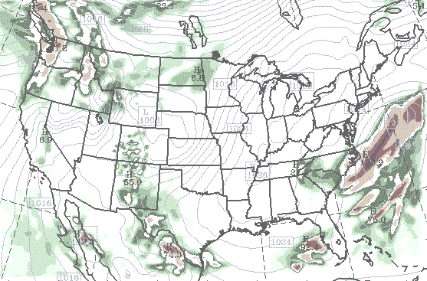
Parallelism in WRFDA: Multi-level Decomposition
Logical domain
Single version of code for efficient execution on:
Distributed-memory
Shared-memory (SMP)
Clusters of SMPs
Vector and microprocessors
1 Patch, divided into multiple tiles
Model domains are decomposed for parallelism on two-levels
Patch: section of model domain allocated to a distributed memory node, this is the scope of a minimization layer solver.
Tile: section of a patch allocated to a shared-memory processor within a node; this is also the scope of a observation layer subroutine.
Distributed memory parallelism is over patches; shared memory parallelism is over tiles within patches
Inter-processor communication

Slide 55
Distributed Memory Communications
When
Needed?
Why?
Signs in
code
Communication is required between patches when a horizontal index is incremented or decremented on the right-hand-side of an assignment.
On a patch boundary, the index may refer to a value that is on a different patch.
Following is an example code fragment that requires communication between patches
Note the tell-tale +1 and –1 expressions in indices for rr, H1, and H2 arrays on right-hand side of assignment.
These are horizontal data dependencies because the indexed operands may lie in the patch of a neighboring processor. That neighbor’s updates to that element of the array won’t be seen on this processor.

Slide 56
Distributed Memory Communications
(da_transfer_xatowrf.inc)
subroutine da_transfer_xatowrf(grid)
. . .
do k=kts,kte
do j=jts,jte+1
do i=its,ite+1
u_cgrid(i,j,k)=0.5*(grid%xa%u(i-1,j ,k)+grid%xa%u(i,j,k))
v_cgrid(i,j,k)=0.5*(grid%xa%v(i ,j-1,k)+grid%xa%v(i,j,k))
end do
end do
end do
. . .
Notes:
Traditional finite difference loop

Slide 57
Distributed Memory Communications
(da_transfer_xatowrf.inc)
subroutine da_transfer_xatowrf(grid)
. . .
do k=kts,kte
do j=jts,jte+1
do i=its,ite+1
u_cgrid(i,j,k)=0.5*(grid%xa%u(i-1,j ,k)+grid%xa%u(i,j,k))
v_cgrid(i,j,k)=0.5*(grid%xa%v(i ,j-1,k)+grid%xa%v(i,j,k))
end do
end do
end do
. . .
Notes:
Traditional finite difference loop

Slide 58
Distributed Memory (MPI) Communications
Halo updates
*
*
+ *
*
*
memory on one processor
memory on neighboring processor
Notes:
Green box plus the surrounding blue box is a single patch.
Blue represents the memory dimension, which includes a halo zone
Operand located in the halo (fig on right), has the updated value on a different patch
We want that updated value (“*” on left) for use in our computation (“+” on right)
Several instances where these communications typically occur.

Slide 59
Grid Representation in Arrays
Increasing indices in WRFDA arrays run
West to East (X, or I-dimension)
South to North (Y, or J-dimension)
Bottom to Top (Z, or K-dimension)
Storage order in WRFDA is IJK , but for WRF, it is IKJ (ARW) and IJK (NMM)
Output data has grid ordering independent of the ordering inside the WRFDA model

Slide 60
Grid Representation in Arrays
The extent of the logical or domain dimensions is always the "staggered" grid dimension. That is, from the point of view of a non-staggered dimension (also referred to as the ARW “mass points”), there is always an extra cell on the end of the domain dimension
In WRFDA, the minimization is on A-grid (non-staggered grid). The wind components will be interpolated from A-grid to C-grid (staggered grid) before they are output

Slide 61
WRFDA I/O
Streams: pathways into and out of model
Input
fg is the name of the input
wrfvar_output is the name of output
Boundary
Only needed for 4DVAR.
Notes:
Different streams: history, input, restart, boundary

Slide 62
Summary
WRFDA is designed to be an easy-to-use data assimilation system for use with the WRF model
WRFDA is designed within the WRF Software Framework for rapid development and ease of modification
WRFDA can be run in parallel for quick assimilation of large amounts of data

Slide 63
Appendix – WRFDA Resources
WRFDA users page
http://www.mmm.ucar.edu/wrf/users/wrfda
Download WRFDA source code, test data, related packages and documentation
Lists WRFDA news and developments
Online documentation
http://www.mmm.ucar.edu/wrf/users/docs/user_guide_V3/users_guide_chap6.htm
Chapter 6 of the WRF Users’ Guide; documents installation of WRFDA and running of various WRFDA methods
WRFDA user services and help desk
wrfhelp@ucar.edu
Notes:
Home page: announcements
source code
test data
working group pages
real-time forecasts
publications, presentations
Users: ARW and NMM
support
online tutorial
news groups
users forum
On line docs: code browser with auto doc
Registry
Nesting
Moving nests
coupling
lateral boundary
Help desk: all questions directoed to wrfhelp@ucar.edu

Slide 64
Appendix – Derived Data Structures
Driver layer
All data for a domain is an object, a domain derived data type (DDT)
The domain DDT is dynamically allocated/deallocated
Only one DDT is allowed in WRFDA; it is head_grid, defined in frame/module_domain.F
WRFDA doesn’t support nested domains.
Every Registry defined state, I1, and namelist variable is contained inside the DDT (locally known as a grid of type domain), where each node in the tree represents a separate and complete 3D model domain/nest.
1
head_grid
Notes:
Data for a domain – in this example there are four domains
Recursive – depth first, drills as deep as possible before processing siblings
Each child has a single parent, children do not overlap
Domains may be instantiated at any time during which the parent exists
Domains on the same level (example doms 2 and 3) do not need to be at the same grid distance ratio or same time step ratio

Slide 65
Appendix – Derived Data Structures
cvt
Real type array to store the control variables
It is an all-ZERO array during the first outer loop and will be updated at the end of each outer loop
xhat
Real type array to store the control variables
It stores the control variables for each inner loop.
be
It is used to store the background error covariance.
Notes:
Data for a domain – in this example there are four domains
Recursive – depth first, drills as deep as possible before processing siblings
Each child has a single parent, children do not overlap
Domains may be instantiated at any time during which the parent exists
Domains on the same level (example doms 2 and 3) do not need to be at the same grid distance ratio or same time step ratio

Slide 66
Appendix – Derived Data Structures
iv
Stores the innovations for each observational type
ob
Stores the observations
re
Store the residual

Slide 67
Appendix – WRFDA structure
Primarily written in Fortran and C
Part of the WRF Software Framework
Hierarchical organization
Multiple functions
Plug observation type interface
Abstract interfaces (APIs) to external packages
Performance-portable
Top-level Control,
Memory Management,
Parallelism, External APIs
driver
3DVAR
4DVAR
FSO
Minimization
minimization Interfaces
Plug-compatible physics
Plug-compatible physics
Plug-compatible physics
observations
Plug-compatible physics
Plug-compatible
Observation interface
Notes:
Architecture – analogy of building a house -> architecture is the set of plans
Hierarchical organization: different levels, each responsible for different activities
i.e., no IO or communications in physics level
Two fully supported dynamical cores:
ARW -> Advanced Research WRF, NCAR NMM -> Nonhydrostatic Mesoscale Model, NCEP
Plug compatible physics: may be called with each other:
cumulus
resolved scale moisture
radiation
surface
sub-surface
boundary layer
some physics schemes may be called by different cores, but not all
External packages: have several kinds
IO formats
communications
time manager
API – contract between WRF and package
analogy of building a house: hook-ups for water, gas, electricity
Performance portable: serial, shared, distributed, clustered available
run-time configurable tile (patch) shape, size, number for OpenMP (DM)
choose which method is best for your application
Designed from beginning to be adaptable:
micro-processor (cache) and vector processor (i,k,j)
maintain page for benchmarks
3d physics calls
allocatable memory for nests
allocatable memory for physics options
real 4 and real 8 support
coupled, as an ESMF object

Slide 68
Appendix – Parallel Computing Terms (Hardware)
Processor:
A device that reads and executes instructions in sequence from a memory device, producing results that are written back to a memory device
Node: One memory device connected to one or more processors.
Multiple processors in a node are said to share-memory and this is “shared memory parallelism”
They can work together because they can see each other’s memory
The latency and bandwidth to memory affect performance
Notes:
-The object commonly referred to as a computer’s “processor” is usually a Central Processing Unit, or CPU; however, these CPUs contain multiple “cores” which are the actual processors
-Node, has many meanings in computer science

Slide 69
Appendix – Parallel Computing Terms (Hardware)
Cluster: Multiple nodes connected by a network
The processors attached to the memory in one node can not see the memory for processors on another node
For processors on different nodes to work together they must send messages between the nodes. This is “distributed memory parallelism”
Network:
Devices and wires for sending messages between nodes
Bandwidth – a measure of the number of bytes that can be moved in a second
Latency – the amount of time it takes before the first byte of a message arrives at its destination
Notes:
Processor
Node
Cluster
Network
→ Moving to the operating system

Slide 70
Appendix – Parallel Computing Terms (Software)
Process:
A set of instructions to be executed on a processor
Enough state information to allow process execution to stop on a processor and be picked up again later, possibly by another processor
Processes may be lightweight or heavyweight
Lightweight processes, e.g. shared-memory threads, store very little state; just enough to stop and then start the process
Heavyweight processes, e.g. UNIX processes, store a lot more (basically the memory image of the job)
Notes:
Next - heavyweight parallelism via distributed memory
Lightweight, threads, OpenMP

Slide 71
Appendix – Parallel Computing Terms (Software)
Every job has at least one heavy-weight process.
A job with more than one heavy-weight process is a distributed-memory parallel job
Even on the same node, heavyweight processes do not share memory
Within a heavyweight process you may have some number of lightweight processes, called threads.
Threads are shared-memory parallel; only threads in the same memory space can work together.
A thread never exists by itself; it is always inside a heavy-weight process.
Heavy-weight processes are the vehicles for distributed memory parallelism
Threads (light-weight processes) are the vehicles for shared-memory parallelism

Slide 72
Appendix – Parallel Computing in WRFDA context
Since the process model has two levels (heavy- weight and light-weight = MPI and OpenMP), the decomposition of the application over processes has two levels:
The domain is first broken up into rectangular pieces that are assigned to heavy-weight processes. These pieces are called patches
The patches may be further subdivided into smaller rectangular pieces that are called tiles, and these are assigned to threads within the process.
Notes:
Patches – overlap
Tiles – smoothly join

Slide 73
Appendix – Parallel Computing APIs
Message Passing Interface – MPI, referred to as the communication layer
MPI is used to start up and pass messages between multiple heavyweight processes
The mpirun command controls the number of processes and how they are mapped onto nodes of the parallel machine
Calls to MPI routines send and receive messages and control other interactions between processes
http://www.mcs.anl.gov/mpi
Notes:
Processes < processors when need more of aggregate memory per process
No real reason to ask for more processes than processors – otherwise a call from the system administrator

Slide 74
Appendix – Parallel Computing APIs
OpenMP is used to start up and control threads within each process
Directives specify which parts of the program are multi-threaded
OpenMP environment variables determine the number of threads in each process
http://www.openmp.org
OpenMP is usually activated via a compiler option
MPI is usually activated via the compiler name
The number of processes (number of MPI processes times the number of threads in each process) usually corresponds to the number of processors
In general, WRFDA should not be run with shared memory!

Slide 75
Appendix – MPI/OpenMP
If the machine consists of 4 nodes, each with 4 processors, how many different ways can you run a job to use all 16 processors?
4 MPI processes, each with 4 threads
setenv OMP_NUM_THREADS 4
mpirun –np 4 da_wrfvar.exe
8 MPI processes, each with 2 threads
setenv OMP_NUM_THREADS 2
mpirun –np 8 da_wrfvar.exe
16 MPI processes, each with 1 thread
setenv OMP_NUM_THREADS 1
mpirun –np 16 da_wrfvar.exe
1 MPI
1 MPI
4 threads
4 threads
1 MPI
1 MPI
4 threads
4 threads

Slide 76
Appendix – MPI/OpenMP
If the machine consists of 4 nodes, each with 4 processors, how many different ways can you run a job to use all 16 processors?
4 MPI processes, each with 4 threads
setenv OMP_NUM_THREADS 4
mpirun –np 4 da_wrfvar.exe
8 MPI processes, each with 2 threads
setenv OMP_NUM_THREADS 2
mpirun –np 8 da_wrfvar.exe
16 MPI processes, each with 1 thread
setenv OMP_NUM_THREADS 1
mpirun –np 16 da_wrfvar.exe
2 MPI
2 MPI
2 threads
2 threads
2 threads
2 threads
2 MPI
2 MPI
2 threads
2 threads
2 threads
2 threads

Slide 77
Appendix – MPI/OpenMP
If the machine consists of 4 nodes, each with 4 processors, how many different ways can you run a job to use all 16 processors?
4 MPI processes, each with 4 threads
setenv OMP_NUM_THREADS 4
mpirun –np 4 da_wrfvar.exe
8 MPI processes, each with 2 threads
setenv OMP_NUM_THREADS 2
mpirun –np 8 da_wrfvar.exe
16 MPI processes, each with 1 thread
setenv OMP_NUM_THREADS 1
mpirun –np 16 da_wrfvar.exe
4 MPI
4 MPI
4 MPI
4 MPI

Slide 78
Appendix – MPI/OpenMP
Note, since there are 4 nodes, we can never have fewer than 4 MPI processes because nodes do not share memory
What happens on this same machine for the following?
setenv OMP_NUM_THREADS 8
mpirun –np 32 da_wrfvar.exe
Notes:
NOTHING GOOD - system administrators knock on your door
We’ve seen how the hardware and the system software interact for parallel jobs.
WRF can be run as a parallel job

Slide 79
Distributed Memory (MPI) Communications
Halo updates
Parallel transposes
Notes:
Show fig of each

Slide 80
Distributed Memory (MPI) Communications
Halo updates
Parallel transposes
all y on
patch
all z on
patch
all x on
patch
Notes:
WRF model is set up with horizontal domain decomposition, middle figure
FFTs for Var use the parallel transposes

Slide 81
Review – Computing Overview
Distributed
Memory
Parallel
Shared
Memory
Parallel
APPLICATION
(WRF)
Domain | contains | Patches | contain | Tiles
Job | contains | Processes | contain | Threads
Cluster | contains | Nodes | contain | Processors
SYSTEM
(UNIX, MPI, OpenMP)
HARDWARE
(Processors, Memories, Wires)

Slide 82
Appendix – WRFDA/var/da Directory structure
Main WRFDA Program (driver):
da_main
WRFDA Subroutines (mediation layer)
OBSERVATION TYPES
da_4dvar
da_control da_etkf
da_define_structures
da_dynamics
da_grid_definitions
da_interpolation
da_minimisation
da_physics
da_setup_structures
da_varbc
da_vtox_transforms
da_airep
da_airsr
da_bogus da_buoy da_geoamv
da_gpspw
da_gpsref
da_metar
da_mtgirs
da_pilot
da_polaramv
da_profiler
da_pseudo
da_qscat
da_radar
da_radiance
da_rain
da_satem
da_ships
da_sound
da_ssmi
da_synop
da_tamdar

Slide 83
Appendix – WRFDA History
Developed from MM5 3DVar beginning around 2002, first version (2.0) released December 2003
Developed and supported by WRFDA group of MMM, part of NESL
Requirements emphasize flexibility over a range of platforms, applications, users, performance
Current release WRFDA v3.5 (April 2013)
Shares the WRF Software Framework
Notes:
Range: serial PC -> shared memory -> distributed -> distributed clusters of shared memory nodes
Range: 50 m LES, 2d and 3d idealized flows
full 3d real-data simulations
Range: users: scientists and researchers using a black box for subsequent processing
NWP developers for physics and dynamics schemes
suitable for operational purposes
Reason for rapid advance is WRF Software Framework
allows physical scientists to implement schemes assuming infrastructure takes care of IO, parallelism, argument passing, allocation, nesting

Slide 84
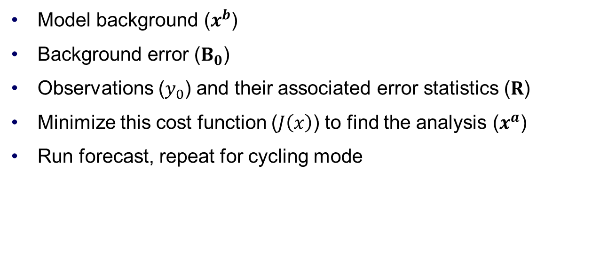
Appendix – WRFDA and J
$$J\left(x\right)=\frac{1}{2}{\left(x−x^{b}\right)}^{T}{B_{0}}^{−1}\left(x−x^{b}\right)+\frac{1}{2}{\left(y_{0}−H(x)\right)}^{T}R^{−1}\left(y_{0}−H(x)\right)$$
Model background ($x^{b}$)
Background error ($B_{0}$)
Observations ($y_{0}$) and their associated error statistics ($R$)
Minimize this cost function ($J\left(x\right)$) to find the analysis ($x^{a}$)
Run forecast, repeat for cycling mode

Slide 85

Appendix – WRFDA and J
$$J\left(x\right)=\frac{1}{2}{\left(x−x^{b}\right)}^{T}{B_{0}}^{−1}\left(x−x^{b}\right)+\frac{1}{2}{\left(y_{0}−H(x)\right)}^{T}R^{−1}\left(y_{0}−H(x)\right)$$
Model background ($x^{b}$) is the “first guess” of the atmospheric state before data assimilation
The background can be provided by WPS and real.exe, or a full WRF forecast

Slide 86
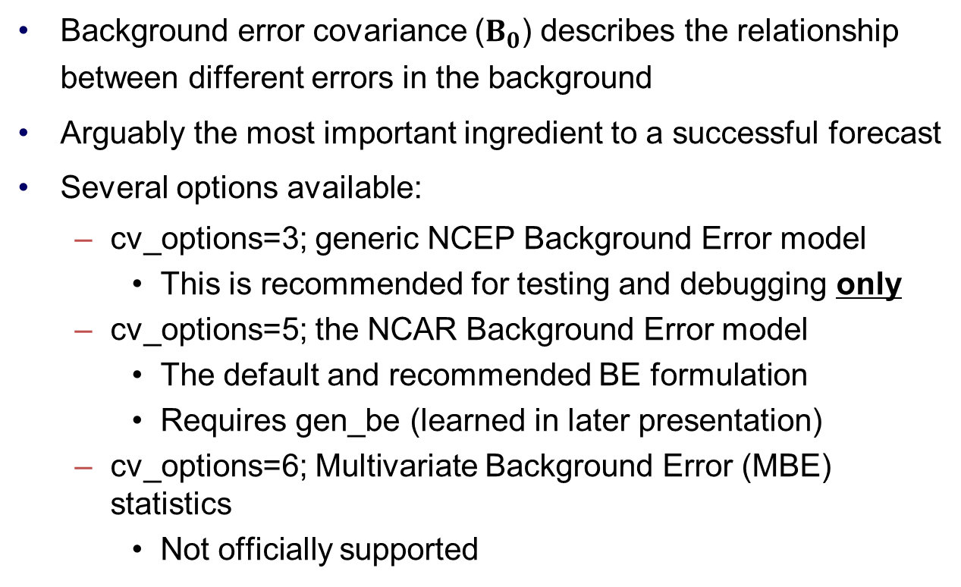
Appendix – WRFDA and J
$$J\left(x\right)=\frac{1}{2}{\left(x−x^{b}\right)}^{T}{B_{0}}^{−1}\left(x−x^{b}\right)+\frac{1}{2}{\left(y_{0}−H(x)\right)}^{T}R^{−1}\left(y_{0}−H(x)\right)$$
Background error covariance ($B_{0}$) describes the relationship between different errors in the background
Arguably the most important ingredient to a successful forecast
Several options available:
cv_options=3; generic NCEP Background Error model
This is recommended for testing and debugging only
cv_options=5; the NCAR Background Error model
The default and recommended BE formulation
Requires gen_be (learned in later presentation)
cv_options=6; Multivariate Background Error (MBE) statistics
Not officially supported

Slide 87
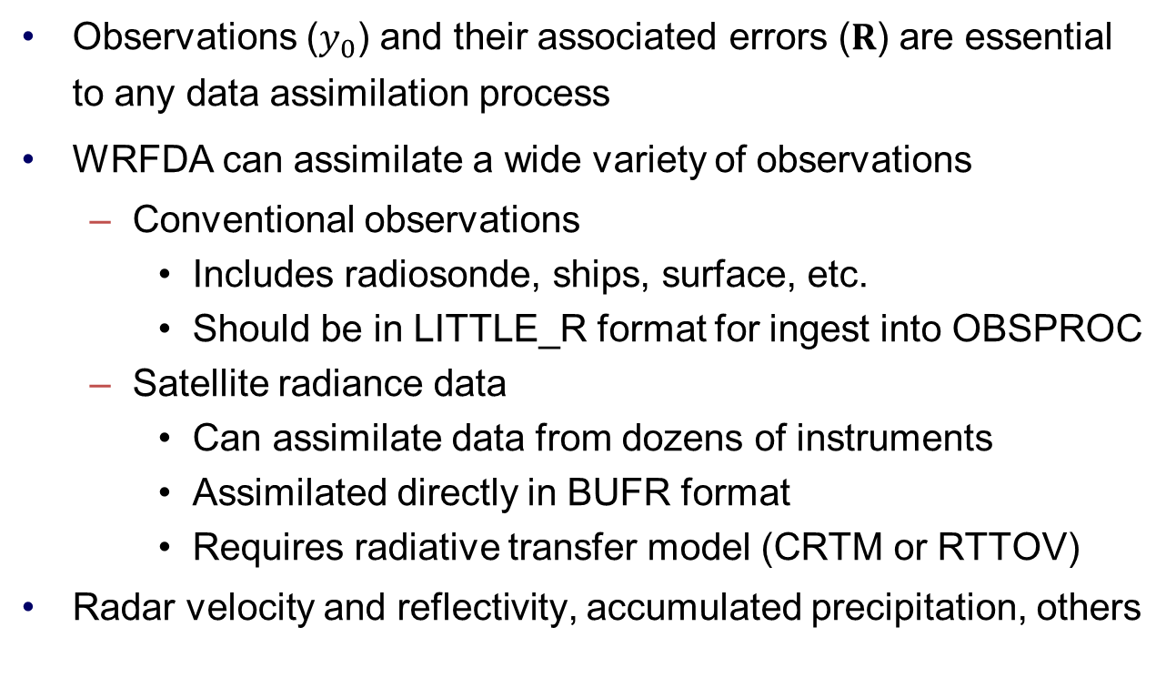
Appendix – WRFDA and J
$$J\left(x\right)=\frac{1}{2}{\left(x−x^{b}\right)}^{T}{B_{0}}^{−1}\left(x−x^{b}\right)+\frac{1}{2}{\left(y_{0}−H(x)\right)}^{T}R^{−1}\left(y_{0}−H(x)\right)$$
Observations ($y_{0}$) and their associated errors ($R$) are essential to any data assimilation process
WRFDA can assimilate a wide variety of observations
Conventional observations
Includes radiosonde, ships, surface, etc.
Should be in LITTLE_R format for ingest into OBSPROC
Satellite radiance data
Can assimilate data from dozens of instruments
Assimilated directly in BUFR format
Requires radiative transfer model (CRTM or RTTOV)
Radar velocity and reflectivity, accumulated precipitation, others

