Slide 1
Optomechanical Lever
物理51 王霄 2015011572
指导教师：刘永椿
2019/4/26

Slide 2
Outline
Motivation of the project
Model and temporary result
Future works

Slide 3
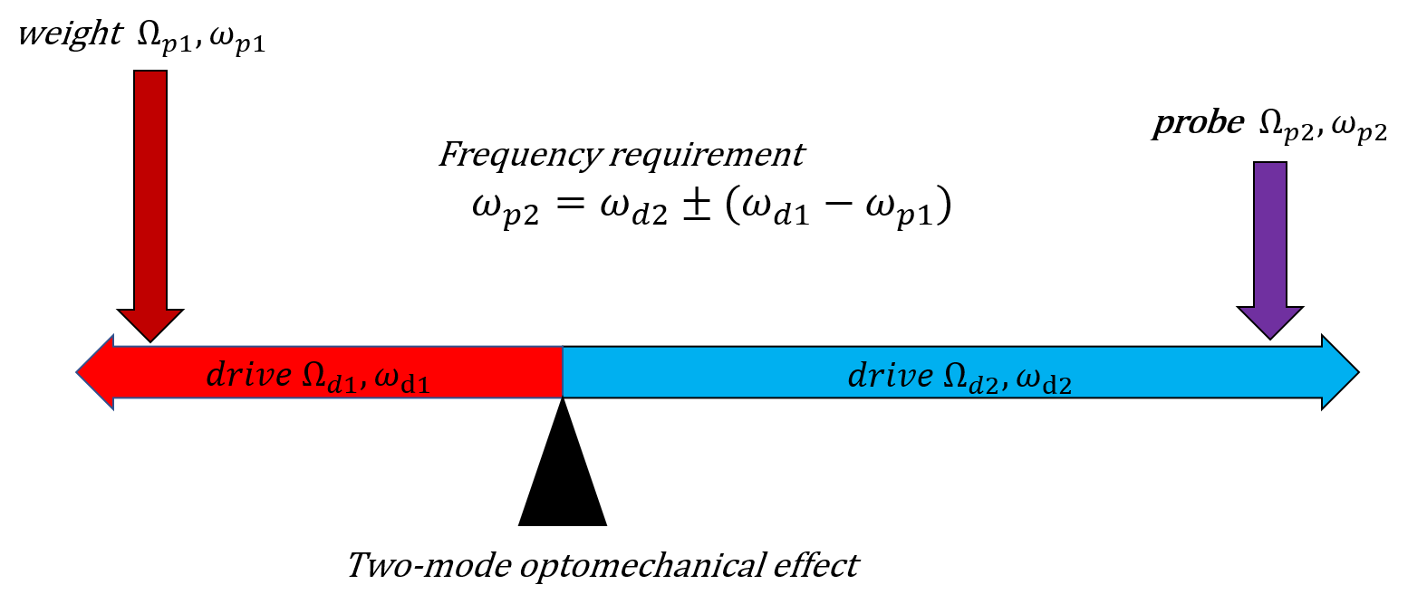
Motivation of the project
Precise measurement on extremely weak signals in various frequencies
A generalization from two-mode OM frequency transfer
Using two strong laser and a weak laser, to probe a weaker one

Slide 4
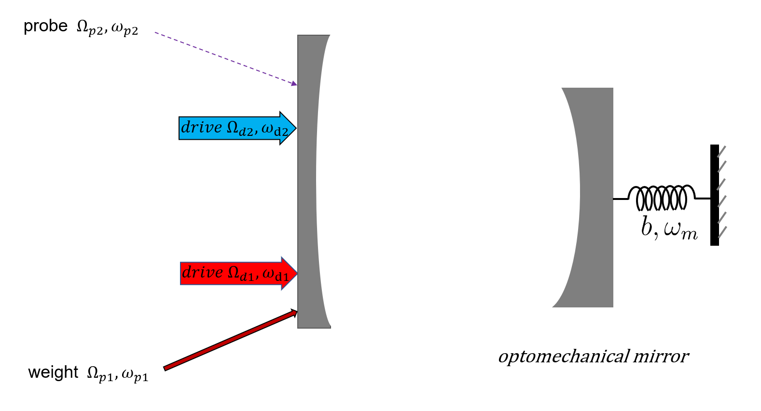
Model: Two driven mode OM system
(beat)

Slide 5
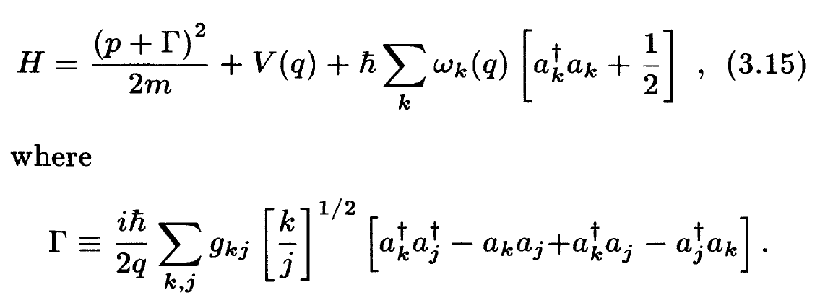



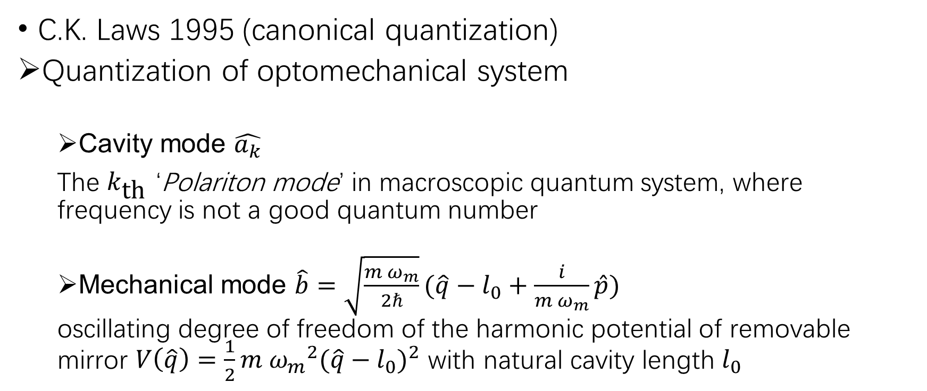
Model: quantization
C.K. Laws 1995 (canonical quantization)
Quantization of optomechanical system
Cavity mode $\hat{a_{k}}$
The $k_{\text{th}}$ ‘Polariton mode’ in macroscopic quantum system, where frequency is not a good quantum number
Mechanical mode $\hat{b}=\sqrt{\frac{m{ ω}_{m}}{2ℏ}}(\hat{q}−l_{0}+\frac{i}{m{ ω}_{m}}\hat{p})$
oscillating degree of freedom of the harmonic potential of removable mirror $V\left(\hat{q}\right)=\frac{1}{2}m {ω_{m}}^{2}{(\hat{q}−l_{0})}^{2}$ with natural cavity length $l_{0}$

Slide 6
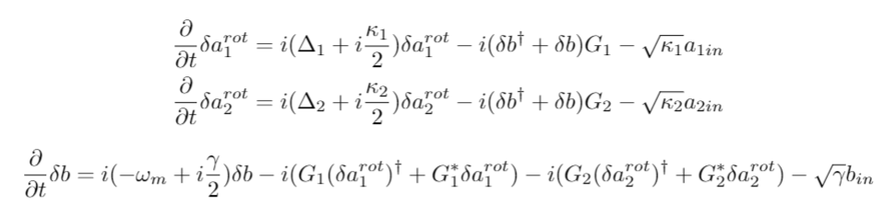

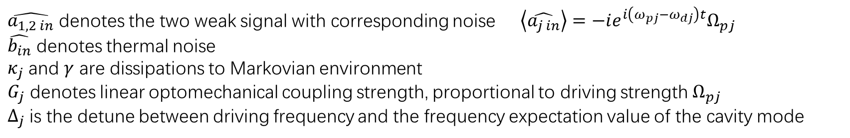
Model: EOM after simplification and basis-rotation
$\hat{a_{1,2 in}}$ denotes the two weak signal with corresponding noise $\left\langle \hat{a_{j in}}\right\rangle =−ie^{i\left(ω_{pj}−ω_{dj}\right)t}Ω_{pj}$
$\hat{b_{in}}$ denotes thermal noise
$κ_{j}$ and $γ$ are dissipations to Markovian environment
$G_{j}$ denotes linear optomechanical coupling strength, proportional to driving strength $Ω_{pj}$
$Δ_{j}$ is the detune between driving frequency and the frequency expectation value of the cavity mode

Slide 7
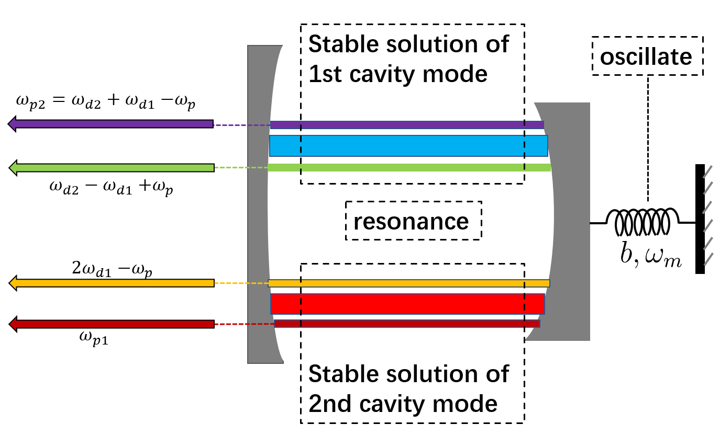
Result: OMIA effect with two new signal frequencies

Slide 8

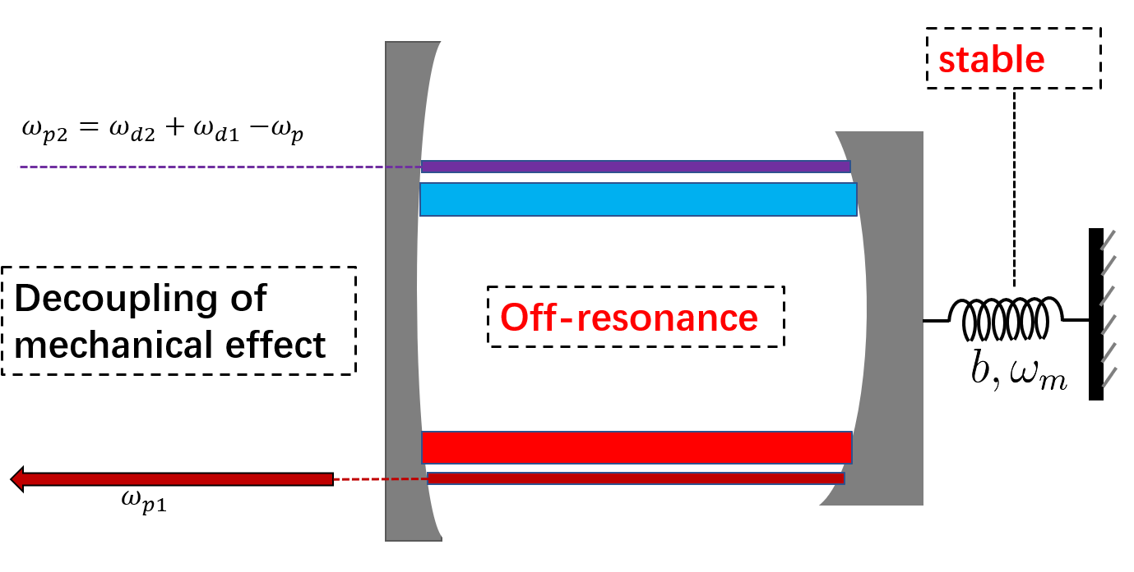
Result: OM Lever’s balance condition

Slide 9
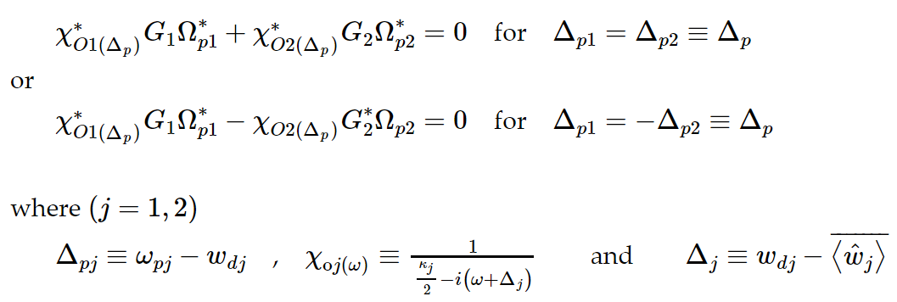
Result: OM Lever’s balance condition

Slide 10
Protocol in practice
Set up OML, let one driving laser much stronger than the other
Match the frequency requirement
Tune weight strength to achieve the Lever balance, when we could not see the other two signal frequencies
Use the balance requirement to calculate the probe strength and its phase

Slide 11
Future works
Expected to be similar with the result of OM frequency transfer
Scrutinize on quantum noise (Signal Noise Ratio)
Evaluation of equilibration (numerical methods, analyse the non-equilibrium response time of the protocol)
Stability analysis

Slide 12
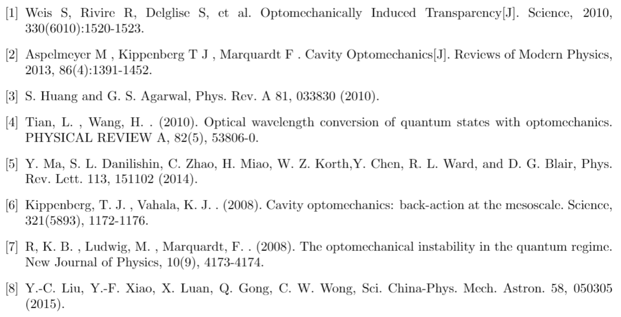
Reference

Slide 13
Thanks for your time

