Slide 1

科研小白如何从逆境中奋起
程勇
腾讯AI
答辩人：千图网
Notes:
www

Slide 2
如何选题
从上代模型的相关工作中借鉴。
用方法去找问题。
用问题去找方法。

Slide 3
从上代模型借鉴：SMT->NMT
Word Alignment Model
Language Model
MERT
Pivot-based Translation

Slide 4
从上代模型借鉴：SMT->NMT
Word Alignment Model
Language Model
MERT
Pivot-based Translation
Agreement-based Joint Training for Bidirectional Attention-based Neural Machine Translation

Slide 5
从上代模型借鉴：SMT->NMT
Word Alignment Model
Language Model
MERT
Pivot-based Translation
Agreement-based Joint Training for Bidirectional Attention-based Neural Machine Translation
Semi-Supervised Learning for Neural Machine Translation

Slide 6
从上代模型借鉴：SMT->NMT
Word Alignment Model
Language Model
MERT
Pivot-based Translation
Agreement-based Joint Training for Bidirectional Attention-based Neural Machine Translation
Semi-Supervised Learning for Neural Machine Translation
Minimum Risk Training for Neural Machine Translation

Slide 7
从上代模型借鉴：SMT->NMT
Word Alignment Model
Language Model
MERT
Pivot-based Translation
Agreement-based Joint Training for Bidirectional Attention-based Neural Machine Translation
Semi-Supervised Learning for Neural Machine Translation
Minimum Risk Training for Neural Machine Translation
Joint Training for Pivot-based Neural Machine Translation
Maximum Expected Likelihood Estimation for Zero-resource Neural Machine Translation
A Teacher-Student Framework for Zero-Resource Neural Machine Translation

Slide 8
用方法去找问题
Conditional Random Field Autoencoders for Unsupervised Structured Prediction
+IBM Model, HMM Model
Maximum Reconstruction Estimation for Generative Latent-Variable Models

Slide 9
用方法去找问题
Conditional Random Field Autoencoders for Unsupervised Structured Prediction
+IBM Model, HMM Model
Maximum Reconstruction Estimation for Generative Latent-Variable Models
Generative Adversarial Networks
+NMT
Adversarial Neural Machine Translation

Slide 10
用问题去找方法
Instablity of the Output of NMT
Input: 他们 不怕 困难 做出 围棋 AI。
Output: They are not afraid of difficulties to make Go AI.
Input: 他们 不畏 困难 做出 围棋 AI。
Output: They are not afraid to make Go AI.
+Noise Generation, GAN
Towards Robust Neural Machine Translation

Slide 11
如何做实验
确保模型或者算法的创新性。
模型框架、算法流程提前梳理出来。
确保代码的正确性、易读性、扩展性。
整理出超参数，画出表格记录实验。
小数据到大数据。（100W->1000W）
善于分析实验现象。
提出修改和改进的方案。
先攻主实验，再做辅助实验。
不怕苦，不怕累，持之以恒，但是也要适当放弃。

Slide 12
如何写论文
Abstract与Introduction重要性。
介绍问题-前人工作-我们工作-做的不错
突出论文创新点。
实验要与创新点呼应，同时与前人工作对比。
引用重要论文。
图表、样例与文字相辅助。
Coarse-to-Fine，循序渐进，精益求精，推荐sharelatex。
听取不同背景读者的反馈。
推荐刘洋老师主页《Tips on Writing Machine Translation Papers 》

Slide 13
Instability of Neural Machine Translation
Input: 他们 不怕 困难 做出 围棋 AI。
Output: They are not afraid of difficulties to make Go AI.
Input: 他们 不畏 困难 做出 围棋 AI。
Output: They are not afraid to make Go AI.
Synonym

Slide 14
Instability of Neural Machine Translation
Input: 毕竟 是 学生，他 不得不 听 学校 的 安排。
Output: After all, he was a student, and he had to listen to the arrangements
of the school.
Input: 毕竟 是 学生，他 不的不 听 学校 的 安排。
Output: After all, is a student, he did not listen to the arrangements of the
school
Homonym

Slide 15
Previous Work
Goodfellow et al., (2015) and Szegedy et al., (2014) finds that small changes to the input can fool state-of-the-art neural network with high probability.
Stephan Zheng et al., (2016) proposes an approach to improving the robustness of deep neural networks in CV.

Slide 16
Previous Work
Goodfellow et al., (2015) and Szegedy et al., (2014) finds that small changes to the input can fool state-of-the-art neural network with high probability.
Stephan Zheng et al., (2016) proposes an approach to improving the robustness of deep neural networks in CV.
Belinkov and Bisk et al., (2108) point out that NMT models are very brittle and easily falter when presented with noisy input.

Slide 17



Neural Machine Translation
$$L(x,y;θ)=−log⁡P(y|x)$$
Decoder
+Attention
$$H_{x}$$
Encoder
$$x$$

Slide 18
Adversarial Stability Training (AST)
The basic idea is to improve the robustness of two important components in NMT: the encoder and decoder.
Propose two approaches to constructing noisy inputs with small perturbations to make NMT models resist them.
Introduce adversarial learning to make behaviors of the encoder consistent for an input and its perturbed input.

Slide 19







The Architecture of NMT with AST
$$L_{inv}(x,x^{′};θ_{enc},θ_{dis})$$
$$L_{true}(x,y;θ_{enc},θ_{dec})$$
$$L_{noisy}(x^{′},y;θ_{enc},θ_{dec})$$
Discriminator
Decoder
$$H_{x}$$
$$H_{x^{′}}$$
Encoder
$$x$$
$$x^{′}$$
+perturbations

Slide 20









The Architecture of NMT with AST
$$L_{inv}(x,x^{′})$$
$$L_{true}(x,y)$$
$$L_{noisy}(x^{′},y)$$
Stability Loss
: Learn an invariant encoder to encourage the encoder to output similar intermediate representations for
: Guide the decoder to generate output given perturbed input .
Discriminator
Decoder
$$L_{inv}(x,x^{′})$$
$$H_{x}$$
$$H_{x^{′}}$$
$$L_{noisy}(x^{′},y)$$
Encoder
$$x$$
$$x^{′}$$
+perturbations

Slide 21




The Architecture of NMT with AST
$$L_{inv}(x,x^{′})$$
$$L_{true}(x,y)$$
$$L_{noisy}(x^{′},y)$$
Stability Loss
: learn an invariant encoder to encourage the encoder to output similar intermediate representations for $x$ and $x^{′}$
: guide the decoder to generate output given perturbed input .
Discriminator
Decoder
$$L_{inv}(x,x^{′})$$
$$H_{x}$$
$$H_{x^{′}}$$
$$L_{noisy}(x^{′},y)$$
Encoder
: guarantee good translation performance.
$$L_{true}(x,y)$$
$$x$$
$$x^{′}$$
+perturbations

Slide 22
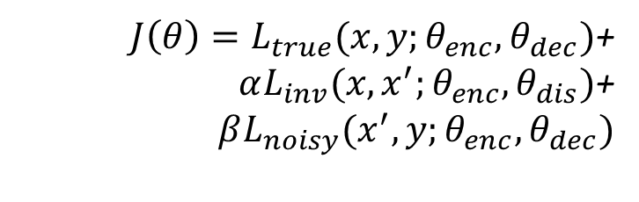
Training
Training objective:
${J\left(θ\right)=L}_{true}(x,y;θ_{enc},θ_{dec})$+
$αL_{inv}(x,x^{′};θ_{enc},θ_{dis})$+
$$βL_{noisy}(x^{′},y;θ_{enc},θ_{dec})$$

Slide 23
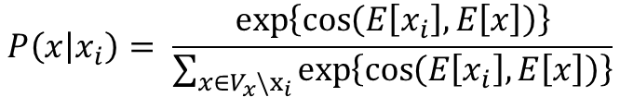
Constructing Perturbed Inputs (lexical level)
Given an input sentence x, we randomly sample some word positions to be modified by replacing them with other words according to the distribution:
$$P\left(x | x_{i}\right)= \frac{\exp\left\{\cos\left(E\left[x_{i}\right],E\left[x\right]\right)\right\}}{\sum_{x∈V_{x}\backslash x_{i}}{\exp\left\{\cos\left(E\left[x_{i}\right], E\left[x\right]\right)\right\}}}$$

Slide 24

Constructing Perturbed Inputs (feature level)
Given an input sentence x, we add the Gaussian noise vectors to all the word embeddings:
$$E\left[x_{i}^{′}\right]=E\left[x_{i}\right]+ε, ε\sim N(0, σ^{2}I)$$

Slide 25
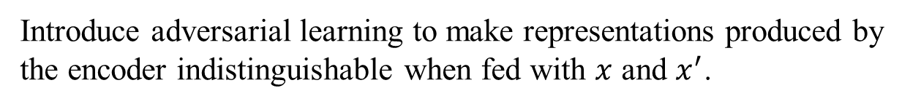
Perturbation-invariant Encoder
Introduce adversarial learning to make representations produced by the encoder indistinguishable when fed with $x$ and $x^{′}$.
$L_{inv}\left(x, x^{′}\right)=E_{x\sim S}\left[−logD\left(G\left(x\right)\right)\right]+E_{x^{′}\sim N(x)}[−\log\left(1−D\left(G\left(x^{′}\right)\right)\right)]$
G: Encoder as the generator
D: Discriminator
N(x): Set of perturbed input

Slide 26
Experiments（Setup）
Chinese-English: LDC corpus consisting of 1.25M sentence pairs with 27.9M Chinese words and 34.5M English words.
English-German: WMT 14 corpus containing 4.5M sentence pairs with 118M English words and 111M German words.
English-French: IWSLT corpus consisting of 0.22M sentence pairs with 4.03M English words and 4.12M French words.
2-layer RNN-based NMT systems.
CNN Discriminator (Kim 2014).

Slide 27
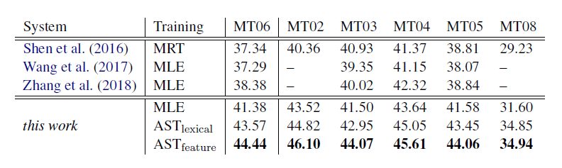
NIST Chinese-English Translation
Case-insensitive BLEU scores on NIST Chinese-English translation

Slide 28
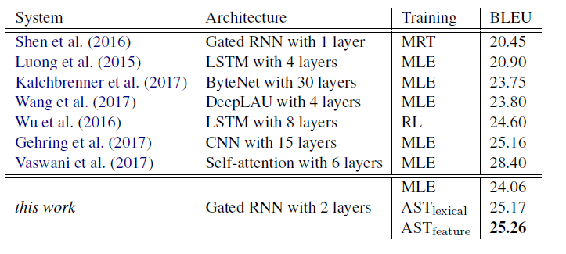
WMT English-German Translation
Case-sensitive BLEU scores on WMT14 English-German translation

Slide 29
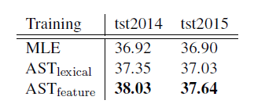
IWSLT English-French Translation
Case-sensitive BLEU scores on IWLST English-French translation

Slide 30
Verifying the Robustness
Swap: we randomly choose N positions from a sentence and then swap the chosen words with their right neighbours.
Replacement: we randomly replace sampled words in the sentence with other words.
Deletion: we randomly delete N words from each sentence in the dataset.

Slide 31
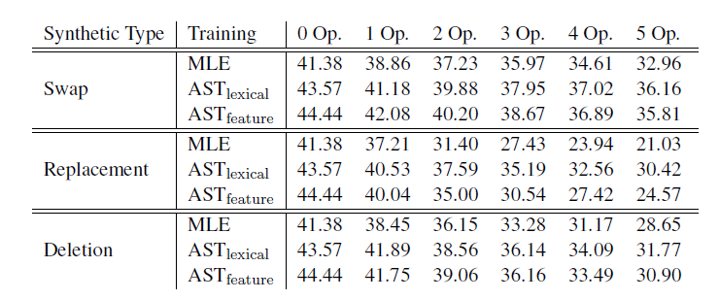
Results on Synthetic Perturbed Data
Translation results of synthetic perturbations on the validation set in Chinese-English translation.

Slide 32
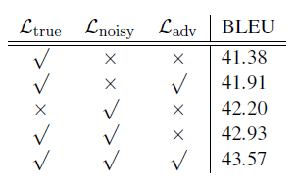
Ablation Study
IMPORTANT!
Ablation study of AST_{lexical} on Chinese-English translation。

Slide 33
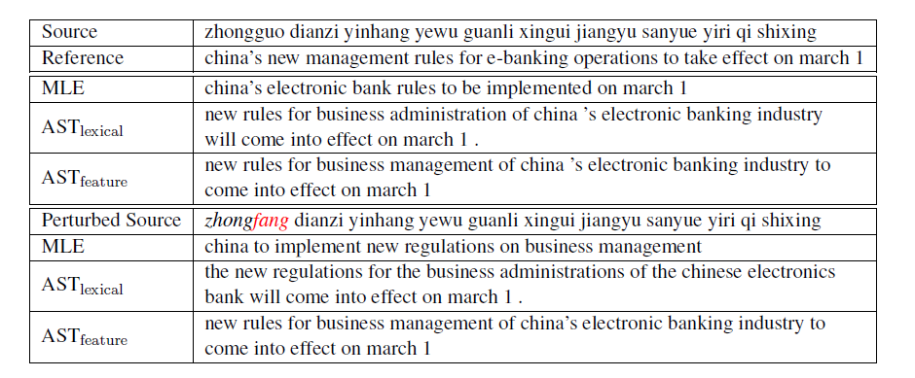
Example Translation
Example translation of a source sentence and its perturbed counterpart by
replacing a Chinese word “zhongguo” with its synonym “zhongfang.”

Slide 34
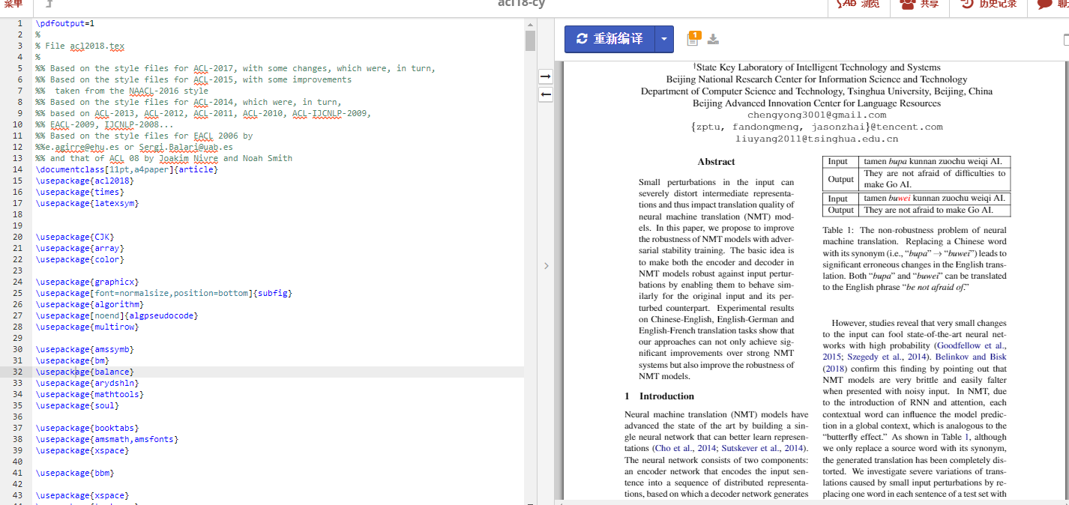
写论文
Take nearly one month.
Write nearly 30 versions.
3 people give insightful suggestions, including one non-professional product staff.
Work hard.

Slide 35
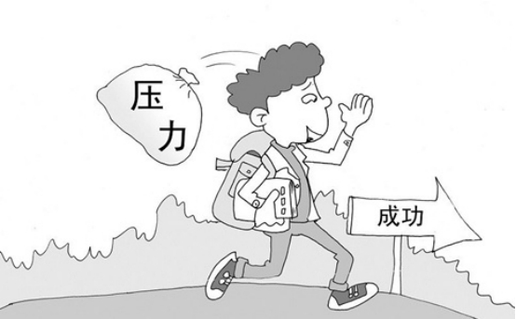
做科研的心态
调整好心态。
锻炼好身体。
适当性放松。
学会独立自主。
多与周围人交流。

Slide 36
谢谢！
答辩人：千图网
Notes:
www

