Slide 1
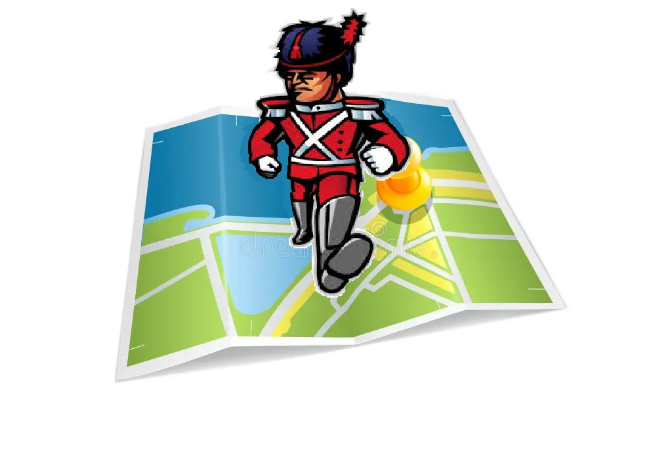

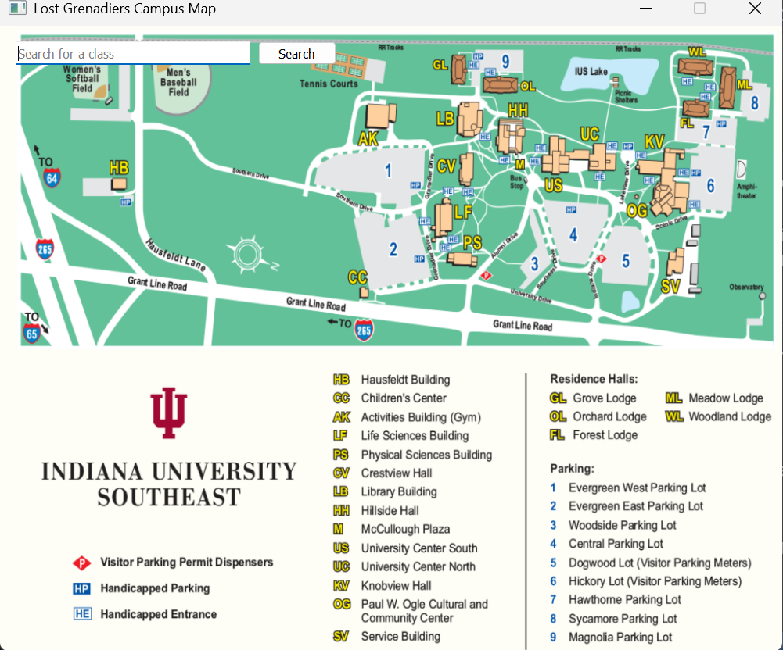
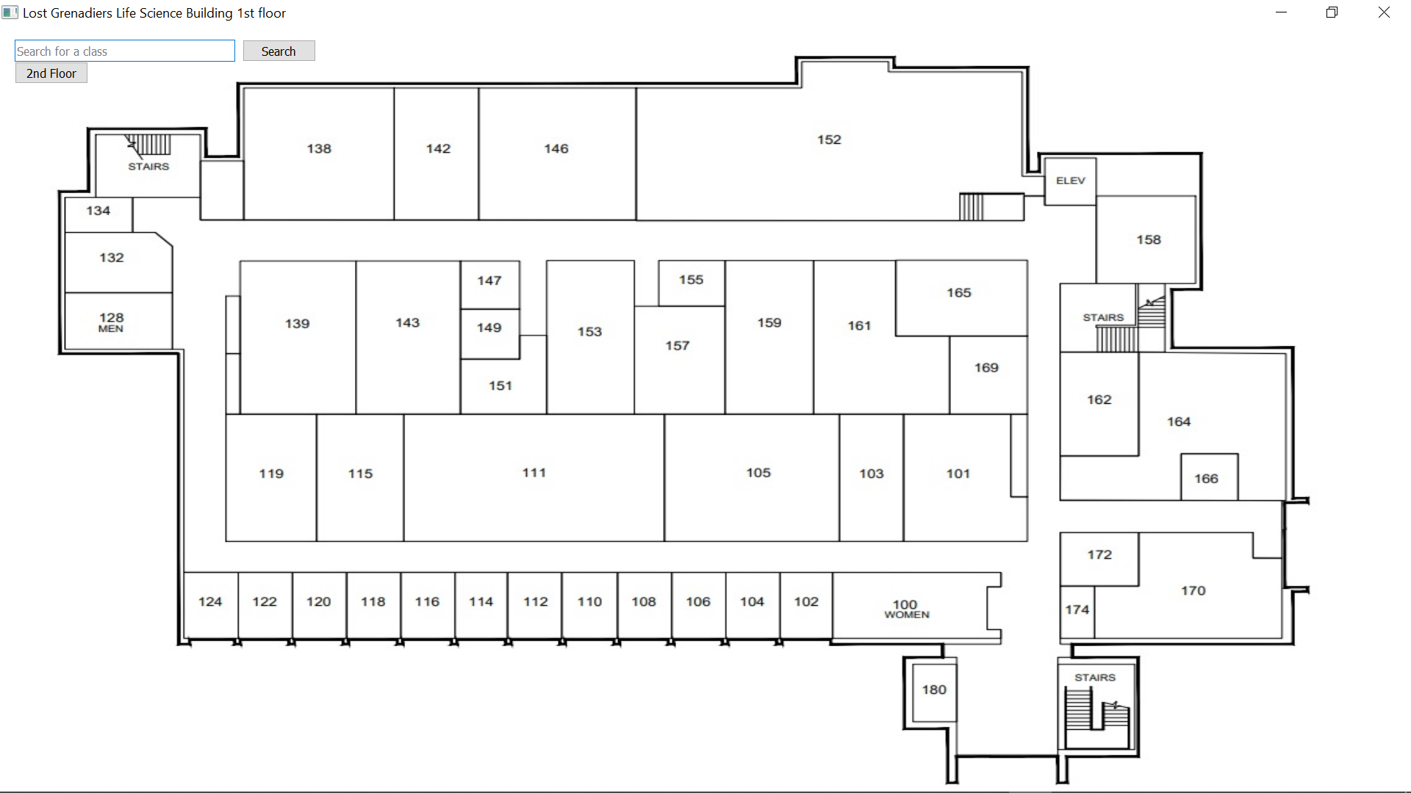
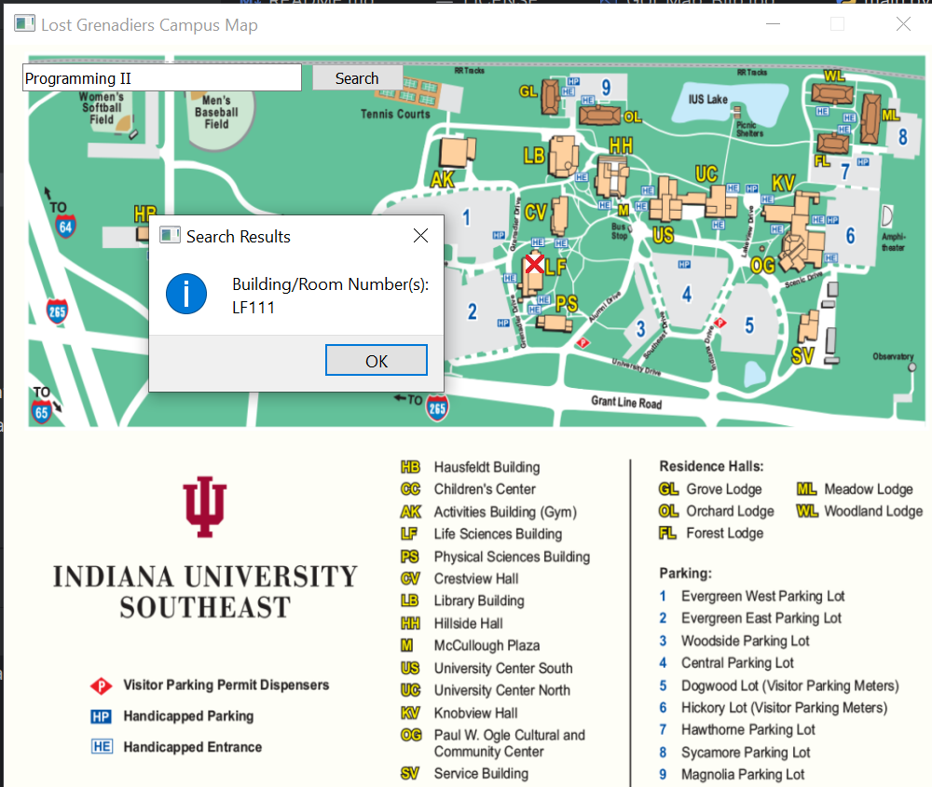





Lost Grenadiers Xiao Wang, Chris Holley, Matthew Higdon Special Thanks to Professor Chris Sexton
Overview
A robust map program that helps students find where their classes are, as well as offices and amenities around campus at Indiana University Southeast. It is an extension to a previous project called Snack Map that helps the user to find certain snacks/drinks at the various vending machines at IUS.
Methodology
The program is written entirely in Python language with PyCharm as the preferred IDE for the duration of the project. This application allows the user to find specific classroom, buildings, and classes through the search inquiry that retrieves the correct output from the users’ input if it’s valid. The database consists of a CSV file that derives from the upcoming school semester and the background maps were obtained through official channels of Indiana University although much redacted and edited. The objective for this project is to assists all members of the IUS community to be able to find what they need by using the Lost Grenadiers app.
Building Interior Map Search
Home Screen
Future Work
Given the architecture of Lost Grenadiers, we feel it has the scalability where other IU campuses can easily be included. Our current version uses a small database of classes, however our database structure allows for all classes offered on campus to be searchable. If integrated within One.IU, searching for classes can be much quicker as the program could pull from a student’s currently enrolled classes, and the locations of classes could be automatically updated. Finally, we propose UI appearance improvements could be made to further polish the user’s experience.
Search Result Highlighting Building
Tools
Repository:
https://github.com/XiaoBWang1/LostGrenadiers

