Slide 1
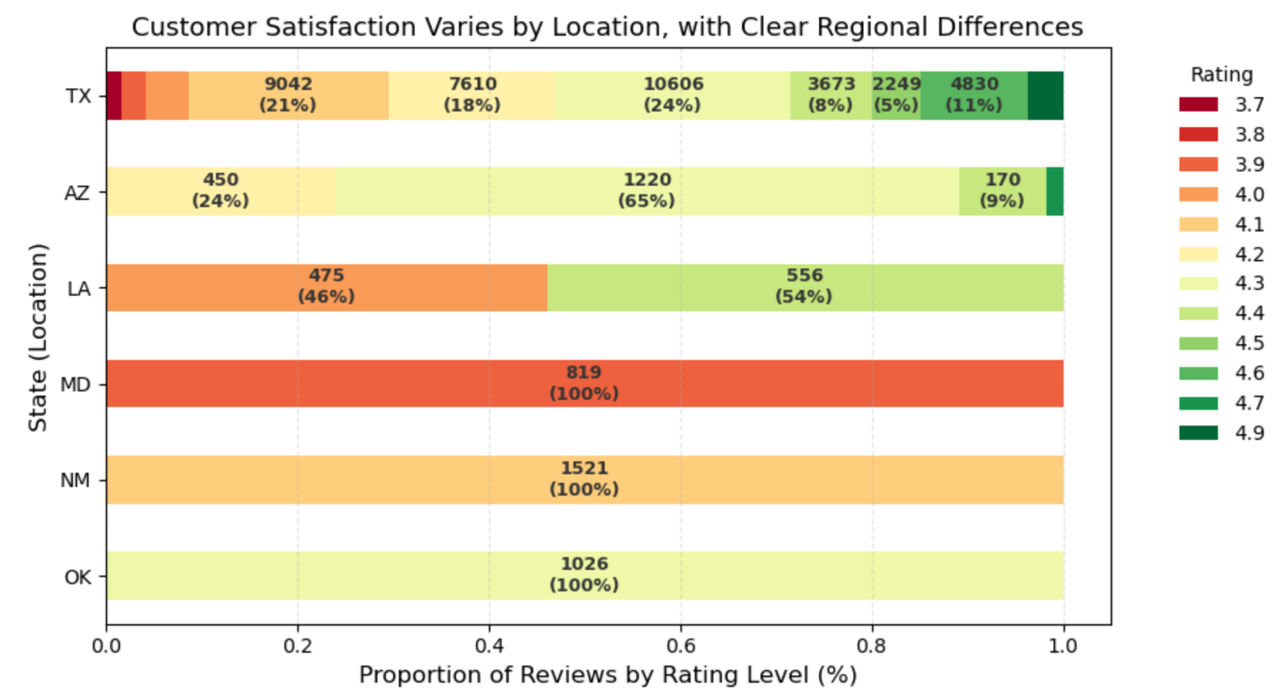
Location Grouped by Rating (Texas)
Rating | Locations
3.7 | Montfort; San Jacinto; Park District - Petite Market & Bakery
4.0 | Preston Forest; Coit & Campbell
4.1 | MacArthur; Midway; Lakeline; DFW; South Arlington
4.2 | Spring; Collin Creek; Mockingbird; West Grand; Huebner Oaks; Arboretum
4.3 | First Colony; Northwoods; Town & Country; Champions; Carillon; The Forum; Park North; Crossroads; Clearlake
4.4 | Parkway Village; Kingsgate; La Villita; Tierra Del Este
4.5 | Tanglewood
4.6 | Fountains at Farrah
4.7 | Gates of Prosper
The left chart provides a state-level overview of rating distributions, showing that customer satisfaction is generally consistent across regions. The right table zooms in on Texas at the location level, revealing that individual stores drive the variation within the state.
Latitude:
XPath: //p[contains(@class,‘location__directions’)]/a/@href Regex: destination=([-0-9.]+),
Alternative: XPath: //div[text()='San Jacinto']/ancestor::div[contains(@class,'location__content')]//a[contains(@href,'destination')]/@href
Regex: destination=([-0-9.]+),
Longitude: XPath: //p[contains(@class,'location__directions')]/a/@href Regex: ,([-0-9.]+)
Alternative:
XPath: //div[text()=‘San Jacinto']/ancestor::div[contains(@class,'location__content')]//a[contains(@href,'destination')]/@href
Regex: destination=[-0-9.]+,([-0-9.]+)
locationName: //div[@class='location__name']
Hours: //p[@class='location__hours']
phoneNumber: //div[@class='location__phone']/a
Distance: //div[@class='location__distance']

