Slide 1
Data Visualization
Lecture 1: Introduction to Data Science Xiao Guo

Slide 2
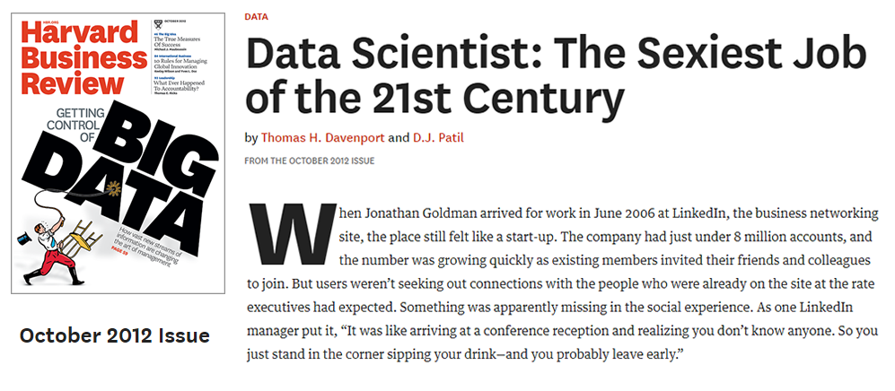
Data Scientist The Sexy Job

Slide 3
See also an old article by NYT (2009): For Today’s Graduate, Just One Word: Statistics
And another famous McKinseay 2011 Report: Big data: The next frontier for innovation, competition, and productivity

Slide 4
What is a data scientist?
Nate Silver (FiveThirtyEight, author of The Signal and the Noise): “Data scientist is just a sexed up word for a statistician.”

Slide 5
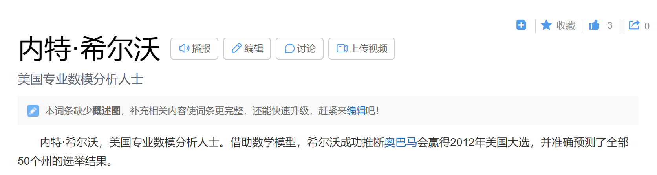

Slide 6
Slide with R Output
summary(cars)
## speed dist ## Min. : 4.0 Min. : 2.00 ## 1st Qu.:12.0 1st Qu.: 26.00 ## Median :15.0 Median : 36.00 ## Mean :15.4 Mean : 42.98 ## 3rd Qu.:19.0 3rd Qu.: 56.00 ## Max. :25.0 Max. :120.00

Slide 7
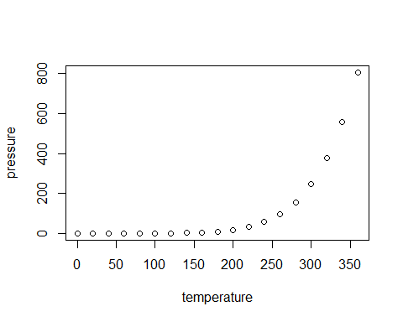
Slide with Plot

