Slide 1

Traffic Accident Prediction
Jenny Xu
Daniel Truong
Ti-Tai Wang
MoonSung Kim

Slide 2
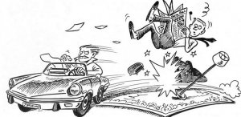
62% increase in deaths from Hit & Runs in the U.S.
The goal
Predict age and gender factors in an accident
In the case of hit n run

Slide 3
Data Source
Datasets
Detailed information about traffic accidents across the UK in 2016
Collected and published by the UK government
Including geographical locations, weather conditions, type of vehicles, number of casualties, etc.
Acc.csv
Cas.csv
Veh.csv
Accident_Casualty_2016.csv

Slide 4
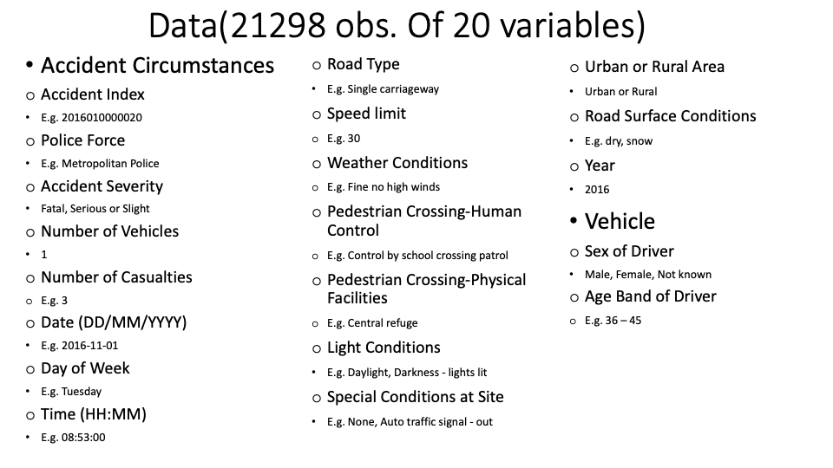

Slide 5
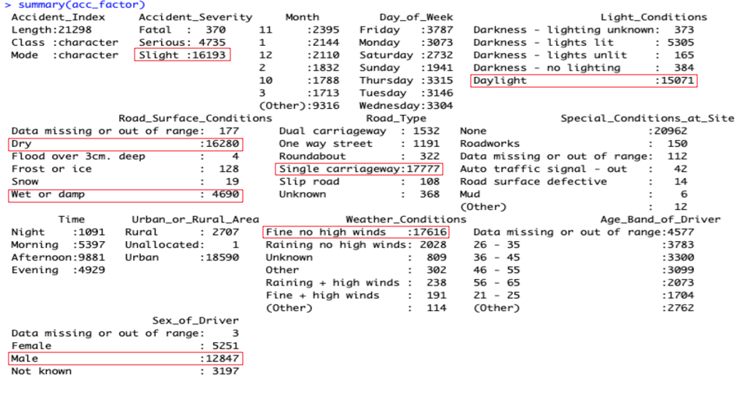
Examine the data

Slide 6
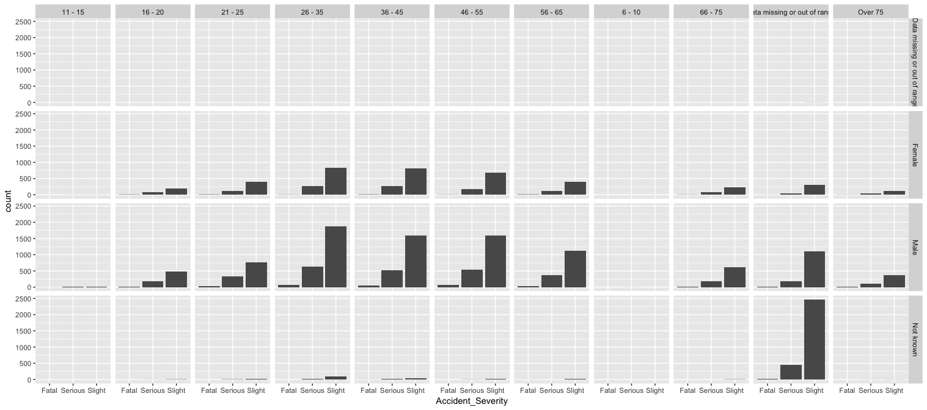
Normal distribution?

Slide 7
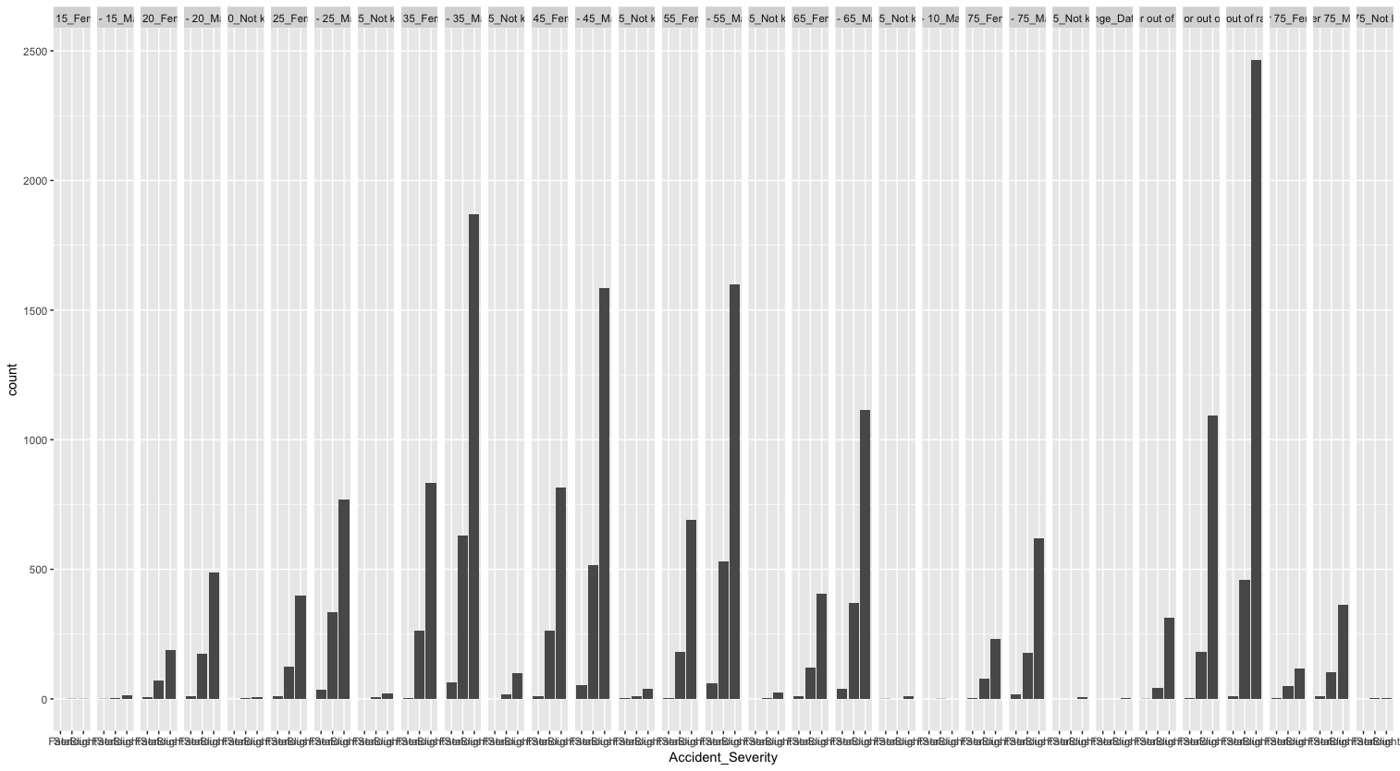
Normal distribution?

Slide 8
Data Preprocessing

Slide 9
Data Preprocessing
Need to deal with:
Missing values
Outliers
Data numerosity
Used Google OpenRefine and R to accomplish

Slide 10
Data Preprocessing - Missing Values
5715 records that had a missing value for any attribute
Attribute with most missing: Age_Band_of_Driver
4577 records with missing age band attribute
Because of large size of dataset we simply removed any record with a missing attribute

Slide 11
Data Preprocessing - Outliers
Several high casualty accidents with few occurrences
Accident with 11 casualties occurred only once
Too young drivers
Removed these as they didn’t seem to fit the types of accidents we were trying to predict

Slide 12
Data Preprocessing - Numerosity
After removing outliers and missing data still too much data
15582 records remaining
Running a single model with this much data was taking >30mins every time
We decided to focus on accidents occurring in rural areas
Reduced dataset to ~1.6k records
Not enough domain knowledge to use sampling techniques

Slide 13
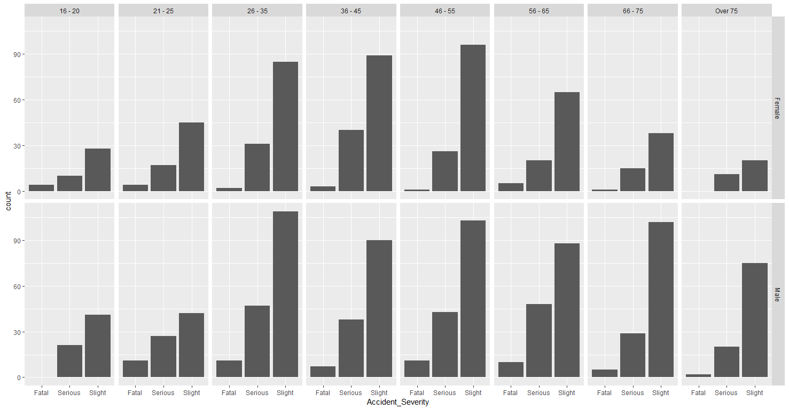

Slide 14
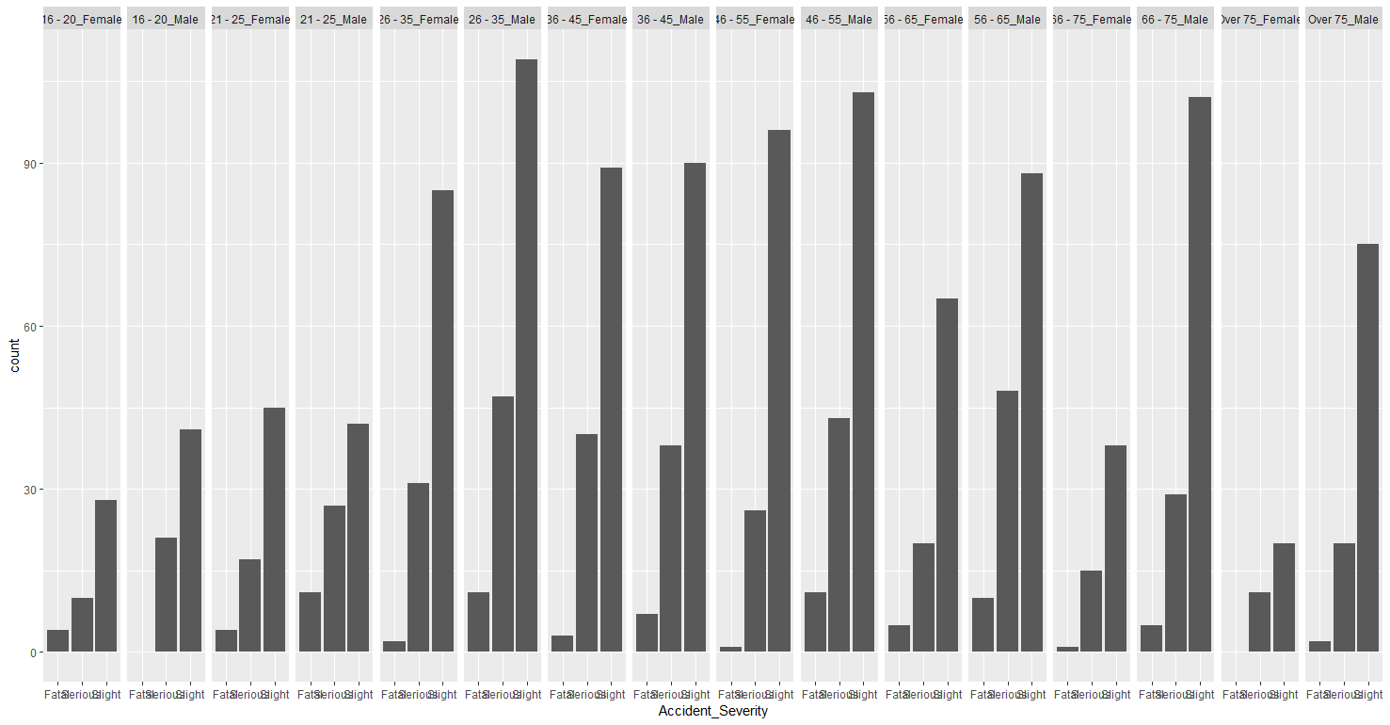

Slide 15
Classification

Slide 16
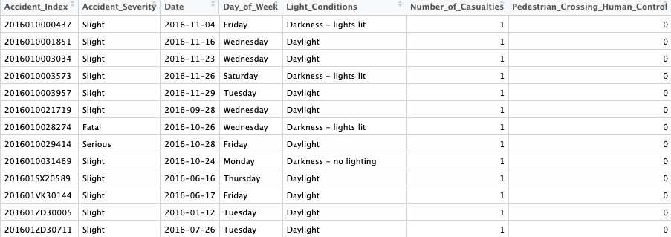
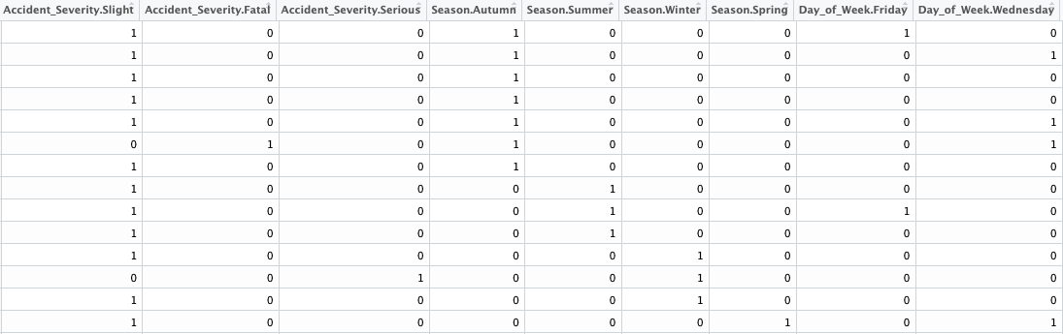
One hot-encoding
“Fatal” = (1, 0, 0)
“Serious” = (0, 1, 0)
“Slight” = (0, 0, 1)

Slide 17
Split Data into Training and Testing
409
409
Train two models for predicting the driver’s age and gender by using SVM and ANN.
409
409

Slide 18
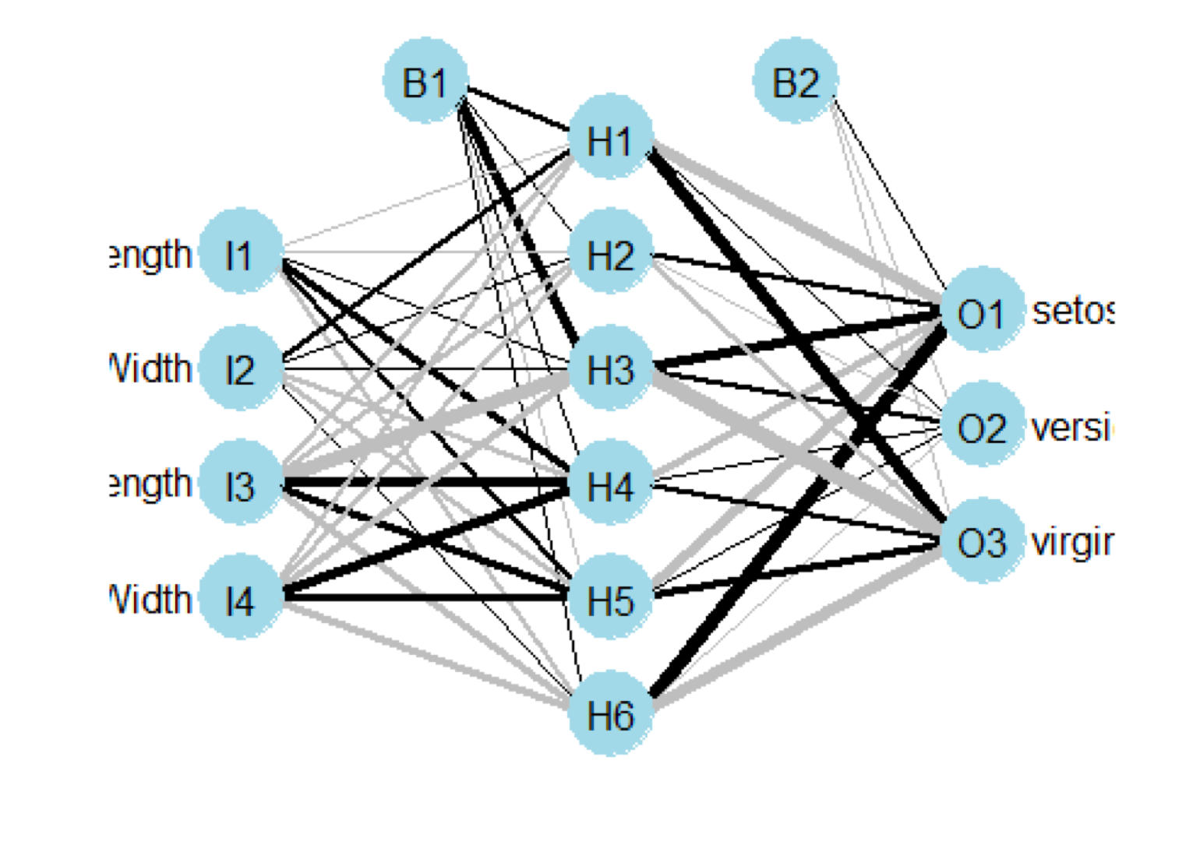
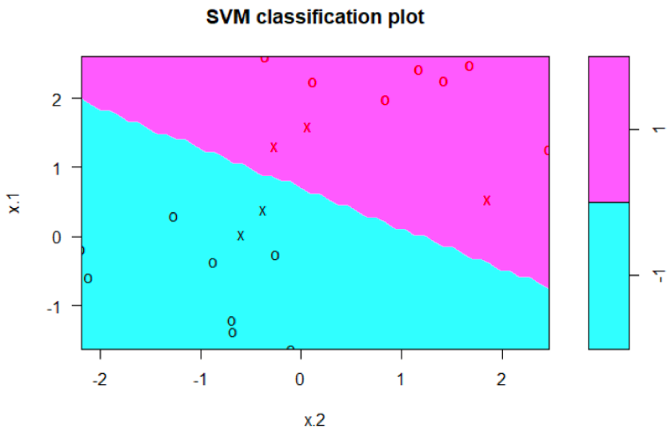
Training Steps
5 Fold CV
Obtain Parameters from the Best Model

Slide 19
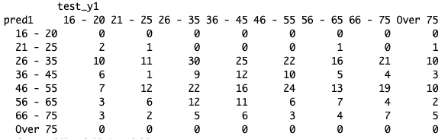
Results and Discussion
Error Rate | SVM (Linear) | SVM (Radial) | ANN
Age Band | 80.2% | 82.9% | 83.3%
Gender | 42.8% | 38.6% | 42.8%

Slide 20



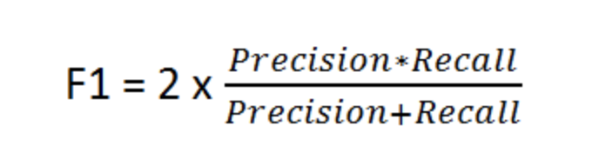
Results and Discussion
SVM(linear)
SVM(radial)
ANN

Slide 21
Clustering

Slide 22
Clustering
Feature selection
MCA (Multiple Correspondence Analysis)
Distance-based clustering
PAM (Partitioning Around Medoids)
Density-based clustering
OPTICS (Ordering Points To Identify the Clustering Structure)

Slide 23
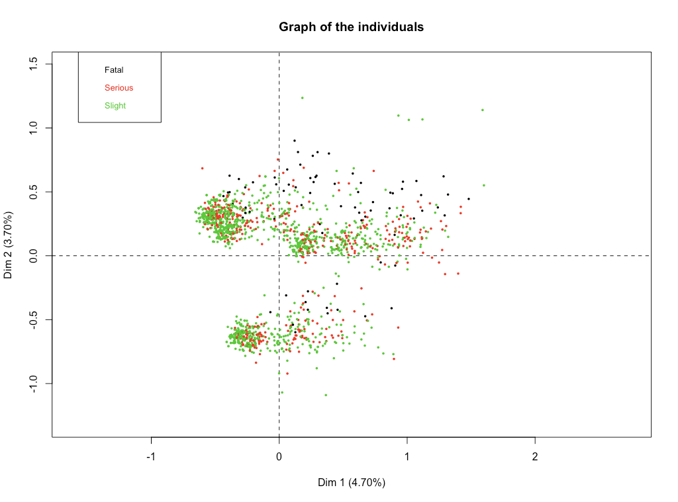
Clustering - Feature Selection (MCA)
Accident_Severity

Slide 24
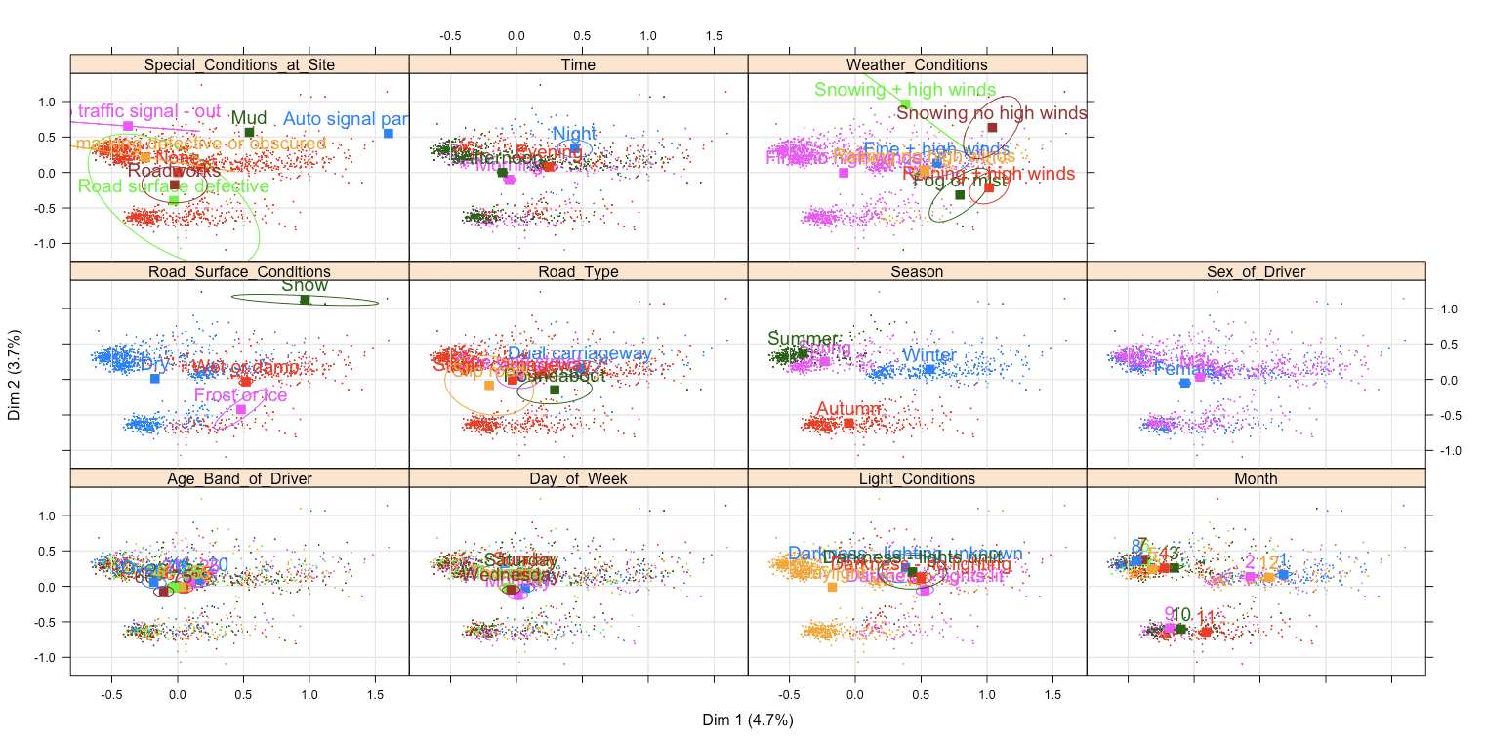
Clustering - Feature Selection (MCA)

Slide 25
Clustering - Feature Selection (MCA)

Slide 26
Clustering - Feature Selection
Meaningful features
Time, Wether_Conditions, Road_Type, Road_Conditions, Season, Sex_of_Driver
What we want to know
Accident_Severiety
Age_Band_of_Driver
But, we have only one year data
Season? Month?

Slide 27
Clustering - Feature Selection
We got 7 Features:
Transform types
Ordinal: Time, Accident_Severiety, Age_Band_of_Driver
Nominal: Wether_Conditions, Wether_Conditions, Road_Type, Road_Conditions, Sex_of_Driver
Time | Morning, Afternoon, Evening, Night | Sex_of_Driver | Female, Male
Wether_Conditions | Fine, Raining, Snowing, Fog | Accident_Severiety | Slight, Severe, Fatal
Road_Type | Single carriage, Dual carriage, Roundabout, One way street, Slip road | Age_Band_of_Driver | 16-20, 21-25, 26-35, 36-45, 46-55, 56-65, 66-75, >75
Road_Conditions | Wet, Dry, Snow, Ice

Slide 28
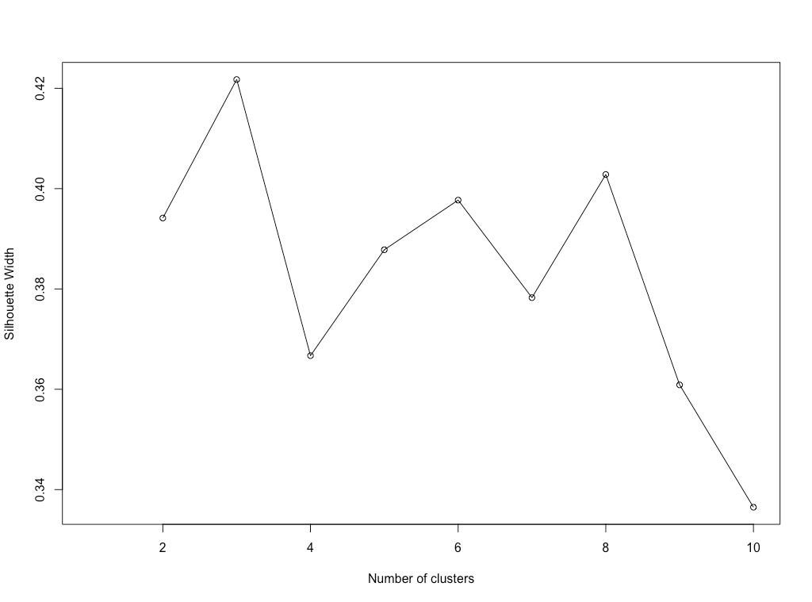
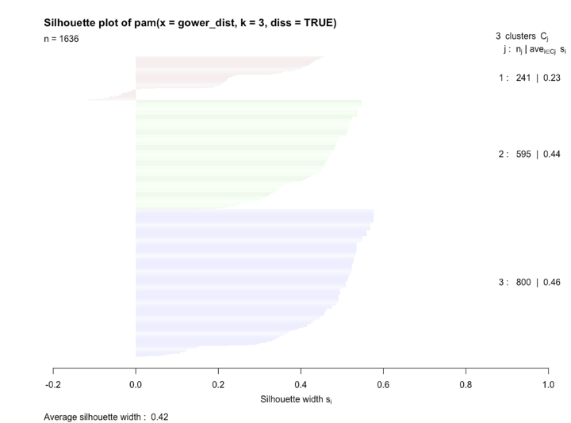
Clustering - PAM
Distance Method: gower
Number of Categories: 3
Silhouette Coefficient

Slide 29
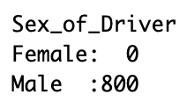

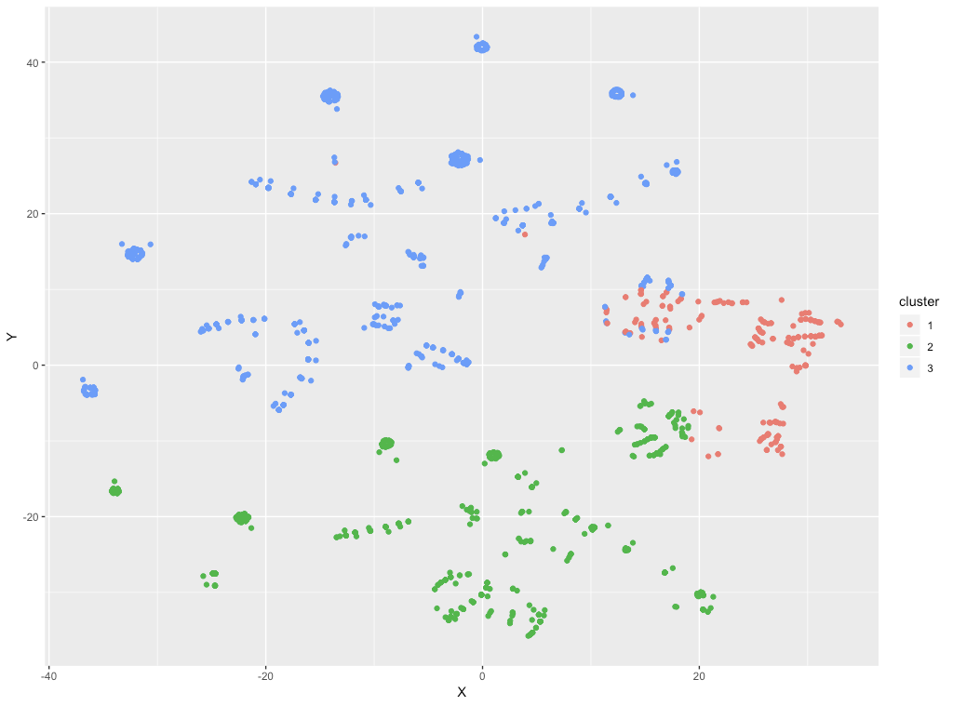
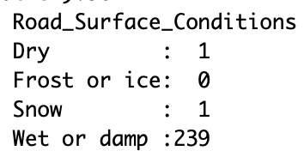
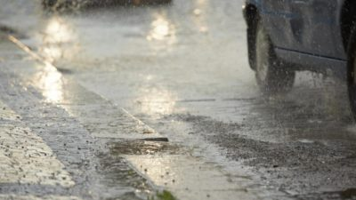
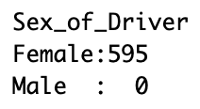
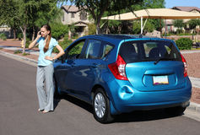
Clustering - PAM
Cluster 3
Cluster 1
Cluster 2

Slide 30
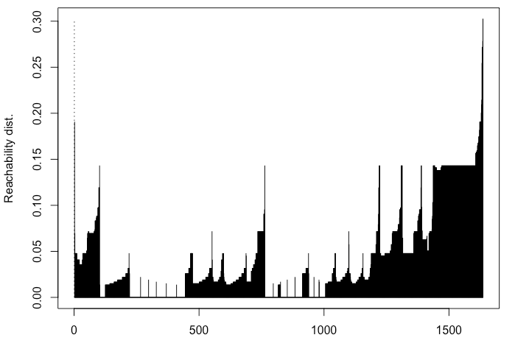
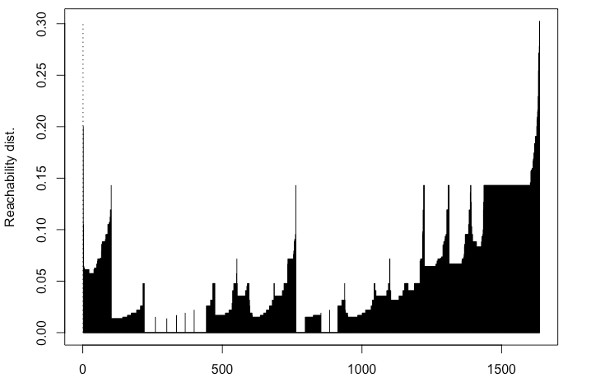
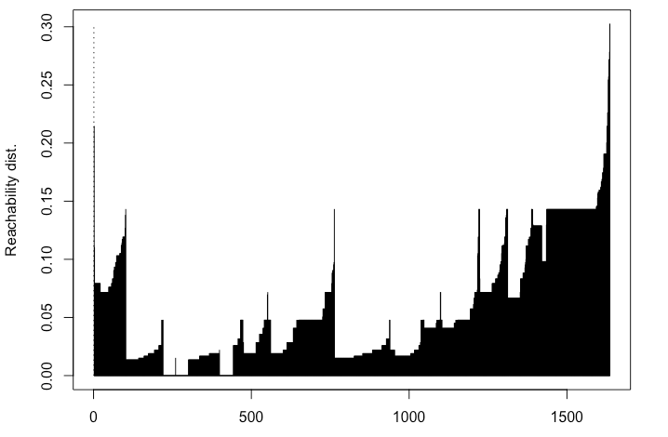
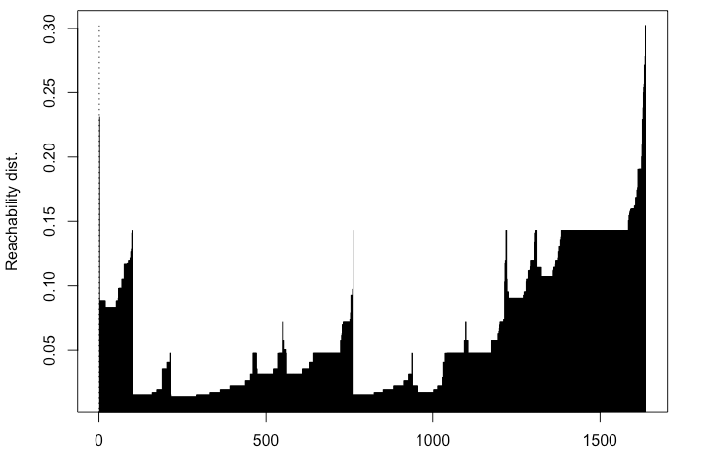
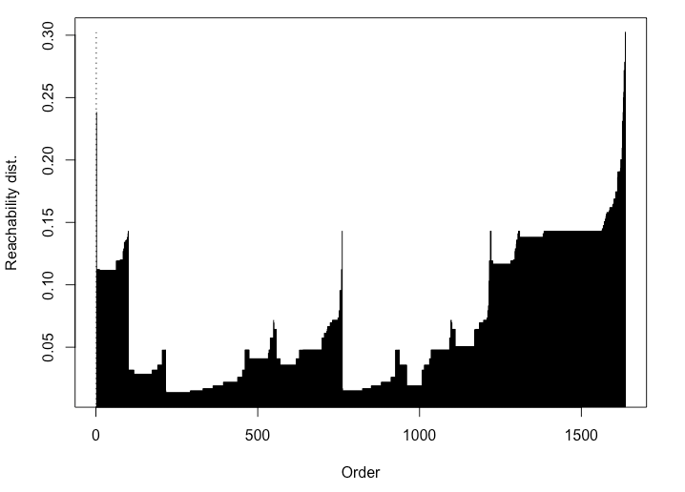
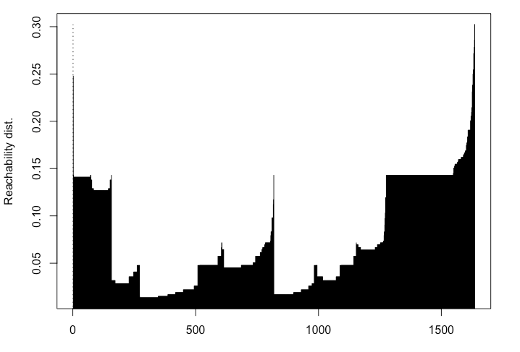
Clustering - OPTICS
minPts = 20
minPts = 30
minPts = 40
minPts = 50
minPts = 60
minPts = 70

Slide 31
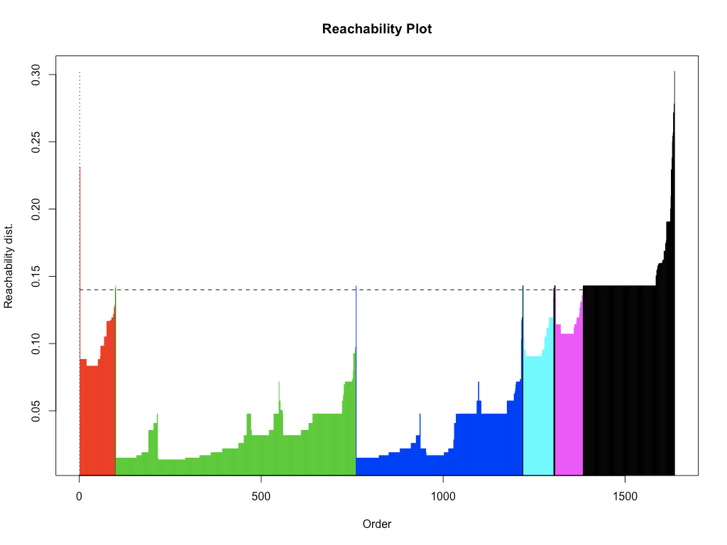
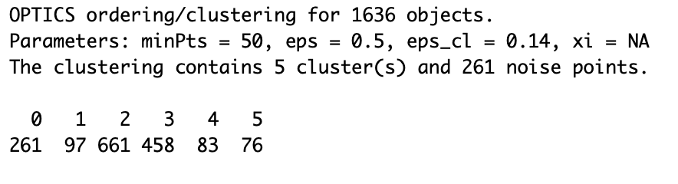
Clustering - OPTICS
minPts = 50
Threshold = 0.14
261
noise points

Slide 32
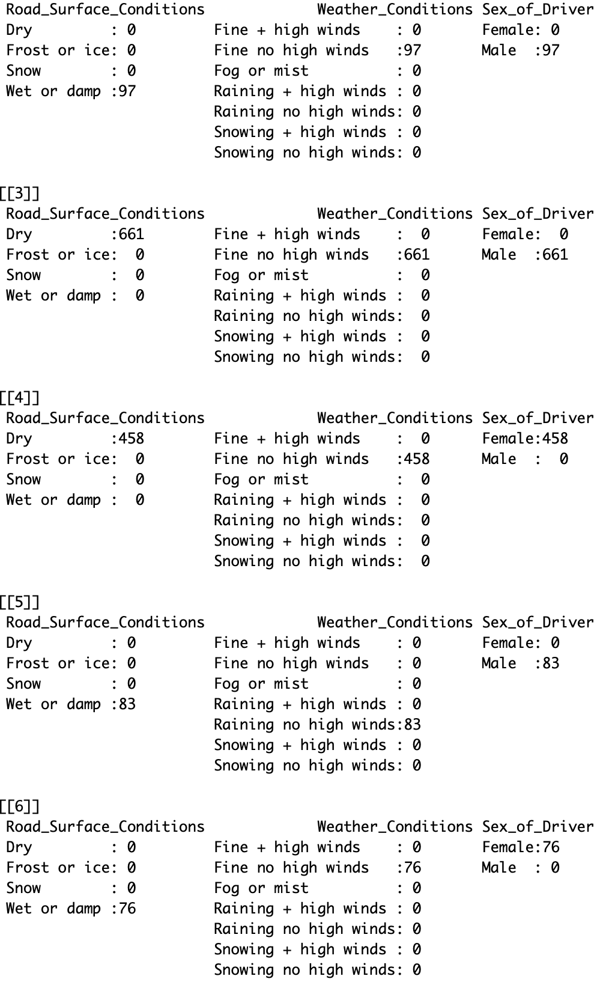
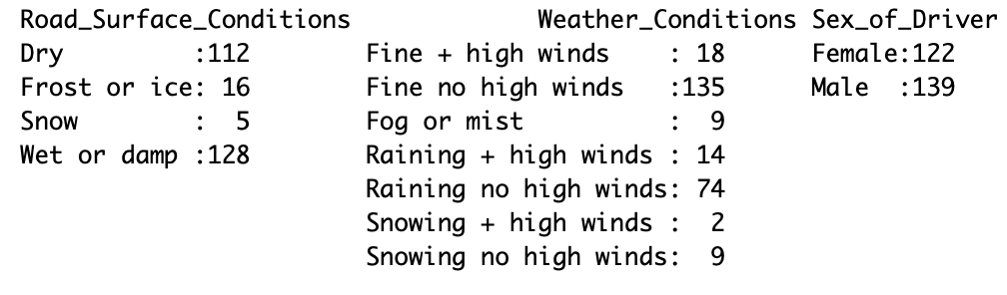
Clustering - OPTICS
C1
C4
C2
C5
C3
Noise
points

Slide 33






Clustering - OPTICS
C4
C5
Male
Female
C3
Rainy
Female
Sunny
Dry
Road
Wet
Road
Sunny
Wet
Road
C2
Male
Sunny
Dry
Road
C1
Male
noise points
Sunny
Wet
Road
97
661
458
83
76
261

Slide 34
Thank you!

