Slide 1
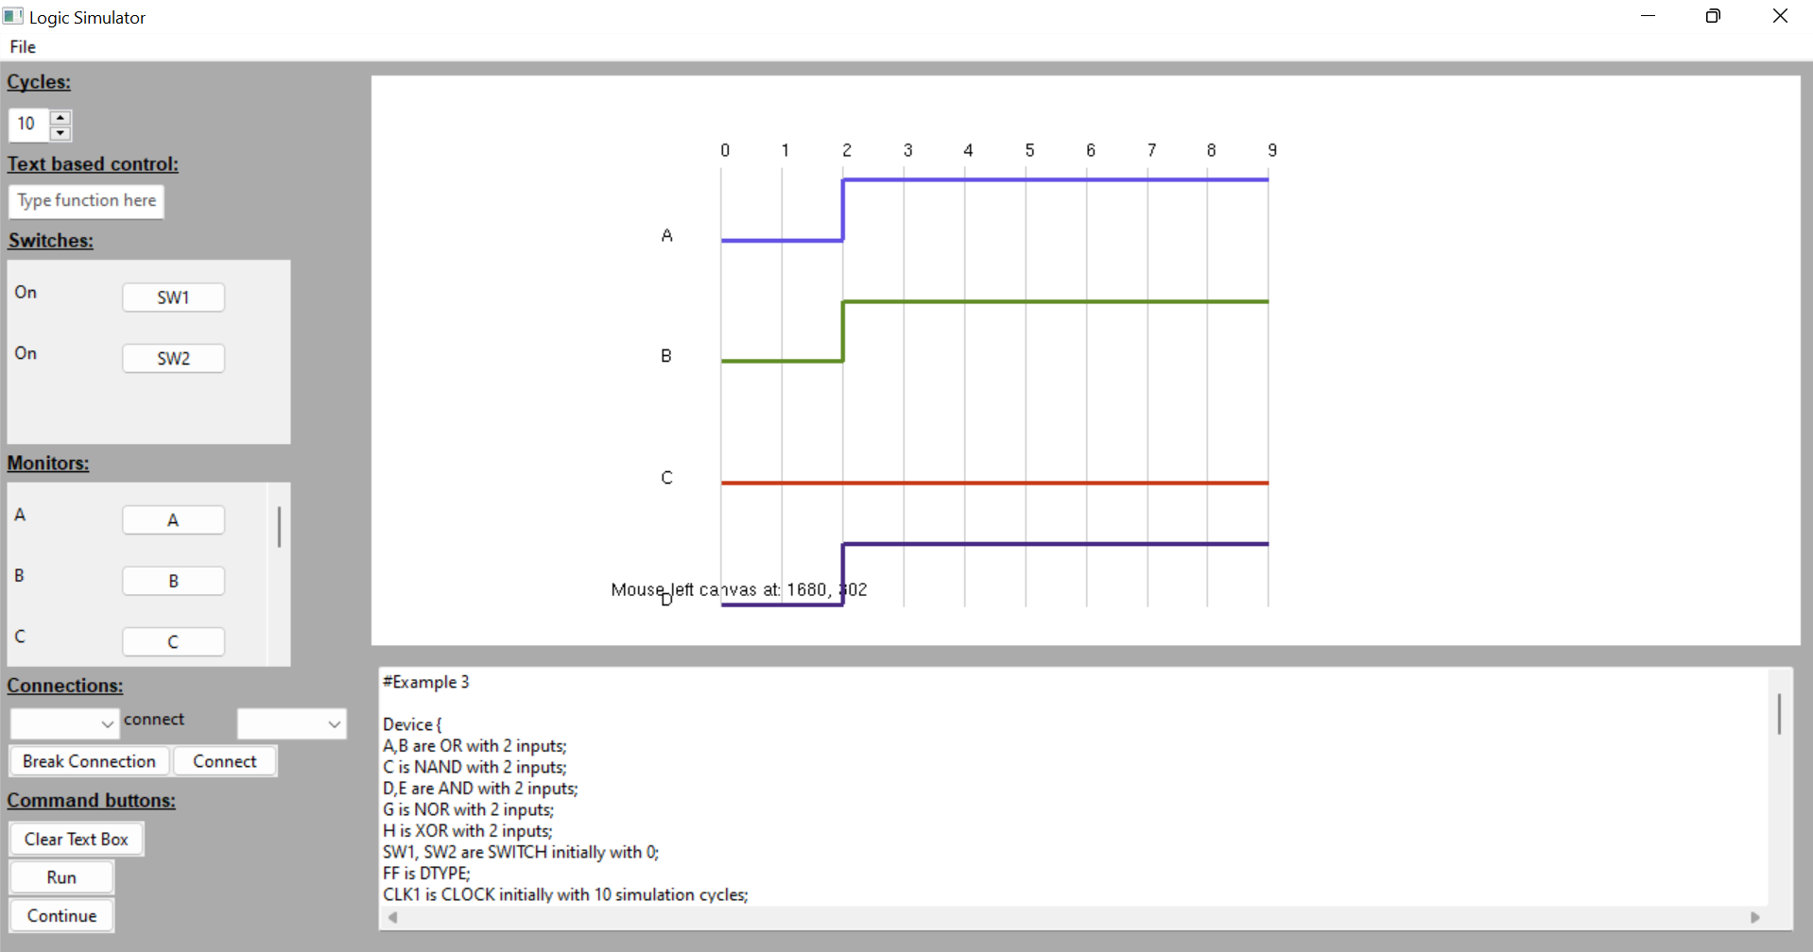
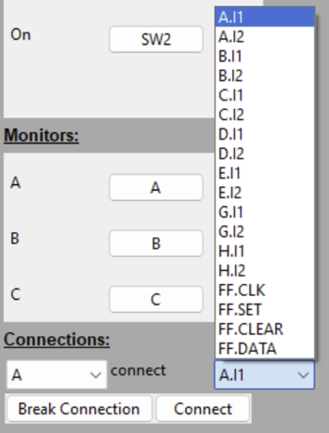
Logic Simulator User Guide
STEP 1: Getting Started
Navigate to the ‘final’ directory using the command line
Type ‘python3 logsim.py’ + definition file name (Definition_Ex3.txt can be used for illustration)
press ENTER with start the GUI with default language (English) according to the system
For Simplified Chinese version: Type ‘LANG=zh_CN python3 logsim.py’ + definition file name
Here to load other files or exit
Cycles number
Simulation cycles
Text based
control
Monitor Output Canvas
Set switch panel
Device names
Set monitor panel
Level high
Level low
Maintenance connections
feature
Loaded Definition File
Input panel
Figure 1 Example GUI
STEP 2: GUI Familiarisation (see Figure 1)
STEP 3: Set the Input
For each switch: set the initial input (0 or 1) by clicking the button
Choose the devices that need to be monitored
Set a time scale by typing or choosing the cycle number
(All default values can be set in the definition file)
STEP 4: Run the Simulation
Click ‘Run’ button when you are ready
Use ‘Clear Text Box’ button to clear the loaded file
Drag or zoom the output traces using the mouse and mouse wheel
Extra Connection Feature:
During the simulation, extra connections can be made and exist connections can be removed.
The available device outputs and inputs are listed in the dropdown menu for you to choose
(see Figure 2)
Figure 2 Dropdown menu for connection

Slide 2
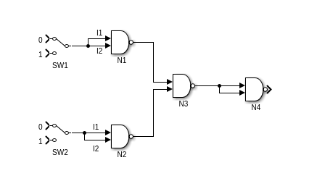
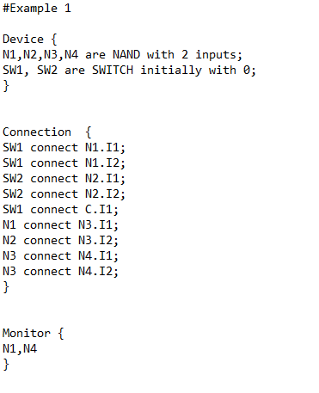
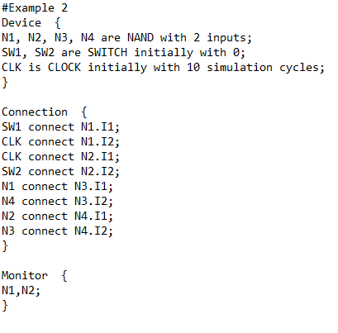
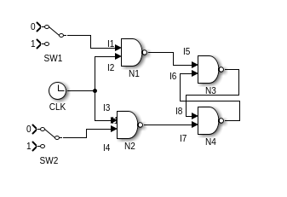
Example Definition File 1 – NOR Gate (NAND Implementation)
Example Definition File 2 – Simple SR FlipFlop
I1
I2
I1
I1
I2
I2

Slide 3
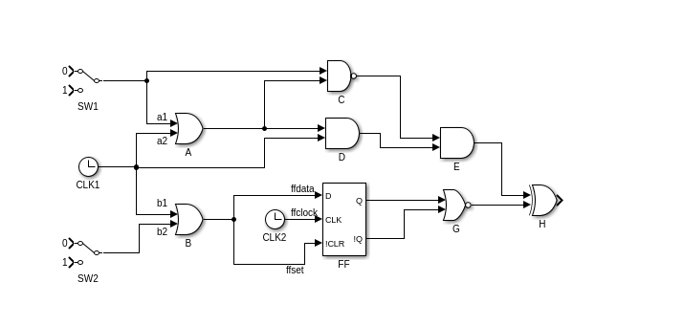
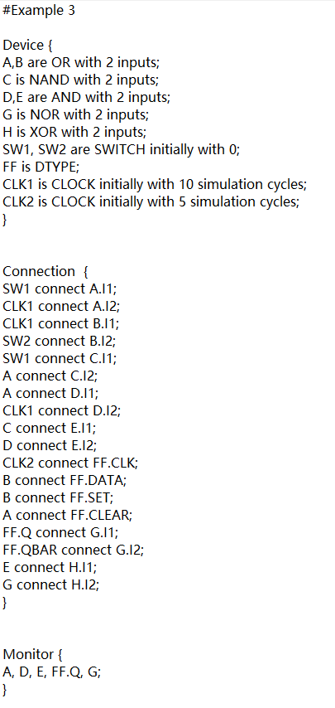
Example Definition File 3 – Complex Circuit
I1
I2
I1
I2

