Slide 1
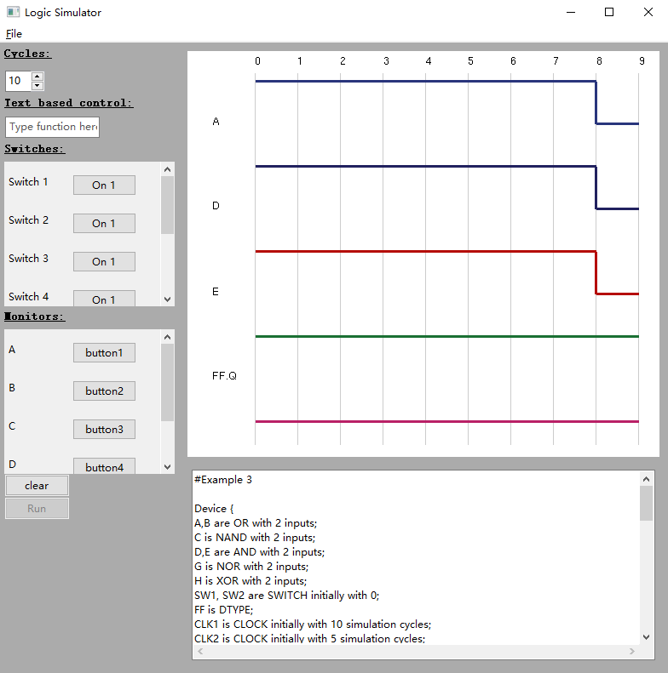
Logic Simulator User Guide
STEP 1: Getting Started
Navigate to the ‘logsim’ directory using the command line
Type ‘python logsim.py’ + definition file name (Definition_Ex3.txt can be used for illustration)
press ENTER
Here to load other files or exit
Simulation cycles
Cycles number
Text based
control
Device names
Level high
Set switch panel
Level low
Monitor Output Canvas
Set monitor panel
Input panel
Loaded Definition File
Figure 1 Example GUI
STEP 2: GUI Familiarisation (see Figure 1)
STEP 3: Set the Input
For each switch: set the initial input (0 or 1) by clicking the button
Choose the devices that need to be monitored
Set a time scale by typing or choosing the cycle number
(All default values can be set in the definition file)
STEP 4: Run the Simulation
Click ‘Run’ button when you are ready
Use ‘Clear’ button to clear the canvas and the loaded file
Drag or zoom the output traces using the mouse and mouse wheel
Example definition files and
corresponding circuits can be found on the next page

Slide 2
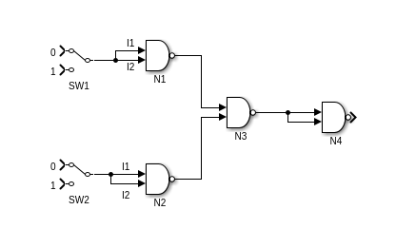
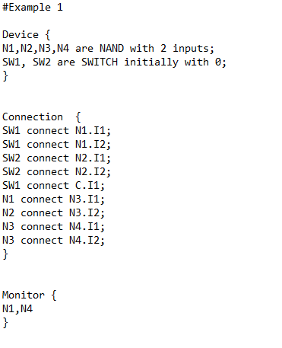
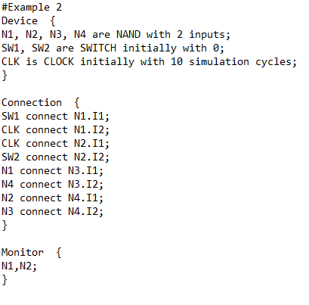
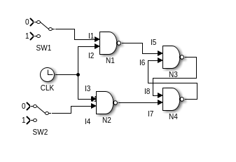
Example Definition File 1 – NOR Gate (NAND Implementation)
Example Definition File 2 – Simple SR FlipFlop
I1
I2
I1
I1
I2
I2

Slide 3
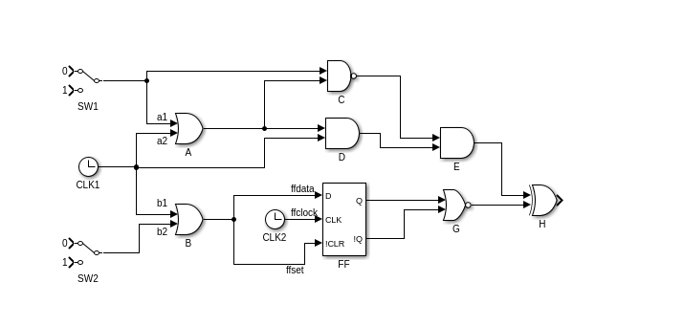
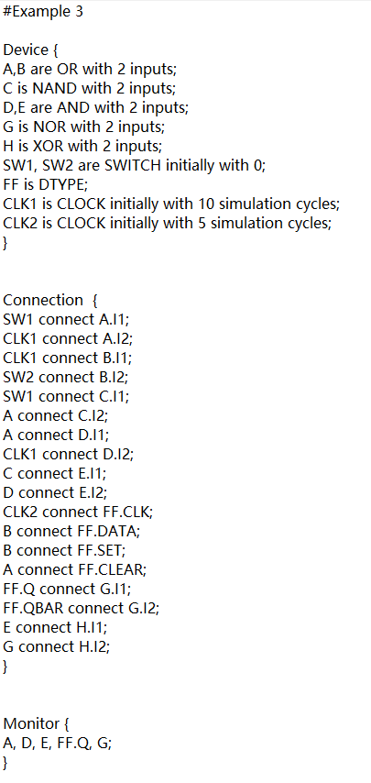
Example Definition File 3 – Complex Circuit
I1
I2
I1
I2

