Slide 1
诊断分析与绘图 准备实验六----直方图的绘制 Chapter 7: X-Y plot (P.39) http://www.ncl.ucar.edu/Applications/bar.shtml

Slide 2
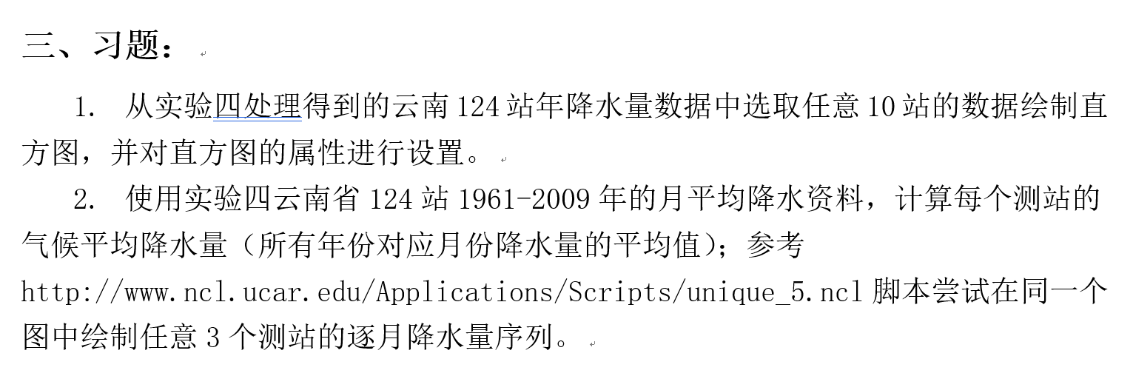

Slide 3
7.4 Bar Chart
Bar charts are simply XY plots that are drawn with bars for each X,Y point.
To get bars instead of curves when using gsn_csm_xy, set the special attribute
res@gsnXYBarChart = True.
看官网：
NCL Graphics: Bar Charts (ucar.edu)
Notes:
还是用uv300数据来练习一下：
先写脚本，加上这个语句，画一个图出来。

Slide 4
7.4 Bar Chart---Resources
Filling bars pivoted about an X or Y reference line:
gsnYRefLine - Defines a Y reference line (horizontal) about which to pivot the bars either up or down.
gsnXRefLine Defines an X reference line (vertical) about which to pivot the bars either left or right.
gsnXYBarChartColors / gsnXYBarChartColors2 - Defines the fill colors for each bar.
gsnXYBarChartPatterns / gsnXYBarChartPatterns2 - Defines the fill patterns for each bar.
gsnXYBarChartOutlineOnly - Outline only the outside edges of each bar.
Notes:
Pivoted [‘pɪvətɪd] 围绕……展开，以……为核心
All Y values greater than this reference line will be drawn as bars pointing up, and all bars less than will be pointing down.

Slide 5
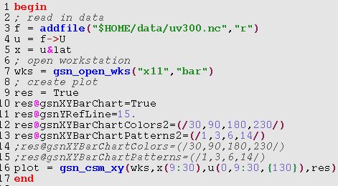
Notes:
先给个不带RefLine的，看一下默认的bar的基准线是什么。----是这个序列的最小值。
再演示一下怎么画横的bar条。就是加XRefLine属性就可以，图形接口函数里的xy顺序也要换一下。
然后再来看颜色设置。

Slide 6
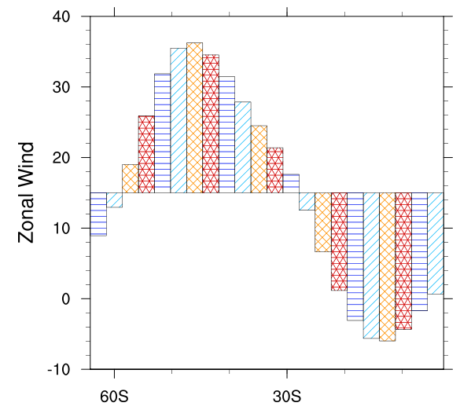

Slide 7
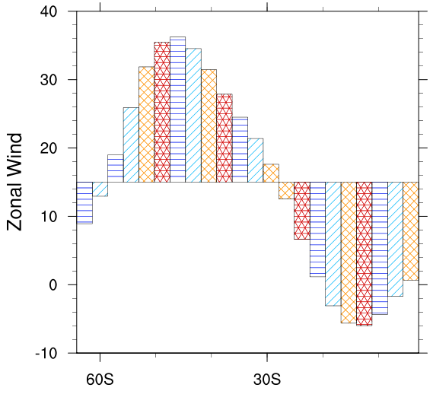
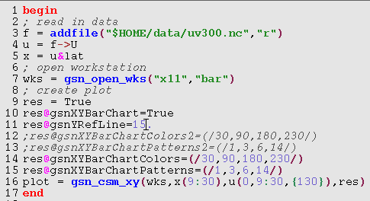

Slide 8
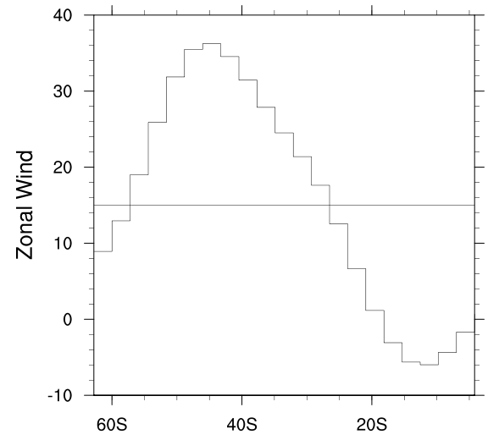
res@gsnXYBarChartOutlineOnly=True

Slide 9
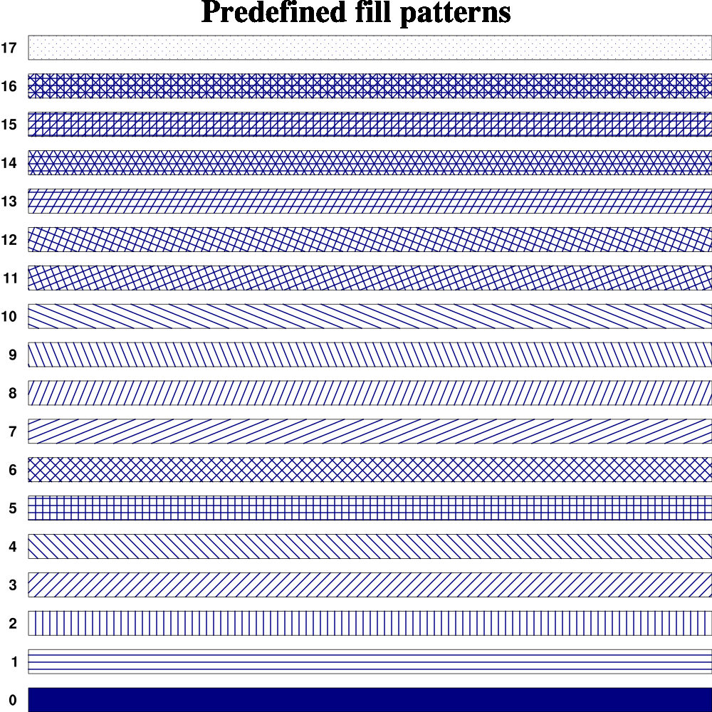
http://www.ncl.ucar.edu/Document/Graphics/Images/fillpatterns.png

Slide 10
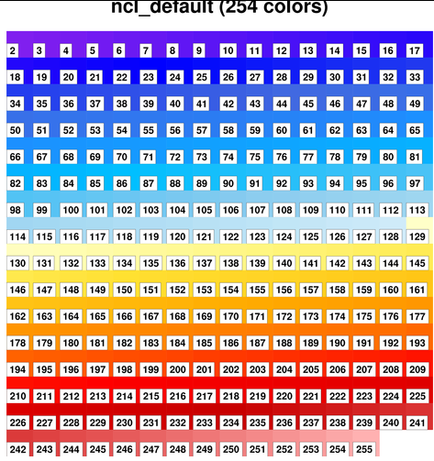

Slide 11
7.4 Bar Chart---Resources
Setting fill colors specifically for a vertically-oriented bar chart:
gsnBelowYRefLineBarColors
gsnBelowYRefLineBarPatterns
gsnAboveYRefLineBarColors
gsnAboveYRefLineBarPatterns

Slide 12
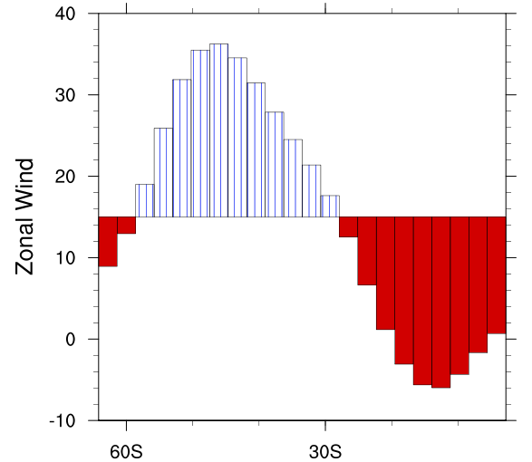


Slide 13
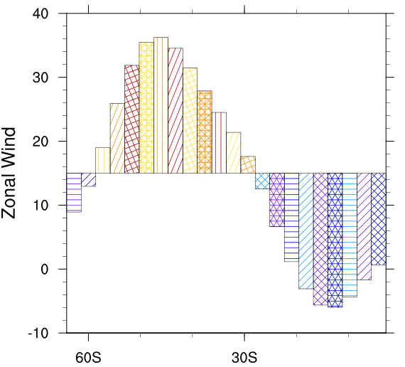


Slide 14
7.4 Bar Chart---Resources
Setting fill colors specifically for a horizontally-oriented bar chart:
gsnLeftXRefLineBarColors
gsnLeftXRefLineBarPatterns
gsnRightXRefLineBarColors
gsnRightXRefLineBarPatterns

Slide 15
7.4 Bar Chart---Resources
Customizing the look of color or pattern filled bars:
gsnXYBarChartBarWidth
gsnXYBarChartFillDotSizeF
gsnXYBarChartFillScaleF
gsnXYBarChartFillLineThicknessF
gsnXYBarChartFillOpacityF
gsnBelowYRefLineBarFillScales
gsnAboveYRefLineBarFillScales
gsnLeftXRefLineBarFillScales
gsnRightXRefLineBarFillScales
gsnXYBarChartOutlineThicknessF
Notes:
gsnXYBarChartFillScaleF: If the bars are filled with a non-solid pattern, then this resource indicates what fill scale to use for the fill pattern. Values less than 1.0 give you a more dense pattern.
gsnXYBarChartFillOpacityF:If the bars are filled with a solid color, then this resource indicates what fill opacity value to use for the fill colors. Values closer to 0 give you less opacity, and values close to 1.0 give you more opacity.
gsnBelowYRefLineBarFillScalesIf gsnYRefLine is set, gsnXYBarChart is set to True, and gsnBelowYRefLineBarPatterns is set, then this resource indicates what fill scales to use for the fill patterns. Values less than 1.0 give you a more dense pattern.

Slide 16
7.4 Bar Chart---Resources
gsnXYBarChartBarWidth:
If gsnXYBarChart is set, then this resource allows the user to control the width of the bars. By default, the width of the bars is the distance between each X or Y value (dx or dy).
To get a bar width that is half the default, then, use a value of dx/2 (dy/2). If you have multiple curves, then you can set an array of bar widths, one for each curve.
Default: dynamic

Slide 17
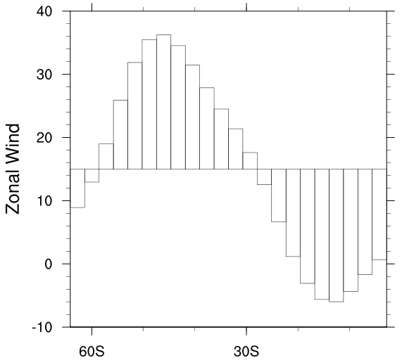
(0) get_bar_widths: Warning: The bar width(s) you selected (3) is larger than the smallest delta (2.79033).
(0) Defaulting to 2.79033.
Notes:
This delta changes when the numbers of bars changed.

Slide 18
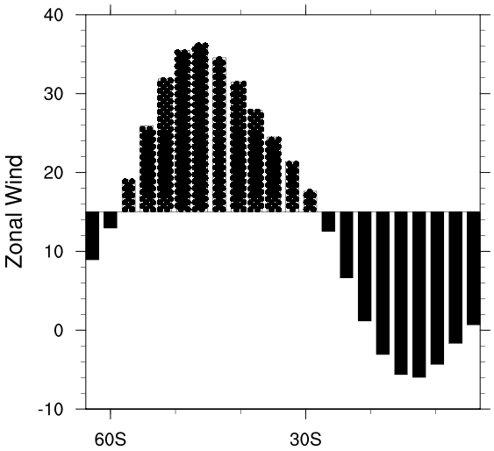

Notes:
gsnXYBarChartFillDotSizeFIf gsnXYBarChart is set to True, and the bars are filled with the stipple dot fill pattern, then this resource allows you to increase the dot size.The default value of 0.0 causes the dots to be drawn as before, using a workstation dependent minimum dot size. A caveat is that individual dots are not clipped around the edges of fill areas; this becomes more noticeable as the dot size increases.

Slide 19
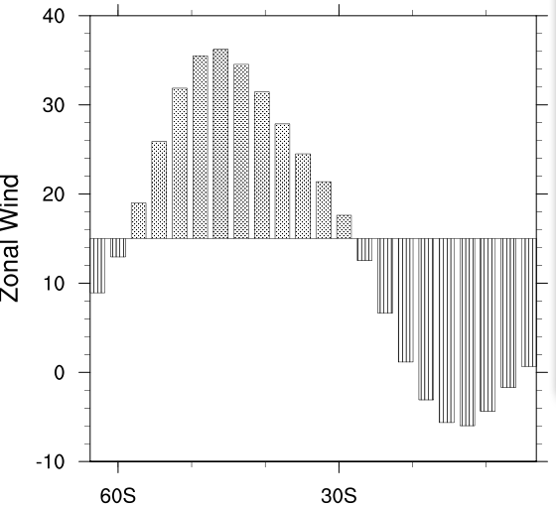

Notes:
gsnXYBarChartFillScaleF: If gsnXYBarChart is set to True, and the bars are filled with a non-solid pattern, then this resource indicates what fill scale to use for the fill pattern. Values less than 1.0 give you a more dense pattern.Available in version 6.2.0 and later.
Default: 1.0

Slide 20

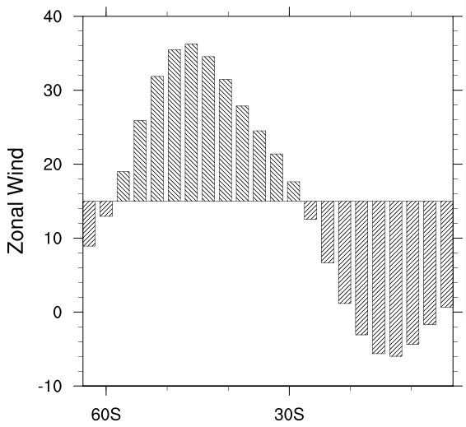

Slide 21
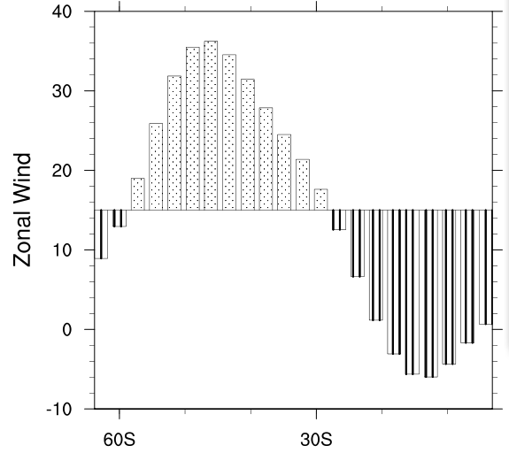


Slide 22
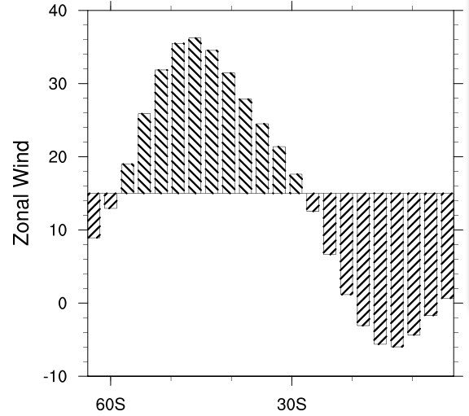


Slide 23
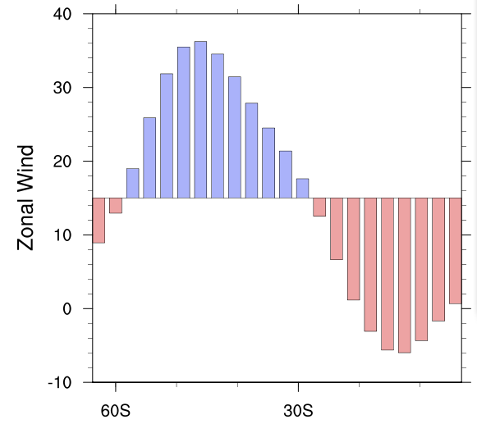

Notes:
gsnXYBarChartFillOpacityF: If gsnXYBarChart is set to True, and the bars are filled with a solid color, then this resource indicates what fill opacity value to use for the fill colors. Values closer to 0 give you less opacity, and values close to 1.0 give you more opacity. Available in version 6.2.0 and later.Default: 1.0

Slide 24
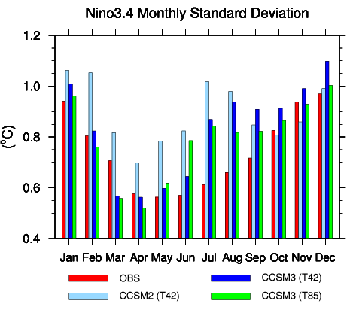
http://www.ncl.ucar.edu/Applications/Scripts/unique_5.ncl
Notes:
Ncl can draw multiple bar charts on one page.

Slide 25
7.5 Other X-Y plot
gsn_csm_x2y ;two different X axes
gsn_csm_xy2 ;two different Y axes
gsn_csm_x2y2 ;two different X&Y axes
……
Notes:
除了前面将到基本的xy图，还有复杂点的，x，y轴双坐标的情况

Slide 26
gsn_csm_xy2
gsn_csm_xy2 (
wks[1] : grahic,
x : numeric,
y1 : numeric,
y2 : numeric,
res1 : logical,
res2 : logical )
；The y1 curve will be represented on the
; left axis, and y2 curve will be on the right.
;res1 for y1
;res2 for y2
Notes:
以此类推，x2y和x2y2分别可以设其他的坐标轴并配不同的res。

Slide 27
2.3 Symbols
; | /; ... ;/ | \
= | :=
@ | ! | &
{...} | [...] | (/.../)
$ | -> | =>
:
| | ::
Notes:
NCL一共用到这17个符号。下面会逐一讲各个符号的用法。
我这里把他们按行分成了7组，是我根据各符号的功能，按我的理解习惯分的类，对比着更容易记住。
同学们学习过程中可以有自己学习方式，最终目的是能正确使用各个符号。

Slide 28
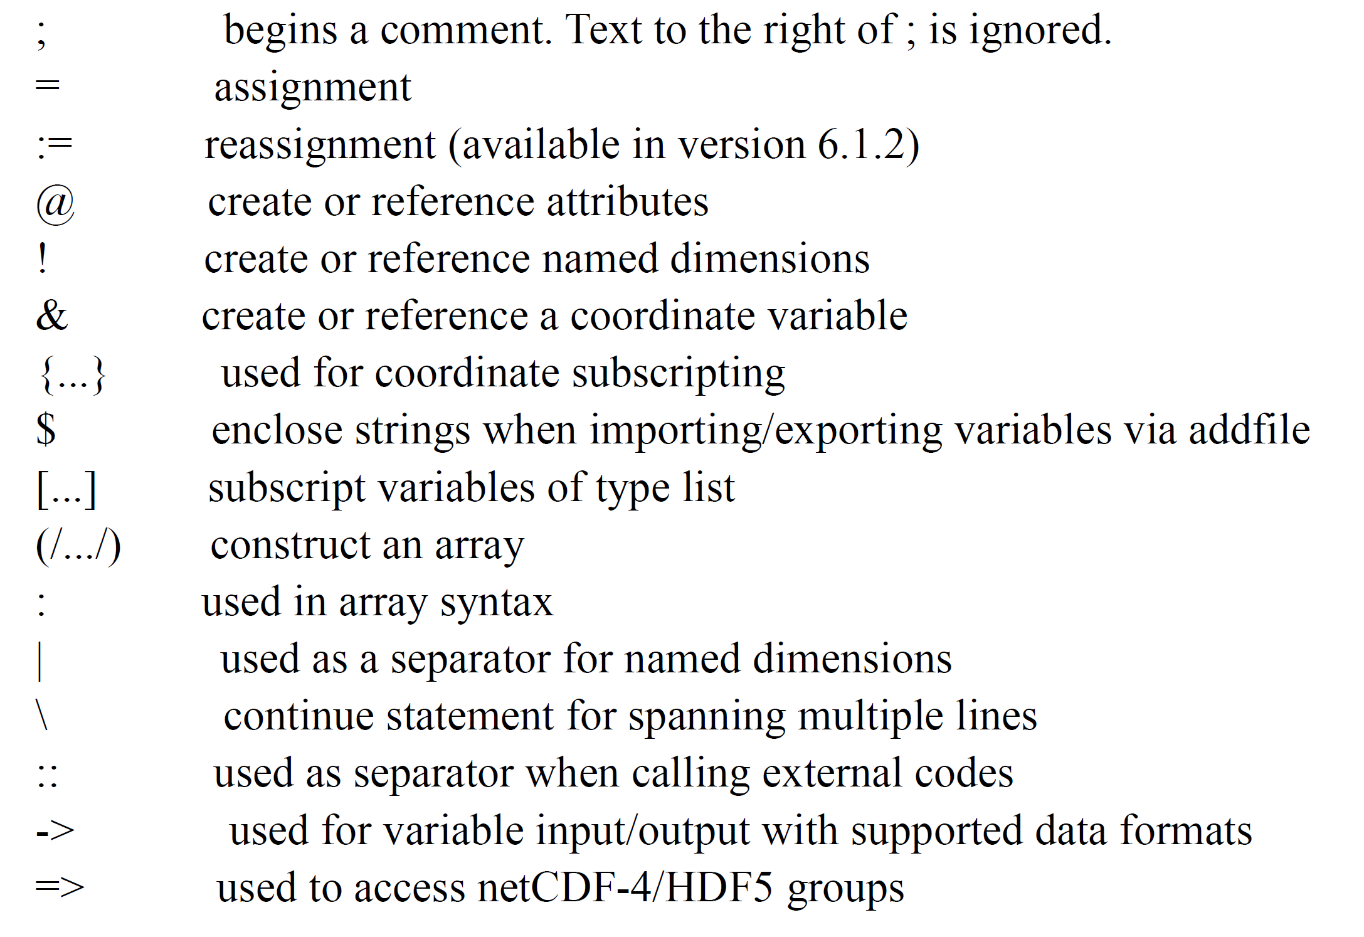

Slide 29
2.4 Data types
Numeric: double (64 bit) ，float (32 bit)
long (32 or 64 bit) , integer (32 bit) ,
short (16 bit) , byte (8 bits)
int64，uint64，
ulong，uint，ushort，ubyte
complex is not supported.
Non-numeric: string ， character
graphic ，file
logical ， list
Notes:
数据类型
数字型：双精度型，浮点型，长整型，整型，短整型，字节。（不支持复数）。常用的是整型和浮点型。除了以上这些，还有int64，uint64，ulong，uint，ushort，ubyte这几种。首字母带u的是无符号的。
具体各类型的默认初值课在下面这个网页查到。
http://www.ncl.ucar.edu/Document/Manuals/Ref_Manual/NclVariables.shtml
非数字型：字符串，字符，图片，文件，逻辑型，列表。
二进制数系统中，每个0或1就是一个位(bit)，位是数据存储的最小单位。其中8bit就称为一个字节（Byte）
List是处理一组有序项目的数据结构，即你可以在一个列表中存储一个序列的项目。
关于字符，常用的是string型，因为character型的赋值是很麻烦的，如下例。
cl = new((/2,3,5/),character)
cl(0,0,0) = integertocharacter( 65) ; 'A'
cl(0,0,1) = integertocharacter( 66) ; 'B'

Slide 30
2.5 Reserved keywords
begin, break, byte, character, continue, create, defaultapp, do, double, else, end, enumeric, external, False, file, float, function, getvalues, graphic, if, integer, int64, list, load, local, logical, long, _Missing, Missing, new, noparent, numeric, procedure, quit, Quit, QUIT, record, return, setvalues, short, string, then, True, undef, while and all built-in function and procedure names.
http://www.ncl.ucar.edu/Document/Manuals/Ref_Manual/NclKeywords.shtml
􀀉􀀇􀀇􀀝􀀟􀀠􀀠􀀡􀀡􀀡􀀢􀀏􀀚􀀛􀀢􀀃􀀚􀀎􀀙􀀢􀀆􀀅􀀃􀀠􀀳􀀈􀀚􀀃􀀍􀀆􀀏􀀇􀀠􀀖􀀎􀀏􀀃􀀎􀀛􀀕􀀠􀀌􀀆􀀘􀁅􀀖􀀎􀀏􀀃􀀎􀀛􀀠􀀊􀀚􀀛􀁊􀀆􀀤􀀡􀀈􀀙􀀅􀀕􀀢􀀕􀀉􀀇􀀍􀀛
Notes:
不能当作变量名的关键字。
注意要避开内部函数的名字，比如刚才用过的new(),就不能再有名为“new” 的变量，会有出错提示“fatal：error in statement”

Slide 31
2.6 Expressions
Four kinds of expressions:
1. Algebraic expressions
2. Logical expressions
3. Array expressions
4. Functions
Precedence rules can be circumvented by use of parentheses "(...)" around expressions.
NCL does not operate on any array element set to _FillValue .
Notes:
（）可以改变表达式的预算优先级；
表达式求值时不对缺测值进行运算。

Slide 32
2.6 Expressions
Algebraic operators:
+ ，- ，* ，/ ，^ ，% ，# ，>，<
Logical:
.lt. ，.le. ，.gt. ， .ge. ，.ne. ，.eq.
.and. ，.or. ，.xor. ，.not.
Logical expressions are guaranteed to be evaluated left to right. Hence, for efficiency, put the logical expression which will most likely fail on the left side.
Notes:
讲义里算术运算符少了个除号，逻辑运算符少了个.ge.。
+号还是字符串连接符，#是矩阵乘法；%求余符号 只对整型数可用。
-作为负号时计算的优先级最高。-3^2=9,和（-3）^2是一样的。
逻辑运算符要记得正确的写法。Xor：逻辑异或，即：真真为假，假假为假，真假为真，假真为真。
Circumvented 规避
Exponentiation 幂

Slide 33
2.7 Variables
Variable names are case sensitive, and must begin with an alphabetic character but can contain any mix of numeric and alphabetic characters. The underscore "_" is also allowed.
e.g. hgt、uwnd_300、sst、slp
Variables may have ancillary information (called metadata) attached to the variable. Metadata may be accessed, created, changed and deleted via NCL functions and syntax .
Notes:
Ancillary 辅助的
元数据是指变量或者文件的文本或数字的信息 Metadata is textual or numeric information associated with a variable or file.

Slide 34
2.7 Variables
There are three types of variable metadata: attributes, named dimensions, and coordinate variables.
Variables imported via NCL's addfile or addfiles functions will have all available metadata automatically attached to the variable.
Notes:
有3种类型的元数据：属性，命名维和坐标变量。

Slide 35
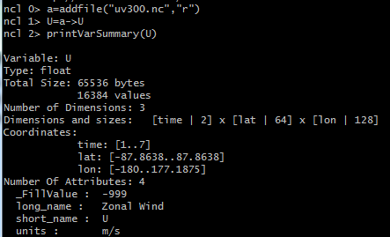
2.7 Variables
Notes:
举例使用的是交互式：直接在ncl运行环境中输入命令，逐条执行。
Addfile（）函数功能是打开文件；
U=a->U是从打开的a文件中读取U这个变量，将其赋值给变量U。注意两个U的区别。
printVarSummary（）功能是显示变量的信息；注意：这里变量的各维大小相乘2*64*128就等于Size里面的values值，values*4就是字节数，因为是浮点型数据。

Slide 36
2.8 Statements
Statements are the fundamental element of NCL.
Everything NCL does happens only after a statement is entered.
Statements are case sensitive and are not restricted to being a single line of source, and statements can be nested within statements.
Statements are blocks (a group of statements), conditional expressions (if-then, if-then-else), loops (do, do-while), assignments, reassignments, procedures, functions, or graphic statements.
Notes:
statements在计算机领域就是语句的意思
语句有以下8个类型：（代码）块；条件表达式；循环；赋值；重新赋值；过程（定义或调用）；函数（定义或调用）；图形语句。
后面有逐一的讲解。
过程和函数都以编译后的形式存放在数据库中，函数可以没有参数也可以有多个参数并有一个返回值。过程 有零个或多个参数，没有返回值。函数和过程都可以通过参数列表接收或返回零个或多个值，函数和过程的 主要区别不在于返回值，而在于他们的调用方式，过程是作为一个独立执行语句调用的，函数以合法的表达 式的方式调用

