Slide 1
诊断分析与绘图 实验七准备 Maps

Slide 2
8 Maps
NCL supports many different map types and projections. By default, the continents are color filled using light grey;
This behaviour can easily be changed by setting the mpLandFillColor resource to the desired color.
You can also turn off the color fill by setting mpFillOn to False.
The default tickmark settings for a map can be changed by some @gsn and @tm resources.

Slide 3

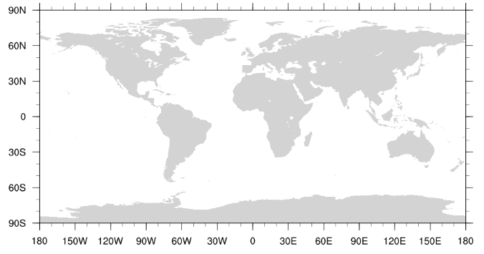
8.1 Default Map
To create a simple map of the Earth open a workstation and call the function gsn_csm_map

Slide 4
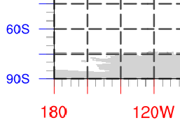
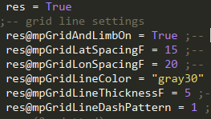
8.2 Map Grid and Tickmark Settings
To control the grid lines of the latitude and longitude axis as well as their major and minor tickmarks you have to use different resource groups like @gsn, @tm, and @mp.
Notes:
mpGridAndLimbOn (MapPlot)This boolean resource determines whether the MapPlot object draws grid lines representing latitude and longitude as well as (when appropriate) a limb line around the edge of the visible surface of the map projection.Default: True

Slide 5
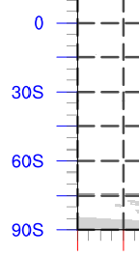
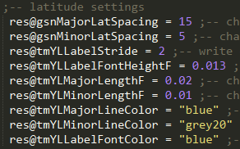
8.2 Map Grid and Tickmark Settings
Notes:
Tm: tick mark
YL: left Y-axis
那么应该可以推断得出也有一组YR的属性，对右边的Y轴进行设置。
Major和Minor分别是指长短刻度线。
这是对lat的设置，那么也对应的有对lon的设置，即对x轴的设置。

Slide 6
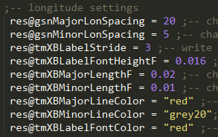

8.2 Map Grid and Tickmark Settings
Notes:
与lat的设置对应，只是YL换成XB，那么对应也会有XT。

Slide 7
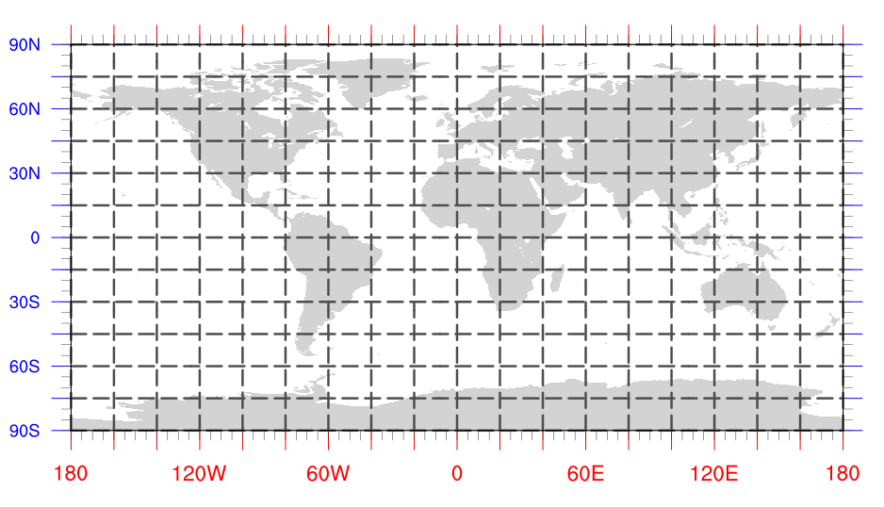
8.2 Map Grid and Tickmark Settings

Slide 8
8.3 Map Content Settings
To change the color of land, inland water and ocean areas NCL provides the resources mpOceanFillColor, mpInlandWaterFillColor, and mpLandFillColor.
The line color and thickness of the continents can be controlled by resources.

Slide 9
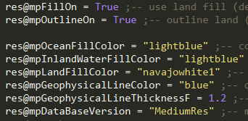
8.3 Map Content Settings

Slide 10
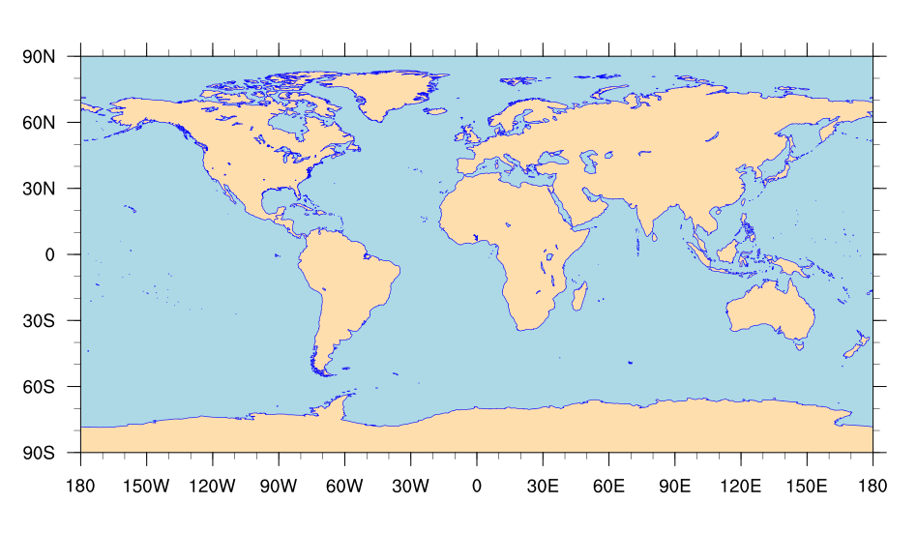
8.3 Map Content Settings

Slide 11
8.4 Change Map Projection
@mpProjection (MapTransformation)
Orthographic、 Stereographic、 LambertEqualArea、 Gnomonic、 AzimuthalEquidistant、 Satellite、 PseudoMollweide、 Mercator、 CylindricalEquidistant、 LambertConformal、 Robinson、 CylindricalEqualArea、 RotatedMercator、 Aitoff、 Hammer、 Mollweide、 WinkelTripel
Notes:
17个

Slide 12
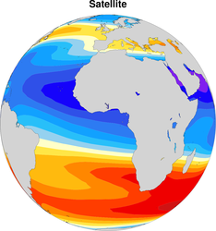
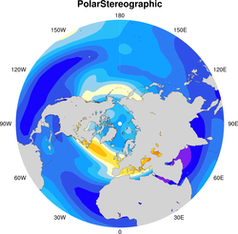
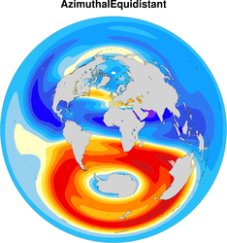
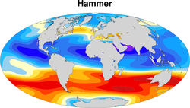
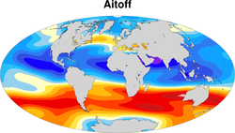
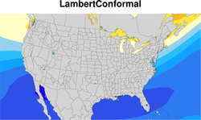
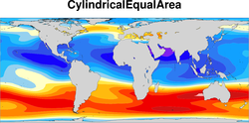
http://www.ncl.ucar.edu/Document/Graphics/map_projections.shtml

Slide 13

8.5 Regional Map
Sometimes just a specific region of the data is of interest.
To define the extent of a map region, insert the following resource settings in the script NUG_map_settings.ncl:

Slide 14
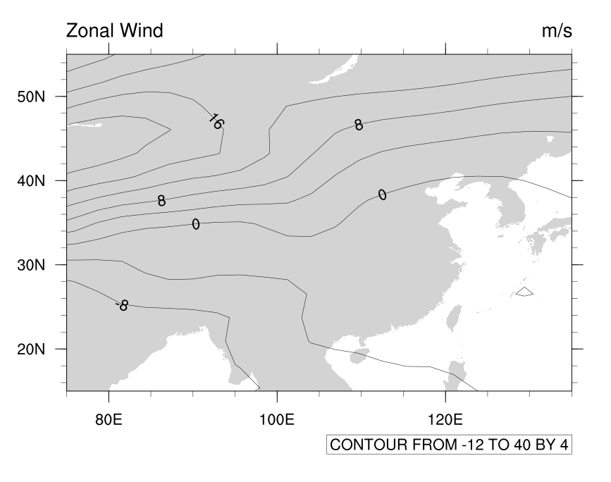

Slide 15

8.6 Polar Plot
To create a polar plot of the Northern Hemisphere, the gsn_csm_contour_map_polar function of NCL can easily be used.
Some additional settings are made to show the capabilities of polar plot resources.

Slide 16
