Slide 1
诊断分析与绘图 实验七准备 contours and shaded plot

Slide 2
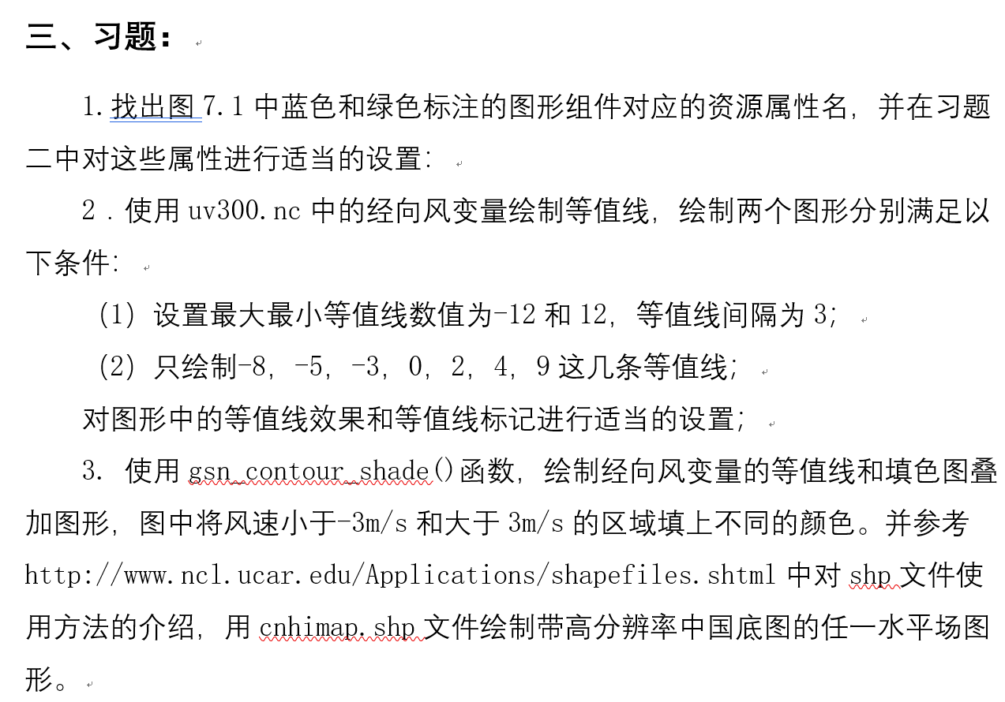

Slide 3
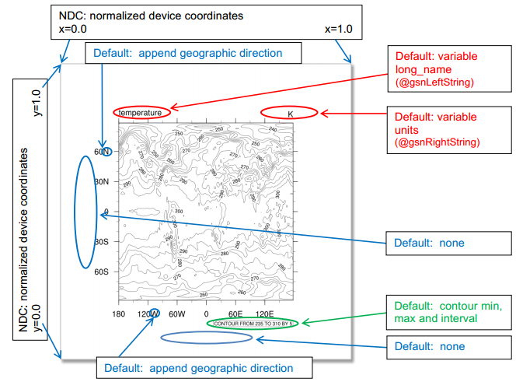
Notes:
X轴标题，Y轴标题。
NDC就是标准化的设备坐标。

Slide 4
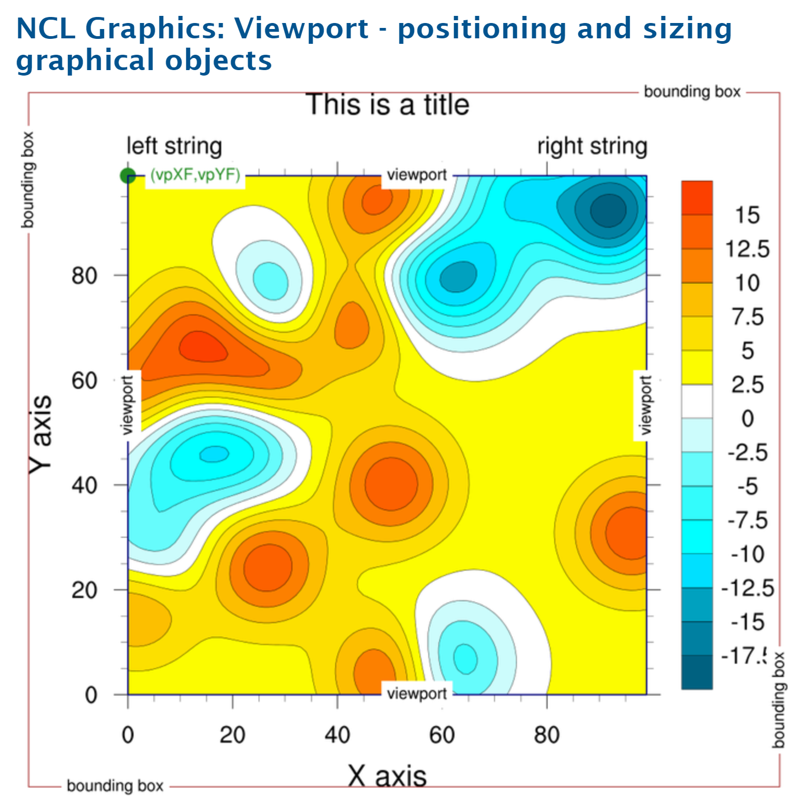
http://www.ncl.ucar.edu/Applications/viewport.shtml
Notes:
VP和边界

Slide 5
Viewport - positioning and sizing graphical objects
The viewport of a plot or drawable object (like a labelbar) is a rectangular subregion of NDC space that specifies where the object will be placed when drawn.
You can use the special resources vpXF, vpYF, vpWidthF, and vpHeightF to reposition and resize the plots.
Notes:
viewport视窗

Slide 6
Viewport - positioning and sizing graphical objects
The precise meaning of the viewport depends on the object.
For XY plots, the viewport specifies where the grid containing the curves will be placed. The labeling, if any, will be drawn outside of the viewport.
For text strings, the viewport is simply a rectangle surrounding the text string
Notes:
viewport视窗

Slide 7
Bounding box
A bounding box is the smallest rectangle in NDC space that contains all of a particular object's attributes.
For an XY plot, this would include the area containing the tickmarks, tickmark labels, the main title, X/Y axis titles, legend, and anything else associated with the XY plot.
For a text string, the bounding box is the same as the viewport.
Notes:
viewport视窗

Slide 8
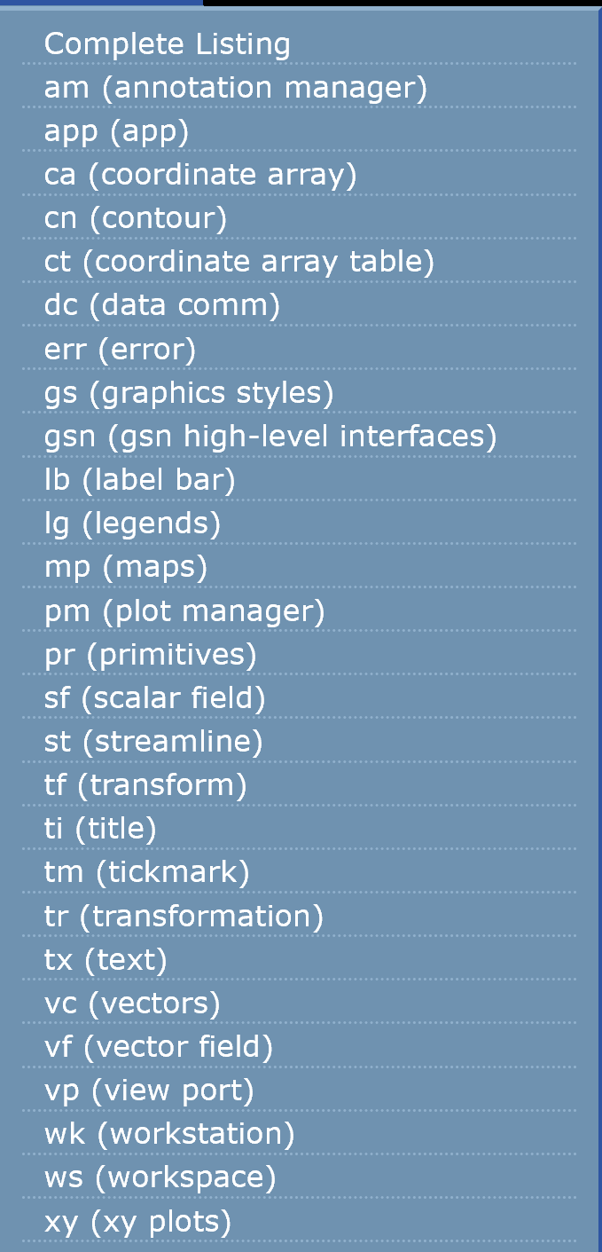

Slide 9
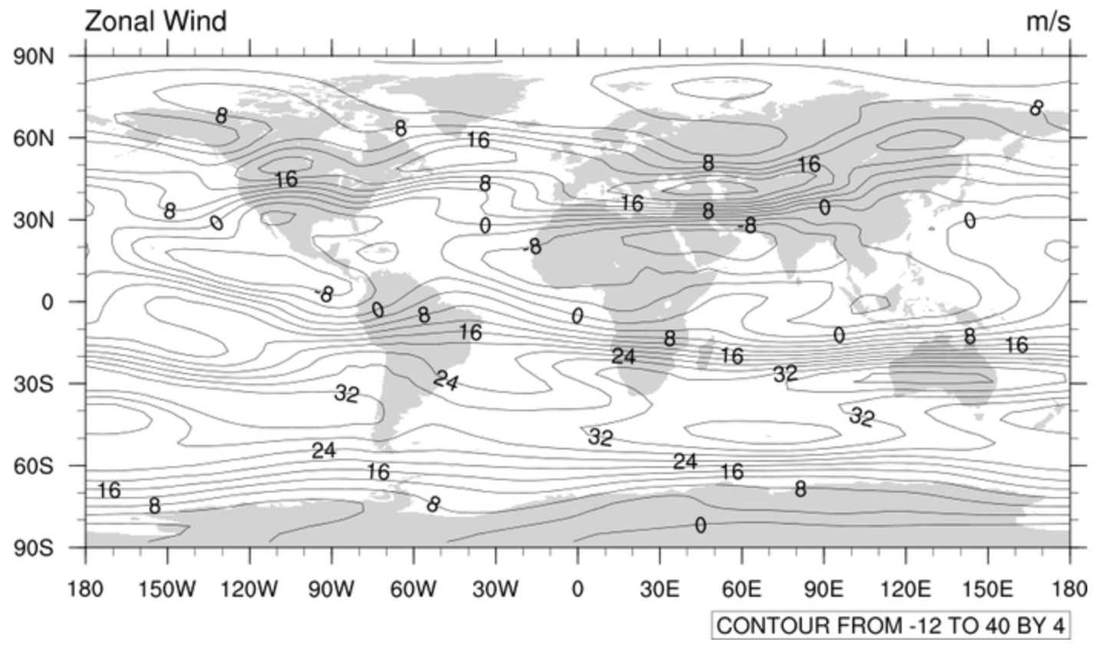
http://www.ncl.ucar.edu/Applications/cylineq.shtml

Slide 10
8.1 Manually setting contour levels
Requires the use of four resources:
res@cnLevelSelectionMode = "ManualLevels”
res@cnMinLevelValF = -30
res@cnMaxLevelValF = 30
res@cnLevelSpacingF = 5

Slide 11
8.2 Contour effects
Numerous functions and gsn resources have been developed to create special contour effects.
res@gsnContourZeroLineThicknessF=5
res@gsnContourPosLineDashPattern=0
res@gsnContourNegLineDashPattern=7

Slide 12
8.3 Explicitly setting contour levels
Requires only two resources:
res@cnLevelSelectionMode= "Explicitlevels"
res@cnLevels = (/.01,4,7.2/)
cnLevelSelectionMode could be set to:
AutomaticLevels
ManualLevels
ExplicitLevels
EqualSpacedLevels

Slide 13
8.4 Contour labels
cnLineLabelPlacementMode：
Constant、 Randomized、 Computed
cnLabelMasking = True
cnLabelBackgroundColor =“blue”
cnLineDashSegLenF=0.1
cnLineLabelDensityF=1.2

Slide 14
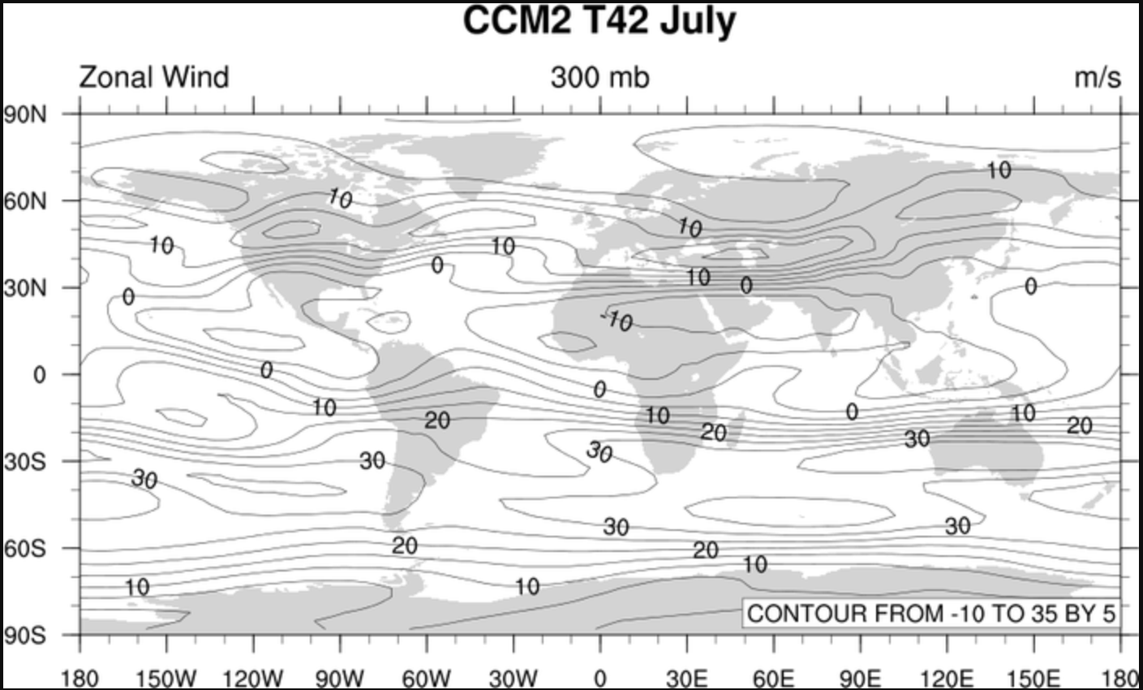
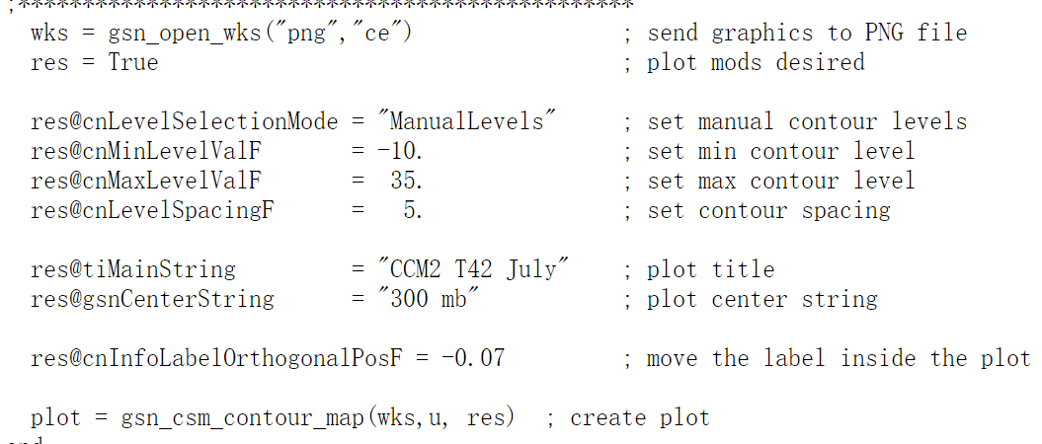

Slide 15
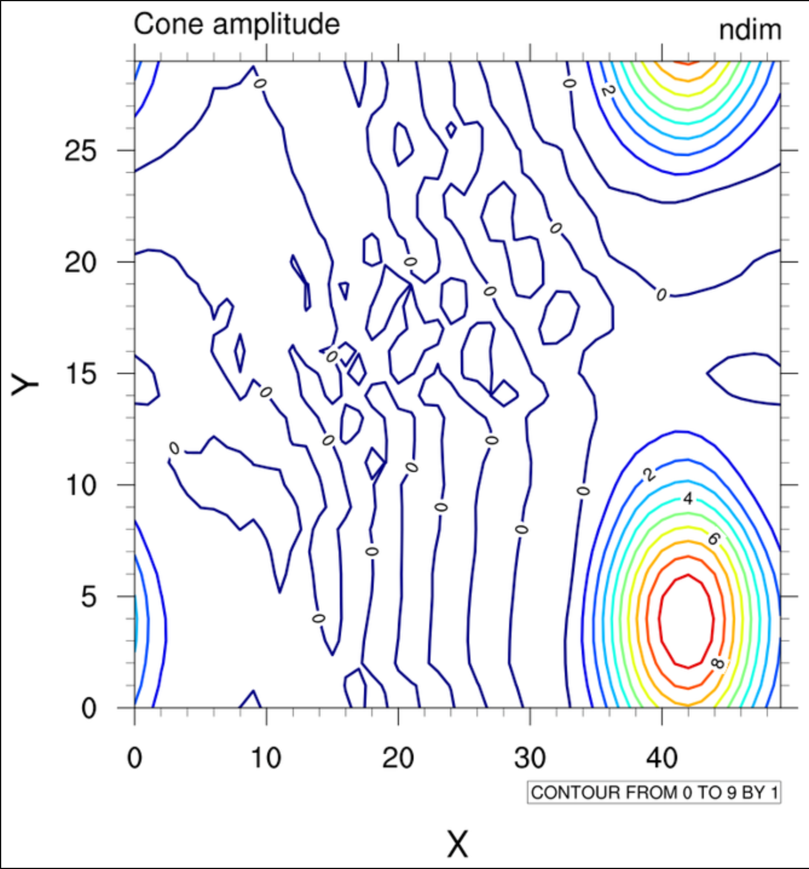
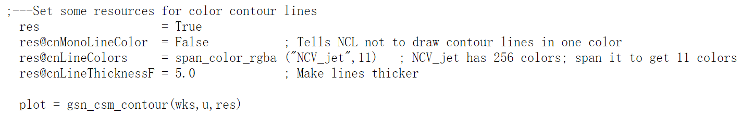

Slide 16
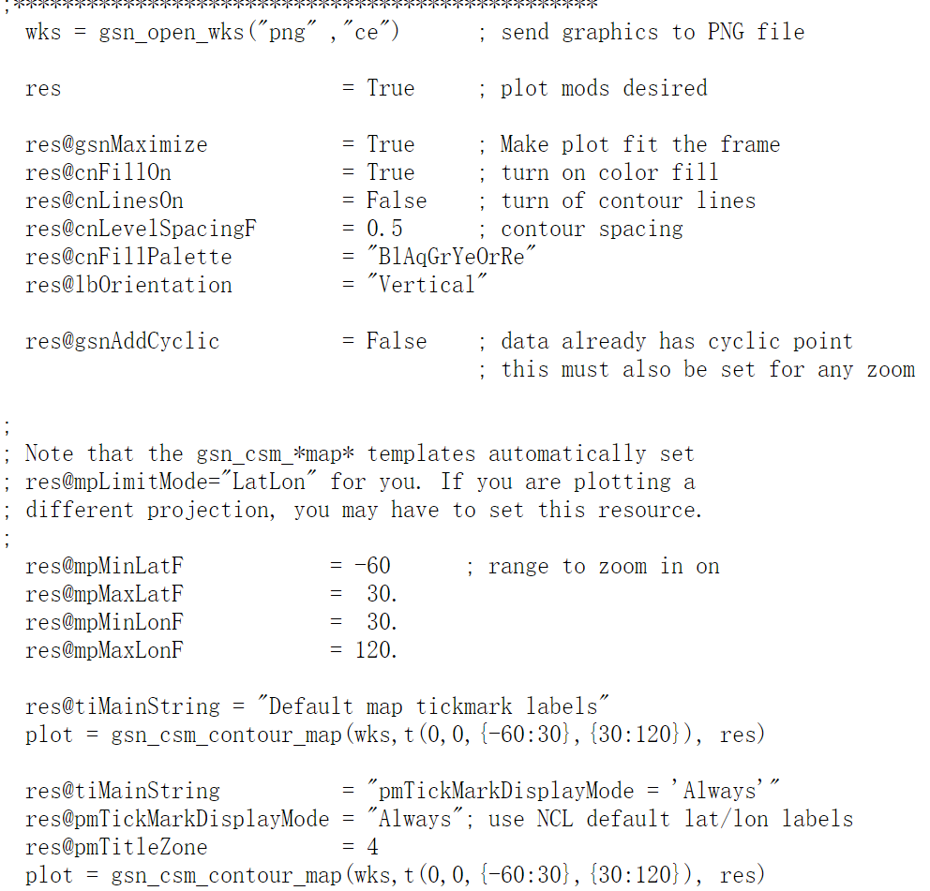
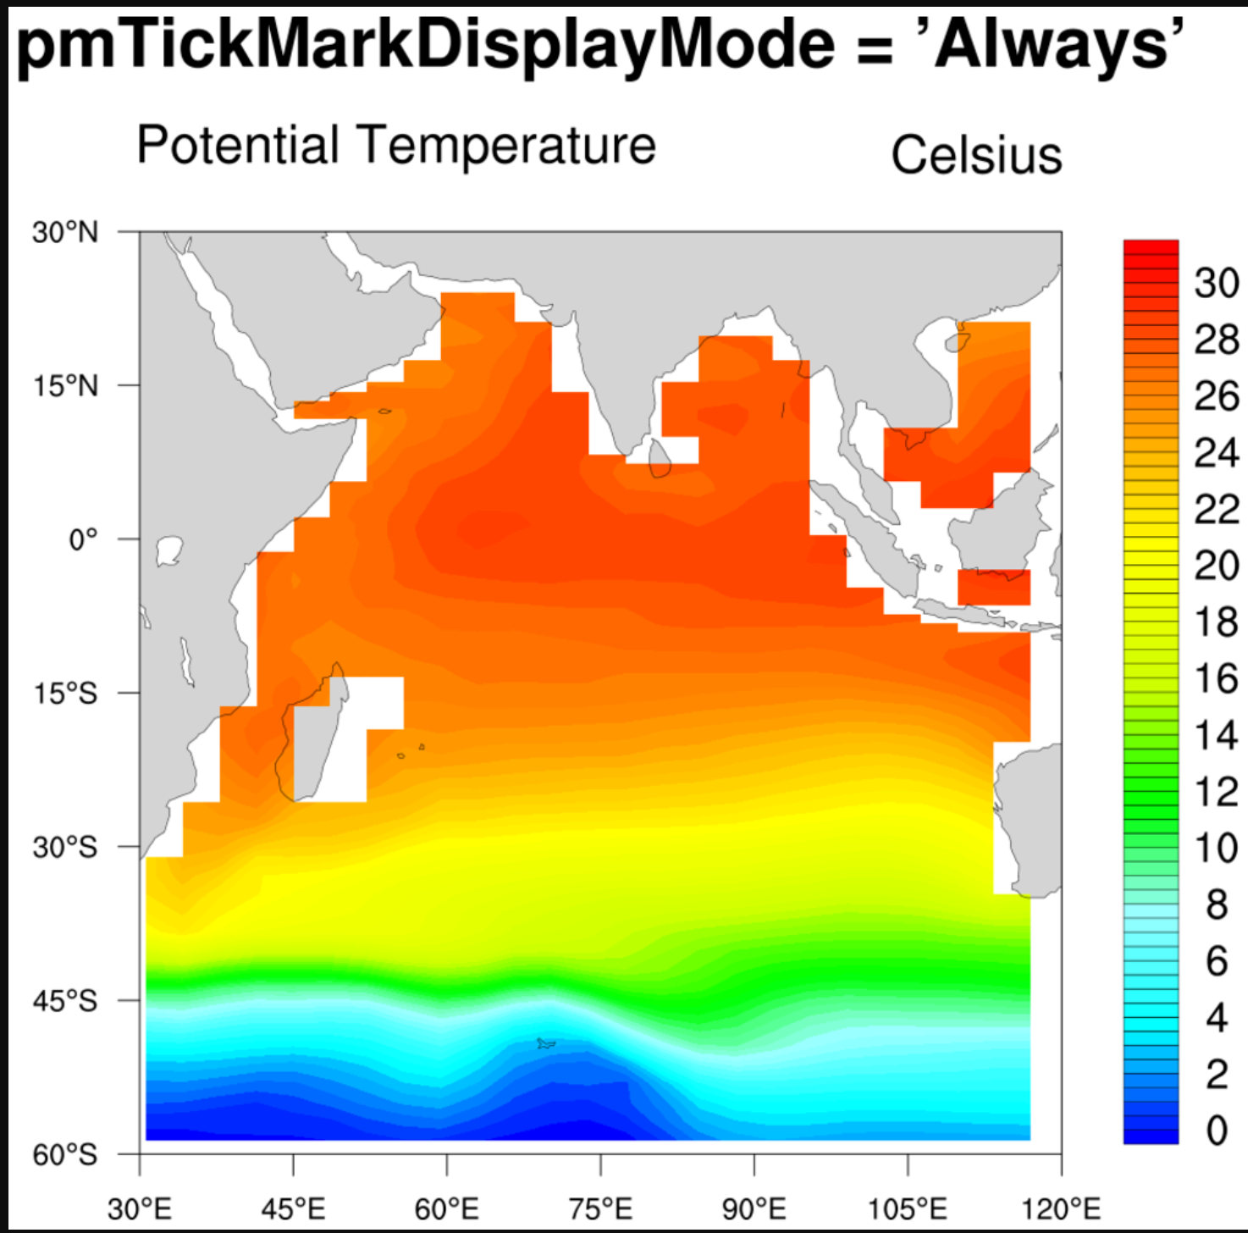

Slide 17
