Slide 1
诊断分析与绘图 实验八准备 Vector ( P.45） Overlay

Slide 2
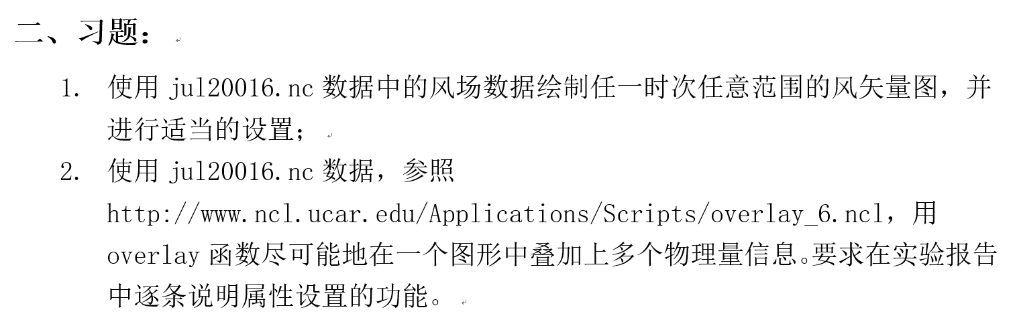

Slide 3
10.1 Type of Vectors
There are four types of vectors in NCL. The types may be changed by setting the resource vcGlyphStyle = “type”:
“LineArrow” : a polyline and arrowhead. This is the default
“FillArrow” : is a filled polygon and arrowhead.
“WindBarb” : uses the standard wind barb glyph seen on weather maps.
“CurlyVector” : a curved polyline tangent to the instantaneous flow in the neighborhood of the grid point.
Notes:
实验的时候比较下4种的差别

Slide 4
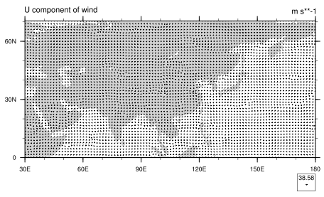
10.2 Controlling Vectors
Notes:
Use all default setting

Slide 5
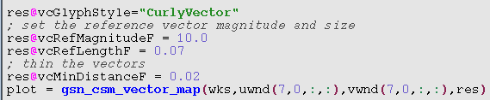
10.2 Controlling Vectors
There are three resources that most vector plots will require. These control the size of the vectors through a reference vector, and thin the vectors for presentation.

Slide 6
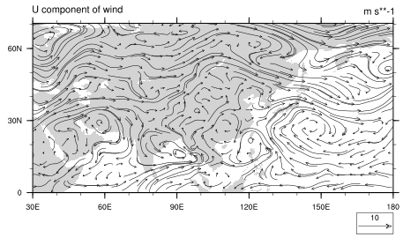
10.2 Controlling Vectors

Slide 7
10.3 Colored Vectors
There are four interfaces that draw vectors and a scalar field (contours) on the same plot:
gsn_csm_vector_scalar_map_ce
gsn_csm_vector_scalar_map_polar
gsn_csm_vector_scalar_map
gsn_csm_pres_hgt_vector
The default behavior of these interfaces is to color the vectors by the magnitude of the scalar field

Slide 8
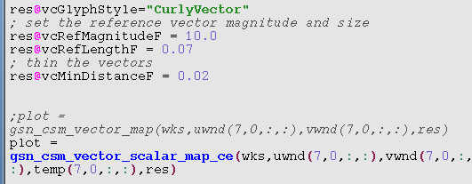
10.3 Colored Vectors

Slide 9
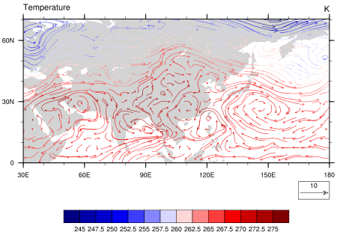

Slide 10
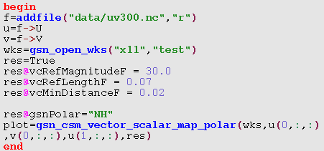
10.3 Colored Vectors

Slide 11
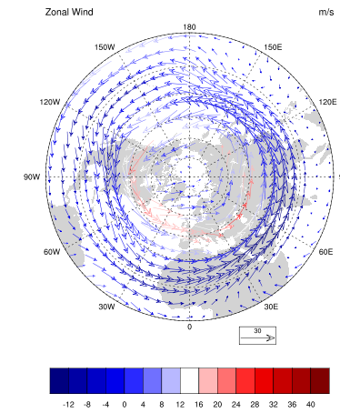

Slide 12
9 Overlay
Overlay plots are different plots (like vectors and contours) that are drawn on top of each other, and possibly on top of a map.

Slide 13
9 Overlay
There are many different ways that one can create overlay plots:
Use the overlay procedure (this is the best method)
Manually overlay plots by drawing each plot and not advancing the frame

Slide 14
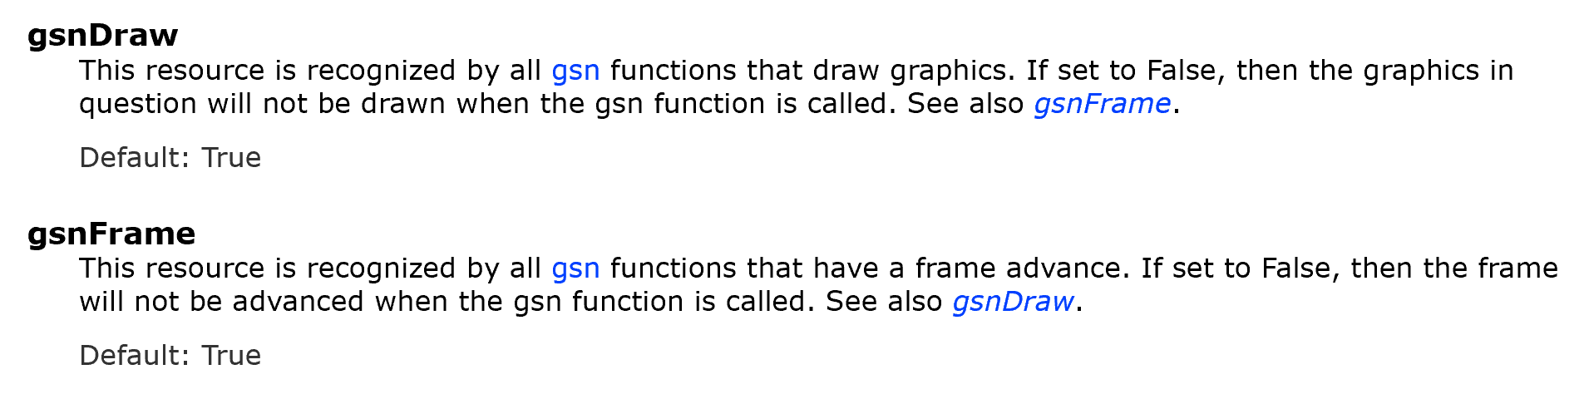
Draw_frame.ncl

Slide 15
9 Overlay
Use NhlAddData to add a line, a legend, or other graphical object to an existing plot.
Use the gsn_csm_contour_map_overlay
plotting function (this method is not usually recommended)
NCL Graphics: Overlay Plots (ucar.edu)

Slide 16
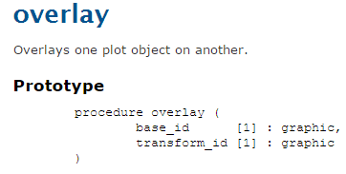
The overlay procedure adds (superimposes) the second object onto the first object.
After the overlay is complete, it is necessary to manually draw the combined object and advance the frame.

Slide 17
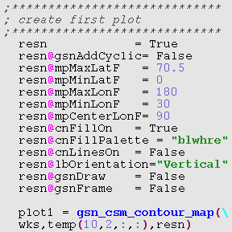
9 Overlay

Slide 18
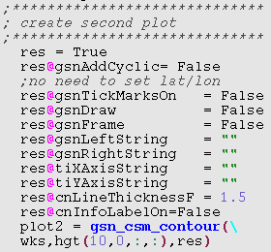
9 Overlay

Slide 19
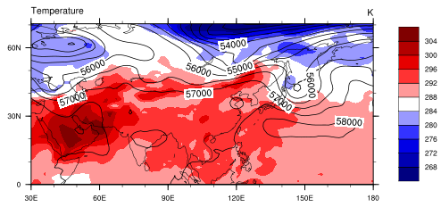

9 Overlay

Slide 20
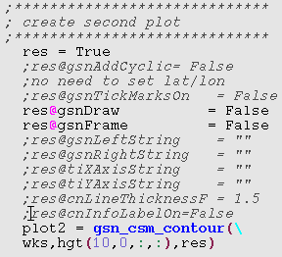
9 Overlay

Slide 21

9 Overlay

Slide 22
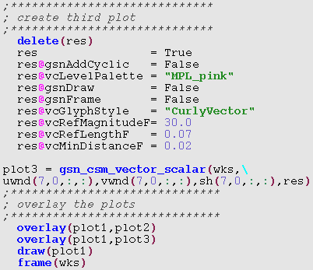
9 Overlay

Slide 23
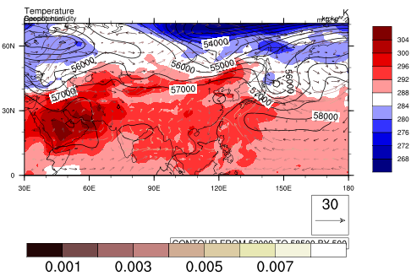
9 Overlay

Slide 24
9 Overlay
The most important aspect of successfully creating an overlay is to ensure that the coordinates variables for the data in the two plots are the same.
If they are not, the overlay may produce incorrect results.

