Slide 1
诊断分析与绘图 （十） Data Analysis and Arrays （P. 48）

Slide 2
10 Data Analysis and Arrays
NCL offers different approaches to analyzing data:
(1) array syntax and operations,
(2) hundreds of built-in functions,
(3) many user contributed functions
(4) invoking Fortran or C language routines
.

Slide 3
10.1 Array ordering and syntax
NCL‘s algebra, like Fortran 90, MATLAB and IDL supports operations on scalars and arrays.
For array operations to work, both operands must have the same number of dimensions and same size dimensions, otherwise an error condition occurs.
Furthermore, the data types of each operand must be equivalent, or one operand must be coercible to the type of the other operand.
Notes:
Operand 操作数 algebra 代数
Coercible 强制类型转换，发生在数据类型不同的计算时。
标量和数组
学生自己构建几个数组，不同类型，不同大小的，来做一下计算。C=A+B，D=A*B
比如A是2*4的数组，B也是2*4的数组，那C和D就可以算出来，但如果有个F，size不一致，就不能运算。
举例时候很好理解，实际分析数据的时候就要多注意，不确定的话就printVarSummary查一下。

Slide 4
操作练习
1. 构建A、B两个大小相同的二维数组（有几种方法？），A为整型数组，B为浮点型数组；
2.用A、B两个数组做+、-、*的运算，分别生成新的C、D、E数组。注意看新的三个数组的类型；
3.构建一个不能和A或B数组做+、-、*运算的数组F(它的特点是什么)；
4.构建一个跟A大小相同的字符型数组S，S的元素是数字字符串（如: (/”1”,”23”,”3”/)；
5.做S=A+B的计算，看结果是什么；
6.做G=S+A的计算，看结果是什么。

Slide 5
2.15 Coercion
Coercion is the implicit conversion of data from one data type to another. This occurs when two or more values of different variable types are operands to the same operator.
A simple example is:
X = 5.2 + 9 ;float+integer
;the 9 is silently coerced (promoted) to
;float prior to the addition
Notes:
Coercion [koʊˈɜ:rʒn] 强制
数据类型强制转换
implicit [ɪmˈplɪsɪt] 隐性的，含蓄的

Slide 6
2.15 Coercion
NCL will automatically coerce when no information is lost.
If K is of type integer and X is of type float (or double) then the following statement would result in a fatal error (no coercion because information is possibly lost):
K = X ;result in a fatal error
When information may be lost, explicit conversion functions must be used.
K = toint(X)

Slide 7
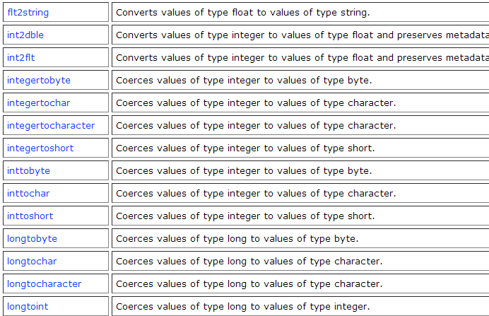
2.15 Coercion
http://www.ncl.ucar.edu/Document/Functions/type_convert.shtml
Notes:
网页上有很多函数，只是要注意有的函数是后续版本里才能用的。

Slide 8
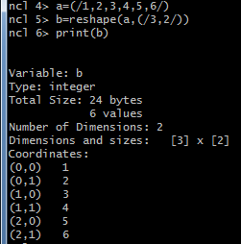
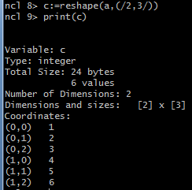
10.1 Array ordering and syntax
Notes:
Reshape()函数的使用

Slide 9
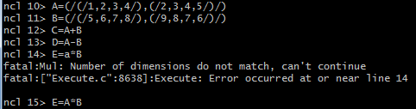
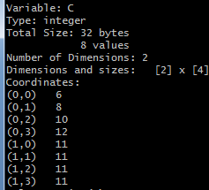
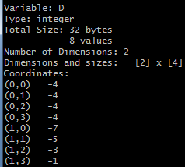
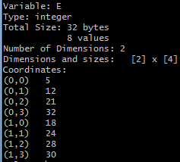

Slide 10
10.1 Array ordering and syntax
C, D and E will be created automatically if they did not previously exist.
If they did exist then the result of the operation on the right hand side must be coercible to the type of left hand side.

Slide 11
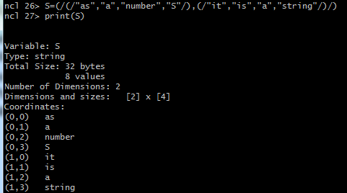
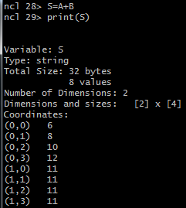
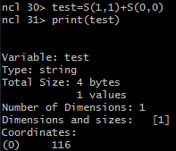
Notes:
数据类型很重要，特别是数值样子的字符型数据不要搞错。

Slide 12
10.1 Array ordering and syntax
Scalar values are special cases when considering array operations.
When scalar values appear in an expression with a multi-dimensional value (i.e., an array), the scalar value is applied to each element of the array.

Slide 13

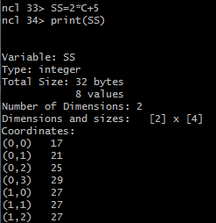

Slide 14
10.1 Array ordering and syntax
NCL’s < and > array operators (sometimes called “clipping operators”) are not commonly used in other languages.
Assume sst is (100,72,144) and sice = -1.8 (a scalar). The statement: sst = sst > sice means that any values of sst less than sice will be replaced by sice.
All array expressions automatically ignore any operation involving values set to _FillValue.

Slide 15
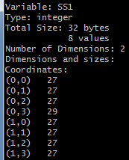
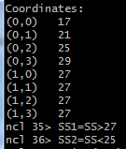
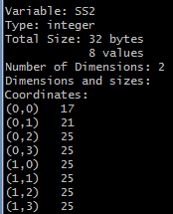

Slide 16
10.2 Array conformance
Array expressions require that all operands have the same number of dimensions and same size dimensions. In this case, the arrays are said to "conform" to each other. Scalars conform to the shape of any array.
Assume T and P are dimensioned (10,30,64,128):
theta = T*( 1000/P )^0.286
This results in theta being dimensioned (10,30,64,128).
Notes:
数组一致性

Slide 17
10.2 Array conformance
conform or conform_dims can be used to generate arrays that conform to another array.
Assume T is dimensioned (10,30,64,128) and P is dimensioned (30):
theta = T*(1000/conform(T,P,1))^0.286
conform expands P, which matches dimension "1" of T.

Slide 18
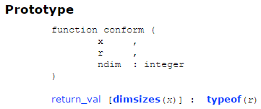
conform
Expands an array or scalar so that it conforms to the shape of the given variable.
Note: it may be preferable to use the conform_dims
function. This function takes as its first argument the dimension sizes of the new array you want to conform to, rather than the array itself.

Slide 19
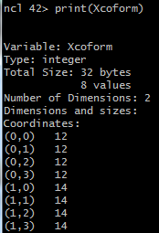

（0，0）
（0，3）
Row0Row1
12
14
12
14
12
14
12
14
（1，0）
（1，2）

Slide 20

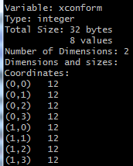
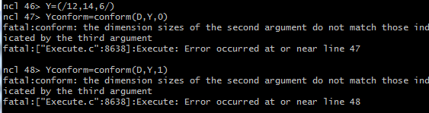
Notes:
如果是scalar，那么没必要用conform函数来处理。

Slide 21
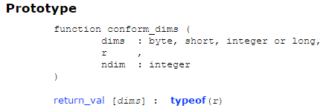
conform_dims
Expands an array or scalar so that it conforms to the shape of the given dimension sizes.

Slide 22
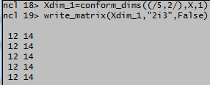

Notes:
Xdim_3=conform_dims((/5,2/),Y,0)
write_matrix(Xdim_3,"5i3",False)

Slide 23
10.3 Array memory allocation
Memory can be explicitly allocated/created for arrays in two ways:
1) Use of the array constructor (/.../)
a_float = (/1.0, 2.0, 3.0/)
a_string = (/“a”,“b”,“c”/)
a_2darray = (/(/1,2/),(/5,6/),(/8,9/)/) ; 3 rows x 2 cols
Use the new(array_size,shape,type,[_FillValue]) statement:
a = new(3,float) ; 9.96921e+36
b = new((/73,144/),float,1e20) ; 1e20
Notes:
可以通过两种方式显式地为数组分配/创建内存
Memory is automatically created by functions for returned variables; thus, use of the new
statement is not often needed or recommended.
New函数的说明：vartype The type of the NCL variable to create. This can either be a string, like “float”, or just the word float (without quotes). 第二个参数可以只是字符串，不要引号。

Slide 24
10.4 Functions and procedures
Functions are expressions because they return one or more values and can therefore be used as part of an expression. Functions are not required to return the same type or size array every time they are called.
e.g. z = exp(sin(max(q))) + 12.345
Procedures cannot be part of an expression because they do not return values. NCL procedures perform a specific task and/or are used to modify one or more of the input arguments.
Notes:
Memory is automatically created by functions for returned variables; thus, use of the new
statement is not often needed or recommended.

Slide 25
Arguments to NCL functions and procedures:
Arguments are passed by reference. This means that changes to their values, attributes, dimension names, and coordinate variables within a function or procedure will change their values in the main program.
By convention, arguments to functions should not be changed by a function although this is not required. In the following discussion, it will be assumed that arguments to functions follow this convention.
Notes:
参数通过引用传递。这意味着对函数或过程中的值、属性、维度名称和坐标变量的更改将更改它们在主程序中的值。按照惯例，函数的参数不应该被函数更改，尽管这不是必需的。

Slide 26
Argument prototyping:
Function and procedure arguments can be specified to be very constrained and require a specific type, number of dimensions, and a dimension size for each dimension, or arguments can have no type or dimension constraints. This is called argument prototyping.
Notes:
Prototype： 原型，最初的形态
Argument： 参数
参数说明，好像更好理解

Slide 27
Argument prototyping:
(a) Constrained argument specification means arguments are required to have a specific type, size and dimension shape.
procedure ex (x[*][*]:float,y[2]:byte,\
res:logical,text:string)
The argument x must be a two-dimensional array of type float, y must be a one- dimensional array of length 2, res and text must be of type logical and string respectively, but can be of any dimensionality.

Slide 28
Argument prototyping:
(b) Generic type prototyping: type only
function xy_interp(x:numeric,y:numeric)
(c) No type, no size, no dimension shape specification:
procedure foo(a,b,c)
(d) Combination:
function ex(d[*]:float, x:numeric, \
wks:graphic, y[2],a)
Notes:
通用的类型原型

Slide 29
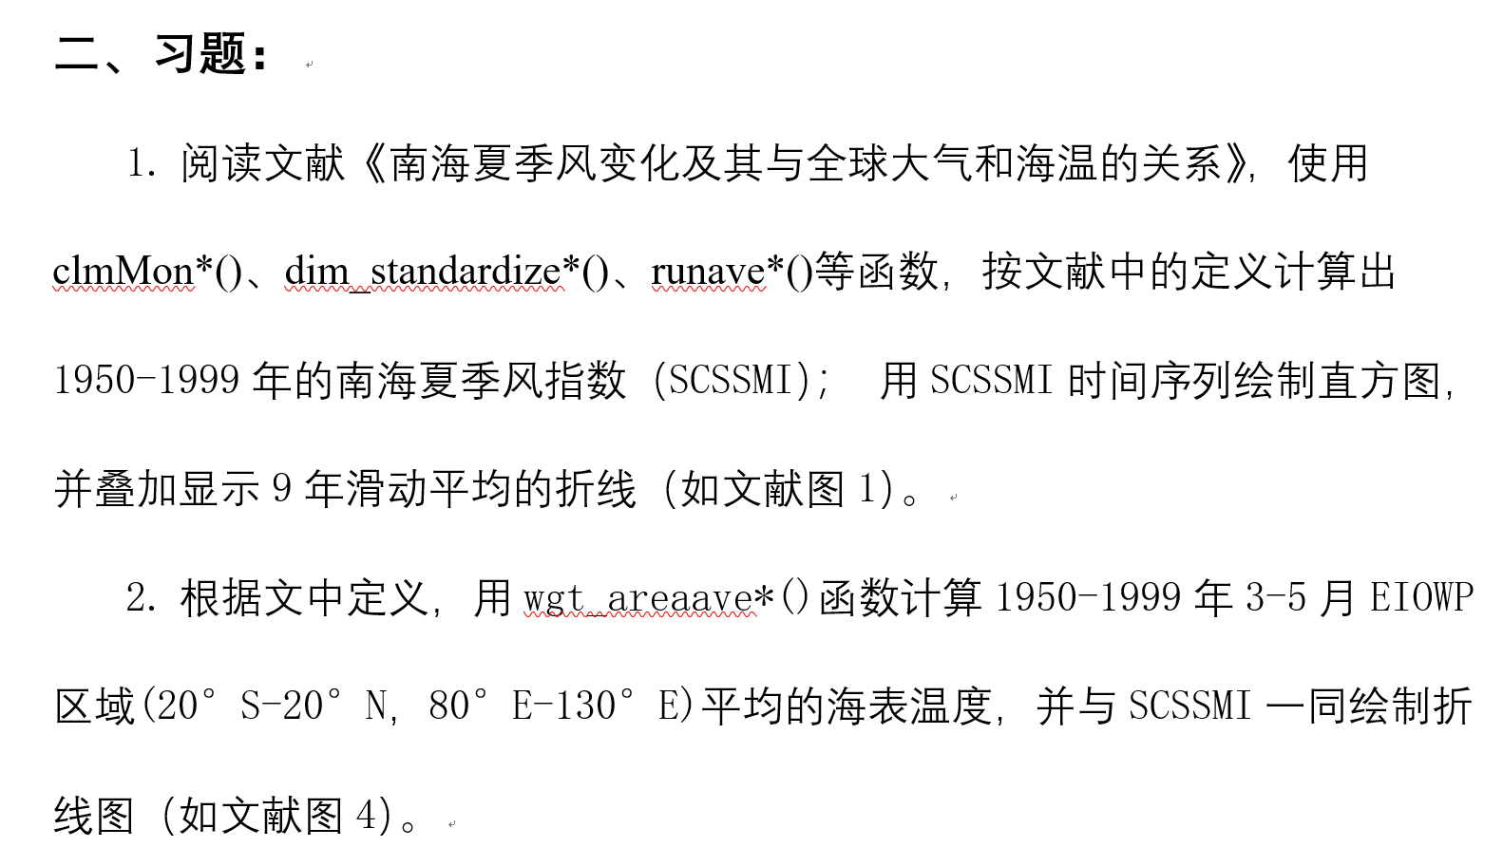

Slide 30
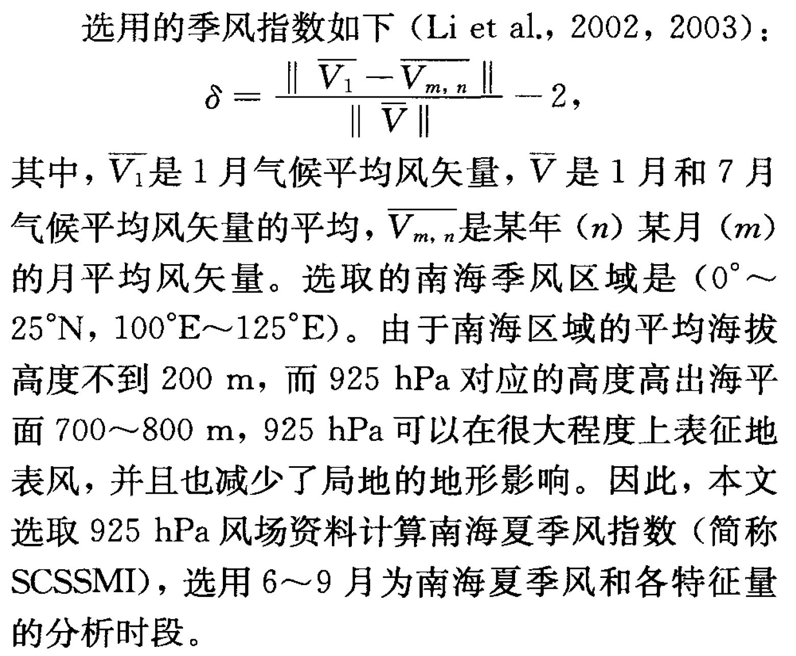

Slide 31



计算步骤
1.先用各物理量按公式计算所有格点（时间和空间）上的 和 ；
2. 计算分子和分母的全风速。就是两个||包含的意思，全风速= 然后按公式计算出δ；
3.求南海季风区域δ的区域平均；
4.计算上一步结果的6-9月平均值得到最后的指数。

Slide 32

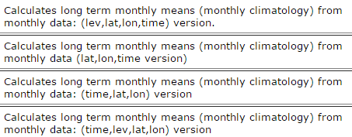
clmMon*()
Notes:
都是算月尺度的气候平均值。
类似bar图那个实验里的习题2，算出1，12月的气候平均值。
除了mon，还有day和dayhour；

Slide 33
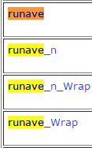
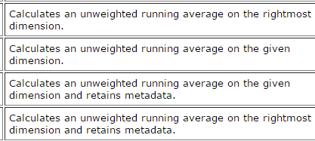
runave*()
Notes:
还有一组wgt_runave。带权重的。
滑动平均。
带n，不带n；
带Wrap和不带Wrap；

Slide 34
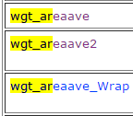
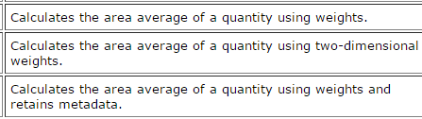
wgt_areaave*()
Notes:
区域平均，带权重的；
带二维权重的；
带元数据的。
函数说明里有权重的考虑方法，实验时也可以不考虑权重。
当然，如果自己对比一下也是很好的。

Slide 35
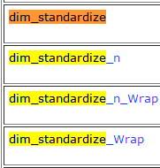
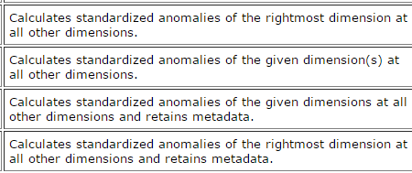
dim_standardize*()
Notes:
标准化的函数。

