Slide 1
诊断分析与绘图 准备实验三 NCL File input/output Language

Slide 2
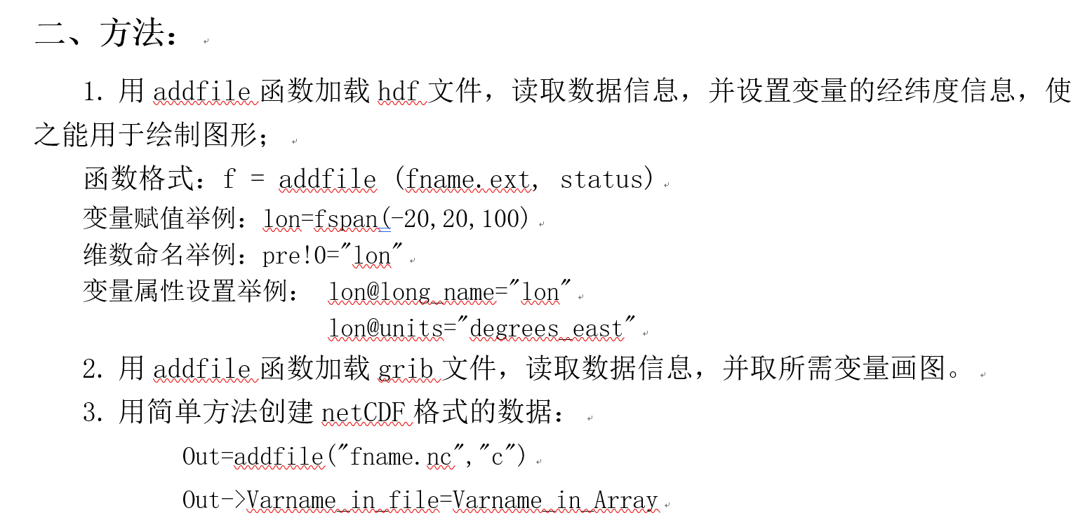

Slide 3
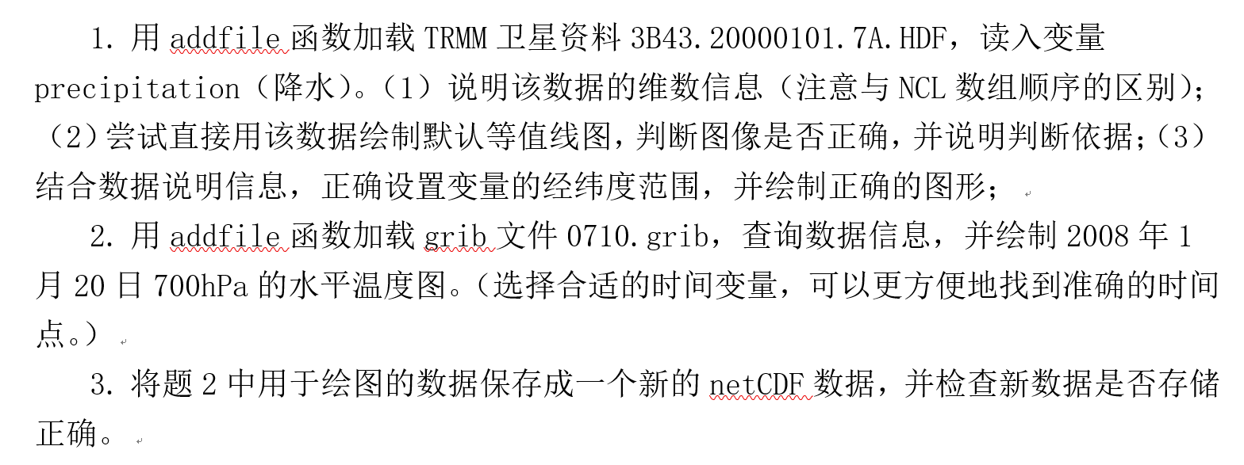

Slide 4
3.1 Supported formats
NCL has robust file input and output.
Read and write: netCDF-3, netCDF-4 classic, netCDF-4, HDF4, binary, and ASCII data.
Read only: HDF-EOS2, HDF-EOS5, GRIB1, GRIB2, and OGR files (shapefiles, MapInfo, GMT, Tiger).
It can be built as an OPeNDAP client.
http://www.ncl.ucar.edu/Document/Manuals/Ref_Manual/NclFormatSupport.shtml

Slide 5
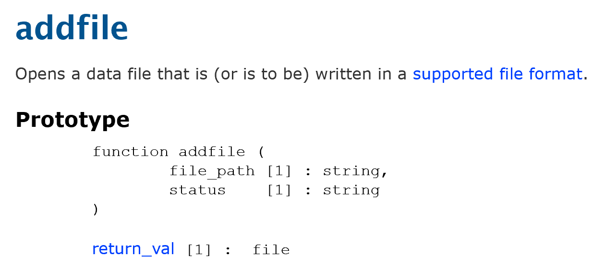
3.1 Supported formats Create file reference
The function, addfile, can be used to import all supported formats:
status: "r" [read: all supported formats]
"c" [create: netCDF, HDF only]
"w" [read/write: netCDF, HDF only ]

Slide 6
When "c" is set, assuming the user has permissions to write in the specified directory and the format is writable, the file is created if it does not exist. If it does exist, an error message is printed and the default missing value for files is returned.
When “w” is set, if the file exists, is in a writable format, and has permissions allowing read/write access, the file is opened for reading and writing. If any of these conditions fail, an error message is reported and the default file missing value is returned.
When "r" is set, if the file exists and has permissions allowing read access, the file is opened for reading; otherwise an error message is printed and the default missing value is returned.
Notes:
Permission，要注意linux里的用户权限问题。
c用来创建文件，没有文件的时候也不能用w
w的文件写入是可以追加的。所以有可能文件越来越大。如果是相同变量名，可能不会增加，但变量名不同就会增加变量。

Slide 7
3.1 Supported formats Create file reference
Examples:
; some other .ext
f = addfile("foo.nc", "r") ; .cdf, .nc4
grb = addfile(“/my/dir/foo.grb”, “r”) ; .grib1, .grib2
hdf = addfile(“/your/hdf/foo.hdf”,“c”) ; .h5, .hdf5
heos = addfile(“foo.hdfeos”, “r”) ; .he2,.he5

Slide 8
3.1 Supported formats Create file reference
Alternate ways of specifying the file path include:
diri = "~/some/other/path/"
fili = "gpm"
ext = ".h5"
sat = addfile(diri+fili+ext, "r")
；+ used for string concatenation
Notes:
字符串连接运算

Slide 9
3.1 Supported formats Reading Variables
Importing (reading) variables from any supported format is simple. If X is a variable on a file referenced (pointed-to) by f, then:
x = f->X
Variable metadata will automatically be attached to the variable x.
Notes:
Metadata 元数据，具体是指什么信息？

Slide 10
2.11 Named dimensions
All variables read from netCDF, GRIB and HDF files have named dimensions.
The ! symbol is used to create a named dimension or to retrieve a dimension name.
Notes:
Named dimensions –命名的维

Slide 11
2.11 Named dimensions
Dimension numbering proceeds from left-to-right with the leftmost dimension equal to 0. The dimensions are numbered from 0 to n-1
Assignment of named dimensions via ! syntax:
Assume T is 3D array with size (ntime, nlat, nlon):
T!0 = "time"
T!1 = "lat"
T!2 = "lon"
Retrieval of named dimensions: LAT = T!1 ; LAT = "lat"

Slide 12

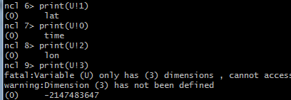
Notes:
命名维：用！来引用
命名维就是查询变量信息是显示在dimensions and sizes部分的，如本页中的time，lat和lon

Slide 13
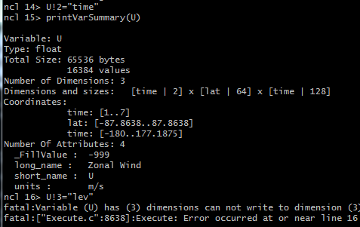
Notes:
创建命名维或重新给某维命名用：U!#=“dim”
注意，这页的第一行是把原来的lon维命名成了time维。这样的操作是不恰当的。
U！3这句就还是出错，没有#3这一维

Slide 14
2.11 Named dimensions Dimension reordering
Dimension reordering: Named dimensions should only be used when dimension reordering is required.
reordered_T = T(lon|:,lat|:,time|:) ; (lon,lat,time)
Named dimensions are not subscripts. However, named dimensions can be used with coordinate and standard subscripting.
X = T({lat|-20:20}, lon|30:42, time|:)
;(Reorder to (lat,lon,time) and select latitudes
;–20 to 20, longitude indices 30 through 42,
;all time values.)
Notes:
前面讲的named dimension，就是用来重新排序的。

Slide 15
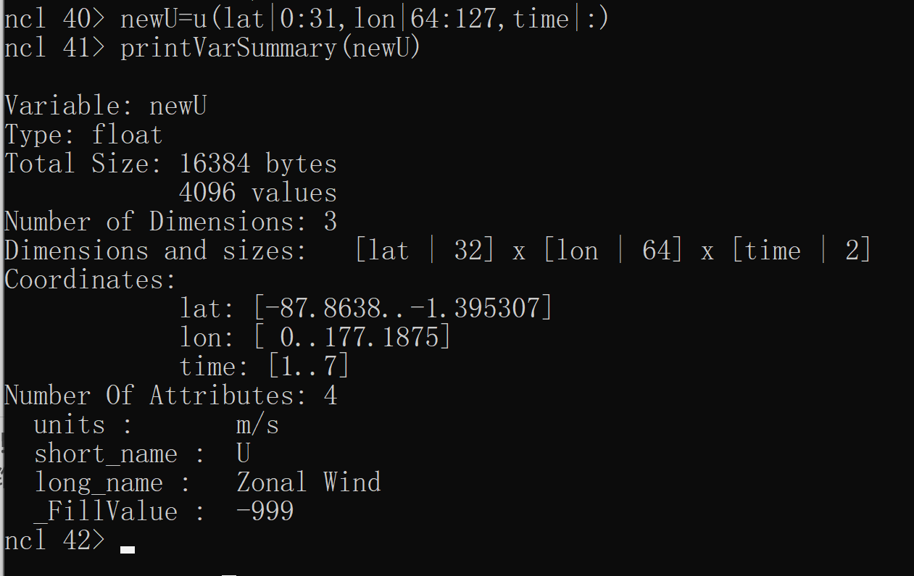

Slide 16
2.12 Coordinate variables
A coordinate variable is a one-dimensional array containing monotonically increasing or decreasing values that has the same name and size as the dimension to which they are assigned (e.g. time(time), level(level), lat(lat), etc.).
The & operator is used to reference and assign coordinate variables.
Notes:
有了named dimension之后，再有coordinate variable。

Slide 17
2.12 Coordinate variables
In order to assign a coordinate variable to a dimension, the dimension must first have a name associated with it:
; step1: name a dimension
T!0 = "lat"
T!1 = "lon"
; step 2: assign values to named dim
T&lat = (/-90.,-85.,...,85.,90./)
T&lon = fspan(0.,355.,72)
Notes:
用到fspan（）
Creates an array of evenly-spaced floating point numbers.
Prototype
function fspan (
start [1] : numeric,
finish [1] : numeric,
npts [1] : integral type
)
return_val [npts] : float

Slide 18
2.13 Attributes
Attributes are descriptive information that may be associated with an existing variable. They are very useful for communicating information to the user about specific data.
Variable attributes are referenced by entering the variable name, followed by the symbol @ and the attribute name:
T@units = "Degrees C" ; assign attribute
T@_FillValue = -9999.0 ; assign scalar float
T@wgt = (/.25,.50,.25/) ; assign 1D array
W = T@wgt ; retrieve attribute

Slide 19

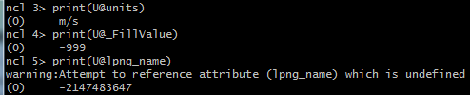
2.13 Attributes
Typical variable attributes include units, long_name, standard_name, coordinates, scale_factor, add_offset, valid_min, valid_max and axis.
Notes:
变量属性：用@符号来引用
也可以给属性重新赋值,用:U@units=“km/s”
注意这两个属性，如果有scale_factor, add_offset,实际的数值结果就要计算后得出，见下一页的例子。

Slide 20
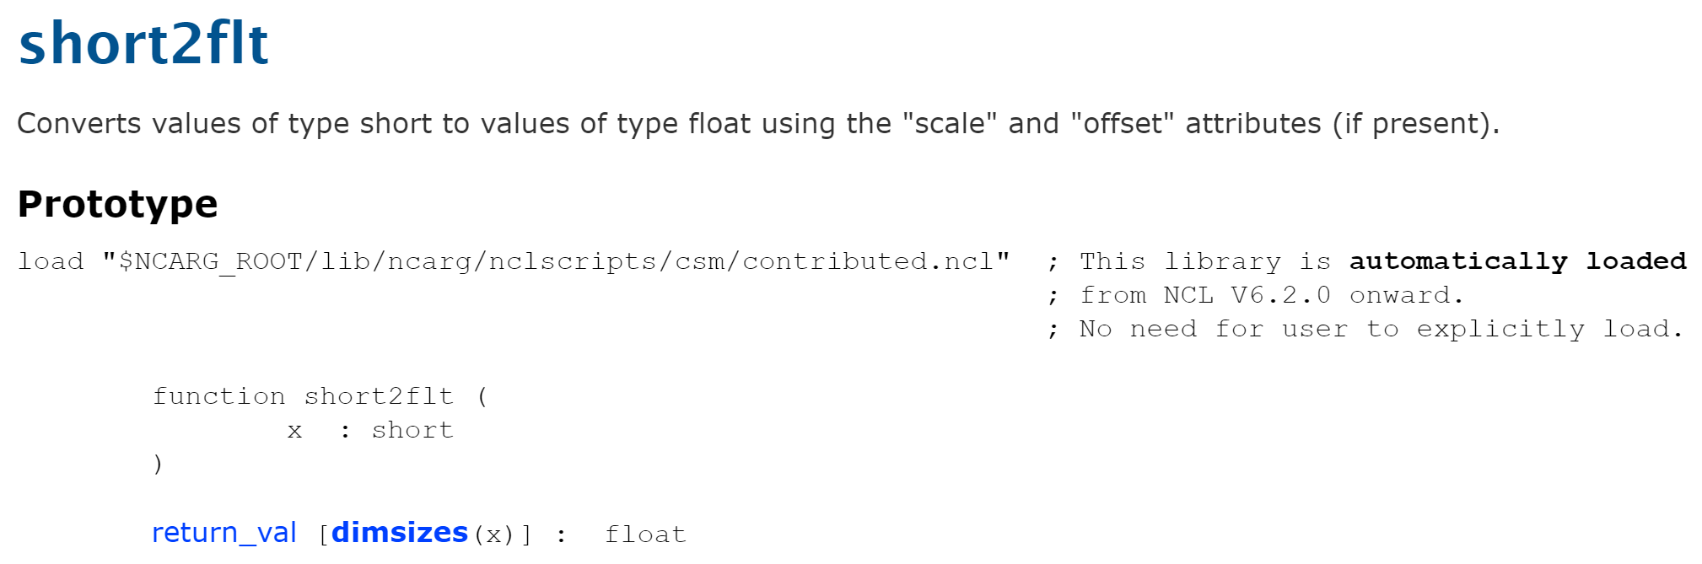
2.13 Attributes
Attributes can be used in expressions and subscripted in the same fashion as variables:
T = TS * TS@scale_factor + TS@add_offset
Notes:
线性处理后的数据要用这两个参数计算后才得到正确的数值。通常不用我们自己再去换算，可以用函数直接做好转换。
下标方式和变量一致。

Slide 21
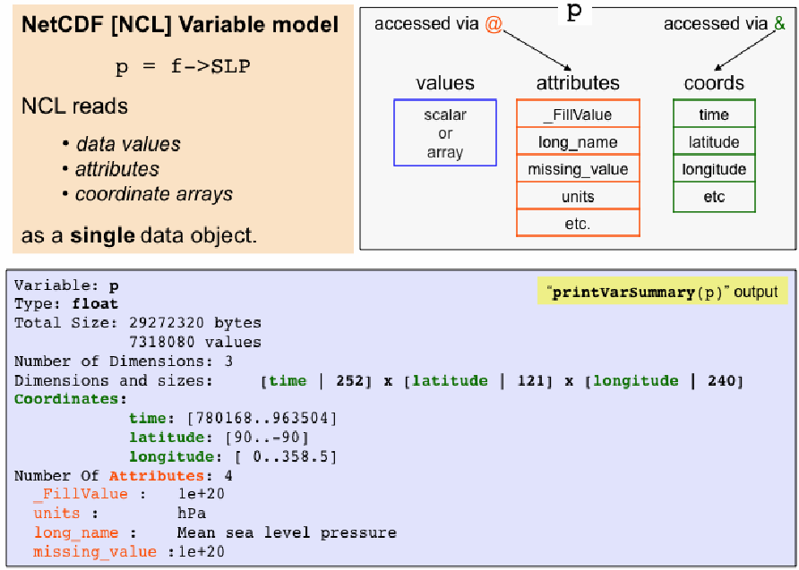
Notes:
从文件中读取的数据包含有：数值、变量属性、坐标数组；

Slide 22
3.4 Writing netCDF/HDF
There are two approaches for creating netCDF (or HDF) files.
The first method is called the "simple method"
The second method follows the "traditional approach" of explicitly predefining the file’s contents before writing any values to the file.
We just focus on the simple method.

Slide 23
3.4 Writing netCDF/HDF Simple method
This method is straightforward. One could substitute ".hdf" for the ".nc" to create an HDF file.
fo = addfile("foo.nc","c")
fo->X = x ；X是nc文件中的变量名
；x是脚本文件中的变量名
fo->Y = y

Slide 24
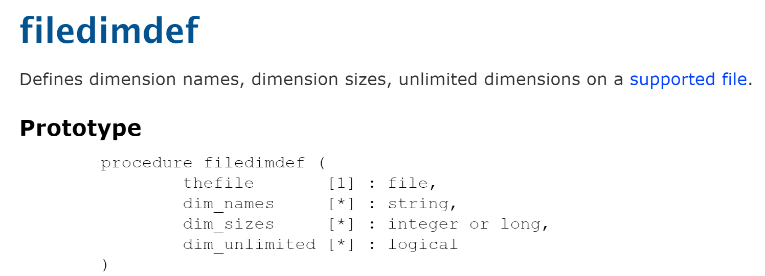
To create an UNLIMITED dimension, which is usually time, it is necessary to add the following line of code prior to writing any values: filedimdef(fo,"time",-1,True)

Slide 25
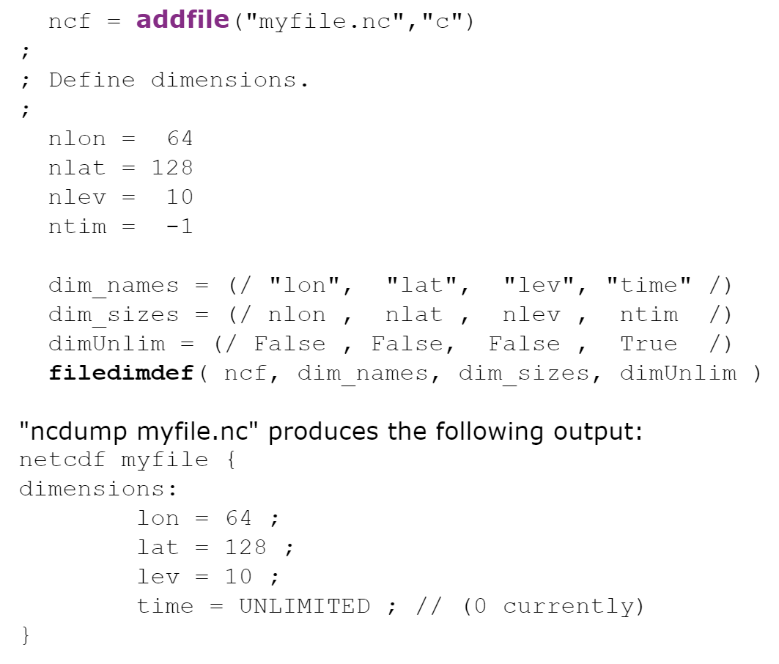
Notes:
这个用法可以一次定义4个维的信息。注意一维数组（/……/）的构建方法。

Slide 26
3.4 Writing netCDF/HDF Simple method
Writing scalars to netCDF:
NCL uses the reserved dimension name "ncl_scalar" to identify scalar values that are to be written to netCDF.
; simple method
fo = addfile("simple.nc","c")
con = 5
con!0 = "ncl_scalar"
fo->constant = con
Notes:
Scalar 标量
这种用法不常见，了解就可以。

Slide 27
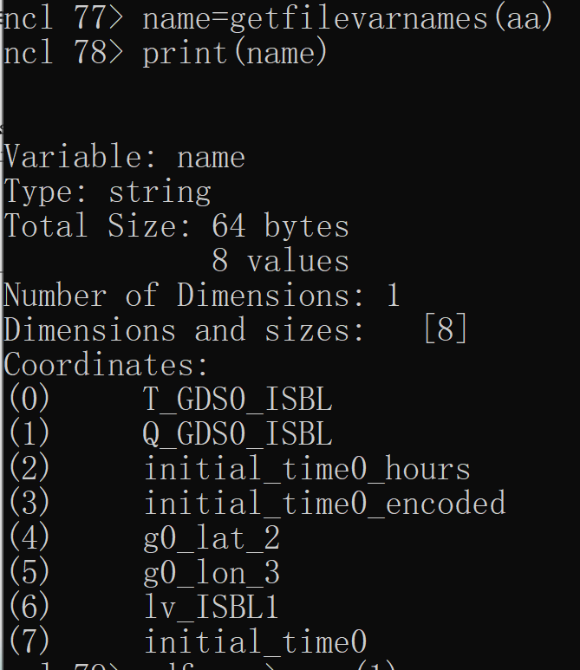
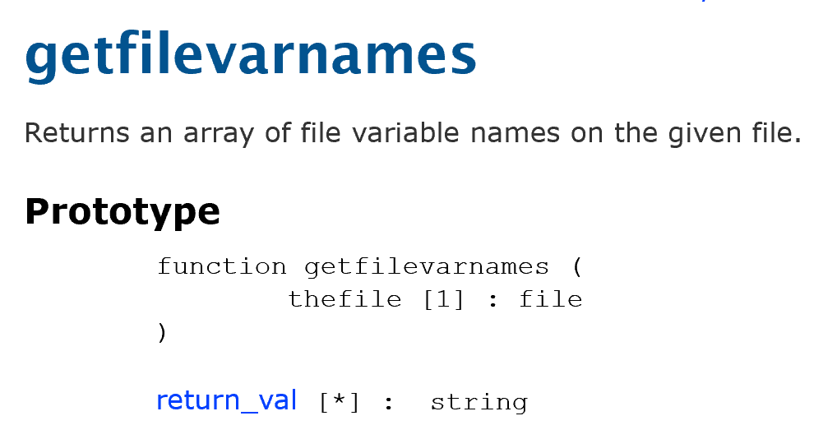
其他小技巧：变量名太长或不规范时。。。

Slide 28
$ syntax
In some instances, the variable name must be enclosed by $ symbols.
This is necessary if the variable on the file has a non-alphanumeric character (e.g., space, "+", "-", etc.) embedded in the name:
x = f->$"ice cream+oreo-cookies…yummy!"$

Slide 29
$ syntax
More commonly, the variable on the right hand side of the pointer (->) is a variable of type string:
vars = (/"T","U","V"/)
x = f->$vars(n)$
; loop indices: n=0,1,2
Notes:
可以用循环的方式读取不同的变量，这时也可以用$符号。

Slide 30
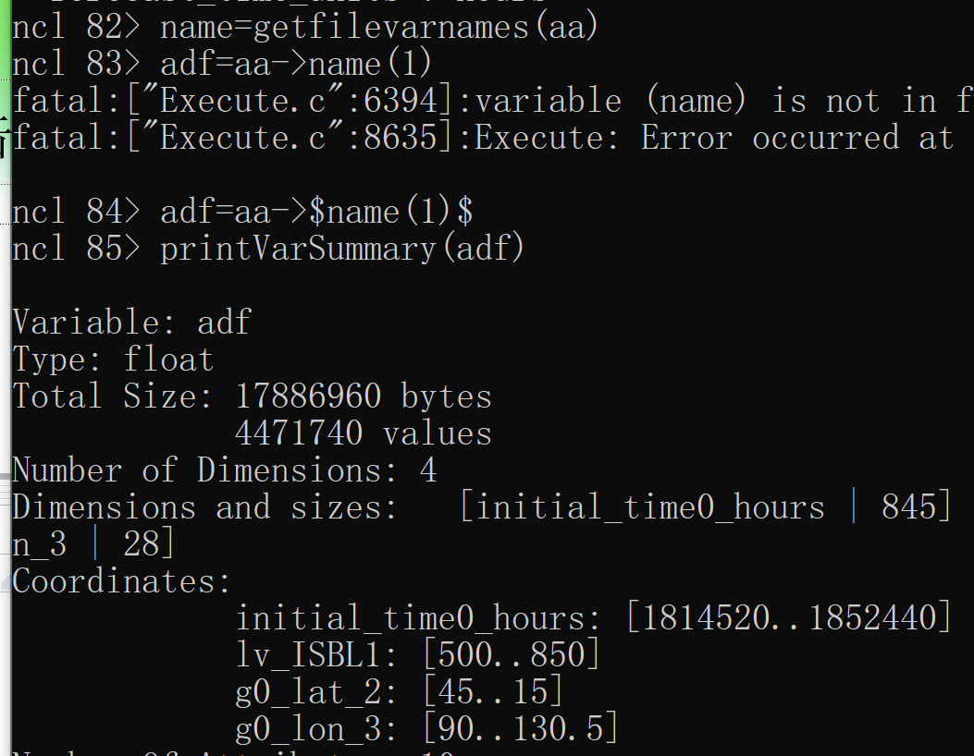

Slide 31
