Slide 1
诊断分析与绘图 准备实验五 Chapter 4: High Level Graphical Interfaces Chapter 7: X-Y plot Chapter 18：Legend (P. 28-32, P.39 and P.63)

Slide 2
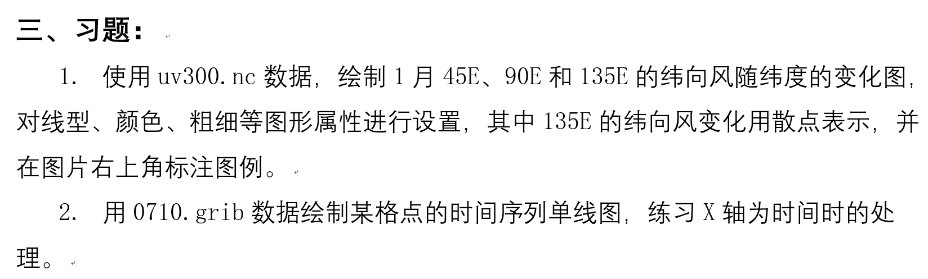
实验五 绘制单线图

Slide 3
4.1 Sample Script
In general, a script has the following characteristics: (1) load the libraries. By convention, this occurs before the begin statement. No need for NCL 6.2 onward.
(2) Read in the data.
(3) Conduct data processing (optional).
(4) Open a workstation.
(5) Choose a color table (optional).
(6) Create a resource variable to which various graphical options (resources) may be assigned as attributes.
(7) Invoke the appropriate graphical interface passing in the workstation, data, and resources.
Notes:
从这个实验开始，就要用脚本来完成任务了。

Slide 4
4.1 Sample Script
;********(1) load the libraries.************
load "$NCARG_ROOT/lib/ncarg/nclscripts/csm/gsn_code.ncl"
load "$NCARG_ROOT/lib/ncarg/nclscripts/csm/gsn_csm.ncl"
;*******************************************
begin
;*********(2) Read in the data**********
in = addfile("myfile.nc","r") ; pointer to file
t = in->T ; read in data
;*******************************************

Slide 5
4.1 Sample Script
;*********(4) Open a workstation*************
wks = gsn_open_wks("ps","ce") ; open ce.ps file
; ********(5) Choose a color table **********
gsn_define_colormap(wks,"BlAqGrYeOrRe")
; ********(6) Create a resource variable****
res = True ; resource varb
res@cnFillOn = True ; turn on color
res@cnLinesOn = False ; no cn lines
res@cnLevelSpacingF = 0.5 ; cn spacing
res@gsnSpreadColors = True ; full colors
res@lbAutoLabelStride = True ; nice lb labels
Notes:
这里主要讲res

Slide 6
4.1 Sample Script
;*****(7) Invoke the appropriate graphical interface****
plot = gsn_csm_contour_map(wks,t,res)
end
;*******************************************

Slide 7
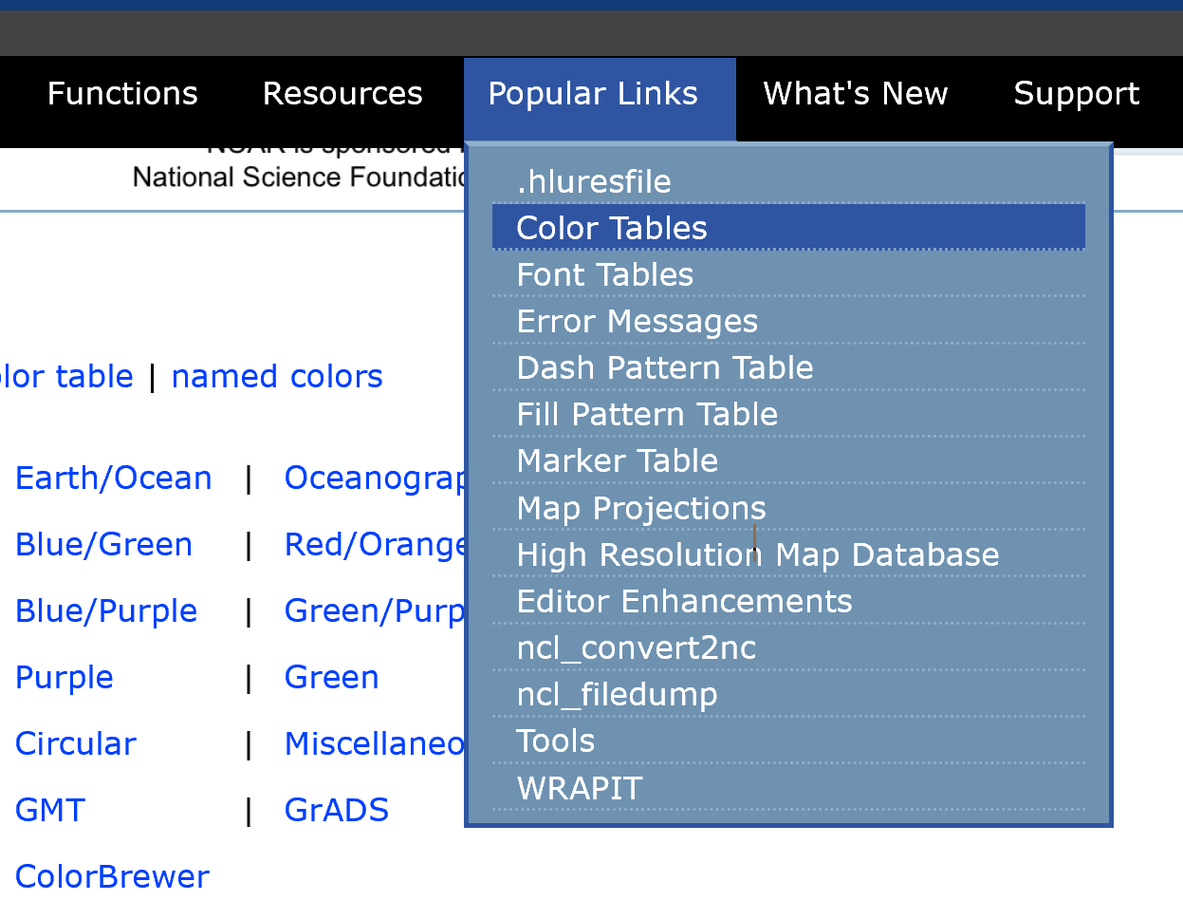
http://www.ncl.ucar.edu/Document/Graphics/color_table_gallery.shtml

Slide 8
4.8 Workstations
Opening a workstation is required prior to the creation of one or more plots. The workstation is simply the location where the graphical instructions are sent (e.g. to a window or postscript file).
The workstation is given a name. This name becomes part of the output filename or title of X11 window.
Users may have many workstations opened at the same time, although most only open one. Only one colormap can be associated with each workstation.

Slide 9
4.8 Workstations
Format:
wks_name=gsn_open_wks(“types”,”file_name”)
There are 7 types of workstations:
PS (postscript)
EPS (encapsulated postscript, contains a bounding box)
EPSI (encapsulated postscript with a bitmap preview)
PDF
X11 window
PNG
SVG (good for web usage)
e.g. wks = gsn_open_wks(“pdf”,”34_x_45”)
wks_2 = gsn_open_wks(“ps”,”myfile”)
http://www.ncl.ucar.edu/Document/Graphics/Interfaces/gsn_open_wks.shtml
Notes:
格式中：
wks_name:可以是任一的变量名；
types：是7种类型之一；
file_name：输出图形文件的文件名，或X11图形窗口的名称，也可以是任意文件名。

Slide 10
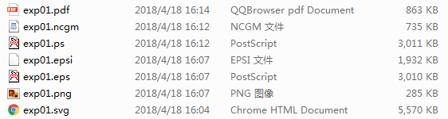
4.8 Workstations
Notes:
其中ncgm是以前版本里提供的一种格式，不太通用。

Slide 11
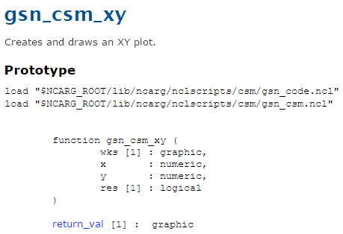
7.1 X-Y plot gsn_csm_xy

Slide 12
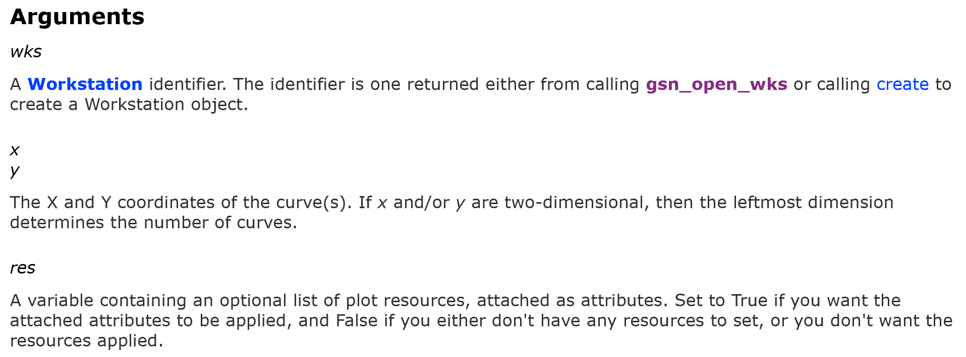

Slide 13
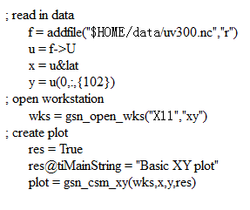
取到绘图数据
绘图
Notes:
新的版本，可以不用load gsn_code和gsn_csm两个文件了

Slide 14
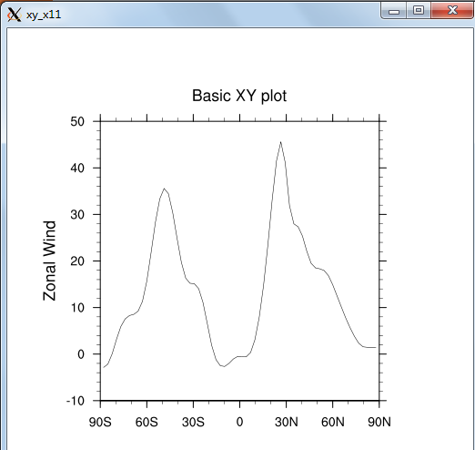
y轴是纬向风数值
线条的物理意义是什么？
x轴是纬度
Notes:
画每个图形都应该想清楚图形的物理意义。

Slide 15
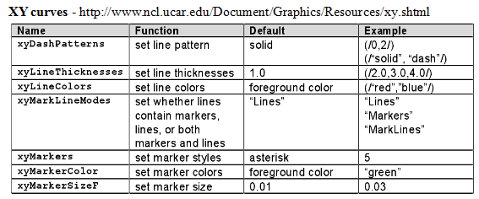
7.2 Related Resources

Slide 16
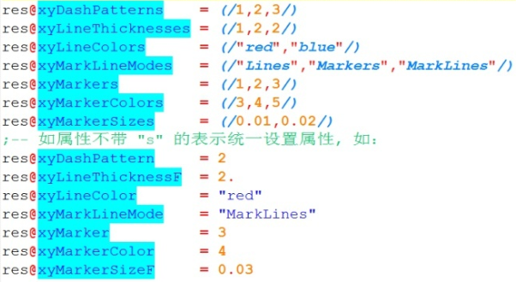

Slide 17
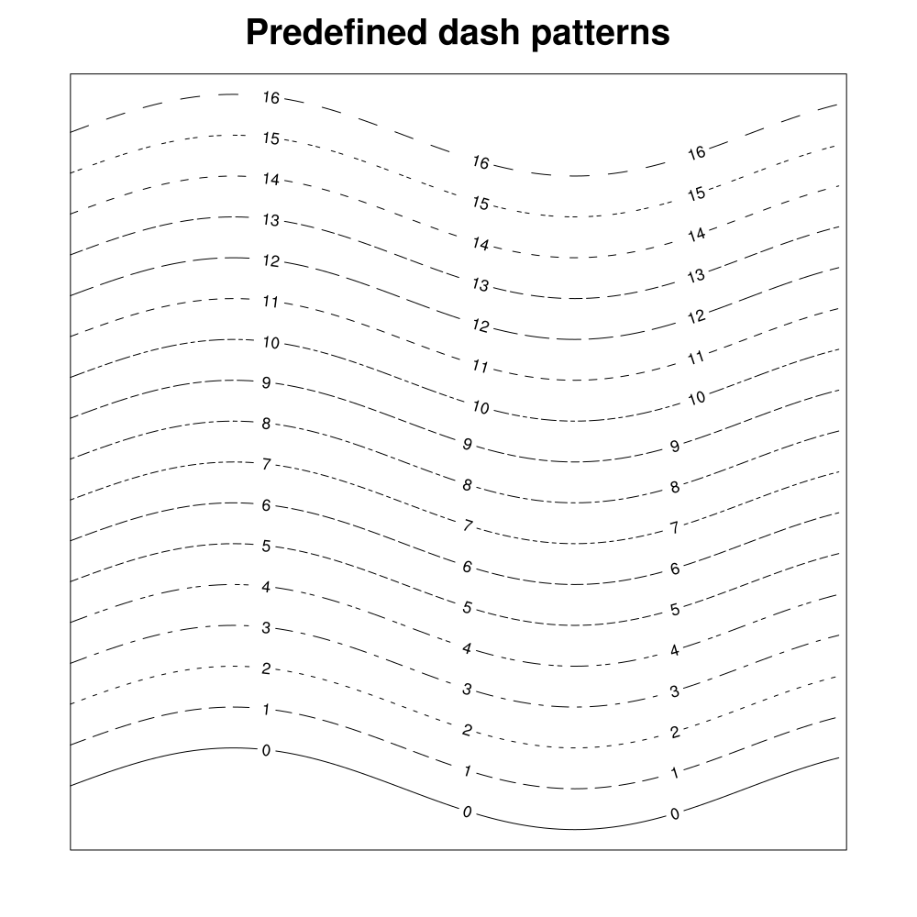
http://www.ncl.ucar.edu/Document/Graphics/Images/dashpatterns.png

Slide 18
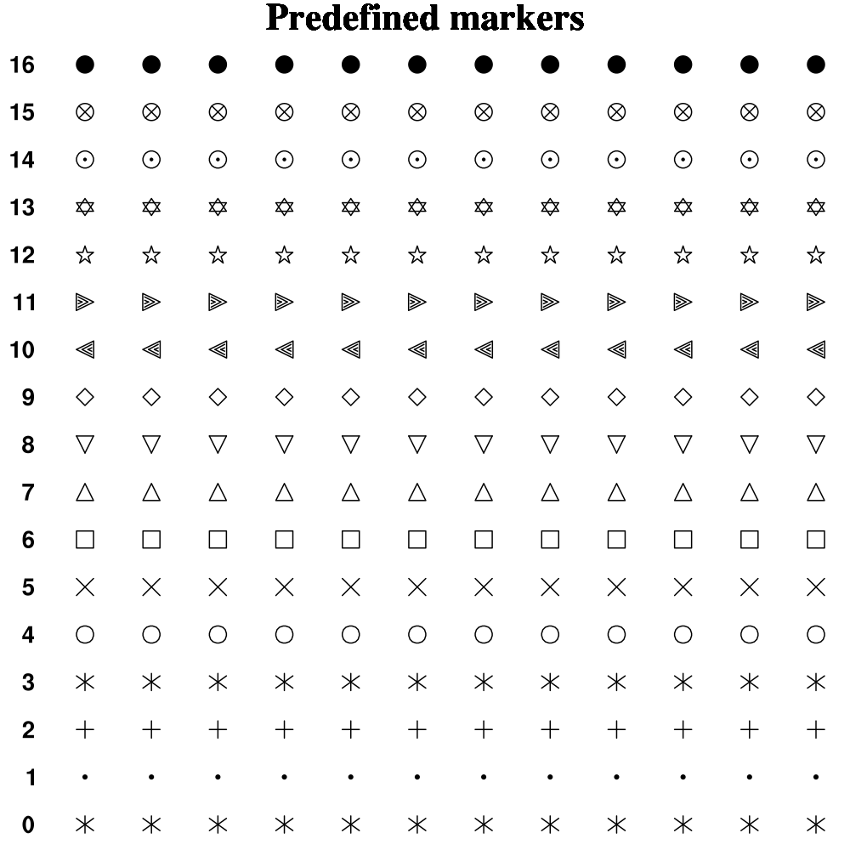
http://www.ncl.ucar.edu/Document/Graphics/Images/markers.png

Slide 19
18 Legends
By default, an x-y plot contains no legend.
To turn a legend on, it is necessary to set pmLegendDisplayMode = "Always".
See Appendix A for a list of other legend resources.（Page 72）

Slide 20
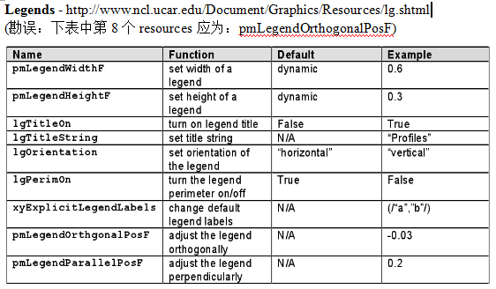
7.2 Related Resources

Slide 21
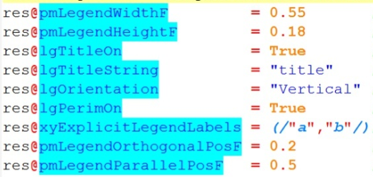
7.2 Related Resources

Slide 22
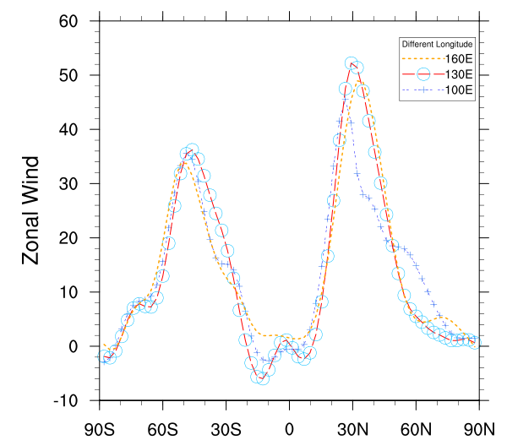
Notes:
对比这两图的差异，充分认识属性设置的功能。

Slide 23
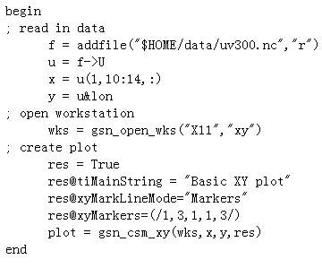
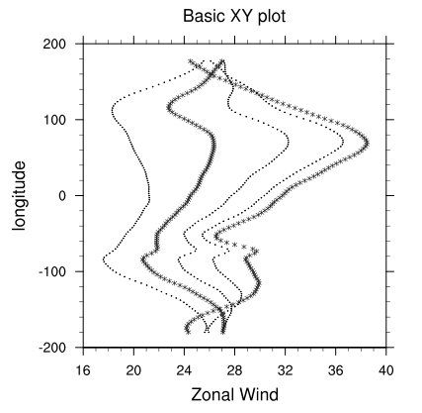
7.3 Scatter Plot
It is easy to change a line plot to a scatter plot by setting xyMarkLineMode to "Markers".

Slide 24
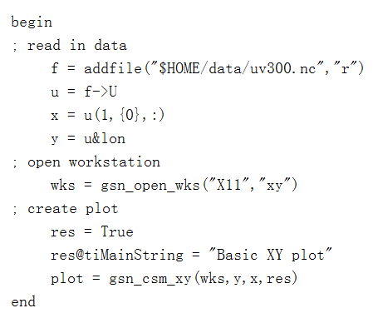
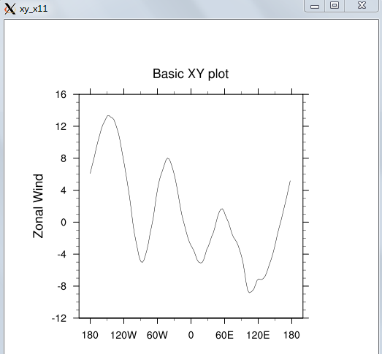
Notes:
绘图语句中y在前，x在后。这时变量y的值被用来作图形中x轴的值，而变量x的数值则对应y轴的数值。

Slide 25
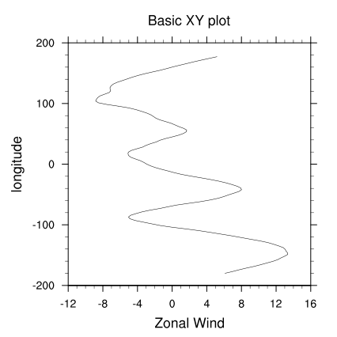
plot = gsn_csm_xy(wks,x,y,res)

Slide 26
time@units
units：A string representing a formatted time unit specification.
Valid strings include:
Seconds minutes hours days months years
The following units qualifiers may also be used:
since after from ref
Examples:
units = "days after 0049-09-01 00:00:00"
units = "hours ref 1-1-1 00:00:00"
units = "months from 1-1-1"
Notes:
限定符 qualifiers

Slide 27
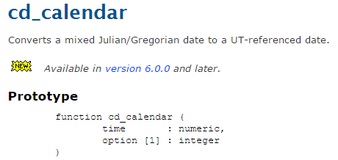
彻底弄懂GMT、UTC、时区和夏令时 - champyin - 博客园 (cnblogs.com)

Slide 28
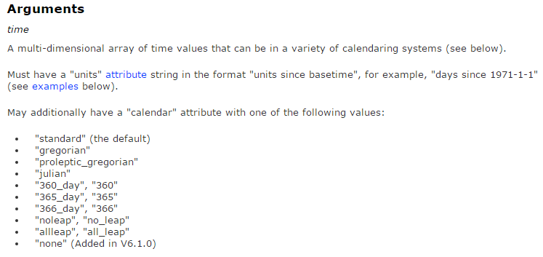
Notes:
还可以指定不同的日历

Slide 29
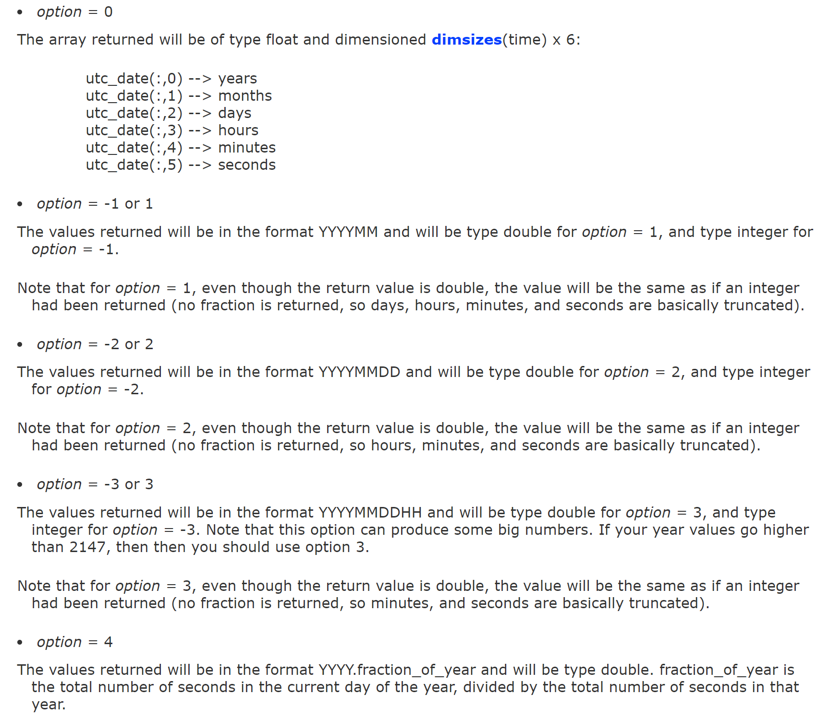

Slide 30
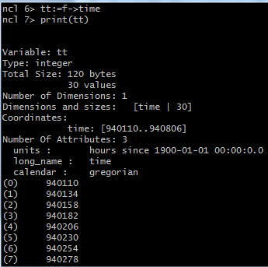
f=addfile("/mnt/d/data/2007apr.nc","r")

Slide 31
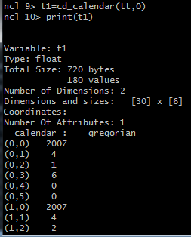

Slide 32
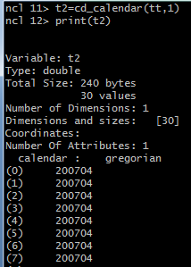
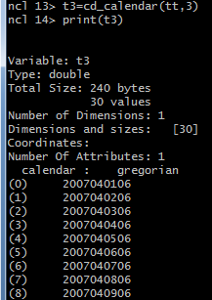

Slide 33
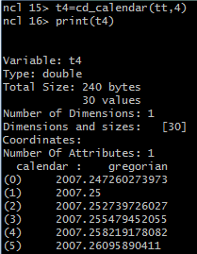
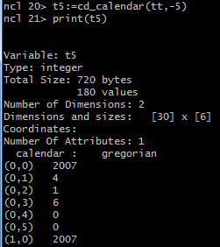
Notes:
5和0 的区别只是type

Slide 34
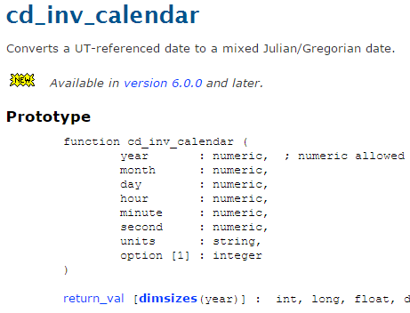

Slide 35
