Slide 1



Understanding the Networking Performance of Wear OS
Xiao Zhu¹ Yihua Ethan Guo² Ashkan Nikravesh¹
Feng Qian³ Z. Morley Mao¹
¹University of Michigan ²Uber Techologies Inc. ³Univeristy of Minnesota
Notes:
Good afternoon everyone/Thanks for the introduction, and thank everyone for being here. I’m Xiao Zhu from U of M. Today I’m presenting our paper on an empirical study to understand the networking performance of Wear OS, one of the most popular smartwatches.

Slide 2
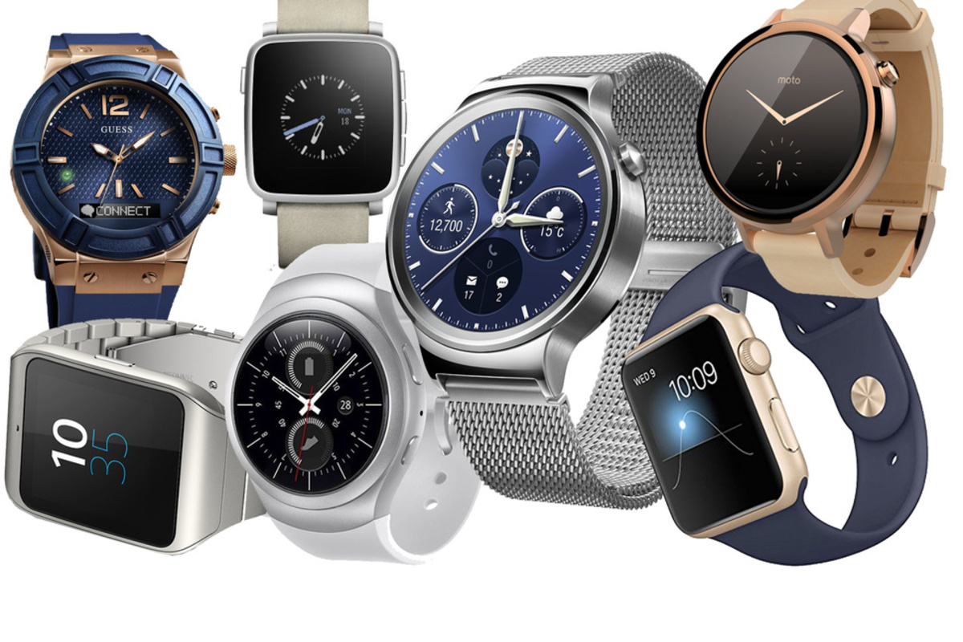
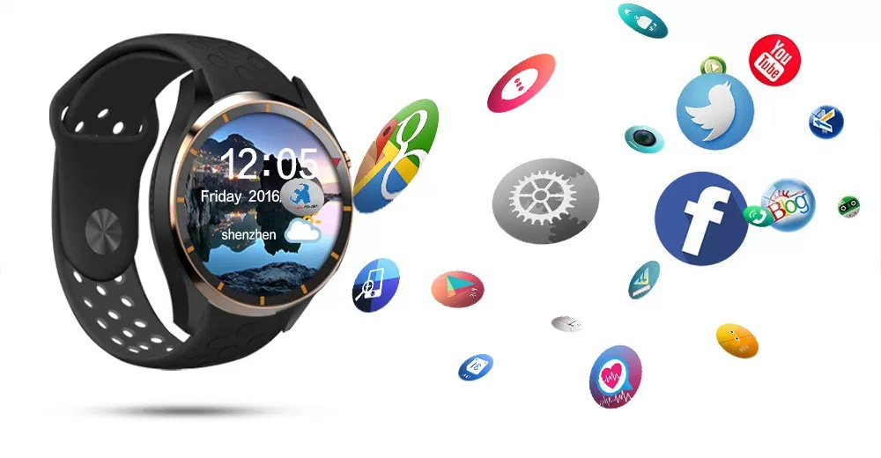
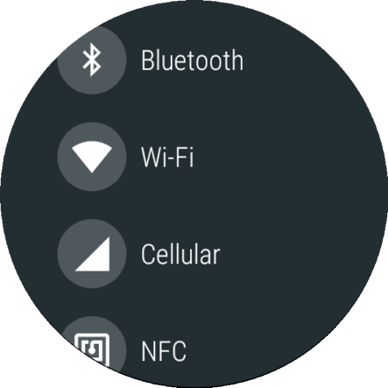
Wearable Networking Is Important
Increased popularity
Third-party apps
Multiple network interfaces
Notes:
Networking on wearable devices is becoming increasingly important as fueled by the new hardware, OS support and applications. Take smartwatches as an example, millions of Wear OS and Apple watches have been shipped during the past year. Comparing to a traditional watch, one main feature of a smartwatch lies in its capability of running diverse third-party apps. Today’s wearables are also usually equipped with multiple network interfaces, such as Bluetooth and WiFi, some of the high-end watches even support cellular and NFC, making the network traffic grow faster and faster.

Slide 3
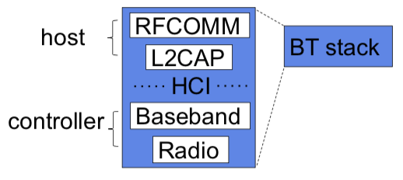
It Is Different from Smartphone Networking
Bluetooth (BT) communication
Different protocol stack and radio state machine
Notes:
Wearable networking is also different from smartphone networking that has been well-studied in the past decade. First, most of the time a wearable transfers data with BT, whose many characteristics are different from WiFi and cellular that dominate the smartphone interface usage. Bluetooth has a complex protocol stack and different working modes. It consists of higher-layer protocols realized in the OS host and lower-layer functions implemented in the controller that resides on the BT chip. The host and controller are bridged by the Host-Controller Interface, or HCI, where control commands and data packets are exchanged.

Slide 4

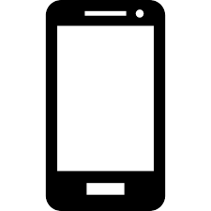

It Is Different from Smartphone Networking
Bluetooth (BT) communication
Different protocol stack and radio state machine
Smartphone as a “gateway”
A pair of proxies in Wear OS
Client app
Server app
TCP/IP stack
TCP/IP stack
TCP/IP stack
Wear OS proxy
Wear OS proxy
BT stack
BT stack
Notes:
Second, a wearable oftentimes does not directly access the Internet, instead, it uses its paired smartphone as a “gateway”, which, if not carefully designed, may incur additional performance degradation. Specifically, since Bluetooth by default does not speak TCP/IP, the wearable OS typically introduces a pair of proxies on the smartphone and the wearable to bridge TCP/IP and BT. For the phone-side proxy, it maintains TCP connections to remote servers on behalf of the wearable [click]. The wearable-side proxy also maintains local TCP connections with client apps [click]. This way, everything becomes transparent to the client and server applications.

Slide 5
It Is Different from Smartphone Networking
Bluetooth (BT) communication
Different protocol stack and radio state machine
Smartphone as a “gateway”
A pair of proxies in Wear OS
Network interface switching
BT has a much shorter range
Vertical handover under mobility
Notes:
Last but not least, due to BT’s short range, network handover could occur on a wearable: when it moves away from the paired phone, the BT session will be torn down and the wearable has to use WiFi or LTE to communicate with the external world.

Slide 6
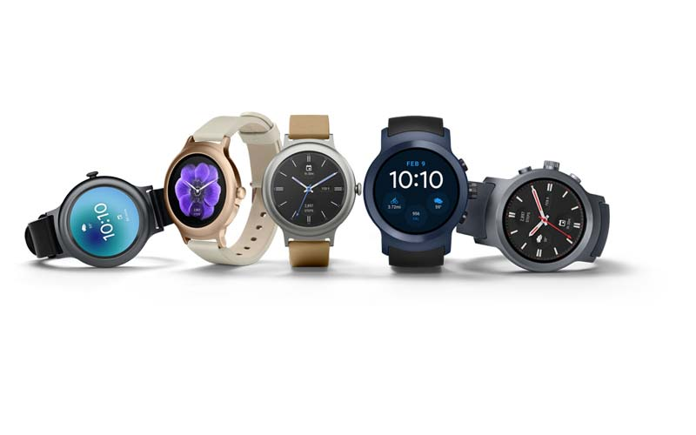
Wearable Networking Stack Is Under-explored
Application [Nirjon MobiSys 15][Shen MobiSys 16]
OS
[Liu APSys 15]
[Liu Mobisys 16]
Networking
Traffic characterization: [Kolamunna IMC 18]
Core networking stack: ?
UI
[Chen CHI 14]
[Xu MobiCom 17]
Power [Liu Mobisys 17][Yang ICNP 17]
The networking performance and application QoE on commercial wearables is not well-studied.
Notes:
Despite the increased popularity of wearables in mobile computer family, networking of wearables is still under-explored. Several efforts have been made towards understanding the OS execution performance [click], power management [click], user interface [click], and applications [click]. However, the networking performance [click] and application QoE is not well-studied on wearables [click].

Slide 7
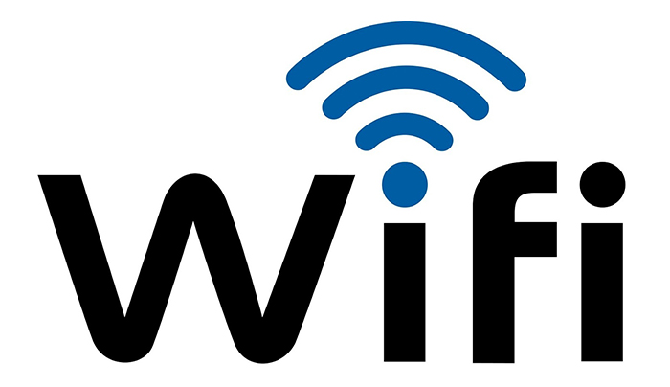

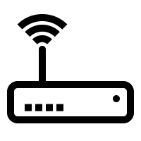
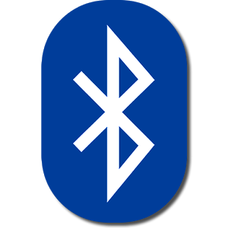


Wearable Networking Testbed
uplink
downlink
Notes:
To fill this critical gap, we develop a holistic testbed to cover common usage scenarios for a wearable to communicate with the external world. They include communicating locally with the phone over BT [click], accessing the Internet directly with WiFi/LTE [click], as well as surfing the Internet via the smartphone as the gateway [click]. We also employ an IP camera to stream real-time video to smartphones and smartwatches.

Slide 8
The Wearable Network Measurement Toolkit
Active Measurements
Bulk data transfer and constant bitrate traffic
Automatic reconnection upon network failure
Passive Measurements
Collect WiFi and BT traces from multiple entities and layers
Packet transmission/reception pipeline Instrumentation
Signal strength and network states
Open-source
3K lines of C++, Java, and Python code
https://github.com/XiaoShawnZhu/WearMan.
Notes:
Given a lack of tools for measuring and analyzing wearable network performance especially over Bluetooth, we also develop a suite of measurement tools. They consist of software programs for both active and passive measurements.
For active measurements, we develop a custom server application running on the server and a custom client app running on the wearable. The client and server apps can exchange data using two traffic patterns: bulk data transfer and constant bitrate traffic. Our application also allows automatic reconnection upon network failure for testing the handover support.
For passive measurements, we collect network traces on different entities and layers to comprehensively examine not only each of the individual components, but also the cross-device, cross-protocol, and cross-layer interplay.
Our toolkit is written in about 3000 LoC and can be found on GitHub.

Slide 9
Overview of Measurement Findings
Proxy at paired smartphone
End-to-end latency is inflated to tens of seconds
Phone’s TCP receive buffer causes bufferbloat
Network handover
Handovers are performed reactively
BT-WiFi handovers may take 60+ seconds
Bluetooth radio resource management
Different state machine models on phone and wearable
BT download experiences frequent “blackout” periods
Network interface selection
Wear OS’s default interface selection policy is often suboptimal
Multipath on wearables faces obstacles
Notes:
Leveraging our measurement infrastructure, we are able to examine different aspects of the wearable networking stack. This is an overview of our measurement findings regarding the key aspects. In this talk, I will only go over first two due to the limited time. Details about the other two can be found in the paper.

Slide 10
Overview of Measurement Findings
Proxy at paired smartphone
End-to-end latency is inflated to tens of seconds
Phone’s TCP receive buffer causes bufferbloat
Network handover
Handovers are performed reactively
BT-WiFi handovers may take 60+ seconds
Bluetooth radio resource management
Different state machine models on phone and wearable
BT download experiences frequent “blackout” periods
Network interface selection
Wear OS’s default interface selection policy is often suboptimal
Multipath on wearables faces obstacles
Notes:
Let’s start with the proxy at the paired smartphone.

Slide 11
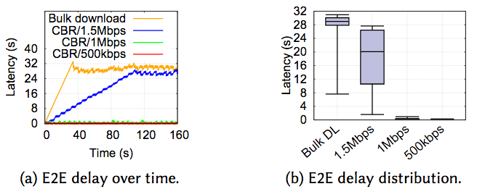
Impact of Smartphone Proxying
End-to-end (E2E) latency characterization
Constant bitrate (CBR) traffic and bulk transfer
E2E latency is dramatically inflated to 30+ seconds for high bitrate traffic.
Notes:
As mentioned earlier, a paired smartphone gateway plays a critical role in wearable networking. Now we study its performance impact by characterizing the end-to-end latency of the packets sent from the server to the smartwatch. We use constant bitrate traffic to emulate real-time applications, we also measure the latency of bulk download for comparison. These figures show the delay over time and the distribution. For CBR traffic whose data rate is low, we still observe fluctuating delay over time. When the CBR rate becomes higher than the BT bandwidth, e.g., at 1.5Mbps, the delay is inflated to an unacceptably high level. [click] For bulk download, its delay is further increased.

Slide 12
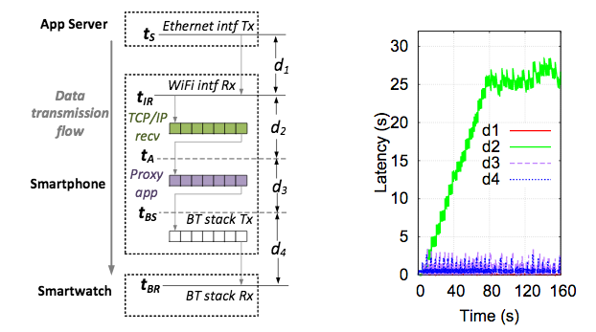
Impact of Smartphone Proxying
Root cause analysis
Breaking down the E2E latency
data is transmitted out
data is received in the phone OS kernel
data is copied to the proxy’s userspace
data is sent to the BT stack
data is delivered to the wearable OS
Notes:
Recall that the smartphone proxy splits an end-to-end client-server connection into a server-phone TCP connection and a phone-wearable BT RFCOMM connection. Because of the two heterogeneous wireless links, the proxy needs multiple buffers at various layers, such as the receive buffer in the TCP/IP stack, the userspace buffer, and the transmission buffers in the BT RFCOMM stack. These buffers, along with other existing in-network and on-device buffers, can potentially cause “bufferbloat” that inflates the end-to-end delay.
To find out where exactly does the bufferbloat come from, we dissect the e2e latency by leveraging our tool that collects BT and TCP/IP traces at several locations to obtain various timestamps as shown in the figure. [click] tS is from tcpdump trace captured on the server when data is transmitted out, [click][click] tIR is from the tcpdump trace on the phone when data is received in the smartphone OS kernel, [click][click] tA is from the kernel log on the phone when data is copied to the proxy’s userspace, [click][click] tBS is from the Android log when data is pushed into the BT stack, finally, [click][click] tBR is from tcpdump trace captured on the wearable when data is delivered to the wearable OS.

Slide 13
Impact of Smartphone Proxying
d2 dominates the E2E latency
Delay incurred by TCP receive buffer
Notes:
The figure on the right-hand side shows the latency breakdown result. We observe that d2, the buffering delay incurred by the TCP recv buffer on the smartphone dominates the entire e2e delay.

Slide 14
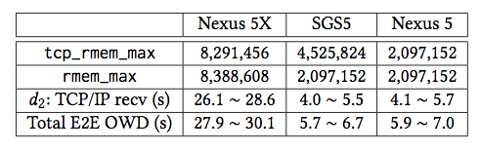
Impact of Smartphone Proxying
Phone’s TCP receive buffer size impact on E2E latency
Smaller TCP receiver buffer size reduces the E2E latency, but setting it to be too small may throttle the server-phone connection throughput.
Notes:
We further examine how the TCP receive buffer size on different smartphones affects the e2e owd. As shown in the table, a phone with a smaller buffer size indeed experiences a smaller d2 as well as the total e2e owd. However, setting it to be too small will throttle the TCP congestion window and hence the throughput. [click] This is a tradeoff that is difficult to balance.

Slide 15
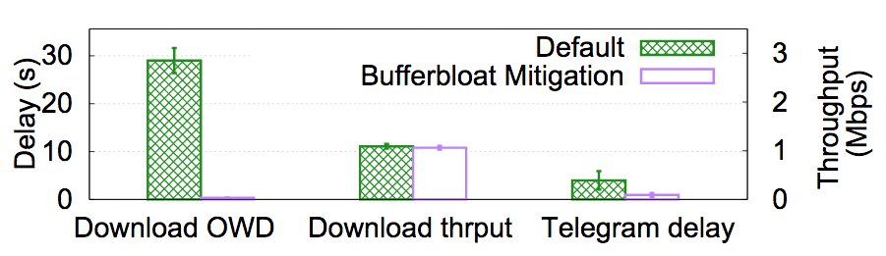
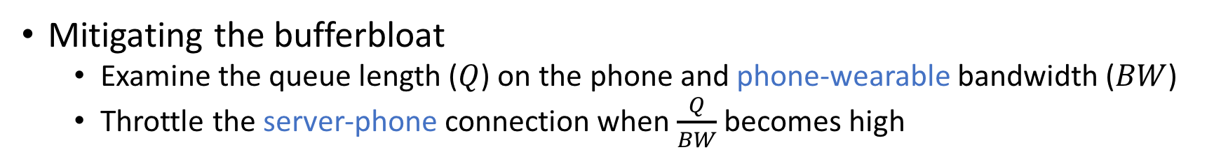
Impact of Smartphone Proxying
Mitigating the bufferbloat
Examine the queue length ($Q$) on the phone and phone-wearable bandwidth ($BW$)
Throttle the server-phone connection when $\frac{Q}{BW}$ becomes high
Dynamic server-phone flow control that considers the phone-wearable network condition reduces the E2E delay.
Notes:
The bufferbloat problem is due to a lack of coordination for the two heterogeneous wireless links. Specifically the phone’s TCP buf size configuration does not consider the phone-wearable connection. Now we try to mitigate it by demonstrating a simple yet effective solution. To prevent excessive queueing on the smartphone, we examine the queue length and BT bandwidth for the phone-wearable connection. Once we observed high Q or low BW, we throttle the server-phone connection to prevent the queue from building up.
We use two workloads to evaluate its effectiveness [click]. Bulk download and receiving short Telegram messages when there is a concurrent transfer. As shown, the delay is substantially reduced for both workloads, and the throughput of bulk download is only marginally reduced [click].

Slide 16
Overview of Measurement Findings
Proxy at paired smartphone
End-to-end latency is inflated to tens of seconds
Phone’s TCP receive buffer causes bufferbloat
Network handover
Handovers are performed reactively
BT-WiFi handovers may take 60+ seconds
Bluetooth radio resource management
Different state machine models on phone and wearable
BT download experiences frequent “blackout” periods
Network interface selection
Wear OS’s default interface selection policy is often suboptimal
Multipath on wearables faces obstacles
Notes:
We now move on to the network handover performance.

Slide 17
BT-WiFi Handover Performance
Monitoring the network state
ConnectivityManager in Wear OS
Avaliable or not: whether the network interface is up
Connected or not: whether the interface provides actual network connectivity
Experiment setup
Both BT and WiFi are enabled
Real-time streaming traffic
tinyCam app: stream real-time videos captured from an IP camera
A user wearing a smartwatch moves away from the paired smartphone
Notes:
A prerequisite for measuring handovers is to monitor the network state change. We capture the state of each network interface from the ConnectivityManager of Wear OS in the background. The state information includes whether a network interface is up, and whether it provides actual network connectivity. For example, when a smartwatch is associating with the WiFi AP, its WiFi is available but not yet connected.
Our experiment focuses on understanding handovers from BT to WiFi. We keep both BT and WiFi enabled on the wearable and let the Wear OS use the default network management policy. We use the commercial tinyCam security camera app to generate real-time streaming traffic. TinyCam requires continuous network connectivity to stream real-time video captured from an IP camera to a wearable. During the experiment, a user puts her smartphone on a desk, and moves away from it with a paired smartwatch wearing on her wrist.

Slide 18
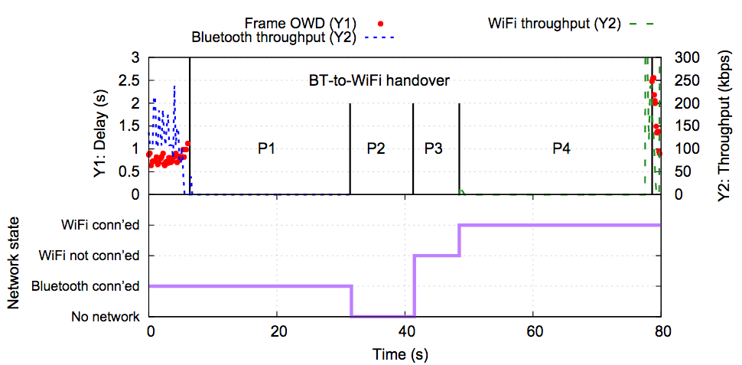
BT-WiFi Handover Performance
Throughput and frame delay severely degrade during the handover
60+ seconds of interruption time when no video data is received
Notes:
The figure shows the video throughput and frame OWD during the handover. As shown, the app QoE severely degrades during the handover. At around 6s, the app stops receiving the video data from the SmartCam and the BT throughput drops to zero. The video transmission resumes over WiFi at around 77s, with high frame OWD observed at the beginning.

Slide 19
Root Cause Analysis: Delay Breakdown
P1: BT is connected but data cannot be actually transmitted
P2: no network available
P3: WiFi available (interface up) but not connected
P4: WiFi connected but no application data transmission
Notes:
To understand the root cause of the high handover delay, we break it down into four phases based on the captured network state information, as shown in the bottom plot. [click] P1 is when BT is still connected but data cannot be actually transmitted due to poor signal strength, [click] P2 is when no network is available, [click] P3 is the WiFi AP association period when WiFi is available but not connected, and [click] P4 is when WiFi is connected but there is no application data transmission.

Slide 20
Root Cause Analysis: Delay from the Wear OS (P1, P2, and P3)
Reactive in nature: Only after BT connection gets lost completely (P1), the Wear OS turn on (P2) and then connect to (P3) WiFi.
Notes:
Our analysis reveals two sources of delay that contribute to the overall handover delay. One is the delay from the Wear OS, composed of P1, P2, and P3. Under the default network management policy of Wear OS, when BT is connected, WiFi is not available even if the device is under the coverage of both BT and WiFi. In this case, when the wearable moves away from the BT coverage, the Wear OS needs to first wait until the BT connectivity is completely lost, then turn on the WiFi interface (P2), and finally perform an AP association [click]. The whole process incurs a long period of time due of the reactive nature of Wear OS.

Slide 21
Root Cause Analysis: Delay Incurred by the Wearable App (P4)
Insufficient protocol support for applications: wearable apps need to implement their own data migration logic.
Notes:
Another source is the Delay Incurred by the Wearable App. As shown, even after WiFi gains its connectivity after P3, the app still spends more than 30s during P4 before the actual data transfer resumes over WiFi. P4 is very likely attributed to the app’s poor handover logic. Unfortunately, since Wear OS does not provide an API for seamlessly migrating data transfers between different networks, wearable apps need to implement their own data migration logic at the app layer [click]. Doing so is tedious and challenging for average app developers.

Slide 22
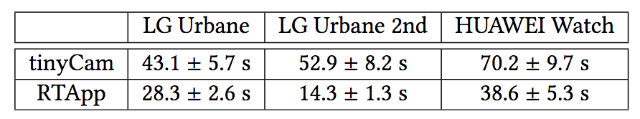
Root Cause Analysis: Delay Incurred by the Wearable App (P4)
P4: 33.3s (tinyCam) v.s. 5.6s (RTApp)
RTApp: downloading a 3KB data chunk every 160ms, establish new connection once a new network interface is connected after a handover.
Overall handover interruption time
Improved application data migration logic (in RTApp) reduces P4 as well as the overall interruption time.
Notes:
To confirm this, we compare P4 as well as the overall handover interruption time of tinyCam with another app -- RTApp, which is a simple app developed by us to emulate the traffic pattern of tinyCam but with improved handover logic, basically it polls to detect the newly connected interface after handover and immediately resumes data transfer over it once it’s connected. RTApp has a much lower P4 than tinyCam, such a disparity of the P4 duration causes the two apps’ vastly different handover duration shown in Table [click].

Slide 23
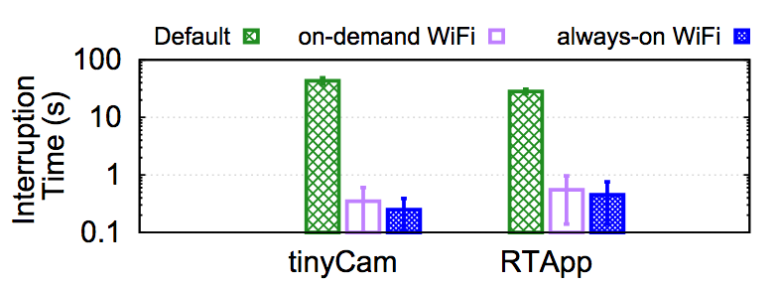
Reducing the Handover Delay
Proactively performing a handover to WiFi when BT quality degrades
Variant 1: establish WiFi when performing handovers (on-demand WiFi)
Variant 2: pre-established WiFi (always-on WiFi)
Notes:
We now propose a solution that reduces the handover delay. An important reason for the bad handover performance of Wear OS is its reactive nature, the WiFi connectivity is not established until the BT connectivity is fully torn down. Our scheme instead predicts a BT-WiFi handover by monitoring the BT channel quality. When the quality drops below a threshold, we proactively perform a handover to WiFi. We examine two variants of our proposed solution, the first one is to establish WiFi when performing handovers in an on-demand fashion; the second one is to pre-establish and always maintain the WiFi connectivity to further speed up the handover. The figure shows the effectiveness of our solution [click]. Both variants significantly reduce the handover delay. We can also see that V2 is better than V1, but the cost is a higher radio energy consumption.

Slide 24
Summary
First in-depth study on the networking performance of Wear OS.
Developed a toolkit for wearable networking measurement and analysis.
Identified performance issues regarding key aspects of wearable networking.
Analyzed the root causes and proposed practical solutions.
Notes:
To summarize, we conducted a first in-depth study on the networking perf of Wear OS by developing a suite of tools. Leveraging our toolkit, we identified, analyzed, and mitigated several performance issues of wearable networking. We believe our findings provide key knowledge and experiences for improving the networking subsystem of future wearable operating systems.

Slide 25
Thank you!
Notes:
Thanks for your listening. And I’m to ready to take questions.

Slide 26
Thank you!

Slide 27
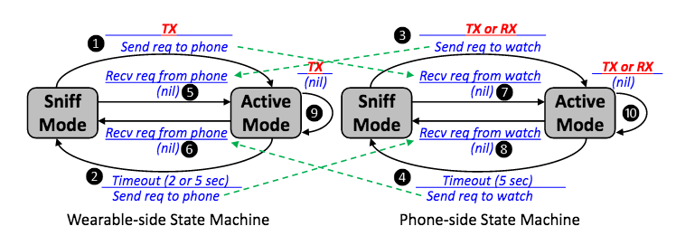
BT State Machines on Wearable and Phone

Slide 28
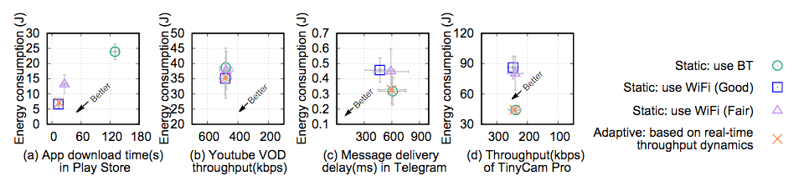
QoE-energy Tradeoffs of Different Networks

