Slide 1
实验室汇报
何润姿
2018.06.0X

Slide 2
Introduction
CON
TEST
Related Work
目录
Core Idea
Future Work

Slide 3
PART
ONE
Introduction

Slide 4
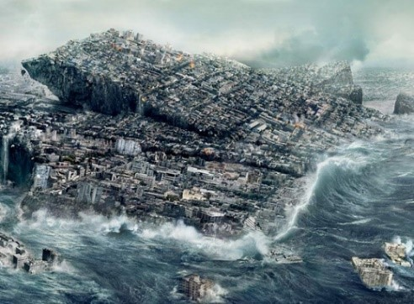
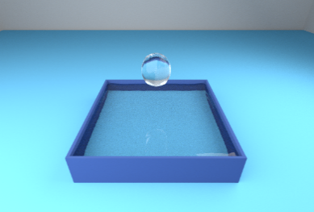
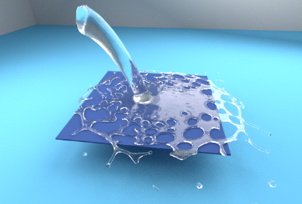
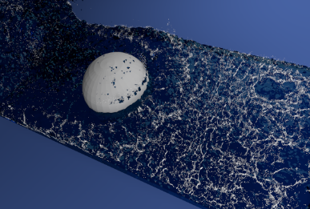
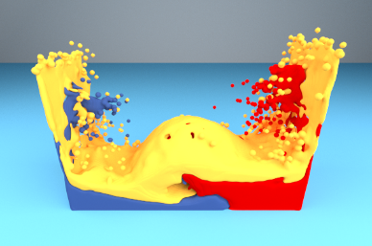
1-1
Fluid Simulation
Notes:
*As people have higher and higher requirements on the visual effects of movies and games, the realistic fluid animation is getting more and more demanding
*Simulating turbulent liquids with breaking waves and splashesis among the most desired features in fluid animation.
*Lagrangian methods such as SPHare a promising way to capture such properties

Slide 5
1-2
Traditional Method
利用数值方法求解非线性问题
求解泊松方程
邻居搜索问题
CFD
Euler
Lagrange
Notes:
RequirementforExpensiveComputing&MemoryResources:
Traditionalfluidsimulationistimeconsumingandrequireslargecomputationalresources.
*DifficultyonScenarioReuse:
Forsimilarscenarios,itstillneedstore-simulateonceeventheinitialstatehasonlyaslightchange.
*ExponentialTimeComplexityontheScaleofScenarios:
Forlarge-scaleliquidsimulations,itisimpossibletoobtainhighlyrealisticsimulationinreal-time.

Slide 6
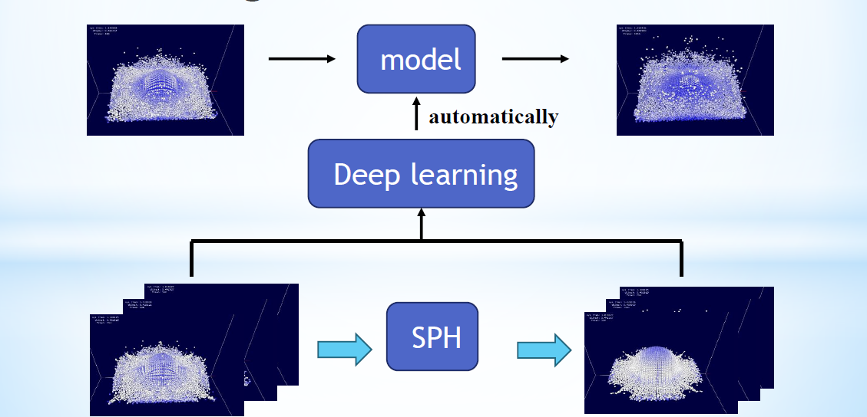
1-3
Data-driven Method
Notes:
faster,
low resourcesdemand &
keep accuracy,

Slide 7
1-4
Goal
Machine Learning
Physics Law
粒子的属性
粒子间关系
粒子的运动

Slide 8
PART
TWO
Related Work

Slide 9
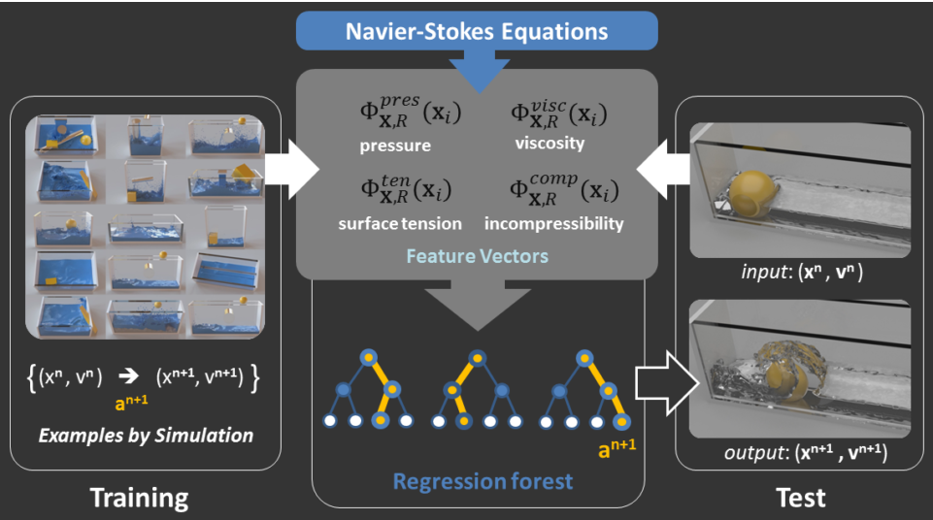
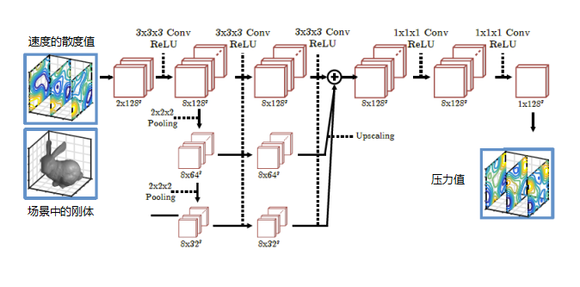
2-1
Research Status
Regression Forests
CNN
Jeong S H, Solenthaler B, Pollefeys M, et al. Data-driven fluid simulations using regression forests[J]. ACM Transactions on Graphics, 2015, 34(6):199.
Yang C, Yang X, Xiao X. Data‐driven projection method in fluid simulation[J]. Computer Animation and Virtual Worlds, 2016, 27(3-4): 415-424.

Slide 10
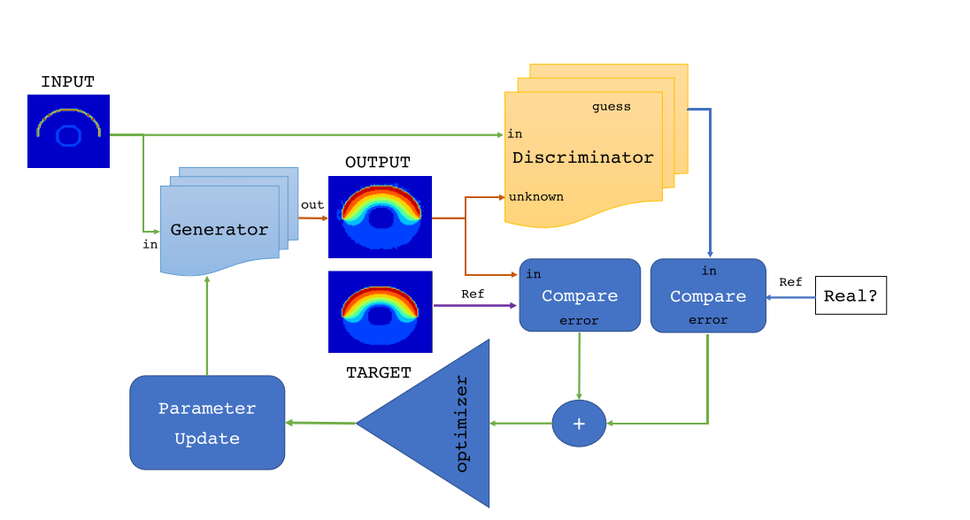
2-2
New Discovery-GAN
Ehrhardt S, Monszpart A, Mitra N J, et al. Learning A Physical Long-term Predictor[J]. 2017.

Slide 11
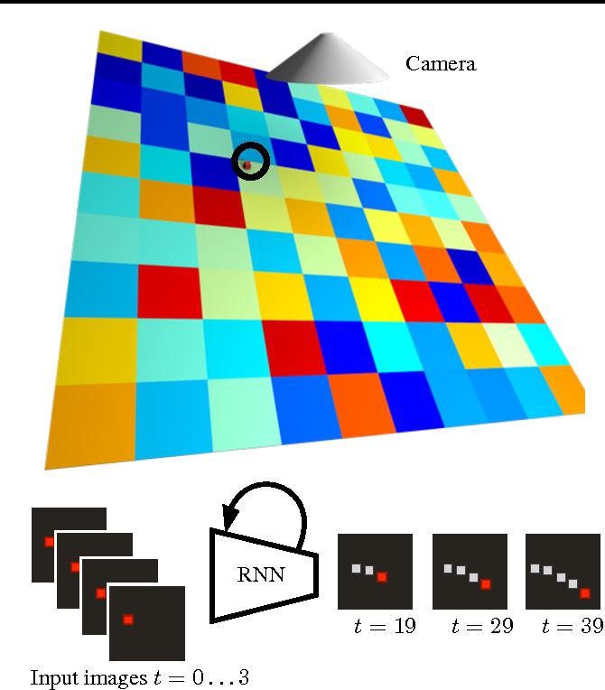
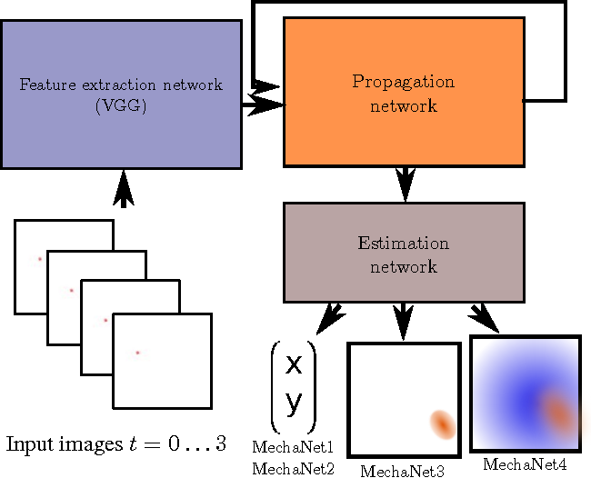
2-2
New Discovery
Ehrhardt S, Monszpart A, Mitra N J, et al. Learning A Physical Long-term Predictor[J]. 2017.

Slide 12
1-4
MORE THAN TEMPLATE
MORE THAN TEMPLATE
MORE THAN TEMPLATE
1
Because you people are too warm, so you always feel that others are indifferent to you. Because you're too love a person
Because you people are too warm, so you always feel that others are indifferent to you. Because you're too love a person
2
3
MORE THAN TEMPLATE
MORE THAN TEMPLATE
Because you people are too warm, so you always feel that others are indifferent to you. Because you're too love a person
Because you people are too warm, so you always feel that others are indifferent to you. Because you're too love a person
4

Slide 13
2-1
MORE THAN TEMPLATE
MORE THAN TEMPLATE
MORE THAN TEMPLATE
MORE THAN TEMPLATE
Because you people are too warm, so you always feel that others are indifferent to you. Because you're too love a person
Because you people are too warm, so you always feel that others are indifferent to you. Because you're too love a person
Because you people are too warm, so you always feel that others are indifferent to you. Because you're too love a person
TEXT
HERE
TEXT
HERE
TEXT
HERE

Slide 14





2-2
MORE THAN TEMPLATE
TEMPLATE
TEMPLATE
TEMPLATE
TEMPLATE
TEMPLATE
Because you people are too warm, so you always feel that others are
Because you people are too warm, so you always feel that others are
Because you people are too warm, so you always feel that others are
Because you people are too warm, so you always feel that others are
Because you people are too warm, so you always feel that others are

Slide 15
2-3
MORE THAN TEMPLATE
TEXT
TEXT
TEXT
TEXT
TEXT
TEMPLATE
TEMPLATE
TEMPLATE
TEMPLATE
TEMPLATE
Because you people are too warm, so you always feel that others are
Because you people are too warm, so you always feel that others are
Because you people are too warm, so you always feel that others are
Because you people are too warm, so you always feel that others are
Because you people are too warm, so you always feel that others are

Slide 16
2-4
MORE THAN TEMPLATE
70%
30%
TEMPLATE
TEMPLATE
Because you people are too warm, so you always feel that others are
Because you people are too warm, so you always feel that others are

Slide 17
PART
THREE
MORE THAN TEMPLATE

Slide 18
3-1
MORE THAN TEMPLATE
MORE THAN TEMPLATE
Because you people are too warm, so you always feel that others are
MORE THAN TEMPLATE
ADD
TEXT
Because you people are too warm, so you always feel that others are
MORE THAN TEMPLATE
Because you people are too warm, so you always feel that others are
MORE THAN TEMPLATE
Because you people are too warm, so you always feel that others are

Slide 19
3-2
MORE THAN TEMPLATE
7.8
MORE THAN TEMPLATE
Because you people are too warm, you always feel that others are
MORE THAN TEMPLATE
Because you people are too warm, you always feel that others are
MORE THAN TEMPLATE
Because you people are too warm, you always feel that others are
MORE THAN TEMPLATE
Because you people are too warm, you always feel that others are

Slide 20
3-3
MORE THAN TEMPLATE
MORE THAN TEMPLATE
Because you people are too warm, you always feel that others are
MORE THAN TEMPLATE
Because you people are too warm, you always feel that others are
MORE THAN TEMPLATE
Because you people are too warm, you always feel that others are
MORE THAN TEMPLATE
Because you people are too warm, you always feel that others are

Slide 21
3-4
MORE THAN TEMPLATE
MORE THAN TEMPLATE MORE THAN TEMPLATE MORE THAN TEMPLATE MORE THAN TEMPLATE
MAY
S | M | T | W | T | F | S
 | 1 | 2 | 3 | 4 | 5 | 6
7 | 8 | 9 | 10 | 11 | 12 | 13
14 | 15 | 16 | 17 | 18 | 19 | 20
21 | 22 | 23 | 24 | 25 | 26 | 27
28 | 29 | 30 | 31
Because you people are too warm, so you always feel that others are indifferent to you. Because you're too love a person

Slide 22
PART
FOUR
MORE THAN TEMPLATE

Slide 23
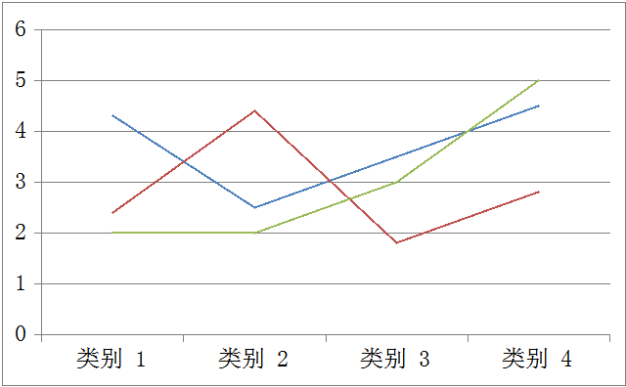
4-3
MORE THAN TEMPLATE
Because you people are too warm, so you always feel that others are indifferent to you.
70%
50%
30%
Because you people are too warm, so you always feel that others are indifferent to you.
112
152
146
172

Slide 24
THANKS
FOR YOUR
ATTENTION
MORE THAN TENPLATE

