Slide 1
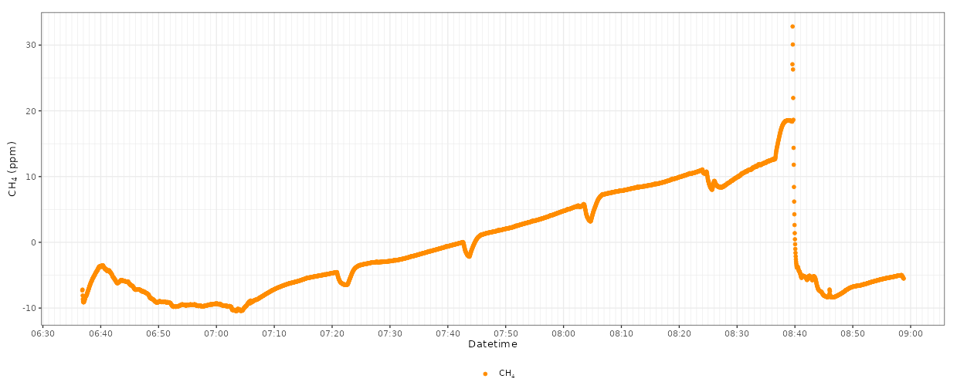
Measurement Start
Measurement End
(3) Three point
(2) Fan on
(1) Fan off
X
X
X
Fan left on after last GC sample ( >6 mins)
Fan operation before GC samples

