Slide 1
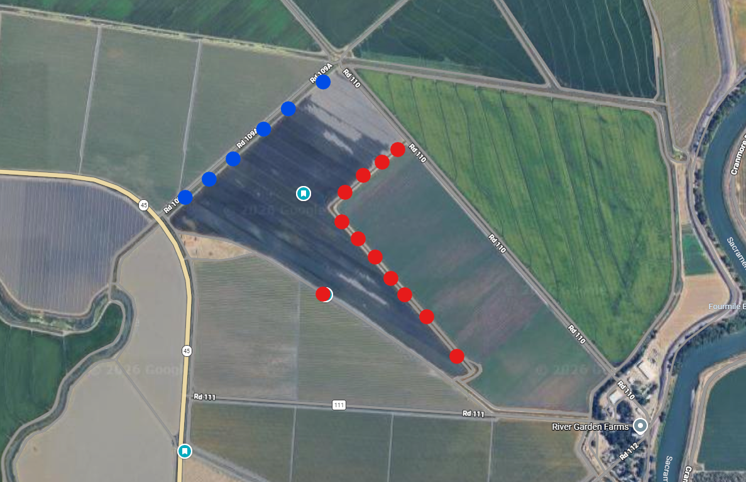














N
Rice
Rice
Rye
Rice
Rice
Alfalfa
Alfalfa

