Slide 1
Effect size and reliability of NPS
2020.06.17

Slide 2
Study No | Study Name | Subjects Num | Trial Num | Include criteria
1 | Bmrk3pain | 33 | 1474 | Multiple temperatures, excluding Stephan_dataset, romantic_dataset
2 | bmrk4 | 27 | 2021 | Many missing voxel values, excluding remi_dataset, 1 subject in bmrk4 and 15 subjects in ie_dataset
3 | Bmrk5pain | 93 | 3232
4 | exp | 17 | 1076
5 | ie | 35 | 1680
6 | ie2 | 19 | 1310
7 | ilcp | 29 | 1856
8 | nsf | 26 | 1149
11 | scebl | 26 | 2496
Sum of Pain |  | 305 | 16294

Slide 3
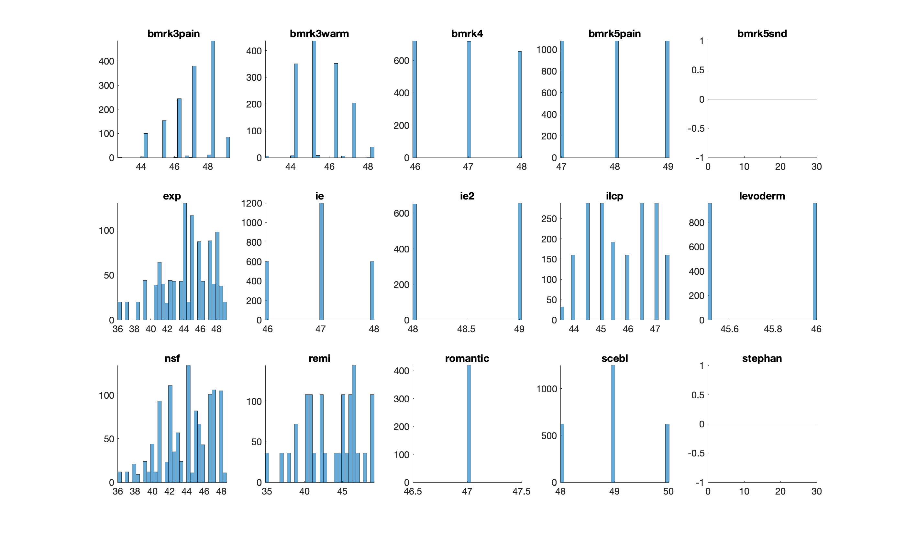
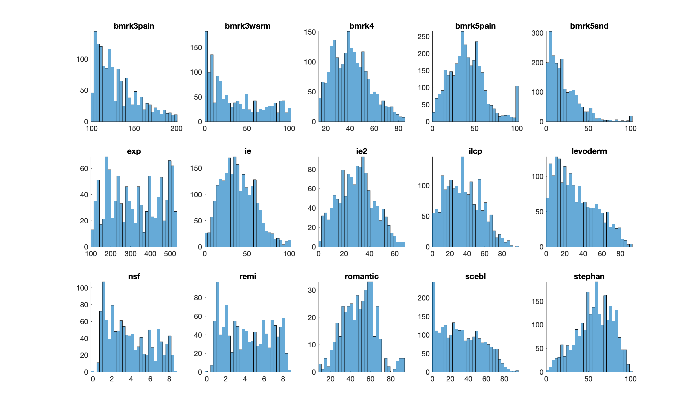
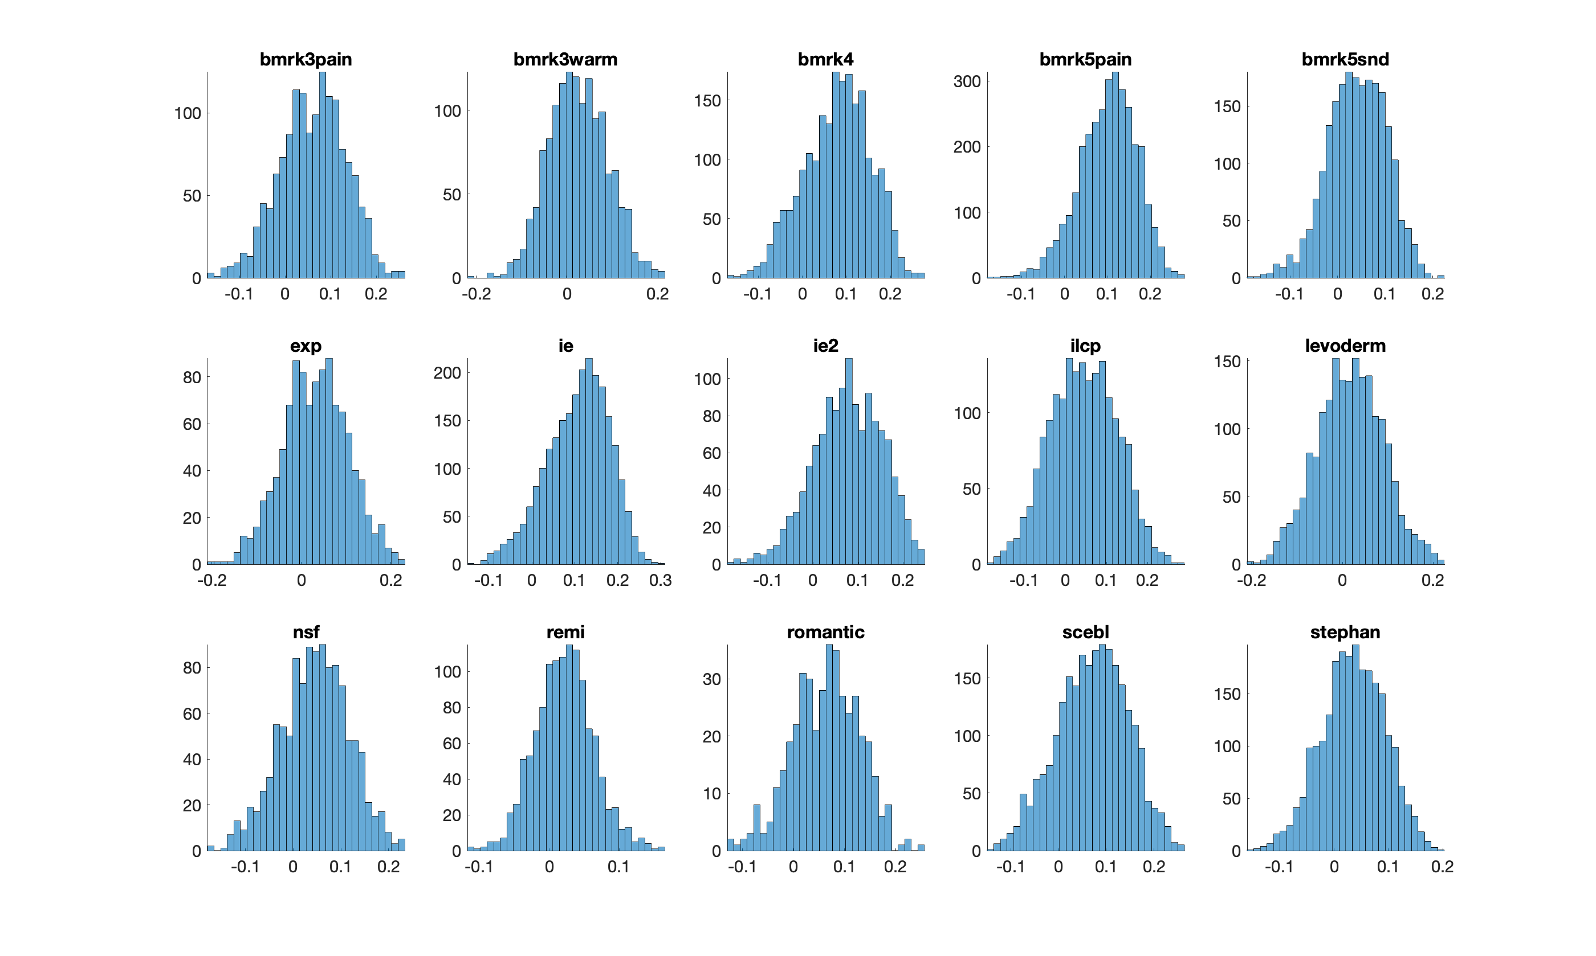
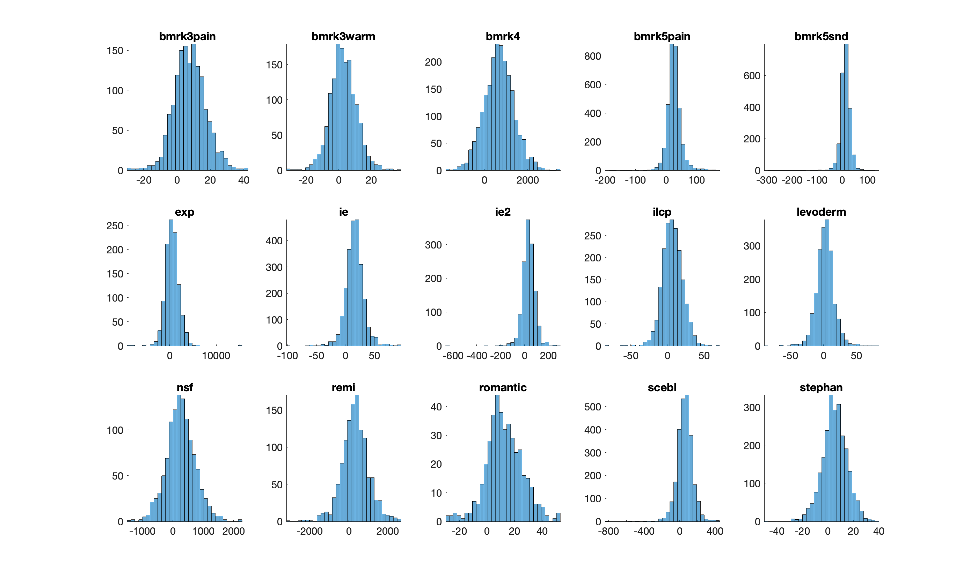
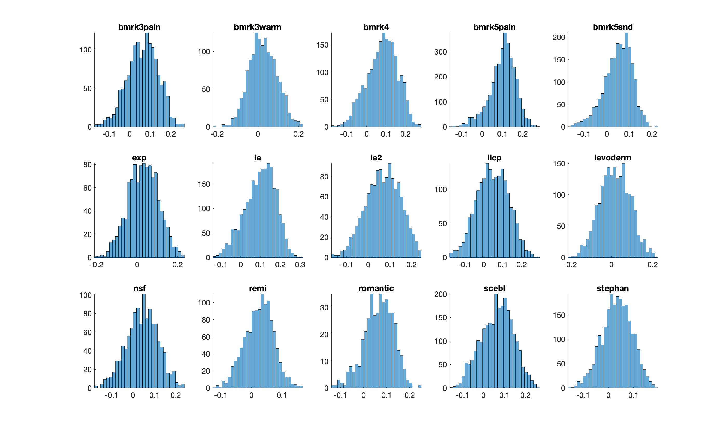
Histogram
Temperature
Pain Rating
NPS correlation sim
NPS dot product
NPS cosine sim

Slide 4
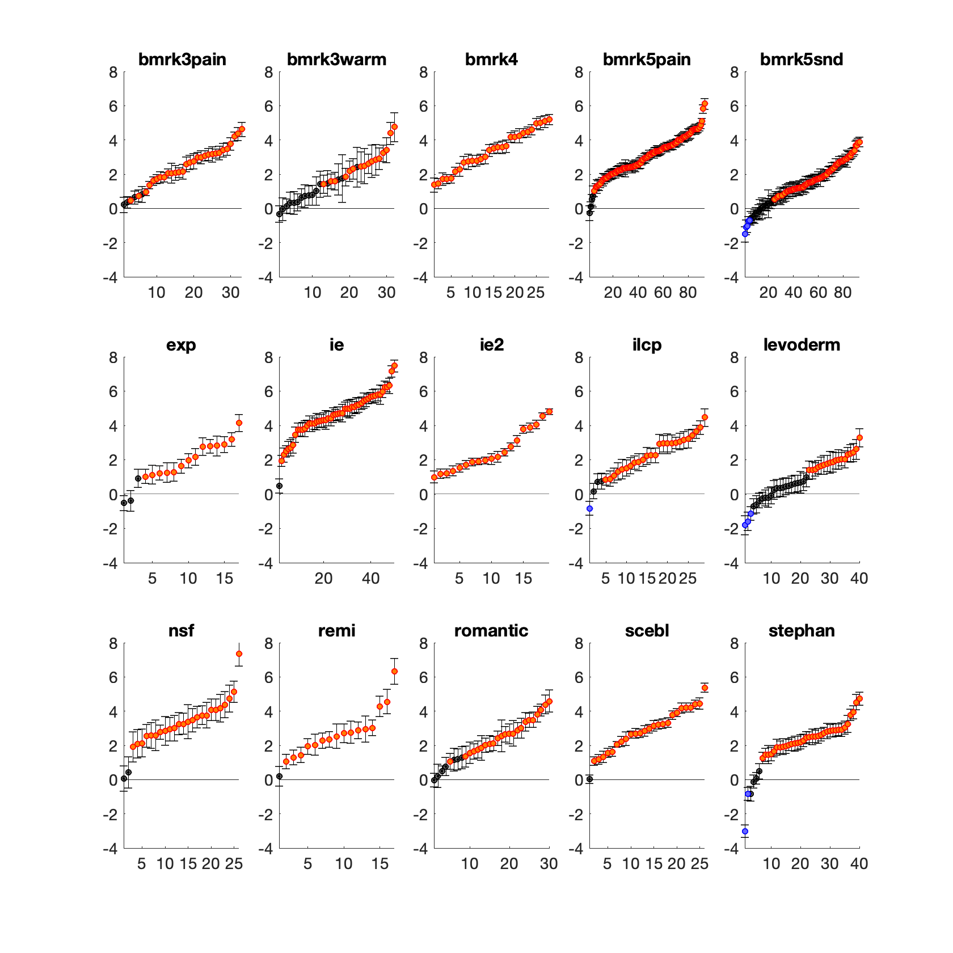
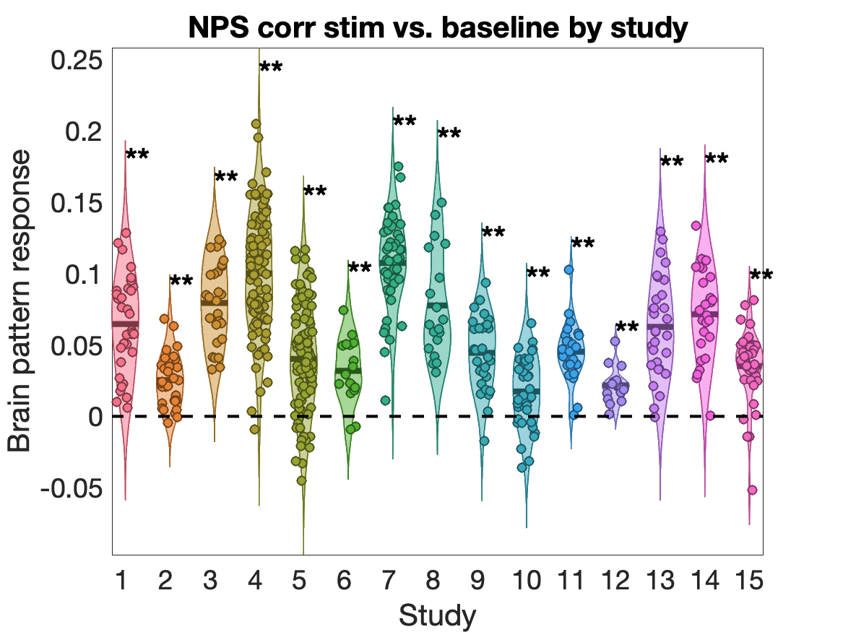
NPS mean response
Positive percentage
87.88%
50%
100%
95.70%
68.82%
82.35%
98%
100%
86.21%
45%
bmrk3 pain/warm
bmrk5 pain/sound
92.31%
94.12%
76.67%
96.15%
85%

Slide 5
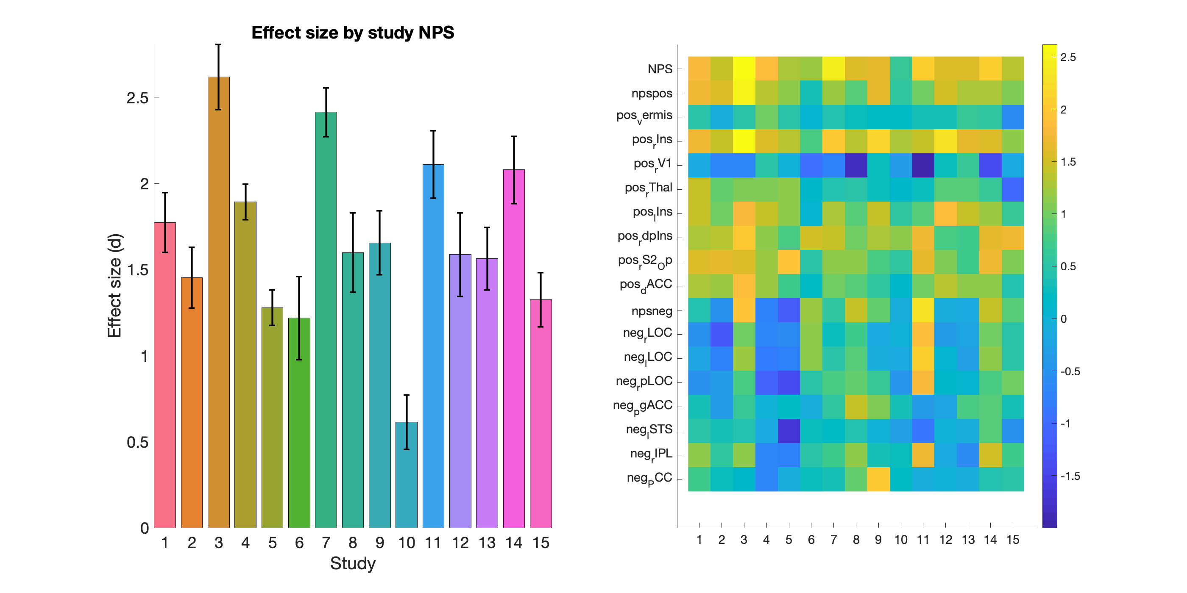
Effect size by study NPS

Slide 6
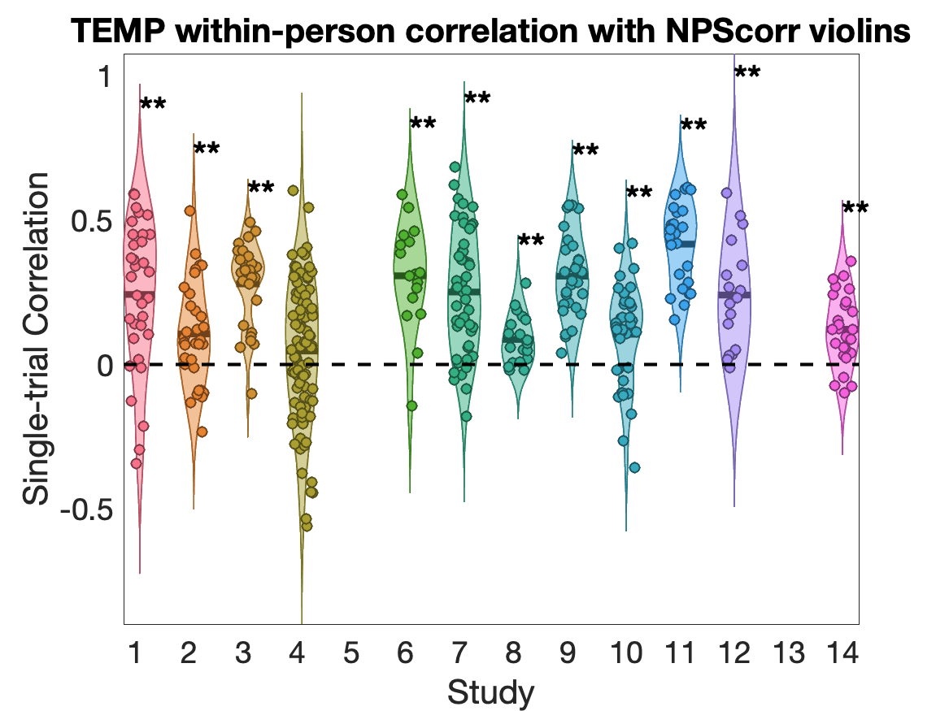
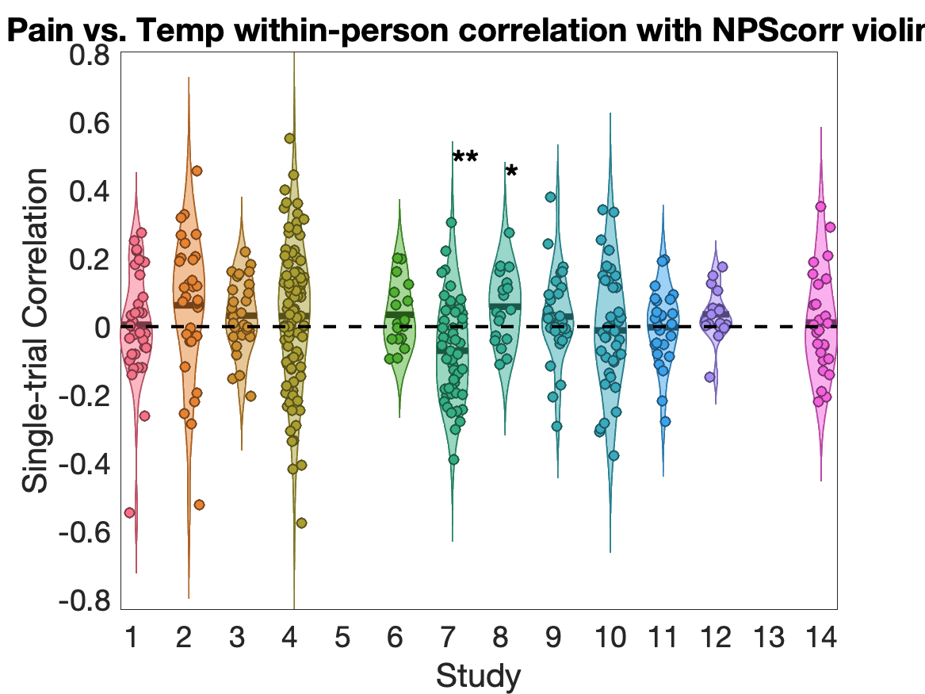
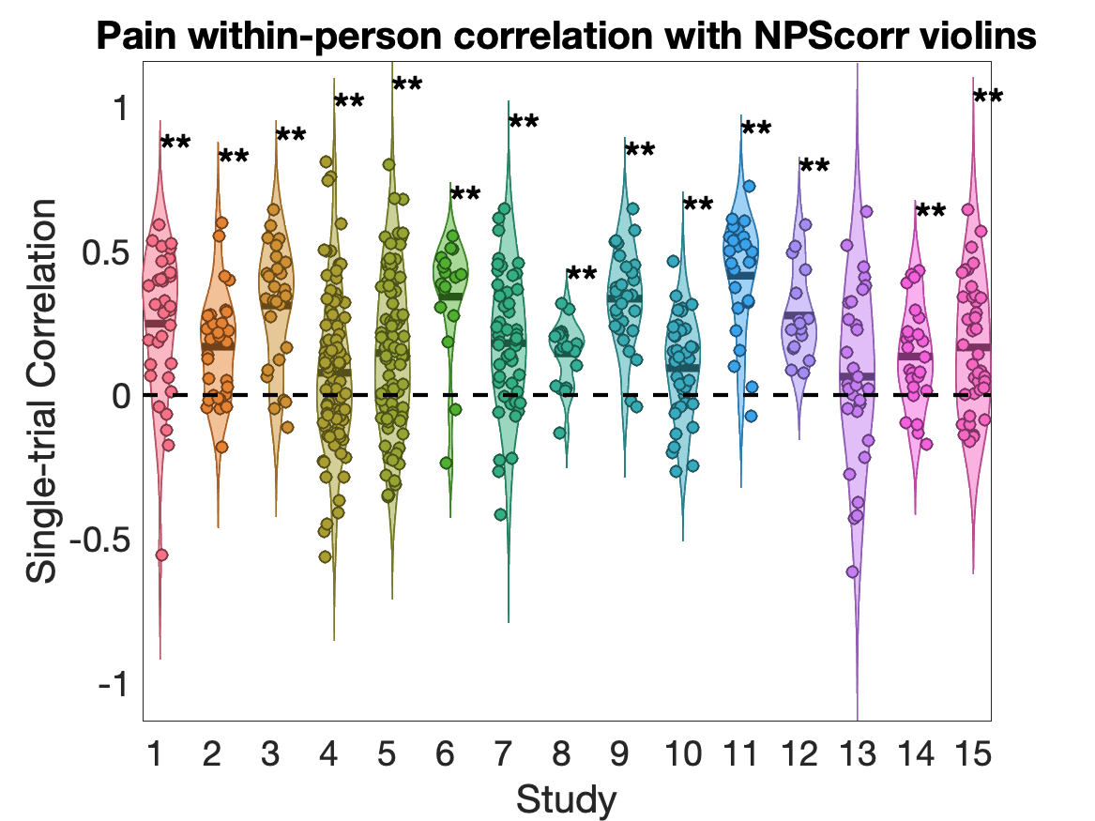
NPS correlation with Pain vs. Temp

Slide 7
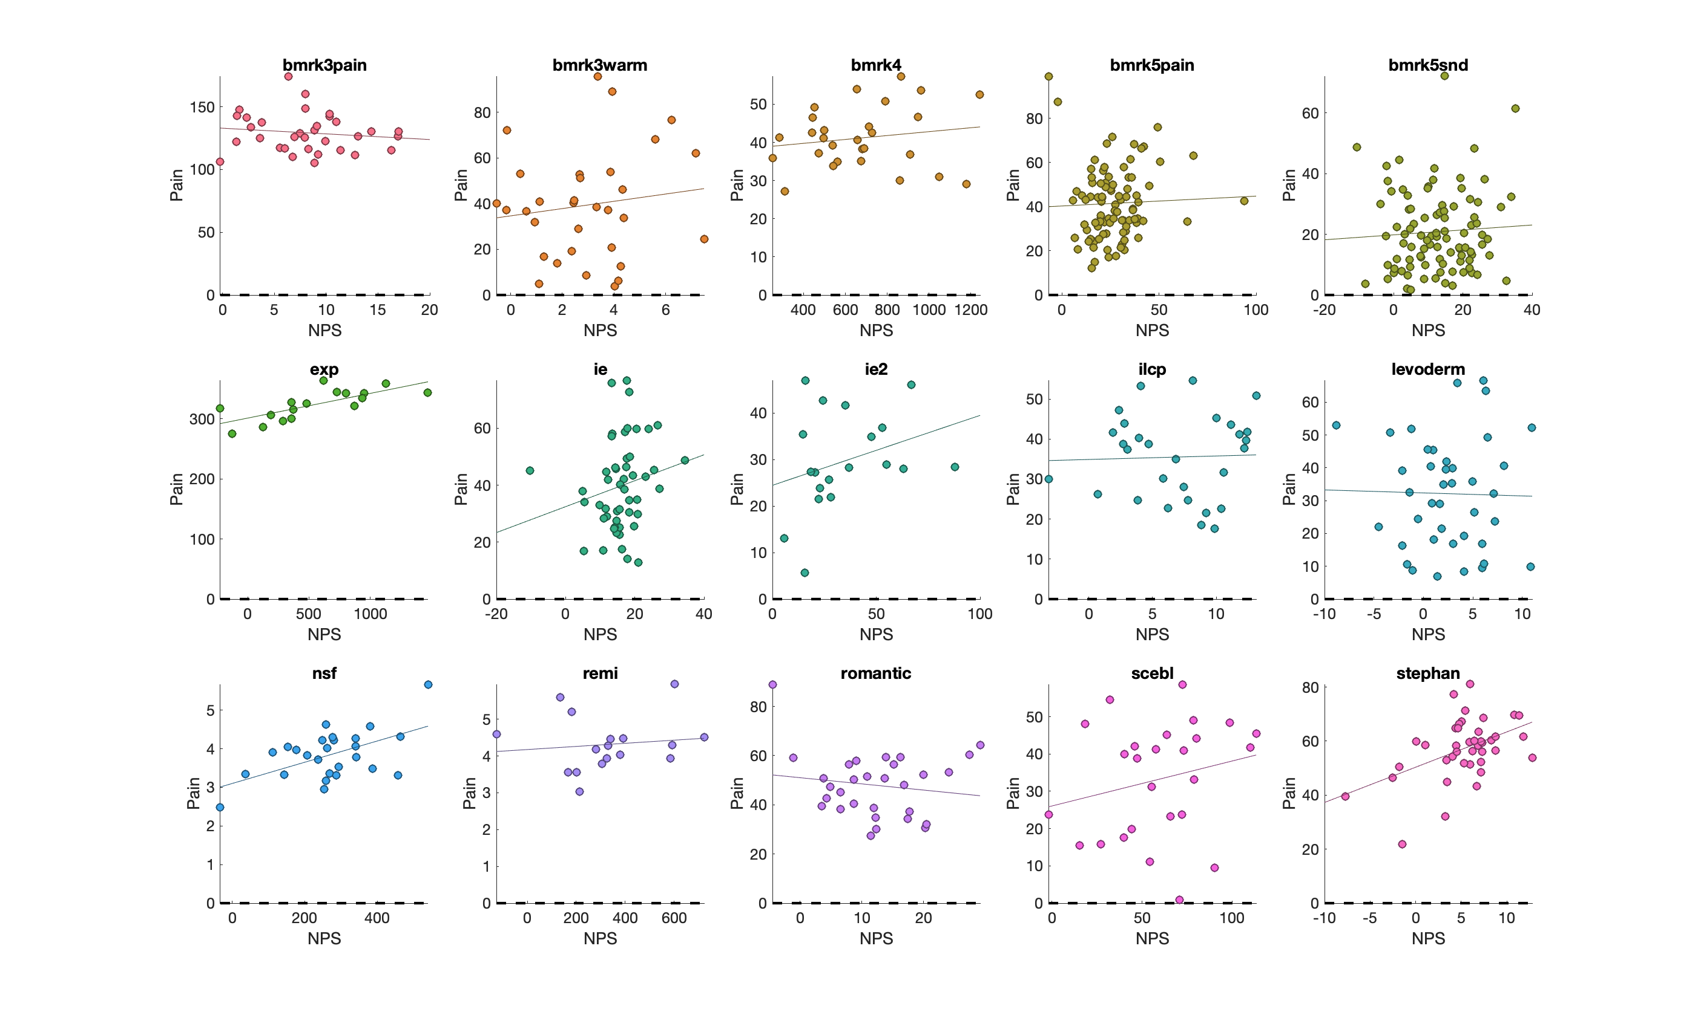
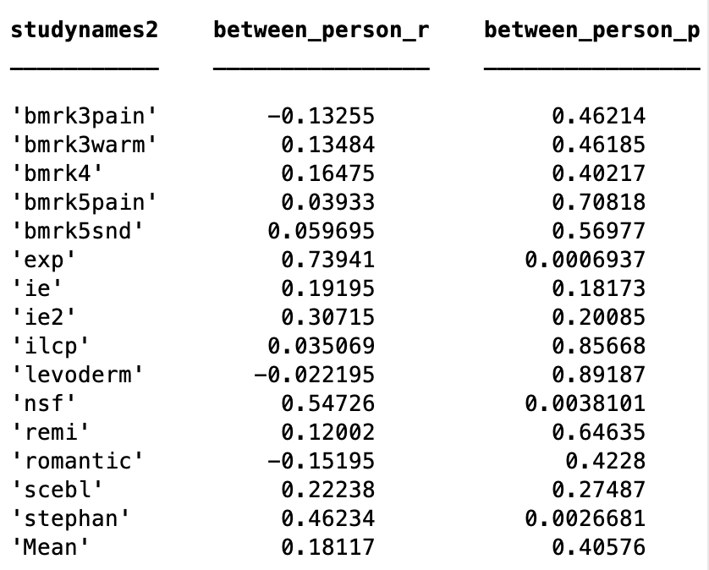
NPS with Pain: between-subject

Slide 8
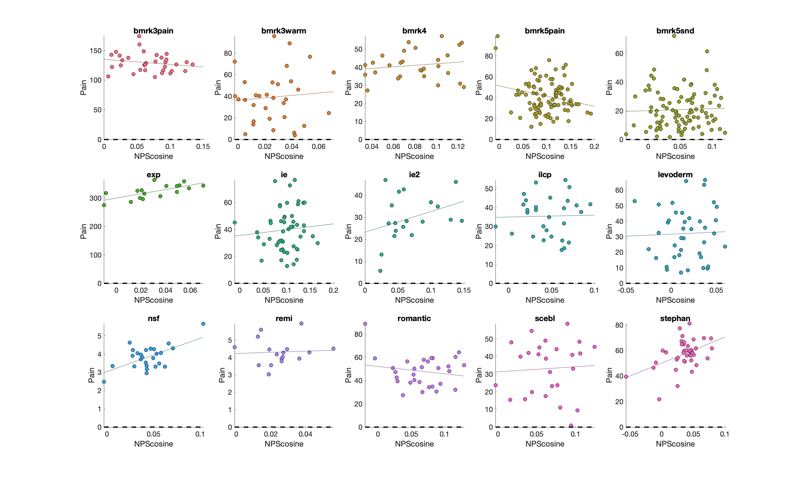

Slide 9
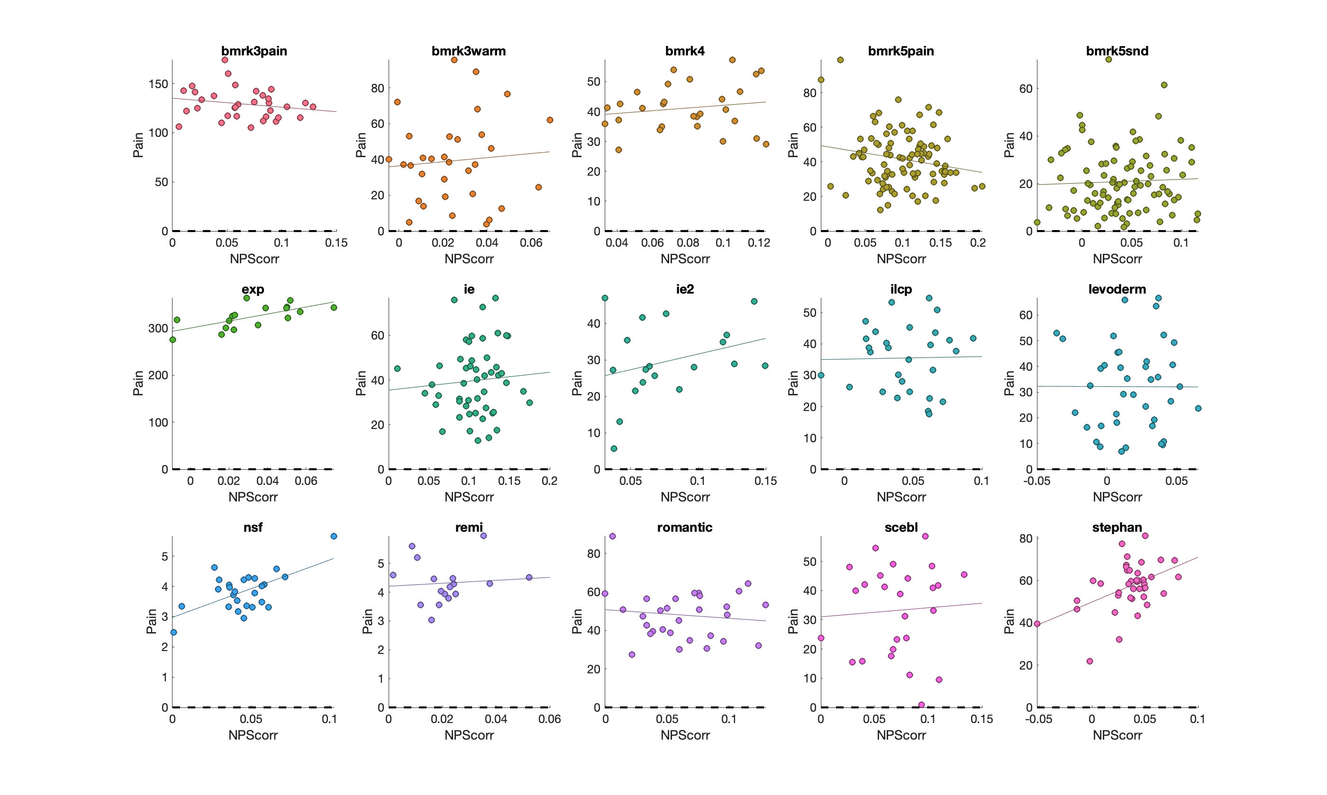

Slide 10
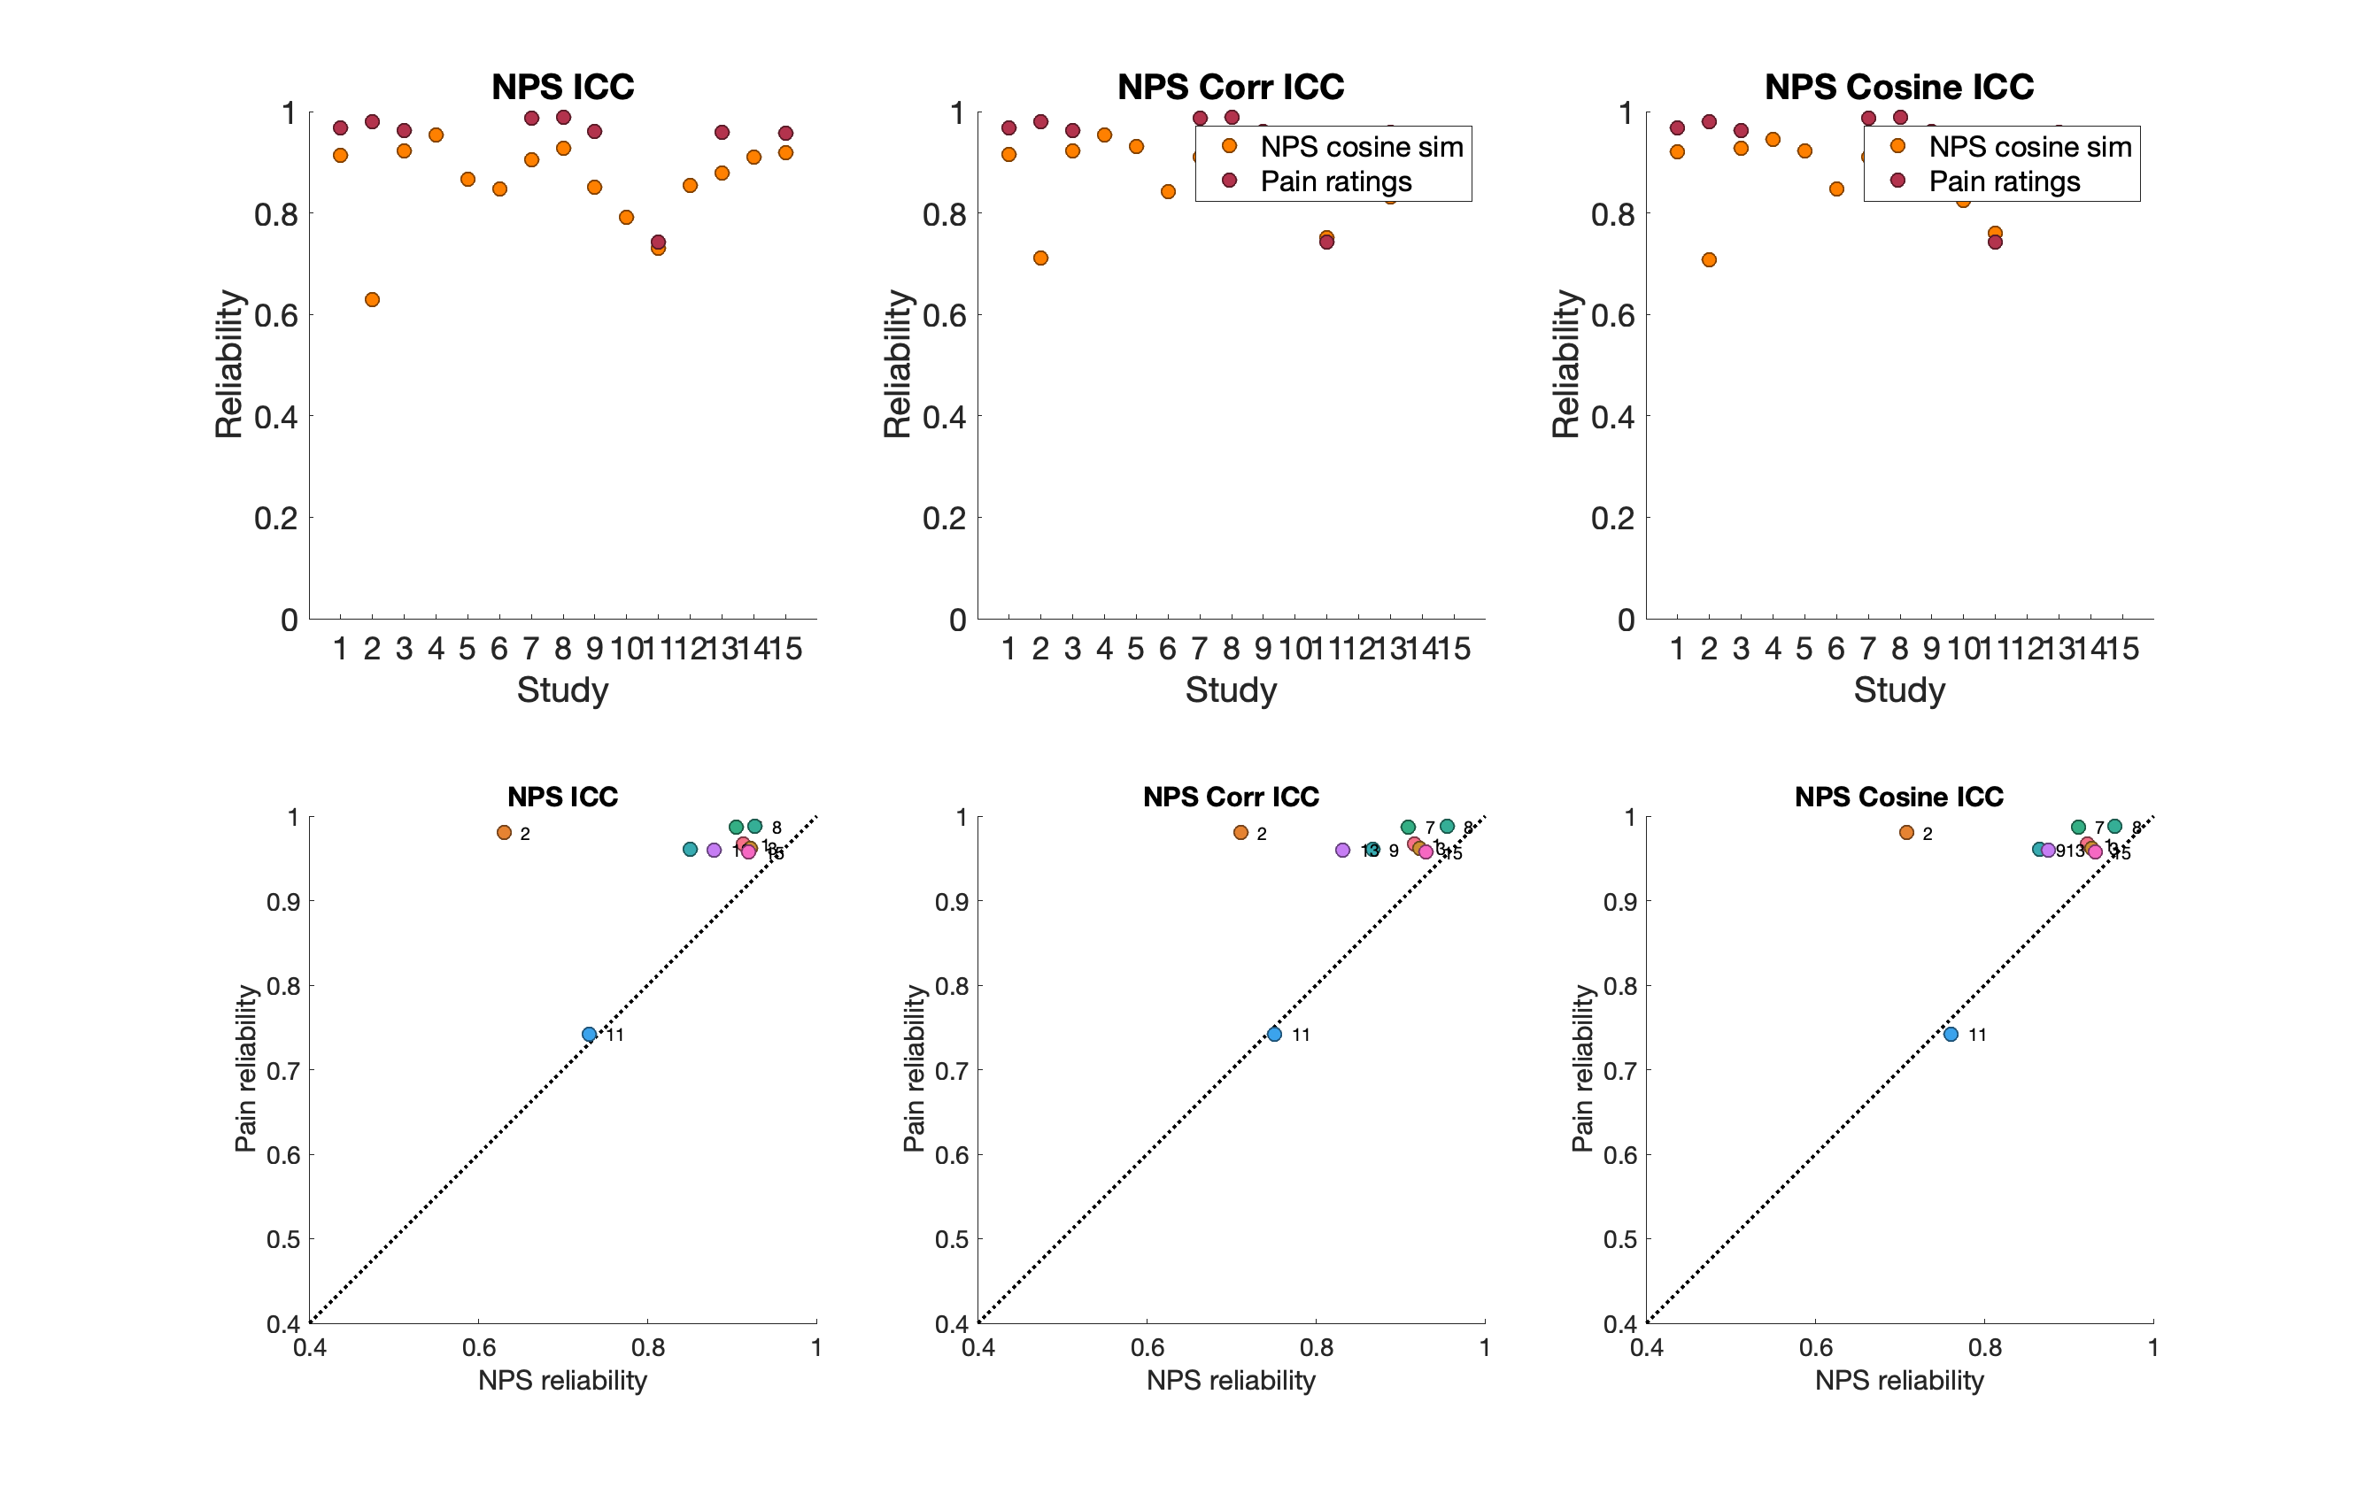
Reliability - ICC

Slide 11
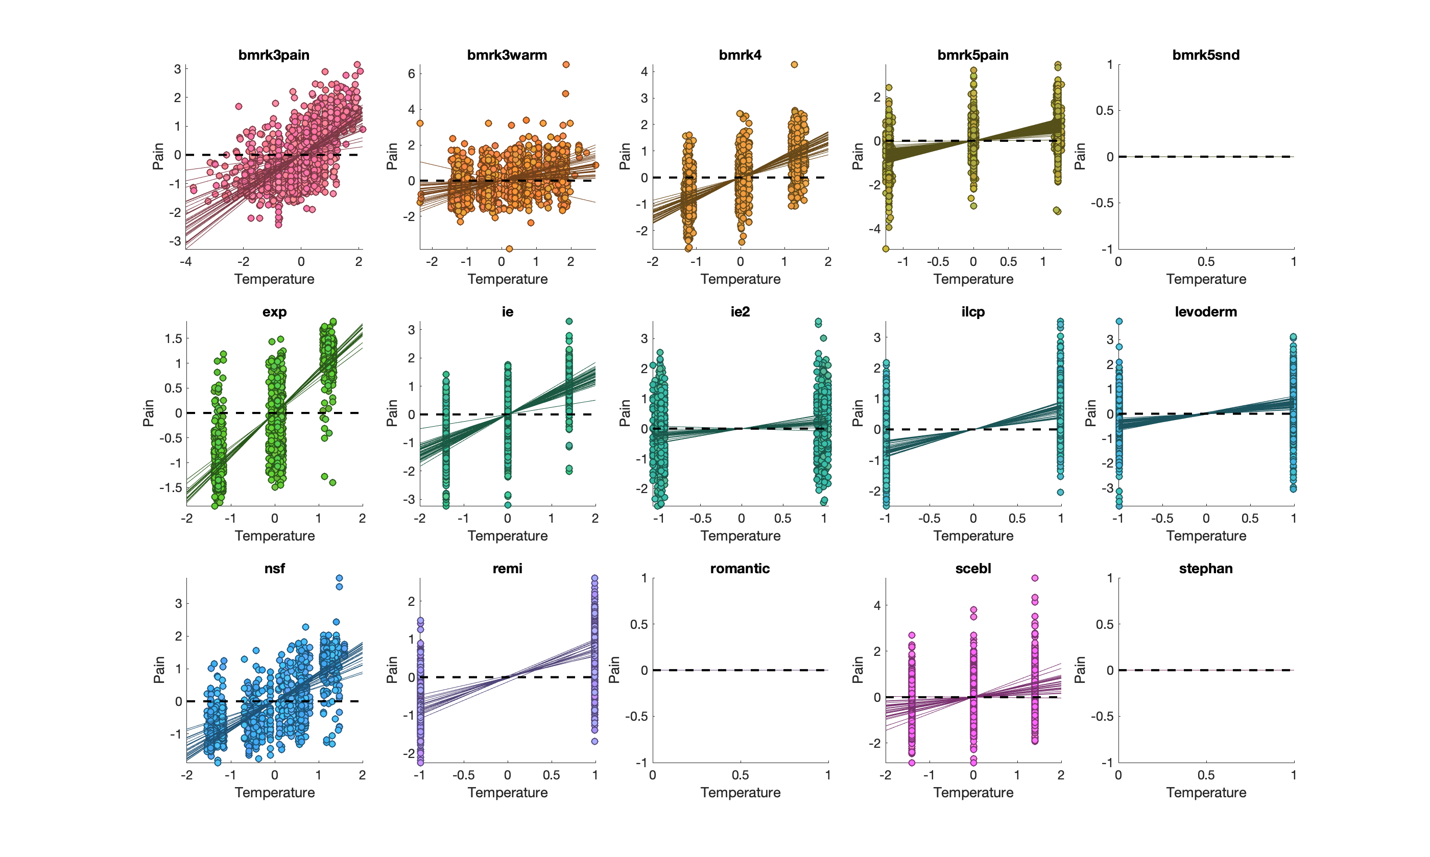
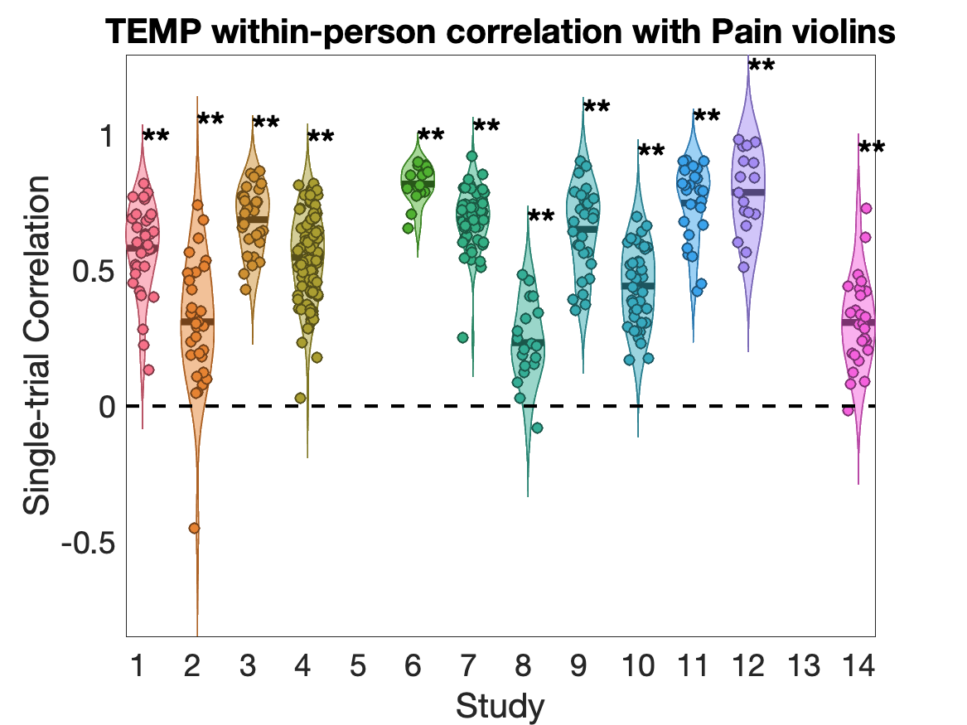
Pain correlation with Temp

