Slide 1
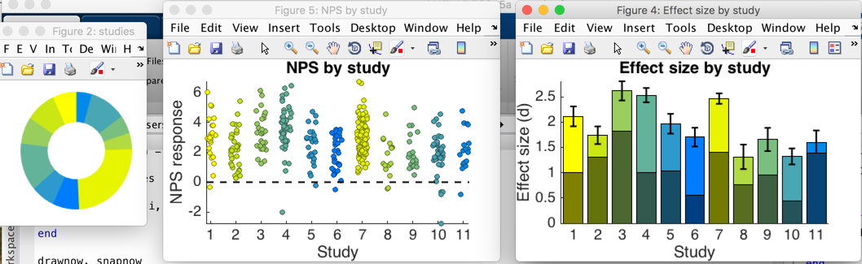
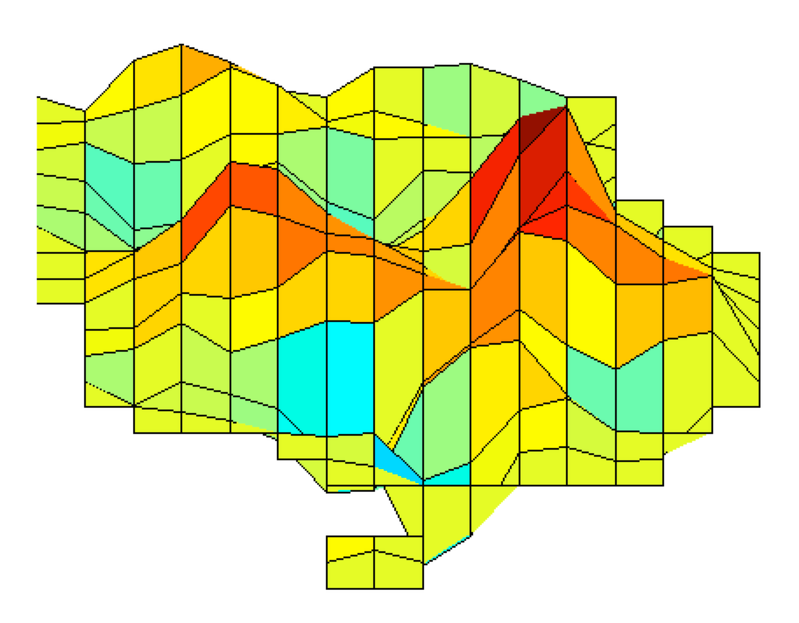
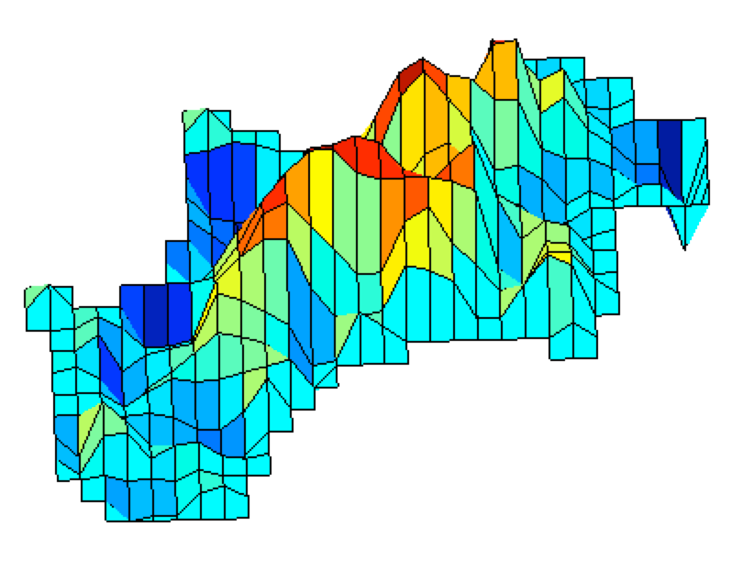
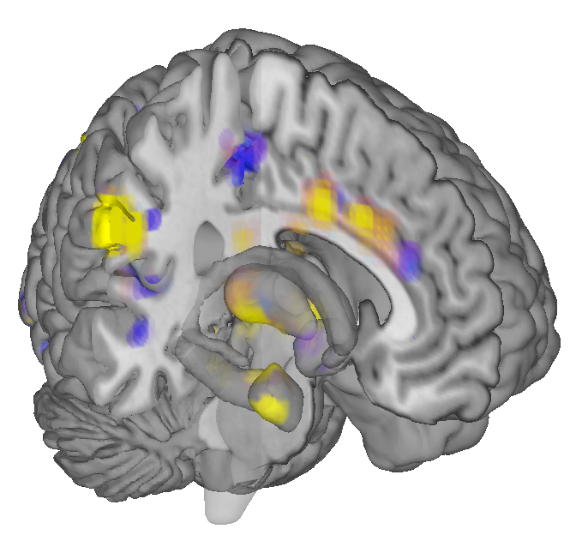
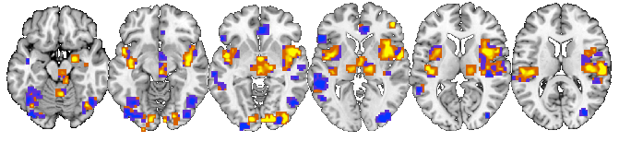
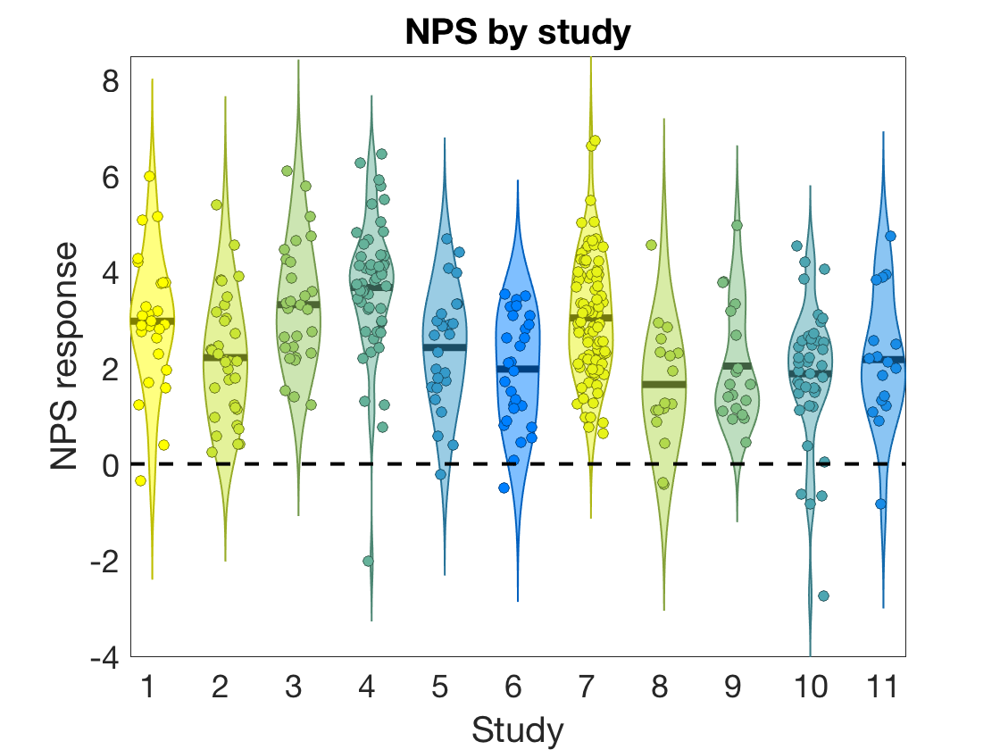
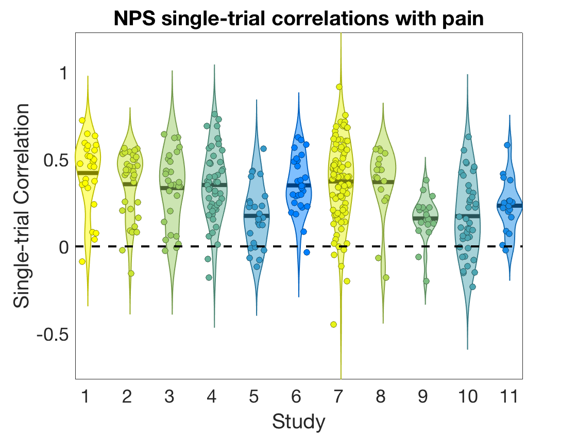
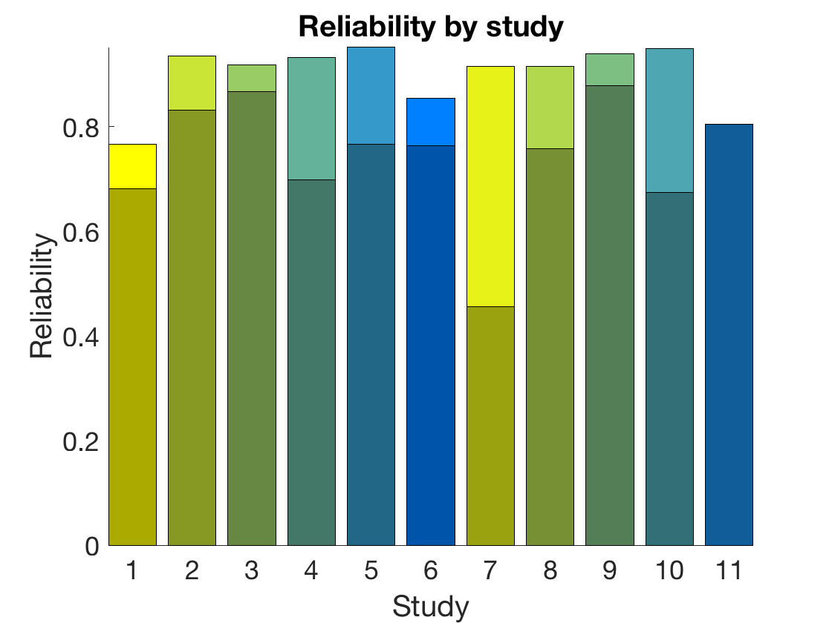
Single-trial database
Neurological Pain Signature (NPS)
Induction of heat pain
11 studies
378 participants
23,493 single-trial images

Slide 2

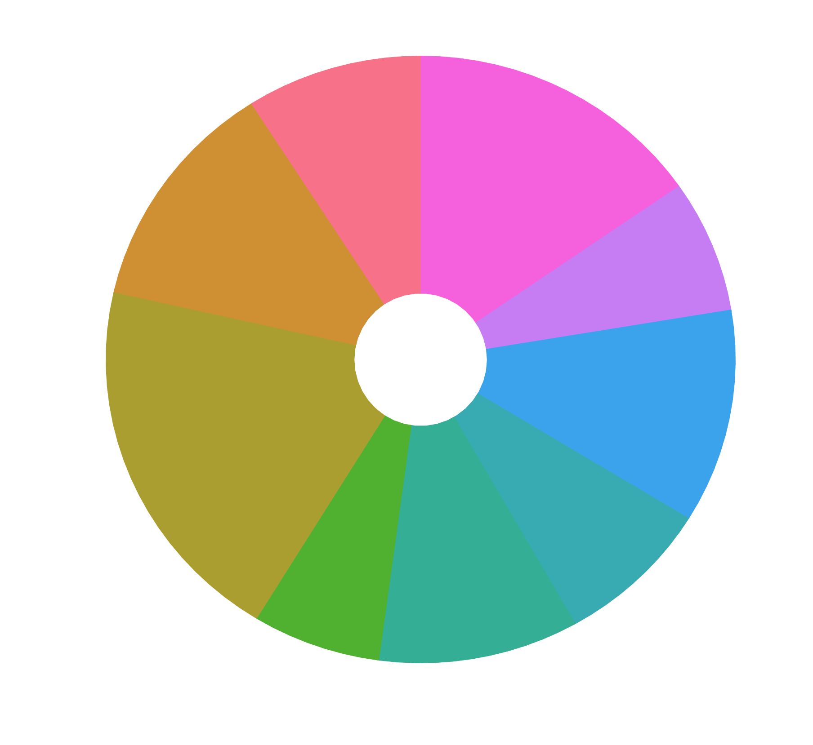
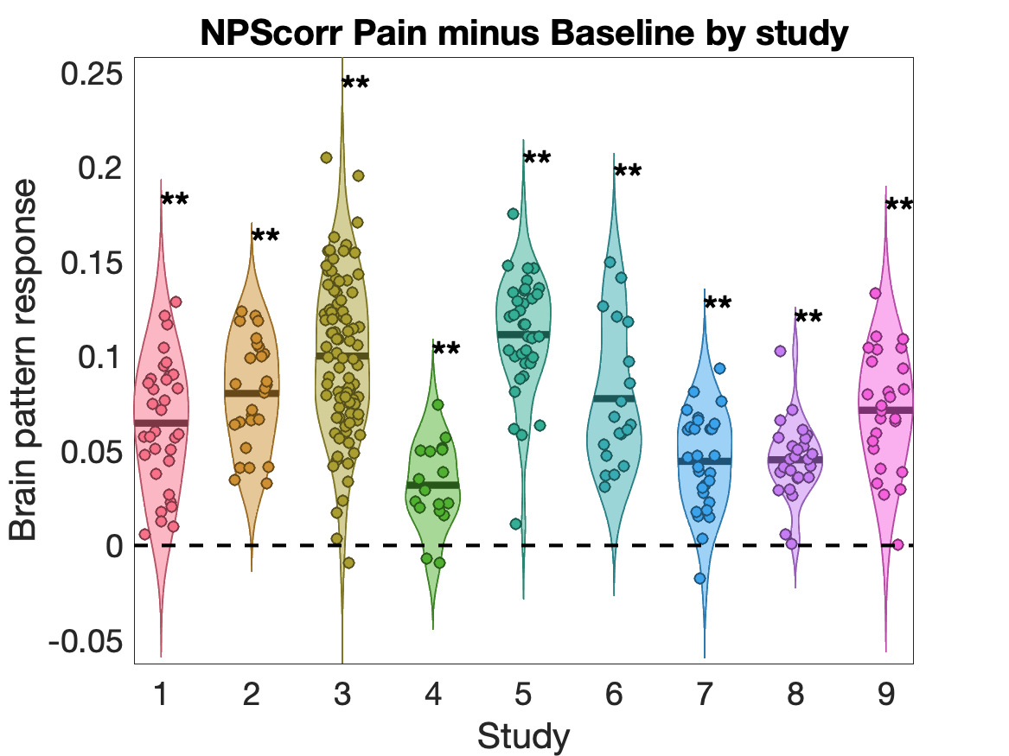
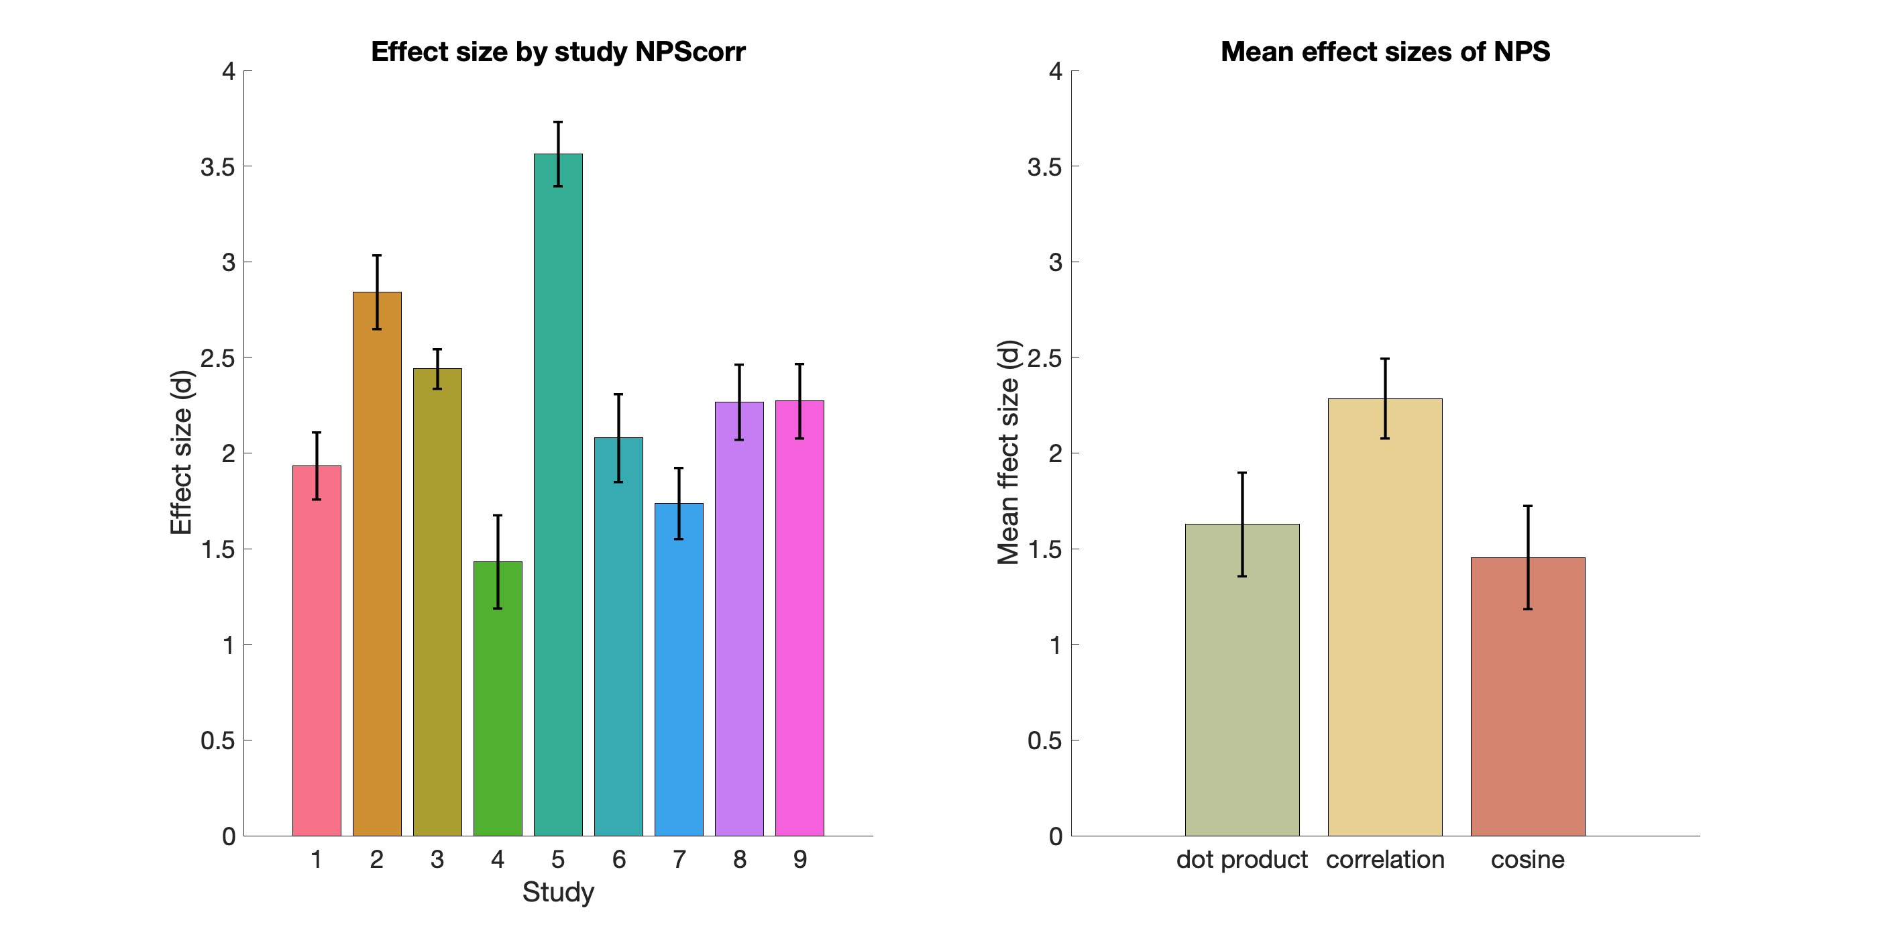
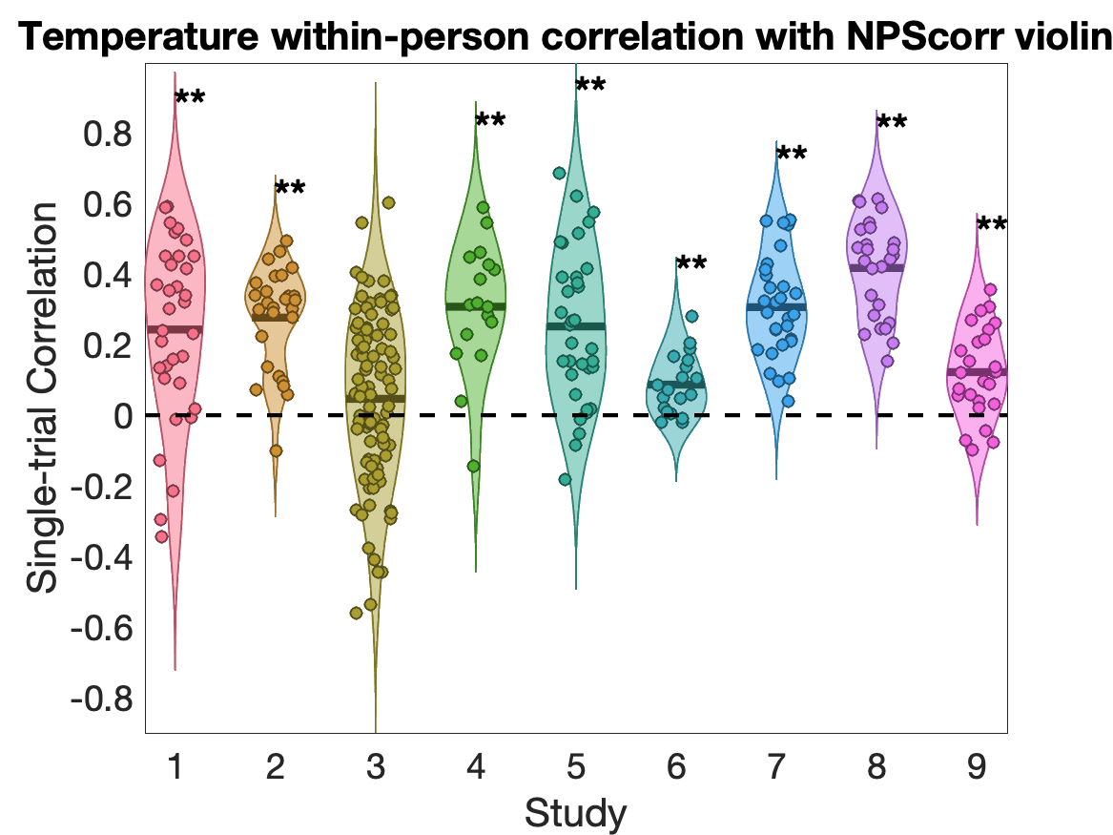
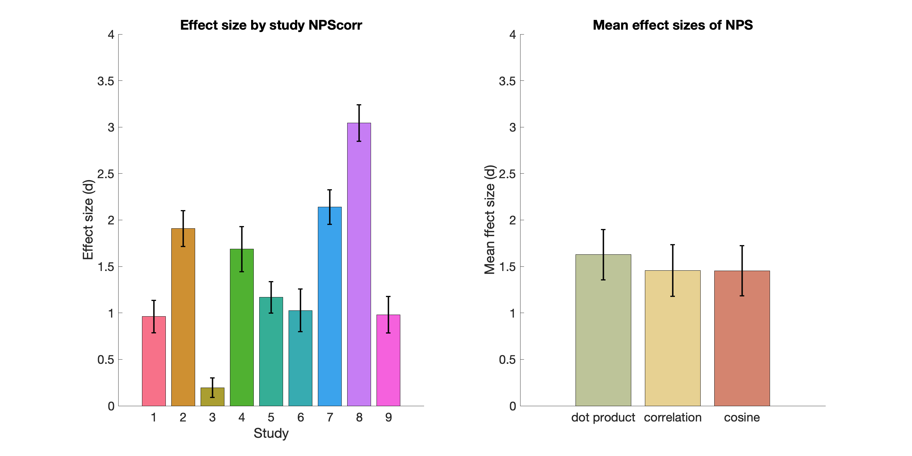
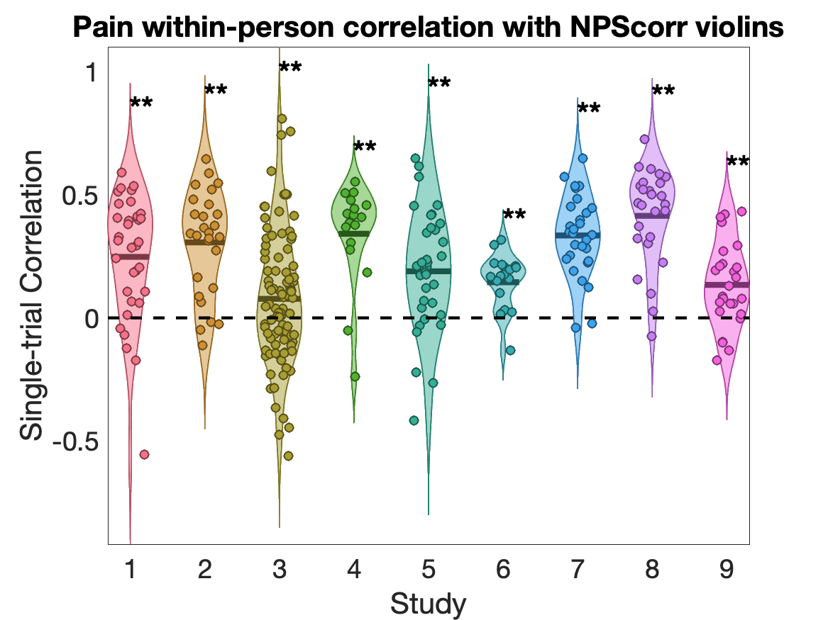
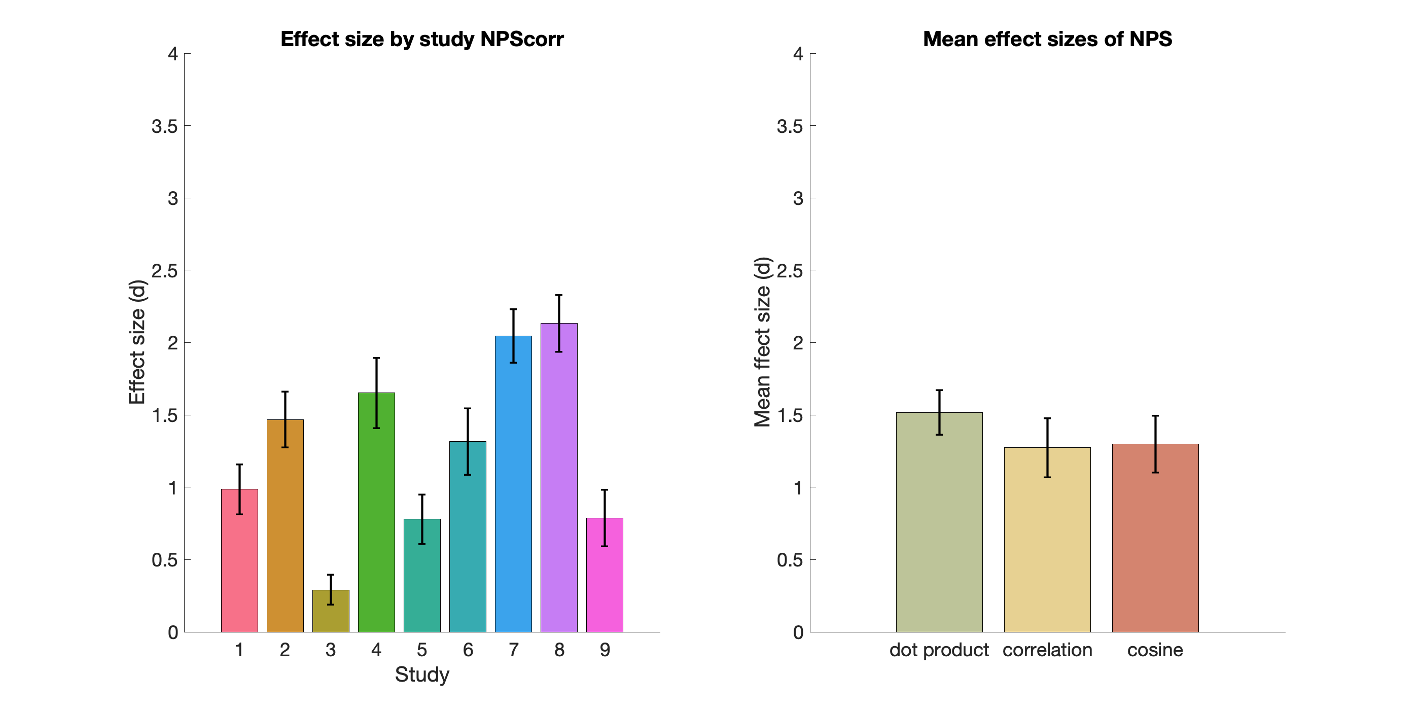
Effect size and reliability of the Neurological Pain Signature
Xiaochun Han¹, Lauren Y. Atlas^{2,3,4}, Luke J. Chang¹, Leonie Koban^{5,6}, Elizabeth A. Reynolds Losin⁷, Mathieu Roy⁸, Choong-Wan Woo^{9,10}, Tor D. Wager¹
(¹Department of Psychological and Brain Sciences, Dartmouth College, Hanover NH, USA; ²National Center for Complementary and Integrative Health, National Institutes of Health, Bethesda MD, USA; ³National Institute of Mental Health, National Institutes of Health, Bethesda MD, USA; ⁴National Institute on Drug Abuse, National Institutes of Health, Baltimore MD, USA; ⁵INSEAD, Fontainebleau, France; ⁶Brain & Spine Institute (ICM), Paris, France; ⁷Department of Psychology, University of Miami, Miami FL, USA; ⁸Department of Psychology, McGill University, CA; ⁹Center for Neuroscience Imaging Research, Institute for Basic Science, Republic of Korea; ¹⁰Department of Biomedical Engineering, Sungkyunkwan University, Republic of Korea.)
Introduction
There is an increasing movement towards establishing neurophysiological markers of mental processes. A priori markers can provide quantitative predictions that can be tested across laboratories, serve as targets for interventions, and increase reproducibility by decreasing analytic flexibility. As markers become more widely shared across labs and translated into practical applications, robust validation of their psychometric properties and performance benchmarks across contexts will become increasingly important.
One such marker is the Neurologic Pain Signature (NPS) ^{[1]}, a multivariate brain measure trained to track pain induced by nociceptive input. Here, we test the effect size and reliability of the NPS in a large dataset of pain studies.
Neurological Pain Signature (NPS)
Method
Single-trial heat pain database
The data used for this study are based on a single trial database on healthy subjects during pain tasks including comprehensive behavioral and fMRI data. The data set included overall 16,294 single-trial images of fMRI activity associated with multiple levels of noxious heat and pain ratings, across over health 305 participants from 9 studies. In each study, thermal stimulations were delivered to multiple skin sites with temperatures ranging from 41 °C to 50 °C and durations from 1.85 to 16 seconds. On each trial, after the offset of stimulation, participants rated the magnitude of pain they experienced. Quantification of single trial response magnitudes was done by constructing a GLM design matrix with separate regressors for each trial.
Effect size
We calculated four types of effect size to quantify the performance of NPS in response to heat pain:
NPS responses in the contrast of [Pain minus Baseline] within each subject
The correlation of NPS with temperature within each subject
The correlation of NPS with subjective pain rating within each subject
The correlation of NPS with subjective pain rating across different subjects
Single-trial database
Induction of heat pain
bmrk4^{[10]}
bmrk3pain^{[2]}
scebl^{[3]}
nsf^{[4]}
bmrk5pain^{[9]}
ilcp^{[5]}
exp^{[8]}
ie^{[7]}
ie2^{[6]}
9 studies
305 subjects
16294 single-trial images
Reliability
We calculate the internal consistency of NPS response of each subject with the split-half correlation and corrected by Spearman-Brown formula.
Pattern similarity representation
We computed for each trial and each subject a single scalar value representing their expression of the NPS pattern. We also compared with performance of three commonly used methods used to calculate the expression of the NPS pattern, e.g., dot-product (NPSdot), correlation (NPScorr) and cosine similarity (NPScos).
NPS vs. Single brain regions
To test the performance of each individual brain region within NPS and further test whether the performance of NPS exceeds any individual brain region within NPS, we also computed the pattern expressions for each individual brain cluster within NPS and compared the effect size and reliability with the complete NPS pattern representation.
Results
NPS responses in the contrast of [Pain minus Baseline]
The results showed that NPS responses in the contrast of [Pain minus Baseline] are significantly greater than zero in each of 9 studies tested, with effect sizes ranging from Cohen‘s d = 1.43 to 3.56. Among the three pattern expression indexes, NPScorr has the largest effect size (Cohen‘s d = 2.29).
Correlation of NPS with temperature
The results showed that the correlation of NPS responses with temperature are significantly greater than zero in 8 out of 9 studies tested, with effect sizes ranging from Cohen‘s d = 0.19 to 3.04. Among three pattern expression indexes, NPSdot has the largest effect size (Cohen‘s d = 1.63).
Correlation of NPS with subjective pain rating
The results showed that NPS responses in the contrast of [Pain minus Baseline] are significantly greater than zero in each of 9 studies tested, with effect sizes ranging from Cohen‘s d = 0.29 to 2.13. Among the three pattern expression indexes, NPSdot has the largest effect size (Cohen‘s d = 1.52).
Correlation of NPS with subjective pain rating between subjects
The results showed that NPS responses in the contrast of [Pain minus Baseline] are significantly greater than zero in each of 9 studies tested, with effect sizes ranging from Cohen‘s d = 0.29 to 2.13. Among the three pattern expression indexes, NPSdot has the largest effect size (Cohen‘s d = 1.52).

