Slide 1


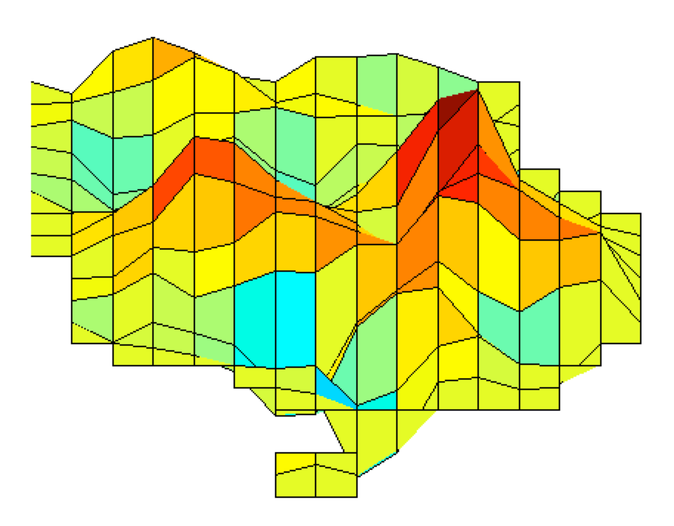
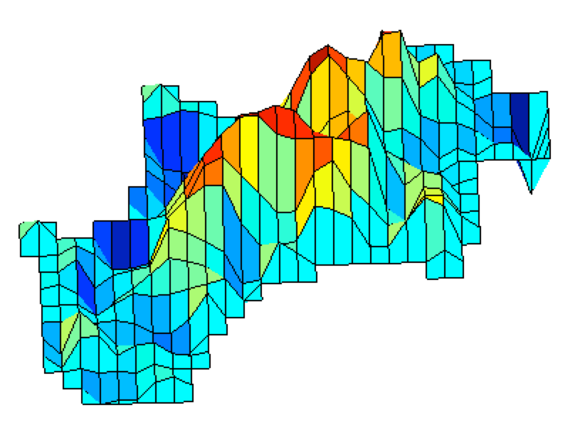
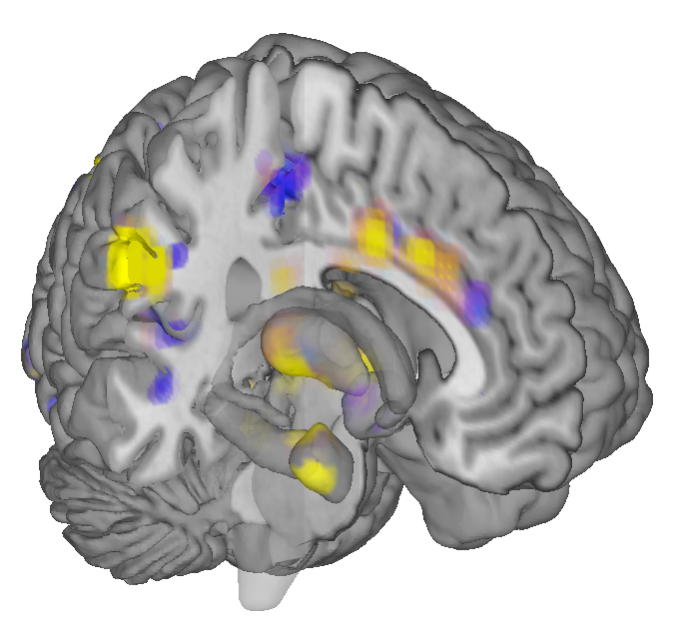
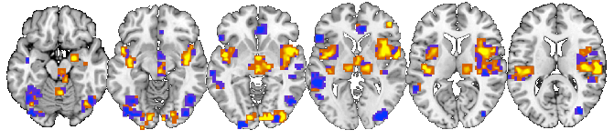
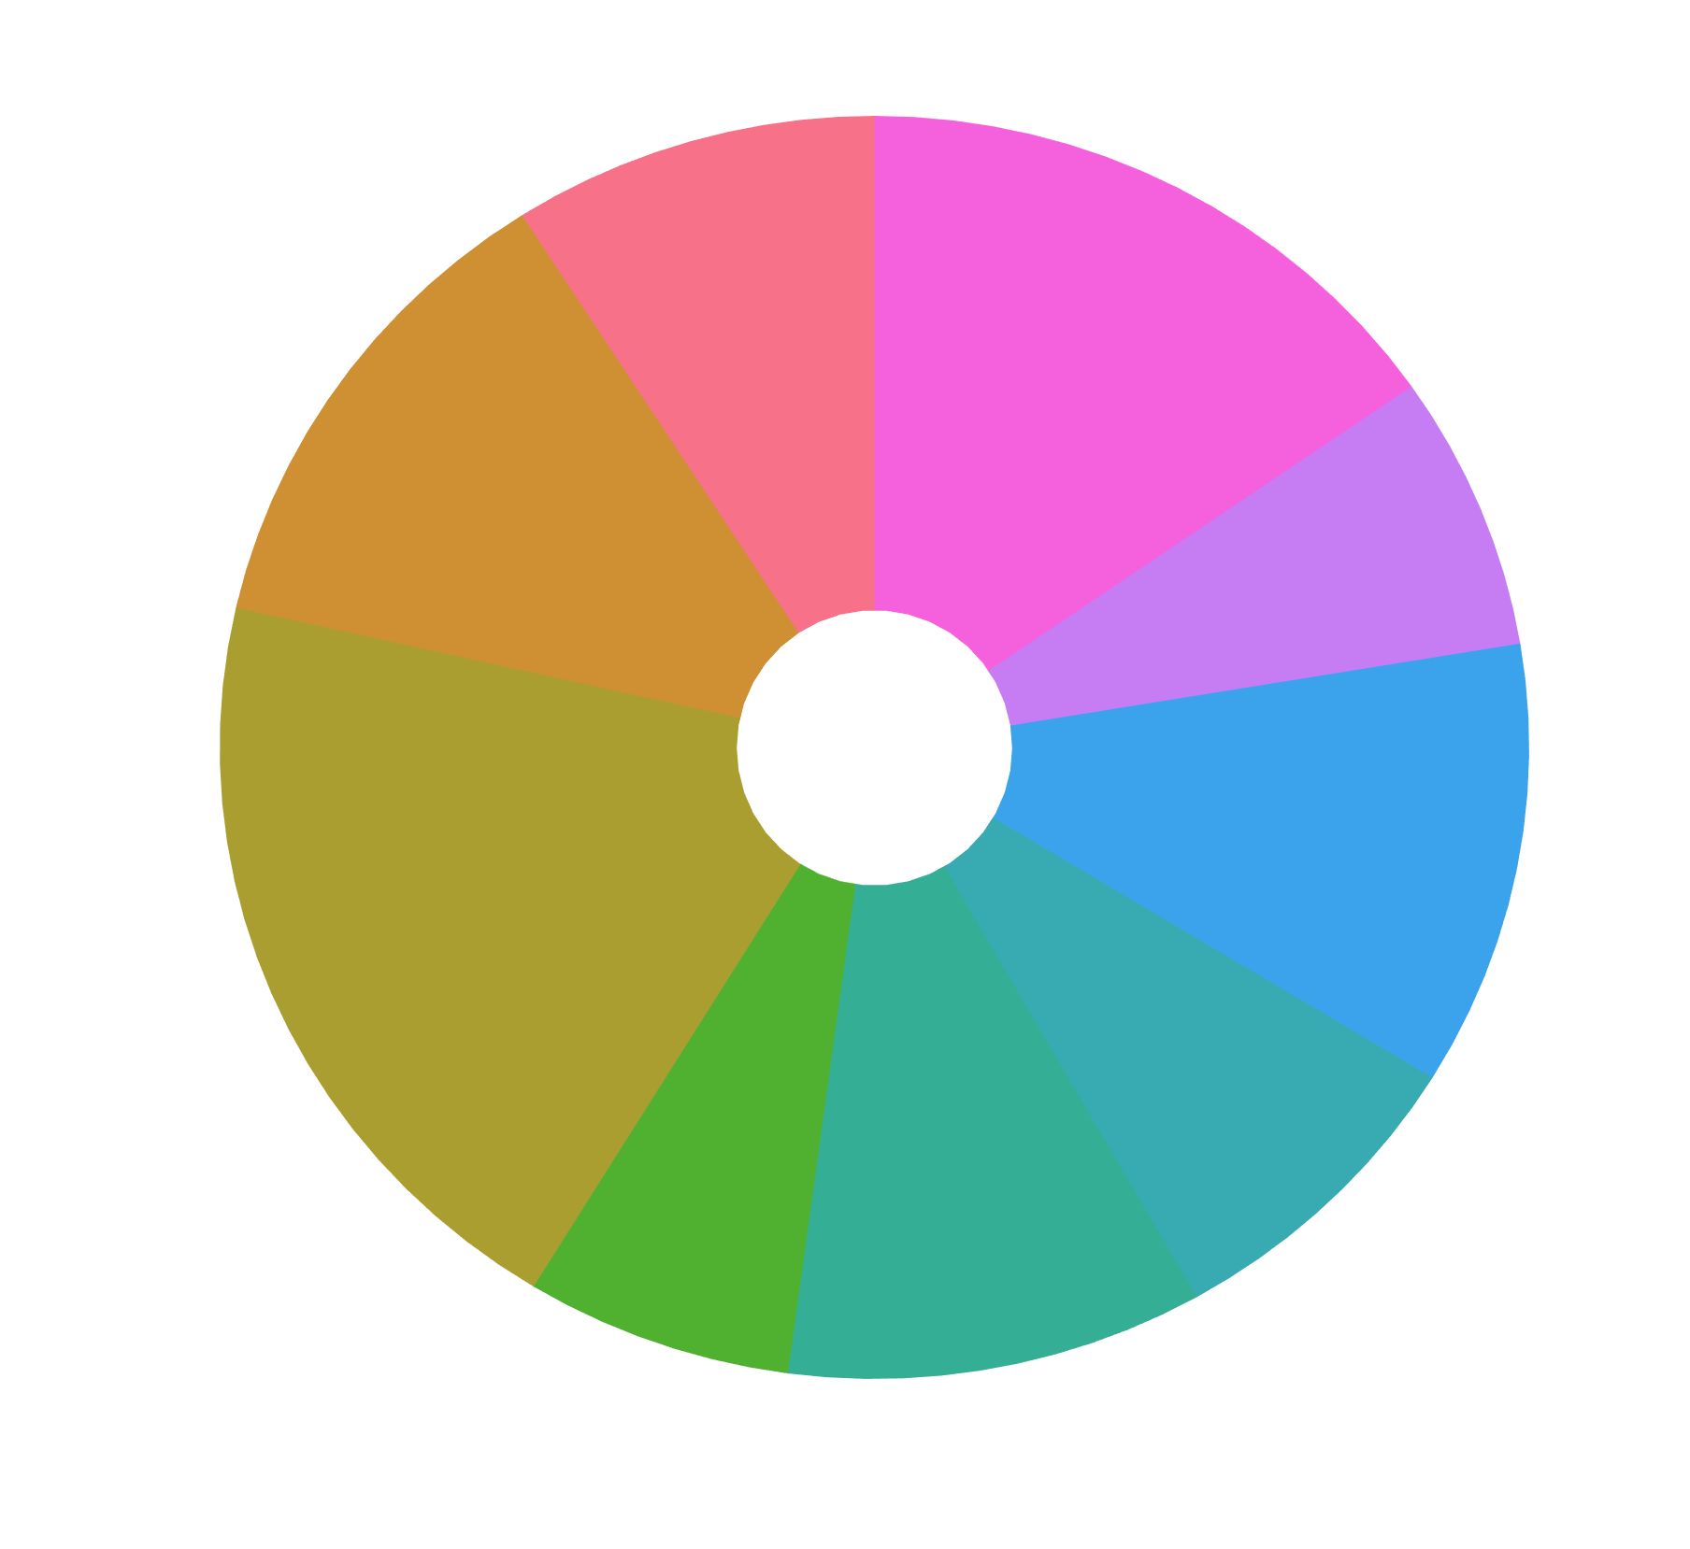
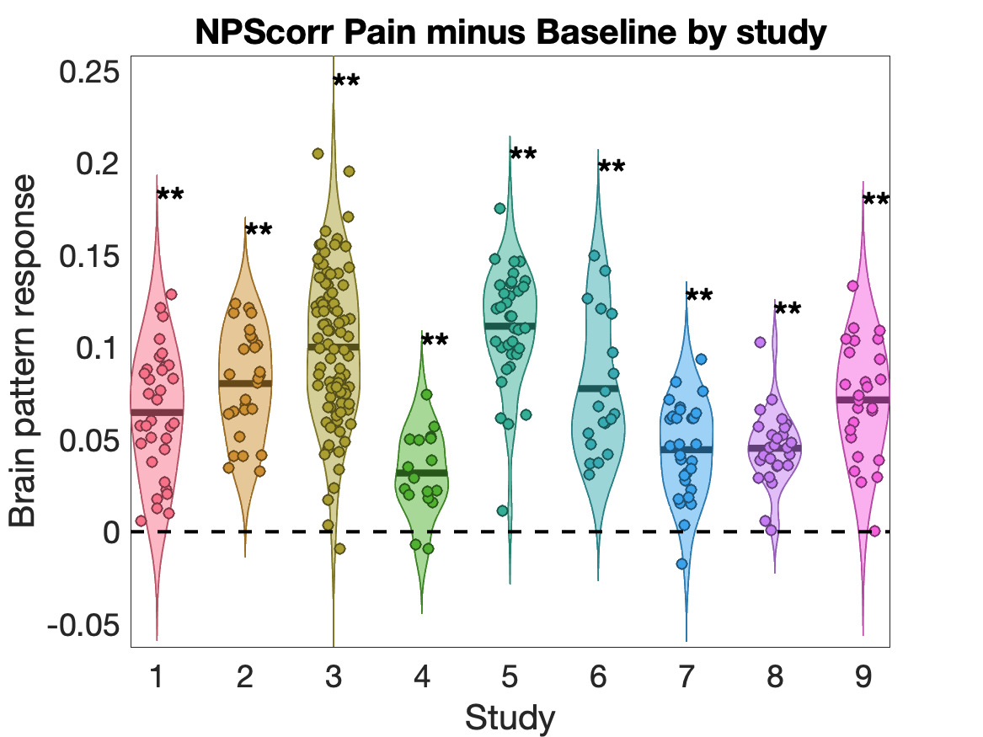
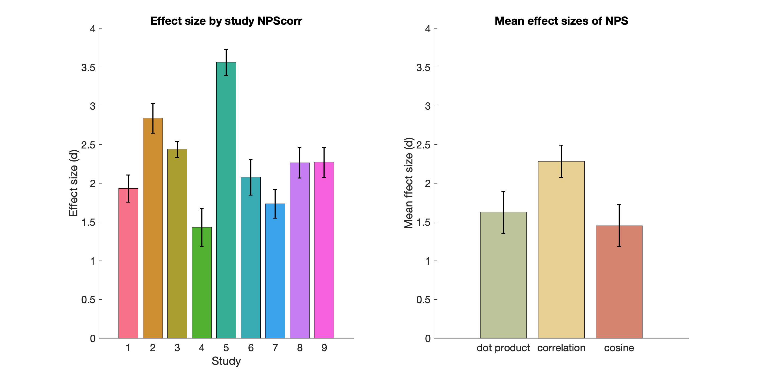
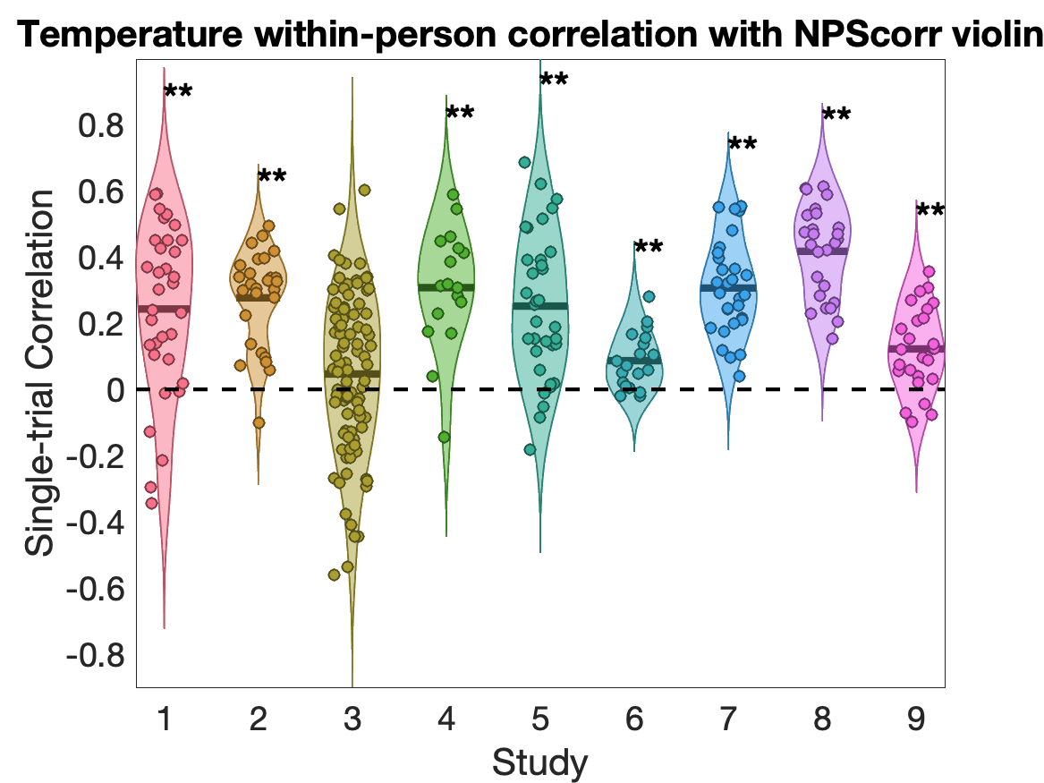
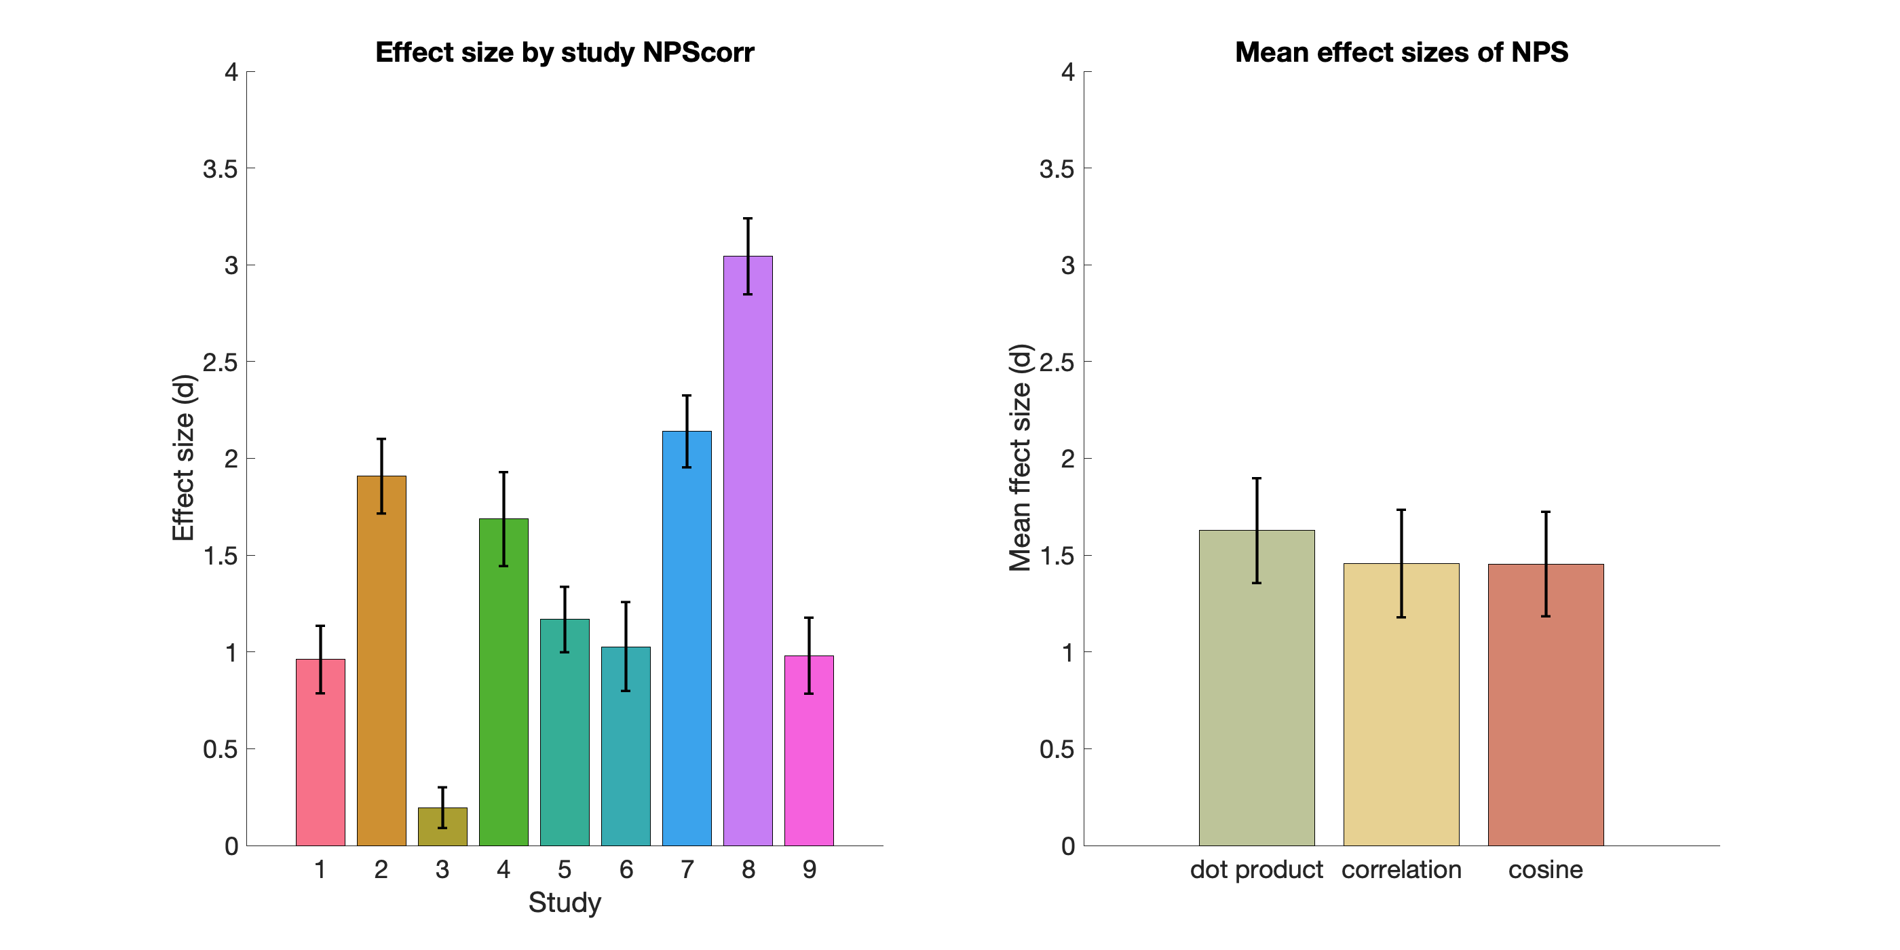
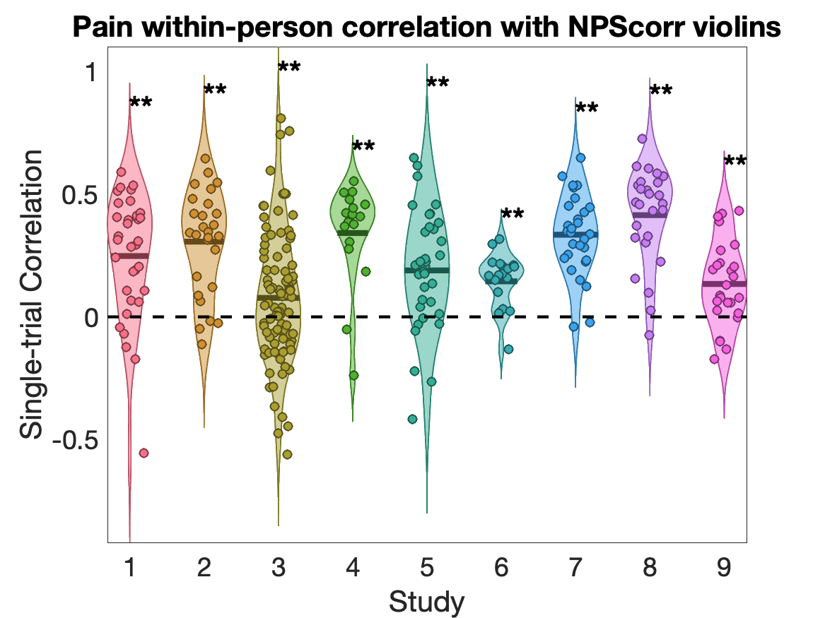
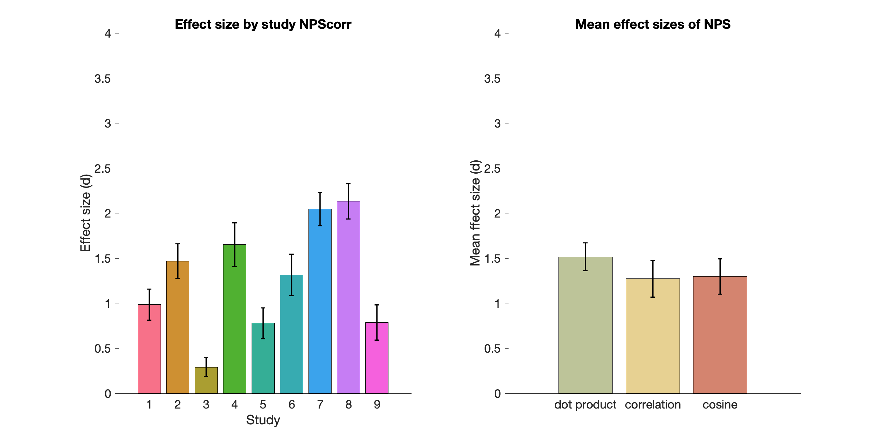
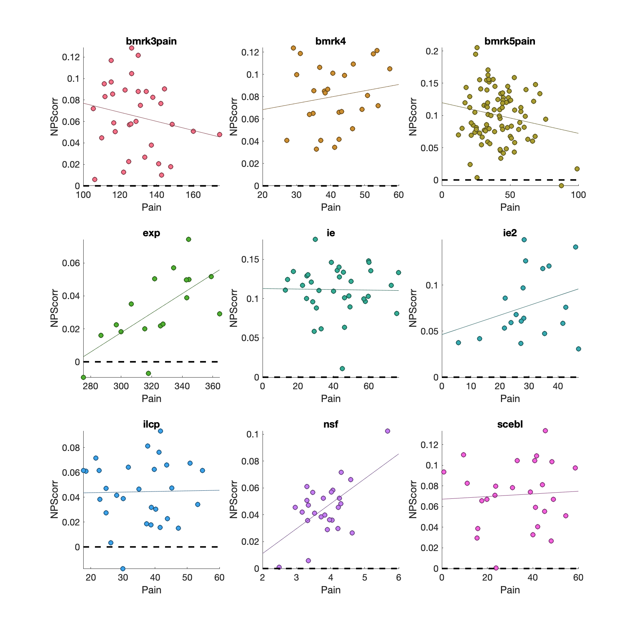
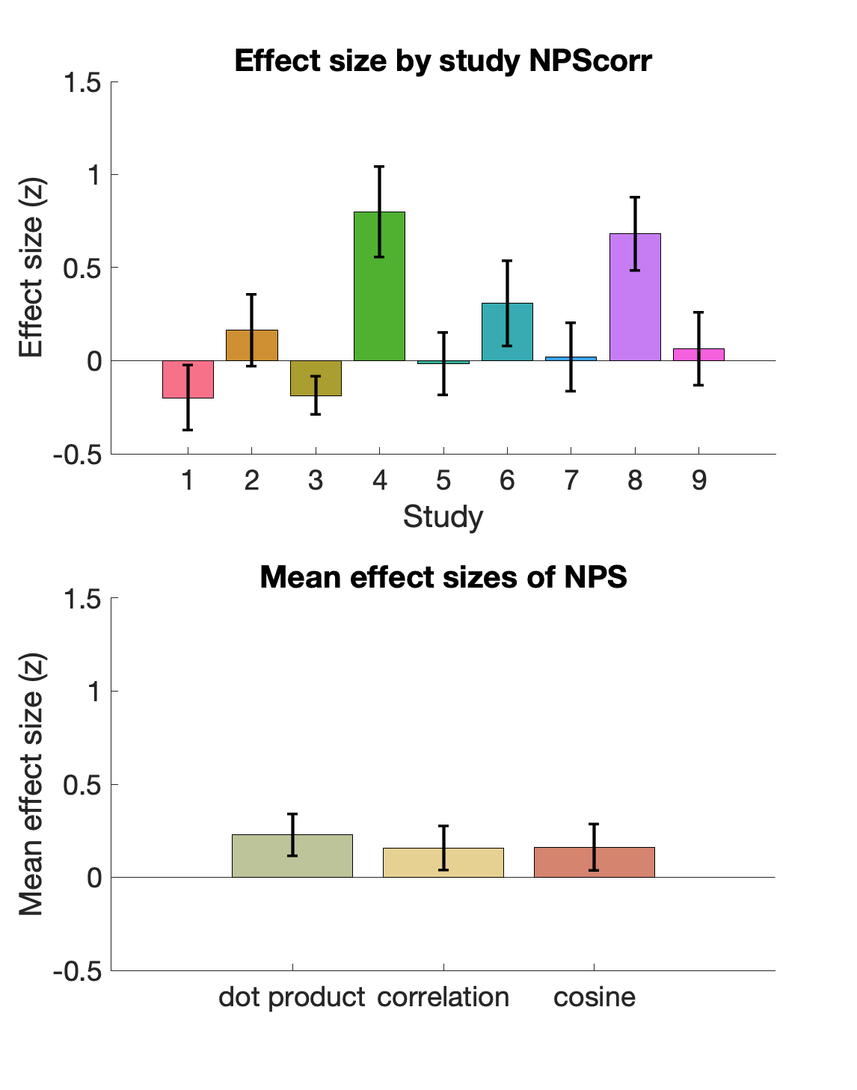
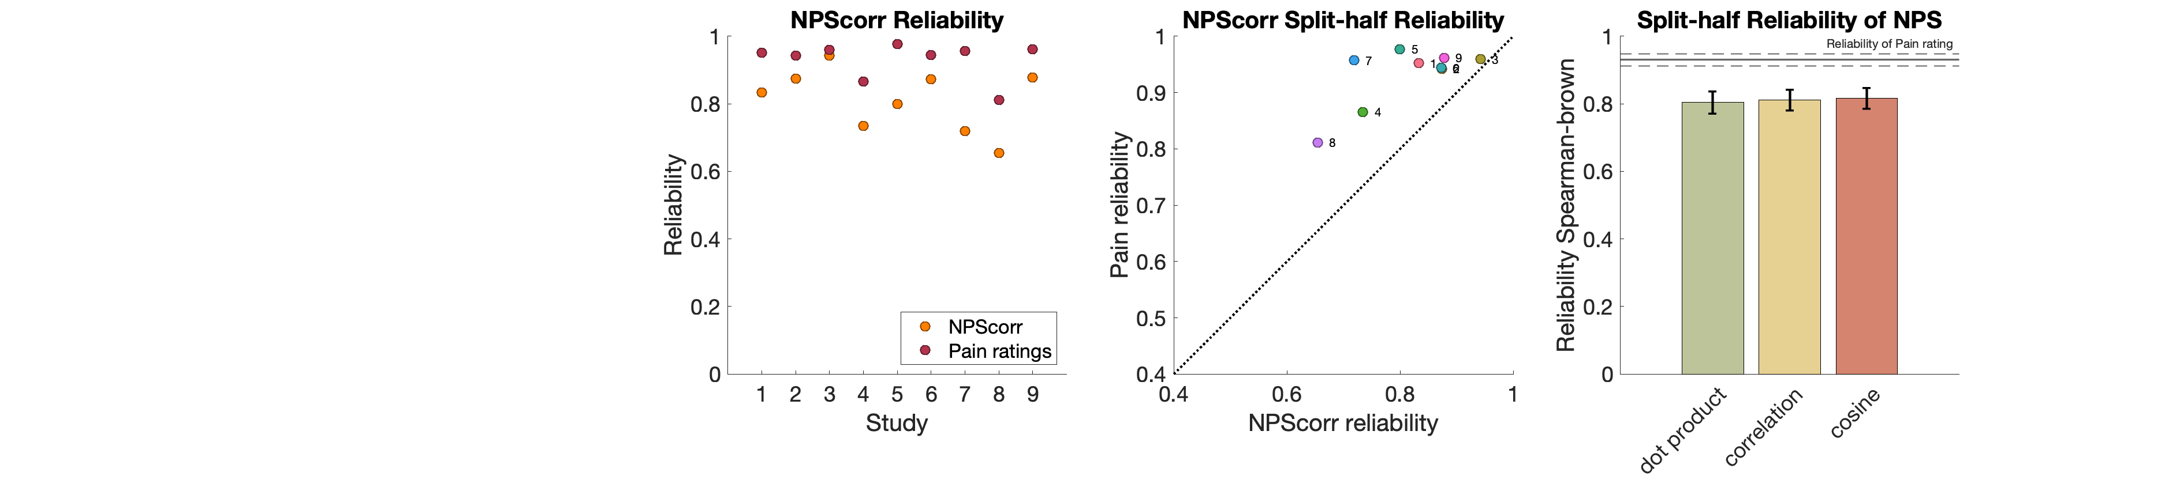
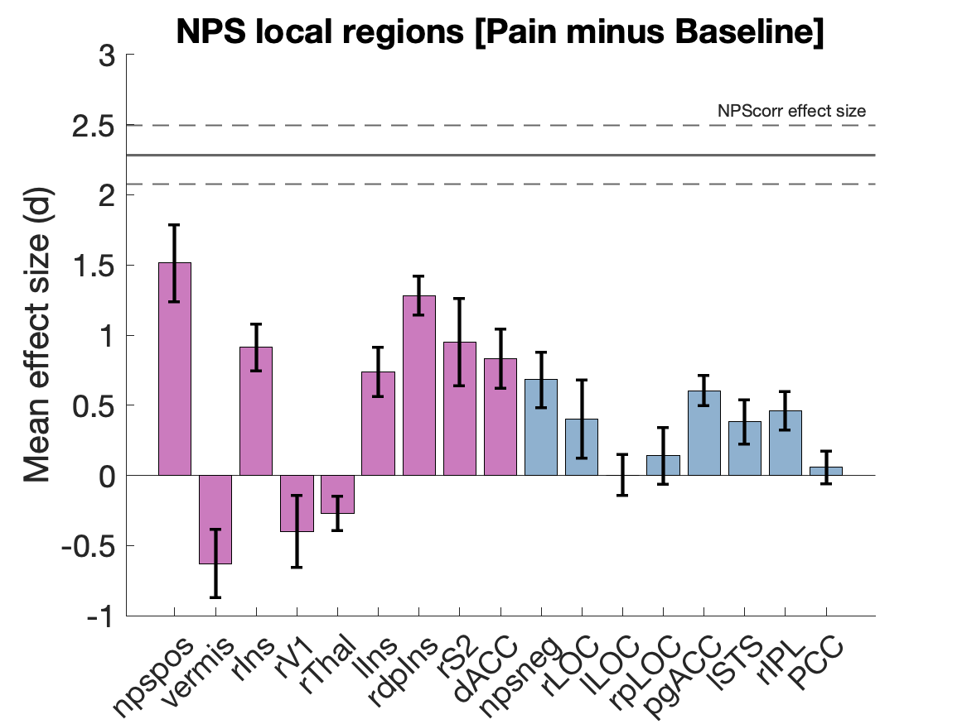
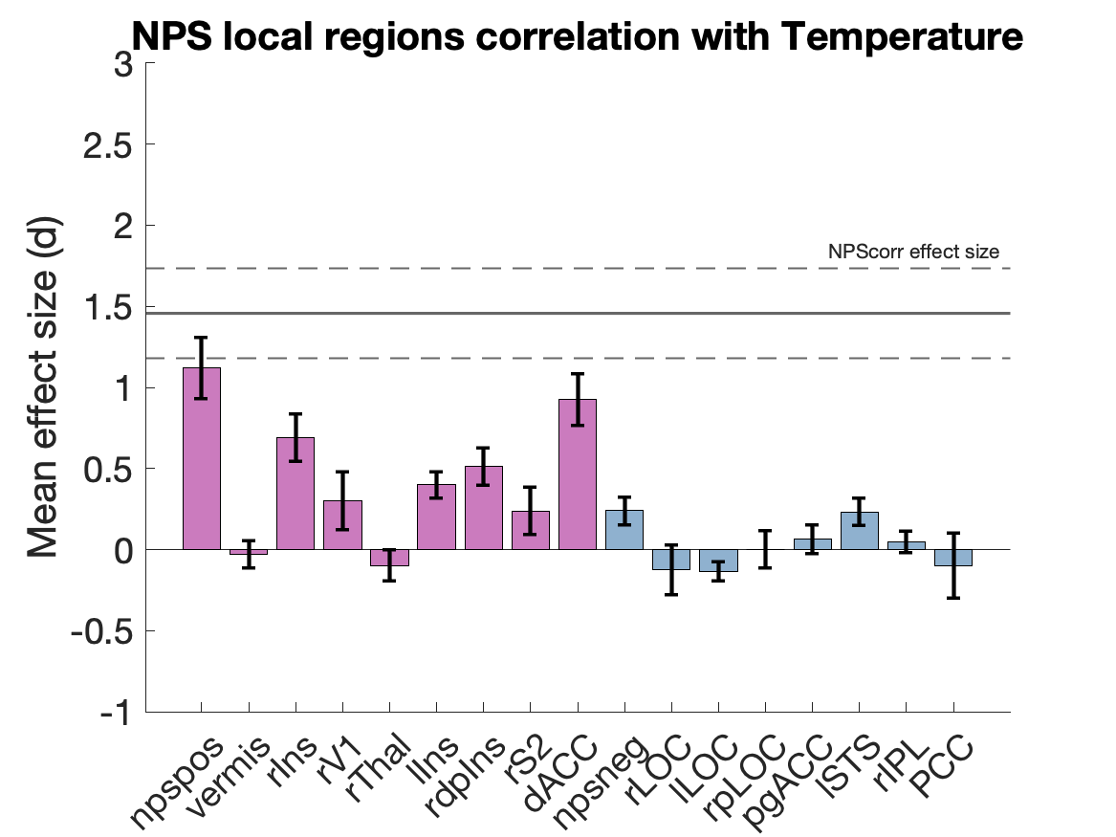
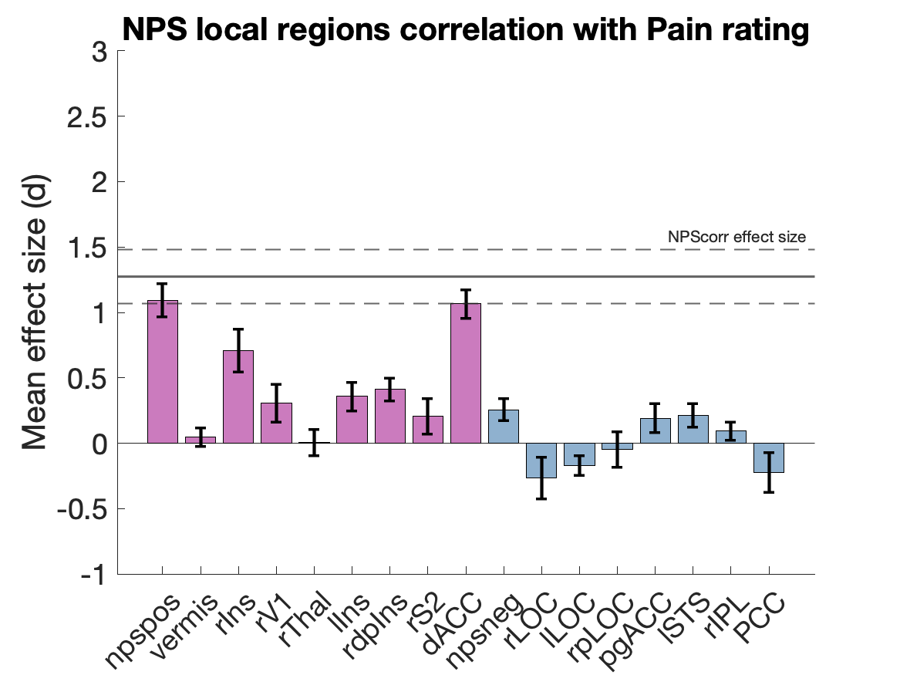
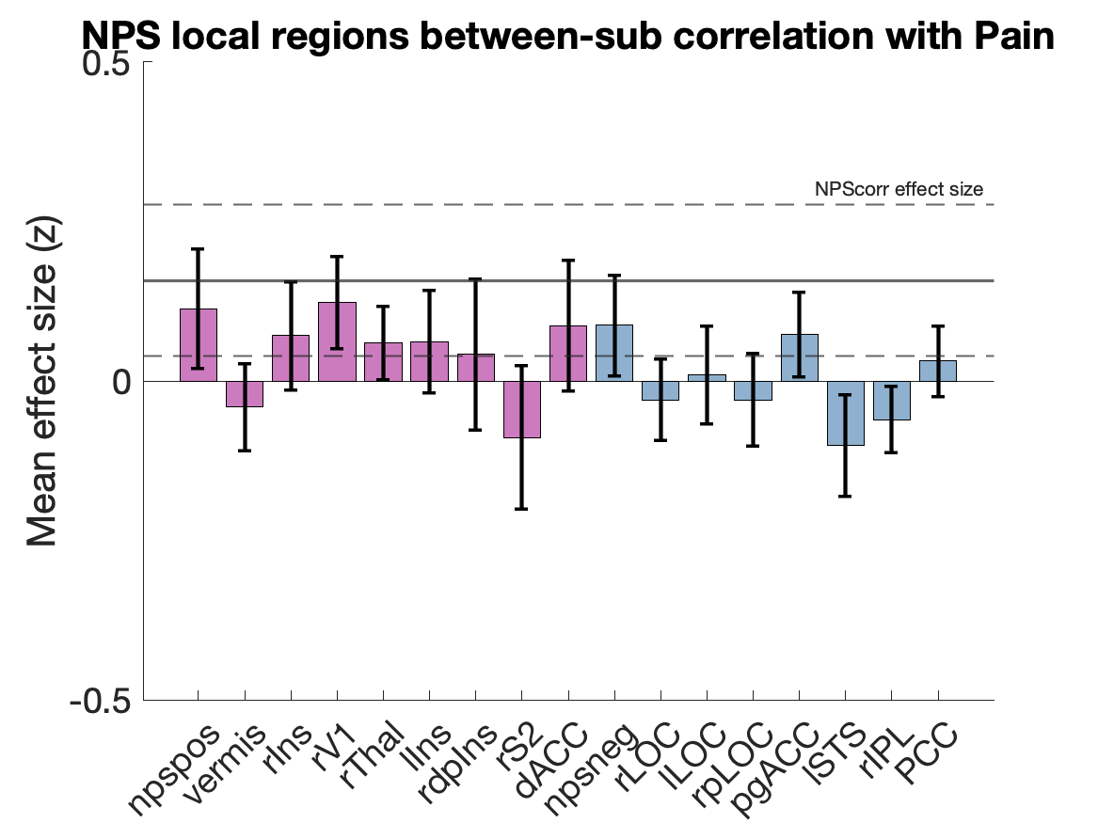
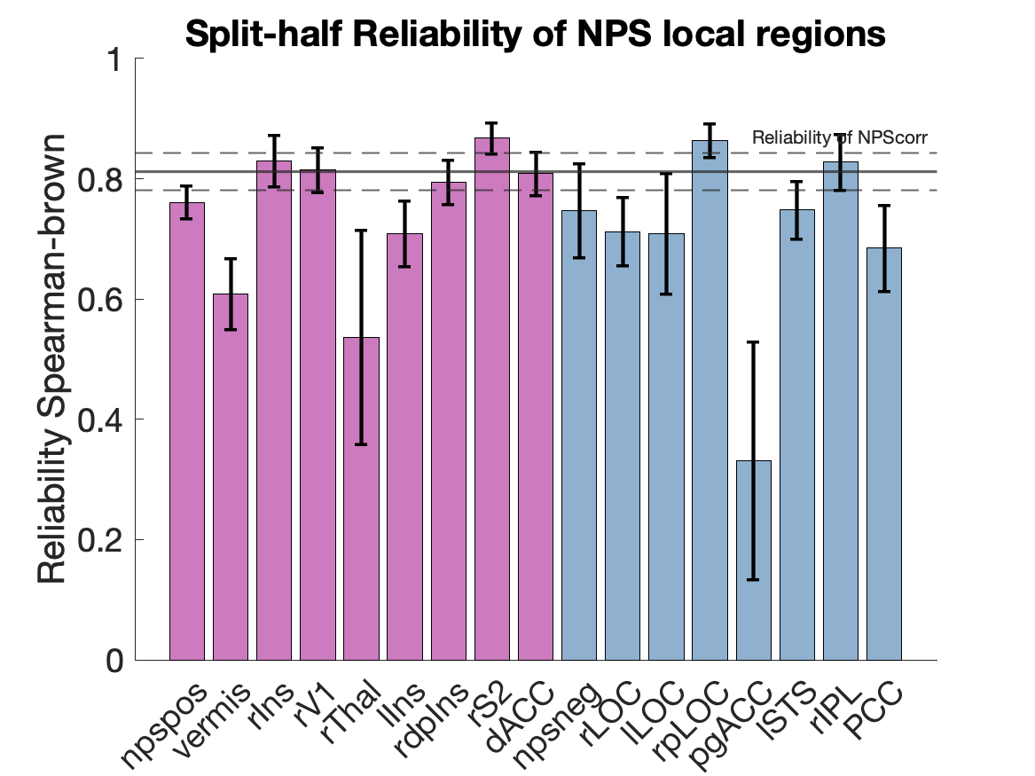
Effect size and reliability of the Neurological Pain Signature
: Xiaochun.han@dartmouth.edu
Xiaochun Han¹, Lauren Y. Atlas^{2,3,4}, Leonie Koban^{5,6}, Elizabeth A. Reynolds Losin⁷, Mathieu Roy⁸, Choong-Wan Woo^{9,10}, Tor D. Wager¹
(¹Department of Psychological and Brain Sciences, Dartmouth College, Hanover NH, USA; ²National Center for Complementary and Integrative Health, National Institutes of Health, Bethesda MD, USA; ³National Institute of Mental Health, National Institutes of Health, Bethesda MD, USA; ⁴National Institute on Drug Abuse, National Institutes of Health, Baltimore MD, USA; ⁵INSEAD, Fontainebleau, France; ⁶Brain & Spine Institute (ICM), Paris, France; ⁷Department of Psychology, University of Miami, Miami FL, USA; ⁸Department of Psychology, McGill University, CA; ⁹Center for Neuroscience Imaging Research, Institute for Basic Science, Republic of Korea; ¹⁰Department of Biomedical Engineering, Sungkyunkwan University, Republic of Korea.)
Introduction
There is an increasing movement towards establishing neurophysiological markers of mental processes. A priori markers can provide quantitative predictions that can be tested across laboratories, serve as targets for interventions, and increase reproducibility by decreasing analytic flexibility. As markers become more widely shared across labs and translated into practical applications, robust validation of their psychometric properties and performance benchmarks across contexts will become increasingly important.
One such marker is the Neurologic Pain Signature (NPS) ^{[1]}, a multivariate brain measure trained to track pain induced by nociceptive input. Here, we test the effect size and reliability of the NPS in a large dataset of pain studies.
Neurological Pain Signature (NPS)
Method
Single-trial heat pain database
* N= 305, 9 studies, > 16,000 single-trial fMRI images
* datasets for generalization:
- various heat intensities: 41 °C to 50 °C; 1.85 to 16 seconds
- multiple skin sites: upper and lower limb
- various scanners: multiple sites, GE vs. Siemens, 1.5T vs. 3T
Effect size
* NPS responses in the contrast of [Pain minus Baseline] within within participants
* The correlation of NPS with temperature within participants
* The correlation of NPS with subjective pain rating within participants
* The correlation of NPS with subjective pain rating between participants, e.g., individual difference
Single-trial database
Induction of heat pain
bmrk4^{[9]}
bmrk3pain^{[2]}
scebl^{[3]}
nsf^{[1]}
bmrk5pain^{[8]}
ilcp^{[4]}
exp^{[7]}
ie^{[6]}
ie2^{[5]}
Reliability
We calculate the internal consistency of NPS response and subjective pain ratings of each subject with the split-half correlation and corrected by the Spearman-Brown formula.
9 studies
305 subjects
16294 single-trial images
Three pattern response matrices
We computed for each trial and each subject a single scalar value representing their NPS pattern response. There are three commonly used matrices used to calculate the NPS pattern responses, e.g., dot-product (NPSdot), correlation (NPScorr), and cosine similarity (NPScos). We compared the performance of the three matrices.
NPS vs. Local brain regions
To test the performance of each brain region within NPS and further test whether the performance of NPS exceeds any individual brain region within NPS, we also computed the pattern expressions for each brain cluster within NPS. We compared the effect size and reliability with the complete NPS pattern representation.
Results
NPS responses in the contrast of [Pain minus Baseline]
* Significantly greater than zero in each of 9 studies tested
* Effect sizes ranging from Cohen‘s d = 1.43 to 3.56
* NPScorr has the largest effect size (Cohen‘s d = 2.29)
Correlation of NPS with temperature
* Significantly greater than zero in 8 out of 9 studies tested
* Effect sizes ranging from Cohen‘s d = 0.19 to 3.04
* NPSdot has the largest effect size (Cohen‘s d = 1.63)
Correlation of NPS with subjective pain ratings
* Significantly greater than zero in each of 9 studies tested
* Effect sizes ranging from Cohen‘s d = 0.29 to 2.13
* NPSdot has the largest effect size (Cohen‘s d = 1.52).
Correlation of NPS with subjective pain rating between subjects
* Significantly greater than zero in 3 out of 9 studies tested
* Effect sizes ranging from Fisher‘s z = -0.2 to 0.8
* NPSdot has the largest effect size (Fisher‘s z = 0.23).
Reliability of NPS response and subjective pain ratings
* NPS: average Spearman-Brown first-second half reliability is 0.81, ranging from 0.65 to 0.94.
* NPScos has the largest reliability (0.82).
* Pain rating: average Spearman-Brown first-second half reliability is 0.93, ranging from 0.81 to 0.98.
Performance of NPS local brain regions
* The effect sizes in the contrast of [Pain minus Baseline] range from Cohen‘s d = -0.63 to 1.51.
* The effect sizes of the within-subject correlations with temperature range from Cohen‘s d = -0.14 to 1.12.
* The effect sizes of the within-subject correlations with subjective pain ratings range from Cohen‘s d = -0.27 to 1.09.
* The effect sizes of the between-subject correlations with subjective pain ratings range from Fisher‘s z = -0.10 to 0.12.
* Reliability tests show that the average Spearman-Brown first-second half reliability range from 0.33 to 0.87.
References
Conclusion
NPS showed very large effect size and high reliability across different studies, superior to the performance of local brain regions.
The performances of three types of pattern similarity representations of NPS are different in different statistics.
The reliabilities for NPS and pain ratings are much higher than their correlations, suggesting that two measurements may be suspected to different sources of inter-individual variability and are not redundant.
These studies were heterogeneous in preprocessing methods, pain duration, scanner, population, body site, and concurrent contexts/cognitive tasks. While this is a strength in demonstrating generalizability, it also limits effect sizes and reliability. Advances could be made by customizing models for particular types of populations/body sites/stimulus durations/contexts.
[1] Wager, T. D., Atlas, L. Y., Lindquist, M. A., Roy, M., Woo, C. W., & Kross, E. (2013). An fMRI-based neurologic signature of physical pain. New England Journal of Medicine, 368(15), 1388-1397.
[2] Woo, C. W., Roy, M., Buhle, J. T., & Wager, T. D. (2015). Distinct brain systems mediate the effects of nociceptive input and self-regulation on pain. PLoS biology, 13(1).
[3] Koban, L., Jepma, M., López-Solà, M., & Wager, T. D. (2019). Different brain networks mediate the effects of social and conditioned expectations on pain. Nature communications, 10(1), 1-13.
[4] Woo, C. W., Schmidt, L., Krishnan, A., Jepma, M., Roy, M., Lindquist, M. A., ... & Wager, T. D. (2017). Quantifying cerebral contributions to pain beyond nociception. Nature communications, 8(1), 1-14.
[5] Jepma, M., Koban, L., van Doorn, J., Jones, M., & Wager, T. D. (2018). Behavioural and neural evidence for self-reinforcing expectancy effects on pain. Nature human behaviour, 2(11), 838-855.
[6] Roy, M., Shohamy, D., Daw, N., Jepma, M., Wimmer, G. E., & Wager, T. D. (2014). Representation of aversive prediction errors in the human periaqueductal gray. Nature neuroscience, 17(11), 1607.
[7] Atlas, L. Y., Bolger, N., Lindquist, M. A., & Wager, T. D. (2010). Brain mediators of predictive cue effects on perceived pain. Journal of Neuroscience, 30(39), 12964-12977.
[8] Losin, E. A. R., Woo, C. W., Medina, N. A., Andrews-Hanna, J. R., Eisenbarth, H., & Wager, T. D. (2020). Neural and sociocultural mediators of ethnic differences in pain. Nature human behaviour, 1-14.
[9] Krishnan, A., Woo, C. W., Chang, L. J., Ruzic, L., Gu, X., Lopez-Sola, M., ... & Wager, T. D. (2016). Somatic and vicarious pain are represented by dissociable multivariate brain patterns. Elife, 5, e15166.

