Slide 1
Effect size and reliability of NPS and SIIPS
Xiaochun Han
2020.06.17

Slide 2
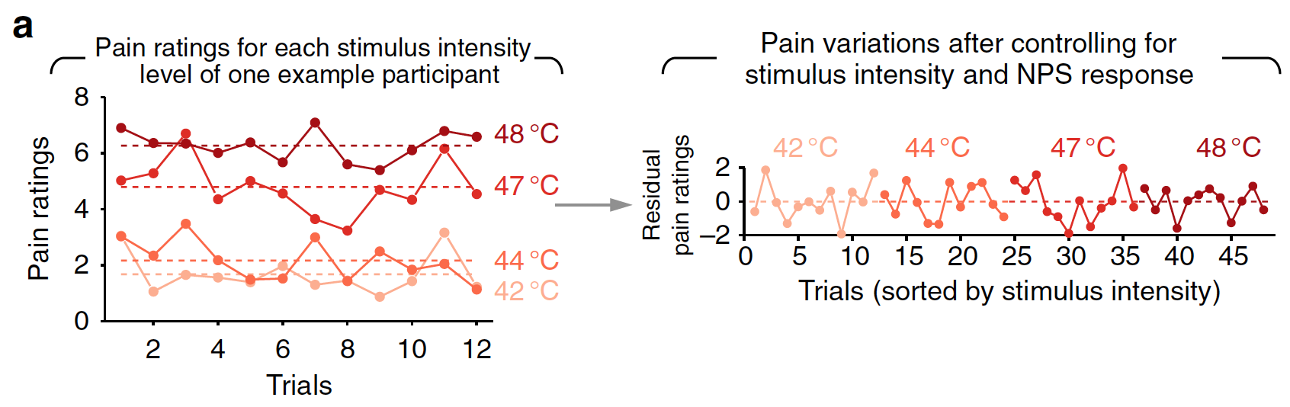
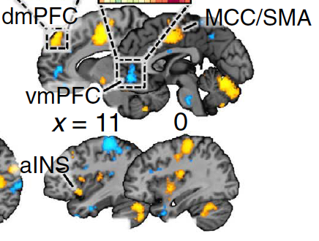
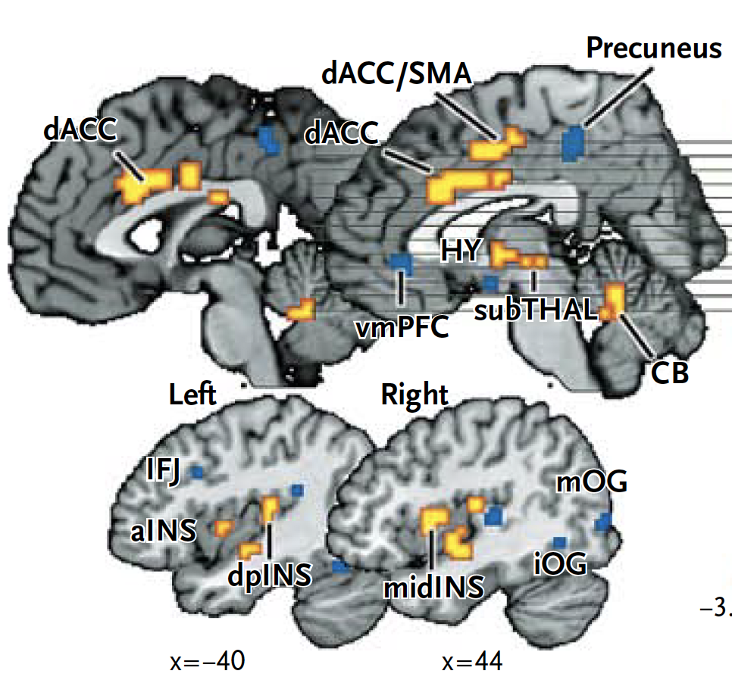
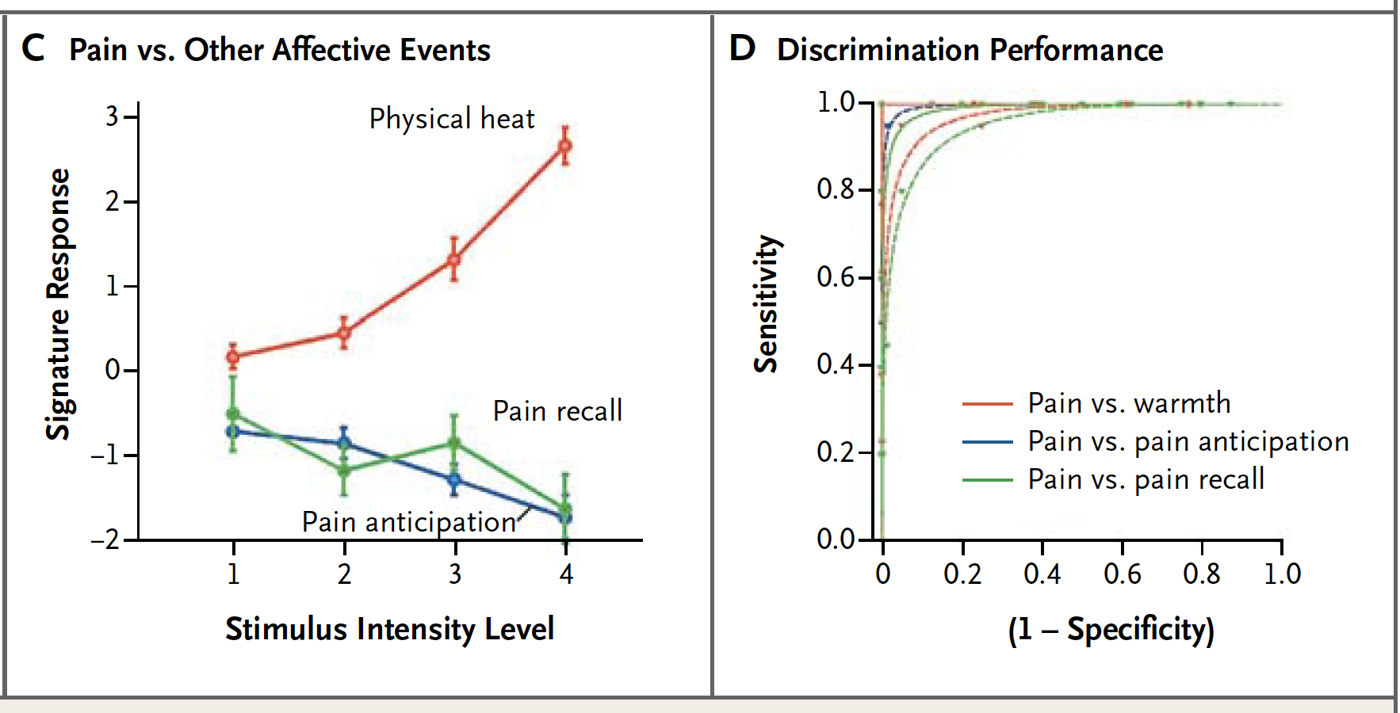
Neurophysiological markers of mental processes
provide quantitative predictions
can be tested across labs
serve as targets for interventions
increase reproducibility by decreasing analytic flexibility
Stimulus Intensity Independent Pain Signature (SIIPS)
cerebral contributions beyond nociception
controlling intensity and NPS
Neurological Pain Signature (NPS)
multivariate brain measure
track intensity of pain induced by nociceptive input
high sensitivity and specificity
(Wager et al., 2013)
(Woo et al., 2016)

Slide 3
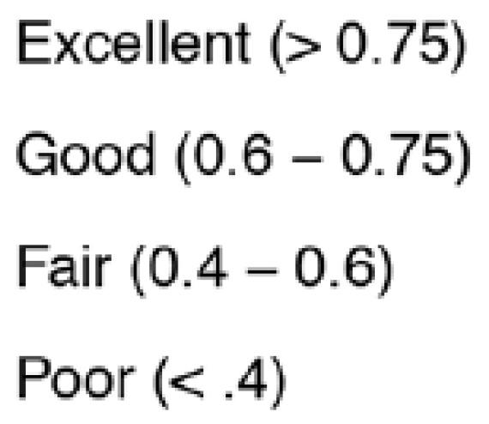
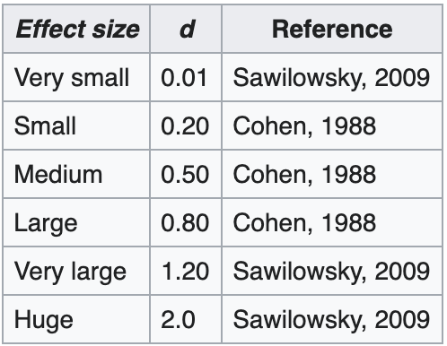
Before more widely used and translated…
Effect size
unit-free description of the strength of an effect
practical significance:
diagnostic of outcomes at the individual level
cohen‘s d
pearson r
Reliability
the ability to give consistent results under similar circumstances
Structure – high
Resting state – fine
Task-based univariate - poor
Put a limit on the predictive utility, power, and validity
(Bennett et al., 2010; Zuo et al., 2014; Reddan et al., 2017; Etkin, 2019; Elliott et al., 2020)

Slide 4
How about the multivariate brain measure across contexts in large datasets?
Study ID. | Study Name | Subjects Num | Trial Num | Excluding dataset
1 | Bmrk3pain | 33 | 1474 | stephan_data – Only one temperature romantic_data – Only one temperature Many missing voxel values excluding remi_data 1 subject in bmrk4 15 subjects in ie_dataset levoderm_data – unpublished and show weird pattern
2 | bmrk4 | 27 | 2021
3 | Bmrk5pain | 93 | 3232
4 | exp | 17 | 1076
5 | ie | 35 | 1680
6 | ie2 | 19 | 1310 | Will be included dataset
7 | ilcp | 29 | 1856 | neurofeedback_data (3 times measurements)
8 | nsf | 26 | 1149
9 | scebl | 26 | 2496
Sum of Pain |  | 305 | 16294

Slide 5
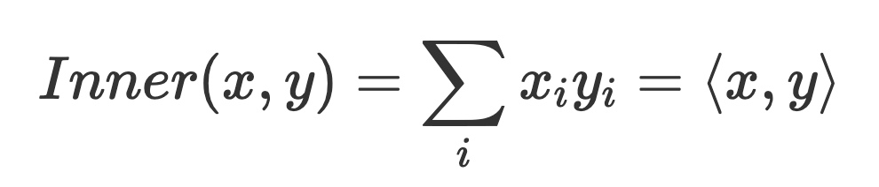
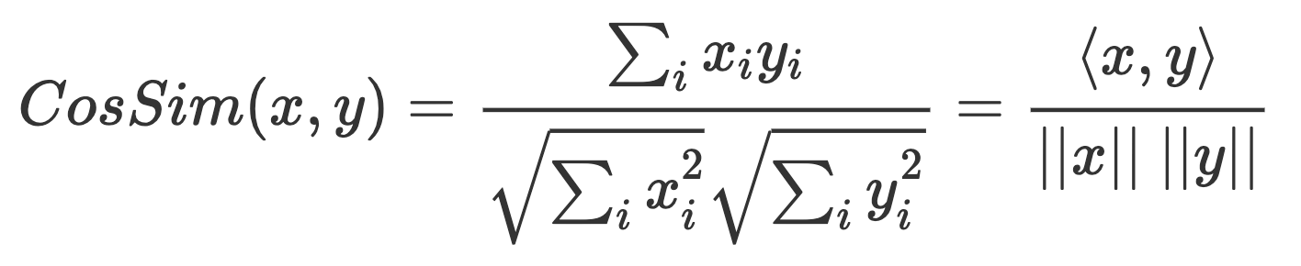
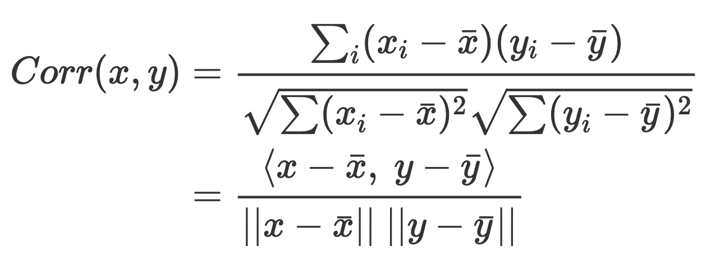
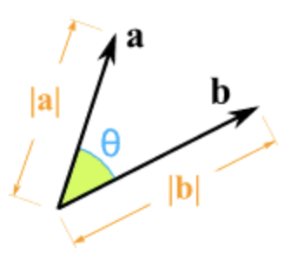
Evaluation dimensions for NPS and SIIPS
Effect size
Within-participant effect size
mean response to the contrast of [Pain minus Baseline]
correlation with temperature
correlation with subjective pain ratings
Individual difference effect size
between-participant correlation with subjective pain ratings
Three pattern response matrices
dot product
cosine similarity:
correlation
Reliability
Split-half correlation
corrected by Spearman-Brown formula
NPS&SIIPS vs. Local brain regions

Slide 6
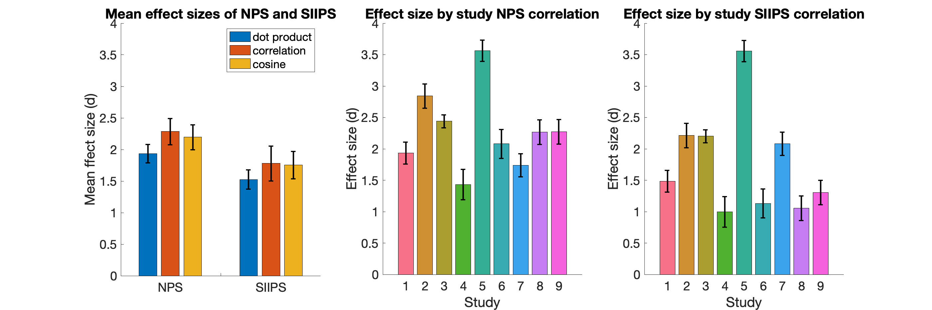
Effect size 1: mean response to the contrast of [Pain minus Baseline]
NPS
* Significantly greater than zero in all 9 studies
* Effect sizes ranging from Cohen‘s d = 1.43 to 3.56
* NPScorr has the largest effect size (Cohen‘s d = 2.29)
SIIPS
* Significantly greater than zero in all 9 studies
* Effect sizes ranging from Cohen‘s d = 1.00 to 3.56
* SIIPScorr has the largest effect size (Cohen‘s d = 1.78)

Slide 7
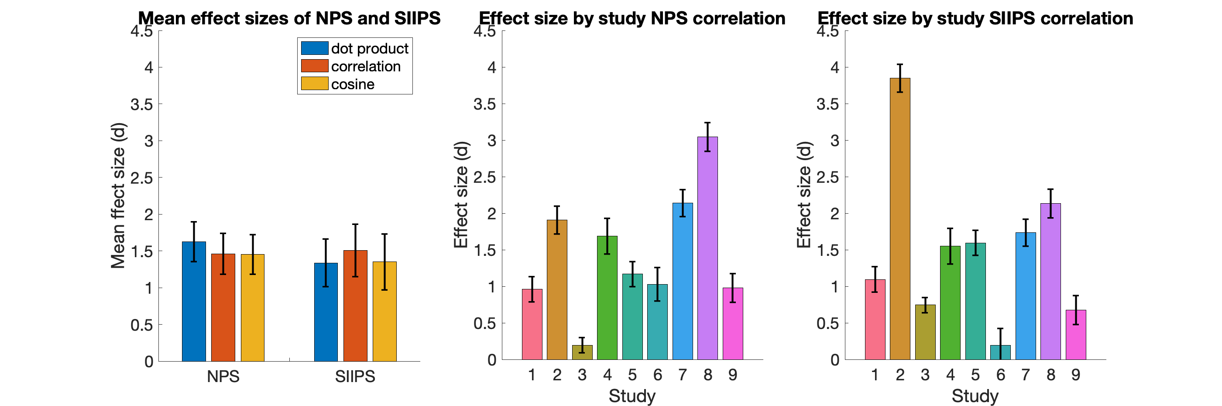
Effect size 2: correlation with temperature
NPS
* Significantly greater than zero in 8 out of 9 studies
* Effect sizes ranging from Cohen‘s d = 0.19 to 3.04
* NPSdot has the largest effect size (Cohen‘s d = 1.63)
SIIPS
* Significantly greater than zero in 8 out of 9 studies
* Effect sizes ranging from Cohen‘s d = 0.20 to 3.85
* SIIPScorr has the largest effect size (Cohen‘s d = 1.51)

Slide 8
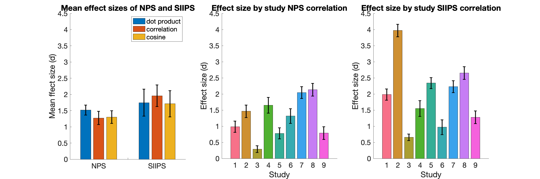
Effect size 3: correlation with subjective pain rating
NPS
* Significantly greater than zero in all 9 studies
* Effect sizes ranging from Cohen‘s d = 0.29 to 2.13
* NPSdot has the largest effect size (Cohen‘s d = 1.52)
SIIPS
* Significantly greater than zero in all 9 studies
* Effect sizes ranging from Cohen‘s d = 0.66 to 3.97
* SIIPScorr has the largest effect size (Cohen‘s d = 1.96)

Slide 9
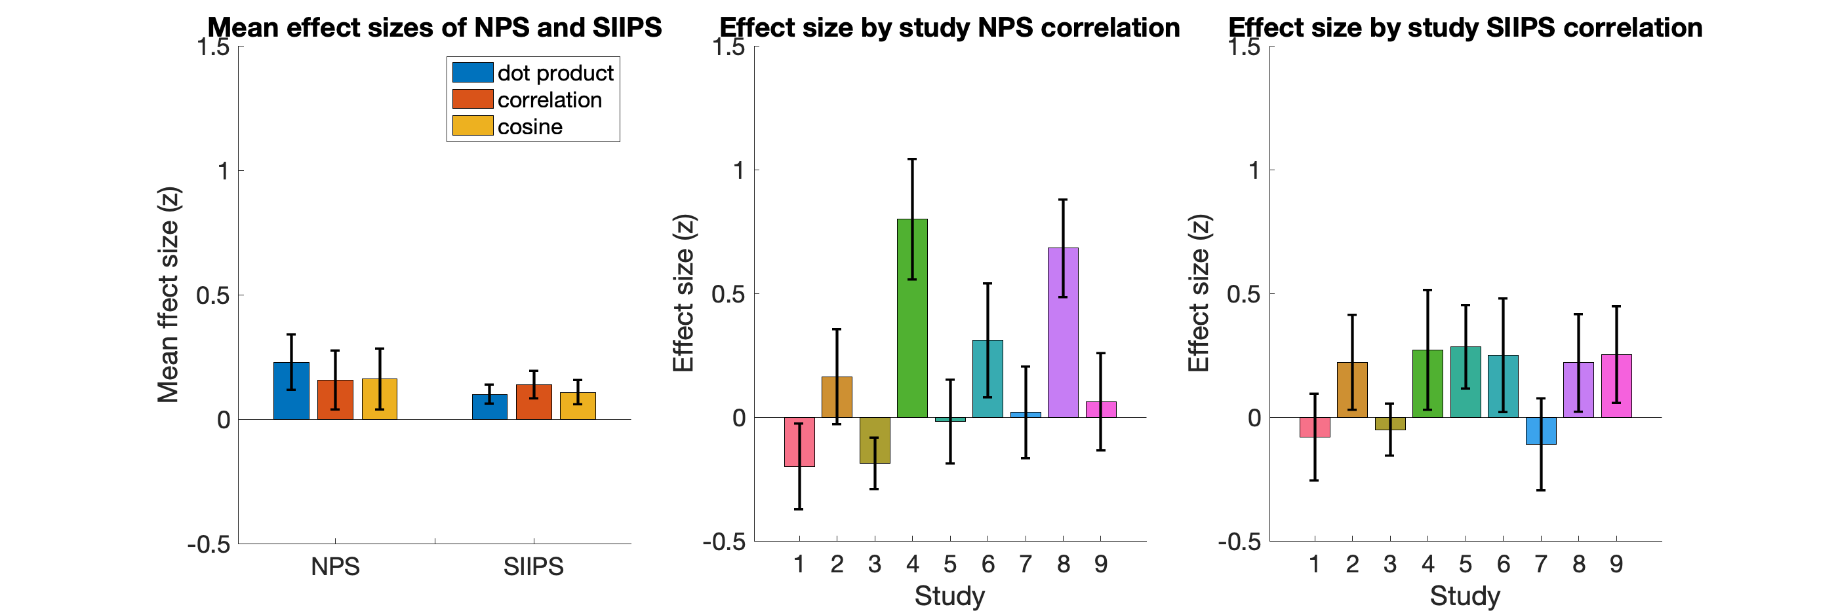
Effect size 4: between-subject correlation with subjective pain rating
NPS
* Significantly greater than zero in 3 out of 9 studies
* Effect sizes ranging from Fisher‘s z = -0.2 to 0.8
* NPSdot has the largest effect size (Fisher‘s z = 0.23)
SIIPS
* Significantly greater than zero in 0 out of 9 studies
* Effect sizes ranging from Fisher‘s z = -0.11 to 0.28
* SIIPScorr has the largest effect size (Fisher‘s z = 0.14)

Slide 10
Summary of effect sizes of three response matrices
 | NPSdot | NPScorr | NPScos | SIIPSdot | SIIPScorr | SIIPScos
Mean response |  | 2.29 |  |  | 1.78
Within-corr temperature | 1.63 |  |  |  | 1.51
Within-corr pain | 1.52 |  |  |  | 1.96
Between-corr pain | 0.23 |  |  |  | 0.14

Slide 11
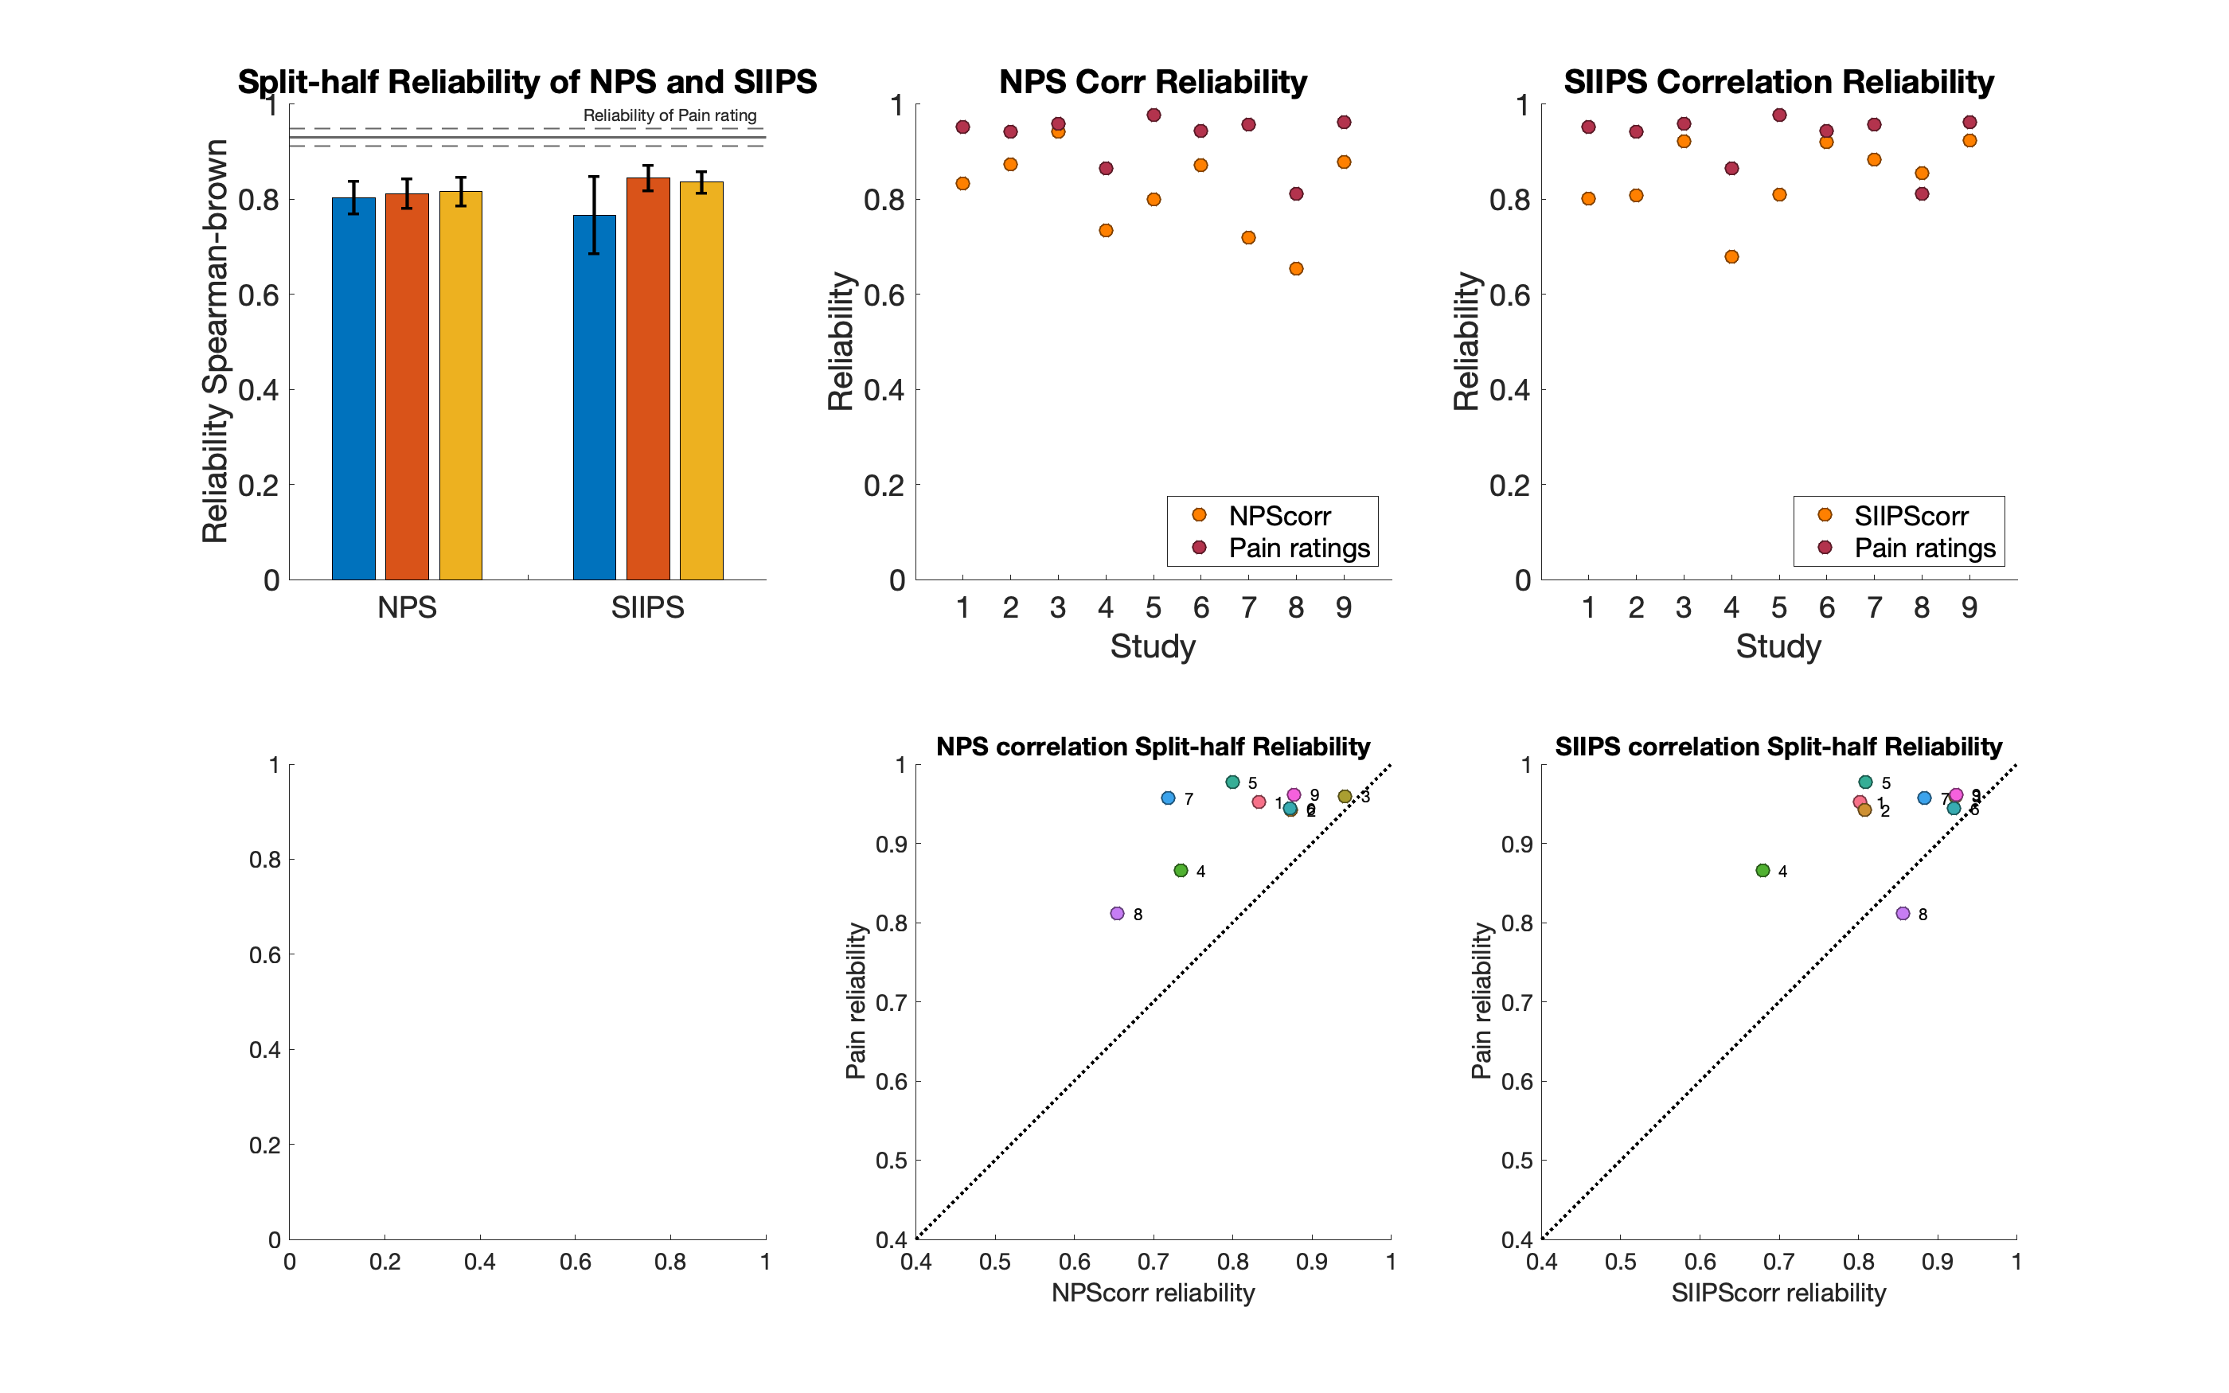
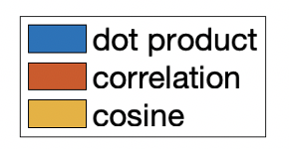
Reliability: Split-half correlation with Spearman-Brown correction
NPS
* Average reliability is 0.81, ranging from 0.65 to 0.94.
* NPScos has the largest reliability (0.82)
SIIPS
* Average reliability is 0.85, ranging from 0.68 to 0.92.
* NPScorr has the largest reliability (0.85)
Subjective Pain ratings
* Average reliability is 0.93, ranging from 0.81 to 0.98.
The brain and subjective pain measurements may be suspected to different sources of inter-individual variability and are not redundant.

Slide 12
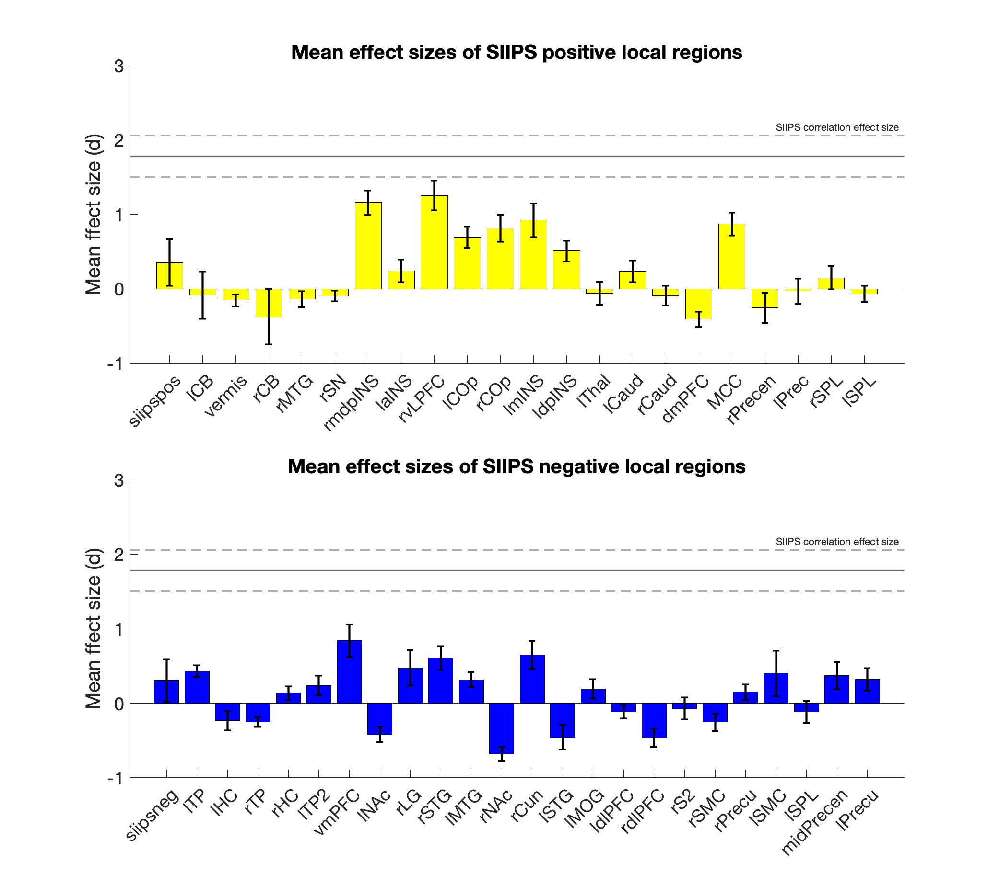
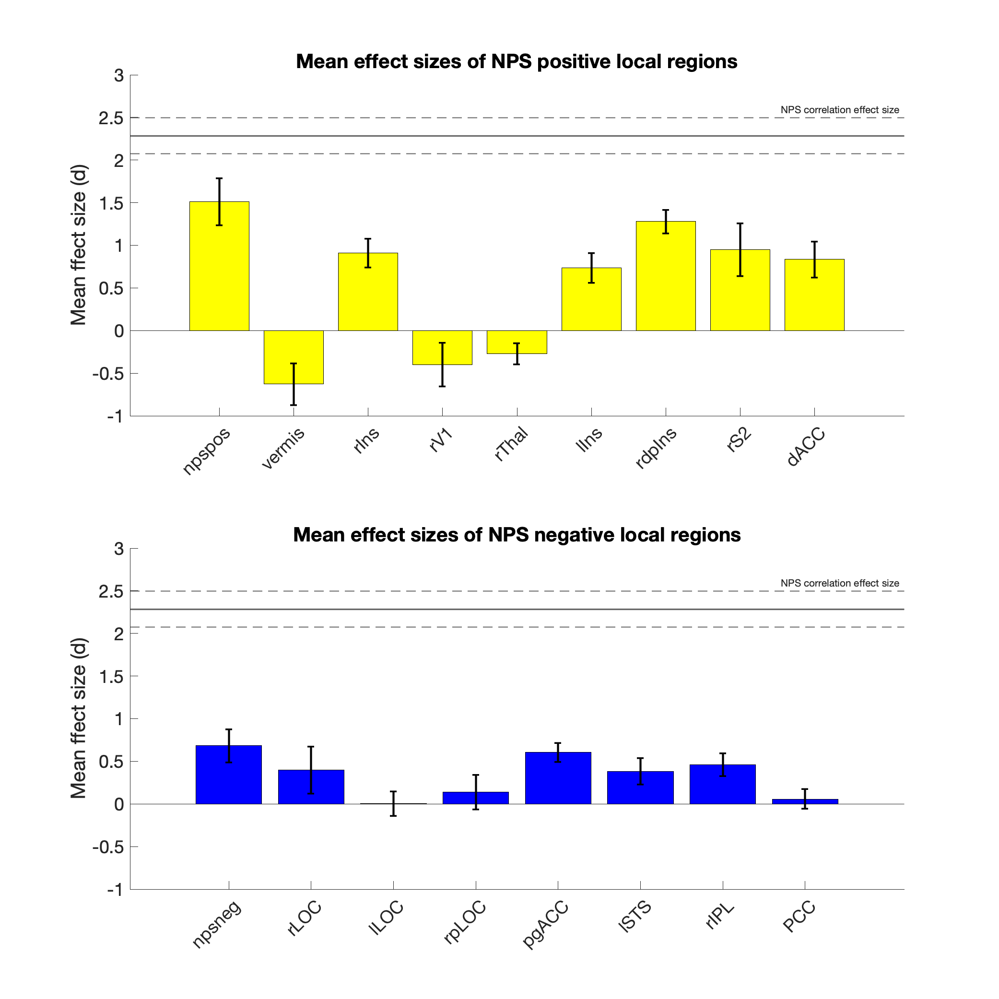
Complete pattern vs. local regions Effect size 1: mean response to the contrast of [Pain minus Baseline]

Slide 13
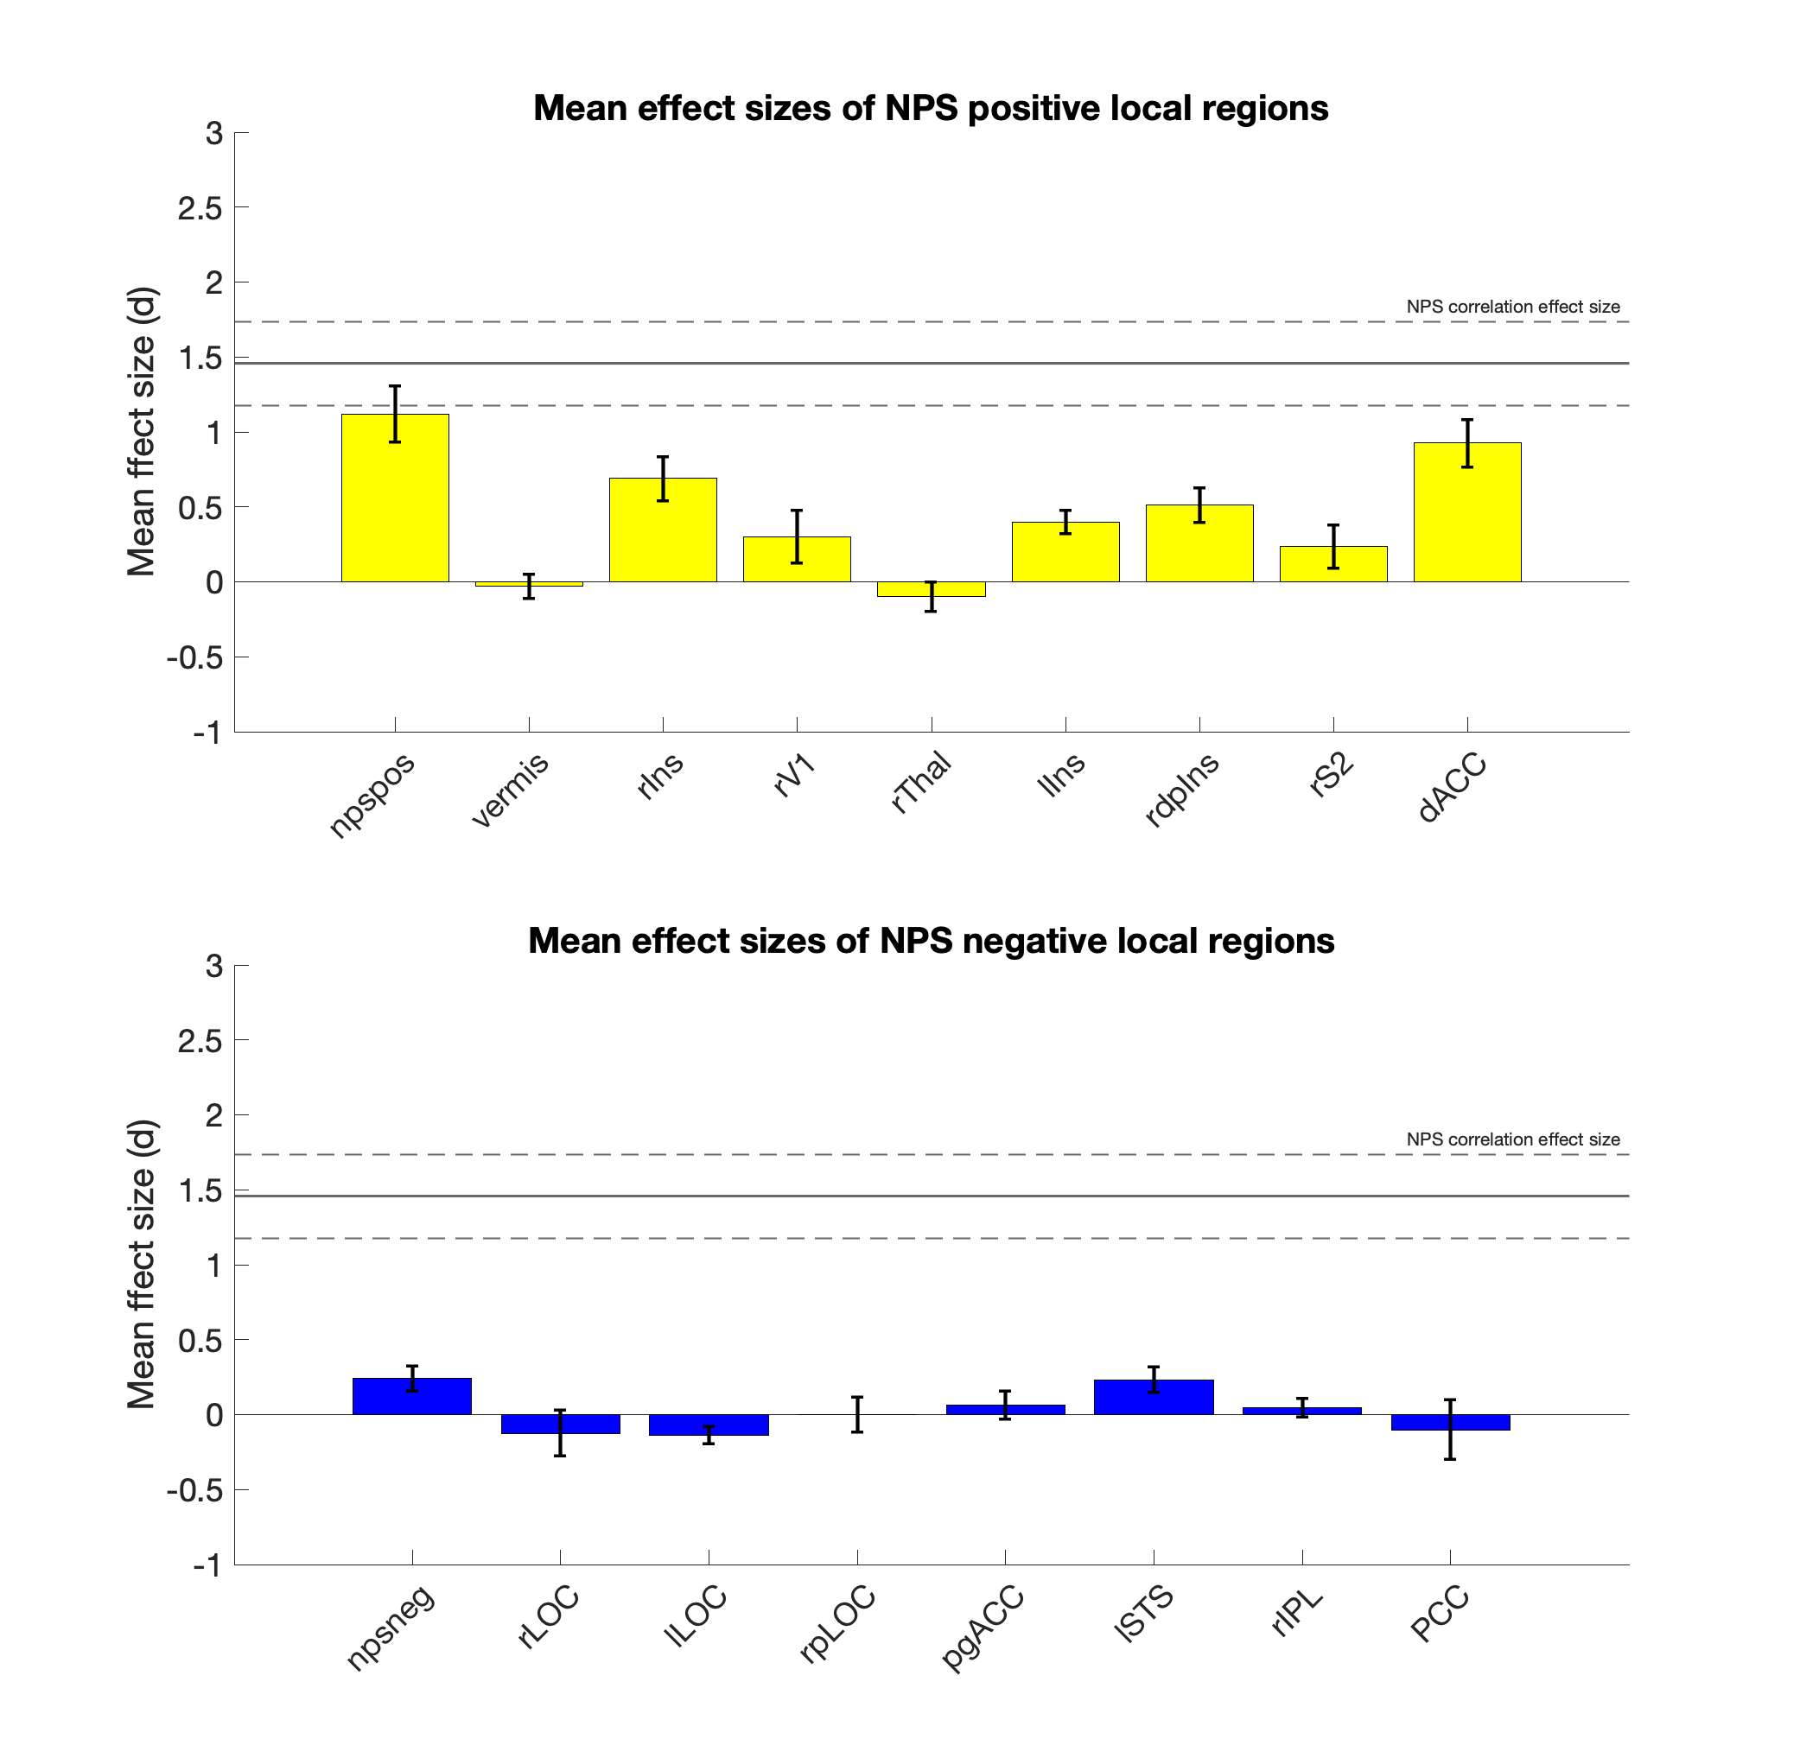
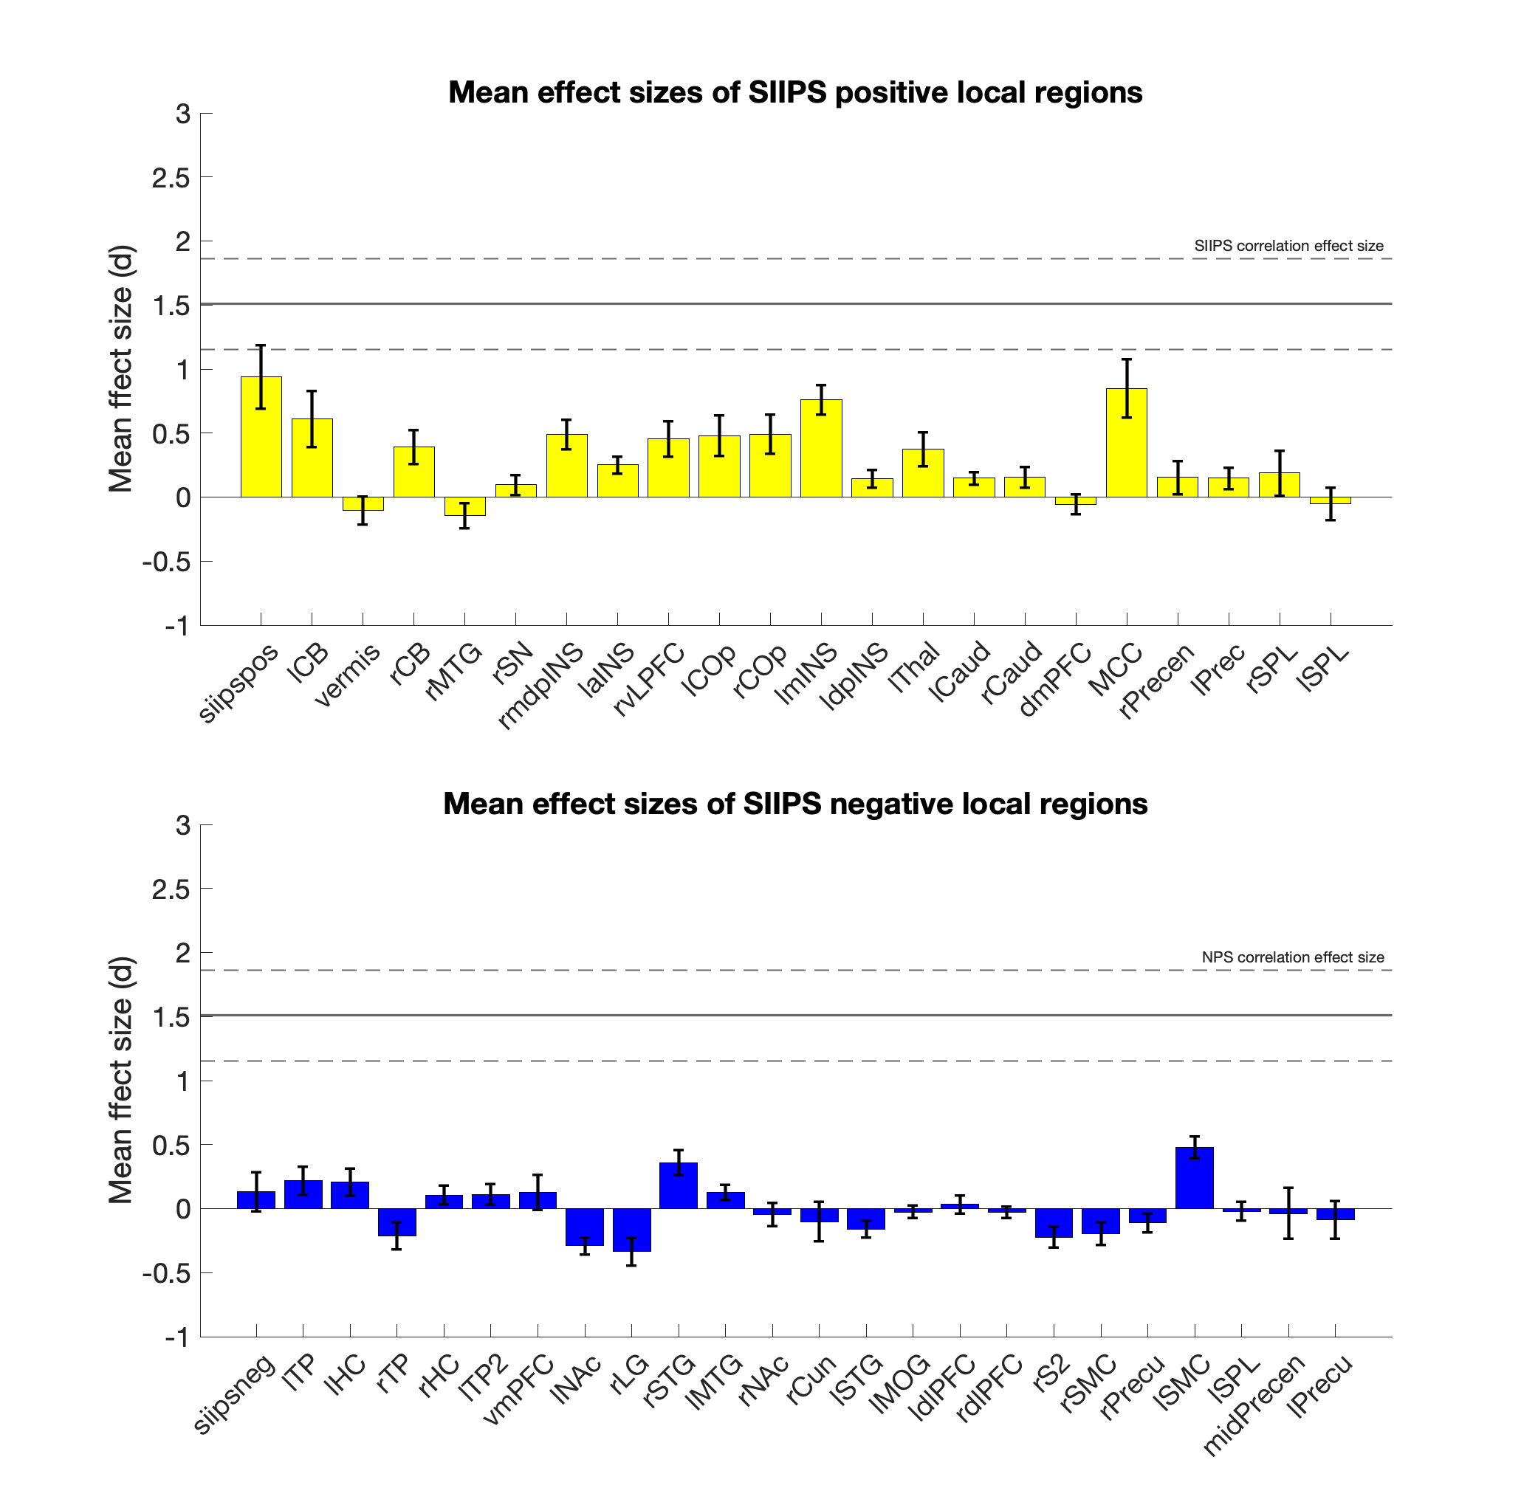
Complete pattern vs. local regions Effect size 2: correlation with temperature

Slide 14
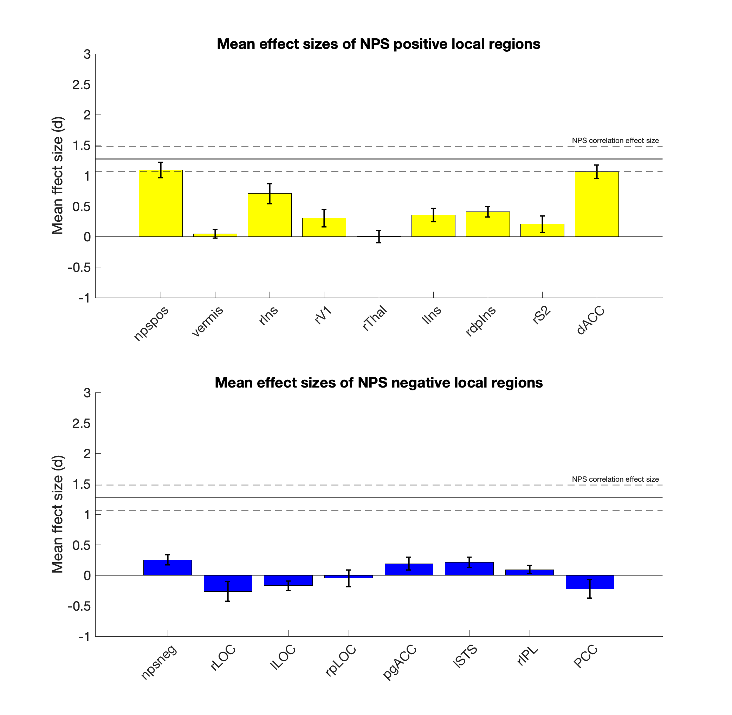
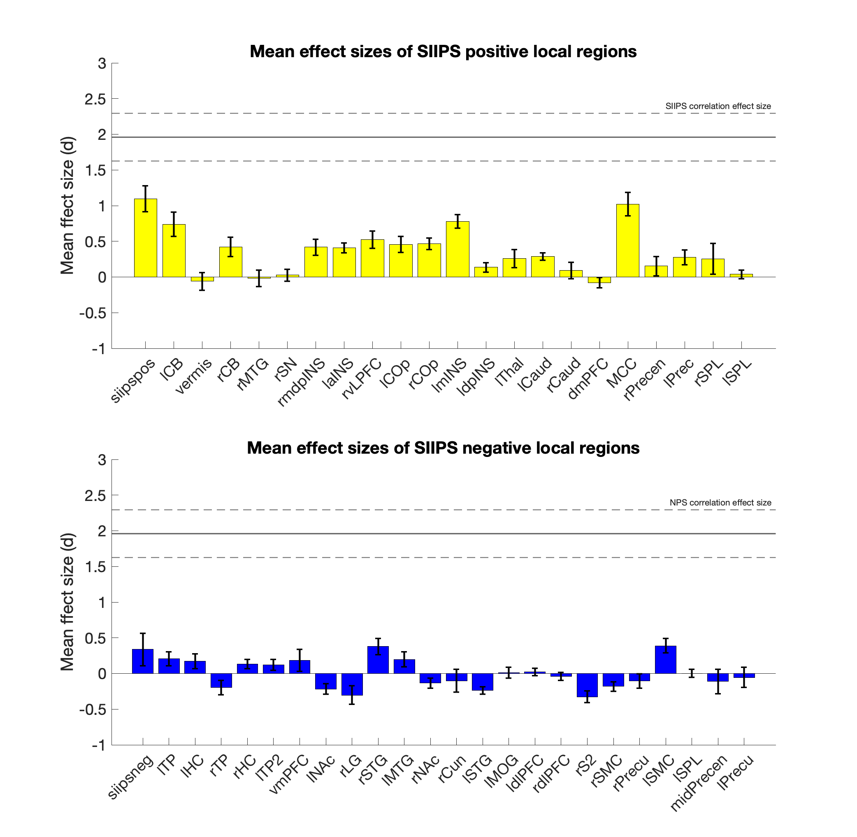
Complete pattern vs. local regions Effect size 3: correlation with subjective pain rating

Slide 15
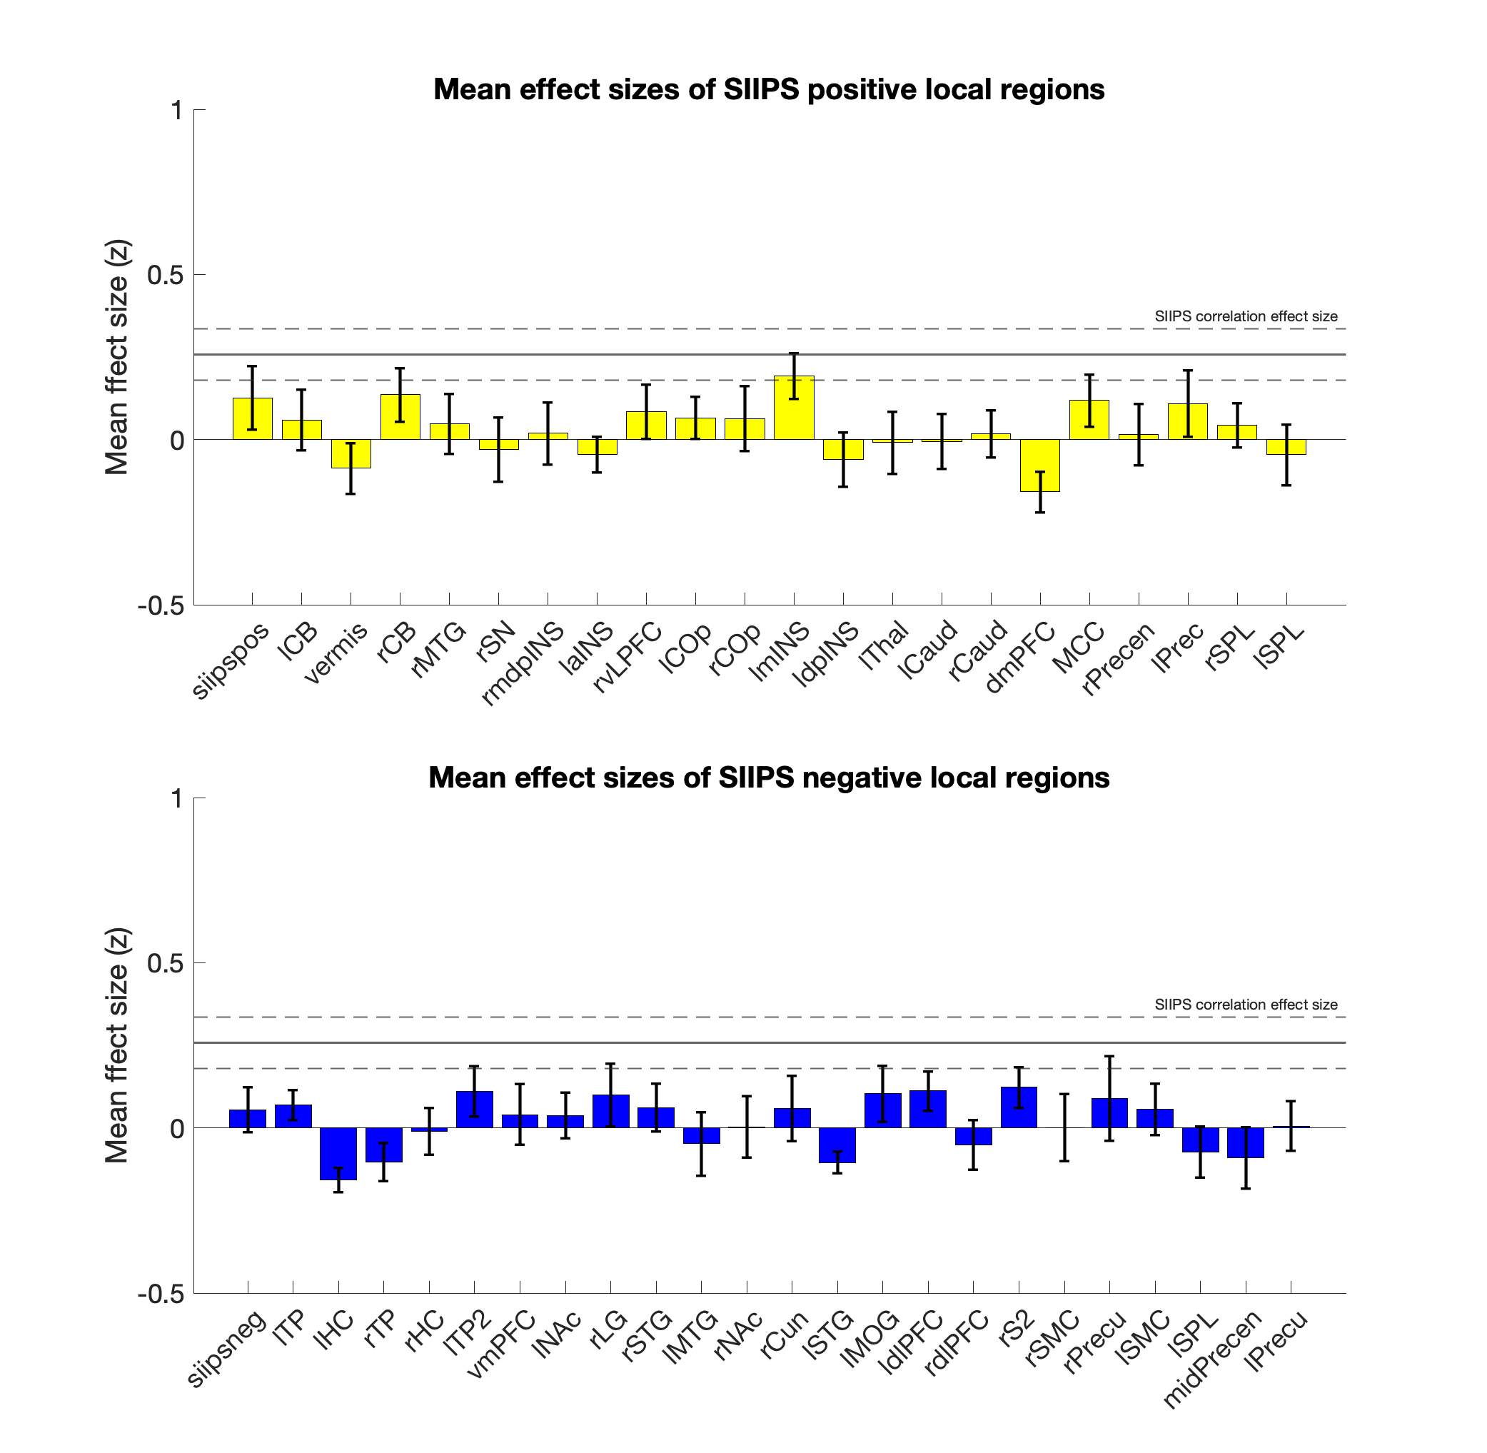
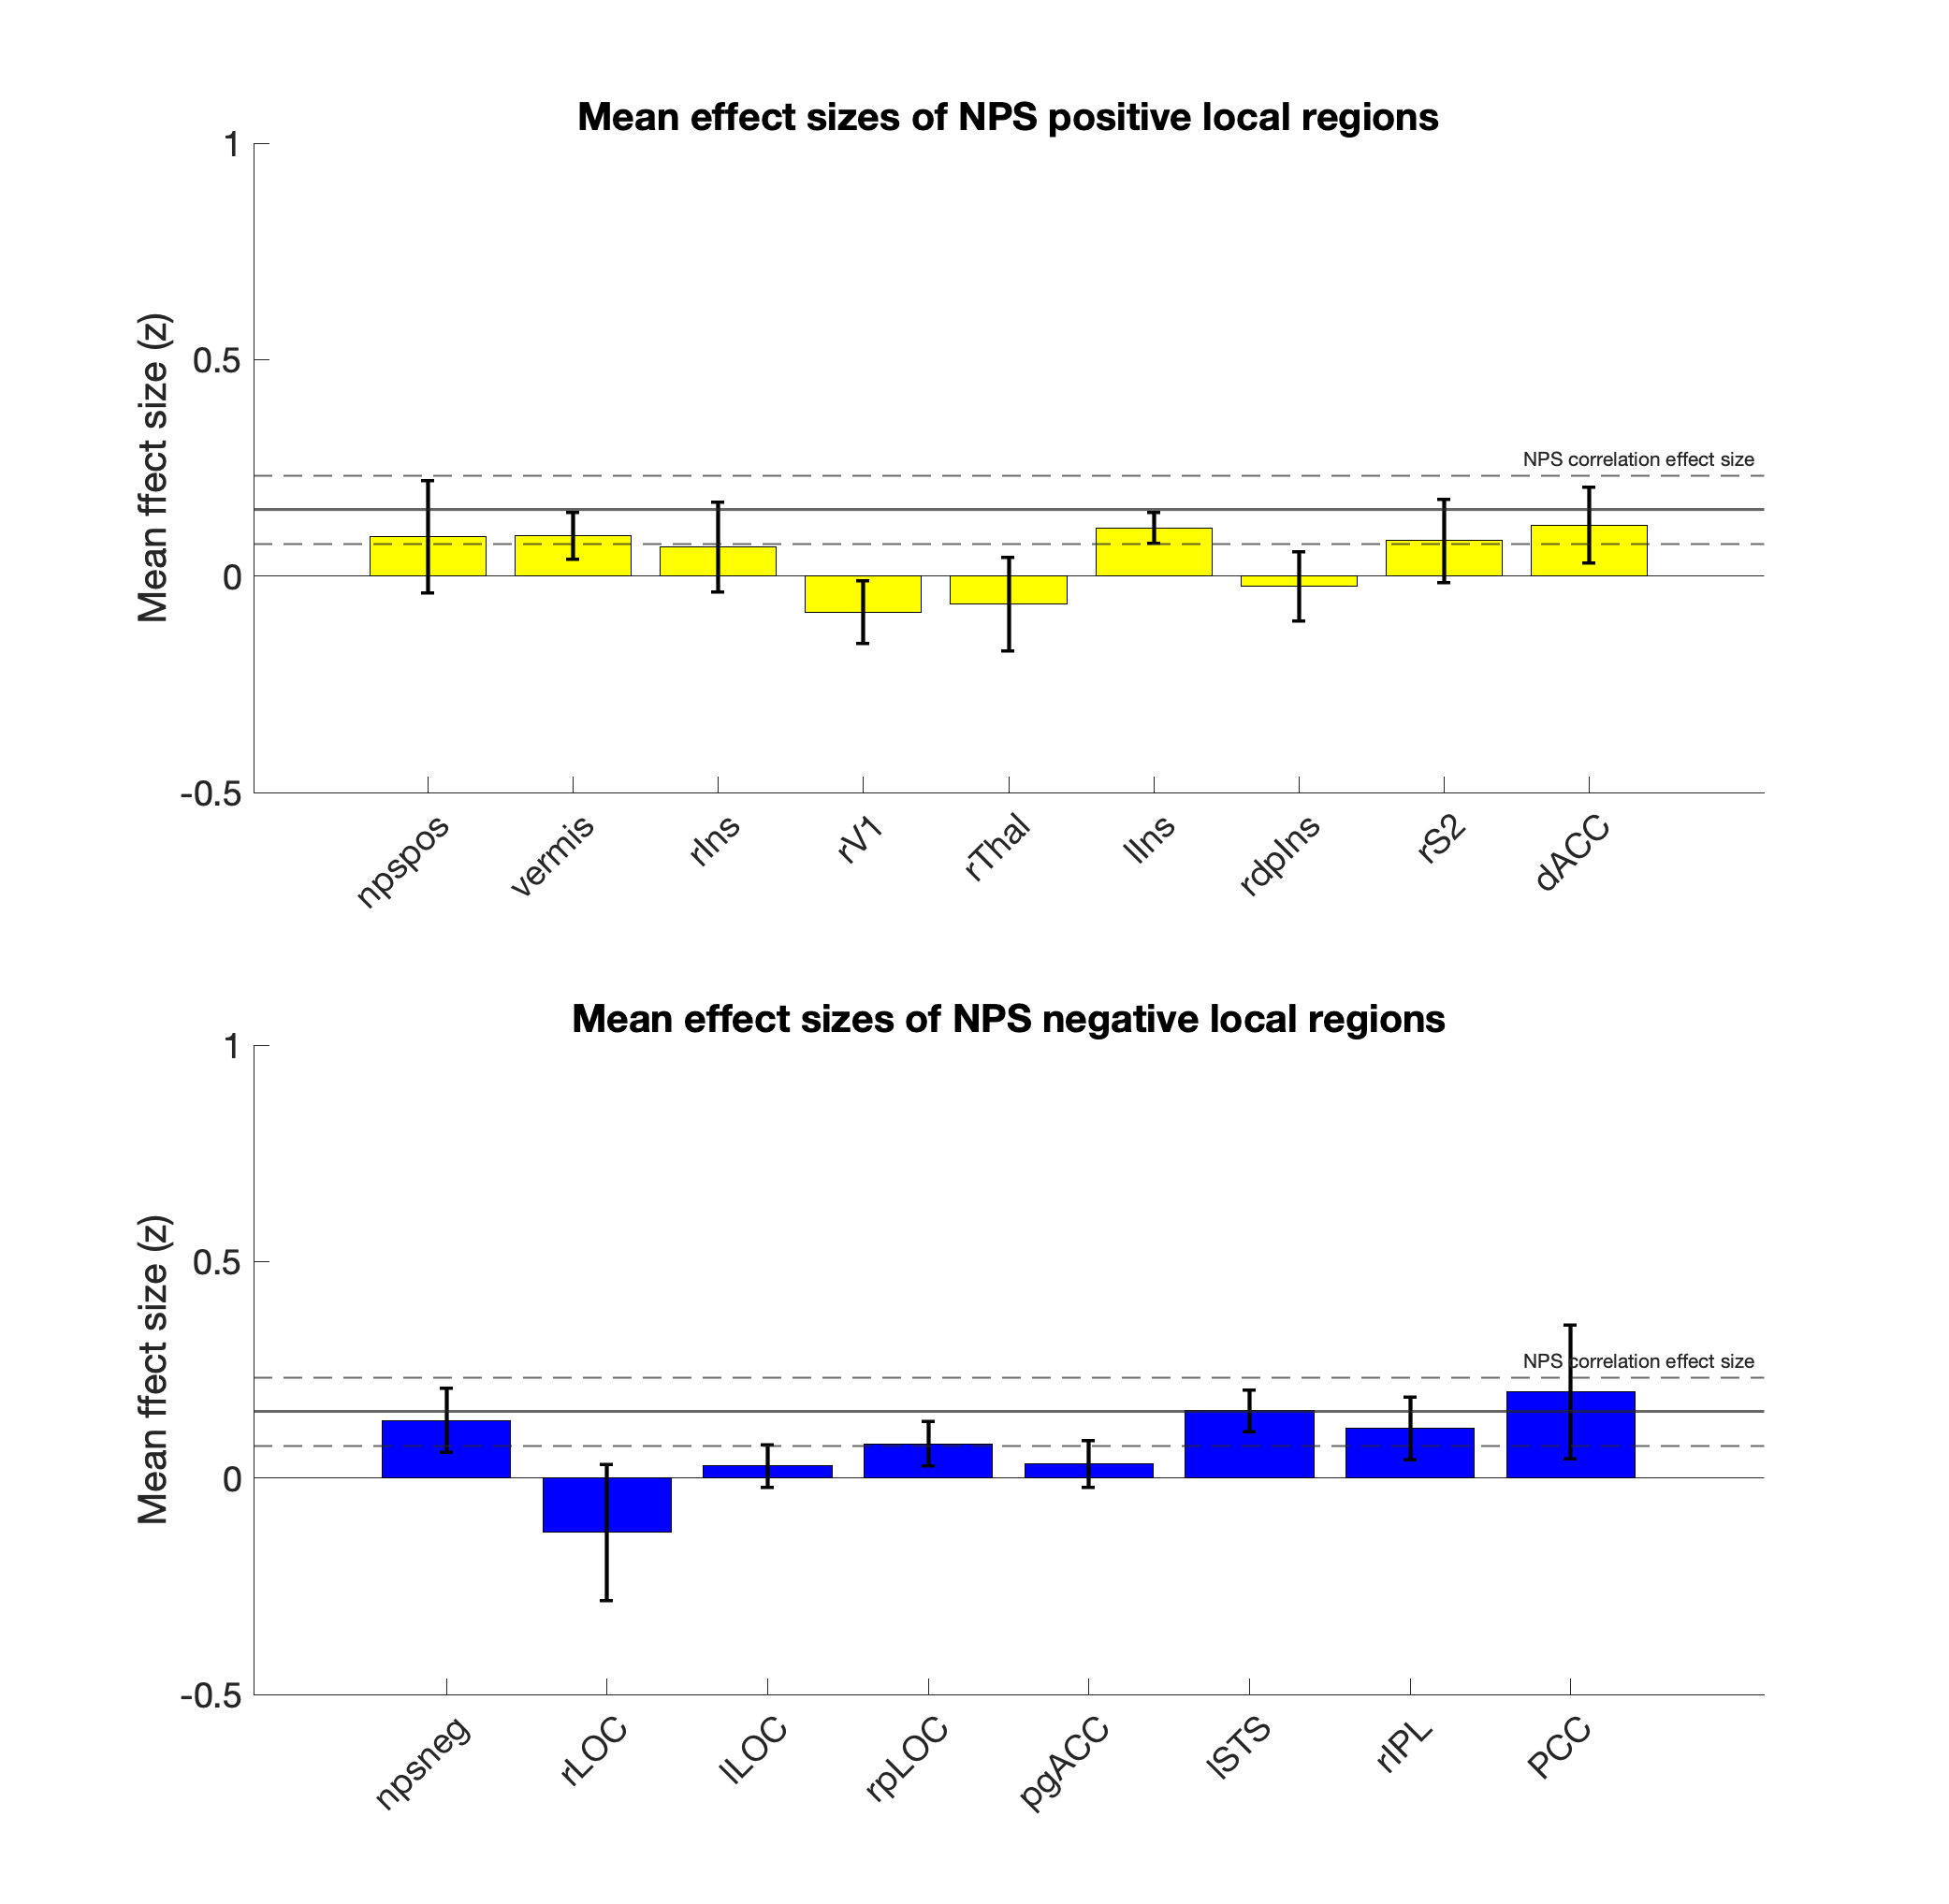
Complete pattern vs. local regions Effect size 4: between-subject correlation with subjective pain rating

Slide 16
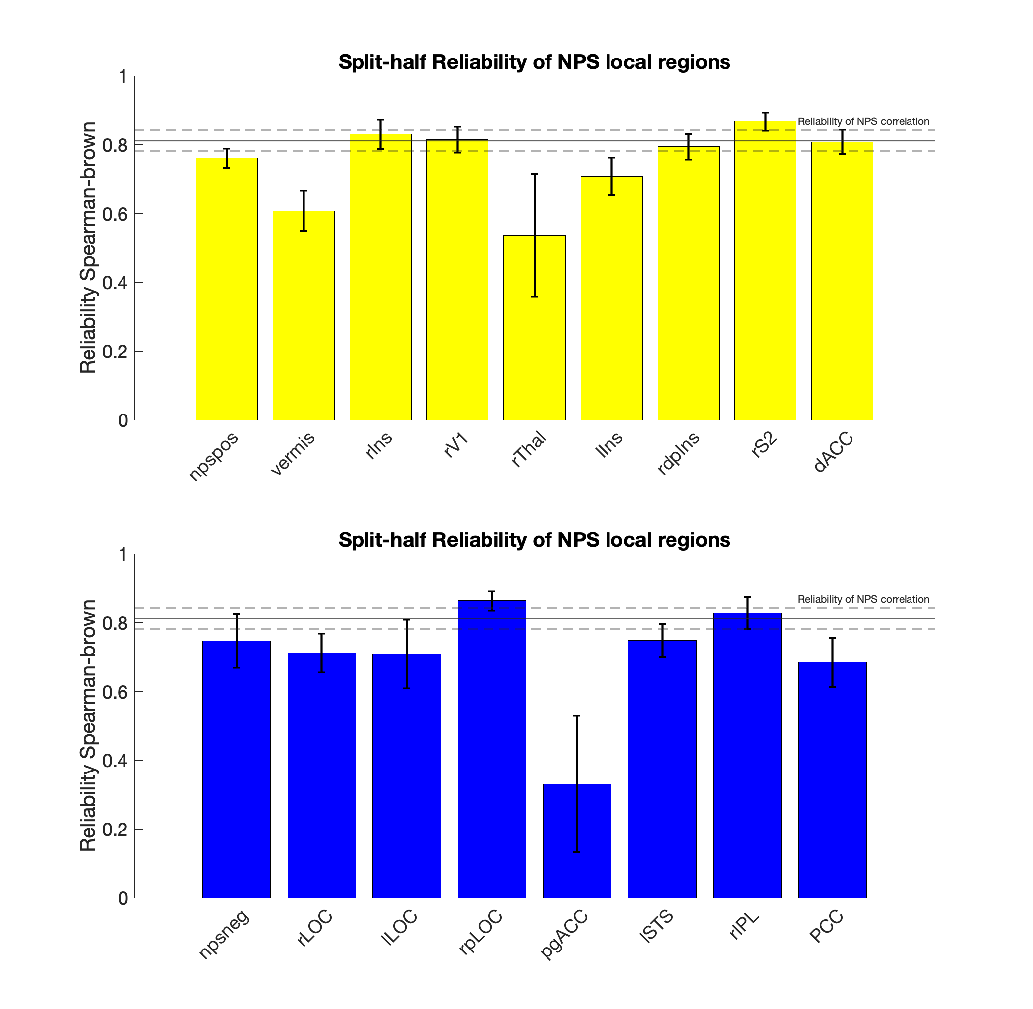
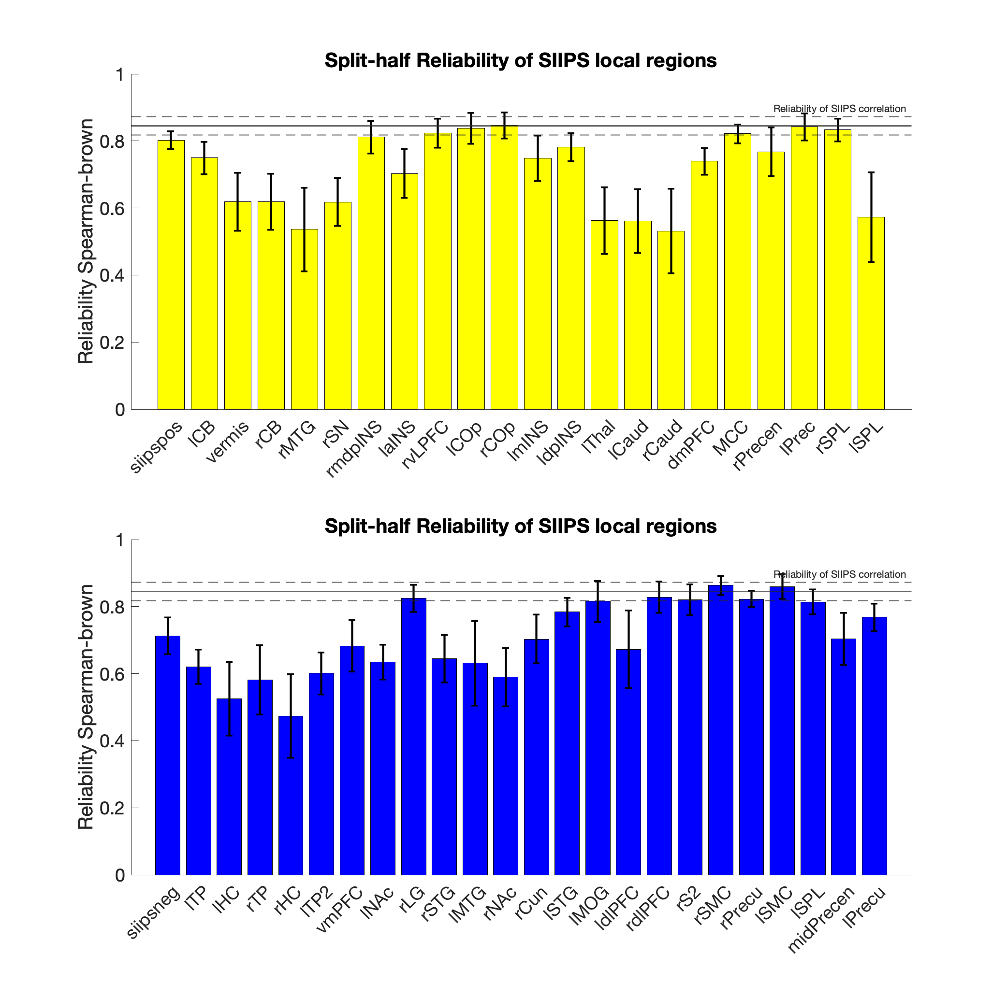
Complete pattern vs. local regions Reliability: Split-half correlation with Spearman-Brown correction

Slide 17
Conclusion
very large effect size and high reliability across different studies
superior to the performance of local brain regions
three response matrices show some difference in different dimensions
brain pattern and subjective ratings might suspect to different sources of inter-individual variability and are not redundant.
These studies were heterogeneous in preprocessing methods, pain duration, scanner, population, body site, and concurrent contexts/cognitive tasks.
demonstrating generalizability
Advances could be made by customizing models for types of populations/body sites/stimulus durations/contexts.

