Slide 1
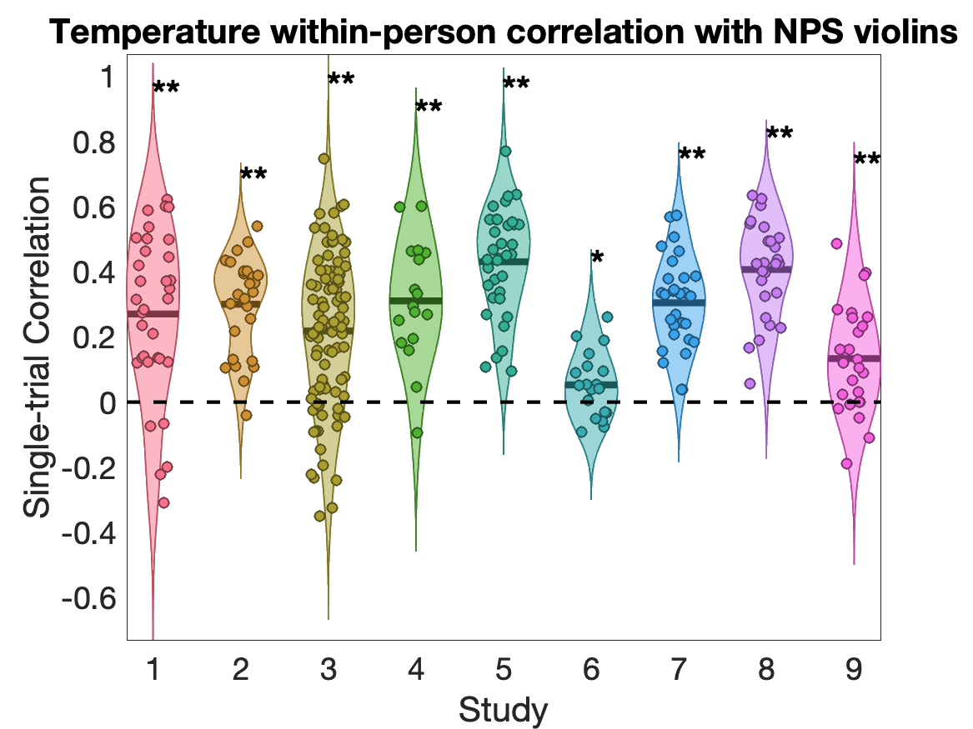
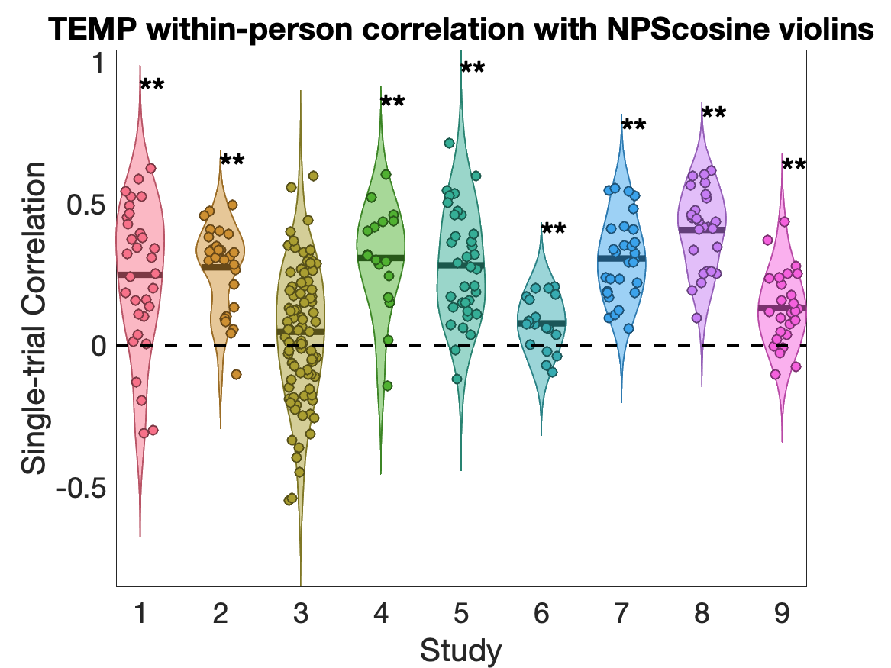
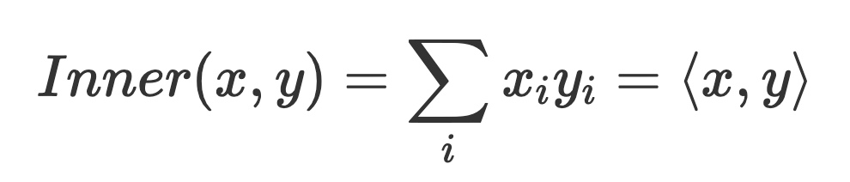
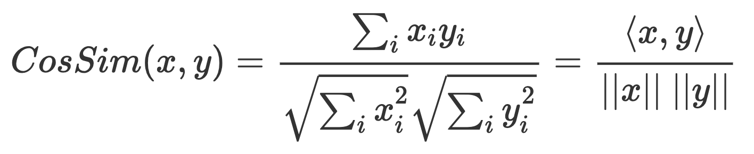
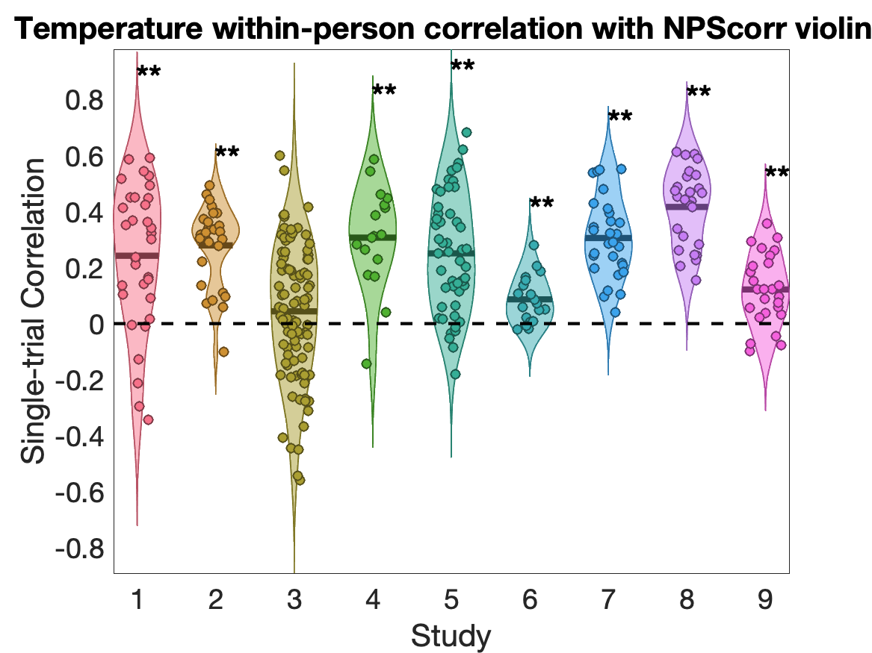
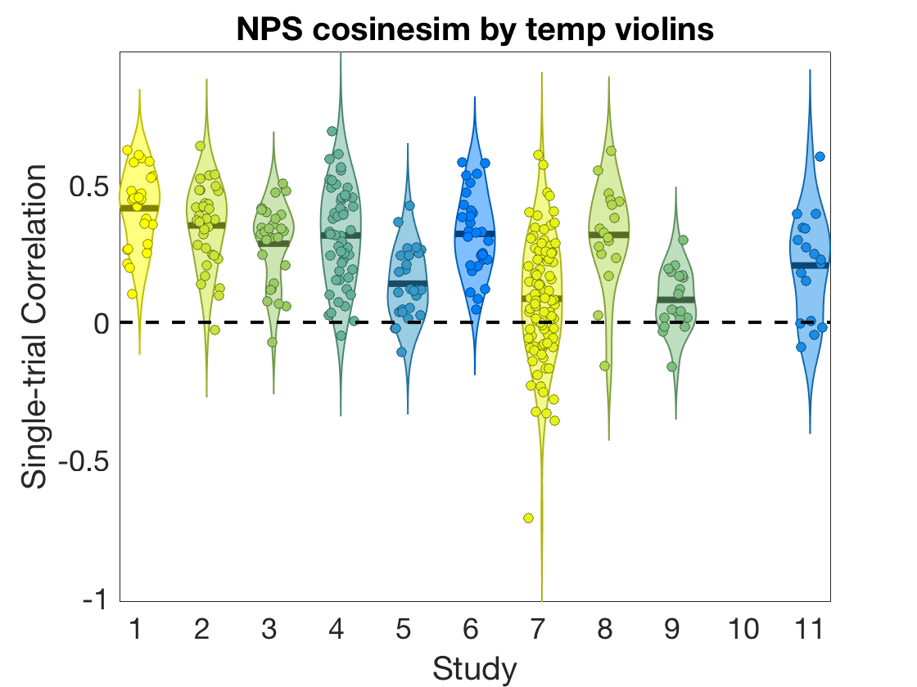
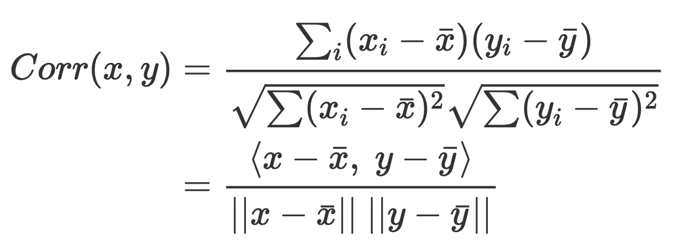
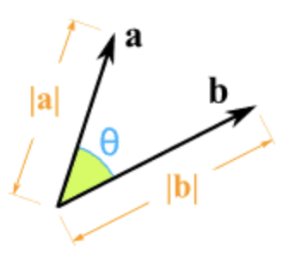
Three pattern response matrices
dot product
cosine similarity:
correlation

Slide 2
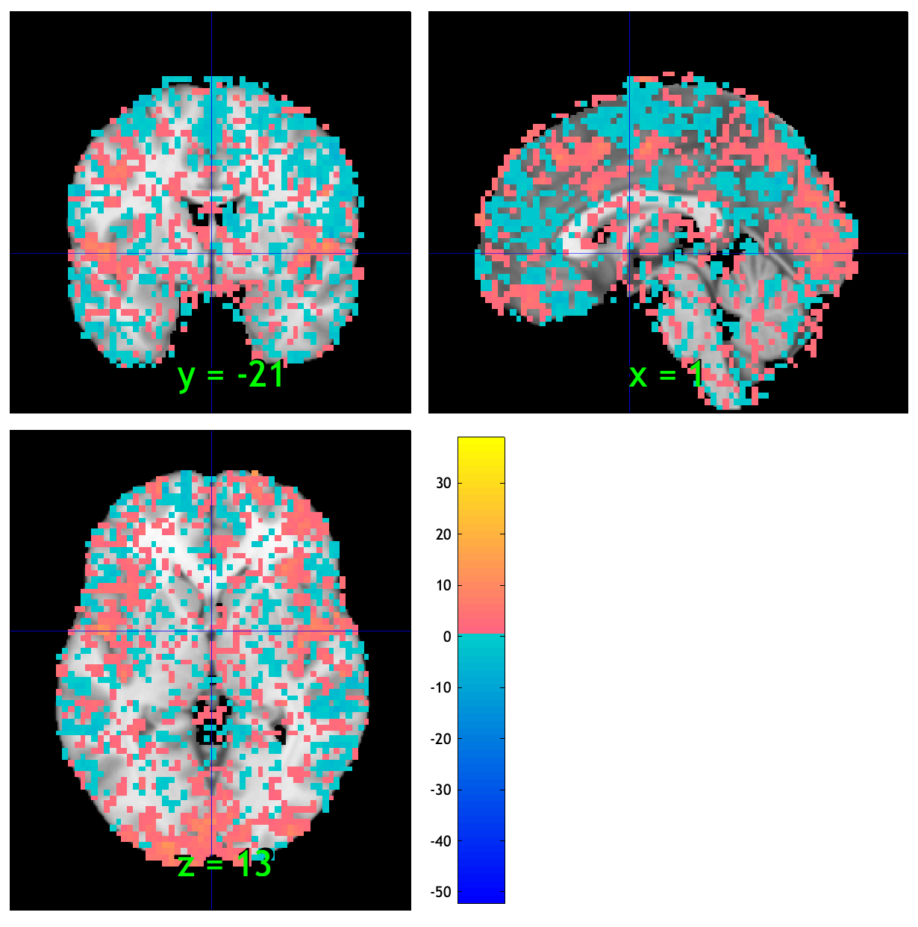
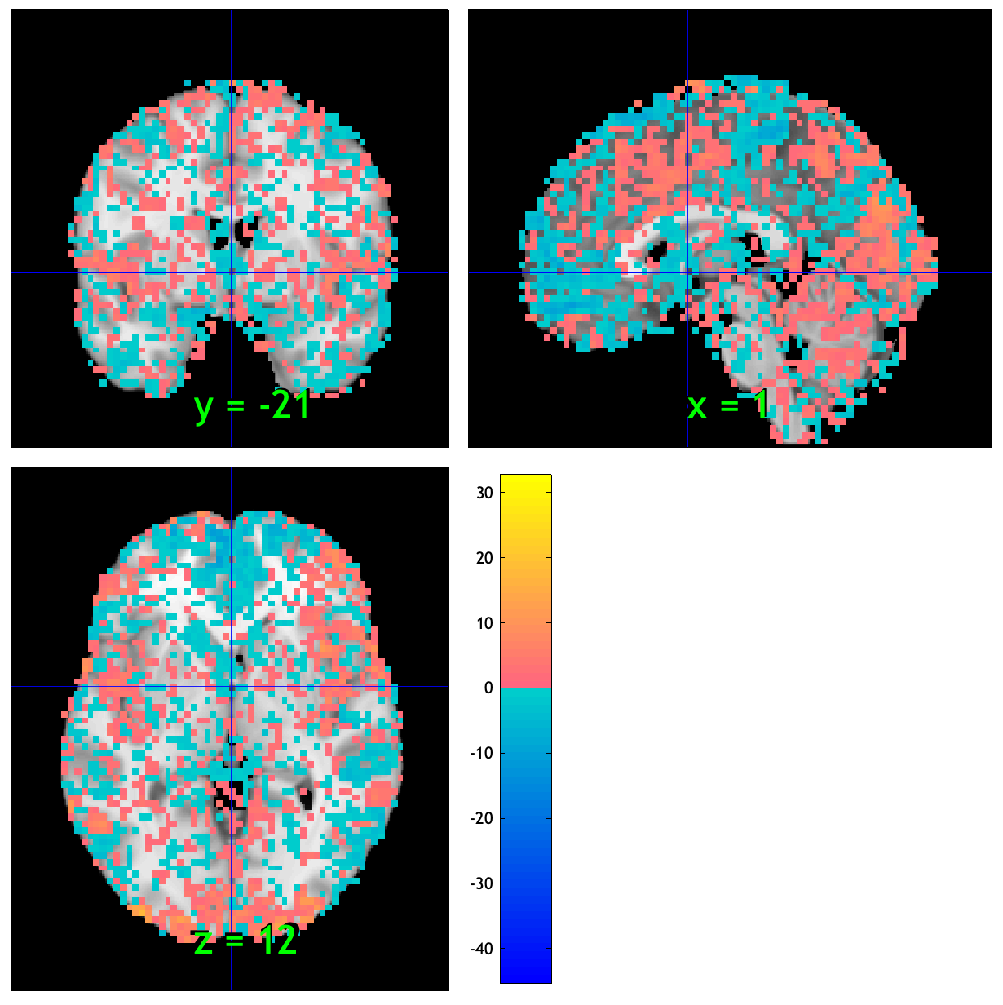
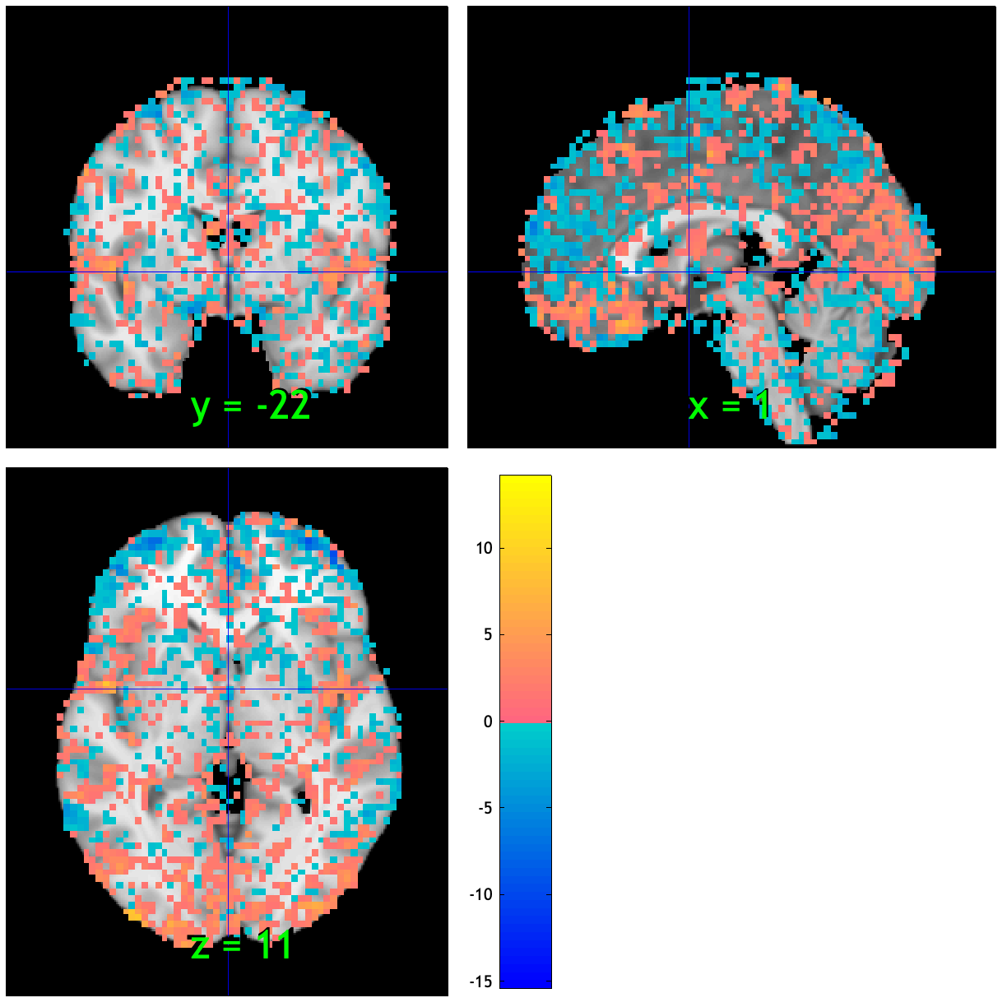
sub-M80311808
ses-1
ses-2
ses-3

Slide 3
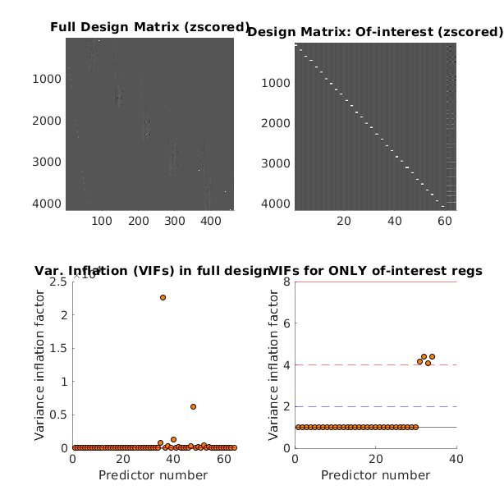


sub-M80311808
ses-1
ses-2
ses-3
Rating and button press

Slide 4
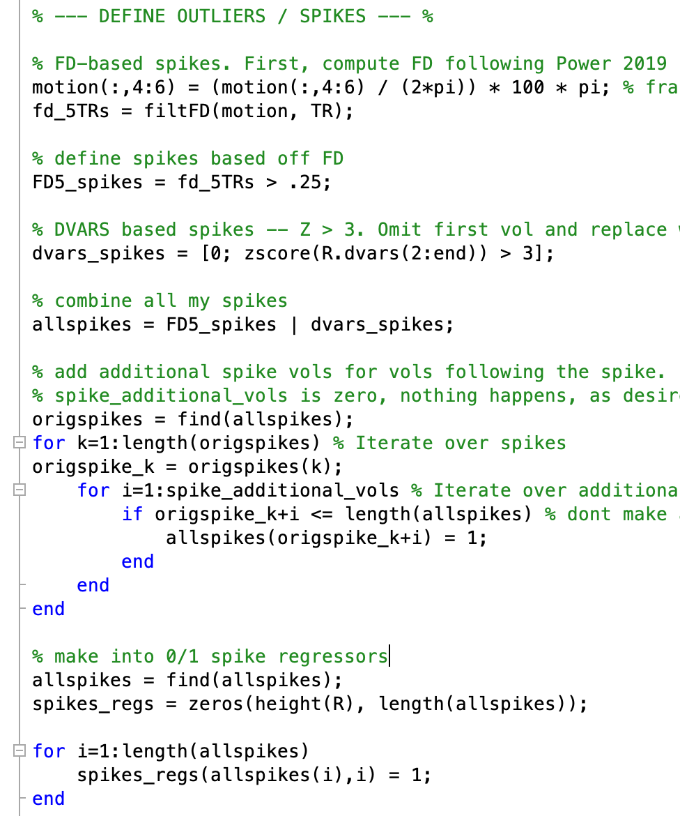
code to get spike
make_nuisance_covs_from_fmriprep_output3.m

Slide 5
Questions for discussion
What’s the purpose of doing this check?
did you look at plots of data, esp first volumes, to look for high-intensity signals? (t1 equilib fx)?
For RTNF data:
20 subjects have complete data, e.g., 3 sessions and 5 runs in each session;
Some participants have missing runs in at least one session (should we include these data?)
6 have missing one or two sessions (should exclude)

