Slide 1


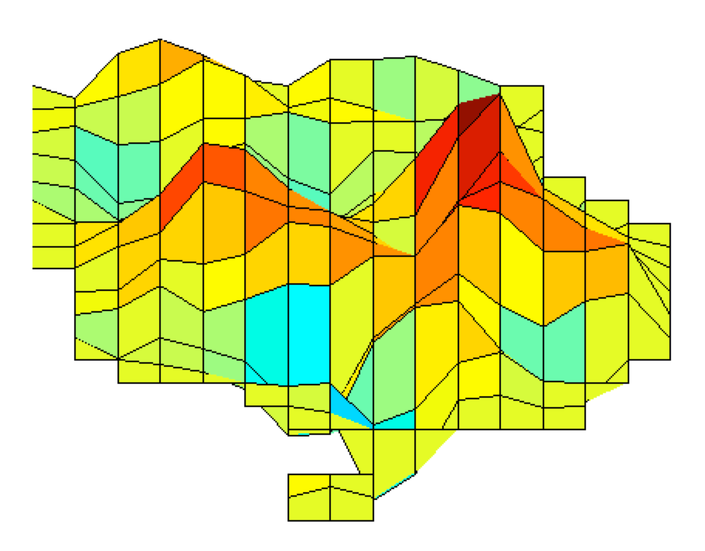
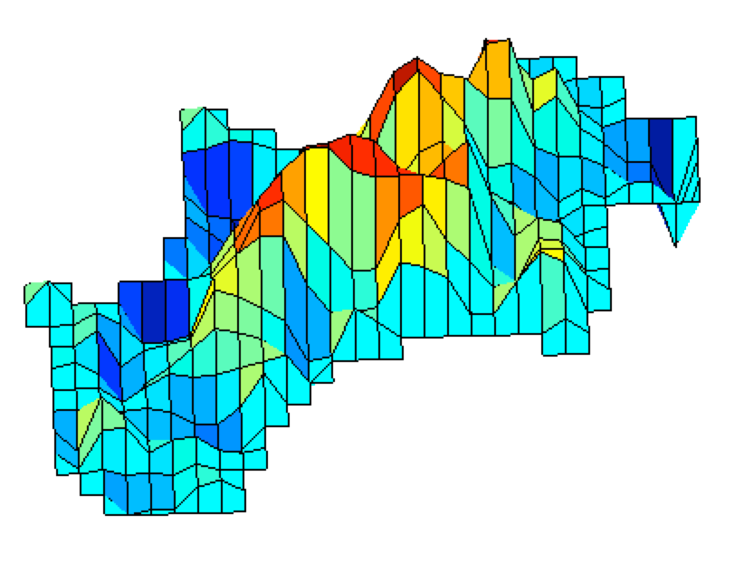
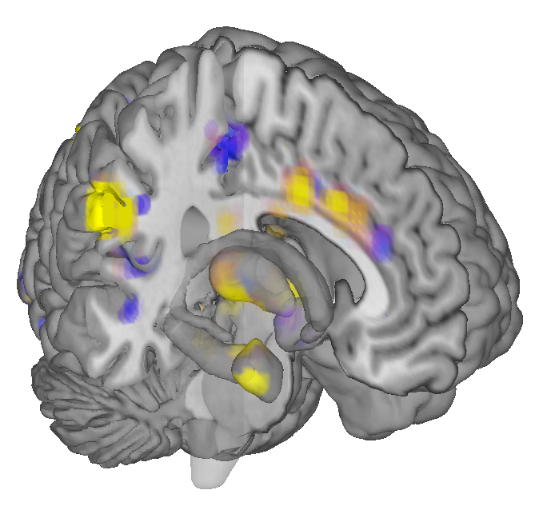
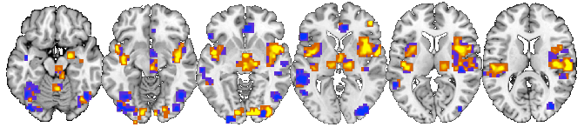
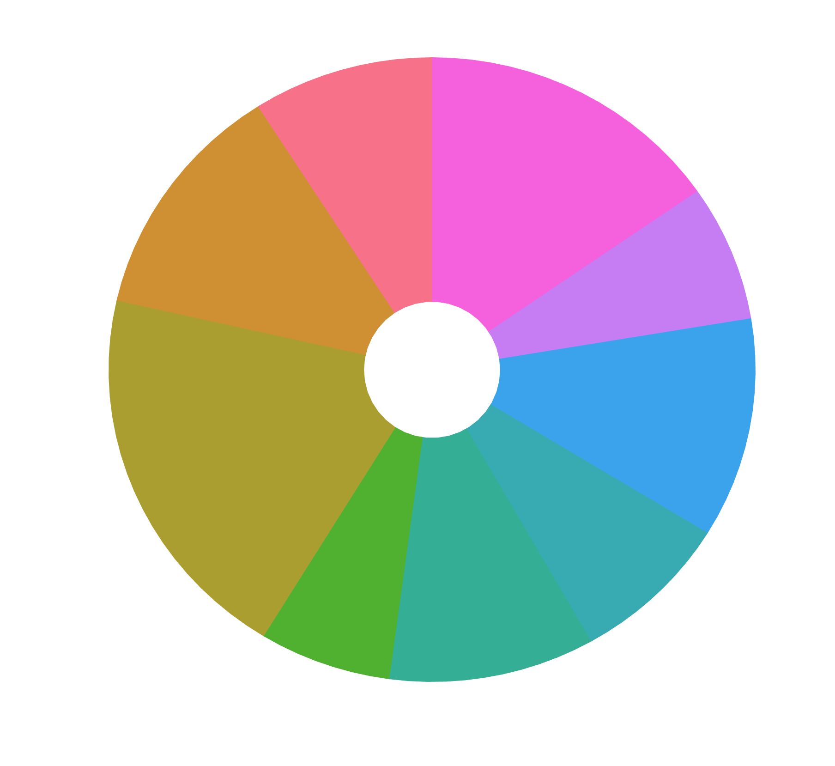
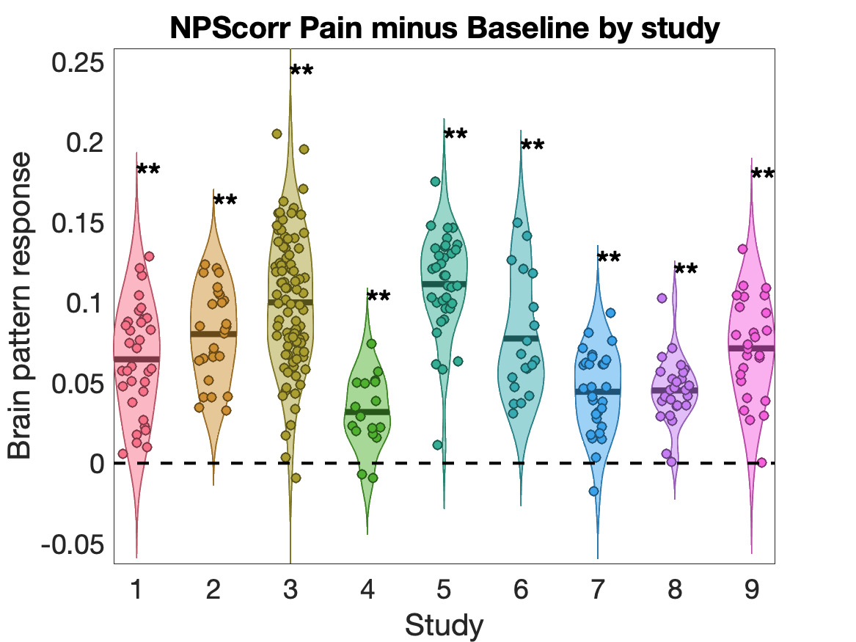
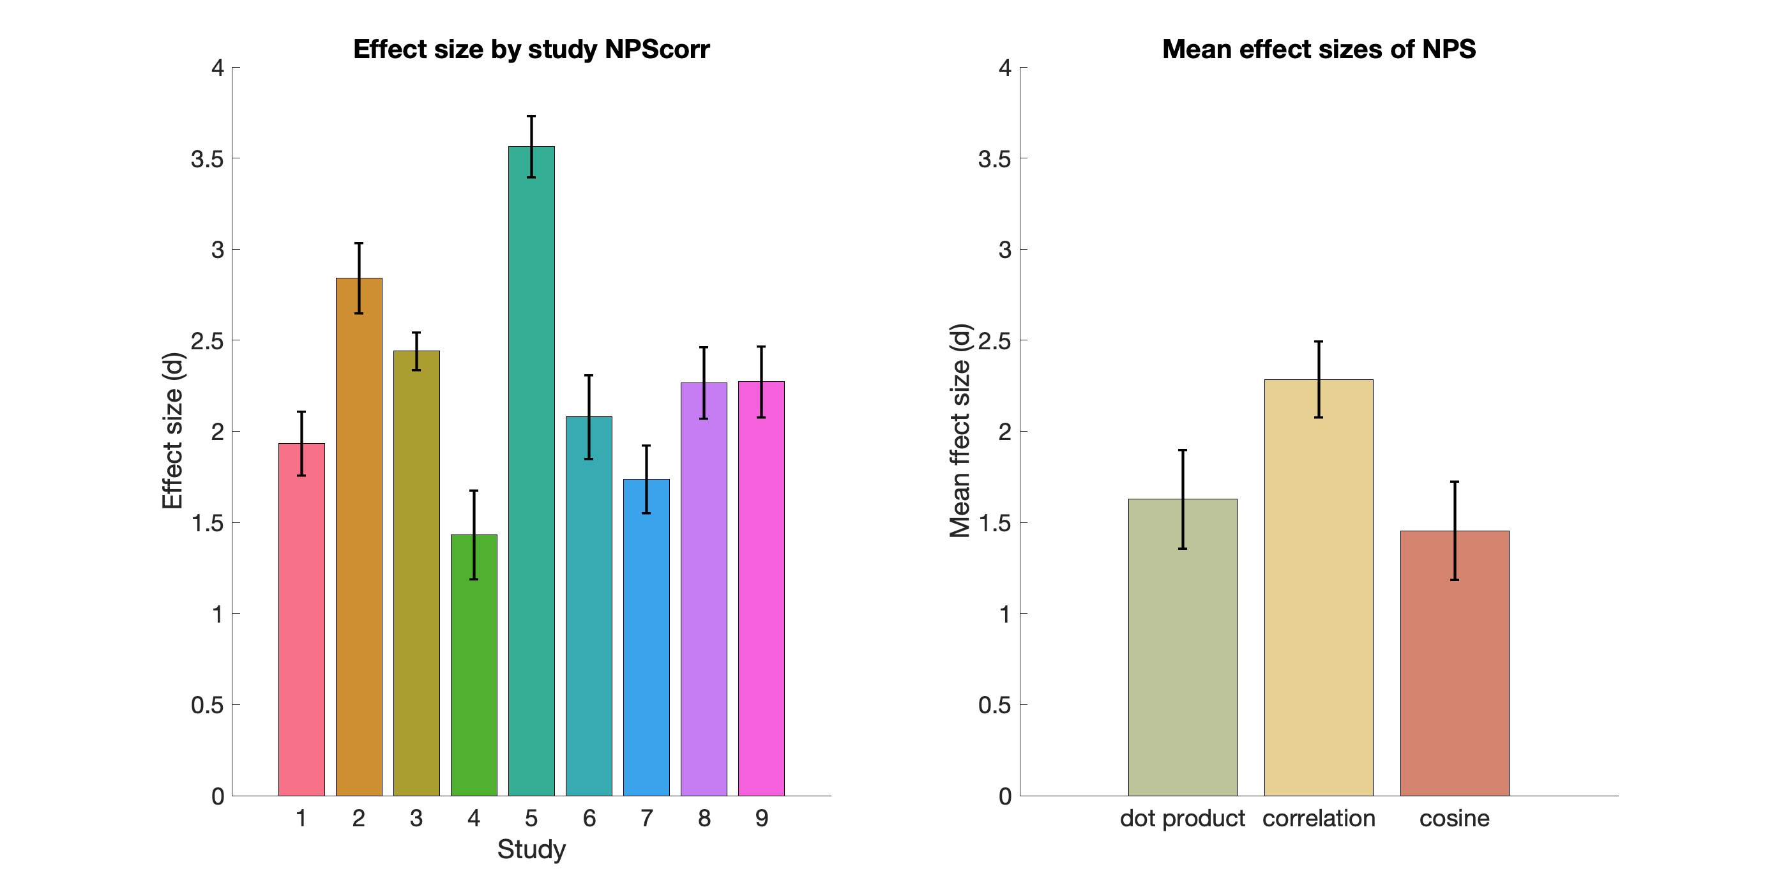
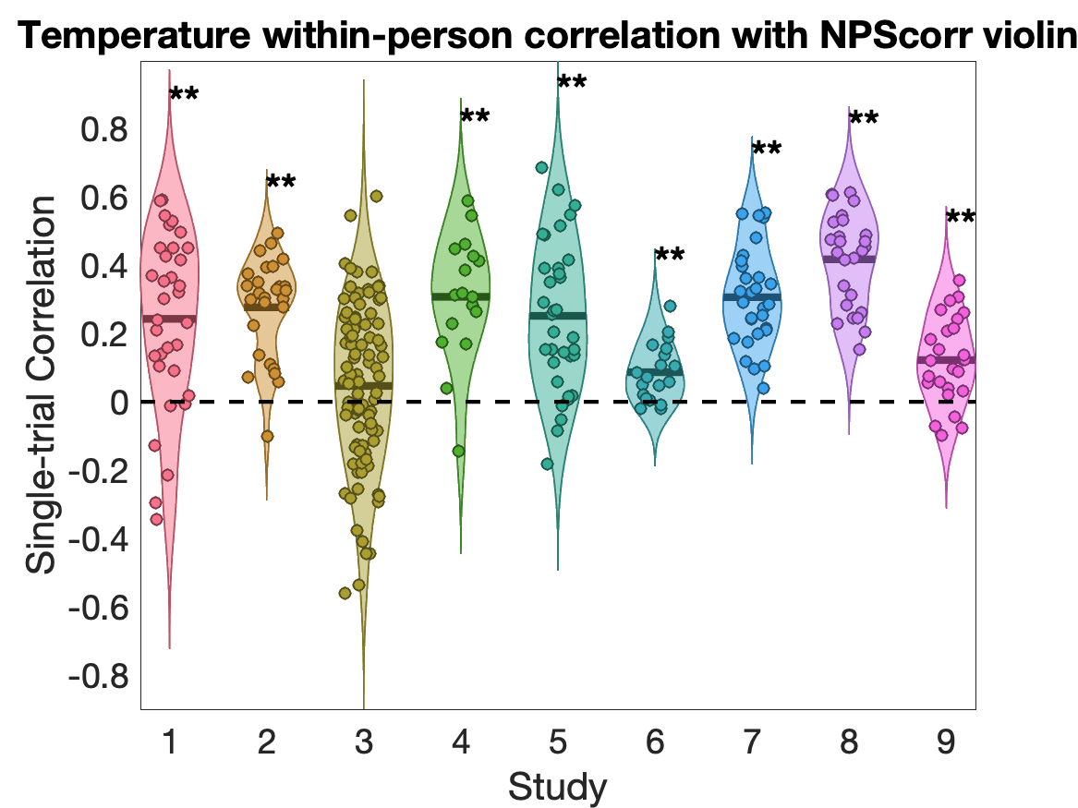
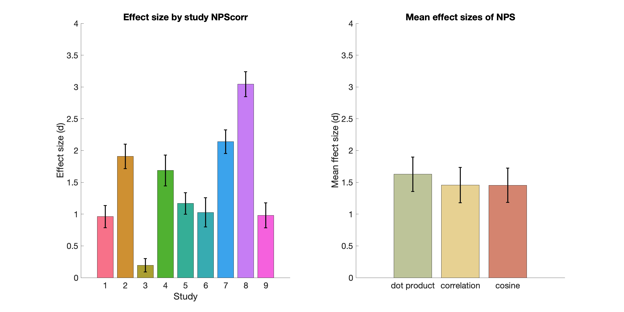
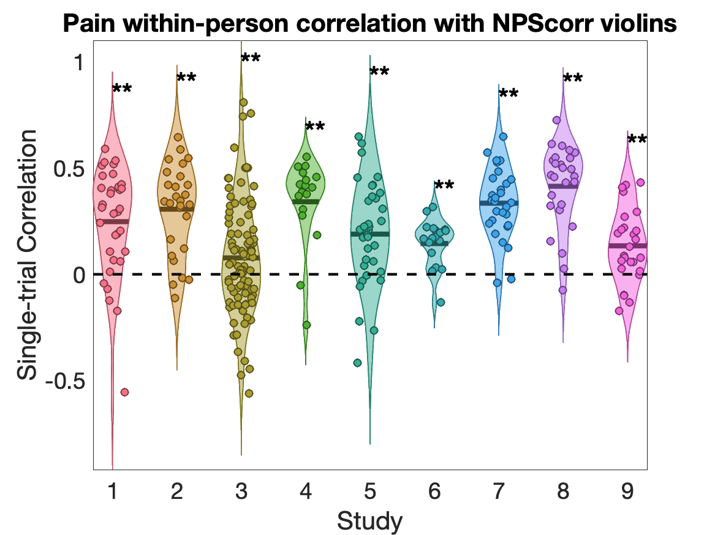
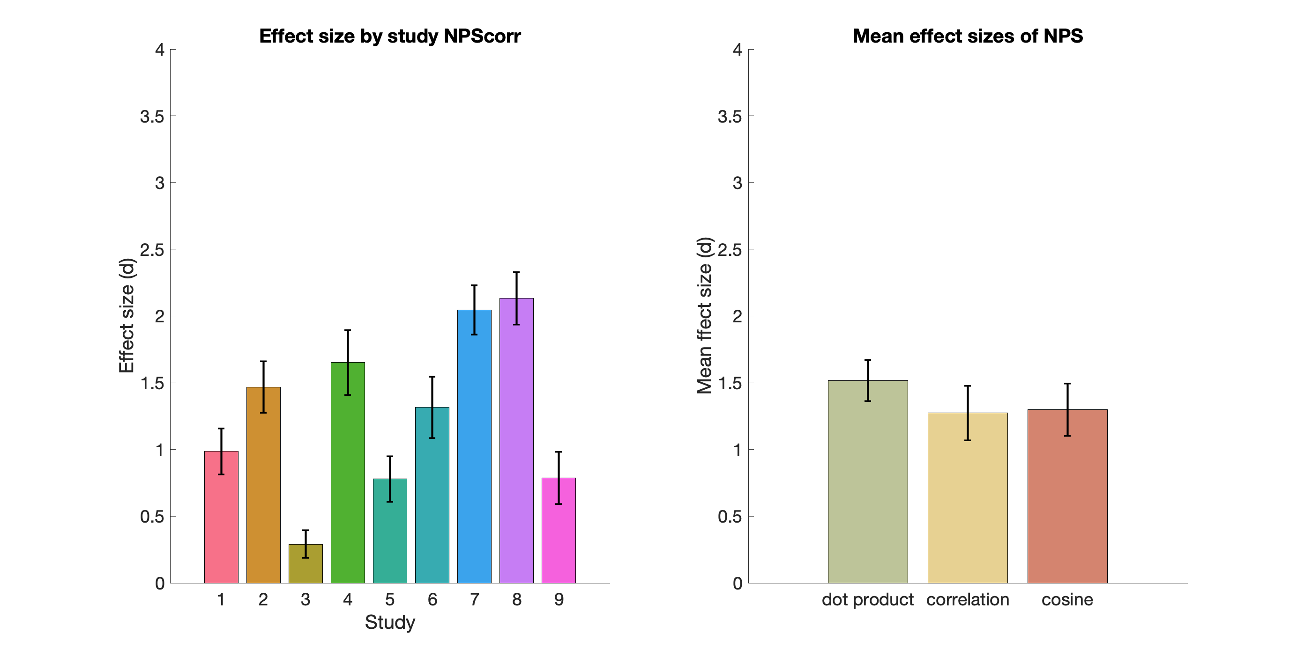
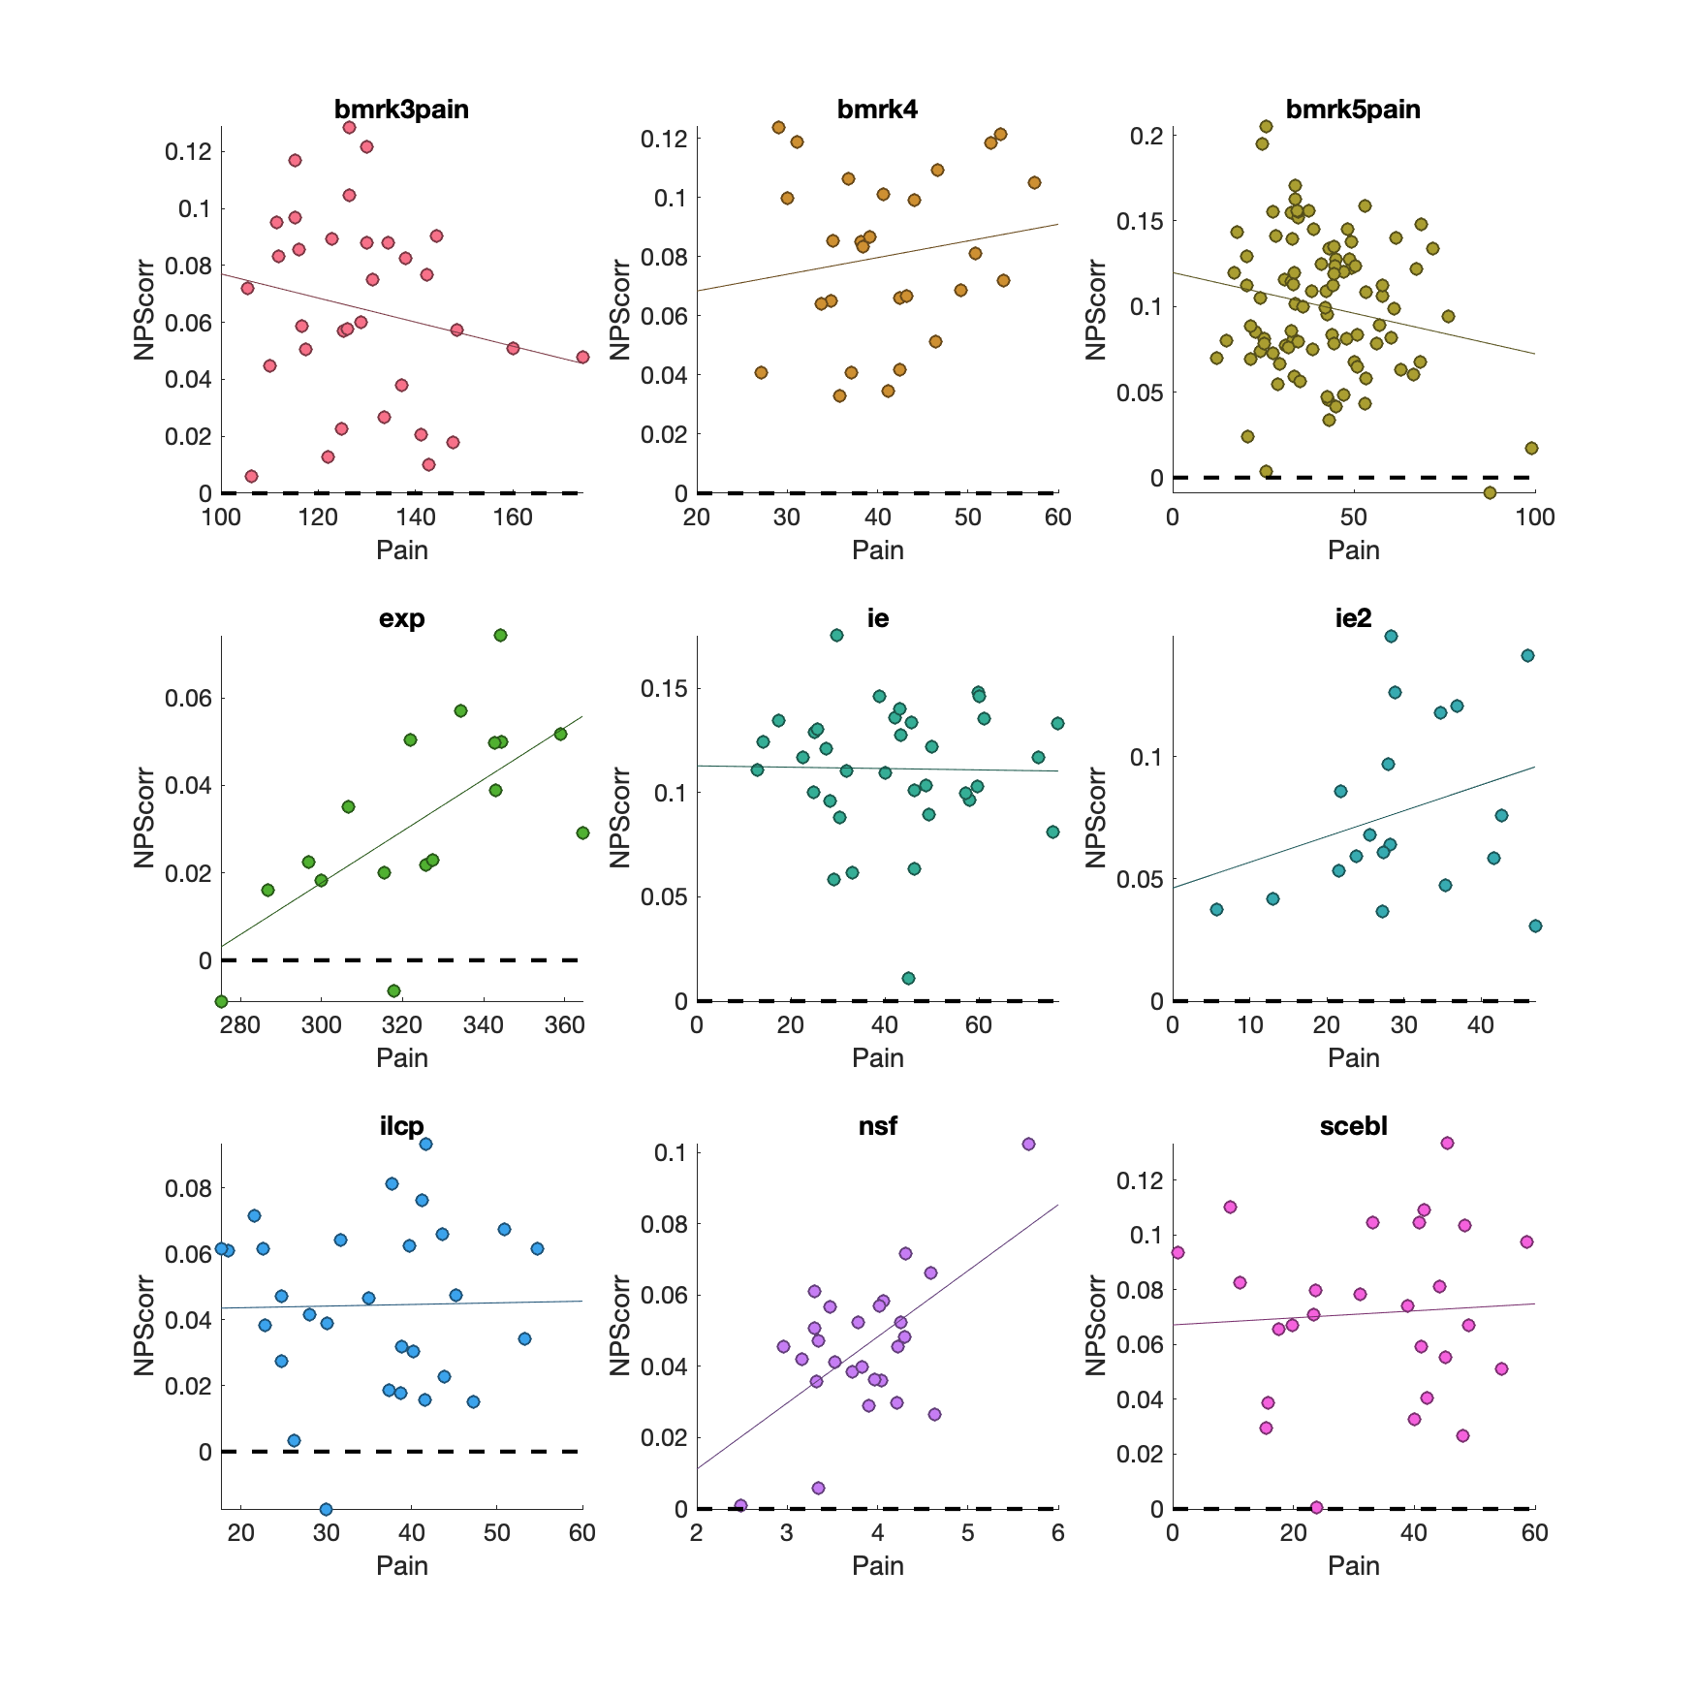
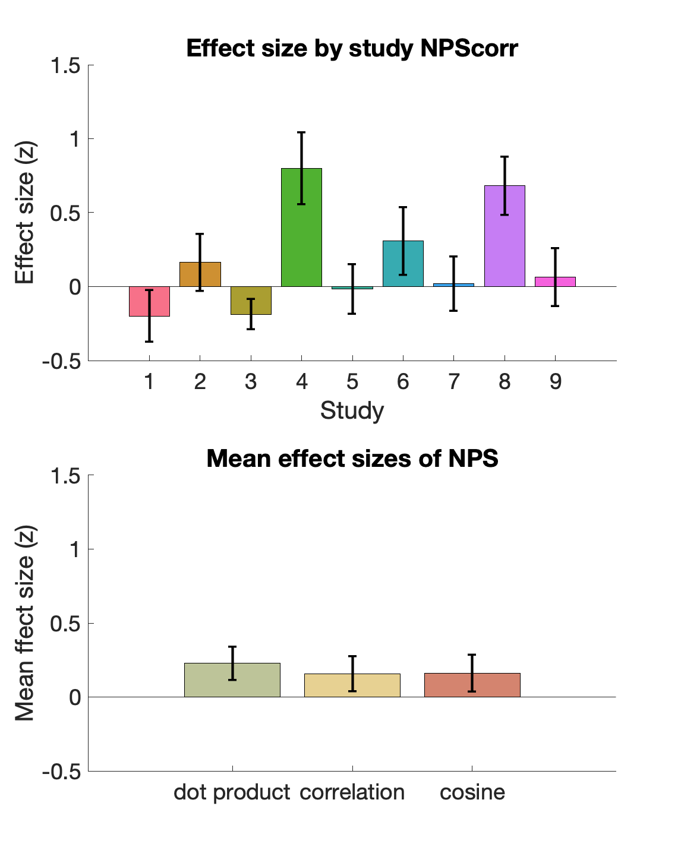
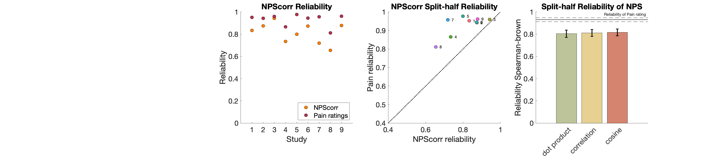
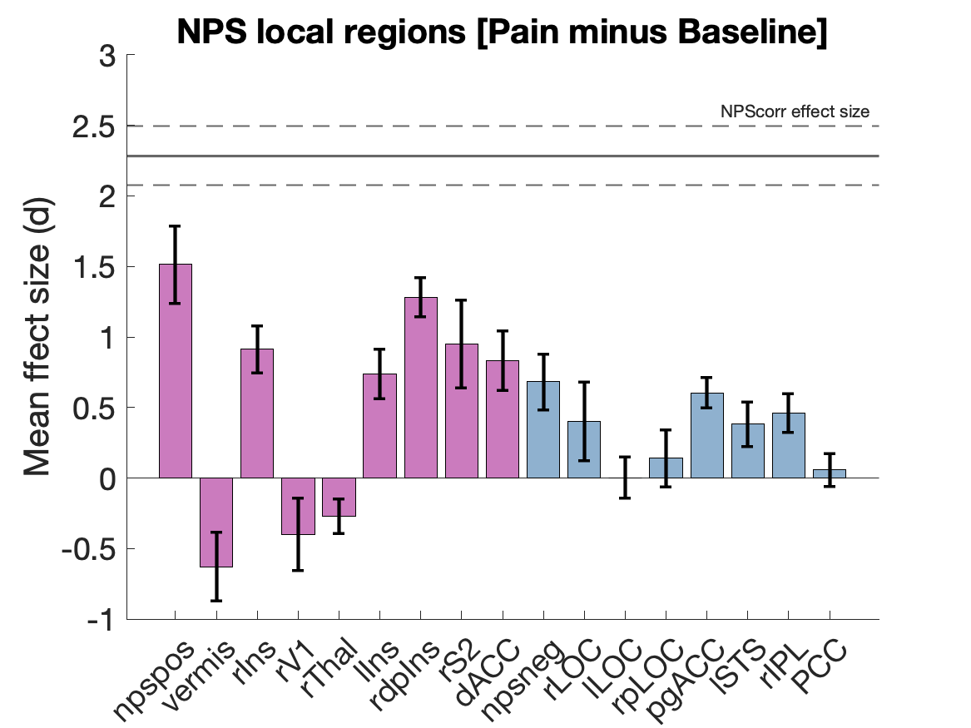
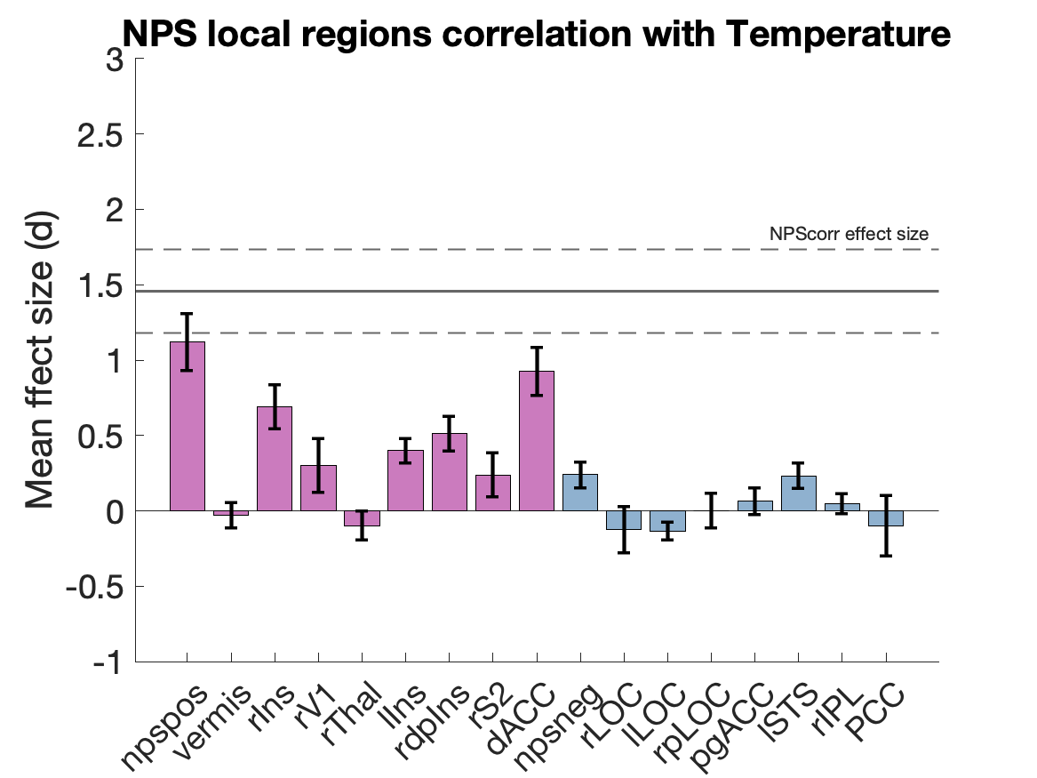
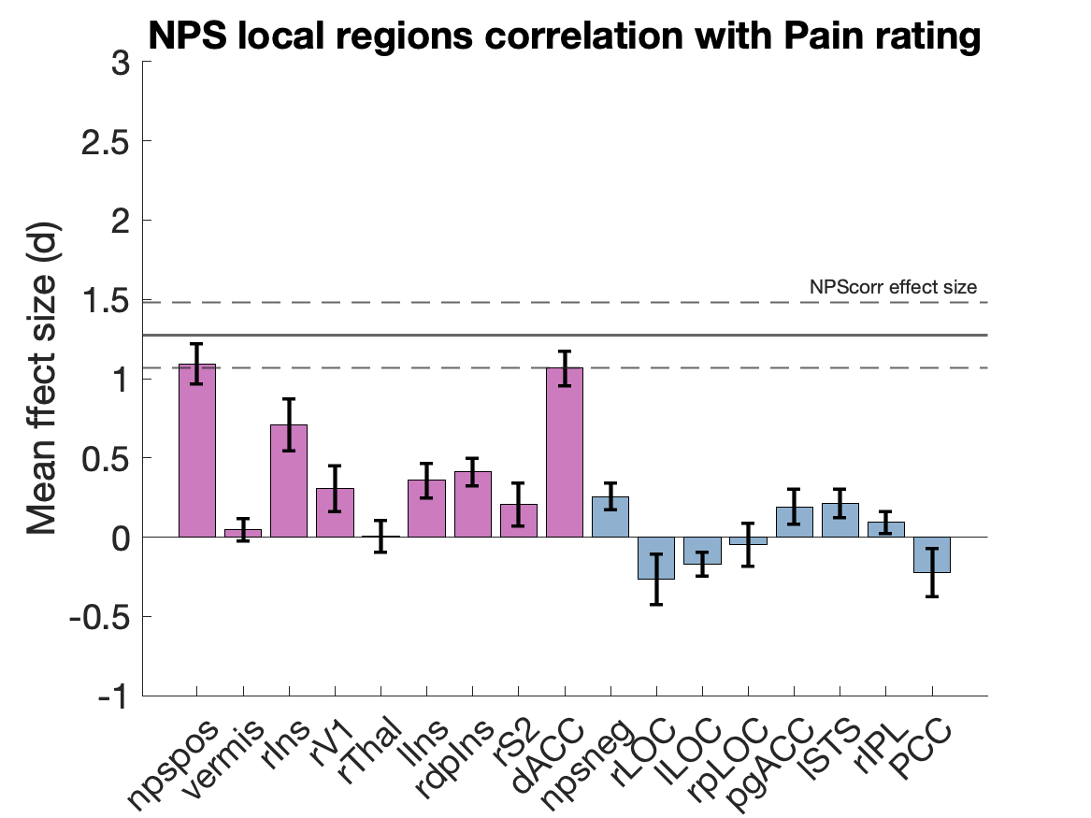
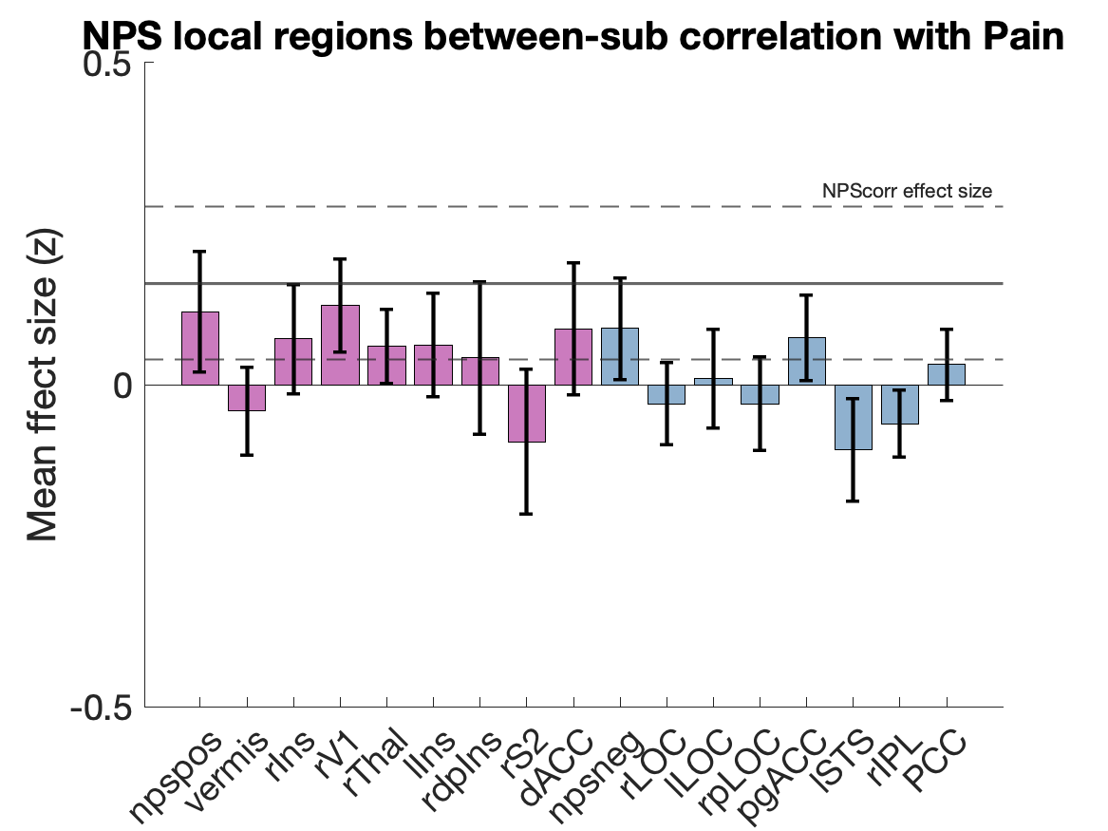
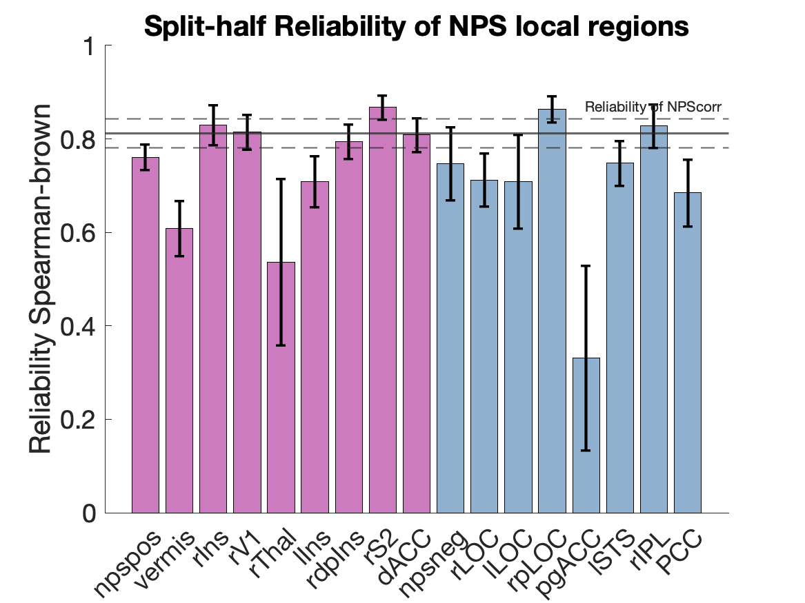
Effect size and reliability of the Neurological Pain Signature
: Xiaochun.han@dartmouth.edu
Xiaochun Han¹, Lauren Y. Atlas^{2,3,4}, Leonie Koban^{5,6}, Elizabeth A. Reynolds Losin⁷, Mathieu Roy⁸, Choong-Wan Woo^{9,10}, Tor D. Wager¹
(¹Department of Psychological and Brain Sciences, Dartmouth College, Hanover NH, USA; ²National Center for Complementary and Integrative Health, National Institutes of Health, Bethesda MD, USA; ³National Institute of Mental Health, National Institutes of Health, Bethesda MD, USA; ⁴National Institute on Drug Abuse, National Institutes of Health, Baltimore MD, USA; ⁵INSEAD, Fontainebleau, France; ⁶Brain & Spine Institute (ICM), Paris, France; ⁷Department of Psychology, University of Miami, Miami FL, USA; ⁸Department of Psychology, McGill University, CA; ⁹Center for Neuroscience Imaging Research, Institute for Basic Science, Republic of Korea; ¹⁰Department of Biomedical Engineering, Sungkyunkwan University, Republic of Korea.)
Introduction
There is an increasing movement towards establishing neurophysiological markers of mental processes. A priori markers can provide quantitative predictions that can be tested across laboratories, serve as targets for interventions, and increase reproducibility by decreasing analytic flexibility. As markers become more widely shared across labs and translated into practical applications, robust validation of their psychometric properties and performance benchmarks across contexts will become increasingly important.
One such marker is the Neurologic Pain Signature (NPS) ^{[1]}, a multivariate brain measure trained to track pain induced by nociceptive input. Here, we test the effect size and reliability of the NPS in a large dataset of pain studies.
Neurological Pain Signature (NPS)
Method
Single-trial heat pain database
The data used for this study are based on a single trial database on healthy subjects during pain tasks, including comprehensive behavioral and fMRI data. Overall, the data set included 16,294 single-trial images of fMRI activity associated with multiple levels of noxious heat and pain ratings across over health 305 participants from 9 studies. In each study, thermal stimulations were delivered to multiple skin sites with temperatures ranging from 41 °C to 50 °C and durations from 1.85 to 16 seconds. On each trial, after the offset of stimulation, participants rated the magnitude of pain they experienced. Quantification of single-trial response magnitudes was done by constructing a GLM design matrix with separate regressors for each trial.
Effect size
We calculated four types of effect size to quantify the performance of NPS in response to heat pain:
NPS responses in the contrast of [Pain minus Baseline] within each subject
The correlation of NPS with temperature within each subject
The correlation of NPS with subjective pain rating within each subject
The correlation of NPS with subjective pain rating across different subjects
Single-trial database
Induction of heat pain
bmrk4^{[9]}
bmrk3pain^{[2]}
scebl^{[3]}
nsf^{[1]}
bmrk5pain^{[8]}
ilcp^{[4]}
exp^{[7]}
ie^{[6]}
ie2^{[5]}
9 studies
305 subjects
16294 single-trial images
Reliability
We calculate the internal consistency of NPS response and subjective pain ratings of each subject with the split-half correlation and corrected by the Spearman-Brown formula.
Three types of pattern similarity representation
We computed for each trial and each subject a single scalar value representing their expression of the NPS pattern. We also compared with the performance of three commonly used methods used to calculate the expression of the NPS pattern, e.g., dot-product (NPSdot), correlation (NPScorr), and cosine similarity (NPScos).
NPS vs. Local brain regions
To test the performance of each brain region within NPS and further test whether the performance of NPS exceeds any individual brain region within NPS, we also computed the pattern expressions for each brain cluster within NPS. We compared the effect size and reliability with the complete NPS pattern representation.
Results
NPS responses in the contrast of [Pain minus Baseline]
The results showed that NPS responses in the contrast of [Pain minus Baseline] are significantly greater than zero in each of 9 studies tested, with effect sizes ranging from Cohen‘s d = 1.43 to 3.56. Among the three pattern expression indexes, NPScorr has the largest effect size (Cohen‘s d = 2.29).
Correlation of NPS with temperature
The results showed that the correlations of NPS responses with temperature are significantly greater than zero in 8 out of 9 studies tested, with effect sizes ranging from Cohen‘s d = 0.19 to 3.04. Among the three pattern expression indexes, NPSdot has the largest effect size (Cohen‘s d = 1.63).
Correlation of NPS with subjective pain ratings
The results showed that the within-subject correlations of NPS responses with the subjective pain ratings are significantly greater than zero in each of 9 studies tested, with effect sizes ranging from Cohen‘s d = 0.29 to 2.13. Among the three pattern expression indexes, NPSdot has the largest effect size (Cohen‘s d = 1.52).
Correlation of NPS with subjective pain rating between subjects
The results showed that the between-subject correlations of NPS responses with the subjective pain ratings are significantly greater than zero in 3 out of 9 studies tested, with effect sizes ranging from Fisher‘s z = -0.2 to 0.8. Among the three pattern expression indexes, NPSdot has the largest effect size (Fisher‘s z = 0.23).
Reliability of NPS response and subjective pain ratings
Reliability tests of NPS show that the average Spearman-Brown first-second half reliability is 0.81, ranging from 0.65 to 0.94. Three pattern expression indexes showed similar reliabilities, and NPScos has the relatively largest reliability (0.82). Reliability tests of pain ratings show that the average Spearman-Brown first-second half reliability is 0.93, ranging from 0.81 to 0.98.
Performance of NPS local brain regions
The effect sizes of NPS local brain regions’ responses in the contrast of [Pain minus Baseline] range from Cohen‘s d = -0.63 to 1.51. The effect sizes of the correlations between NPS local brain regions and temperature range from Cohen‘s d = -0.14 to 1.12. The effect sizes of the correlations between NPS local brain regions and subjective pain ratings range from Cohen‘s d = -0.27 to 1.09. The effect sizes of the between-subject correlations between NPS local brain regions and subjective pain ratings range from Fisher‘s z = -0.10 to 0.12. Reliability tests of NPS local brain regions show that the average Spearman-Brown first-second half reliability range from 0.33 to 0.87.
References
Conclusion
NPS showed a decent performance in effect size and reliability across different studies, superior to the performance of local brain regions.
The performances of three types of pattern similarity representations of NPS are similar, with some minor differences in different statistics.
The reliabilities for NPS and pain ratings are much higher than their correlations, suggesting that two measurements may be suspected to different sources of inter-individual variability and are not redundant.
These studies were heterogeneous in preprocessing methods, pain duration, scanner, population, body site, and concurrent contexts/cognitive tasks. While this is a strength in demonstrating generalizability, it also limits effect sizes and reliability. Advances could be made by customizing models for particular types of populations/body sites/stimulus durations/contexts.
[1] Wager, T. D., Atlas, L. Y., Lindquist, M. A., Roy, M., Woo, C. W., & Kross, E. (2013). An fMRI-based neurologic signature of physical pain. New England Journal of Medicine, 368(15), 1388-1397.
[2] Woo, C. W., Roy, M., Buhle, J. T., & Wager, T. D. (2015). Distinct brain systems mediate the effects of nociceptive input and self-regulation on pain. PLoS biology, 13(1).
[3] Koban, L., Jepma, M., López-Solà, M., & Wager, T. D. (2019). Different brain networks mediate the effects of social and conditioned expectations on pain. Nature communications, 10(1), 1-13.
[4] Woo, C. W., Schmidt, L., Krishnan, A., Jepma, M., Roy, M., Lindquist, M. A., ... & Wager, T. D. (2017). Quantifying cerebral contributions to pain beyond nociception. Nature communications, 8(1), 1-14.
[5] Jepma, M., Koban, L., van Doorn, J., Jones, M., & Wager, T. D. (2018). Behavioural and neural evidence for self-reinforcing expectancy effects on pain. Nature human behaviour, 2(11), 838-855.
[6] Roy, M., Shohamy, D., Daw, N., Jepma, M., Wimmer, G. E., & Wager, T. D. (2014). Representation of aversive prediction errors in the human periaqueductal gray. Nature neuroscience, 17(11), 1607.
[7] Atlas, L. Y., Bolger, N., Lindquist, M. A., & Wager, T. D. (2010). Brain mediators of predictive cue effects on perceived pain. Journal of Neuroscience, 30(39), 12964-12977.
[8] Losin, E. A. R., Woo, C. W., Medina, N. A., Andrews-Hanna, J. R., Eisenbarth, H., & Wager, T. D. (2020). Neural and sociocultural mediators of ethnic differences in pain. Nature human behaviour, 1-14.
[9] Krishnan, A., Woo, C. W., Chang, L. J., Ruzic, L., Gu, X., Lopez-Sola, M., ... & Wager, T. D. (2016). Somatic and vicarious pain are represented by dissociable multivariate brain patterns. Elife, 5, e15166.

