Slide 1
Detection of Discriminative Neurological Circuits Using Hierarchical Graph Convolutional Networks in fMRI Sequences
Xiaodan Xing, Lili Jin, Qinfeng Li, Lei Chen, Zhong Xue, Ziwen Peng, Feng Shi and Dinggang Shen
Shanghai United Imaging Intelligence Co., Ltd., Shanghai, China
Department of Child Psychiatry, Shenzhen Kangning Hospital, Shenzhen Mental Health Center, Shenzhen, China

Slide 2
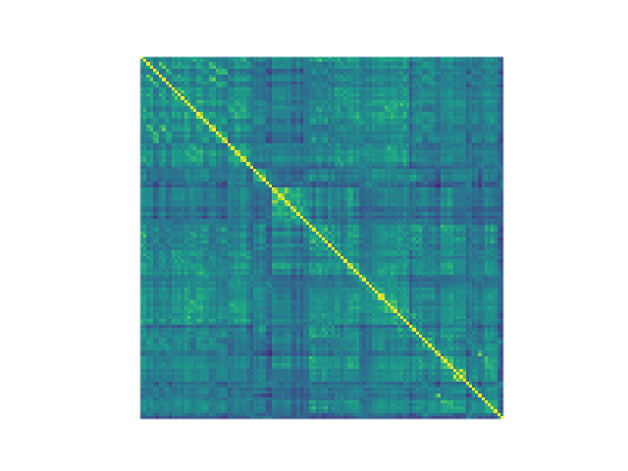
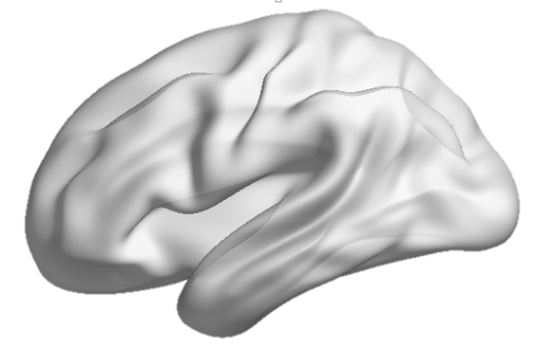
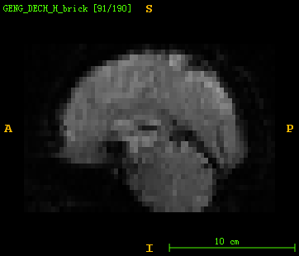
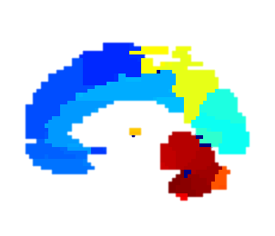
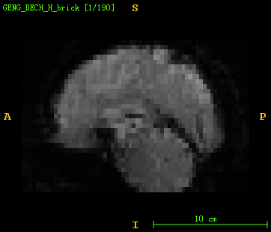
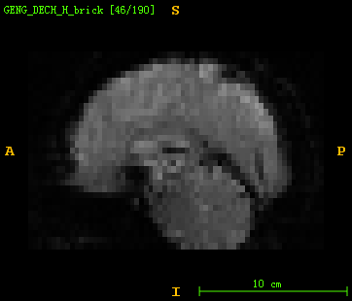
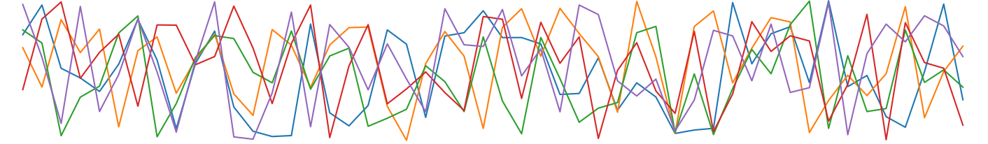
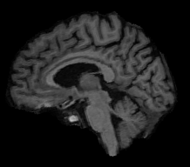

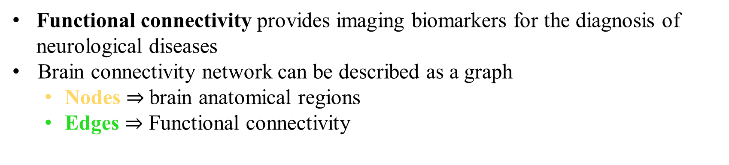

Background
Functional connectivity provides imaging biomarkers for the diagnosis of neurological diseases
Brain connectivity network can be described as a graph
Nodes $⇒$brain anatomical regions
Edges $⇒$ Functional connectivity
Functional MR image series
Parcellation
BOLD* signals for each ROI
Functional connectivity matrix
Functional graph
* BOLD: blood oxygenation level dependent
Structural Image

Slide 3
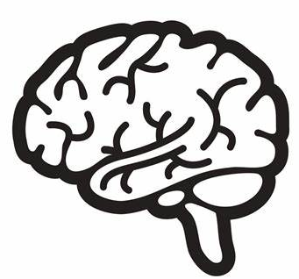
Existing Method
Graph Convolutional Networks learn graph representations in a convolutional neural network
Functional connectivity matrix
Functional graph
Graph convolutional networks
Diagnosis
Lacks the learning of hierarchical graph representations
Graph convolution maintains graph structure
Lacks explainability
Only independent regions identified
Ignores the dynamic nature of brain activity

Slide 4
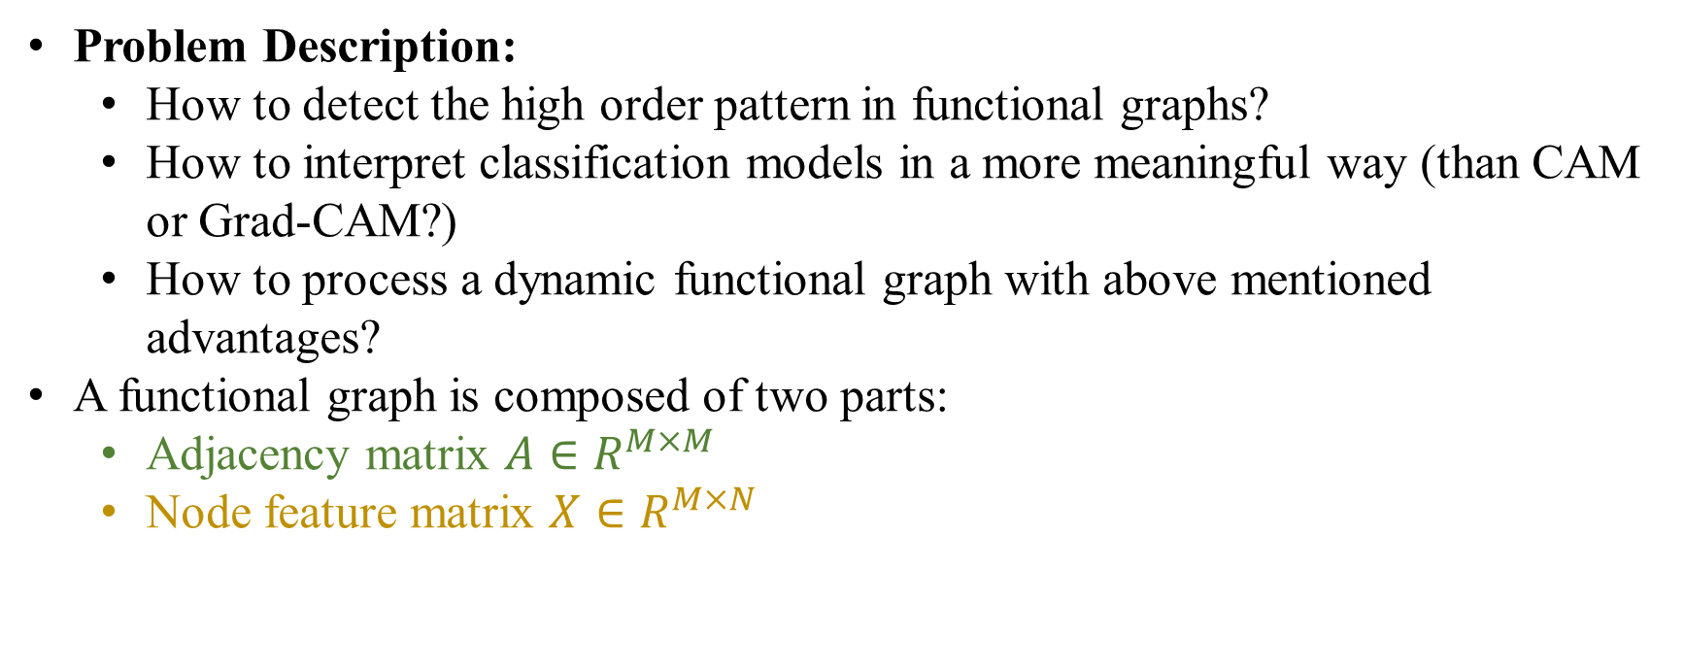
Goal
Problem Description:
How to detect the high order pattern in functional graphs?
How to interpret classification models in a more meaningful way (than CAM or Grad-CAM?)
How to process a dynamic functional graph with above mentioned advantages?
A functional graph is composed of two parts:
Adjacency matrix $A∈R^{M×M}$
Node feature matrix $X∈R^{M×N}$
[Volume, intensity, shape,…]
Node feature matrix describe the features of each node
Adjacency matrix reflects the graph topology

Slide 5
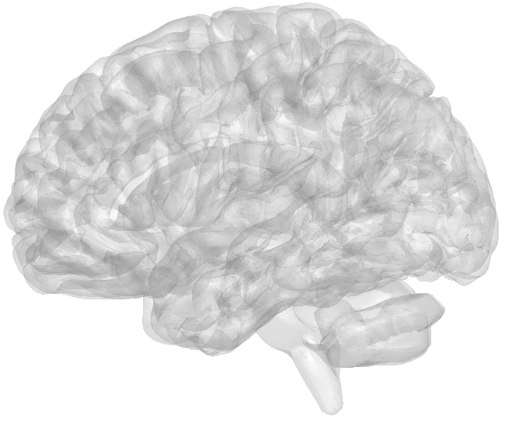
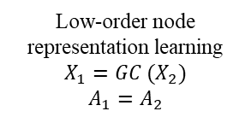
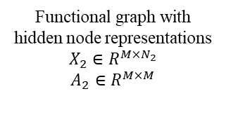
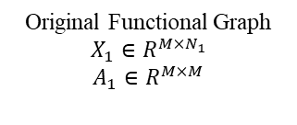
Proposed Method
Message passing model only update features in each node, does not investigate the graph structure.
Fully connected layers
Graph convolutional (GC) layers
Diagnosis Result
Original Functional Graph
$$X_{1}∈R^{M×N_{1}}$$
$$A_{1}∈R^{M×M}$$
Low-order node representation learning
$$X_{1}=GC (X_{2})$$
$$A_{1}=A_{2}$$
Functional graph with hidden node representations
$$X_{2}∈R^{M×N_{2}}$$
$$A_{2}∈R^{M×M}$$

Slide 6
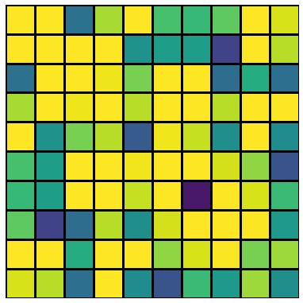
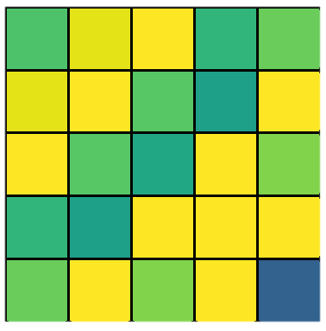


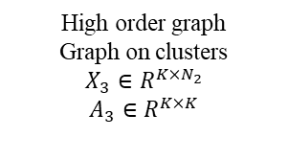



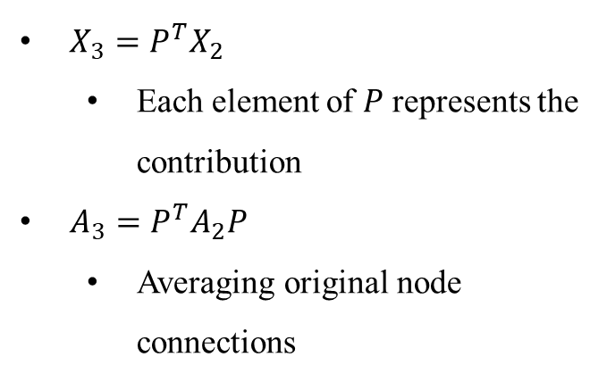

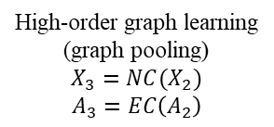


Proposed Method
Differential graph pooling block to learn a high order graph pattern
$X_{3}=P^{T}X_{2}$
Each element of $P$ represents the contribution
$A_{3}=P^{T}A_{2}P$
Averaging original node connections
Node Clustering (NC)
Edge Clustering (EC)
$$1$$
$$1$$
…
$$P^{T}× ×P =$$
$$P^{T} × =$$
…
$$M$$
$$K$$
Assign Matrix
$$P∈R^{M×K}$$
$$X_{2}∈R^{M×N_{2}}$$
$$X_{3}∈R^{K×N_{2}}$$
$$A_{2}∈R^{M×M}$$
$$A_{3}∈R^{K×K}$$
Graph convolutional (GC) layers
Differential graph pooling block
Original Functional Graph
$$X_{1}∈R^{M×N_{1}}$$
$$A_{1}∈R^{M×M}$$
Low-order node representation learning
$$X_{1}=GC (X_{2})$$
$$A_{1}=A_{2}$$
Functional graph with hidden node representations
$$X_{2}∈R^{M×N_{2}}$$
$$A_{2}∈R^{M×M}$$
High-order graph learning
(graph pooling)
$$X_{3}=NC(X_{2})$$
$$A_{3}=EC\left(A_{2}\right)$$
High order graph
Graph on clusters
$$X_{3}∈R^{K×N_{2}}$$
$A_{3}∈R^{K×K}$

Slide 7
Proposed Method
Differential graph pooling block to learn a high order graph pattern
Weights of fully connected layers to detect disease related brain clusters
Most Decisive Cluster
GC
Layers
Graph convolutional (GC) layers
Differential graph pooling block
Patient
Control
Original Functional Graph
$$X_{1}∈R^{M×N_{1}}$$
$$A_{1}∈R^{M×M}$$
Low-order node representation learning
$$X_{1}=GC (X_{2})$$
$$A_{1}=A_{2}$$
Functional graph with hidden node representations
$$X_{2}∈R^{M×N_{2}}$$
$$A_{2}∈R^{M×M}$$
High-order graph learning
(graph pooling)
$$X_{3}=NC(X_{2})$$
$$A_{3}=EC\left(A_{2}\right)$$
High order graph
Graph on clusters
$$X_{3}∈R^{K×N_{2}}$$
$A_{3}∈R^{K×K}$

Slide 8
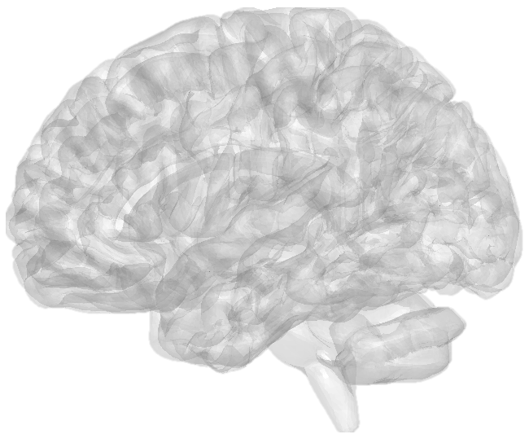

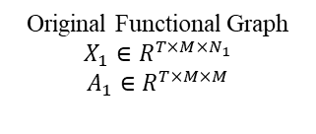
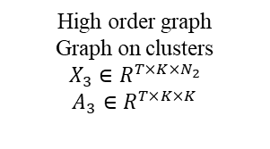
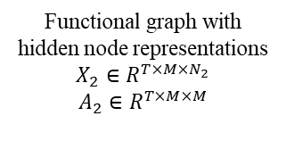
Proposed Method
Differential graph pooling block to learn a high order graph pattern
Use weights of fully connected layers to detect disease related brain clusters
Use GC-LSTM layer [1] to process dynamic information
GAP: Global average pooling
[1] Xing, Xiaodan, et al. "Dynamic spectral graph convolution networks with assistant task training for early mci diagnosis. " MICCAI 2019.
Most Decisive Cluster
GC
Layers
GAP
GCLSTM
Layers
Differential graph pooling block
Patient
Control
Original Functional Graph
$$X_{1}∈R^{T×M×N_{1}}$$
$$A_{1}∈R^{T×M×M}$$
Low-order node representation learning
$$X_{1}=GC (X_{2})$$
$$A_{1}=A_{2}$$
Functional graph with hidden node representations
$$X_{2}∈R^{T×M×N_{2}}$$
$$A_{2}∈R^{T×M×M}$$
High-order graph learning
(graph pooling)
$$X_{3}=NC(X_{2})$$
$$A_{3}=EC\left(A_{2}\right)$$
High order graph
Graph on clusters
$$X_{3}∈R^{T×K×N_{2}}$$
$A_{3}∈R^{T×K×K}$

Slide 9
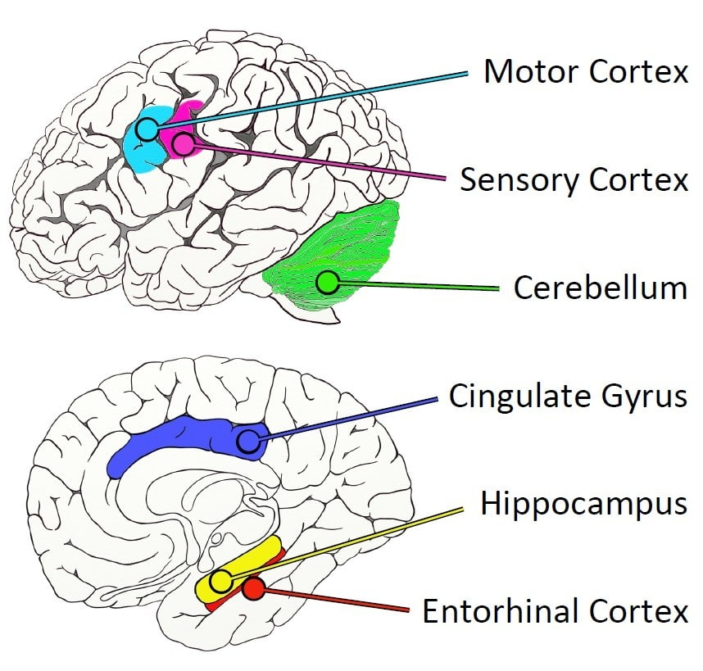
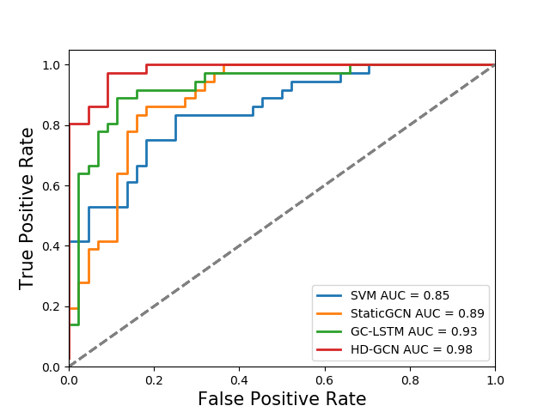
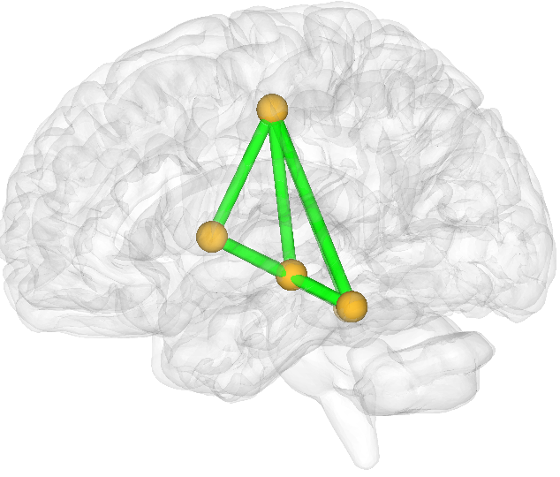
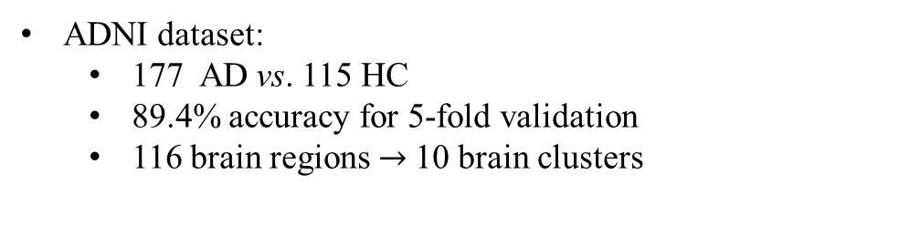
Experimental results
ADNI dataset:
177 AD vs. 115 HC
89.4% accuracy for 5-fold validation
116 brain regions $→$10 brain clusters
Cingulum-Mid-R
Putamen-L
Hippocampus-L
Fusiform-R
Putamen-L
Fusiform-L
The identified most decisive cluster for AD patients from our algorithm
Six mostly identified brain areas in AD from medical researches [1]
[1] Xu, Jingshu, et al. "Regional protein expression in human Alzheimer’s brain correlates with disease severity." Communications Biology 2.1 (2019): 1-15.

Slide 10
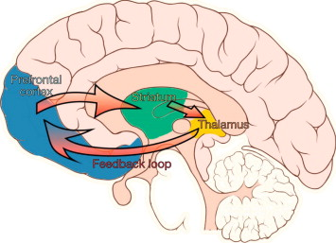
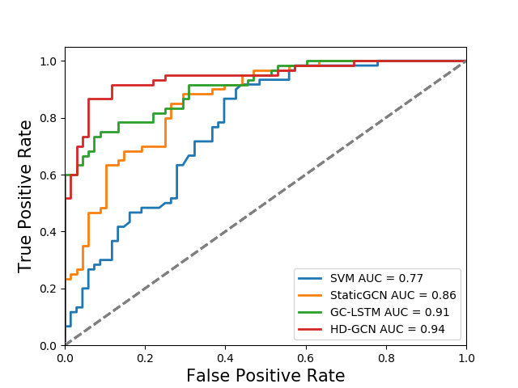
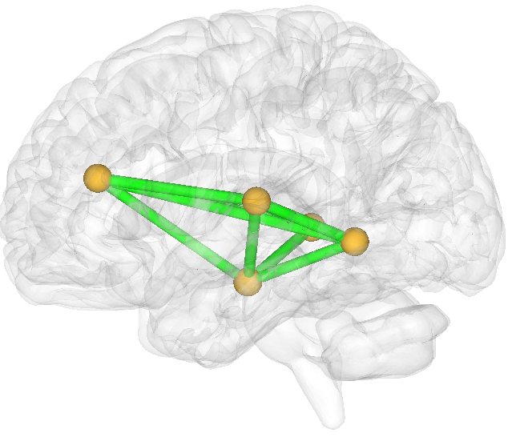
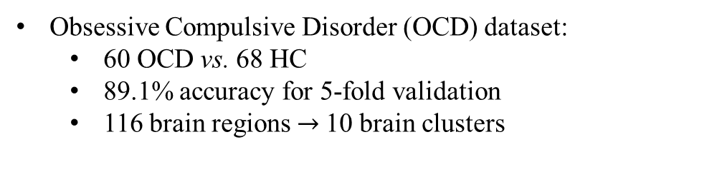
Experimental results
Obsessive Compulsive Disorder (OCD) dataset:
60 OCD vs. 68 HC
89.1% accuracy for 5-fold validation
116 brain regions $→$10 brain clusters
Cingulum-Ant-R
Thalamus-L
Temporal-Mid-R
ParaHippocampal-R
Cortico–striatal–thalamic–cortical (CSTC) circuit [1]
The identified most decisive cluster for OCD patients from our algorithm
[1] Vahabzadeh, A., and C. J. McDougle. "Obsessive–compulsive disorder." (2014): 2512-2521.

Slide 11
Conclusion
Contributions
Differential graph pooling for functional graph
Dynamic graph convolutional layers
Identification of disease related brain circuits
Future works
Permutation invariant assign matrix
Contact information
xiaodan.xing@united-imaging.com

Slide 12


