Slide 1
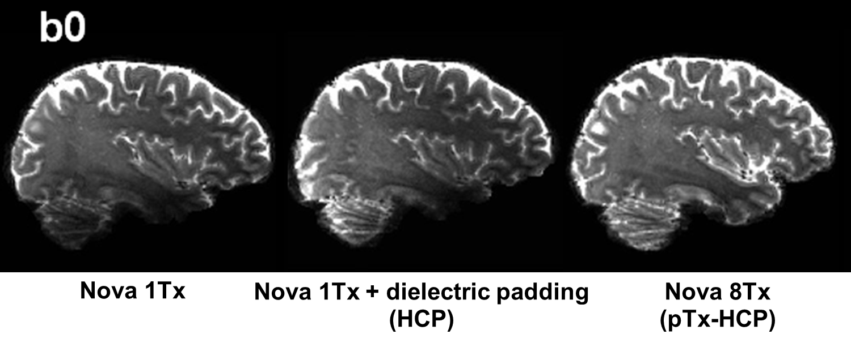
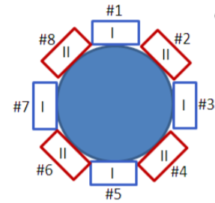
sTX v.s. pTX
Single transmit (sTX) coil
sTx image
Parallel transmit (pTX) coil
pTX pulse design algorithm
B0, B1 maping
SAR, peak B1 constraints
pTx image

Slide 2
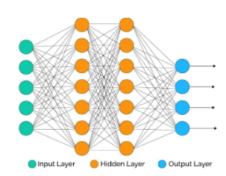
Creating parallel-transmission-style MRI with deep learning: DeepPTx
sTx image
pTx image
End-to-end image mapping using neural network
pTx hardware or software may no longer be needed
T1/T2 imaging, diffusion, fMRI, …
Notes:
If you remember, two months ago, at our last group meeting, we talked about this new idea, which is end-to-end img mapping using AI.
We wonder if there is a nn to map the sTX image into pTX style directly, so that pTX ha…or soft.. Is not longer needed.

Slide 3






Preliminary results
sTx
ResNet
pTx
b=0
b=1000

Slide 4
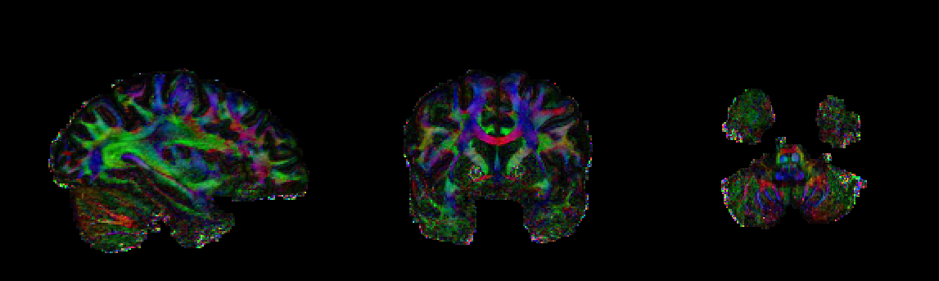
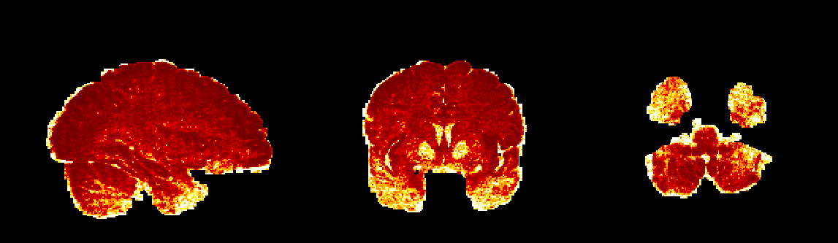
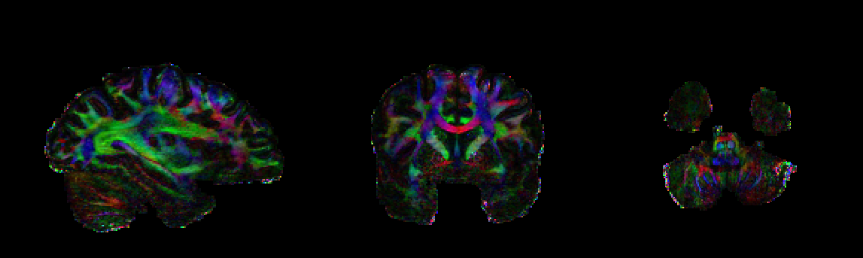
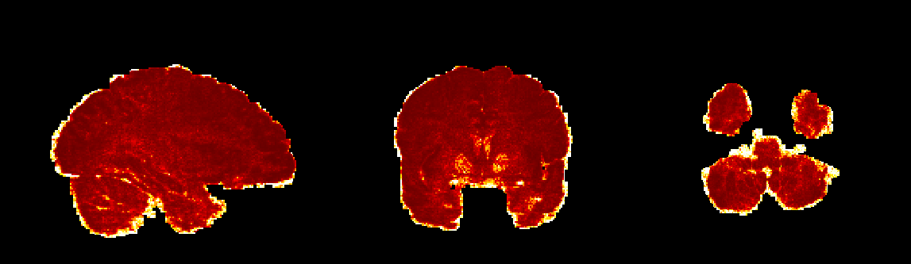
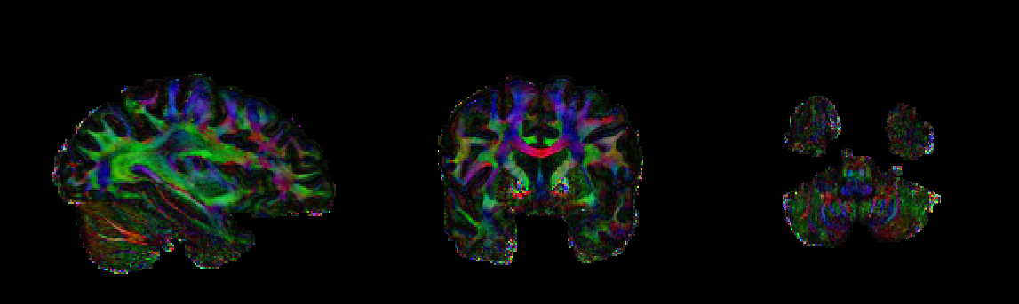
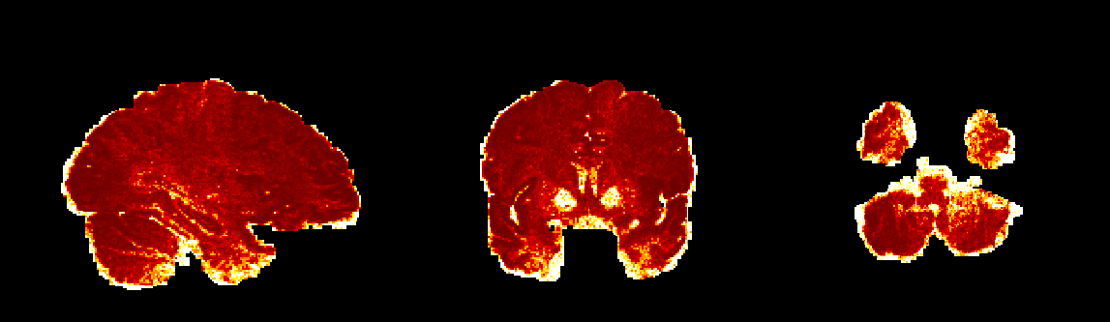
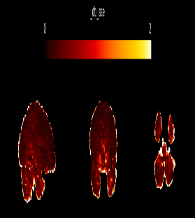
Preliminary results
Color-coded FA map
SSE map
sTx
ResNet
pTx
2
0

