Slide 1
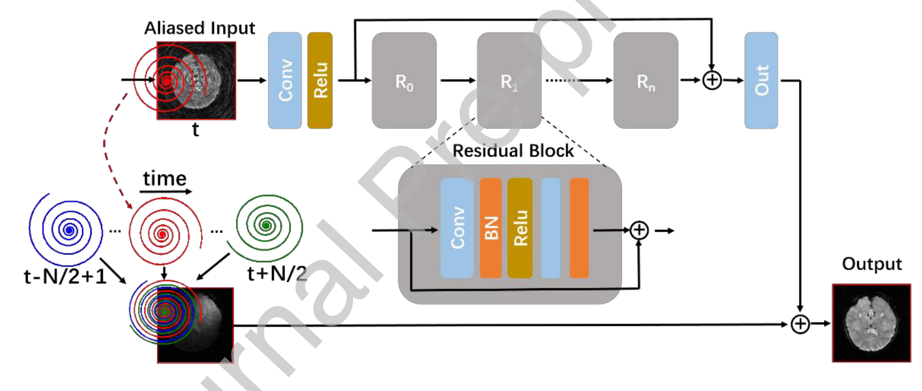
ResNet

Slide 2
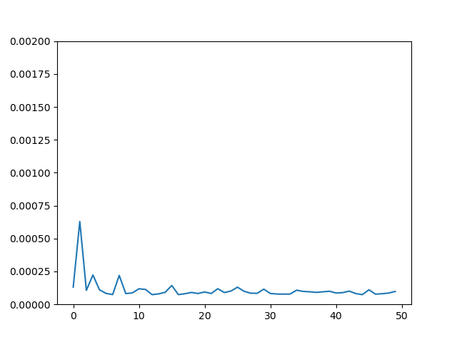
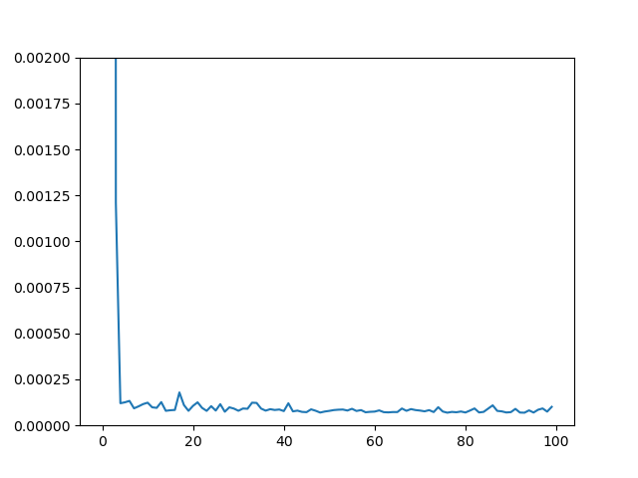
UNet vs. ResNet (Nblock=4)
50 epochs
UNet
ResNet

Slide 3
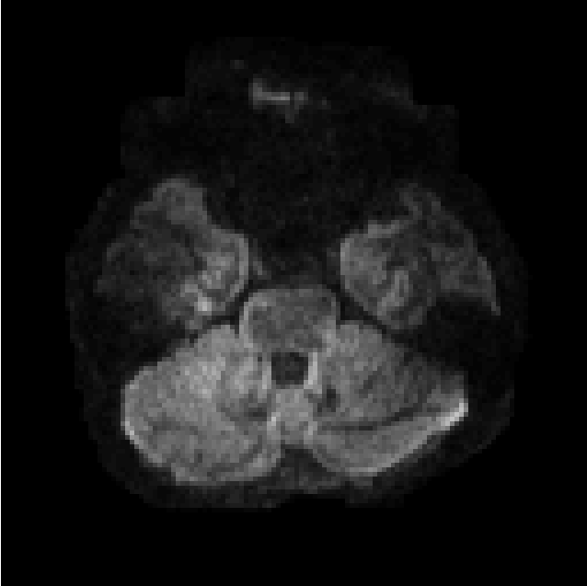
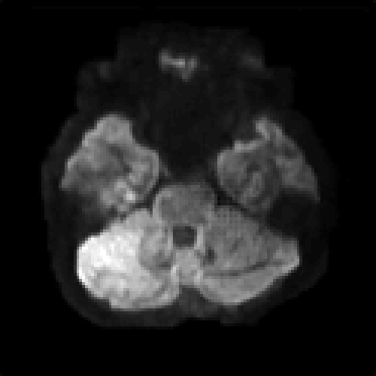
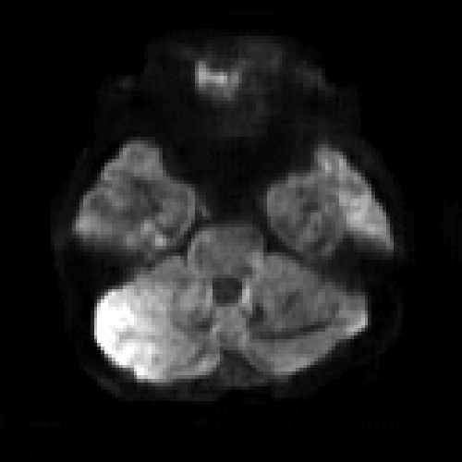
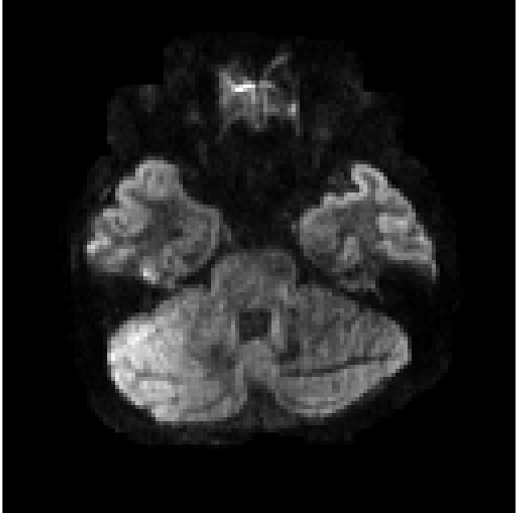
1TX
uNet
ResNet
pTX

Slide 4
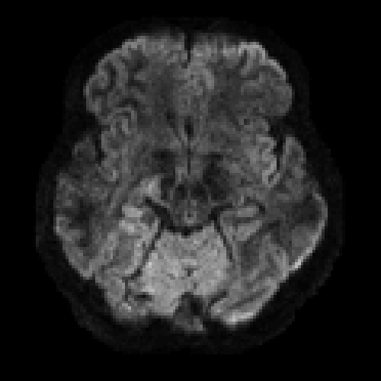
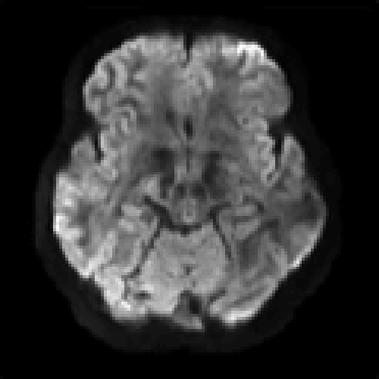
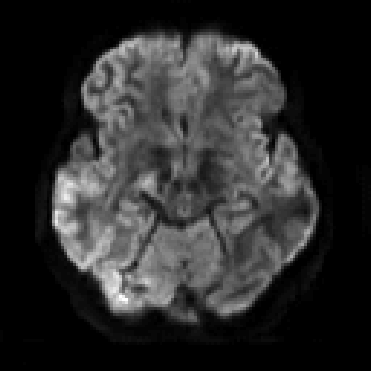
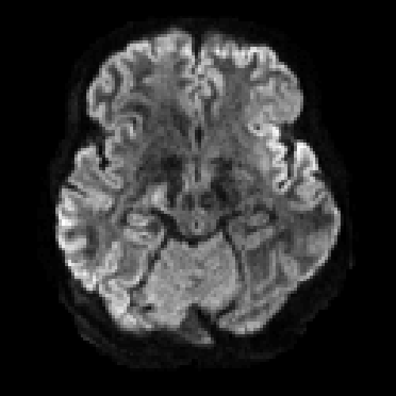
ResNet seems sharper
1TX
UNet
ResNet
pTX
Notes:
2D -> 3D learning?

Slide 5
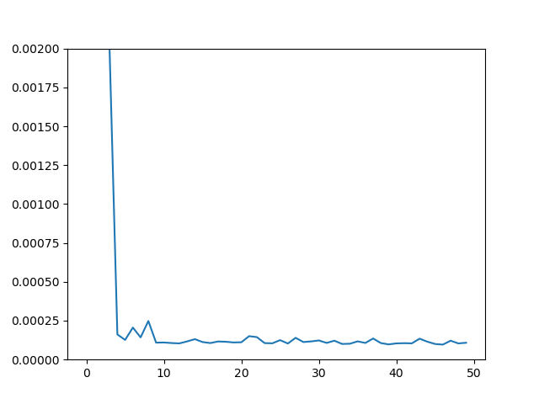
ResNet w and w/o T1W as input
w/o T1W
w T1W

Slide 6
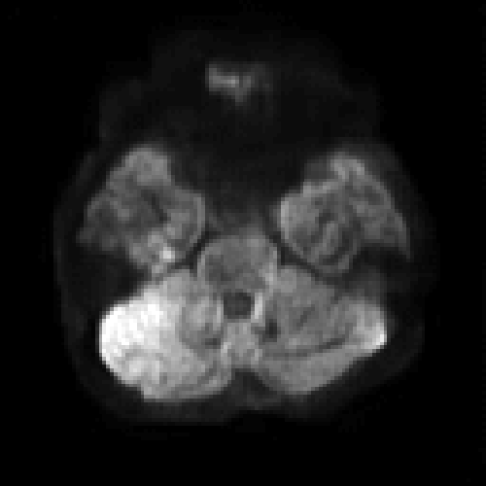
With T1 looks blurry overall but has enhanced structures in some local regions.
Needs more comparison.
1TX
ResNet-7Vol
ResNet-7Vol-T1W
pTX

Slide 7
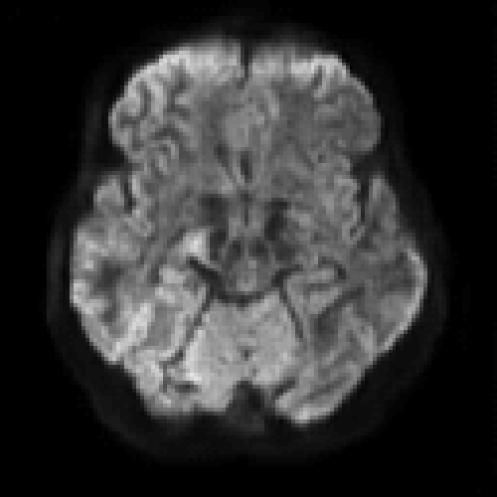
1TX
ResNet-7Vol
ResNet-7Vol-T1W
pTX

Slide 8
ResNet 7 volumes vs. 71 volumes
Note: The 7-volume or 71-volume case actually contains both b1000 and b2000 because of my mistake.
100 epochs

Slide 9
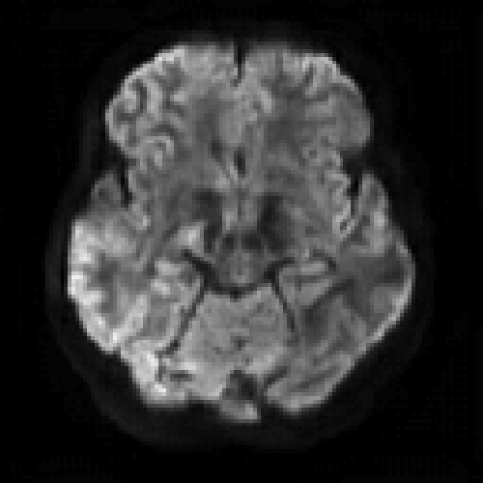
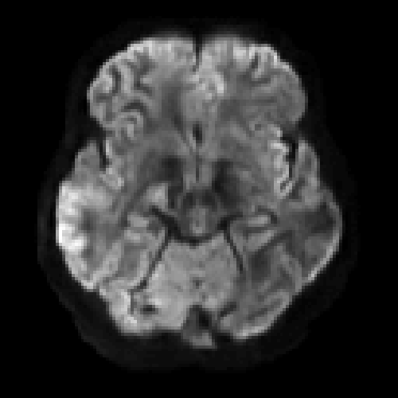
b =1000
1TX
ResNet-7Vol
ResNet-71Vol
pTX

Slide 10
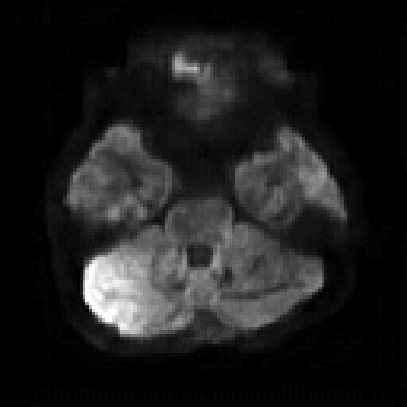
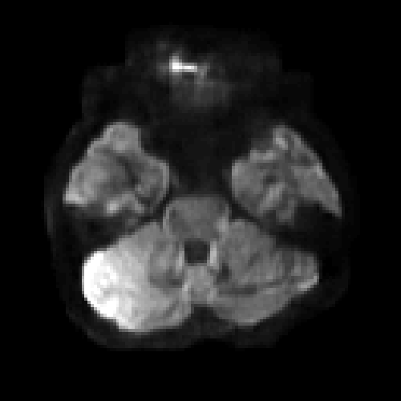
b =1000
71 volumes has higher SNR and more blurry contrast for b1000
1TX
ResNet-7Vol
ResNet-71Vol
pTX

Slide 11
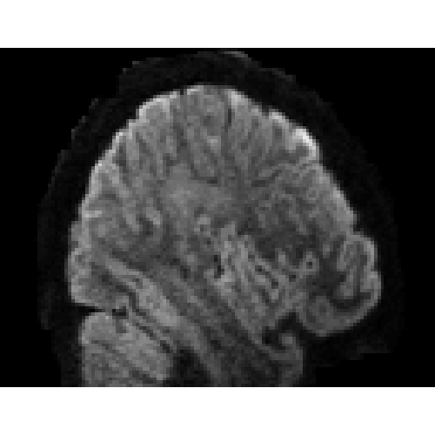
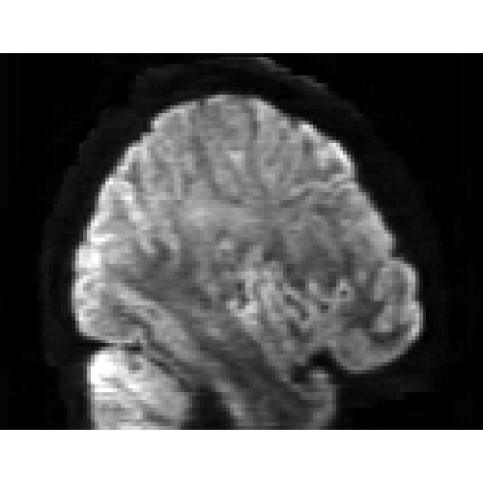
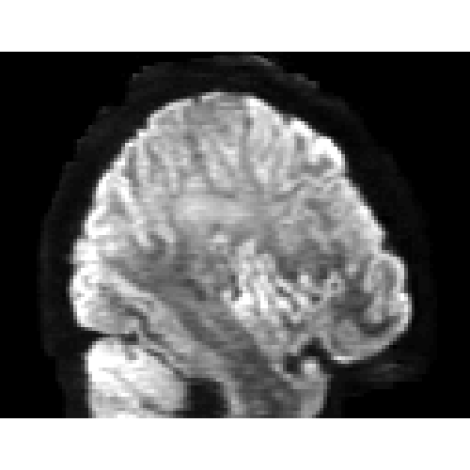
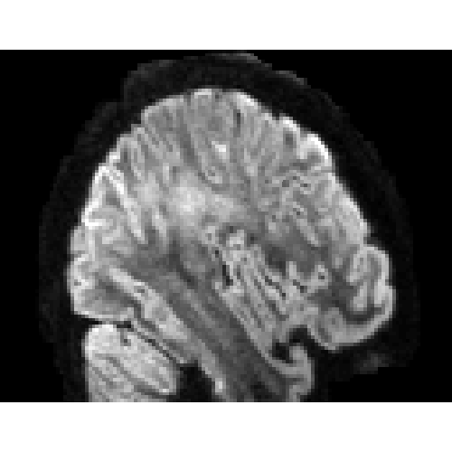
b =1000
1TX
ResNet-7Vol
ResNet-71Vol
pTX

Slide 12
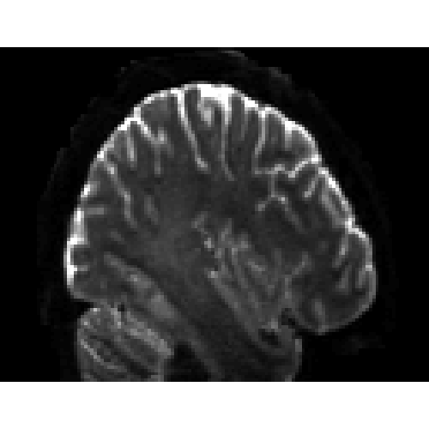
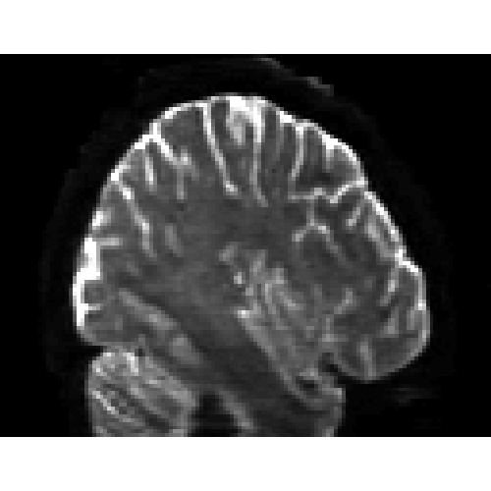
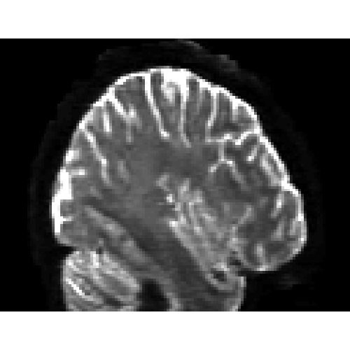
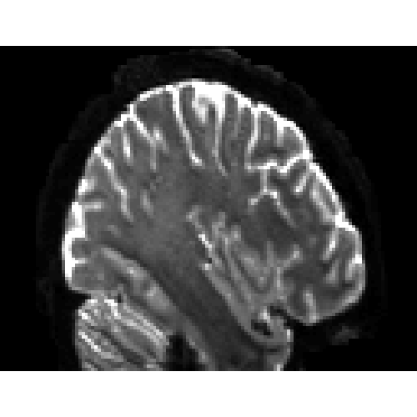
b =1000
1TX
ResNet-7Vol
ResNet-71Vol
pTX

Slide 13
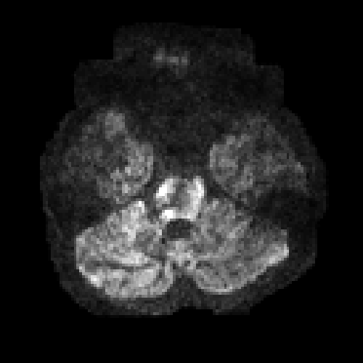
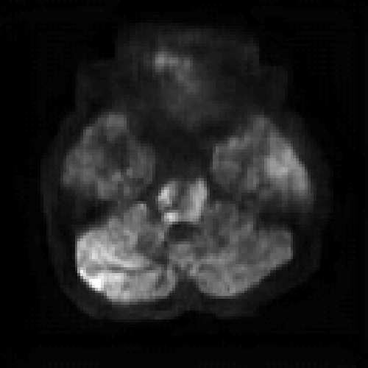
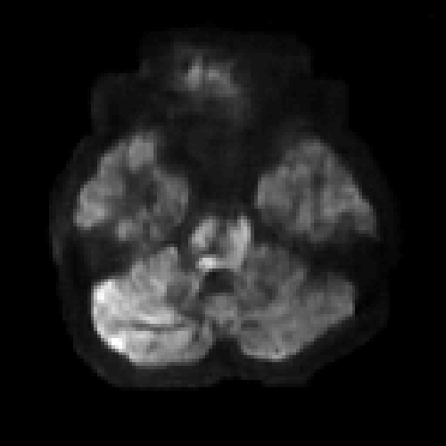
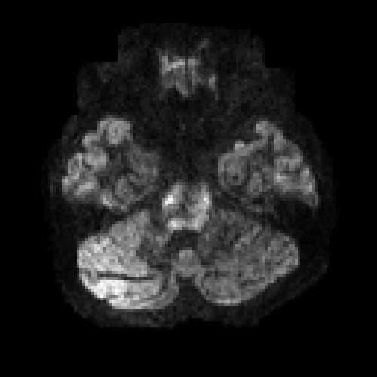
b =2000
1TX
ResNet-7Vol
ResNet-71Vol
pTX

Slide 14
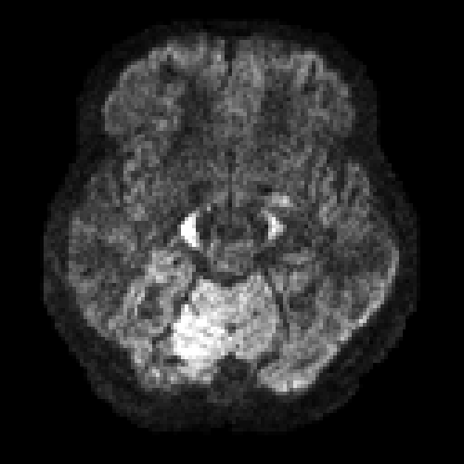
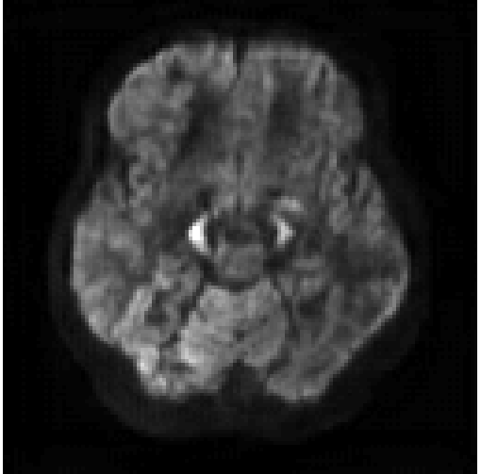
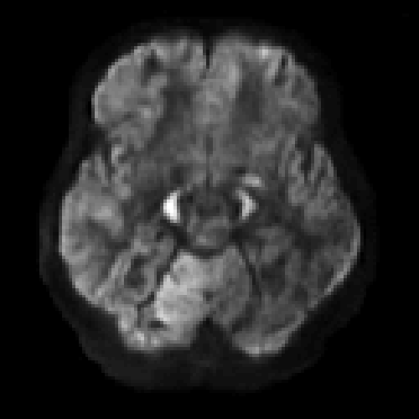
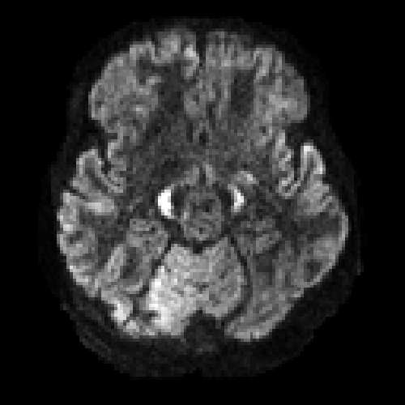
b =2000
71 volumes has shaper edges than 7 volumes for b2000
1TX
ResNet-7Vol
ResNet-71Vol
pTX

Slide 15
NN parameters
How many layers?
Kernel size? (3x3, 5x5, or 7x7)
Loss function (L1, L2, SSIM, Gradient, etc)
Mini-batch size, learning rate
Notes:
Cross-Validation

