Slide 1
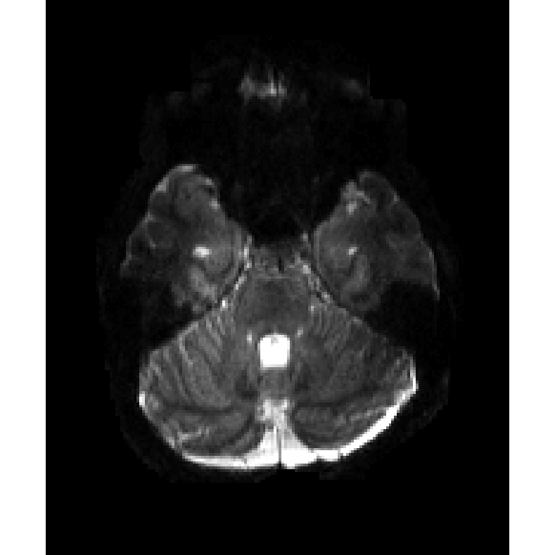
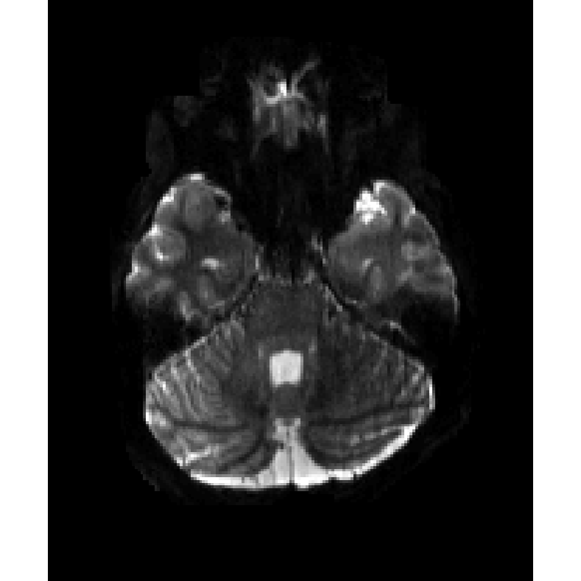
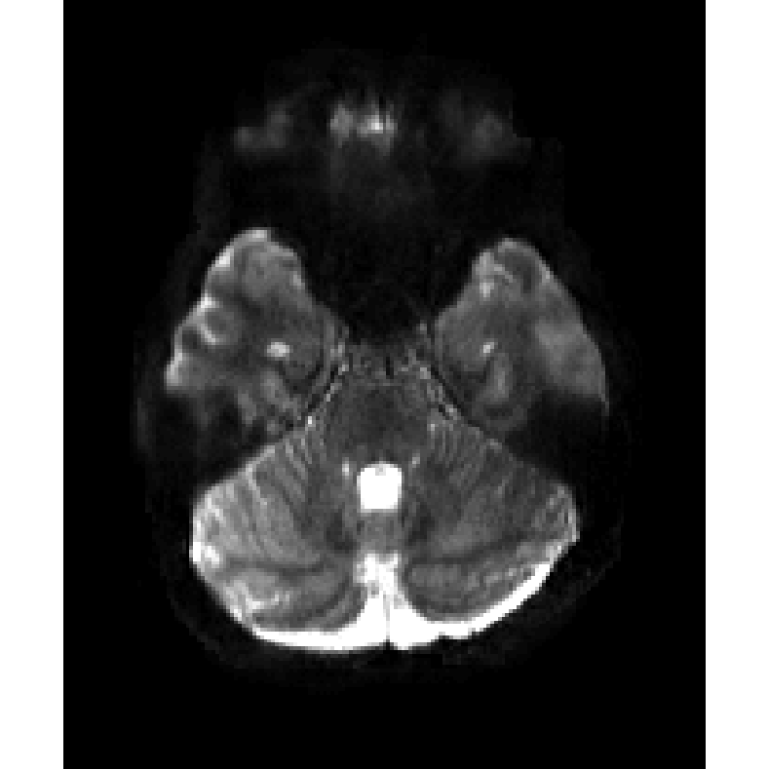
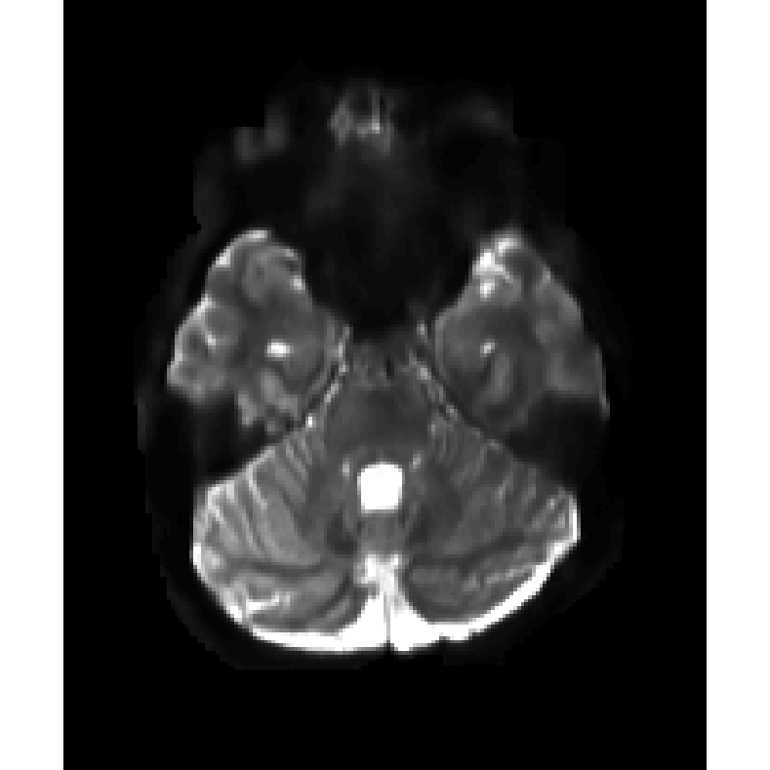
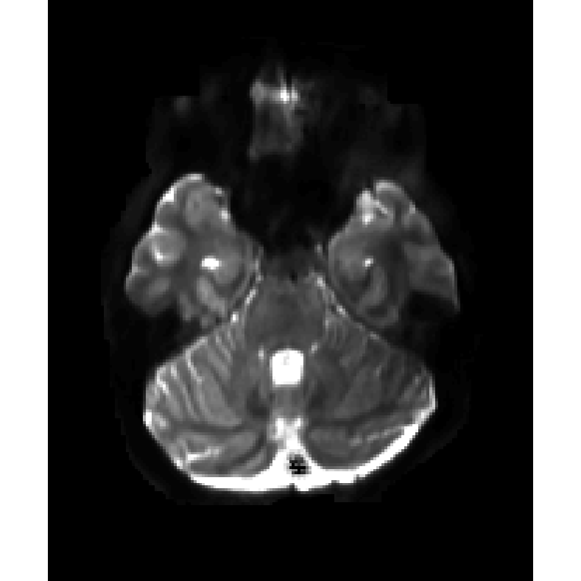
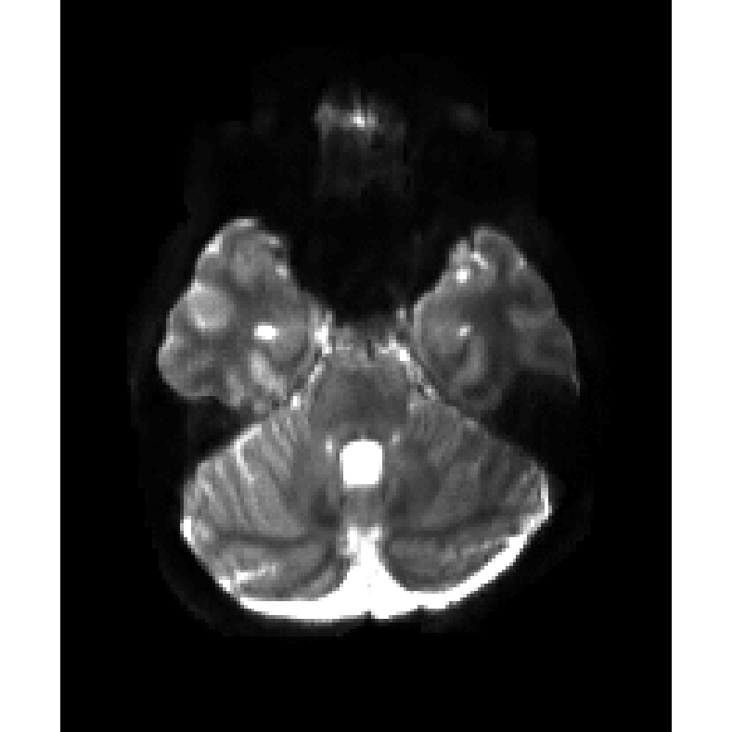
1TX
pTX
T1W, L1-res
ResNet
b=0
noT1W, L1
UNet
T1W, L1
UNet
T1W, L1-res
UNet

Slide 2
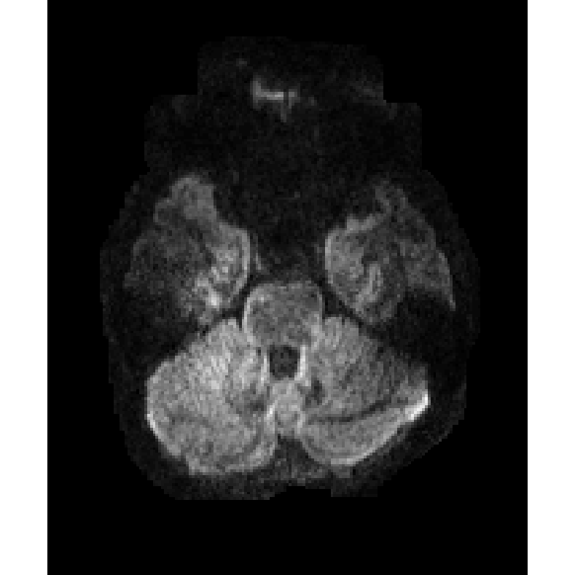
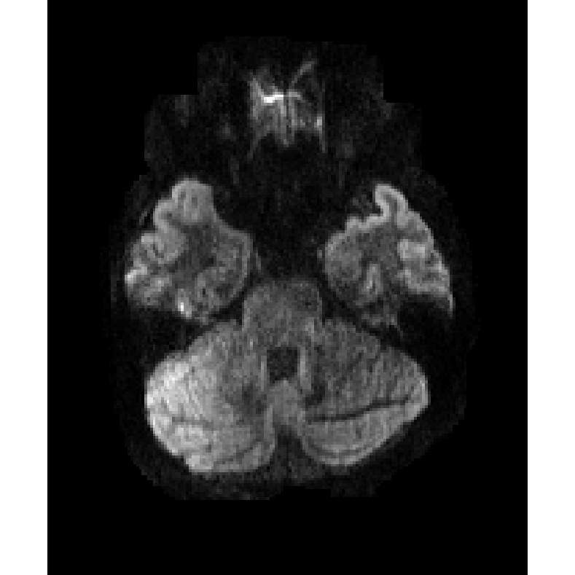
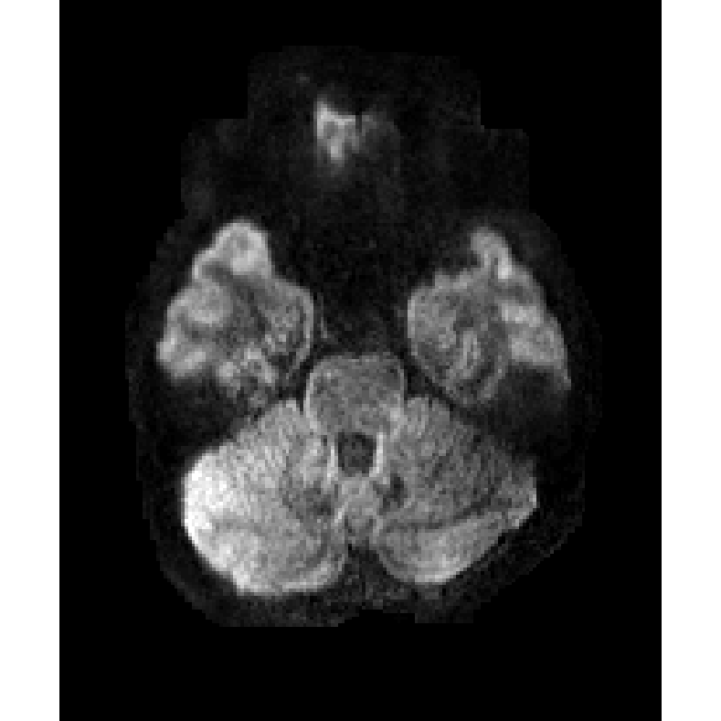
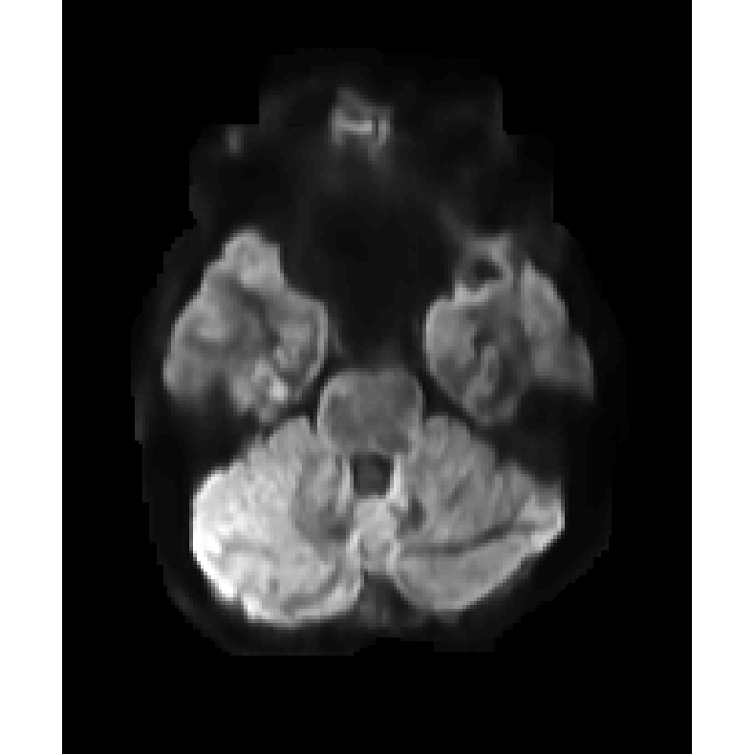
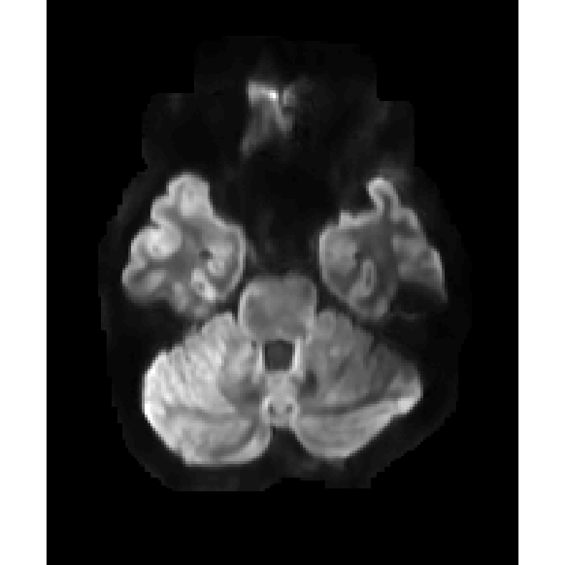
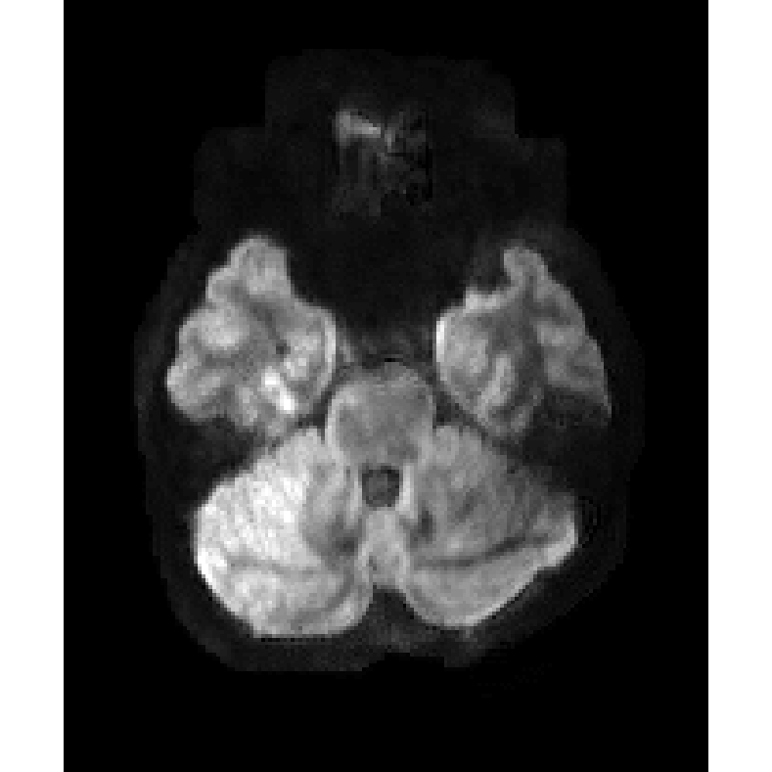
1TX
pTX
T1W, L1-res
ResNet
b=1000
noT1W, L1
UNet
T1W, L1
UNet
T1W, L1-res
UNet

Slide 3
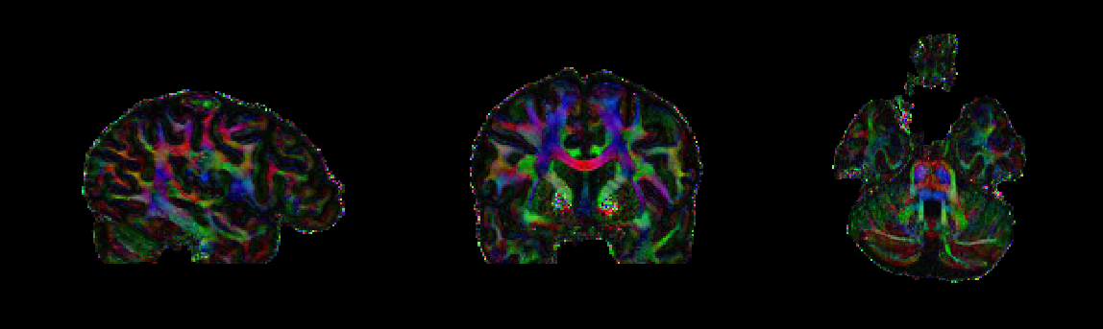

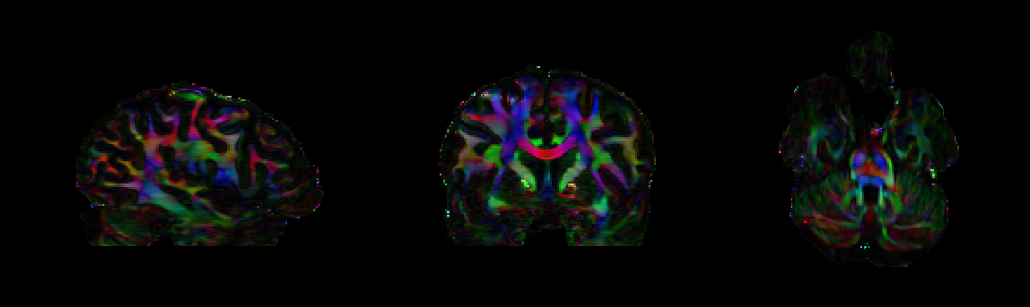
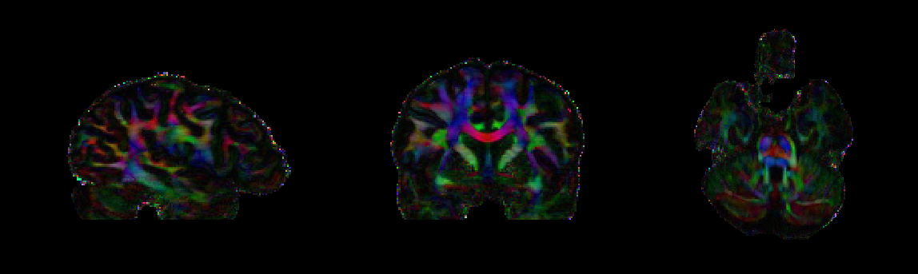
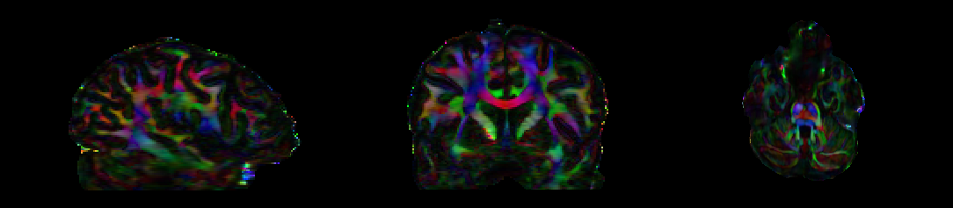
pTX
sTX
noT1W, L1
UNet
T1W, L1
UNet
T1W, L1-res
UNet
L1 Error
0.0030
0.0034
0.0048
DTI-SSE
0.793
0.847
0.196
0.148
0.353

Slide 4
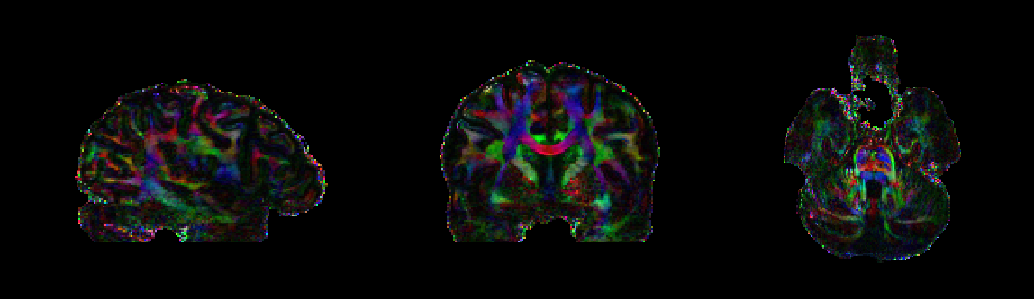
pTX
sTX
L1-res, T1W
ResNet
L1-res, T1W
UNet
L1 Error
0.0017
0.0048
DTI-SSE
0.793
0.847
0.915
0.353

Slide 5
pTX
sTX
L1-residual-T1W
ResNet
noT1W, L1
UNet
T1W, L1
UNet
T1W, L1-residual
UNet
L1 Error
0.0017
0.0030
0.0034
0.0048
DTI-SSE
0.793
0.847
0.915
0.196
0.148
0.353

Slide 6
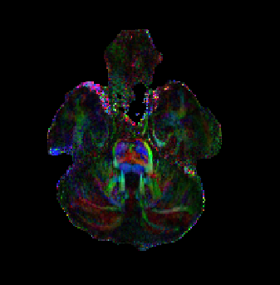
pTX
sTX
T1W, L1-residual
ResNet
noT1W, L1-residual
ResNet
noT1W, L1
UNet
T1W, L1
UNet
T1W, L1-residual
UNet

Slide 7
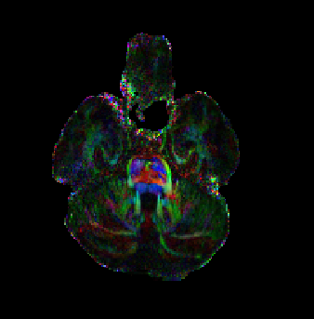
pTX
sTX
L1-residual-T1W
ResNet
noT1W, L1
UNet
T1W, L1
UNet
T1W, L1-residual
UNet

Slide 8
pTX
sTX
noT1W, L1
UNet

Slide 9
pTX
sTX
T1W, L1
UNet

Slide 10
pTX
sTX
T1W, L1-residual
UNet

Slide 11
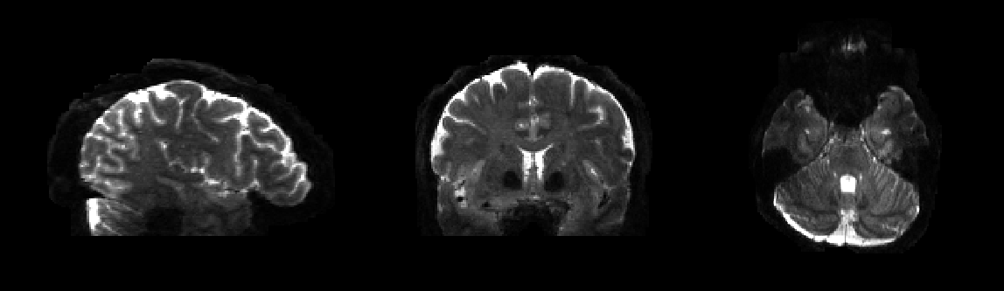
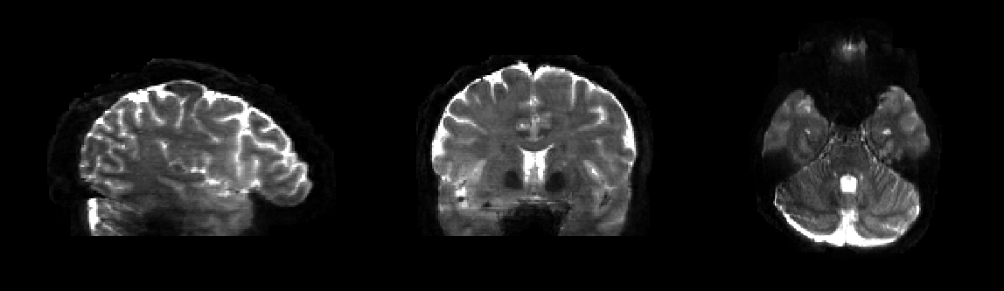
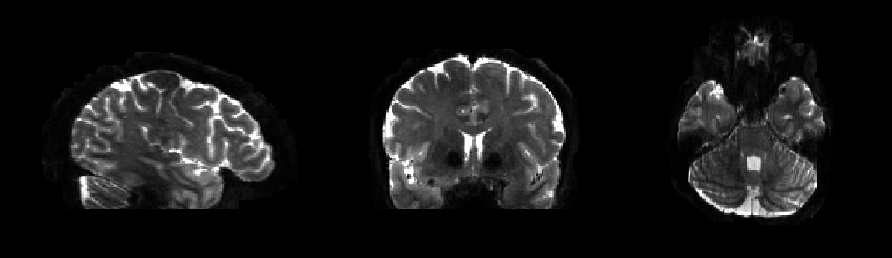
1TX
L1-residual-T1W
pTX

Slide 12
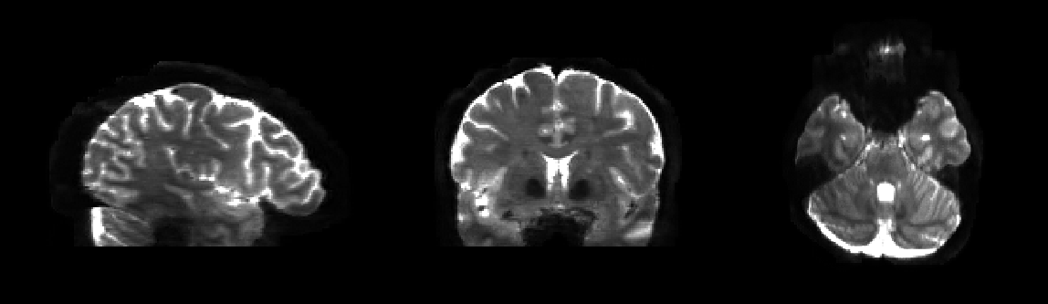
1TX
L1-residual-T1W, unet
pTX

Slide 13
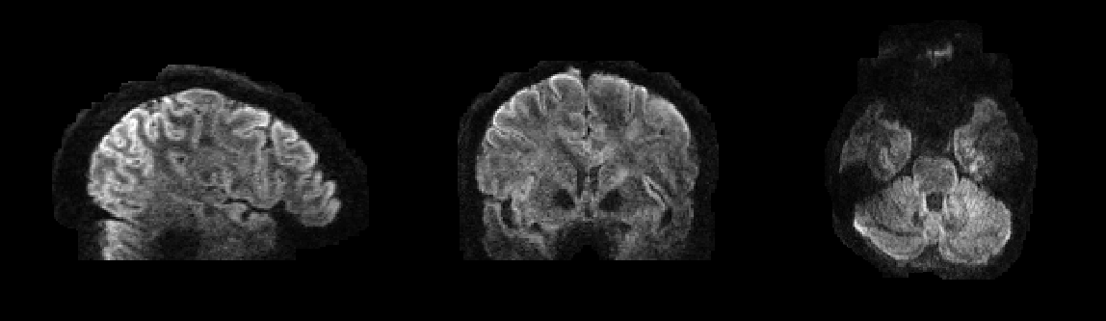
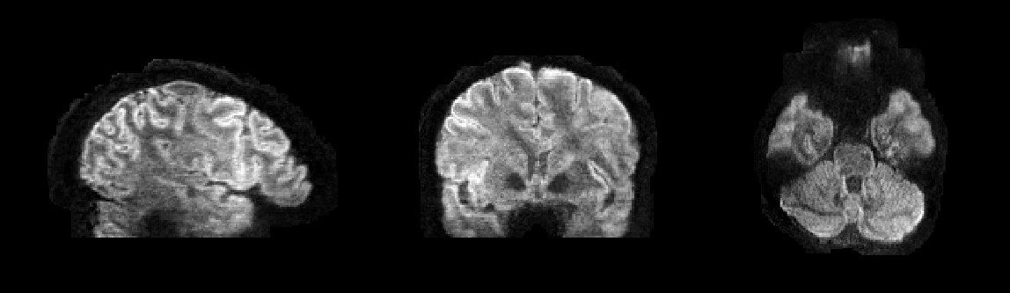
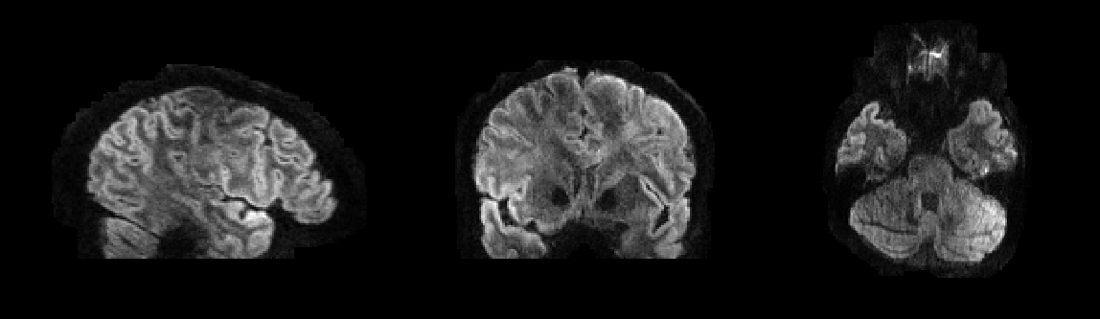
1TX
L1-residual-T1W, 224
pTX

Slide 14
1TX
L1-residual-T1W, 40 blocks, 224
pTX

Slide 15
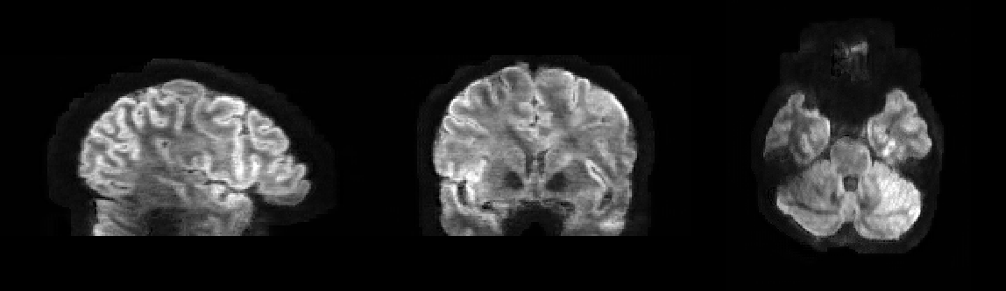
1TX
L1-residual-T1W, unet
pTX

Slide 16
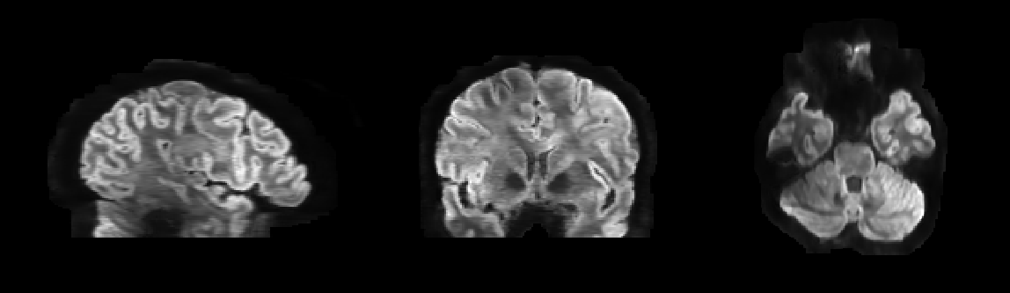
1TX
L1-T1W, unet
pTX

Slide 17
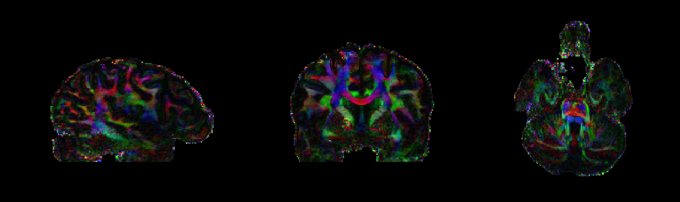
1TX
L1-ResIO-T1W, 224
pTX

Slide 18
1TX
L1-residual-T1W, 224
pTX

Slide 19
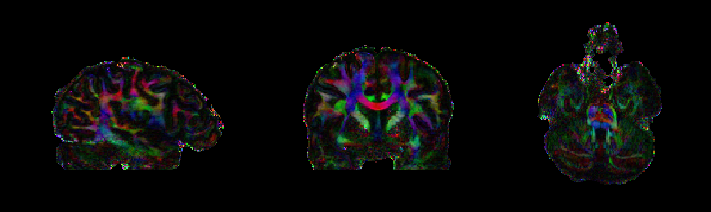
1TX
L1-residual-T1W, 40 blocks, 224
pTX

Slide 20
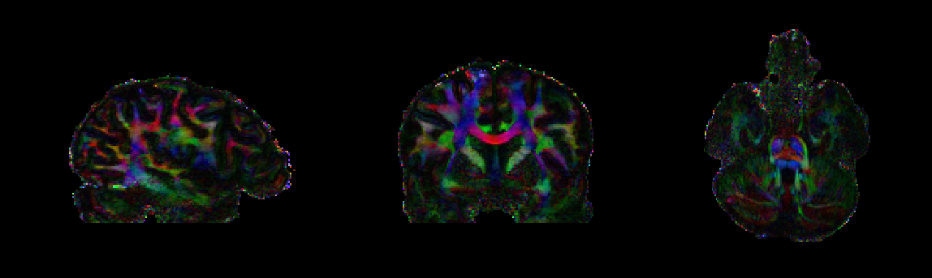
1TX
L1-residual-T1W, 80 blocks, 224
pTX

Slide 21
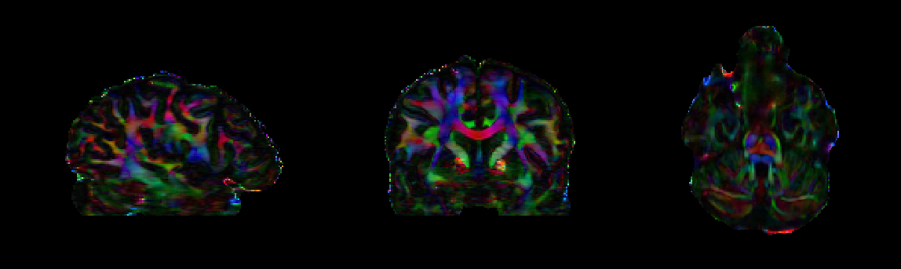
1TX
L1-noT1W, unet
pTX

Slide 22
1TX
L1-T1W, unet
pTX

Slide 23
1TX
L1-residual-T1W, unet
pTX

Slide 24
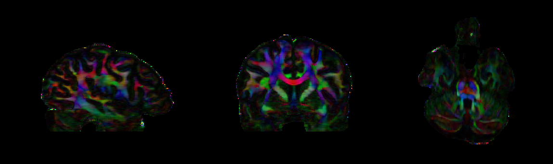
1TX
L2-T1W, unet
pTX

