Slide 1
My implementation at first
Revised implementation based on original ResNet paper
Revised implementation
+ End-to-end skip
7x7 conv, 64, /2
7x7 conv, 64, /2
7x7 conv, 64, /2
Input image (sTX)
Input image (sTX)
Input image (sTX)
BatchNorm
BatchNorm
BatchNorm
3x3 conv, 64
ReLU
3x3 conv, 64
ReLU
3x3 conv, 64
Pool, /2
ReLU
BatchNorm
BatchNorm
BatchNorm
Residual Block 1
ReLU
Residual Block 1
ReLU
Residual Block 1
ReLU
Pool, /2
Pool, /2
3x3 conv, 64
3x3 conv, 64
3x3 conv, 64
Residual Block 2
Residual Block 2
Residual Block 2
BatchNorm
BatchNorm
BatchNorm
ReLU
ReLU
Residual Block N
Residual Block N
Residual Block N
...
...
...
4x4 conv transp, 1
4x4 conv transp, 1
4x4 conv transp, 1
BatchNorm
BatchNorm
BatchNorm
ReLU
ReLU
Output image
Output image
My ResNet
Output image
Original ResNet

Slide 2
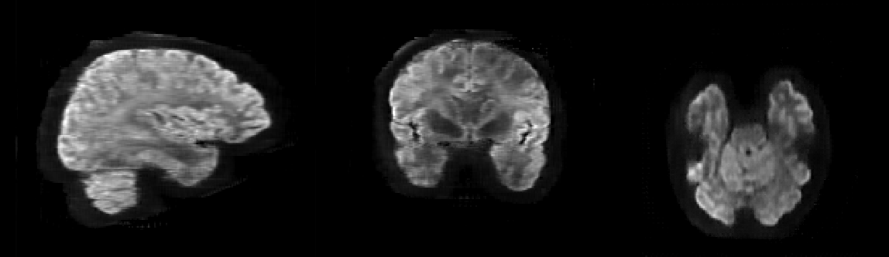
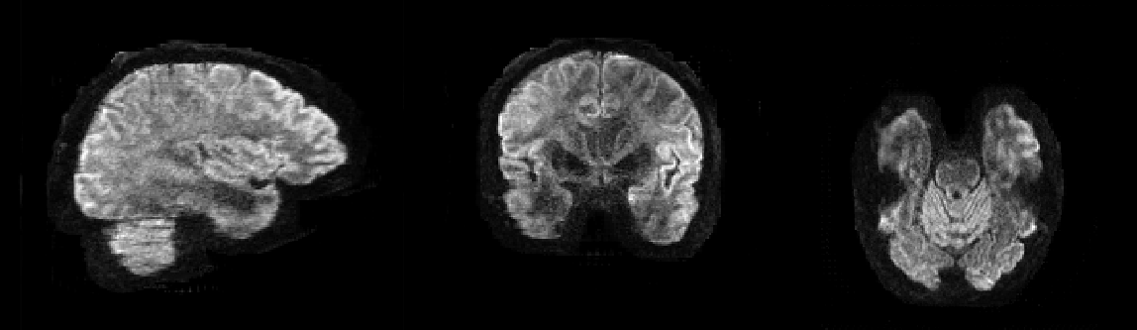
Orignal ResNet
Orignal ResNet with End-to-end skip

Slide 3
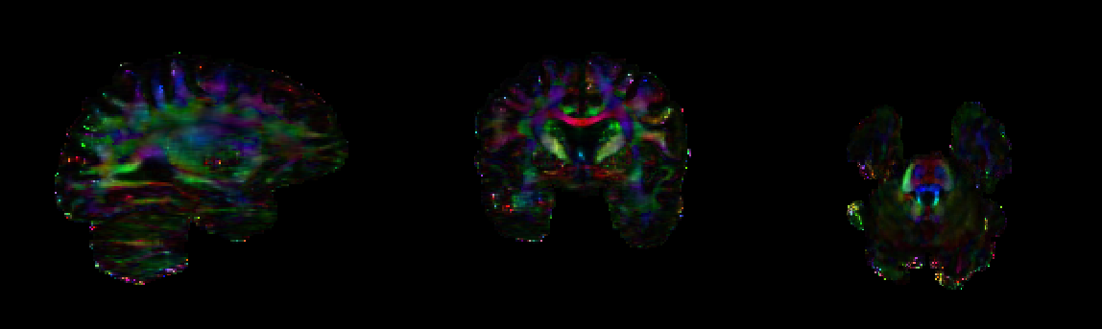
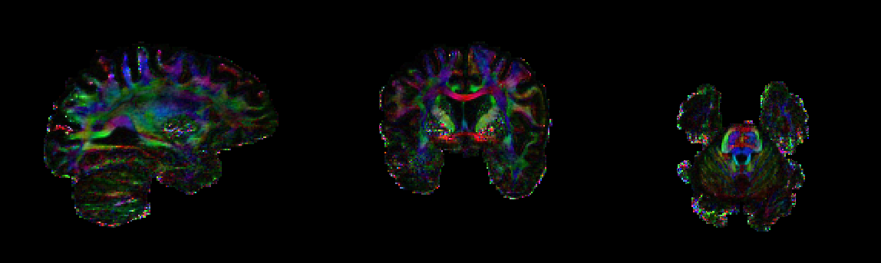
Orignal ResNet
Orignal ResNet with End-to-end skip

Slide 4
Revised implementation
+ End-to-end skip
full pre-activation
7x7 conv, 64, /2
7x7 conv, 64, /2
Input image (sTX)
Input image (sTX)
BatchNorm
BatchNorm
ReLU
3x3 conv, 64
ReLU
ReLU
BatchNorm
BatchNorm
Residual Block 1
ReLU
Residual Block 1
3x3 conv, 64
Pool, /2
Pool, /2
3x3 conv, 64
ReLU
Residual Block 2
Residual Block 2
BatchNorm
BatchNorm
ReLU
3x3 conv, 64
Residual Block N
Residual Block N
...
...
4x4 conv transp, 1
4x4 conv transp, 1
BatchNorm
BatchNorm
ReLU
ReLU
Output image
Original ResNet
Output image
Original ResNet Preact

Slide 5
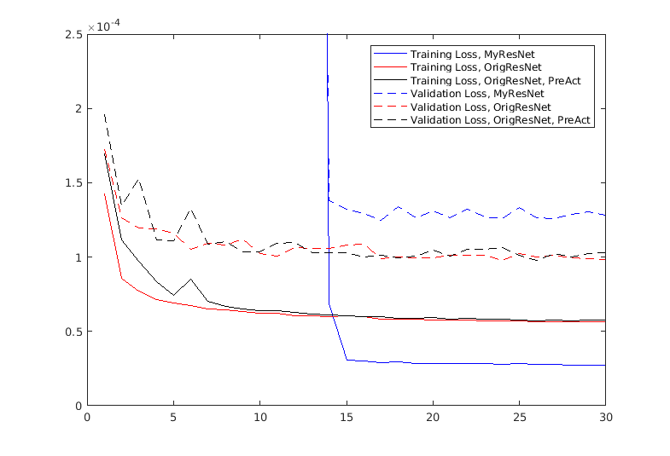
Comparison of different implementations
MSE
Epochs

Slide 6
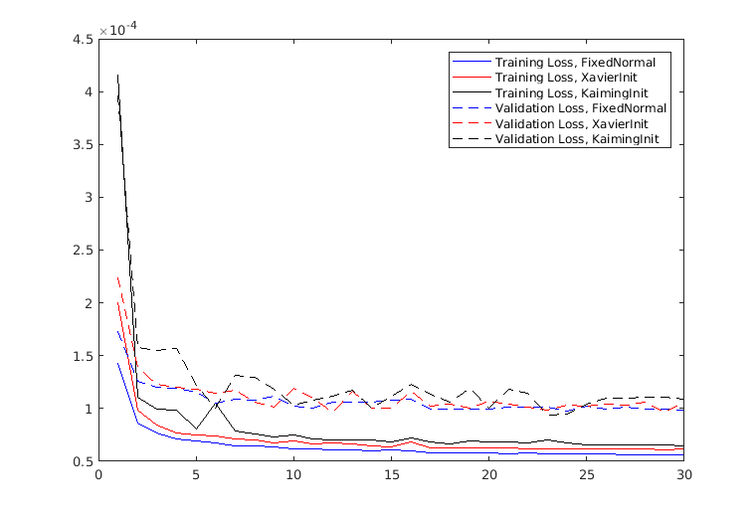
Initialization for Original ResNet (simple, 20-layer)
MSE
FixedNormal:
std = 0.02
Xavier init:
std = sqrt(2 / (n_in + n_out))
Kaiming init:
std = sqrt(2 / (n_in))
Epochs

Slide 7
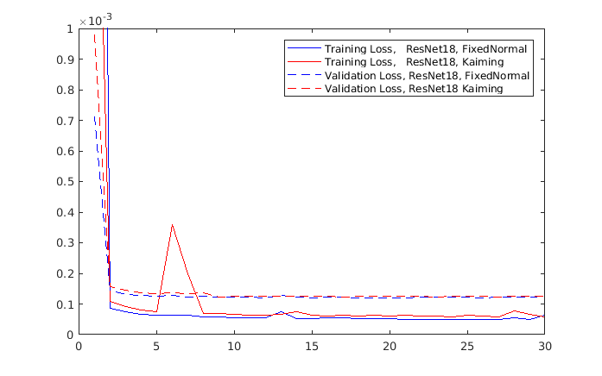
Initialization for ResNet18
MSE
FixedNormal:
std = 0.02
Xavier init:
std = sqrt(2 / (n_in + n_out))
Kaiming init:
std = sqrt(2 / (n_in))
Epochs

Slide 8
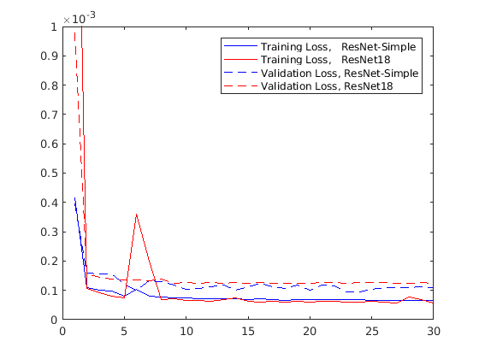
ResNet18 vs Simple
MSE
Number of weightings/biases
ResNet18: 11,568,515
ResNet-simple: 745,984
UNet: 32,425,729
Training time
ResNet18: ~8.3 hours
ResNet-simple: ~35 mins
Epochs

Slide 9
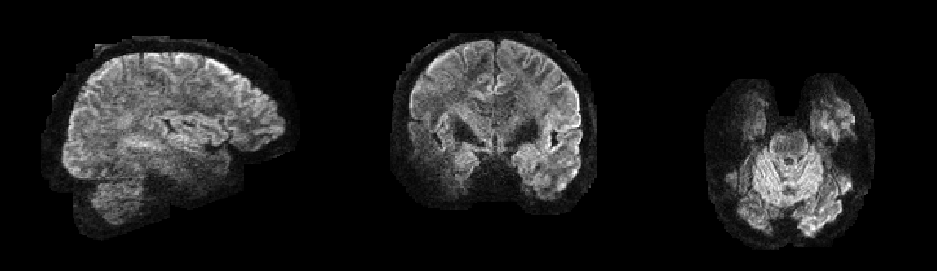
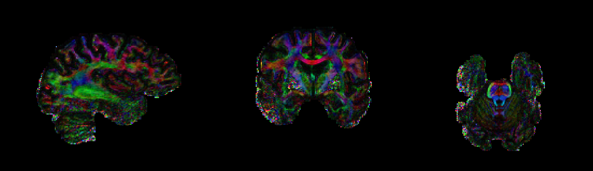
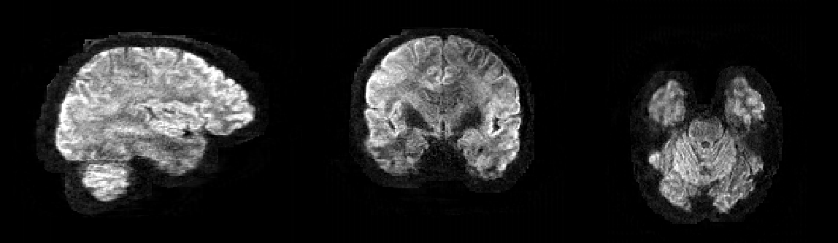
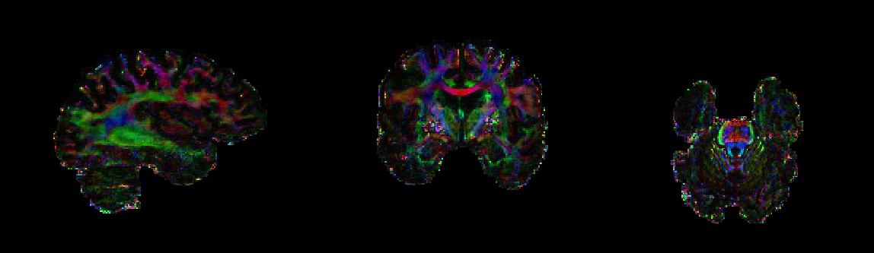
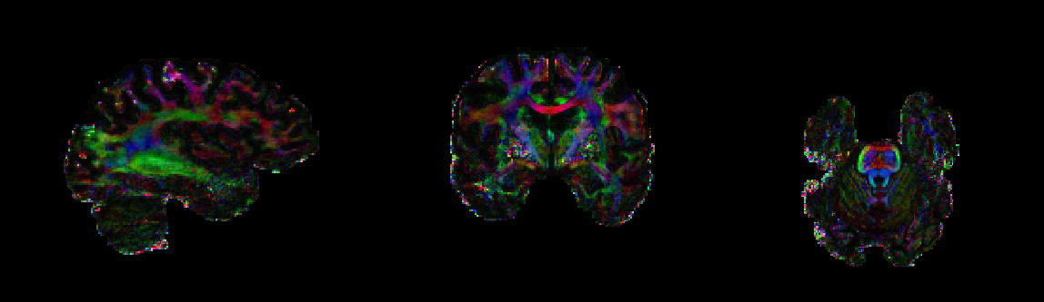
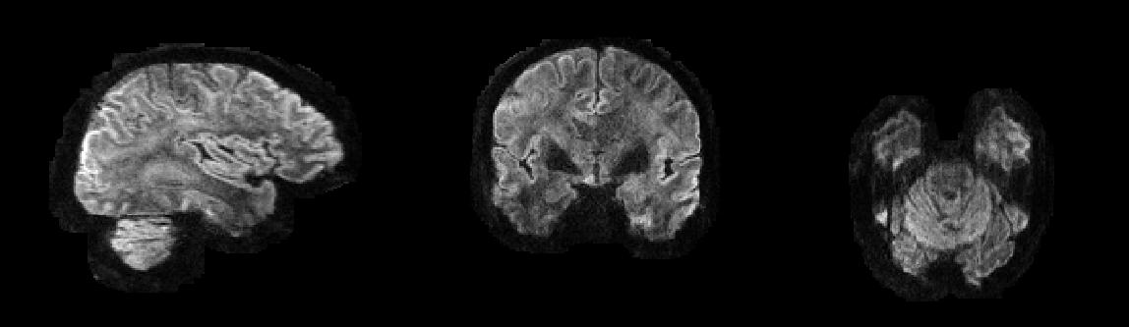
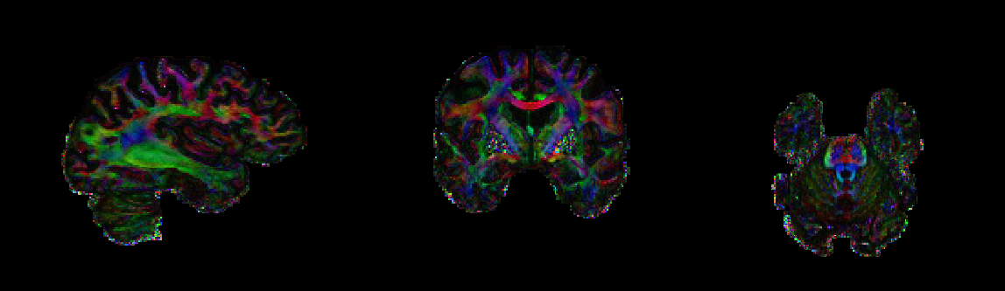
sTX
sTX
My ResNet
My ResNet
Original ResNet
Original ResNet
pTX
pTX

Slide 10
DTI metrics
 | RMSE – Images | RMSE - FA | RMSE - MD | RMSE - AD | RMSE - RD | SSE (no CSF)
sTX | 0.41 | 0.45 | 0.30 | 0.27 | 0.33 | 0.53
My ResNet | 0.29 | 0.48 | 0.41 | 0.38 | 0.44 | 0.44
Original ResNet | 0.30 | 0.45 | 0.31 | 0.28 | 0.33 | 0.32
pTX | - | - | - | - | - | 0.40

