Slide 1
ResNet (baseline)
7x7 conv, 64
Input images (sTx + T1W)
BatchNorm
Pre-activated ^{[1]}
No pooling
No global skip connection
Kaiming initialization ^{[2]}
Residual Block 1
ReLU
Residual Block 2
3x3 conv, 64
BatchNorm
ReLU
Residual Block N
...
3x3 conv, 64
1x1 conv, 1
Output image
Residual Block
[1] He, K. (2014). Delving Deep into Rectifiers: Surpassing Human-Level Performance on ImageNet Classification.
[2] He, K., Zhang, X., Ren, S., & Sun, J. (2016). Identity Mappings in Deep Residual Networks.

Slide 2
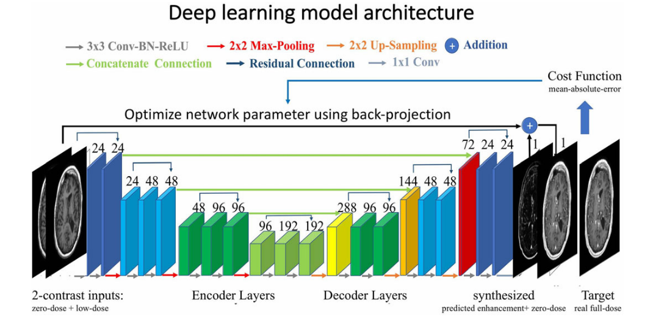
Unet (encoder-decoder)
Tunable hyperparameters: initial channels, pooling layers, dropout
[1] Zbontar, J., Knoll, et al. (2018). fastMRI: An open dataset and benchmarks for accelerated MRI. ArXiv, 1–35.
[2] Gong, E., et al. (2018). Deep learning enables reduced gadolinium dose for contrast-enhanced brain MRI. JMRI, 48(2), 330–340.

Slide 3
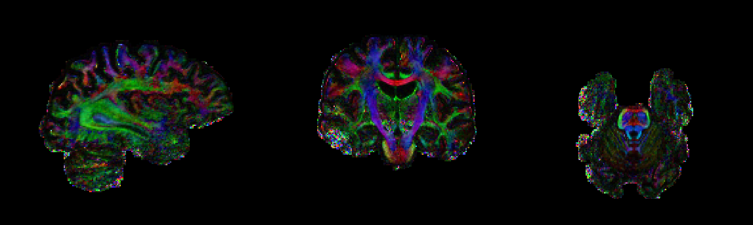
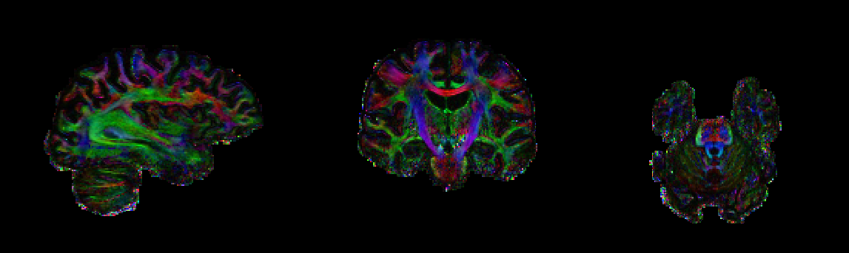
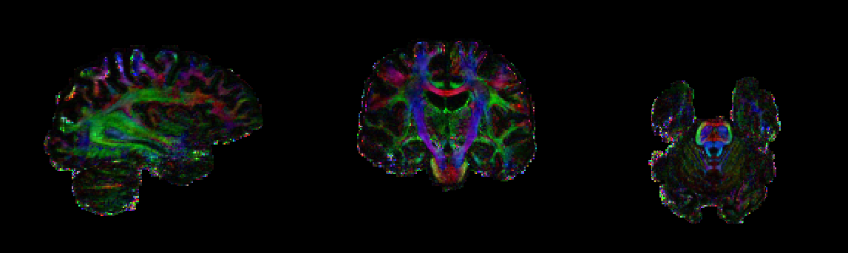
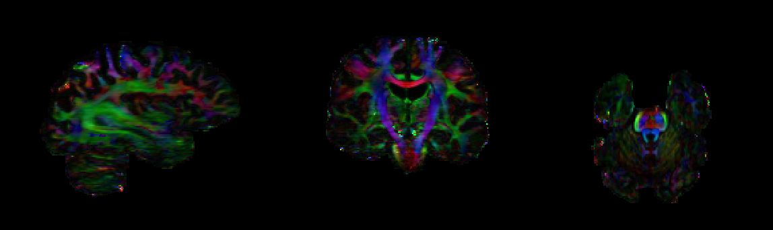
sTX
pTX
ResNet (ISMRM)
Unet-3pool

Slide 4
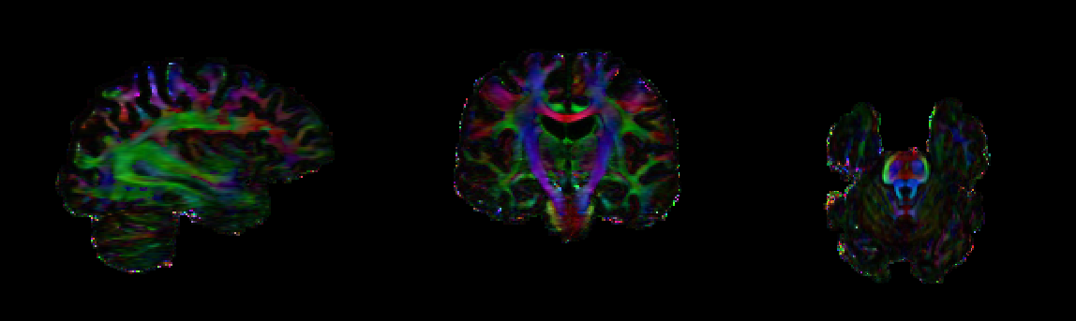
sTX
pTX
Unet-3pool
Unet-3pool
+ global skip

Slide 5
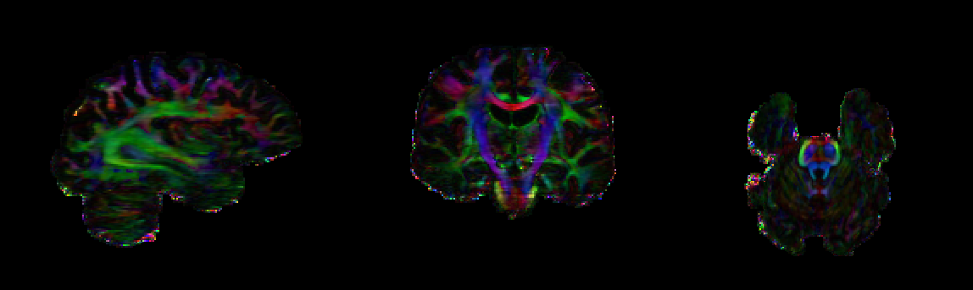
sTX
pTX
Unet-3pool
+ global skip
Unet-2pool
+ global skip

Slide 6
Loss (MSE)
 | ResNet (ISMRM) | UNet-3pool | UNet-3pool + Global skip | UNet-2pool + Global skip
Loss - train | 4.38e-5 | 2.06e-5 | 1.84e-5 | 2.77e-5
Loss - valid | 1.12e-4 | 1.17e-4 | 1.21e-4 | 1.09e-4

Slide 7
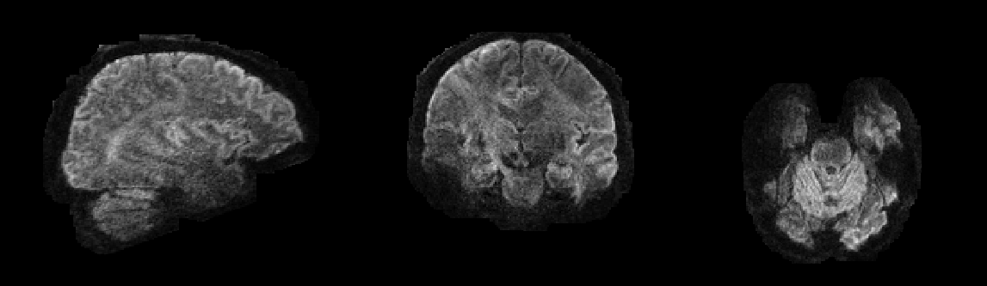
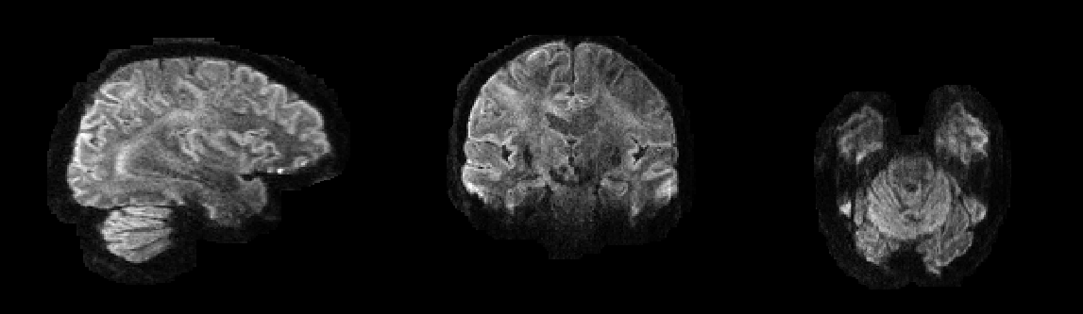
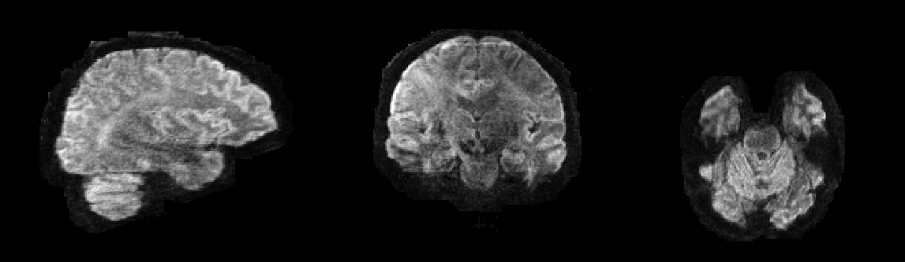
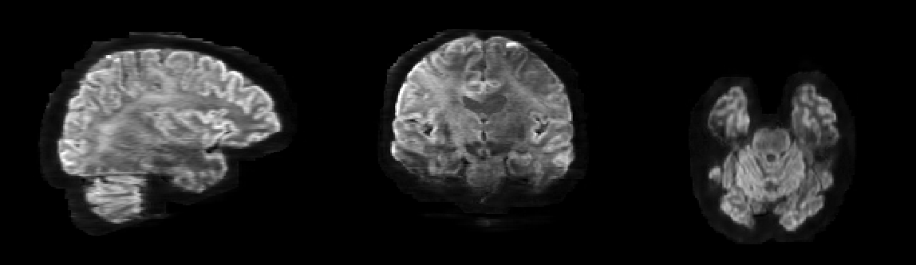
sTX
pTX
ResNet (ISMRM)
Unet-3pool

Slide 8
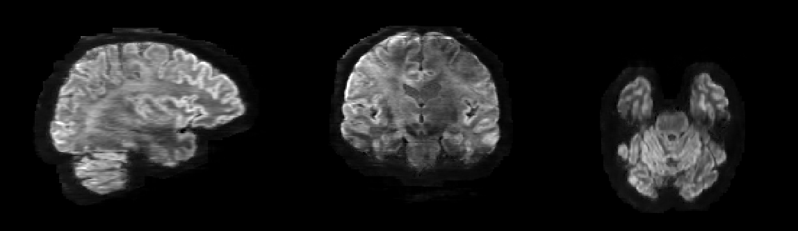
sTX
pTX
Unet-3pool
Unet-3pool
+ global skip

Slide 9

pTX
pTX
Unet-3pool
+ global skip
Unet-2pool
+ global skip

Slide 10
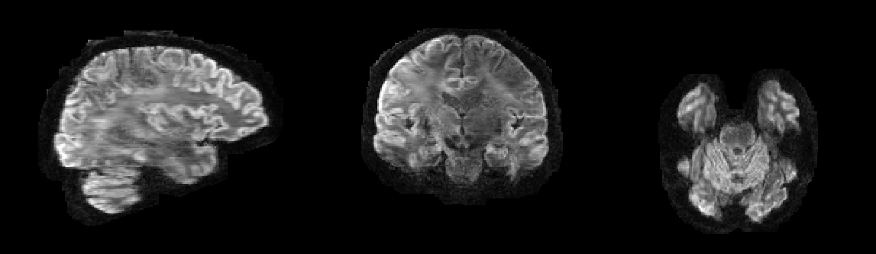
sTX
pTX
Orignal ResNet
ResNet without pooling

Slide 11
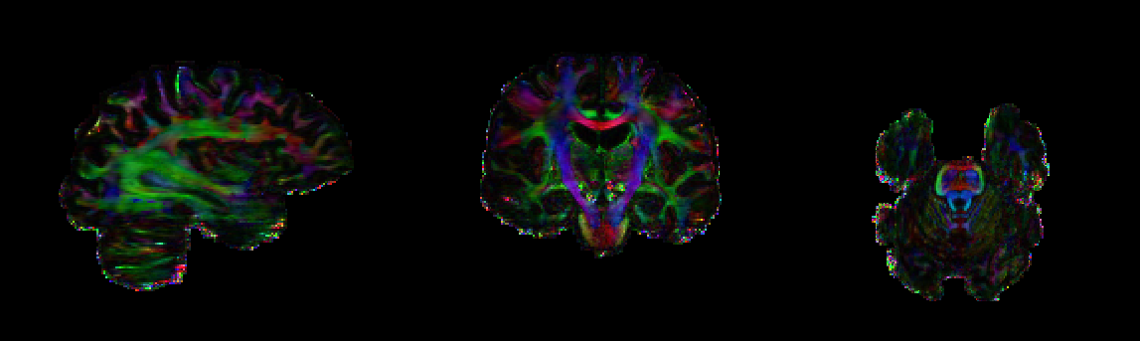
sTX
pTX
Orignal ResNet
ResNet without pooling

Slide 14
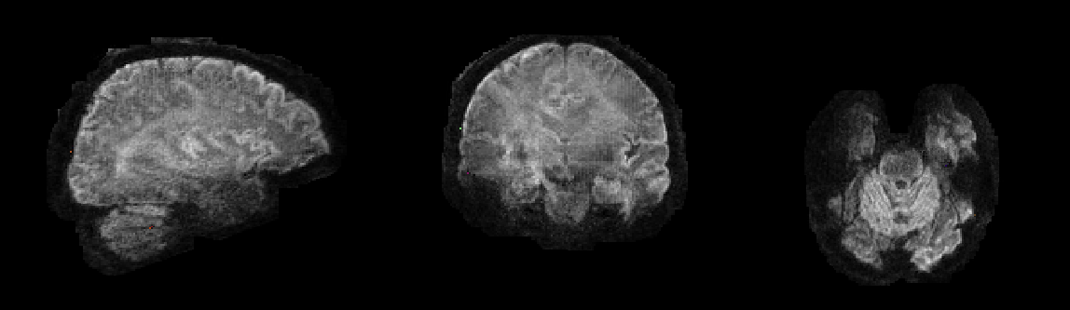
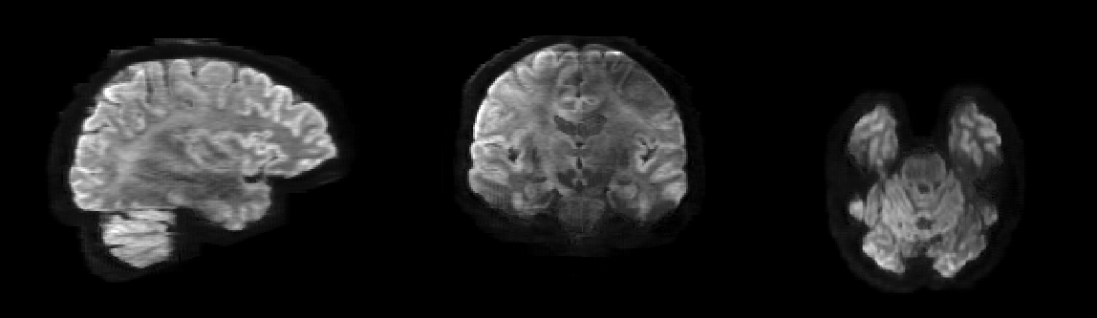
sTX
pTX
Unet-3pool
Unet-3pool
+T1W

Slide 15
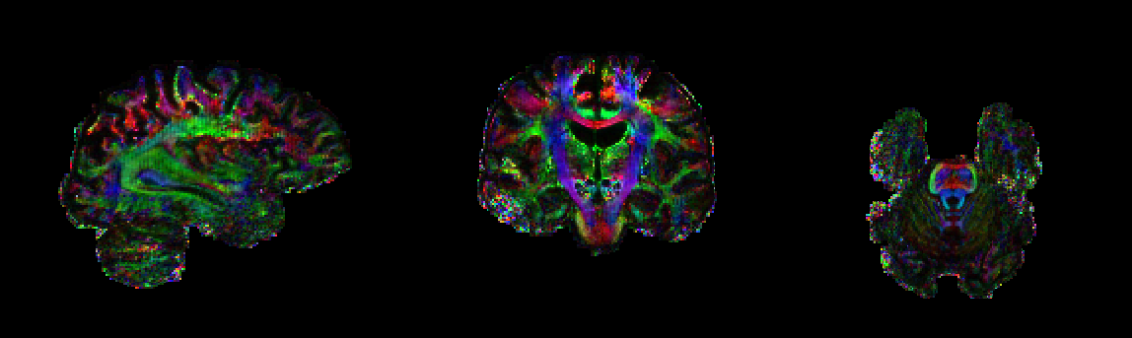
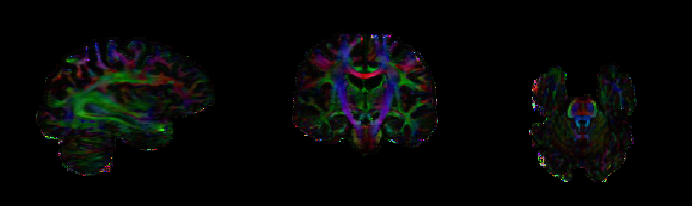
sTX
pTX
Unet-3pool
Unet-3pool
+T1W

Slide 16
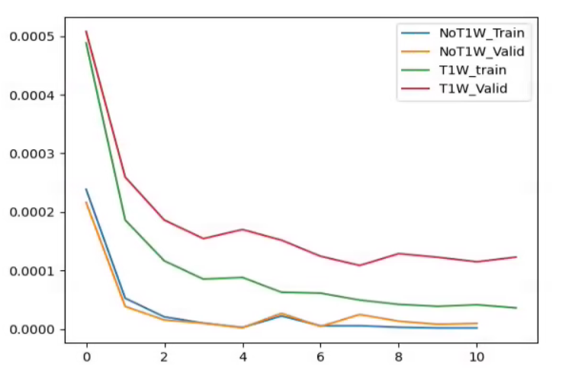
Train/valid MSE loss

Slide 17
DeepPTx development pipeline
Baseline model
Encoder-decoder CNN without T1W
Manually hyper-parameter tuning
NN structure modification (global skip, T1W)
Automatic hyper-parameter tuning
Nested CV with random search
Performance Metrics
RMSE, SSE
Early stopping
Qualitative
Quantitative:
MSE,MAE,SSIM
Images, FA, V1
Regularization
Collecting more data
Notes:
Training/test MSE<8e-5

Slide 18
Manual hyperparameter tuning
Encoder-decoder
-> Encoder-decoder + Res
-> Encoder-decoder + Res +T1W

Slide 20


sTX
pTX
Encoder-Decoder
Encoder-Decoder
+Global skip

Slide 21
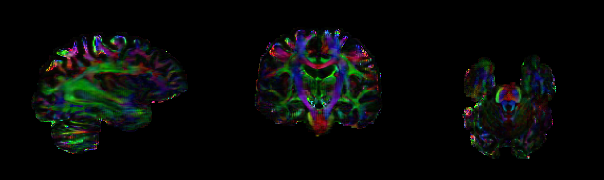
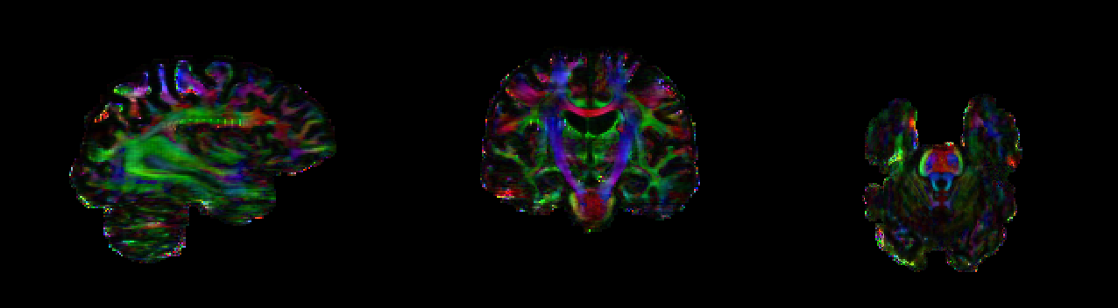
sTX
pTX
Encoder-Decoder
Encoder-Decoder
+Global skip

Slide 22
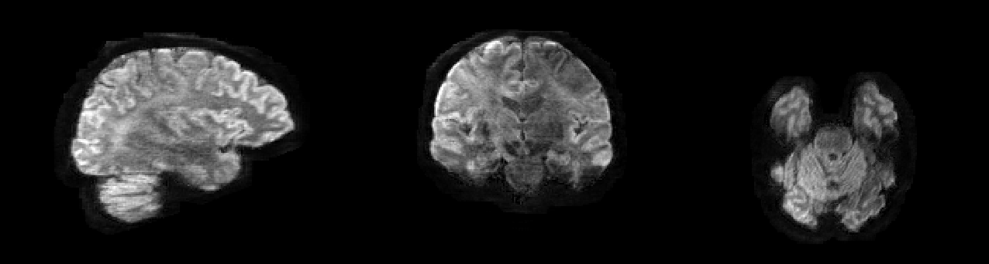
sTX
pTX
Encoder-Decoder
+Global skip
Encoder-Decoder
+Global skip
+T1W

Slide 23
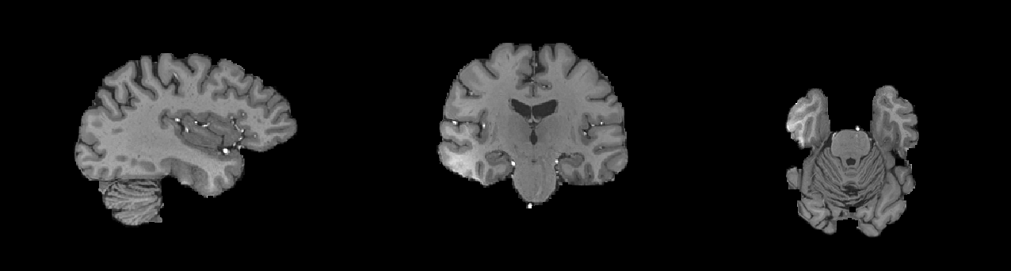
sTX
pTX
Encoder-Decoder
+Global skip
Encoder-Decoder
+Global skip
+T1W

Slide 24
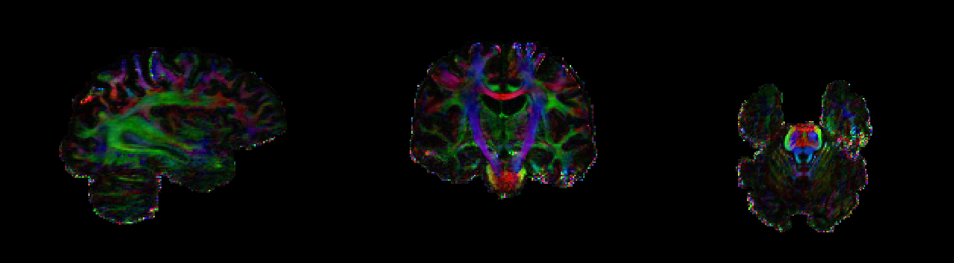
sTX
pTX
Encoder-Decoder
+Global skip
Encoder-Decoder
+Global skip
+T1W

Slide 25
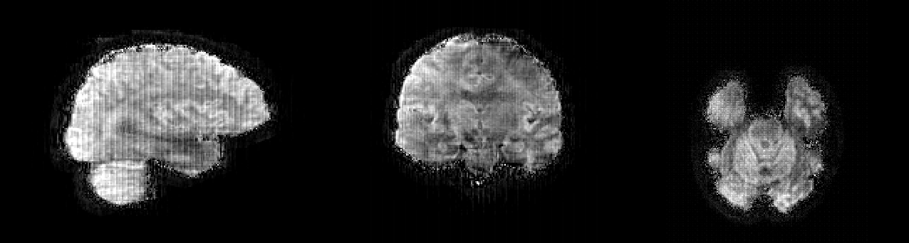
sTX
pTX
Encoder-Decoder
+Global skip
+T1W
Encoder-Decoder
+Global skip +Res
+T1W

Slide 26
sTX
pTX
Encoder-Decoder
+Global skip
+T1W
Encoder-Decoder
+Global skip +Res
+T1W

Slide 27
sTX
pTX
ResNet (ISMRM)
Encoder-Decoder
+Global skip
+T1W

Slide 28
sTX
pTX
ResNet (ISMRM)
Encoder-Decoder
+Global skip
+T1W

Slide 29
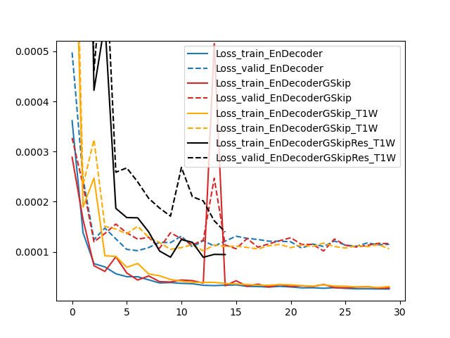
Loss

