Slide 1
7x7 conv, 64, /2
Input images (sTx + T1W)
BatchNorm
Fig. 1. The structure of our deep residual neural network. Our neural network comprised a number of residual blocks (each with two 3×3 convolutional layers), taking single-transmit (sTx) diffusion and T1-weighted MPRAGE images as input and spitting out the parallel-transmit (pTx) version of diffusion images. The loss function was formed to measure the mean squared error (MSE) between the predicted pTx and acquired pTx diffusion images and the minimization was performed using a stochastic gradient descend algorithm. The neural network was trained and evaluated on data of 5 healthy subjects.
3x3 conv, 64
ReLU
BatchNorm
ReLU
Residual Block 1
Pool, /2
3x3 conv, 64
Residual Block 2
BatchNorm
ReLU
Residual Block N
...
4x4 conv transp, 1
BatchNorm
Residual Block
ReLU
Output image

Slide 2
Outer loop
Inner loop
Test
Train + Valid
Train
Valid
k=1
l=1
k=2
l=2
…
…
…
…
k=K
l=L
Test
Retrain model
on Train + Valid
Random search in
hyperparameter space
Retrain final model on Train + Valid + Test
Model evaluation
using regular CV
Fig. 2. The diagram of model selection and evaluation. For model selection, a 5-fold (3/1/1 for Train/Valid/Test, each fold comprising data of a single subject) nested cross-validation (CV) was used. Hyperparameter tuning was conducted in the inner loop by training the model on Train and selecting the hyperparameter set with the minimum validation loss. In the outer loop, the model with tuned hyperparameters was trained on both Train and Valid and the hyperparameter set with the minimum testing loss was selected for the final model. The evaluation of the final model was estimated using a regular 5-fold (4/1 for training/testing) CV.

Slide 3






sTx
ResNet
pTx
Fig. 3. Example b0 and b1000 diffusion images (one diffusion direction) for single transmission (sTx) vs deep learned pTx (ResNet) in reference to acquired pTx images. Shown is a representative axial slice in lower brain from one subject, in which case the model with tuned hyperparameters was trained on data of the other 4 subjects. Note that the use of ResNet substantially improved the image quality by effectively recovering the signal dropout observed in the lower temporal lobe (as marked by the yellow arrowheads), and producing images that were comparable to those obtained with pTx.
b=0
b=1000

Slide 4
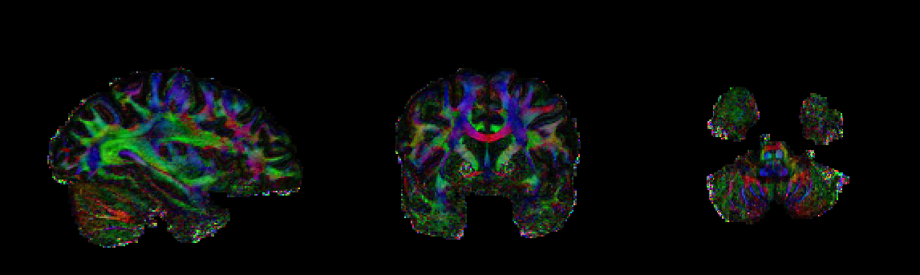
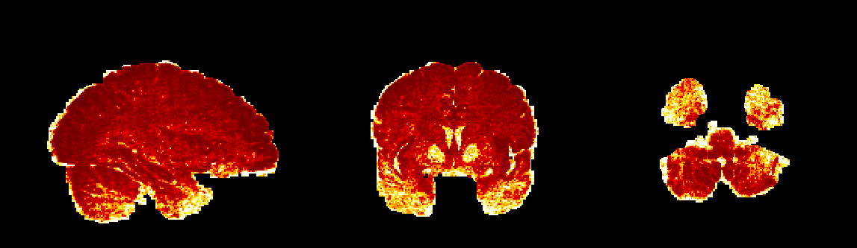
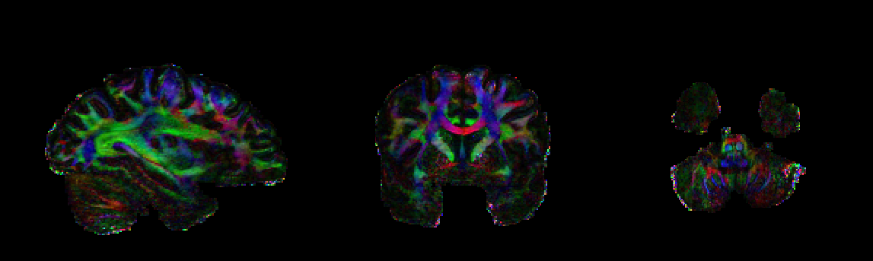
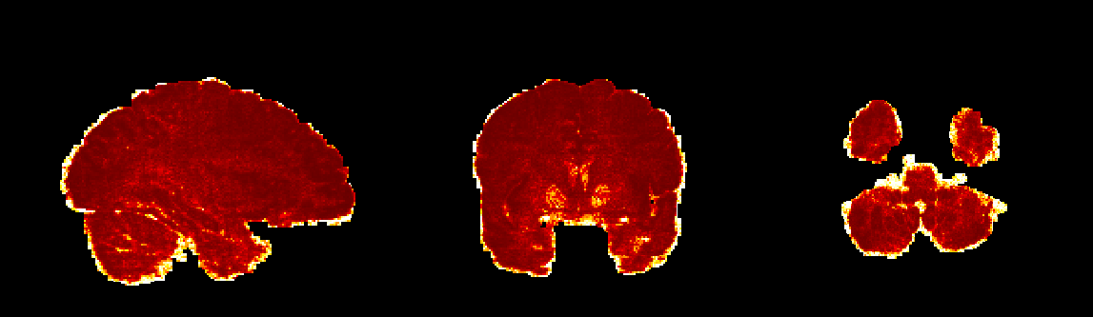
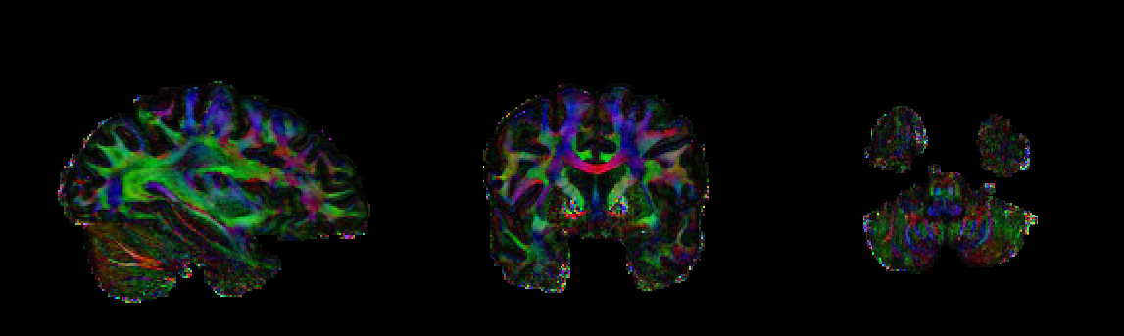
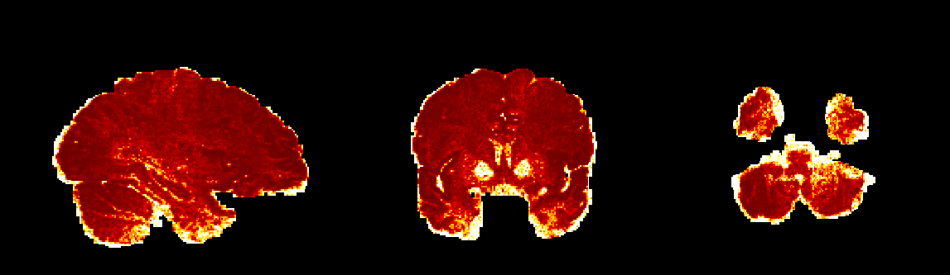
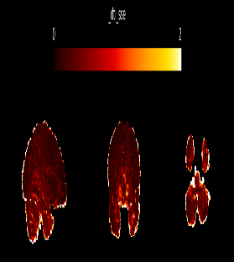
Color-coded FA map
SSE map
sTx
ResNet
pTx
2
0
Fig.4. Example color-coded fractional anisotropy (FA) maps and sum of square error (SSE) maps of DTI fitting for single transmission (sTx) vs deep learned pTx (ResNet) in reference to those of pTx. Shown are representative sagittal, coronal and axial views from one subject, in which case the model with tuned hyperparameters was trained on data of the other 4 subjects. Note that the use of ResNet improved DTI fitting by producing color-coded FA maps that were similar to those obtained with pTx, and reducing SSE in the lower temporal lobe (as marked by the yellow arrowheads).

Slide 5
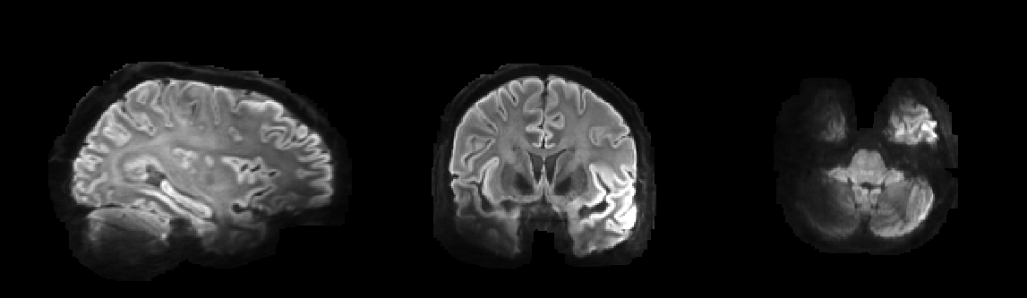
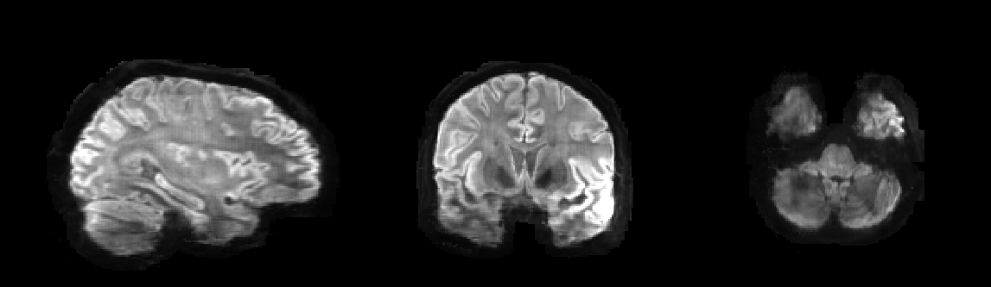
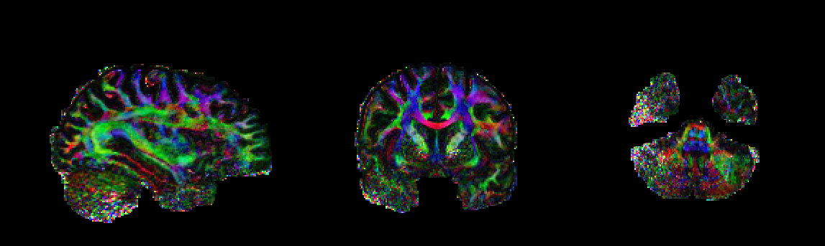
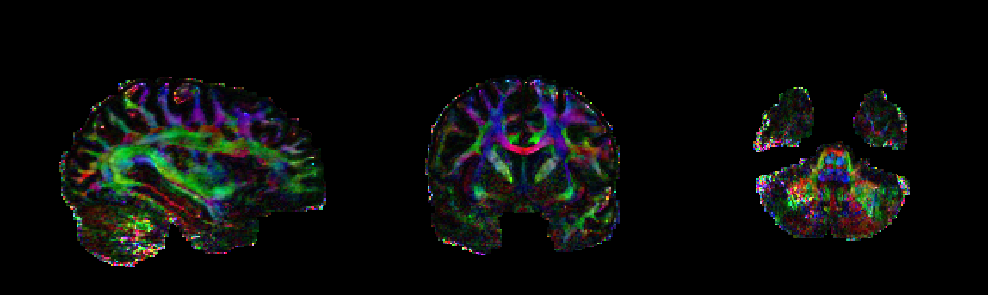
Fig.5. The result of testing our model on a new subject from HCP database (No. 102311). The mean DWI images (b=1000) and color coded FA maps in the sagittal, coronal and axial views are shown. Compared with the sTX images (i.e., input of ResNet), the output of ResNet can recover the signal drop on the mean DWI images (e.g, in the temporal lobe and cerebellum marked by the yellow arrowheads), and improve the color-coded FA maps by reducing the noise level.
sTx
ResNet
sTx
ResNet

