Slide 1
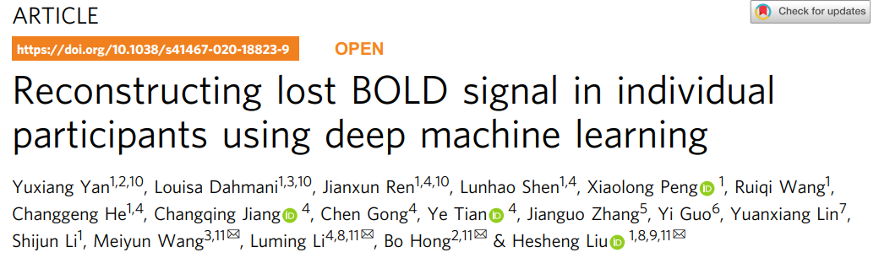

Slide 2
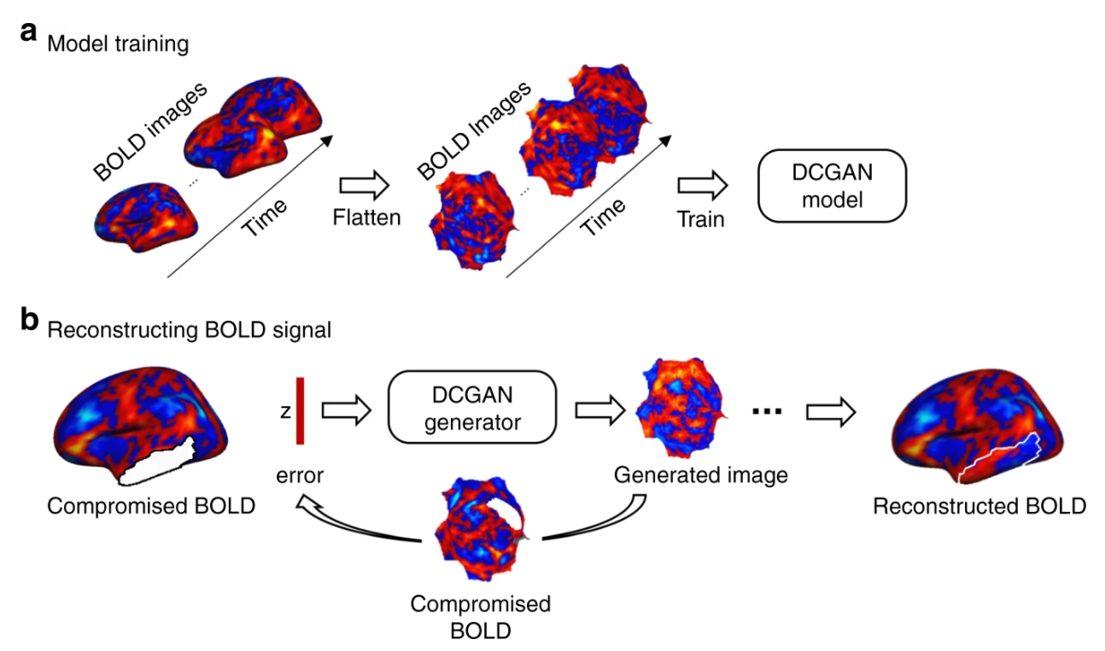
Model training and signal reconstruction
Generator and discriminator are 4-layer CNN

Slide 3
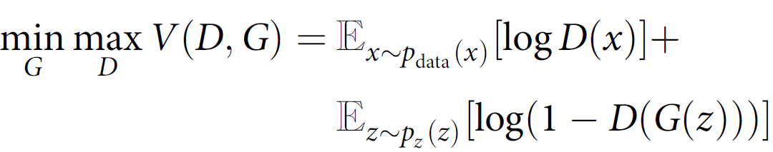
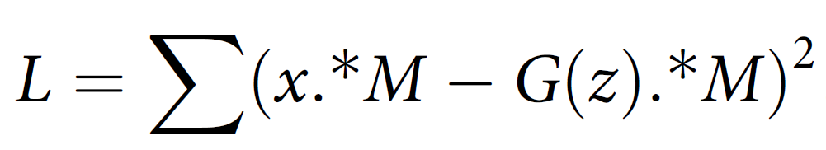
Model training and signal reconstruction
Step 1: Training
Flatten original images and input into generator
Generator samples data x, produces parameters, maps parameters onto a random vector z (sampled from latent space Z) and creates artificial images G(z)
Optimize generator and discriminator simultaneously
Step 2: Creating compromised BOLD frames
Step 3: Reconstruction
Flatten compromised images
Optimize z using gradient descent

Slide 4
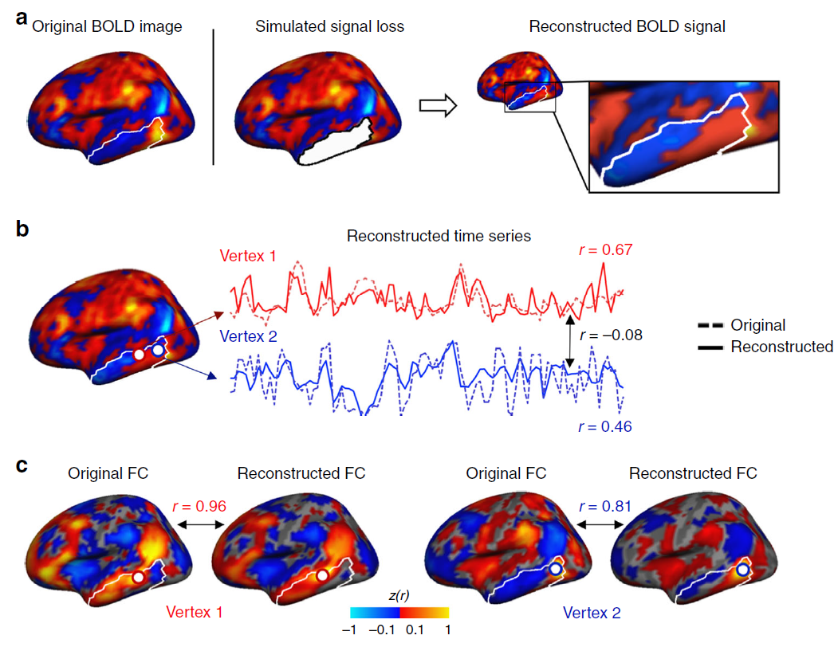
Results
Correlation between
reconstructed signal and
original signal

Slide 5
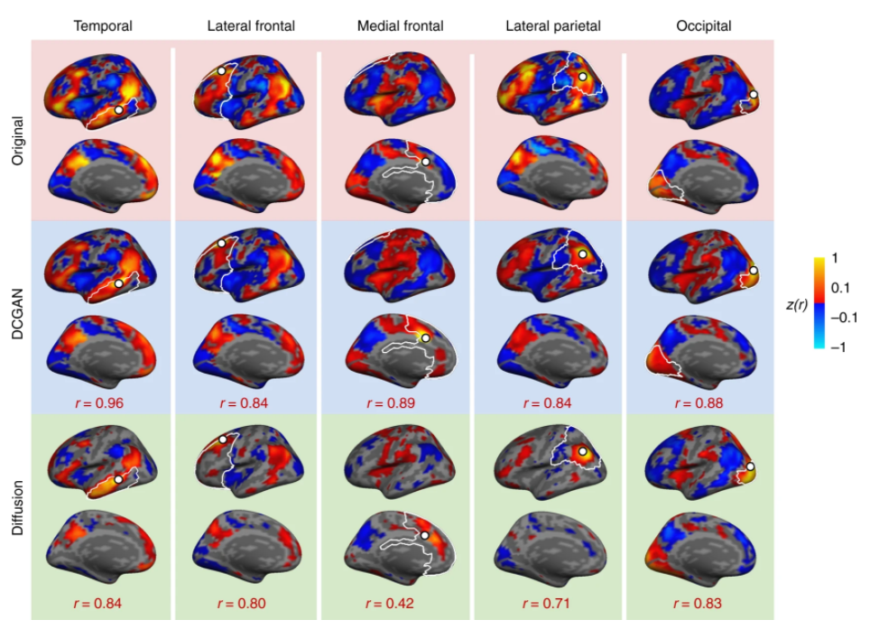
Results
Correlation between
reconstructed signal and
original signal

Slide 6
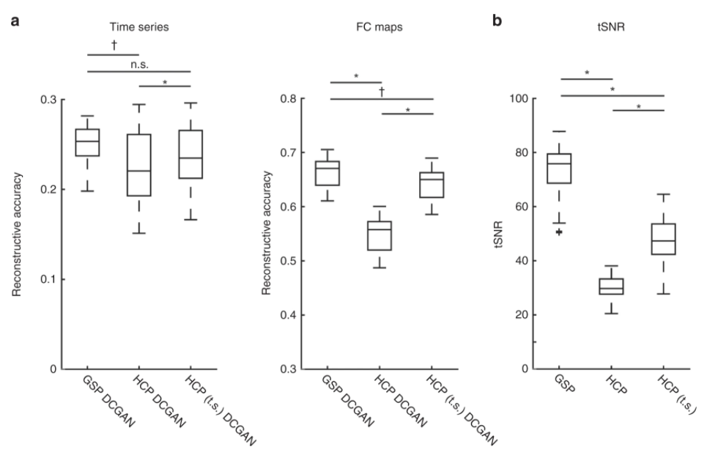
Results
Correlation between
reconstructed signal and
original signal

Slide 7
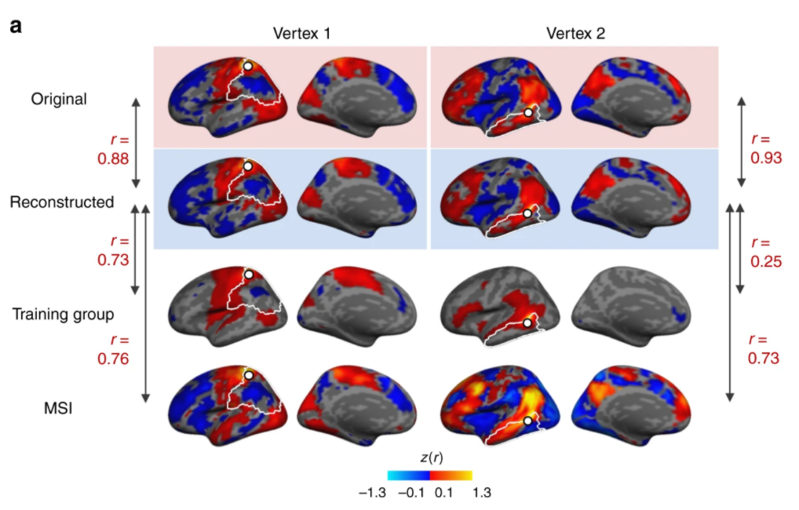
Results
Individual-specificity
testing

Slide 8
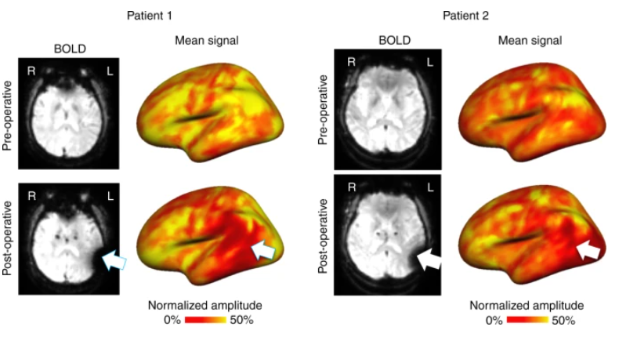
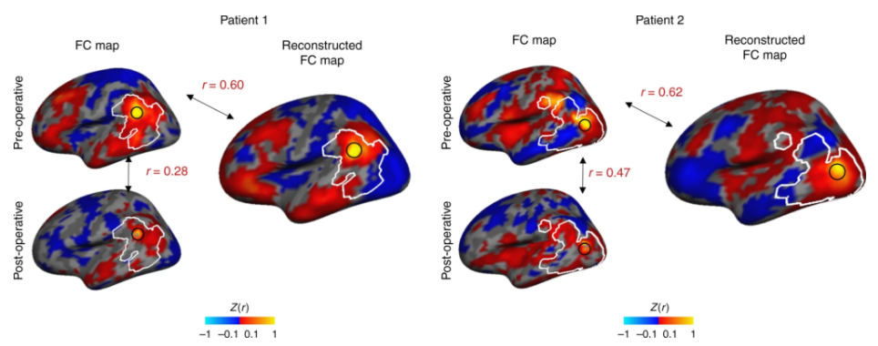
Results
Clinical application
to Parkinson’s disease

Slide 9
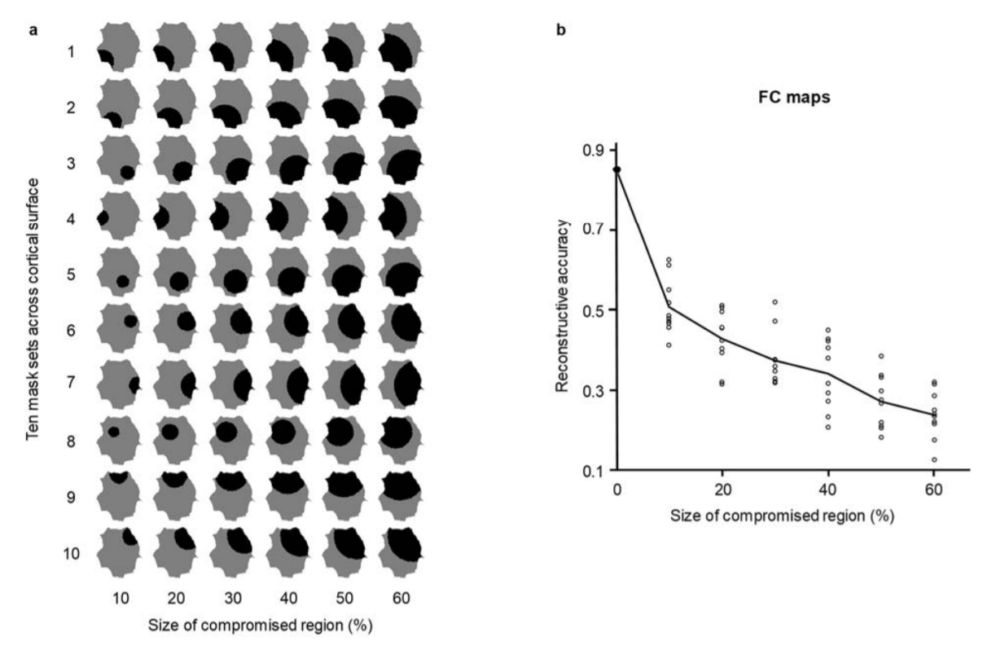
Results
Reconstructive accuracy varies according to the size of the compromised area.

