Slide 1
Progress report on sTx to pTx image mapping using deep learning
Xiaodong Ma
10/26/2020

Slide 2
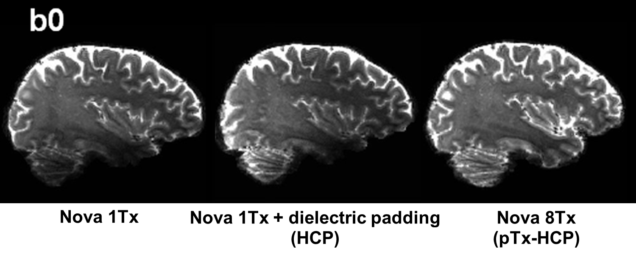
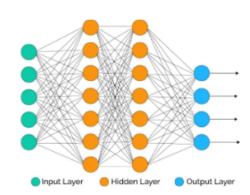
Can we directly map the image from sTx to pTx?
?
sTx image
pTx image
End-to-end image mapping using neural network
pTx hardware or software may no longer be needed
T1/T2 imaging, diffusion, fMRI, …
Notes:
If you remember, two months ago, at our last group meeting, we talked about this new idea, which is end-to-end img mapping using AI.
We wonder if there is a nn to map the sTX image into pTX style directly, so that pTX ha…or soft.. Is not longer needed.

Slide 3
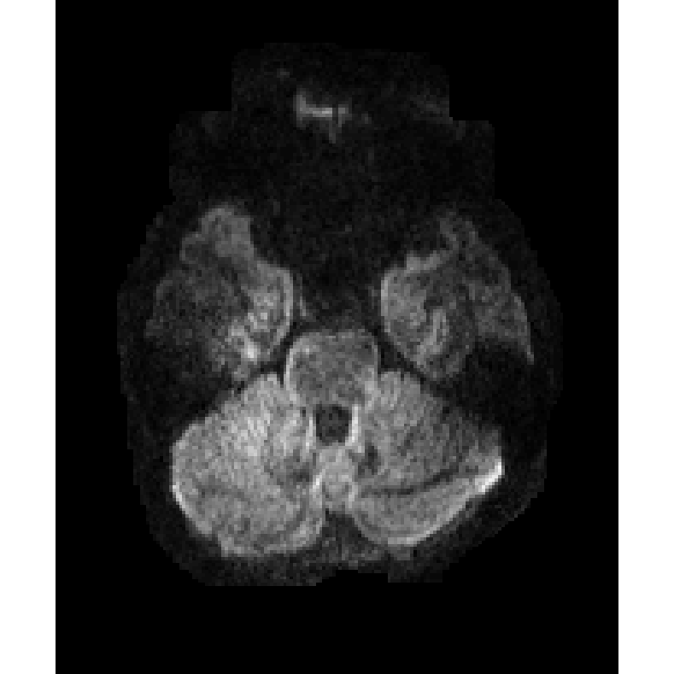
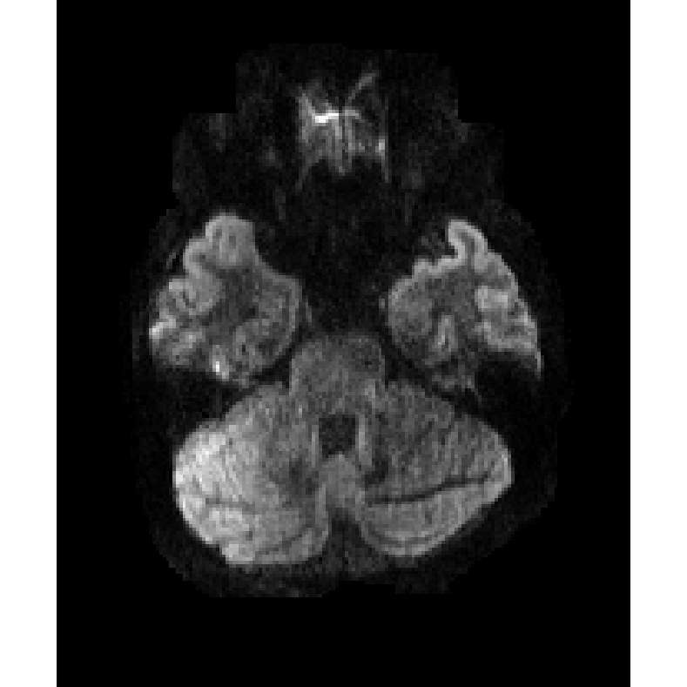
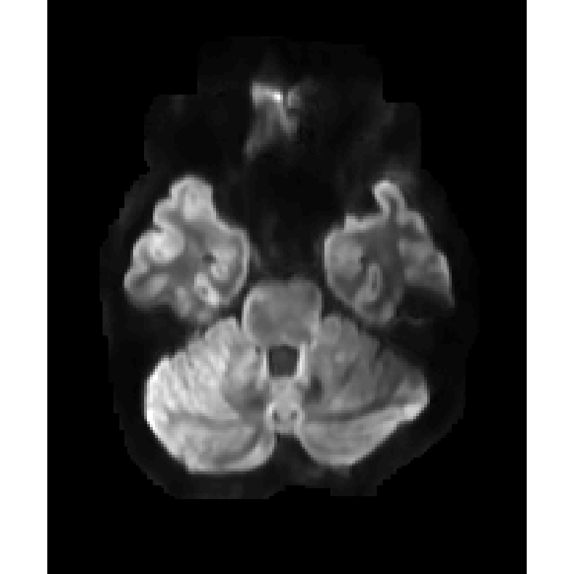
The answer may be yes
T1W
U-Net
sTx
pTx
Deep learning
Notes:
I tried to implement this idea on DTI data, and it seems that it works.
This slide gives you a first impression of how the result looks like.
As you can see, if we input the sTx DTI image and T1W together into U-Net, we are able to recover the signal dropout in the sTx image, with some additional denoising effect as well.
I will introduce the details next..

Slide 4
Data summary
DTI data on 5 healthy subjects
Single transmission (sTx) - HCP protocol
Oblique axial, 1-ch Nova coil
Dielectric padding
Parallel transmission (pTX) ^{[1]}
Sagittal, 8-ch Nova coil, single-spoke pTX
T1w MPRAGE (0.7 mm)
Pre-processed following HCP pipeline
[1] Wu, X., High-resolution whole-brain diffusion MRI at 7T using radiofrequency parallel transmission, MRM, 80(5), 1857–1870. 2018
Notes:
As I mentioned, we implemented it on DTI data. The data were actually from Xiaoping’s paper of pTX-DTI.
We have whole-brain DTI data of 5 healthy subjects, with both sTX and pTX, and also T1w MPRAGE data.

Slide 5
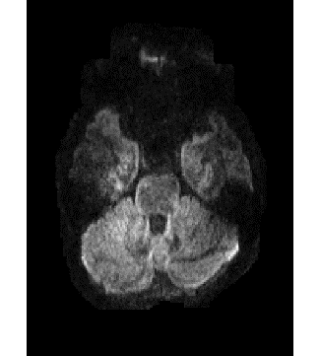
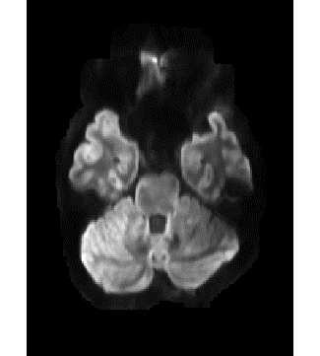
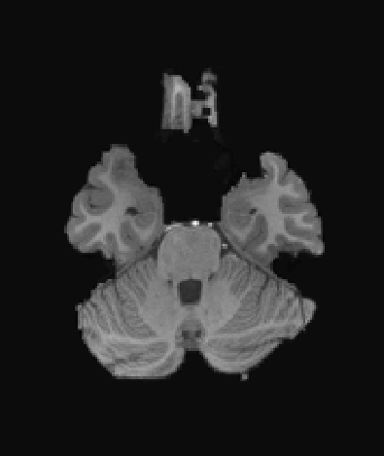
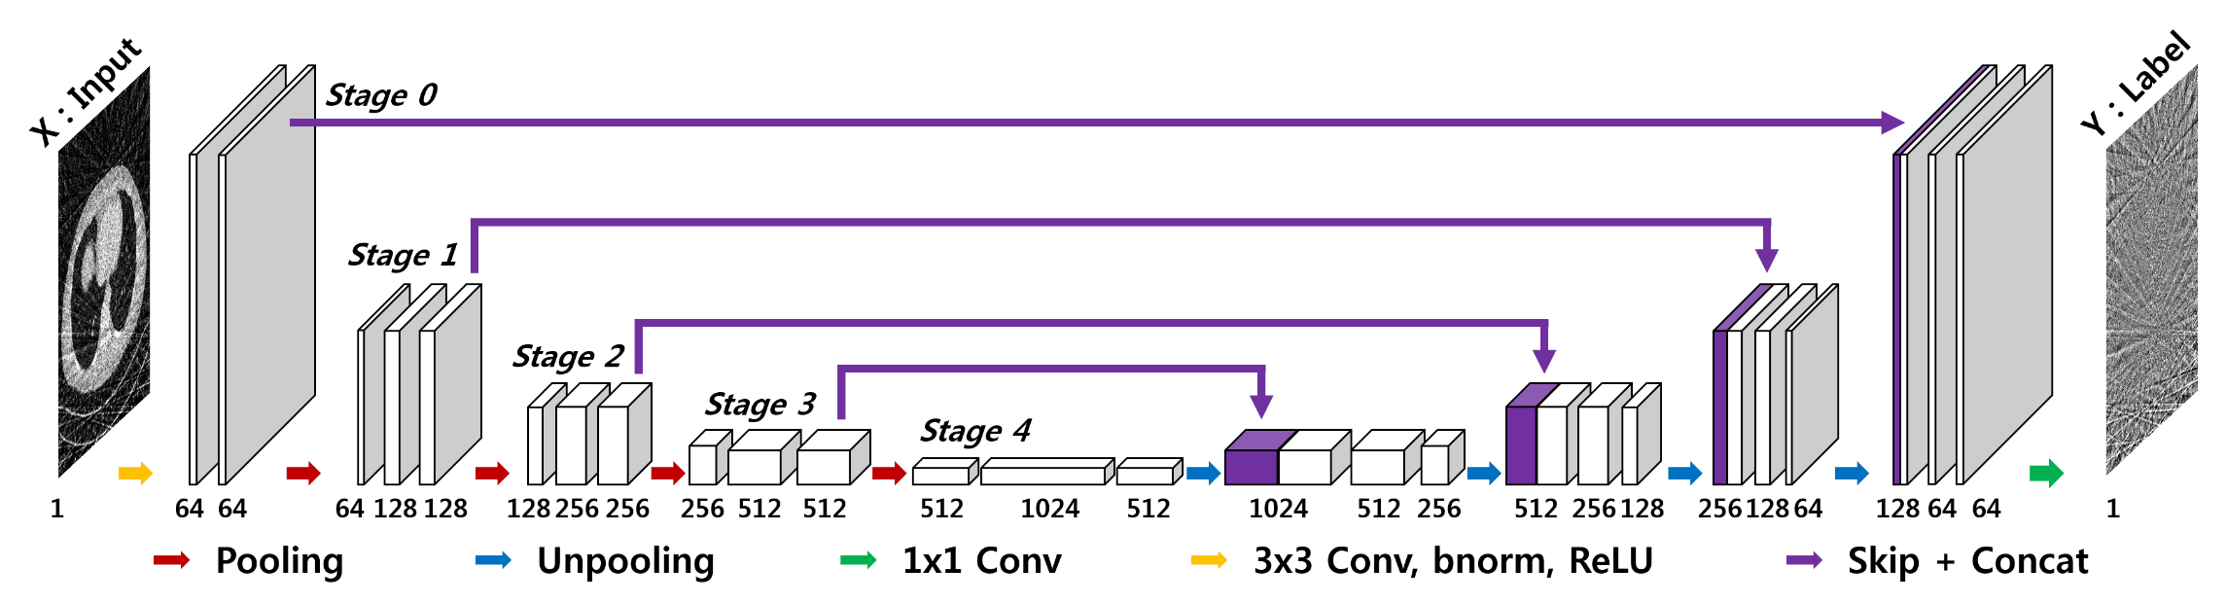
Neural network
Residual blocks
Conv (3x3)
Batch norm
ReLU
Conv (7x7)
Batch norm
Res-Net
U-Net
T1w
sTX
Conv (7x7)
ReLU
R1
R2
Rn
...
Output
+
64
T1w
sTX
+
Output
Notes:
I tried two kinds of neural network, one is Res-Net, and the other is U-Net. They are both convolutional neural networks, and both are widely used in biomedical image processing.
I will no go into details for this. As you will see next, both networks can recover the signal dropout in sTx image.

Slide 6
Training
DTI Data (36 volumes: 4 b=0 and 32 b=1000)
4 subjects for training (100-slices x 36-vols x4-subj = 14,400 samples)
1 subject for validation
Computation
Minnesota Supercomputing Institute (MSI), Tesla V100 GPU
Training time: ~15 mins for Res-Net, ~6 hours for U-Net
Notes:
And we train the neural networks using these data. For simplicity, only 36 volumes with 4 b=0 and 32 b=1000 are used.
4 subjects are used for training, and the other 1 sub for validation.
The computation is performed on the supercomputing platform in our university, using GPU, since I am not yet able to access GPU in CMRR.
The time cost is…

Slide 7
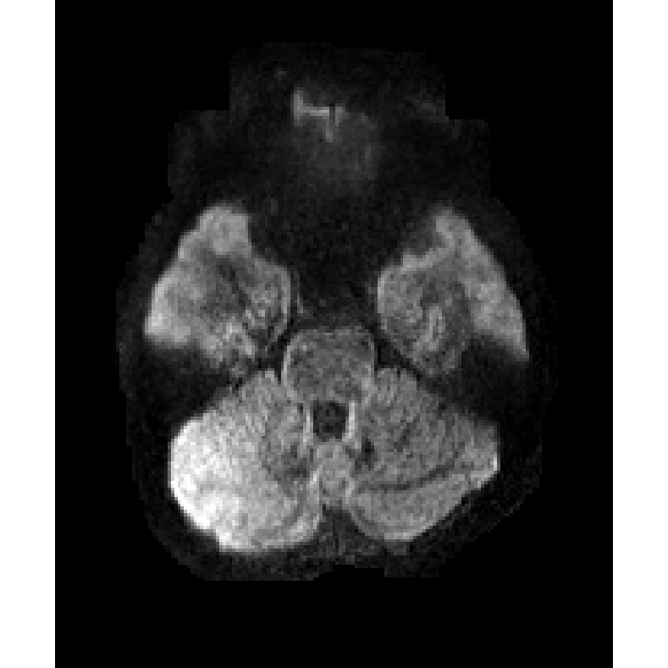
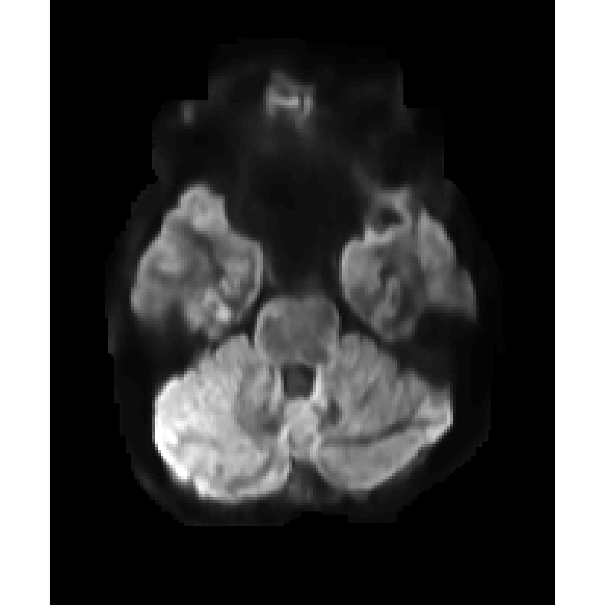
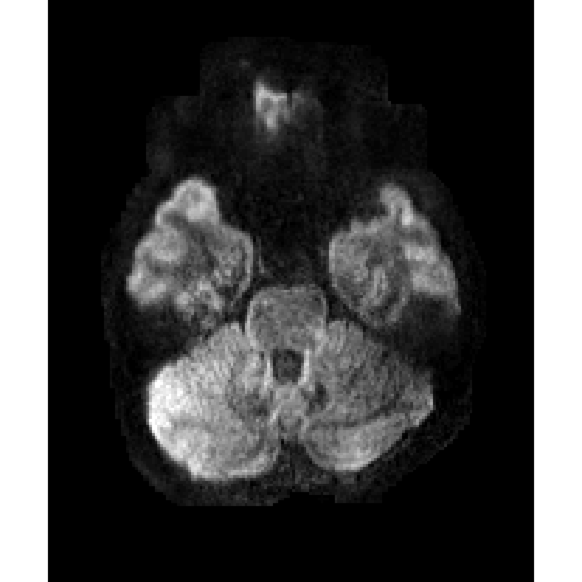
pTx
sTx
sTx + Res-Net
without T1W
sTx + U-Net
without T1W
T1W
sTx + Res-Net
with T1W
sTx + U-Net
with T1W
Notes:
Let us see the result. This is one representative slice from the validation data. In the top row, only sTX image was input to the neural network, and in the bottom row, both sTX and T1W images are input to the neural network.
We can see that with T1W image as the input, the output will have sharper edges, for example, at the temporal lobe shown by the yellow circles. This makes sense because the T1W image provides additional structural information for the neural network.
The benefit of using T1W image seems more prominent in the Unet result. Unet may better use T1W structural information
And there is denosing effect in the Unet results. I do not have a theory about this, but I also saw similar denoising effect in another paper about DTI distortion correction. And I will investigate this further.

Slide 8
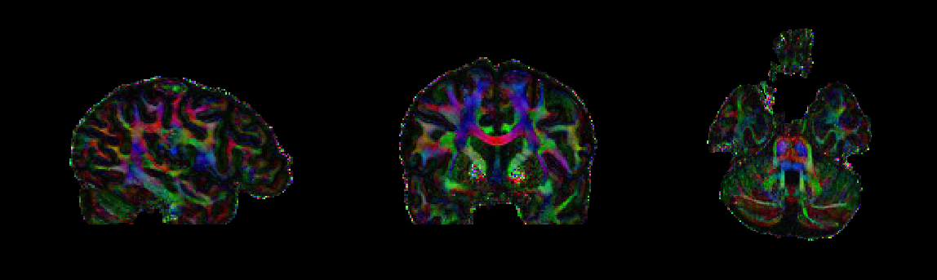
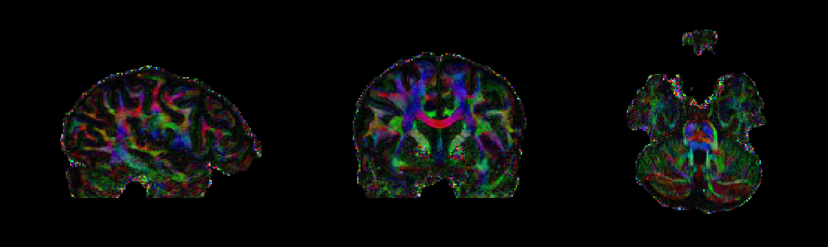
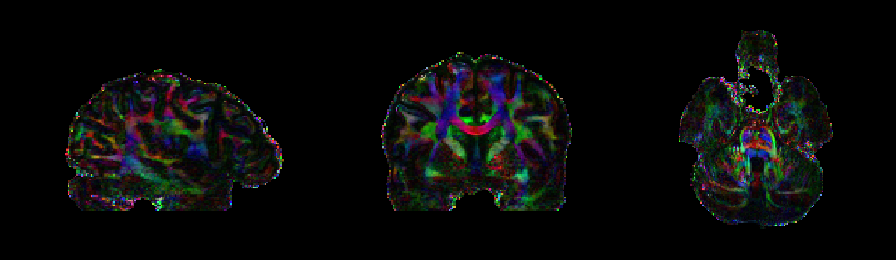
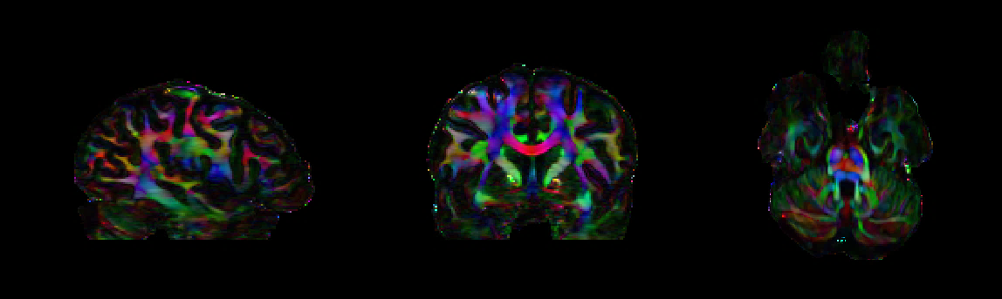
pTx
sTx
sTx + Res-Net
with T1W
sTx + U-Net
with T1W
Notes:
The signal recovery after deep learning in DTI images can be translated into the tensor fitting.
We can see that the calculated cFA maps have higher SNR compared with original sTX image. And the SNR improvement is more obvious for U-Net. Actually it has higher SNR than pTX.

Slide 9
Next steps
Cross-validation for U-Net
To optimize the model through hyper-parameter tuning
To quantify the model performance
Volume-to-volume mapping using 3D U-Net
Applied to other sequences
fMRI, MPRAGE, T2-SPACE, etc
File an IP
Notes:
This is the progress for this project. Since this is just the preliminary test, we have more work to do in the next.
Currently I am working on the cv. I plan to focus on Unet, since the SNR improvement is attractive. The cv can be used to optimize the model through hyper-parameter tuning, and to … as well.
In the future, if we are able to acquire more volunteer data, we may consider to do vol-to-vol mapping using 3D Unet.
And of course this AI method can be applied to other sequences, including..
Xiaoping and I are considering to file an IP for this idea. We would like to hear your thoughts about this.

