Slide 1
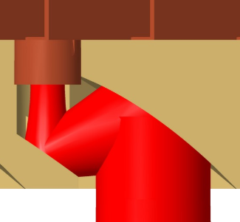
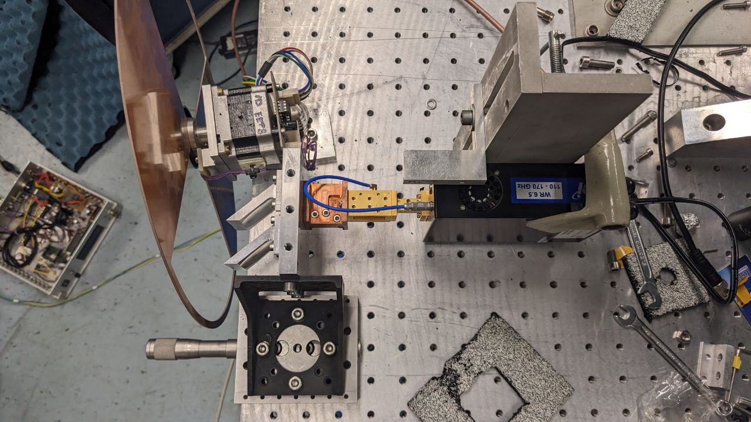
Horn
M2
M1
Horn
Amp
VDI
Source
Fore-optics

Slide 2
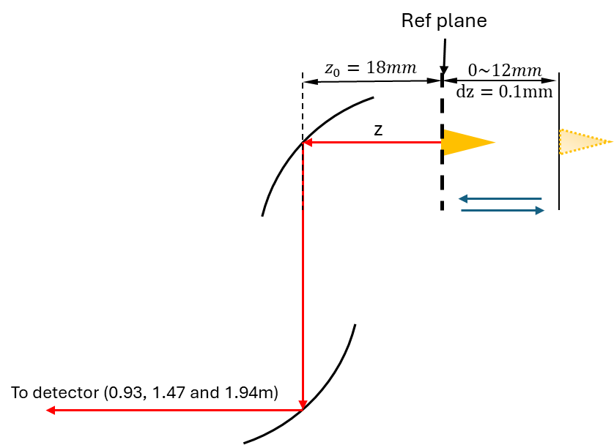


Ref plane
$$z_{0}=18mm$$
$$0\sim 12mm$$
$$dz=0.1mm$$
z
To detector (0.93, 1.47 and 1.94m)

Slide 3
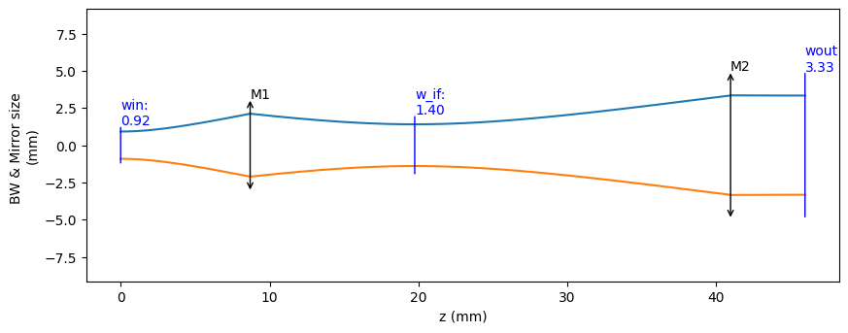
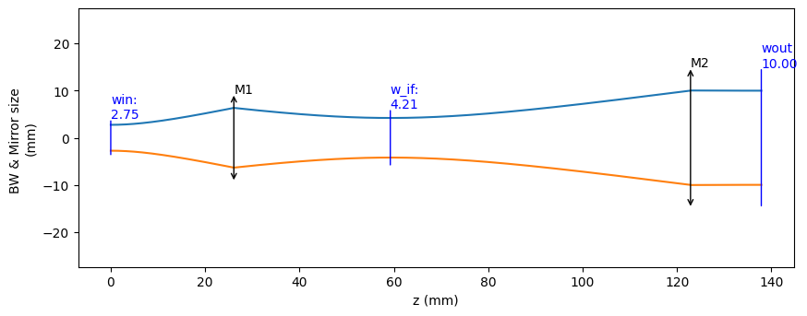
@475GHz
8.696
11.052
21.21
5
26.0865
33.155
63.618
15

