Slide 1
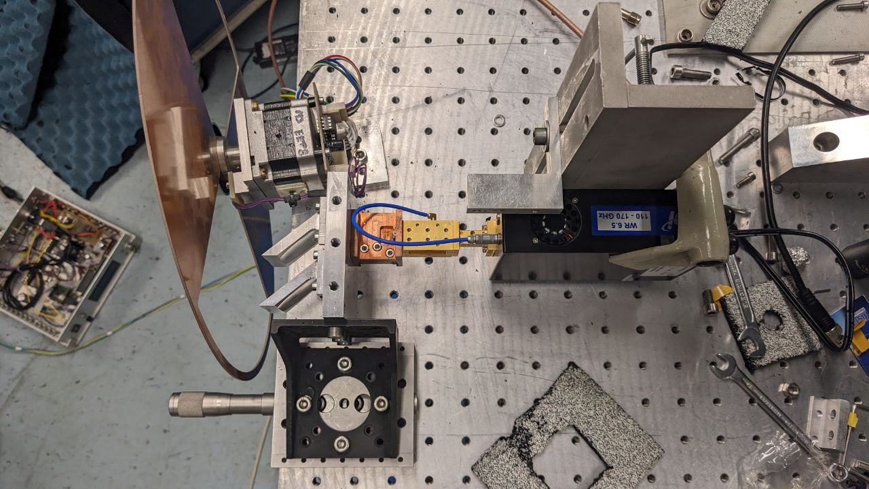
Horn
Amp
VDI
Source
Fore-optics

