Slide 1
Small Aperture Telescope Optics Simulations
PO analysis using GRASP;
POP analysis in Zemax;

Slide 2
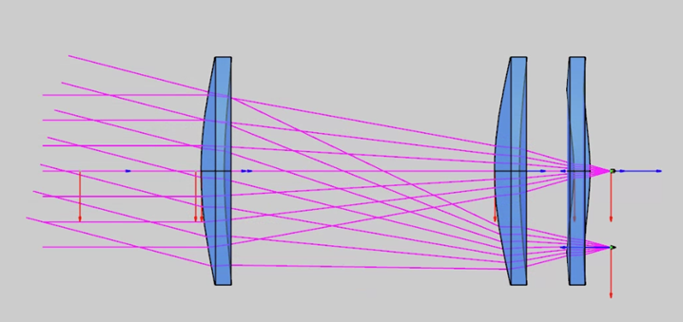
1. Lens-only SAT model
The simplest and most critical components.
No anti-reflection coating

