Slide 1
Small Aperture Telescope Optics Simulations
Lens-only Optics analysis in GRASP;
Physical Optics Propagation method in Zemax;

Slide 2
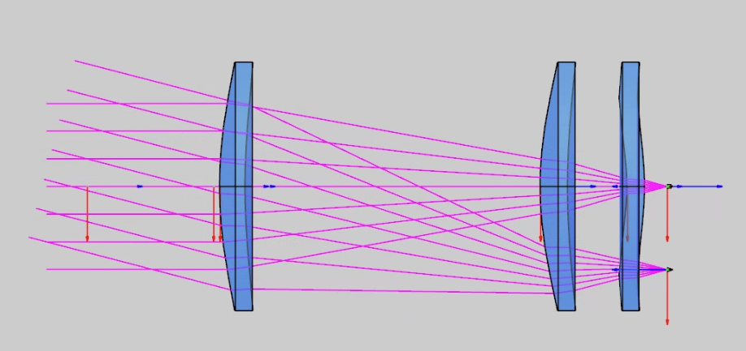
1. Lens-only SAT model
The simplest and most critical model

