Slide 1
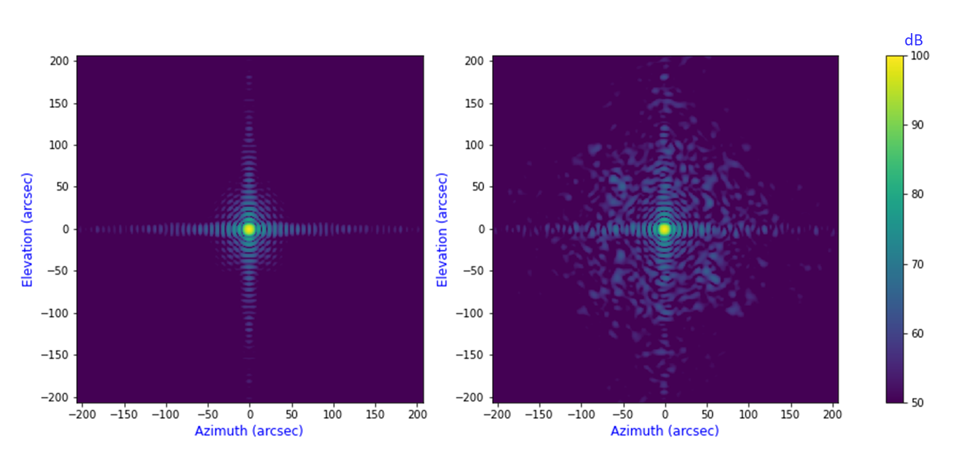
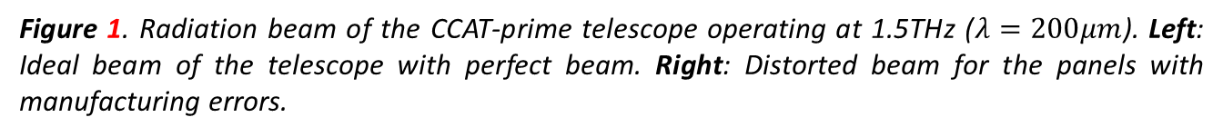
Effect on telescope’s electromagnetic performance.
Figure 1. Radiation beam of the CCAT-prime telescope operating at 1.5THz ($λ=200μm$). Left: Ideal beam of the telescope with perfect beam. Right: Distorted beam for the panels with manufacturing errors.

Slide 2
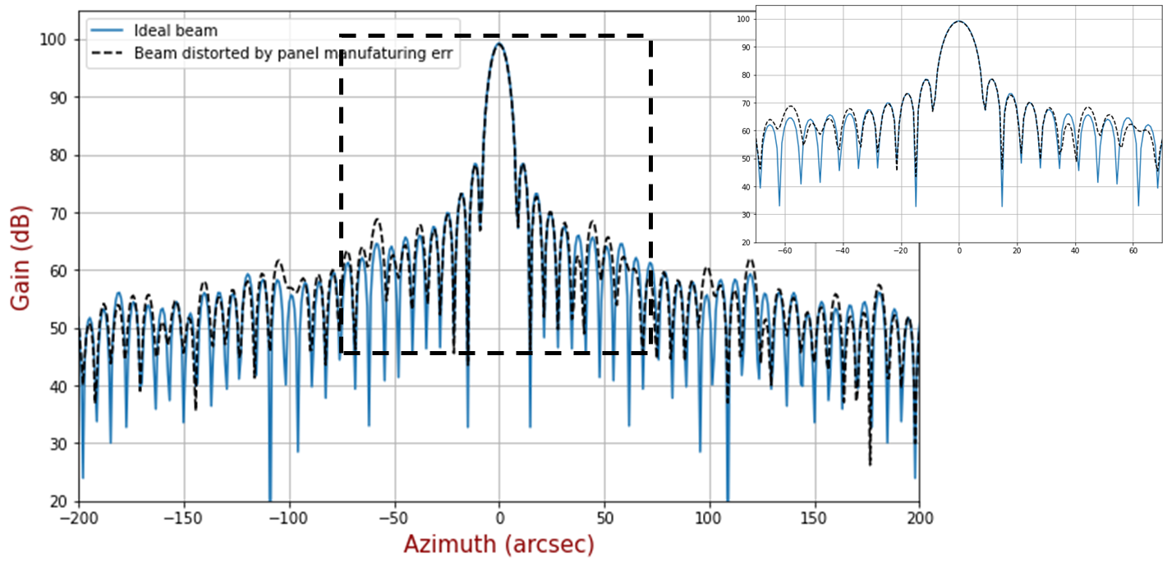
Figure 2. $\sim 3μm$ RMS surface error of the panels degrades telescope’s gain by ~0.17dB at 1.5THz. Energy loss in main beam is converted to power increasing of error beams.

