Slide 1


Introduction to CUDA
Alper Kinaci, Sr. Computational Specialist
Yeguang Xue, Graduate Assistant
Research Computing Services
https://github.com/nuitrcs/intro-cuda-workshop

Slide 2
OUTLINE
Introduction to CUDA and GPU
GPU and CPU Comparison
CUDA Programming Essentials
Kernels
Block & Thread Hierarchy
Memory Hierarchy, Global and Shared Memory
Unified Memory Model
Atomic Operations

Slide 3
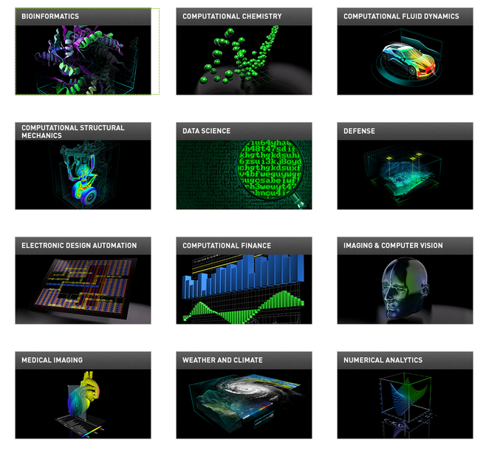
GPU & CUDA
CUDA is a parallel computing platform and application programming interface (API)
Developed for graphics processing units (GPUs) created by Nvidia.

Slide 4
GPU & CUDA
Support for Programming Languages
C (natively)
https://docs.nvidia.com/cuda/cuda-c-programming-guide/index.html
C++ (natively)
https://docs.nvidia.com/cuda/cuda-c-programming-guide/index.html
Fortran (PGI CUDA Fortran)
https://www.pgroup.com/resources/cudafortran.htm
Python (Numba)
http://numba.pydata.org/
Java (JCuda)
http://www.jcuda.org/

Slide 5

Brief History of GPU
1975
Early 3D consumer graphics
1995
3Dfx Voodoo graphics
2000
NVIDIA vs ATI Era, beginning of programmable GPUs
2006
Modern GPU (General purpose GPU), CUDA -
Compute Unified Device Architecture

Slide 6
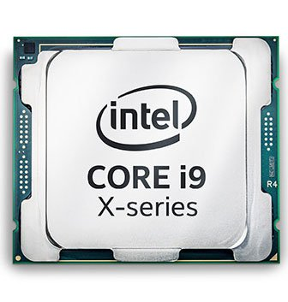
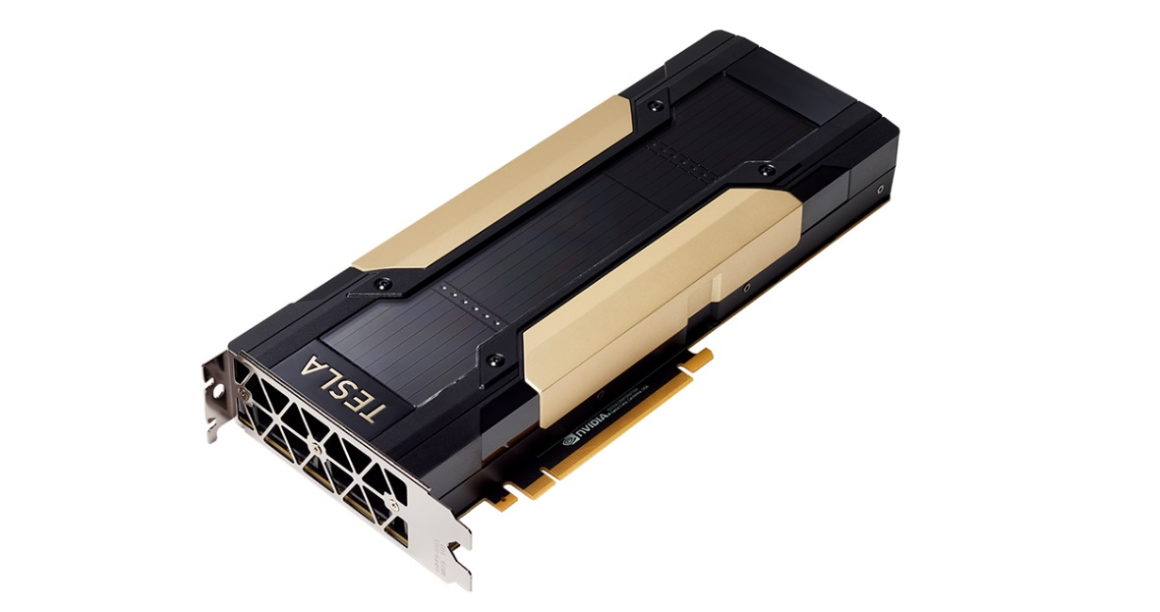
Comparison of CPU and GPU
CPU
Complex compute units.
Limited cores, but each core runs fast.
High power consumption limits the increase of clock speed.
GPU
Lots of simple compute units.
Running lots of threads in parallel.
More power efficient.
The GPU and its memory are called device.
The CPU and its memory are called host.

Slide 7
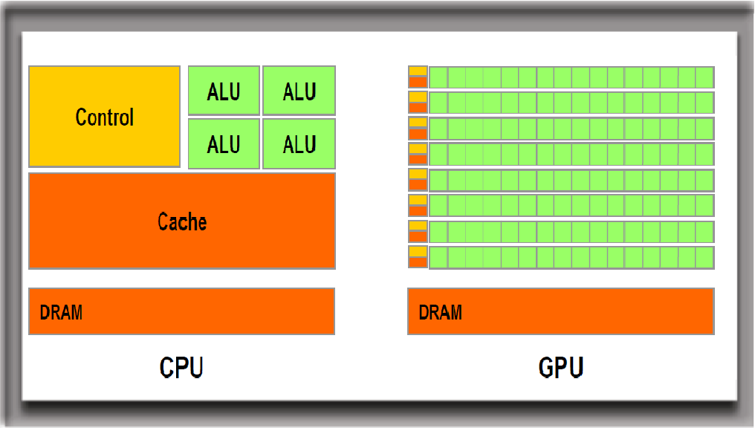
Comparison of CPU and GPU
ALU = Arithmetic Logic Unit
GPU is composed of several dozens of Streaming Multiprocessors (SMs)
SMs themselves consist of many ALUs, control logic and cache
SMs run in parallel and independently.
https://www.foxrenderfarm.com/share/post-id-1166
Advantage: Efficiency (no waiting), scalability
Disadvantage: Simplified parallel tasks, small communication

Slide 8
Comparison of CPU and GPU
GPU/Cuda parallelism is better suited for Single Instruction Multiple Data (SIMD)
CPU/OpenMP is better for Multiple Instruction Multiple Data (MIMD)
Complicated work-flows with a lot of branching and heterogeneous mix of algorithms, prefer CPU/OpenMP instead of GPU/Cuda.

Slide 9
CUDA and Other Platforms
CUDA
Introduced in 2007 with Nvidia Tesla architecture
Currently the most popular platform for GPU computing
OpenCL
CUDA only runs on Nvidia GPUs
OpenCL runs on CPUs and GPUs from many vendors
Potential convergence with Vulkan (3D graphics and compute API like OpenGL) in the future
ROCm
Computing platform for AMD GPUs

Slide 10
CUDA Program Diagram
CUDA Program
CPU code
GPU code
CPU
(Host)
GPU
(Device)
Memory
PCIe
Memory
GPU computing requires explicit programming model
CUDA allows a single program both for host and device
Host controls the data transfer between host memory and device memory, and launches kernels on device

Slide 11
CUDA Program Essentials
CPU allocates storage on GPU
CPU copies input data from CPU to GPU
CPU launches kernels on GPU
CPU copies results from GPU to CPU
cudaMalloc
cudaMemcpy
<<<…,…>>>
cudaMemcpy
Communication (copying data) is expensive. Successful CUDA application has high ratio of computation to communication.

Slide 12
CUDA Program Essentials: Kernels
Kernel functions run on GPUs
Define kernel function
__global__ void myfunc(float *d_out, float *d_in)
Launching kernels
myfunc <<<1,1024>>>(d_out, d_in)
Number of blocks
Number of threads per block

Slide 13
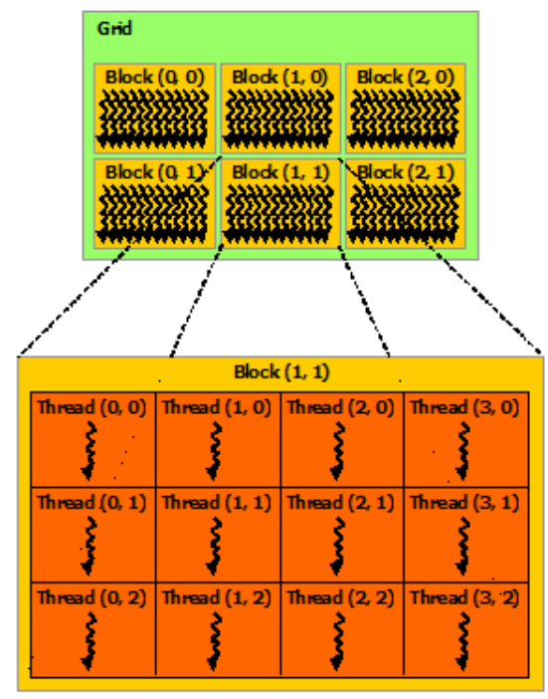
CUDA Program Essentials:
Threads & Blocks
CUDA supports natively 1D to 3D for block and thread grids
myfunc <<<dim3(bx,by,bz), dim3(tx,ty,tz)>>>(…)
CUDA makes four pieces of information available to each thread:
threadIdx
blockDim
blockIdx
gridDim
Thread index
Size and shape of a thread block
Block index
Size and shape of a block grid
https://docs.nvidia.com/cuda/cuda-c-programming-guide/index.html#thread-hierarchy

Slide 14
CUDA Program Essentials:
Threads & Blocks
For a kernel call with 3D block grid of 3D thread block, the block and thread ID are calculated as:
int blockId = blockIdx.x + blockIdx.y * gridDim.x + gridDim.x * gridDim.y * blockIdx.z;
int threadId = blockId * (blockDim.x * blockDim.y * blockDim.z) + (threadIdx.z * (blockDim.x * blockDim.y)) + (threadIdx.y * blockDim.x) + threadIdx.x;
There is a limit to the number of threads per block
On current GPUs, a thread block can contain 1024 threads
Threads are scheduled and run synchronously in groups of 32 which are called Warps

Slide 15
CUDA Program Essentials:
Memory Management
cudaMalloc ( void** devPtr, size_t size )
devPtr: Pointer to allocated device memory
size: Requested allocation size in bytes
cudaMemcpy ( void* dst, const void* src,
size_t count, cudaMemcpyKind kind )
dst: Destination memory address
src: Source memory address
cudaMemcpyHostToHost, cudaMemcpyHostToDevice cudaMemcpyDeviceToHost cudaMemcpyDeviceToDevice
count: Size in bytes to copy
kind: Type of transfer

Slide 16
CUDA Program Essentials:
Query, Compile, Run
From the terminal:
Check current GPU driver version and get an instant snapshot
nvidia-smi
Print out GPU specifications
deviceQuery
Compile single code file for C/C++ Cuda runtime API
nvcc -o code.exe code.cu
Run the binary
./code.exe

Slide 17
CUDA Program Essentials
Code Example 1: cpu_serial.cpp
Create two one dimensional vectors with 500 million elements
Add each vector element by element on 1 CPU core
Record runtime
Code Example 2: cuda_serial.cu
Create two one dimensional vectors with 500 million elements
Add each vector element by element using 1 GPU thread
Record runtime
Code Example 3: cuda_parallel.cu
Create two one dimensional vectors with 500 million elements
Add each vector element by element using many GPU threads
Record runtime

Slide 18
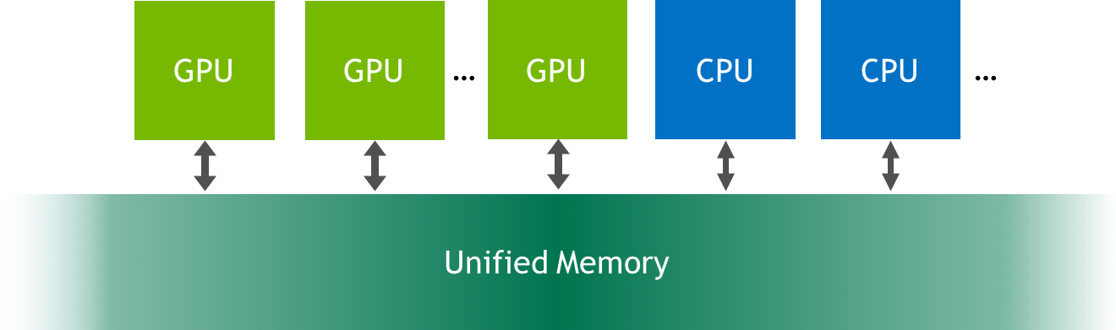
CUDA Program Essentials:
Unified Memory
https://devblogs.nvidia.com/unified-memory-cuda-beginners/
No explicit memory management between CPU/GPU
Unified memory allows programs to allocate data that is accessible by CPUs or GPUs.
The memory migration between CPU and GPU is managed by CUDA.

Slide 19
CUDA Program Essentials:
Unified Memory
Simpler and shorter codes
CPU memory allocation
malloc
Memory allocation
GPU memory allocation
cudaMalloc
cudaMallocManaged
Memory migration
cudaMemcpy

Slide 20
CUDA Program Essentials:
Unified Memory
cudaMallocManaged (void** devPtr, size_t size,
unsigned int flags = cudaMemAttachGlobal)
devPtr: Pointer to allocated device memory
size: Requested allocation size in bytes
flags: either cudaMemAttachGlobal (default) or cudaMemAttachHost
Code Example 4: cuda_parallel_unimem.cu
Create two one dimensional vectors with 50 million elements
Use unified memory for data migration
Add each vector element by element with many GPU threads
Record runtime

Slide 21
CUDA Program Essentials:
Memory Hierarchy
Local memory (per thread)
Share memory (per block)
Global memory
Host memory
Fast
Slow
Thread can access each other’s results using shared or global memory.
Synchronization is needed to avoid conflict between read and write operations.

Slide 22
Thread
GPU Memory
Per-thread local memory
Thread Block
Per-block shared memory
Grid 0
(Kernel 0)
Thread (0,0)
Thread (1,0)
Thread (0,1)
Thread (1,1)
Global memory
Thread (0,2)
Thread (1,2)
Grid 1
(Kernel 1)
Thread (0,0)
Thread (1,0)
Thread (2,0)
Thread (0,1)
Thread (1,1)
Thread (2,1)
Reproduced from https://docs.nvidia.com/cuda/cuda-c-programming-guide/index.html#thread-hierarchy

Slide 23
CUDA Program Essentials:
Synchronization
__syncthreads()
Acts as a barrier at which all threads in the block must wait before any is allowed to proceed
Call this function to create synchronization points within the kernel
cudaDeviceSynchronize()
Blocks until the device has completed all preceding requested tasks.
Call from the host

Slide 24
CUDA Program Essentials:
Shared Memory & Synchronization
__shared__
Modifier to assign a variable to shared memory
Code Example 5: shared_memory.cu
Create one dimensional array with 1024 elements
Sum every element <= i^{th} for all i where i is the array index
Change the value in i^{th} element with the sum
Summation for each index position should be done by a GPU thread
0
1
2
3
4
……………………..
1024
Thread 2
+
3
Thread 4
10
+

Slide 25
CUDA Program Essentials:
Atomic Operations
parallel operation
atomic operation
parallel operation
Thread A
parallel operation
wait for A
atomic operation
Thread B
Time
No other threads can perform read-modify-write operations on memory (global or shared) until the current thread’s operation is complete
Often used to prevent race conditions common encountered in multi-threaded applications.
atomicAdd(), atomicSub(), atomicExch(), atomicMin(), …

Slide 26
CUDA Program Essentials:
Atomic Operations
int atomicAdd(int* address, int val)
Adds val to the variable value at the address
Code Example 6: atomics.cu
Use 1 million GPU threads to increment the components of a 16-element array
Initially, all array elements are zero
Each thread adds 1 to only one element of the array
Each element of the array is incremented by equal number of threads

Slide 27
Summary
GPU architecture and differences with CPU
CUDA integration with GPU
Fundamentals of CUDA programming including
Kernels
Blocks & Threads
Memory management
Global and shared memory
Unified memory
Atomic operations

Slide 28
Questions?
email: quest-help@northwestern.edu
Research Computing Services

