Slide 1
Requirements
Market Research
1. Login
2. Withdrawal
3. Balance checking
4. Transfer
5. Change password

Slide 2
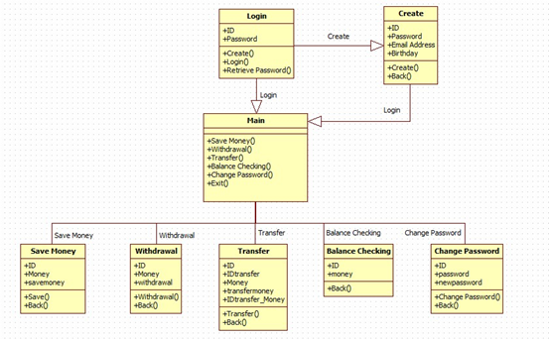
Design

Slide 3
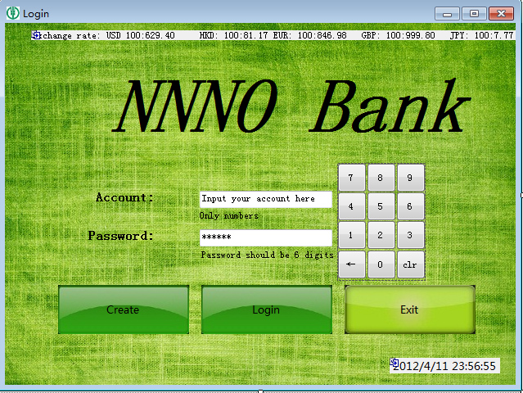
Implementation

Slide 4
Verification
1.Every textbox should have a key_press checking.
2.Every button should have lots of if…else checking.

Slide 5
Maintenance
Use MySQL database.
Make a better UI
More theme to choose
Currency translation
Android

