Slide 1
Internet Secure Chat
莫晓光
杨皓凌

Slide 2
Requirement :write an Internet Secure Chat Program which should ensure that the users can chat securely on the Internet

Slide 3
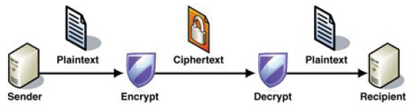

Slide 4
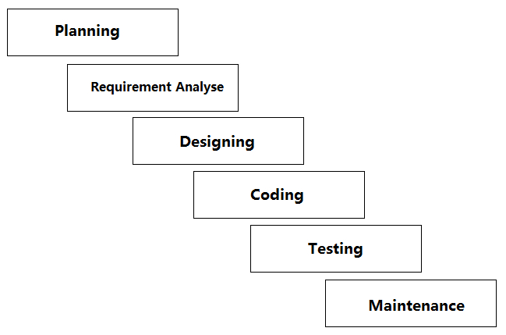

Slide 5
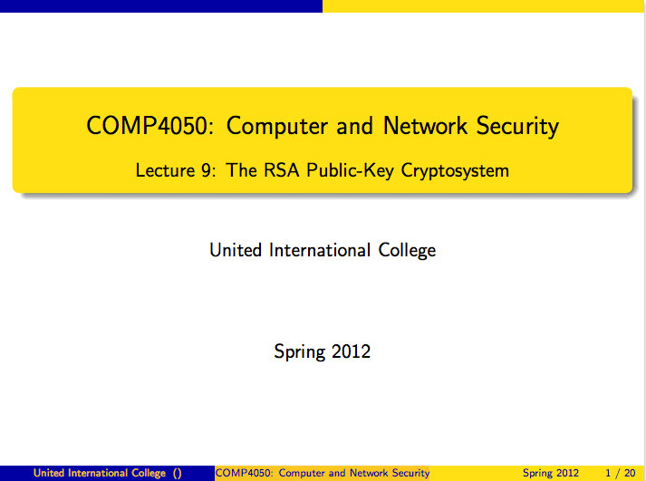

Slide 6
Choose two distinct prime numbers p and q.
For security purposes, the integers p and q should be chosen at random, and should be of similar bit-length. Prime integers can be efficiently found using a primality test.
Compute n = pq.
n is used as the modulus for both the public and private keys. Its length, usually expressed in bits, is the key length.
Compute φ(n) = φ(p)φ(q) = (p − 1)(q − 1) = n - (p + q -1), where φ is Euler's totient function.
Choose an integer e such that 1 < e < φ(n) and gcd(e, φ(n)) = 1; i.e., e and φ(n) are coprime.
e is released as the public key exponent.
e having a short bit-length and small Hamming weight results in more efficient encryption – most commonly 216 + 1 = 65,537. However, much smaller values of e (such as 3) have been shown to be less secure in some settings.[5]
Determine d as d ≡ e−1 (mod φ(n)); i.e., d is the multiplicative inverse of e (modulo φ(n)).
This is more clearly stated as: solve for d given d⋅e ≡ 1 (mod φ(n))
This is often computed using the extended Euclidean algorithm. Using the pseudocode in the Modular integers section, inputs a and n correspond to e and φ(n), respectively.
d is kept as the private key exponent.

Slide 7
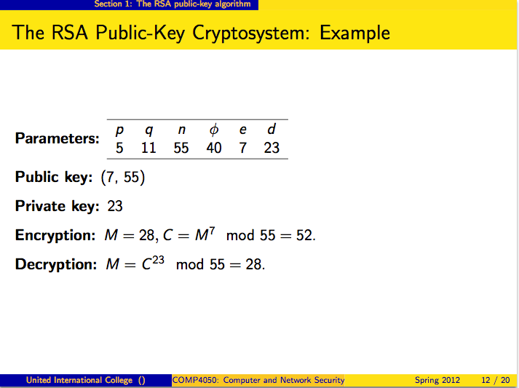

Slide 8
DEMO

